Slide 1



Slide 2
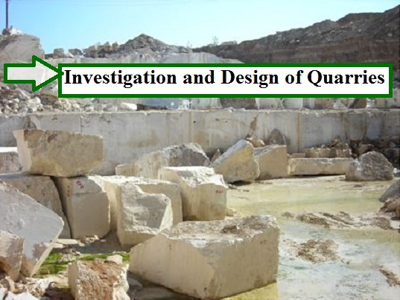

Slide 3
Submitted to :
Dr. Isam Jardaneh
Prepared by:
Sabrin Rabay
Ola Bakeer
Saif Alawneh
Notes:
Talk with other Lions to gather information about what is needed to improve Lions clubs in your district.
Summarize the needs and prioritize according to importance.
You may not be able to address all the needs, so select the most important needs that you will address in goals.

Slide 4
Introduction:
Quarries are very important since their products are used in many structures, such as, roads, airports, schools, buildings, and many thing else that needs crushing stone.
In addition to that, Palestine has large numbers of quarries and crashers that make this issue of huge significant.

Slide 5
Objective of our project:
The work in this project emphasizes on reviewing the existing quarries and crushers in Palestine and compare them to the international codes.
Also, summarizes the construction of excavations as it should be according to engineering standards and rules.

Slide 6
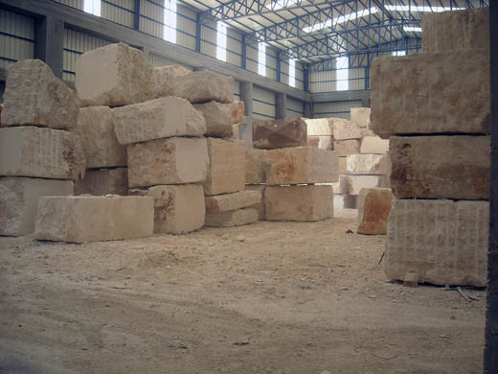
QUESTIONNAIRE REGARDING QUARRIES AND CRUSHERS :
We present the questionnaire to show the existing conditions of quarries and crushers in Northern Palestine, to compare them to the international codes that were described in volume one of this graduation project.

Slide 7
QUESTIONNAIRE REGARDING QUARRIES AND CRUSHERS :
The questionnaire used to collect data.
In our questionnaire there are six places we visit it and collect the data required for the project

Slide 8
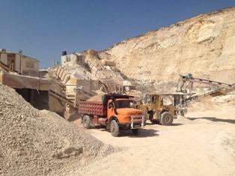
QUESTIONNAIRE REGARDING QUARRIES AND CRUSHERS :
Al-Sala’ous Quarry and Crusher – Nablus.

Slide 9
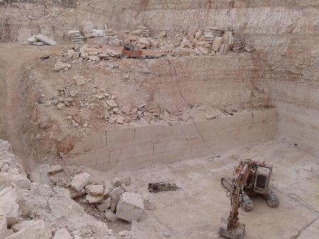
QUESTIONNAIRE REGARDING QUARRIES AND CRUSHERS :
2. Al-Hajj Ali Quarry – Jammaa’een.

Slide 10
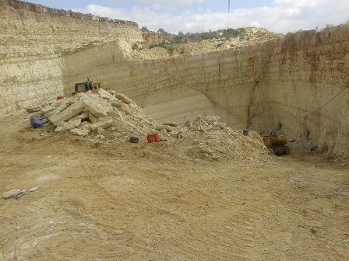
QUESTIONNAIRE REGARDING QUARRIES AND CRUSHERS :
3. Al-Fannaneen Quarry – Jammaa’een.

Slide 11
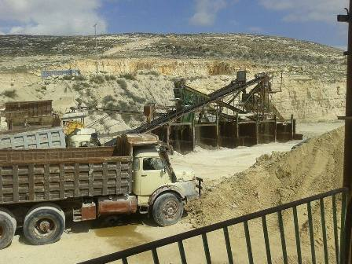
QUESTIONNAIRE REGARDING QUARRIES AND CRUSHERS :
4. Jammaa’een National Crusher – Jammaa’een.

Slide 12
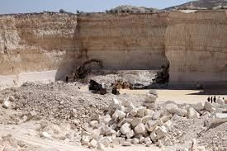
QUESTIONNAIRE REGARDING QUARRIES AND CRUSHERS :
5. Al-Motawakel Quarry – Qabatieh.

Slide 13
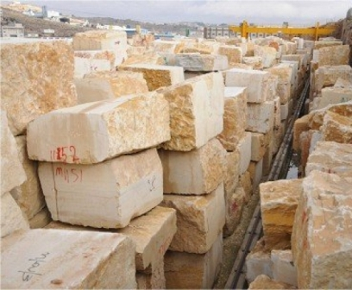
QUESTIONNAIRE REGARDING QUARRIES AND CRUSHERS :
6. A’lawneh Quarry – Qabatieh

Slide 14
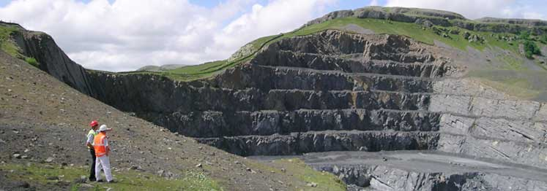
Results of the Questionnaire:

Slide 17
From the analysis of the previous questionnaire the following points may be concluded for quarries and crushers:
Feasibility study: most of them do not carry out feasibility study.
2. Land use policy: all of them are according to land use policy.
3. Uses of top soil for re-use: all of them they do not use or store it for re-use.

Slide 20
4. Slope stability analysis and design: half of them do slope stability and design of cuts.
5. Insurance: most of them have insurance on the employers only. Some of the them make insurance for machines and visitors.
6. Borders and fences: half of them have borders and fences.

Slide 22
7. Dust control: half of them do dust control.
8. Noise control: most of them do noise control.
As a conclusion, it found out that most of international conditions of quarries and crushers are not applied locally.

Slide 23
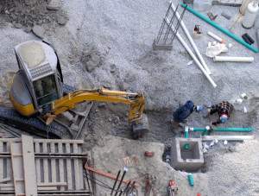
Excavations and Tips Guidelines and Rules
The construction of excavations and tips should be according to engineering standards and rules.

Slide 24
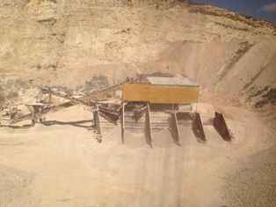
Excavations and Tips Guidelines and Rules
The guidelines and rules covering tipping and excavation must be clear. Too many drivers are killed and injured while working on stockpiles and tips so we need to follow these tips

Slide 25
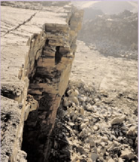
Different situation of construction of excavations and tips that should be according to engineering standards and rules
1. This face fall onto the loading excavator while the operator had break.

Slide 26
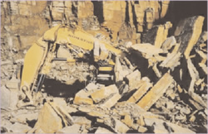
2. Here the face collapsed onto the loader and dump trucks while loading was occur after the explosion.

Slide 27
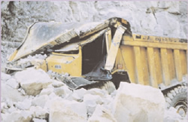
3. This excavator was crushed after being left under a face overnight.

Slide 28
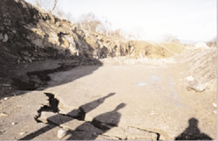
4.This face is showing obvious signs of movement, and the geotechnical specialist was contacted to redesign the slope.

Slide 29
Conclusions:
This project summarizes the results of comparing quarries and crushers in Palestine with the international standards codes by the questionnaire. By comparing the result, the most quarries and crushers in Palestine don't match the international standard codes.

Slide 30
Recommendations:
Since the most of the quarries and crushers do not suit international standards and codes agreed for the quarries and crushers. Therefore, we recommend that local codes for quarries and crushers in Palestine doesn't suit international standard and codes.

Slide 31


