Slide 1

Graduation project 2
Prepared by: Fouad. Hussein
Suhaib. Bsharat
Second Semester 2016/2017

Slide 2
Development of Pavement PI for part of Deteriorated Roads of Asira AS-Shamaliyya Roads Network

Slide 3
INTRODUCTION
What is PMS?
“A Pavement Management System is a set of tools or methods that assist decision-makers in finding optimum strategies for providing, evaluating, and maintaining pavements in a serviceable condition over a period of time”

Slide 4
OBJECTIVE
1.Calculating the PCI for each section & Identify the proper treatment.
2. Calculation the composite Priority Index (PI)&Ranking the sections in descending order based on PI value.

Slide 5
What did we in Project 1?
Calculating the PCI for each section based on the density and severity of pavement distresses.

Slide 6
Review
The PCI is a numerical indicator that rates the surface condition of the pavement.

Slide 7
Road Sections: In order to develop a PCI, the road network needs to be divided into manageable segments. Sections with relatively uniform pavement structures, design and traffic volumes. The pavement was divided into equal sections each section has length equal to 100m or 100ft.

Slide 8
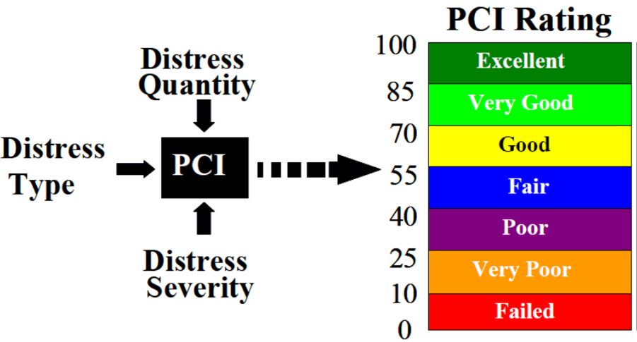
PCI Procedure function of severity and density.

Slide 9
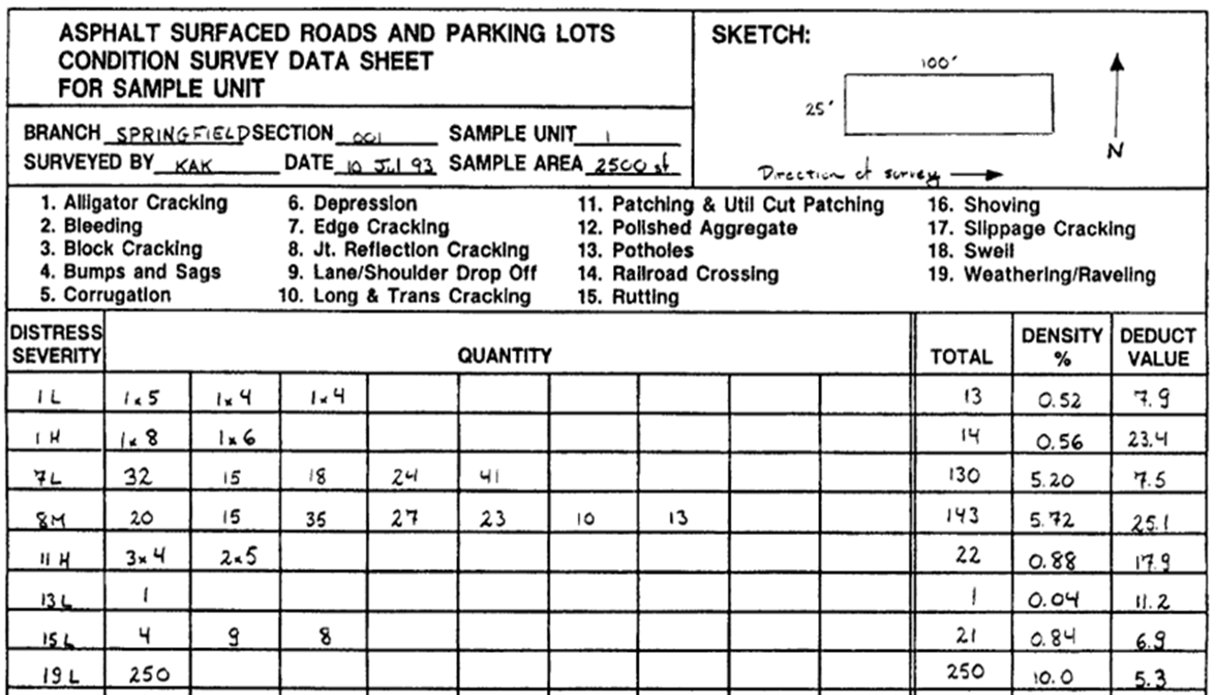

Slide 10
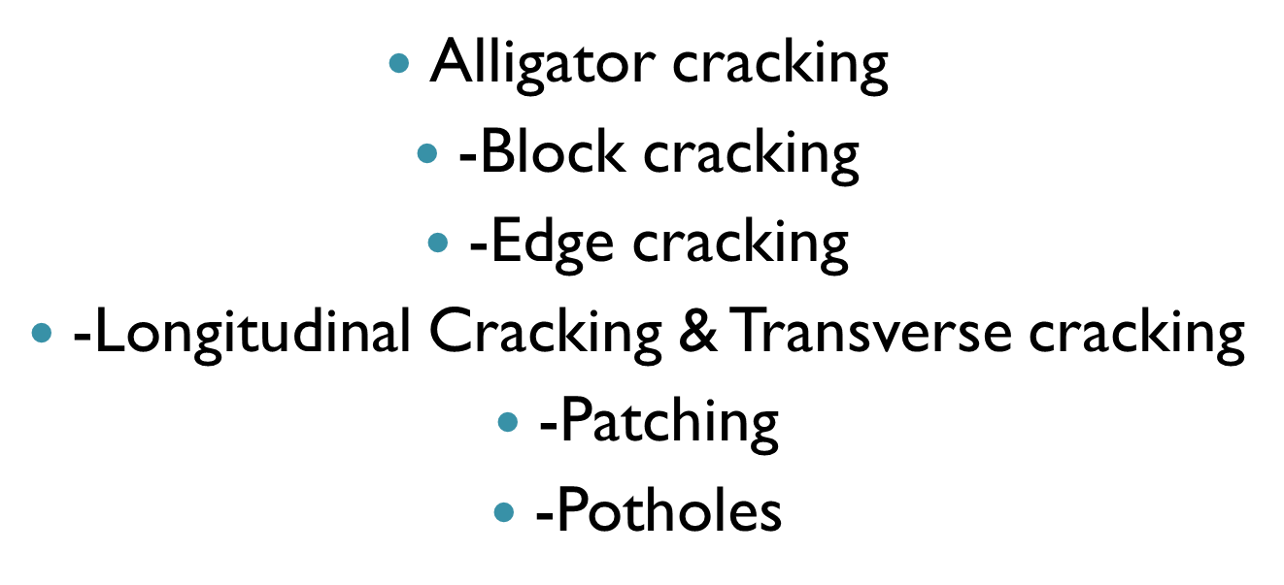
Distress Definitions

Slide 11
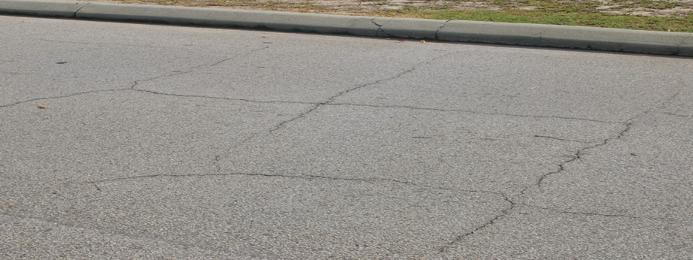
Block Cracking
Block cracks are interconnected cracks that divide the pavement into approximately rectangular pieces. The blocks may range in size from approximately 1 by 1 ft. (0.3 by 0.3m)to ( 3 by 3).

Slide 12
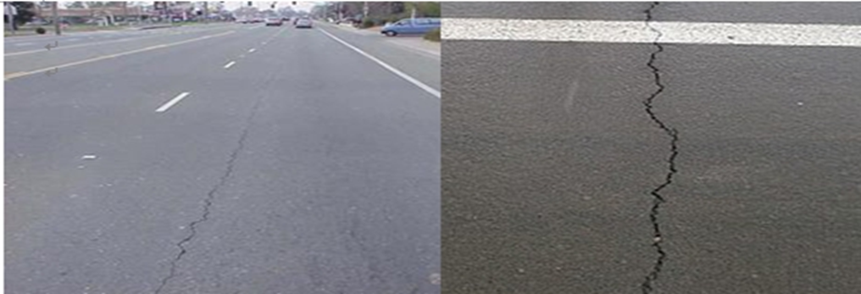
Longitudinal and Transverse Cracking.
Longitudinal cracks are parallel to the pavement's centerline . Transverse cracks extend across the pavement at approximately right .angles to the pavement.centerline

Slide 13

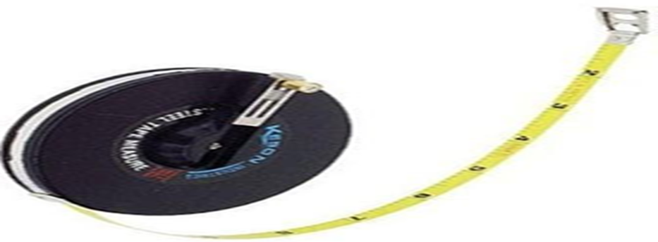
TAPE(Hand Odometer wheel)

Slide 14
Record data in data sheet(fill condition survey data sheet)

Slide 15
Calculate total deduct value as a function of density and severity.

Slide 16
Determine corrective deduct value : function of total deduct value & q=number of deduct greater than 5 points.

Slide 17
DV | Density % | Total | Quantities(m² ) |  |  |  | severity
65 | 14.0 | 48.5 |  | 3.5 | 20 | 25 | 1H
22 | 1.31 | 4.6 |  |  |  | 4.6 | 12H
12 | 1.8 | 6.5 |  | 1.65 | 1.60 | 3.3 | 11H
5 | 0.45 | 1.6 |  |  |  | 1.6 | 10H
6 | 0.85 | 3 |  |  |  | 3 | 7M
110
Alligator cracking with severity high condition.

Slide 18
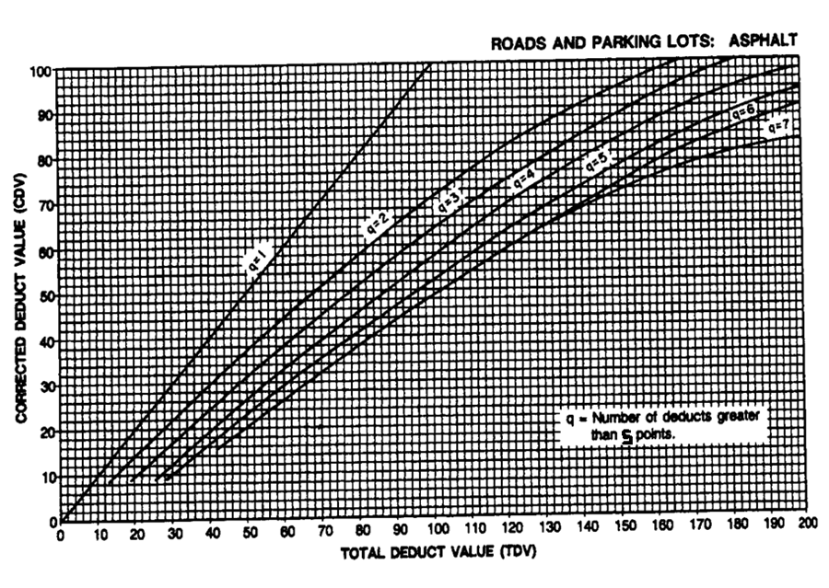



Slide 19
PCI =100-CDV

Slide 20
PCI=100-68=32
The rating is poor

Slide 21
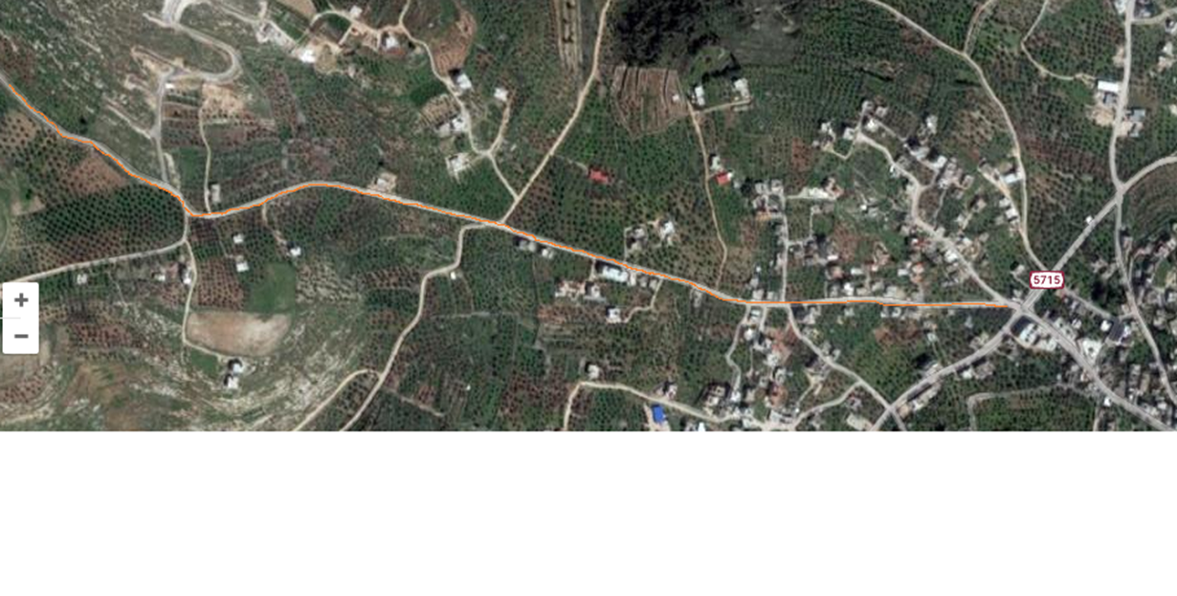
Plan view

Slide 23
Now we can calculation of Composite Priority Index (PI) & Proper Maintenance

Slide 24
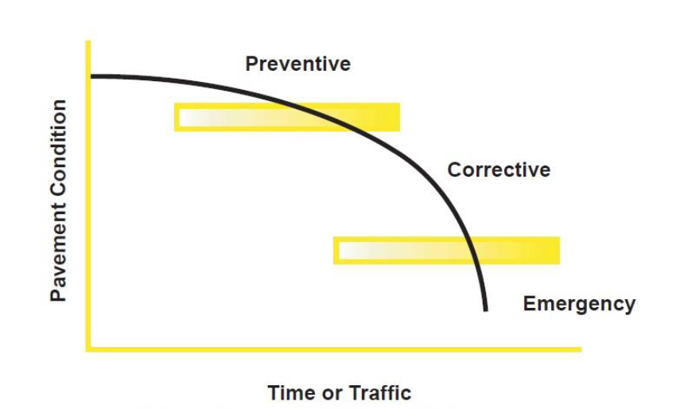

Slide 25
RATINGS ARE RELATED TO NEEDED MAINTENANCE OR REPAIR According AASHTO - Highway Manual
.Rating 9 & 10 No maintenance required
.Rating 8 Little or no maintenance
.Rating 7 Routine maintenance, crack sealing and minor patching
.Rating 5 & 6 Preservative treatments (sealcoating)
Rating 3 & 4 Structural improvement and leveling (overlay or .recycling)
.Rating 1 & 2 Reconstruction

Slide 26
Prioritization
The composite maintenance priority index is the method selected for pavement maintenance priority ranking procedure. The composite index method considers several factors that affect the priority ranking. Two types of information are needed: the priority factor value and the priority factor weight.

Slide 27
Four factors are considered in this project from municipal. These factor are road classification, pavement condition, operating traffic, and the overall importance of the road section to the community.

Slide 28
To obtain the priority index of each pavement section in the road network, the value of each of the four priority factors should be determined. These factors along with their suggested weight of importance are shown in Table below. The sum of all factor weights should be equal to 1.00.

Slide 29
Factor Weights

Slide 30
The priority index (PI) is calculated for every section that reflects the importance and urgency of repair to that section. PI is calculated by multiplying each priority factor value by its weight and summing the products as follows:
PI=Σ wi * Fi
where:
PI=Priority Index.
Wi=weight priority factor, total weight=1.0
Fi=priority factor weight for Each section.

Slide 31
FACTORS

Slide 32
Road classification

Slide 33
Traffic Volume
The Traffic Volume is also one of the important factors which affected the pavement condition . The priority factor (Fi) related to the traffic volume factor (TF) is calculated from the following equation:
T.F = 100(ADT/ Max. ADT)
Where:
ADT = Average Daily traffic.
Max.ADT = Maximum Average Daily Traffic.

Slide 34
PC
PC=100-PCI

Slide 35
Road Importance to Community
The value is considered from Municipal and it equal 0.25

Slide 36
Ranking Method
The second step after identifying and calculating the value of PI for each section is to rank the sections in descending order based on the value of PI (100-99-98--------50-49---)

Slide 38
Result and Recommendation
For evaluation, we divided the local road system into individual section which are similar in construction and condition.

Slide 39
By excel sheet and Using function on the Excel program .We summarized the results as follows so that we divided each section as needed for maintenance and preliminary as described below. The objective from it to establishing a plan for roadway maintenance and capital improvement investments is to first decide upon long-range goals and objectives .

Slide 40
CONCLUSTION
PCI Uses and Benefits:
• Identify immediate maintenance and rehabilitation needs.
• Monitor pavement condition over time.
• Develop a network preventive maintenance strategy.
• Develop road maintenance budgets.
• Evaluate pavement materials and designs.

Slide 41
PCI Limitations
It deals with surface conditions only. Surface conditions are symptoms of underlying problems and need to be properly diagnosed. In the worst case, there can be severe distresses below the pavement with no visual signs of distress.

Slide 42

THANKS

