Slide 1


Measuring Palestinian Labors Productivity
Prepared By :
Rabea Hamdan
Ahmad Ghanayem
Supervisor :
Eng. Reema Nassar
May 2017

Slide 2

Legend
Introduction
Study Area
Objectives
Methodology
Data Collection
Analysis
Results and conclusion

Slide 3
INTRODUCTION
What Is labor productivity measurement?
Rate of output per worker (or group of workers) per unit time.

Slide 4
Factors Affecting Worker Performance
Temperature
Motivating workers
Quality
Labor Productivity
Hazardous work area
Experience
Communication

Slide 5

Problem Definition
Construction sector in Palestine is facing a problem of not having a manual illustrating labor productivity rate.

Slide 6


  To Determine the labor productivity rate in different conditions
study the effect of CC on
Compare the performance of labor productivity between sites

Slide 7
Methodology:
First step : select the activities that will be analyzed and checked for labor productivity rate, which are: Paint work, Tile work and Plaster work .
Second step: random 30 sample selected from the West Bank for each item.
Third step : get the information about the 30 sample (name and phone number).
Fourth step: analyze the result to calculate the productivity rate for each item.

Slide 8
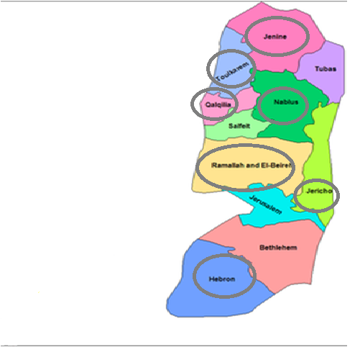
The Study Area :
Different west bank governorates:
Nablus
Qalqilya
Hebron
Ramallah
Tulkarem
Jenin
Jericho

Slide 9
Data Collection:
Workers' phone numbers was obtained .
The workers have been called and got the daily labor productivity by square meter for them.
workers have been visited in their workplaces.
The average labors productivity rate has been calculated.
The comparison has been done between our study and the structural project .

Slide 10
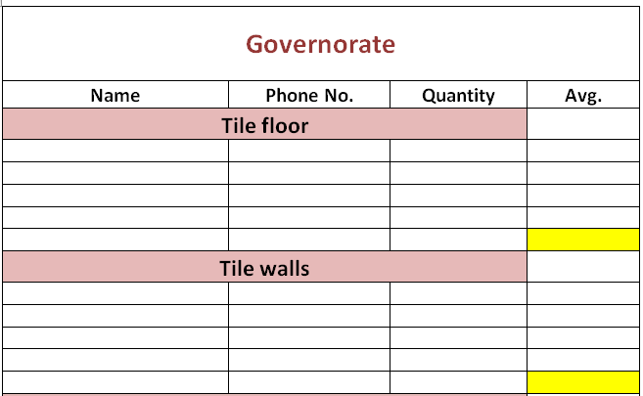
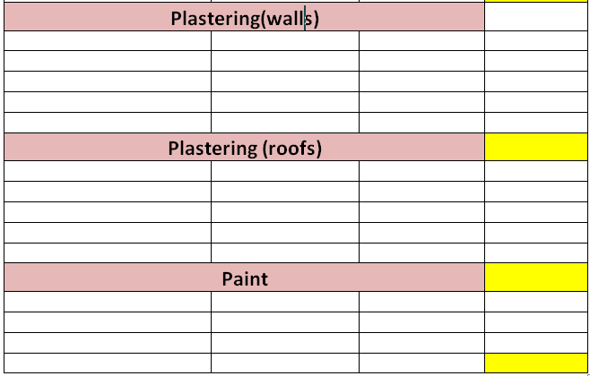

Slide 11
Analysis and Discussion

Slide 12
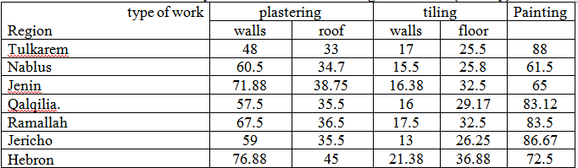
Labor Productivity in different west bank governorates(m² /day).

Slide 13
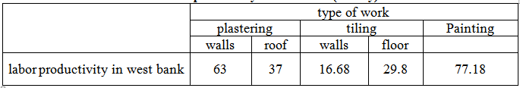
labor productivity in West Bank(m² /day).

Slide 14
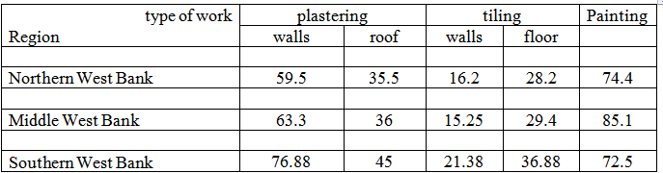
labor productivity according to the geographic variation (m² /day).

Slide 15
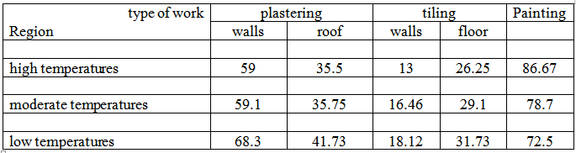
labor productivity according to the temperatures variation(m² /day).

Slide 16
Application of study

Slide 17
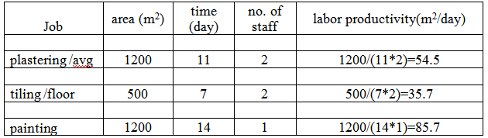
The data obtain from the faculty of IT and administrative science building at Al-Quds Open University – Nablus Branch.

Slide 18
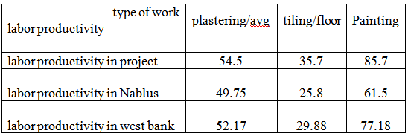
Labor productivity in the project has been compared with labor productivity at Nablus city level and at West Bank level. The following table shows the results.

Slide 19
The previous table shows that the project labor productivity was higher than the study one. These results attributed to the following:
Spacious areas.
Public site which does not need decorations as the private one needs .
The project has a fixed time contract which has a dead line for implementing.
The availability of the controlling over the labor productivity by the contractor engineer .

Slide 20
Conclusion
There is an inverse relationship between the increase of labor age and the drop in productivity rate.
The results showed that the geographic variation affects the productivity rate.
The temperature has great effect on the labor productivity rate , where it reduces then the productivity rate of labors increase.

Slide 21
Thank YOU!

