Slide 1
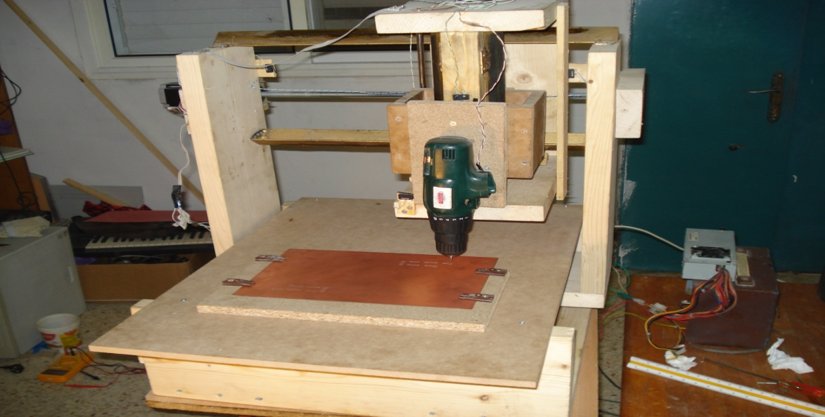
CNC PCB Machine
Prepared by :
*Jafar Yasin
*Hussam Salameh
Supervised by:
Dr. Sufyan Samara

Slide 2
Outline
What is CNC
Usage of CNC machines
Advantages of CNC machines
Mechanical part
Electrical part
Software part
Problems and errors

Slide 3
What is CNC ?
CNC stands for Computerized Numerical Control.
CNC Machine is a mechanical machine which moves using motors in different directions and controlled via microcontroller or computer through a set of commands called G-Code.

Slide 4
Usage Of CNC Machines
There are many uses for CNC machines depends on their shape, size, and design.
Each machine is used only for the purpose that designed for, and can make real problems if it’s used for another purpose.
Some of its Common uses:
Drilling, Milling, Cutting, and plotting.

Slide 5
Advantages of CNC machines
Low cost of production.
High part to part accuracy and consistency.
Less time and effort required.
Easier to fix, when an error occurred.
Programmable.

Slide 6
Our Project: PCB CNC Machine
A CNC machine that dedicated to make printed circuit boards.
In our project the machine performs two main tasks:
- Milling: is the process of removing areas
of copper from printed circuit board sheet.
- Drilling: is the process of making holes in the printed circuit board sheet.

Slide 7
Mechanical Part
Since our CNC machine moves in three different directions, we have three parts.
We fixed each part with a screw, so the part can move only when we turn the screw.
Then, We fixed each screw with two bearings, to make its move easier.
Finally, we connect each screw with a stepper motor. Now we can moves CNC parts using stepper motors.

Slide 8
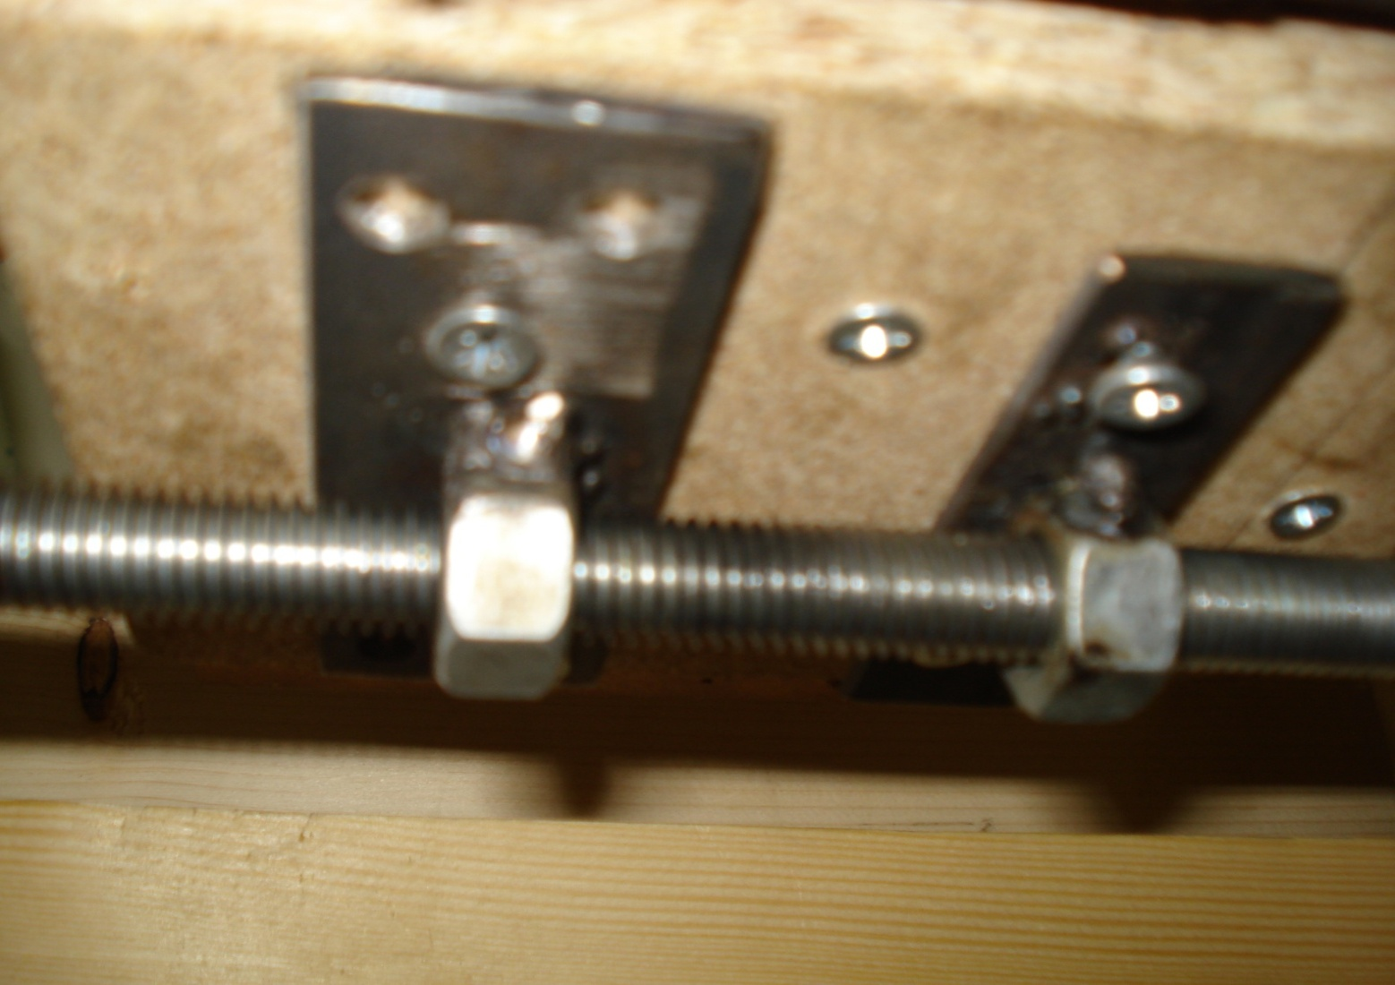
Mechanical Part
Figure shows how Z part fixed with a screw

Slide 9
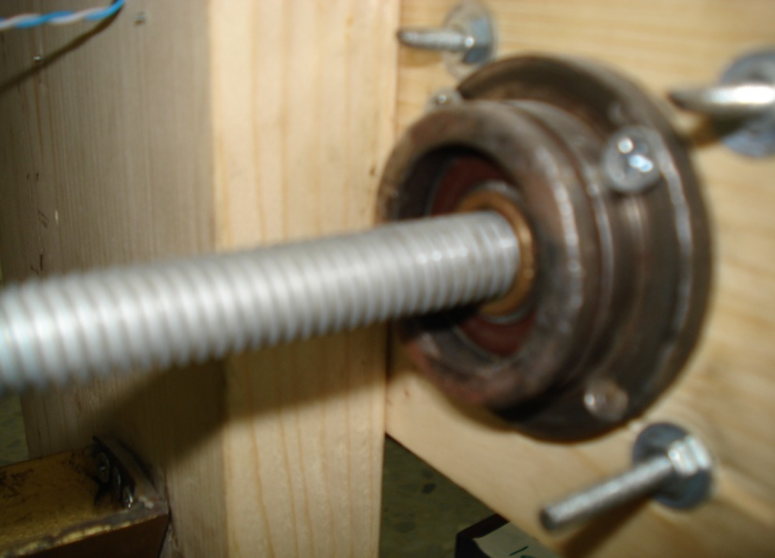
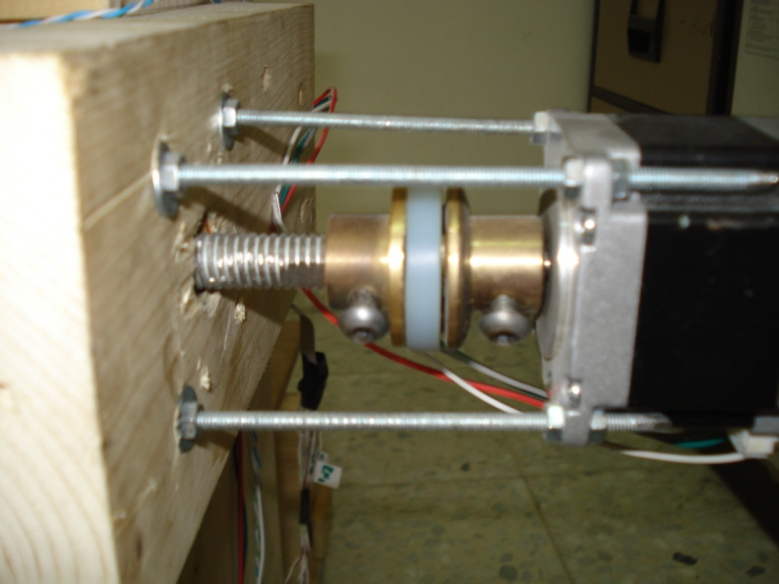
Mechanical Part
Figure shows how screw fixed with a bearing
Figure shows how screw connected with the motor

Slide 10
Electrical Part
In our CNC project we use bipolar stepper motors to move three parts of CNC.
We use L298 H-Bridge to make driving circuits for the stepper motors.
We use PIC18F4620 microcontroller to receive commands from computer, and control stepper movement according to the received command.

Slide 11
Software Part
In our CNC project we wrote a software for PIC microcontroller using PICC Compiler, and another software for Host using java
Java software is responsible to read g-code files, send them serially to the microcontroller, and receive ACK from microcontroller.

Slide 12
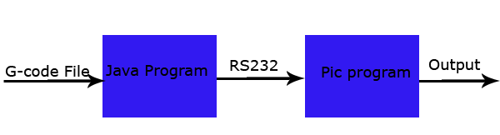
Software Part
PIC software is responsible for parsing received G-Code commands, and output signals to the ports to control machine.

Slide 13
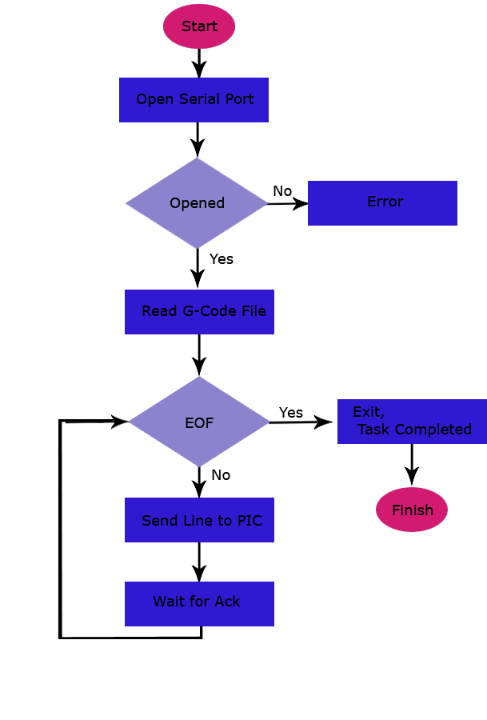
Java Code

Slide 14
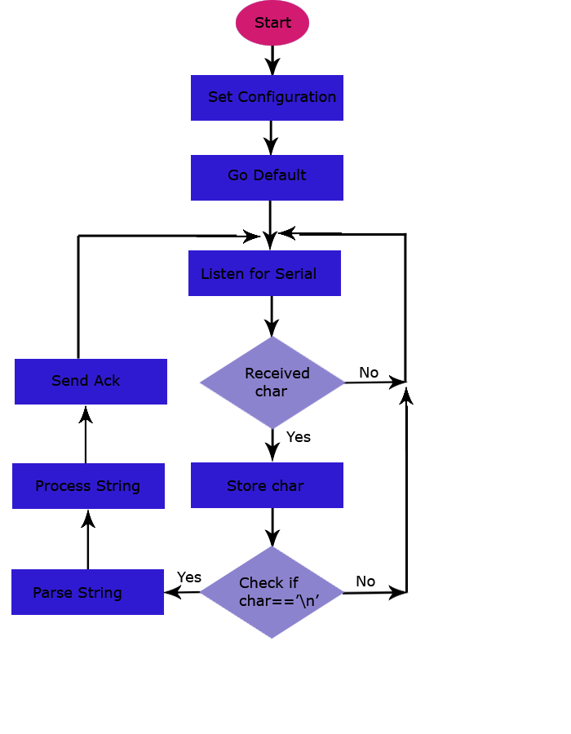
Microcontroller Code

Slide 15
Problems and errors
Our CNC project is built from scratch using available and cheap components by hand.
So, we have some mechanical errors in our design.
The most error bias happens because of the drilling machine.

Slide 16
Video
This Video demonstrates how the machine work.

