Slide 1

Development Of Human Resource Management System at An-Najah National Educational Hospital
Prepared by:
Alaa Khalifeh
Muna Omaria
Sireen Kharoub
Wafa’ Moqadi
Supervisor:
Eng. Suliman Daifi

Slide 2
Project Description
The project main objective is to develop a human resource management manual for the use of the administration department at the hospital to be as reference guide.

Slide 3
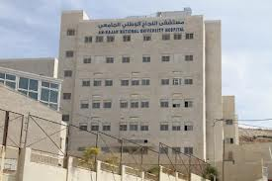
An-Najah University Hospital
An-Najah University Hospital was established in April 2013 on the land of Nablus city on an estimated area of ​​17,000 square meters. The main objective of the hospital is to help patients and practical training for medical students to improve their best possible level of service to the nation.
The hospital currently contains the following sections:
Department of Radiology
Department of dialysis
Department of tumors

Slide 4
Problem Statement
An-Najah national Educational Hospital located at Nablus city, was established recently. The hospital includes huge number of employees. The organizational structure of the hospital includes an administrative department, the department does not have any written documented procedures relating to human resources management.

Slide 5
Project Activities
Reviewing the organizational structure of the department
Reviewing and updating the job description of the employees
Developing standard operating procedures for human resources affairs
Developing standard forms to be used in the human resources activities

Slide 6

Implementation Methodology

Slide 7
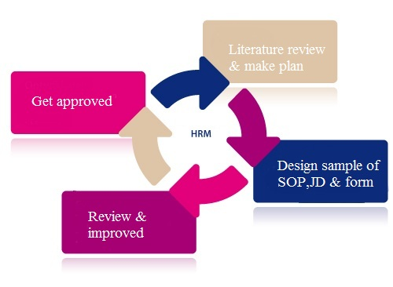

Slide 8
The problem
Solution
There is no system for HRM in the hospital
development HR for the hospital
Results
Organizational Structure
SOP’s
JD’s
Forms

Slide 9
Literature Review

Slide 10
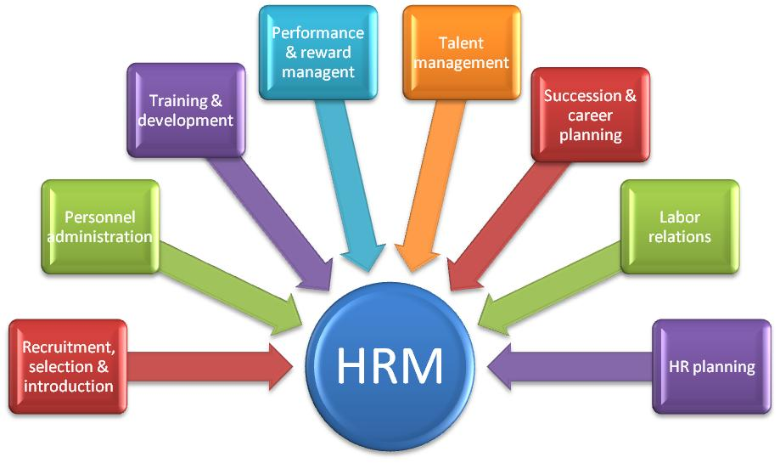

Slide 11
Institutional Development
Tools & Methods
Behaviors & Attitudes
Action Plans

Slide 12
Organizational Structure
Scope
Line of Authority
Arrangement of Departments
Arrangement of Job Titles

Slide 13
Job Description
Essential & non-essential Tasks
Qualifications & Requirements
Work Conditions
Responsibilities & Duties

Slide 14
Documentation Tool
Step-by-Step Work Instructions
Standard Operating Procedure

Slide 15
Forms
Receive Info.
Transmit Info.
Store Info.

Slide 16
Project Deliverables

Slide 17
No. | First Graduation Project Outcomes | Second Graduation Project Outcomes
1. | Improved Organizational Structure | Final modifications and improvements on the suggested O.S
2. | 66 Job Descriptions were designed | Modifications on the previously designed J.Ds and SOPs
3. | 20 Standard Operating Procedures were designed | New SOPs were also designed (final # - 29 SOPs)
4. | Forms for the SOPs | New Forms for the newly designed SOPs(48)

Slide 18
Organizational Structure

Slide 19
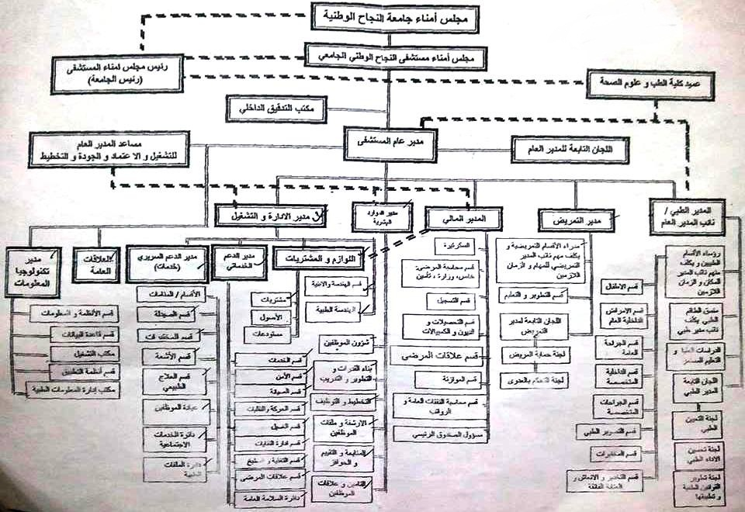

Slide 20
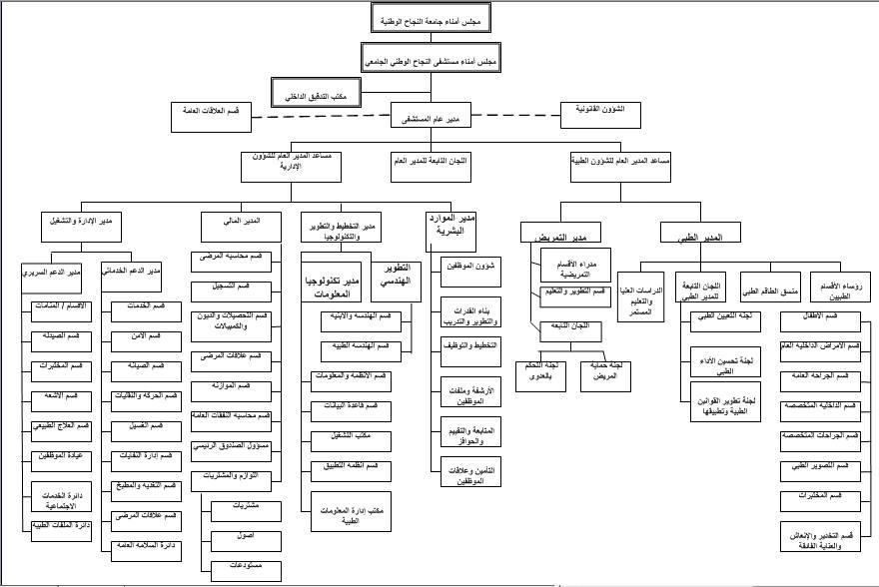

Slide 21
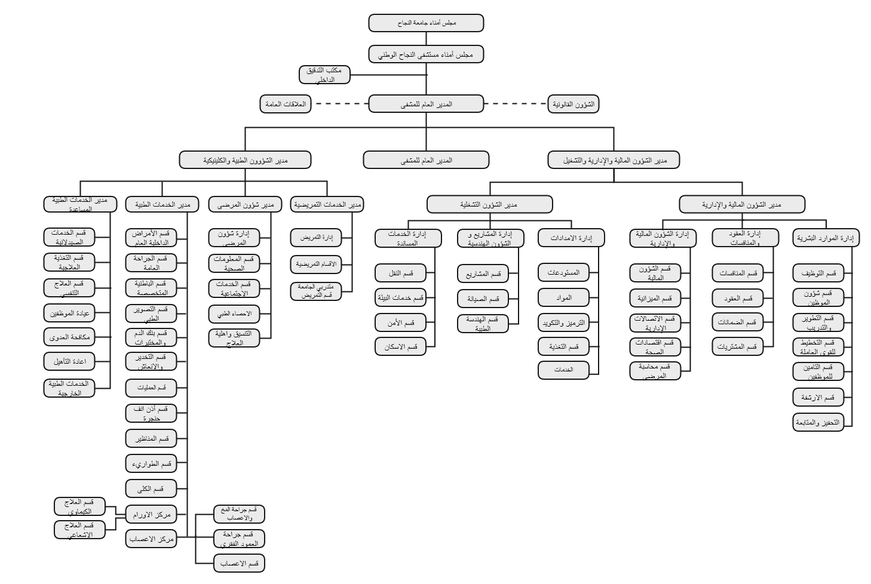

Slide 22
Job Descriptions

Slide 23
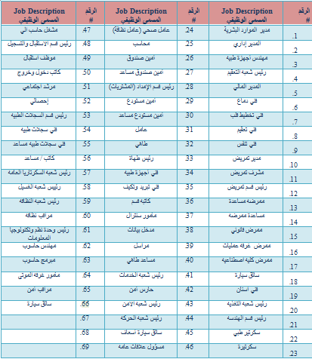

Slide 24

Sample of JD

Slide 25
Standard Operating Procedures

Slide 26
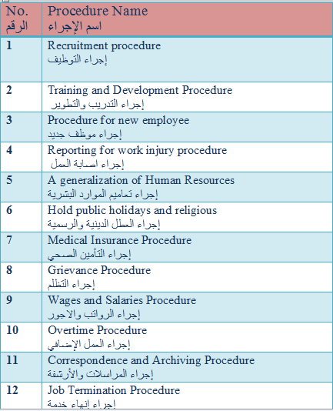

Slide 27
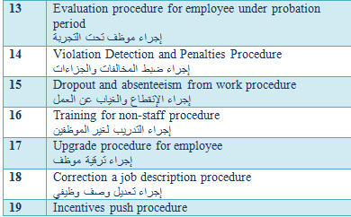

Slide 28
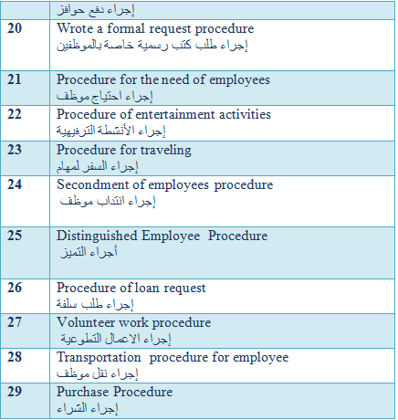

Slide 29
Sample of SOP

Slide 30
Forms

Slide 31
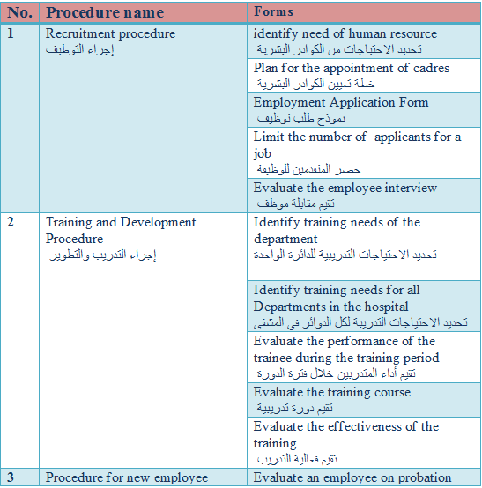

Slide 32
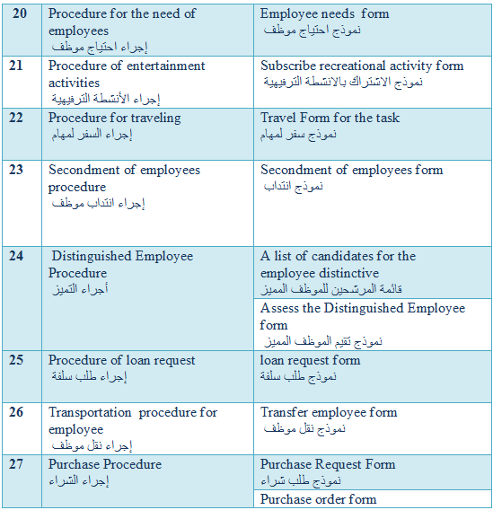
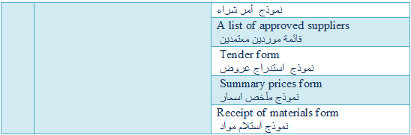

Slide 33
Sample of Form

Slide 34
The Expected Benefits
Organize and develop work at the hospital
Execute the work efficiently and effectively
Implementation of the project SOP’s will lead to a well files and information archiving at the hospital
Reduce the time wasted
Offering a clear way to do the job accurately
Explain the rights and the duties of the staff at the hospital
Providing the organizational structure in a clear and orderly manner

Slide 35
What have been learned during implementation?
Expansion in the field of Human Resource Management
The ability to formulate SOPs properly and in a good way
The ability to design Forms for each procedure
The ability to design Job Descriptions
The ability to design and develop Organizational Structures
The ability to withstand the pressures of work and dealing with others
The ability to work as a team

Slide 36
Constraints
Insufficient knowledge about the human resources management
Employees turnover
Lack of cooperation from hospital employees and departments
Delay of responding to calls and emails
Location of the hospital that it is far from the university

Slide 37
Earlier course work

Slide 38
No. | Course name | How it contributed to our work
1. | Total Quality Management (TQM) | Using principles of ISO for the documentation of SOPs, JDs and forms
2. | Methods Engineering | Methods for the design of forms
3. | Special Topics (PMLC) | How to manage the project and set the appropriate plans
4. | Project Management & Network Analysis | How to manage the project and set the appropriate plans
5. | Human Resource Management | Basic principles of HRM and how to design JDs

Slide 39
Conclusion
As planned in the start of this project, a system for Human Resource Management was developed since there was no system of the hospital.
The benefits gained after the development of the Human Resource Management system, were mainly concentrated on a good background of Human Resource Management, increased skills in designing JD and SOP’s forms and improved SOP writing skills.

Slide 40
  Recommendations
Approve and implement the suggested Organization Structure, Job Descriptions and SOP's.
Develop computerized system for the developed Human Resources Management system.
Design new SOPs for other departments at the hospital

Slide 41


