Slide 1


SHAQATI
شُقّتي
Ahmad hanani
Abdallbaset Rajab

Slide 2


Main Problem
SHAQATI is a unified property management platform that streamlines rental operations. It provides landlords, tenants, and administrators with tools for property listings, maintenance tracking, contract management, and payments. The system centralizes workflows to improve communication and reduce manual processes in the rental ecosystem.

Slide 3
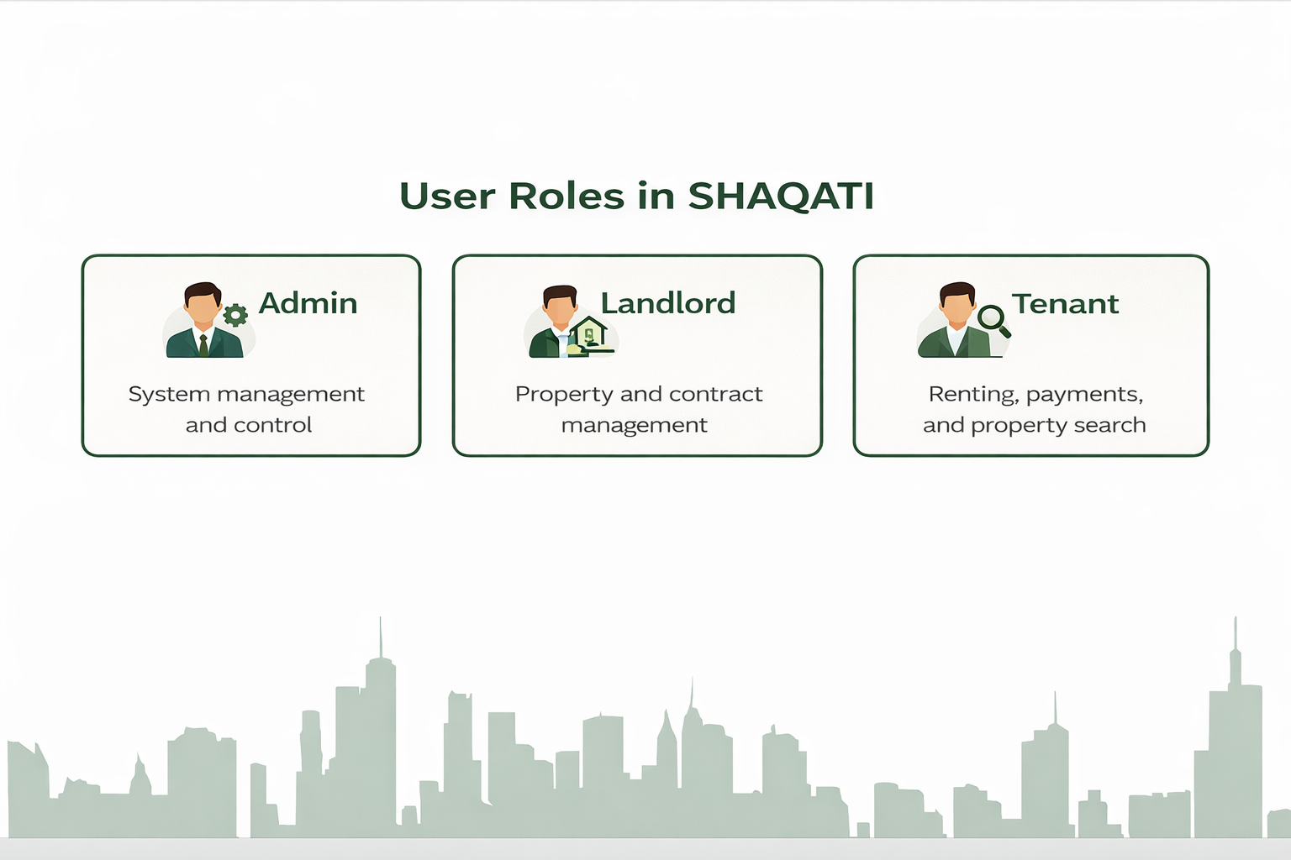

Slide 4
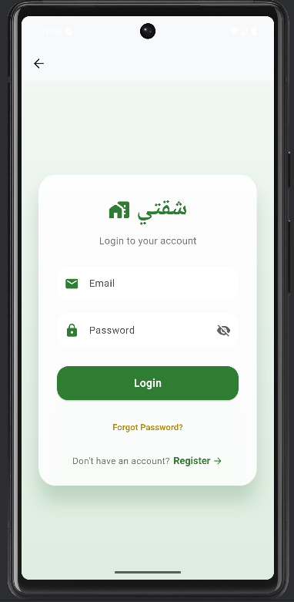

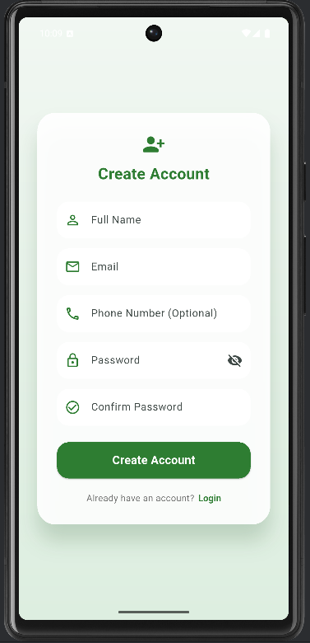

Login and Register
Login allows users to use their correct email address and password.
Register allows new users to create an account in SHAQATI by entering their basic information securely.

Slide 5
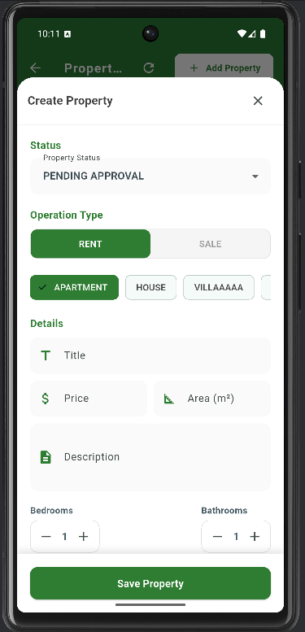
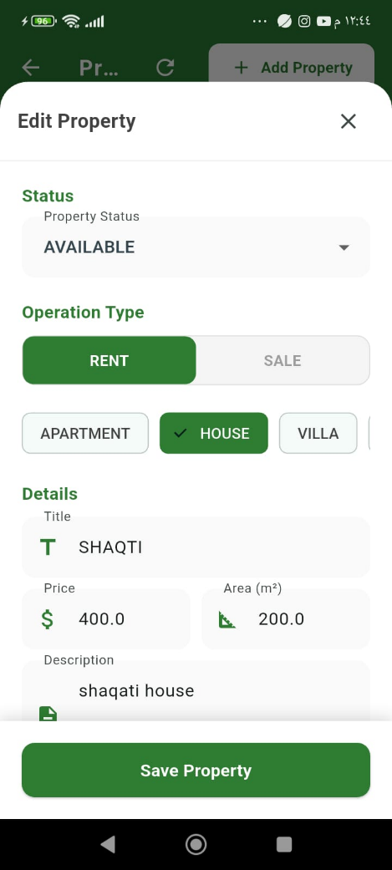
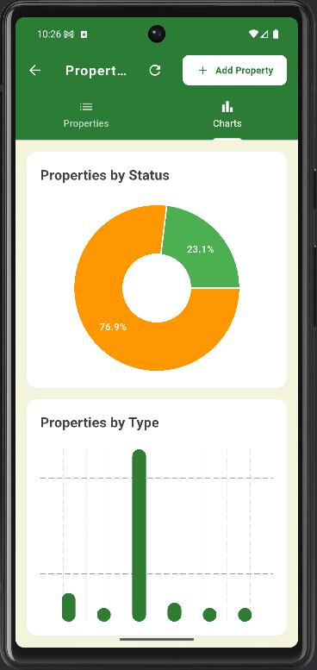
Property Management
(Admin)
Add Property allows Admin to create a new property by entering its basic details.
Edit Property lets Admin update property information when needed.
Charts provide visual insights into properties by status and type for better management

Slide 6
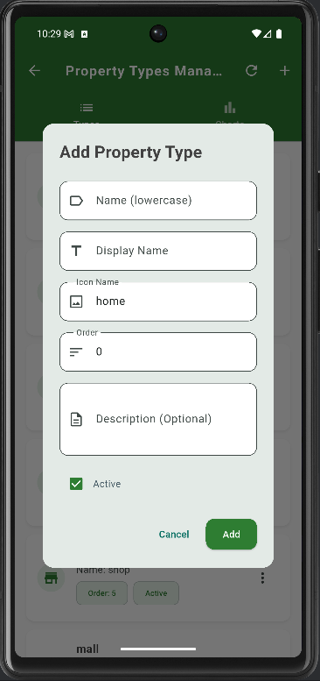
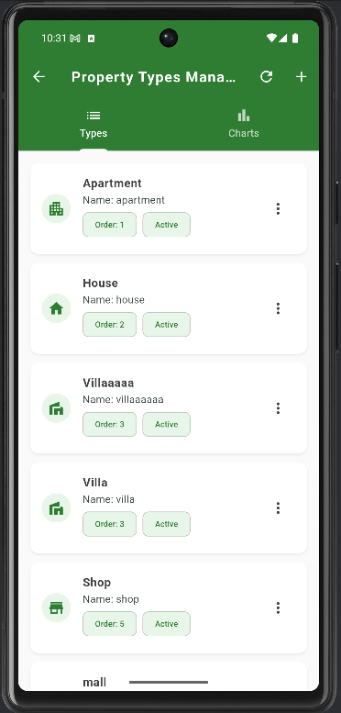
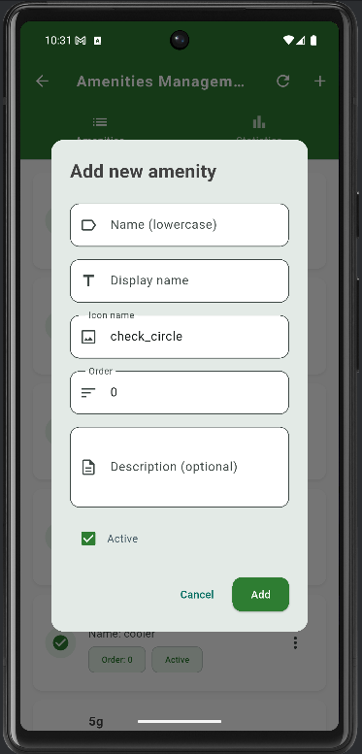

Property Management (cont...) (Admin)
Property Types and Amenities are dynamic and can be managed by the admin (add, edit, delete).
These changes are reflected in the Add Property Details screen automatically.

Slide 7
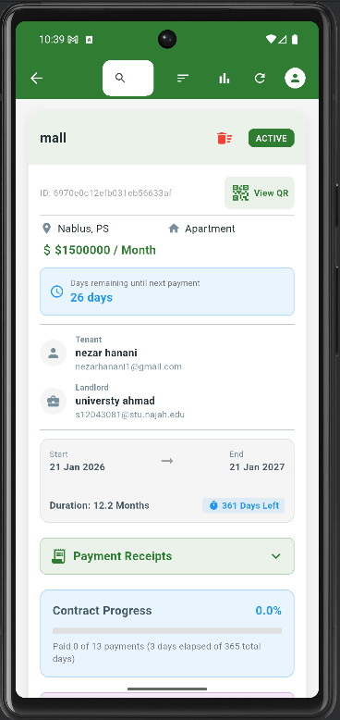
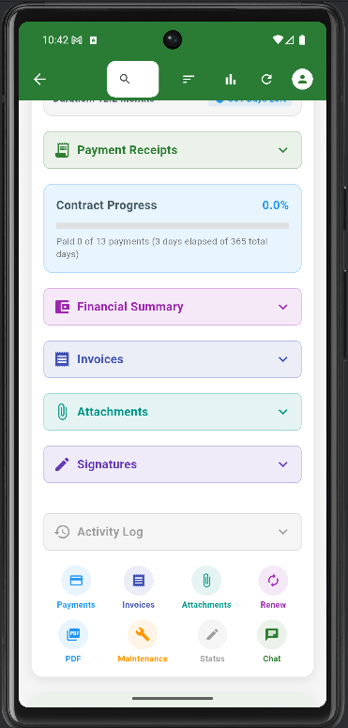

Contract Management
(Admin)
Contract Management allows Admin to view and manage rental contracts with all essential details such as property, rent amount, tenant name, landlord name , dates, and contract status.
It includes features like payment receipts, invoices, attachments, signatures, and contract progress tracking, making it easy to monitor payments and the contract lifecycle.

Slide 8
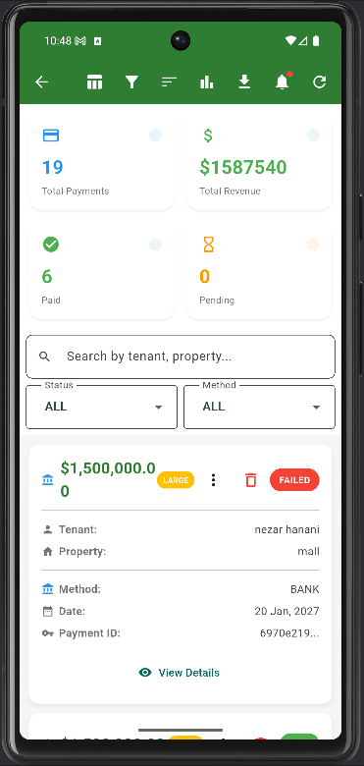
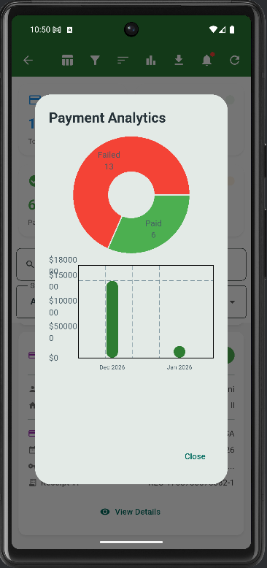

Payment
(Admin)
Payment Management displays all payments submitted by tenants.
Admins can review each payment and approve or reject it, with analytics and charts to track paid, pending, and failed payments

Slide 9
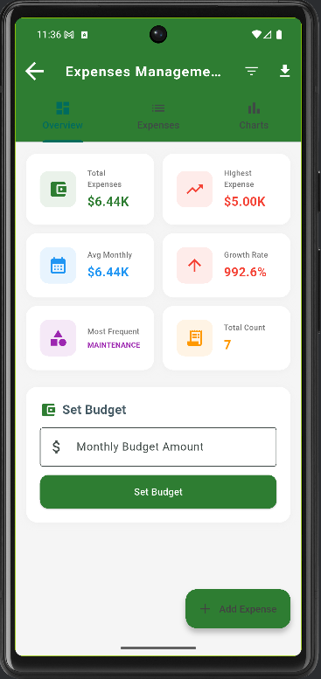
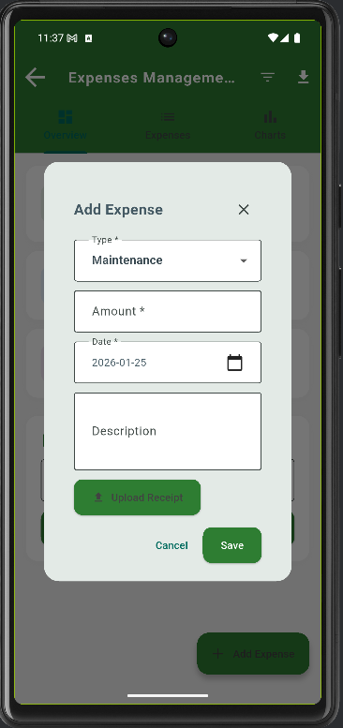
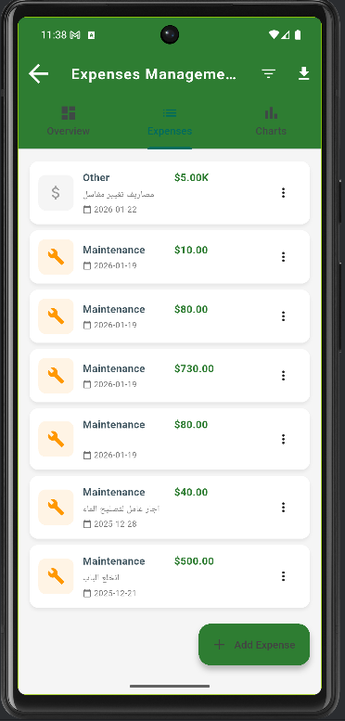

Expenses
(Admin)
Expenses Management allows admins to record and manage all property-related expenses digitally instead of using paper notes.
It helps track spending, add new expenses, set budgets, and view summaries and charts for better financial awareness

Slide 10
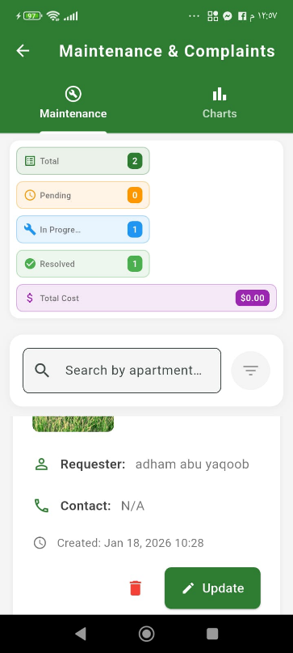
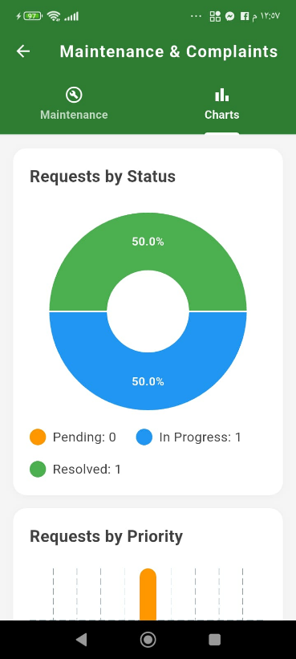

Maintenance and complaints
(Admin)
Maintenance & Complaints displays all maintenance requests and complaints submitted by tenants.
Admins can review new requests, approve them, assign a technician, and set the priority and status (pending, in progress, resolved).
The page also includes charts to track requests by status and priority.

Slide 11

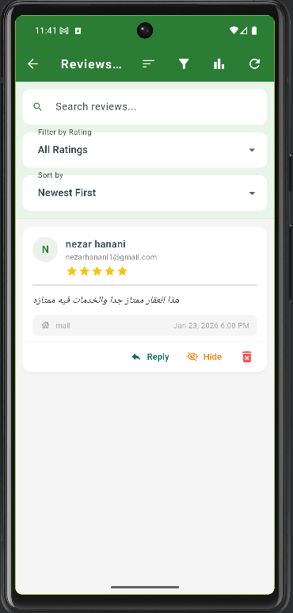
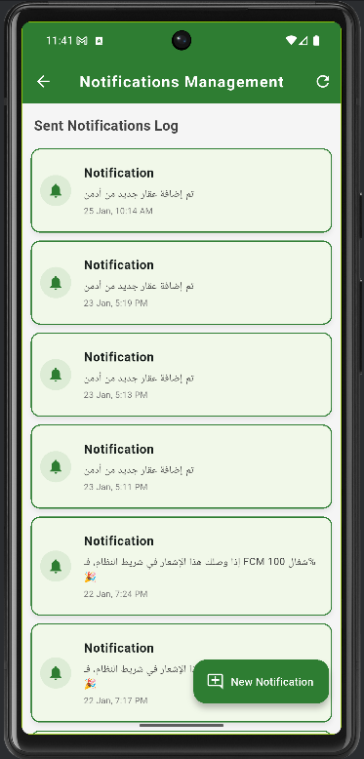
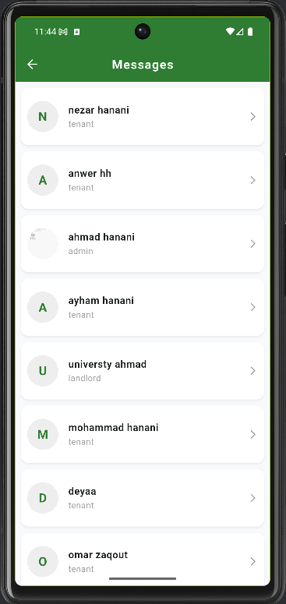

Chat & Notifications & Review
(Admin)
Maintenance & Complaints displays all maintenance requests and complaints submitted by tenants.
Admins can review new requests, approve them, assign a technician, and set the priority and status (pending, in progress, resolved).
The page also includes charts to track requests by status and priority.

Slide 12
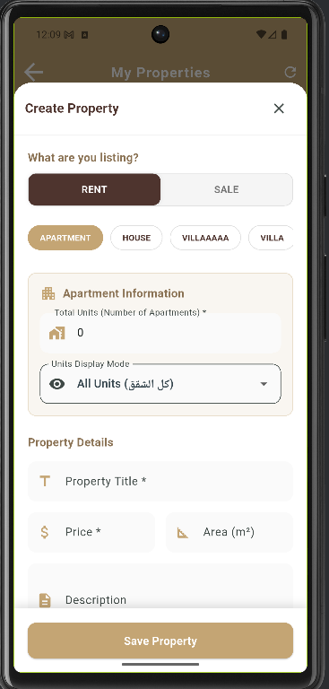
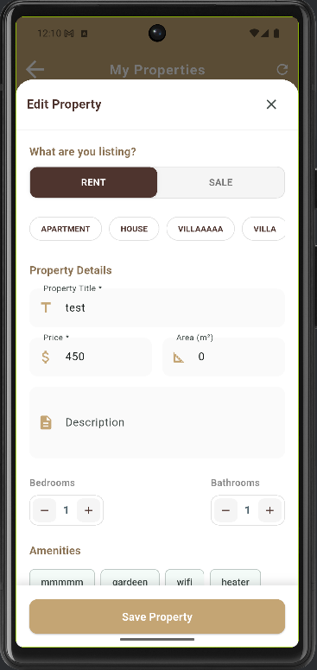
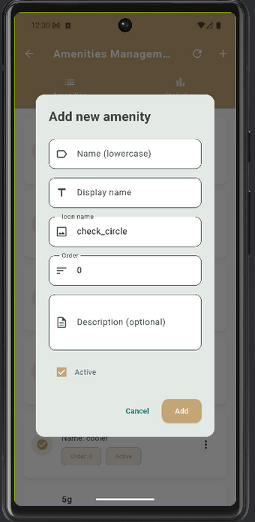


Property Management
(Landloard)
Property Management (Landlord) allows landlords to add and edit their properties easily.
They can enter property details such as type, price, area, description, and amenities, and manage their listings in one place

Slide 13
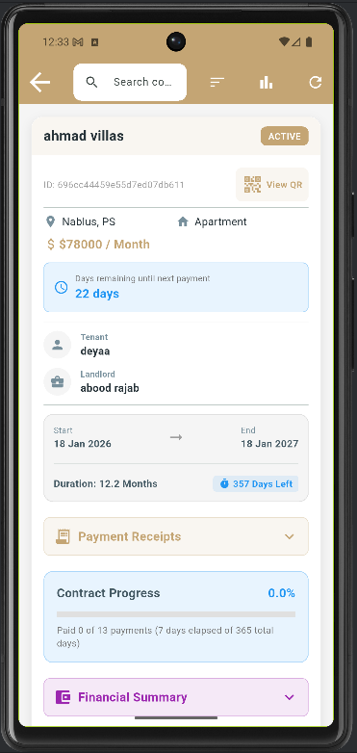
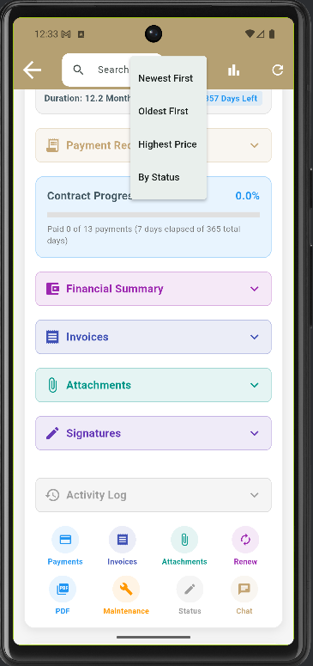
Contract Management
(Landloard)
Contract Management (Landlord) allows landlords to view and manage all rental contracts related to their properties. They can track contract details, payments, progress, invoices, attachments, and signatures in one place.

Slide 14
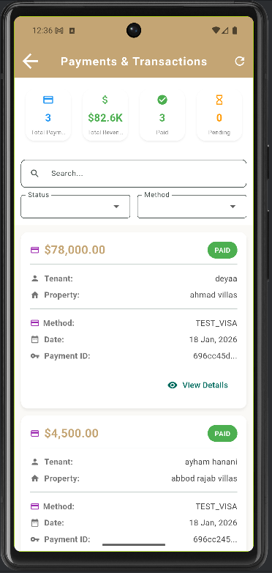
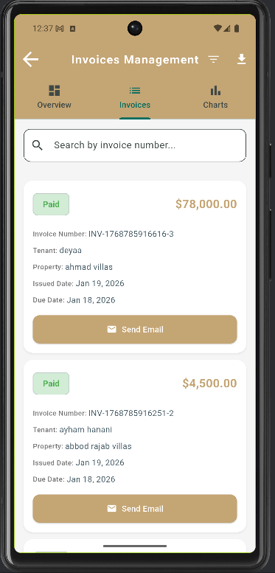


Payment & invoices
(Landloard)
Payments & Transactions shows all payments made by tenants to the landlord.
Each payment is automatically reflected in the Invoices page to ensure transparency, generate receipts, and allow landlords to send invoices to tenants.

Slide 15
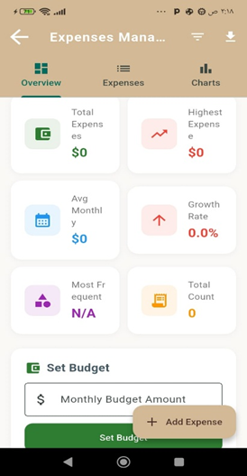
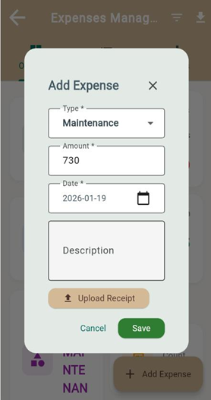
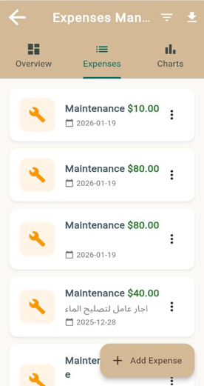

Expenses
(Landloard)
Expenses (Landlord) allows landlords to record and manage all property-related expenses digitally.
They can add new expenses, upload receipts, set monthly budgets, and view expense summaries and charts to track spending easily

Slide 16
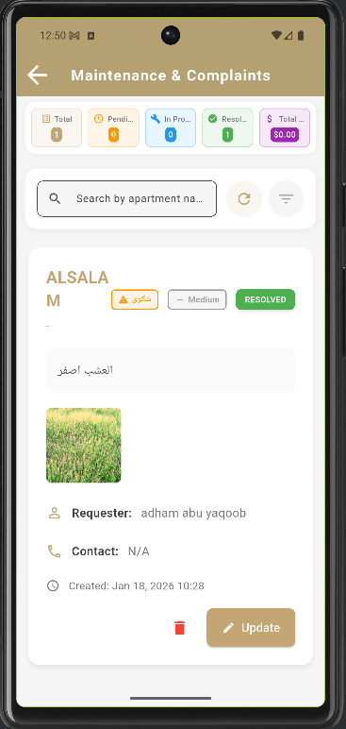
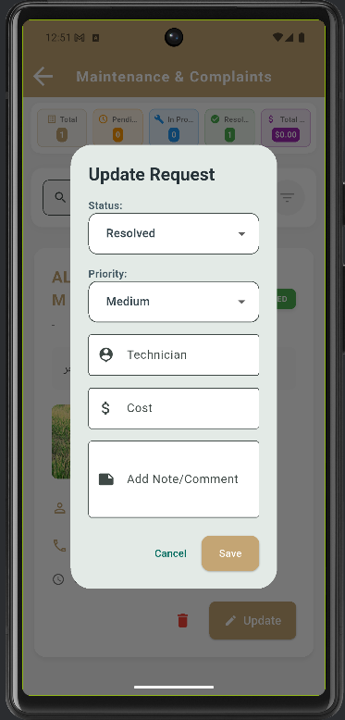

Maintenance and complaints
LICERIA.CO
(Landloard)
Maintenance & Complaints displays all maintenance requests and complaints submitted by tenants.
Admins can review new requests, approve them, assign a technician, and set the priority and status (pending, in progress, resolved).
The page also includes charts to track requests by status and priority.

Slide 17
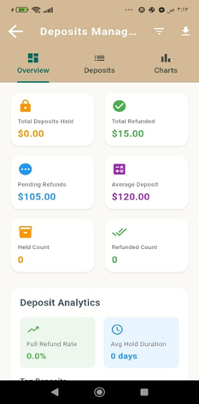
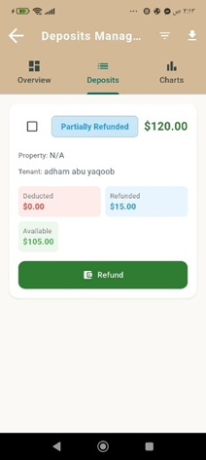
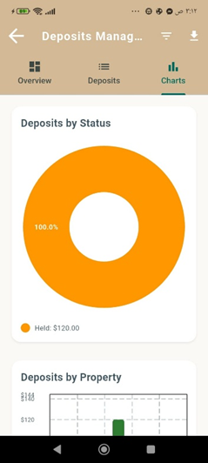
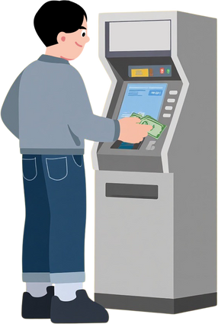
Deposite
(Landloard)
Deposits Management allows landlords to manage tenant security deposits like a banking system.
Payments due from a tenant can be deducted from their deposit, and these payments appear as coming from the tenant’s deposit.

Slide 18

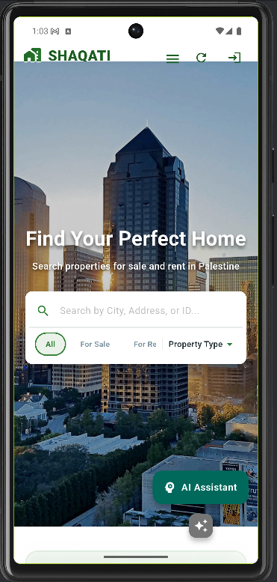


Filtering System
Tenant
Filtering System (Tenant) allows tenants to search and filter properties by city, address, property type, and rent or sale.
It helps users quickly find suitable properties that match their preferences.

Slide 19

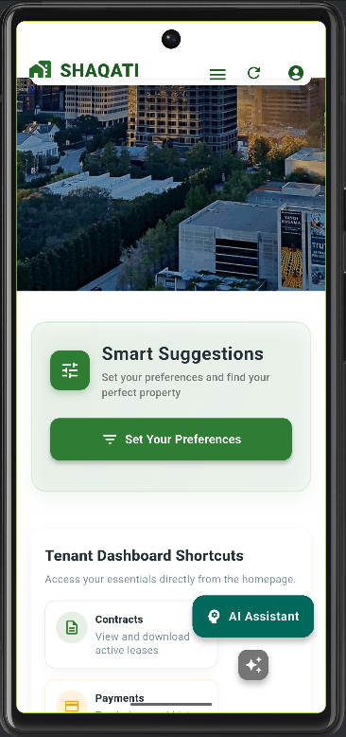
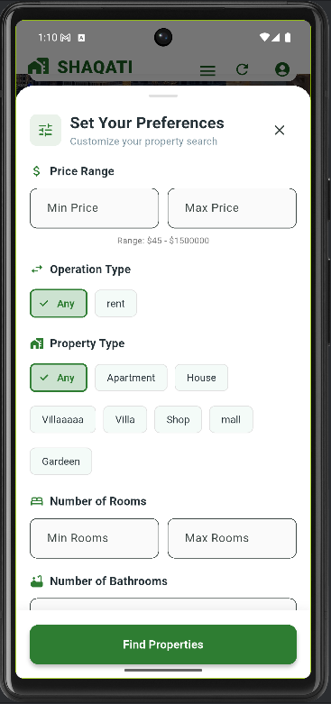

Smart Suggestion
LICERIA.CO
Tenant
Smart Suggestions (Tenant) allows tenants to set their preferences such as price range, property type, and number of rooms.
The system then recommends suitable properties that match their needs and preferences.

Slide 20

ARTIFICIAL INTELLIGENCE
SHAQATI AI is a smart real-estate assistant that understands user questions,
queries real data from MongoDB, and generates intelligent responses
using advanced AI models such as GPT-4.1.
It avoids hallucinations by using the database as the source of truth
and supports multiple AI providers for flexibility and scalability.

Slide 21

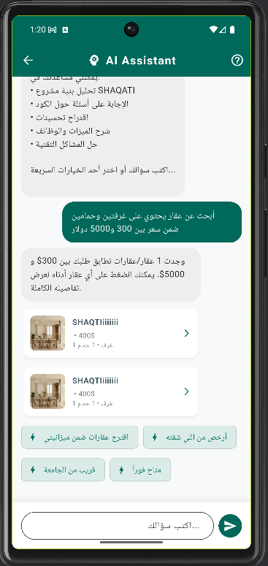
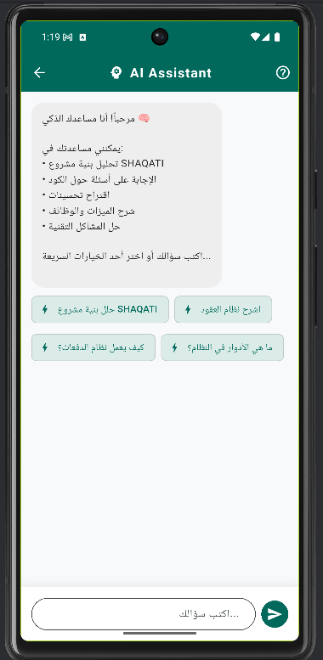
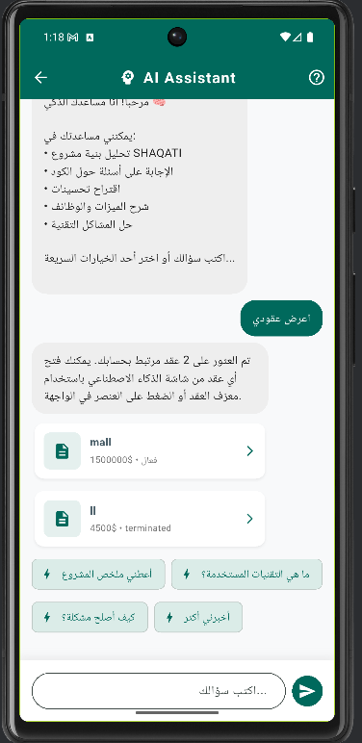


Slide 22
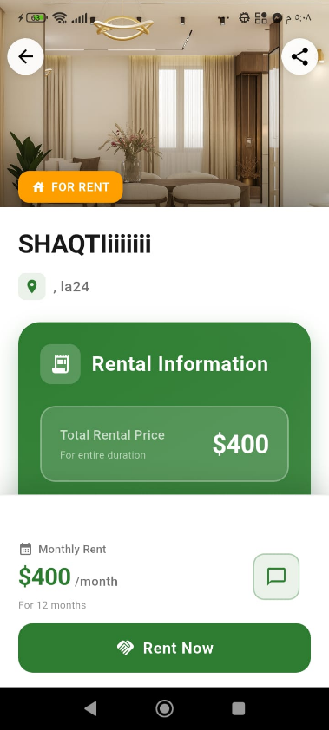
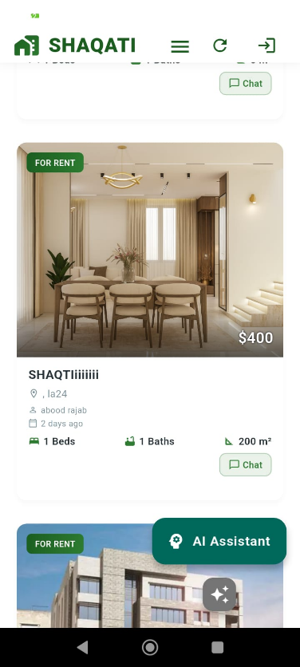
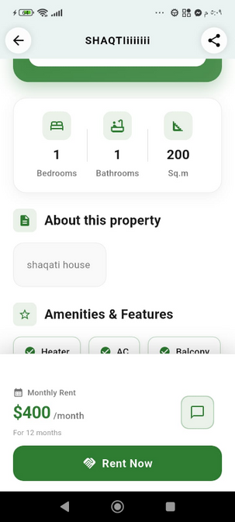

Property details
Tenant
Property Details shows all important information about a property, including price, location, images, amenities, and rental details.
Tenants can rent the property or make a payment directly from this page.

Slide 23
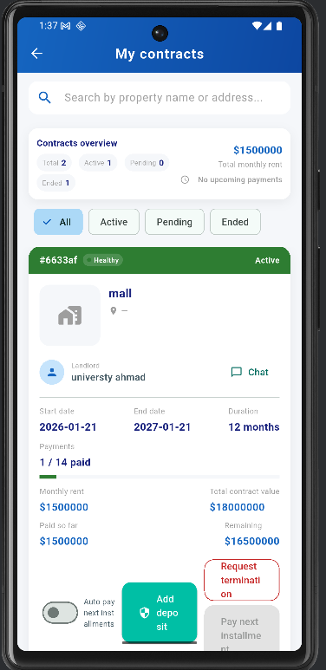
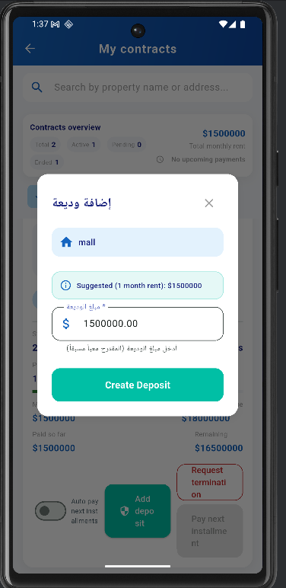
Contract Management
Tenant
Contract Management (Tenant) allows tenants to view their rental contracts in read-only mode.
They can see contract details and add a security deposit when required.

Slide 24
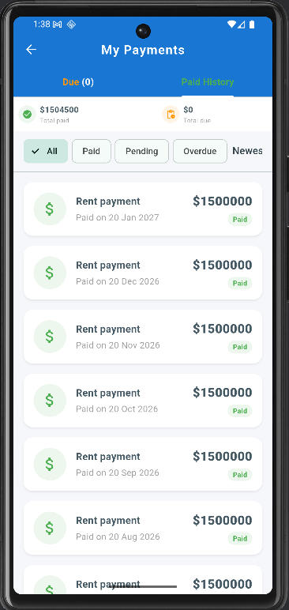
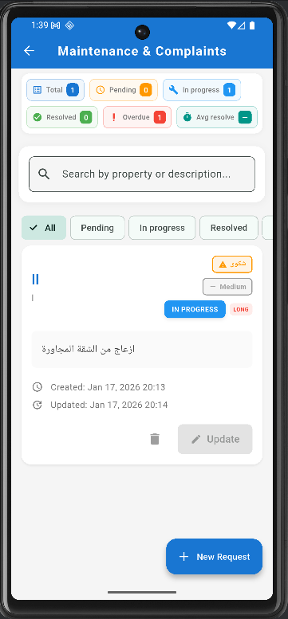

Maintenance & Payment
Tenant
Maintenance & Payment (Tenant) allows tenants to view their payment history and track rent payments.
Tenants can also submit maintenance requests or complaints, add descriptions and photos, and follow the request status (pending, in progress, resolved)

Slide 25



Expenses & deposits
Tenant
Expenses Management allows tenants to view and track their expenses digitally instead of using manual records.
Deposits Management lets tenants add a deposit balance, from which their rent payments can be deducted.
Currently, deposits are not linked to a real bank card, but they can be integrated with real payment methods in the future.

Slide 26




  Thank you

