Slide 1

Graduation Project (2)
Mixed Use Building
Prepared by :
Ahmad jitan
Hanadi bani fadel
Jihad elyyan
Marah derieh
Supervisor:Eng.Hasan mathar

Slide 2
Outline
Introduction
Site analysis
Architectural design
Structural design
Environmental design
Electrical design
Mechanical design
Safety
Quantity Survey

Slide 3
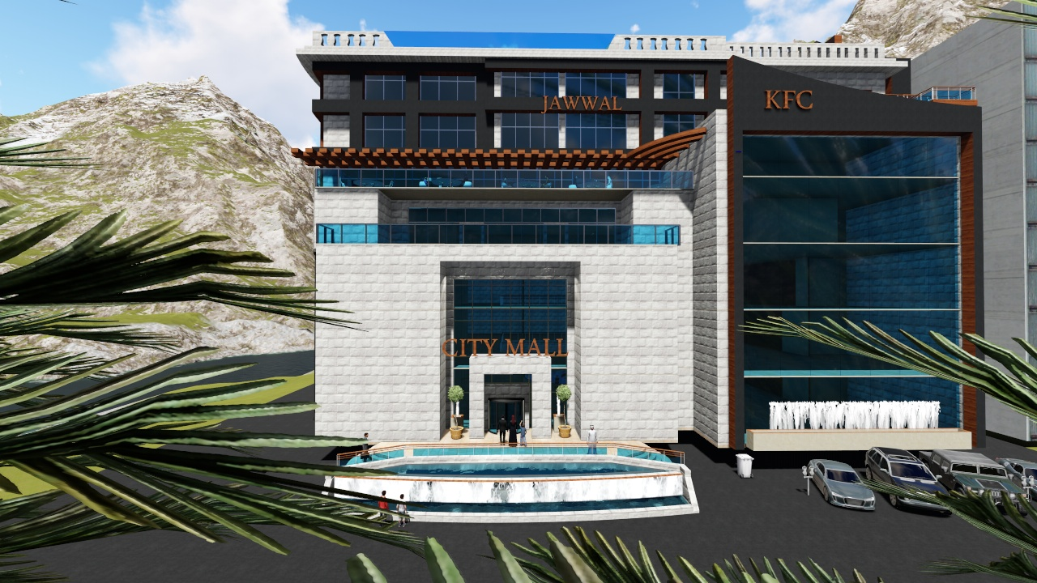
Introduction

Slide 4
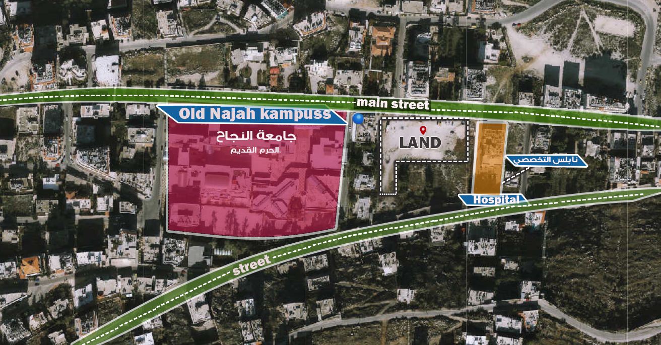
SITE ANALYSIS
The proposed land was chosen to be in the south of Nablus on Gerizim Mountain.

Slide 5
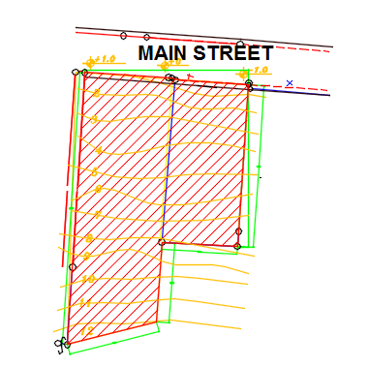
CONTOUR AND LEVEL
land is 3488 m² with slope 12m from north to south.

Slide 6
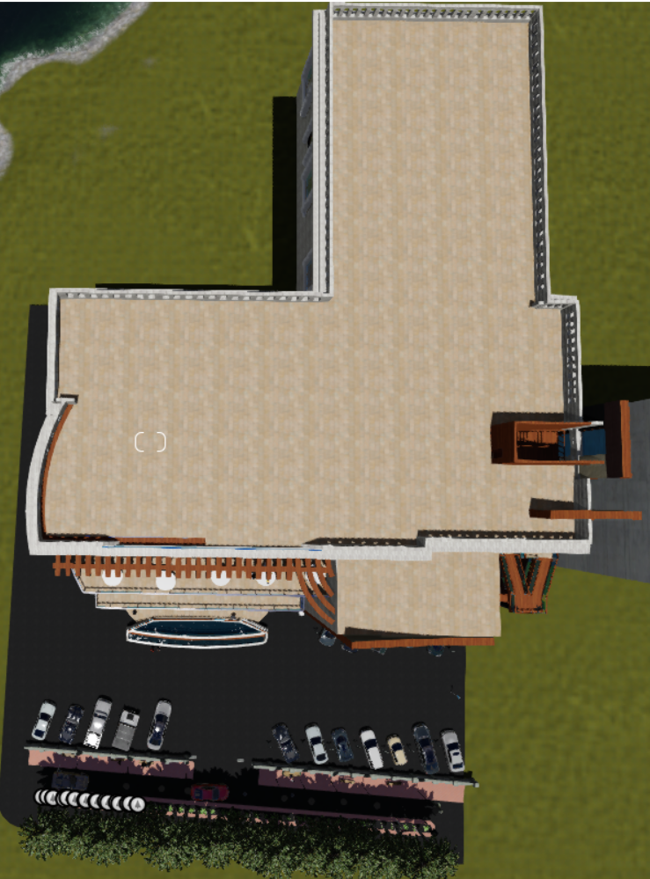
Architectural Design
Site Plan

Slide 7
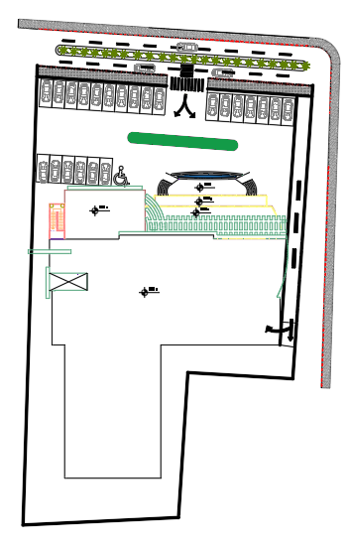
Site plane

Slide 8
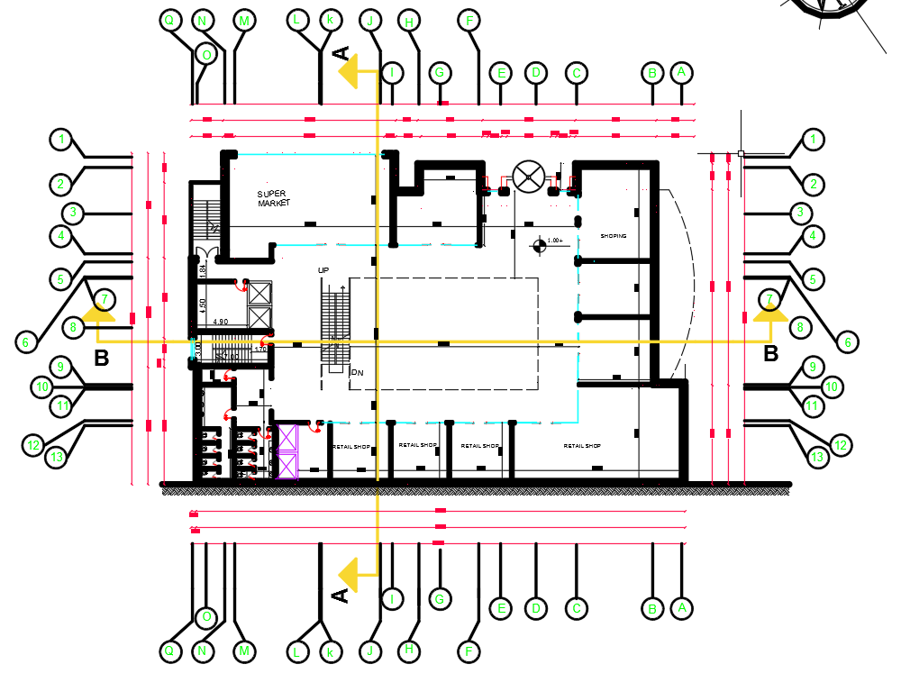
Architectural Design
Ground floor
1289.5 m² which contains, entrance, shops, store.

Slide 9
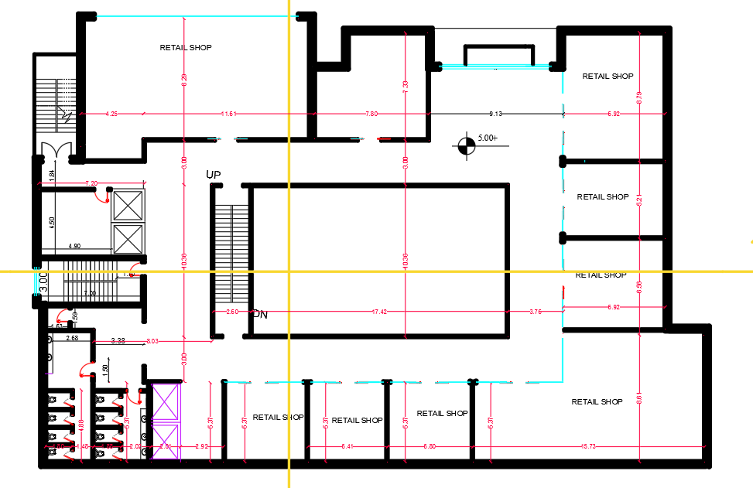
Architectural Design
first&second floor
1289.5 m² which contains, shops, store.

Slide 10
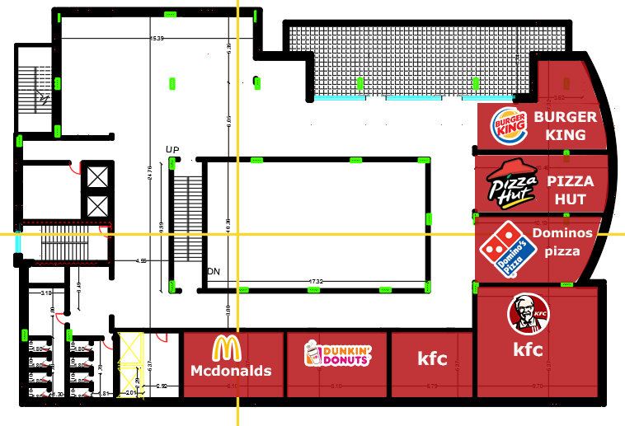
Architectural Design
Third floor (food court).

Slide 11
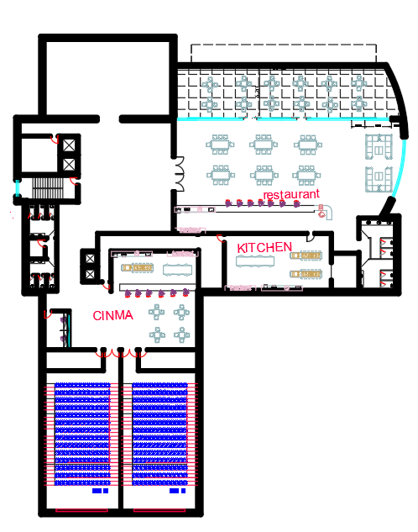
Architectural Design
fourth floor (resturant).
Area 1788.5m²
contain two cinema

Slide 12
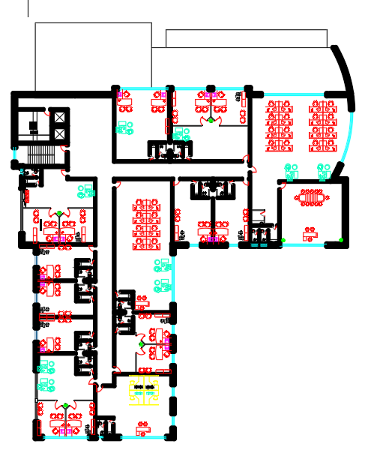
Architectural Design
5th + 6th floor (offices).
Area 1788.5m²

Slide 13
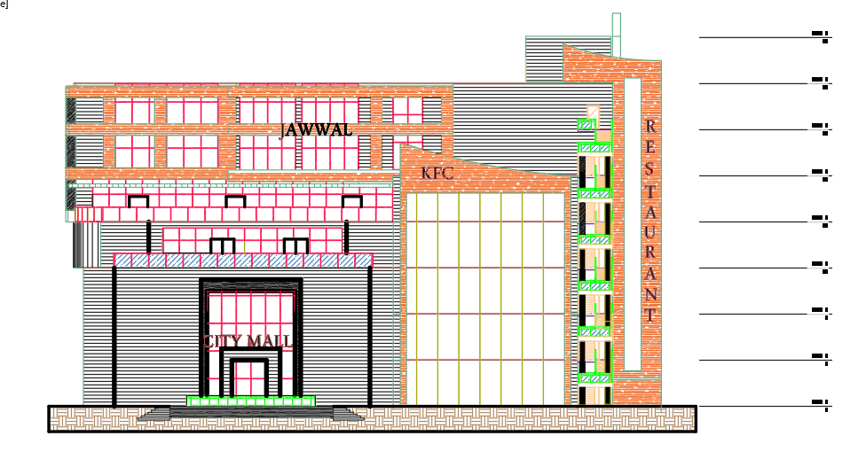
Elevations
NORTH ELEVATION

Slide 14
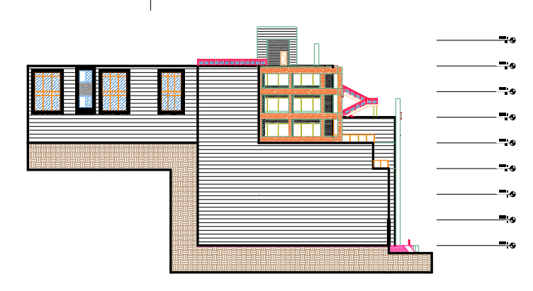
Elevations
EAST ELEVATION

Slide 15
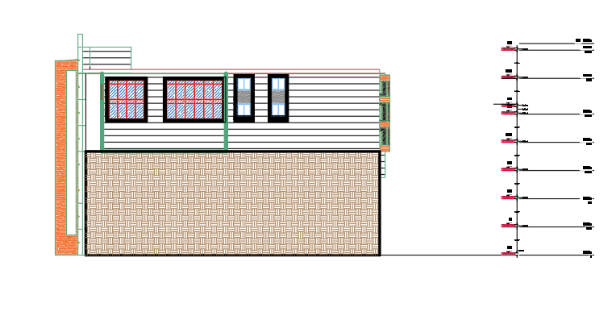
Elevations
SOUTH ELEVATION

Slide 16
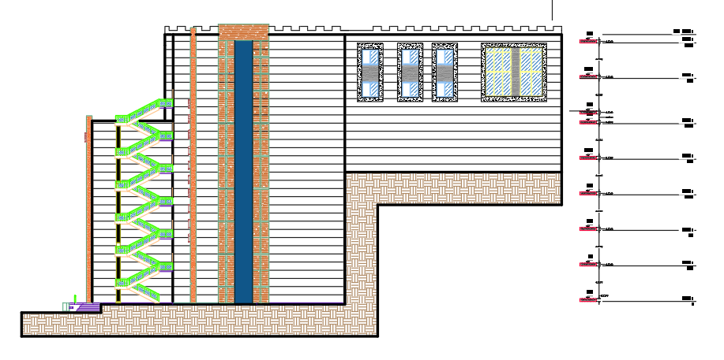
Elevations
WEST ELEVATION

Slide 17
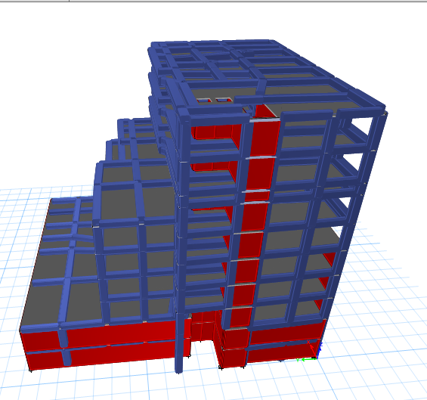
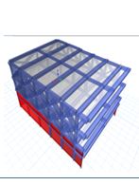
Structural Design

Slide 18
Structural Design
The software's used for analysis and design is:
ETABs2015 and sap2000 for structural analysis & design.
AutoCAD for all drawings.

Slide 19
Structural Design
The design of the building was done according to the following codes and standards:
ACI -318-2011 for reinforced concrete structural design.
UBC -97 for earthquake load computations and seismic design .

Slide 20
Material Property
The materials used in the construction have the following characteristics :
Compressive strength of Concrete (f'c`)
Compressive strength of Concrete “f′c”. | Type of frame or shells
24 | Slabs
28 | Beams
28 | Column
28 | Wall
28 | Footing
12 | Bracing
28 | Water tank
28 | Stair case

Slide 21
Soil property
Adding the following layers to improve the bearing capacity of the soil:-
Rock fill 60 cm depth.
Two layer of base course each with 20cm depth
200 KN/m2.
Notes:
The structure has been built on soil profile has a low bearing capacity can be improved by
Adding the following layers:-

Slide 22
Loads on the floors
Load on slab and frames | Type of load
4 for office and for other stories 5KN/m2 | Super imposed on slab
2.5 for office and 5 for other stories KN/m2 | Live load on slab
21KN/m | Load on beams from stone

Slide 23
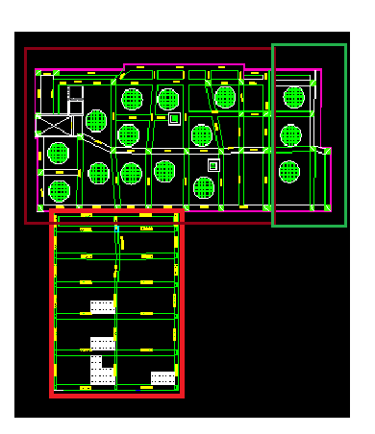
Structural Design

Slide 24
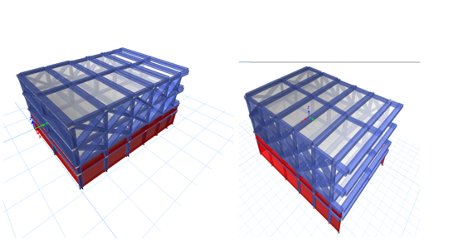
First block

Slide 25
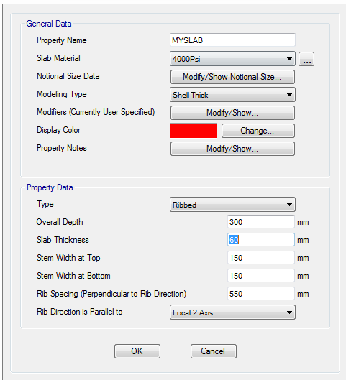
Structural elements information
One way ribbed slab with thickness h = 30cm.

Slide 26
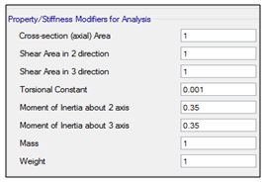
beams
Main beams (600*500)
Secondary beams (30*25 cm).

Slide 27
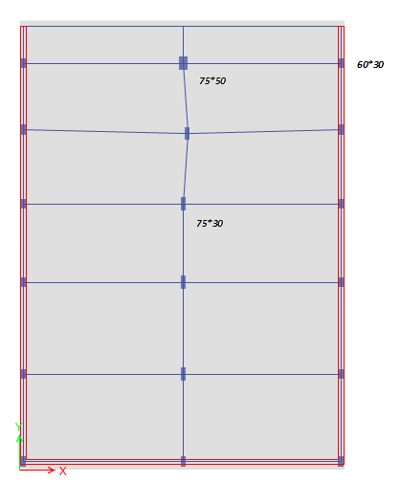
Columns

Slide 28
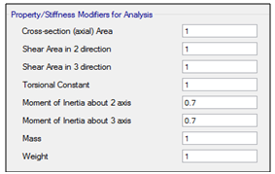
Structural Design

Slide 29
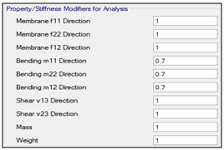
Walls
Shear wall with thickness of 30 cm

Slide 30
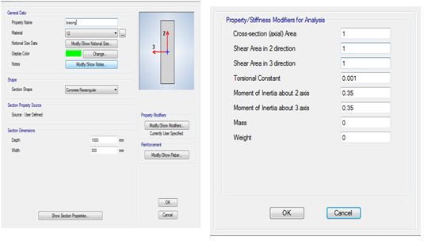
Bracing
Notes:
Bracing is constructed in model in order to simulate the reality of the stone and glass elevations

Slide 31
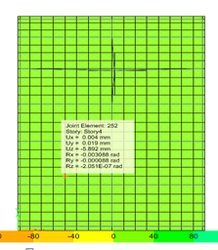
Analysis the model and checks
Compatibility and deformation check.
Modal is combatable .
Deformation:
Deflection on slab = L/360 = 4650/360 =12.9mm
Etabs result due to live load is
Uz= 8.555mm
Thus , ok .

Slide 32
Equilibrium checks
Percentage of Error (%) | Base reaction from manual calculation | Base reaction from ETABs | Load type
1.8% | 18380.3 | 18048.2277 | Dead
0.0343% | 5054.595 | 5056.3273 | Live
The percentages of error are too small thus, the checks are acceptable.

Slide 33
Stress –strain relation checks
Percentage of error (%) | ETABs result | Manual Moment result (KN.m) | Beams label
6.875% | 103.3 | 110.93 | B47(First floor)
7.1% | 42 | 39 | B3(Ground floor )
9.6% | 150.2 | 135.6 | B32 (Ground floor)

Slide 34

Check column (live load)
ETABS result: P live 30.1kN
Manual : (5.32*8.61)/2*2.5=28.62
Error 5.2%

Slide 35
Making sure modal participation mass ratio > 90% in both x and y.
TABLE: Modal Participating Mass Ratios
Case | Mode | Period | UX | UY | UZ | Sum UX | Sum UY | Sum UZ
 |  | sec
Modal | 1 | 0.312 | 0.5166 | 0 | 0 | 0.5166 | 0 | 0
Modal | 2 | 0.116 | 0.00000186 | 0.6112 | 0 | 0.5166 | 0.6112 | 0
Modal | 3 | 0.112 | 0.1375 | 0.00001043 | 0 | 0.6541 | 0.6112 | 0
Modal | 4 | 0.103 | 0.0535 | 8.564E-07 | 0 | 0.7076 | 0.6112 | 0
Modal | 5 | 0.082 | 0.2143 | 0 | 0 | 0.922 | 0.6112 | 0
Modal | 6 | 0.044 | 0 | 0.28 | 0 | 0.922 | 0.8912 | 0
Modal | 7 | 0.039 | 0.035 | 0 | 0 | 0.957 | 0.8912 | 0
Modal | 8 | 0.033 | 0 | 0.0872 | 0 | 0.957 | 0.9784 | 0
Modal | 9 | 0.03 | 0.0335 | 0 | 0 | 0.9905 | 0.9784 | 0
Modal | 10 | 0.021 | 0 | 0.0025 | 0 | 0.9905 | 0.9809 | 0
Modal | 11 | 0.01 | 0.0042 | 0.0000295 | 0 | 0.9947 | 0.9809 | 0
Modal | 12 | 0.008 | 0.00001718 | 0.0094 | 0 | 0.9947 | 0.9903 | 0

Slide 36
Check period of mode of maximum Modal participation mass ratio.
for the first mode =T etabs =0.312 sec.
T=1.4Ct * (hn) ^3/4
h_{n} =13.2
Ct =0.0488
T= 0.473 sec
T _{etabs} should be <Tcode
Thus, ok.

Slide 37
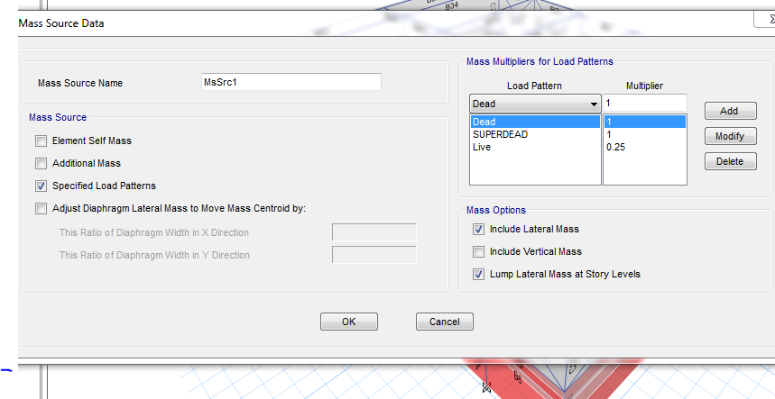
mass source

Slide 38
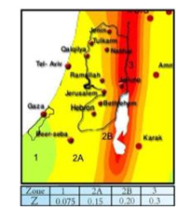
Seismic-design
seismic zone factor of Nablus Z = 0.20

Slide 39
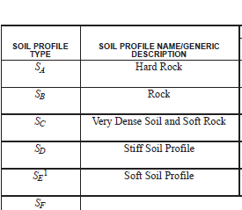
Structural Design
soil profile type Sc

Slide 40
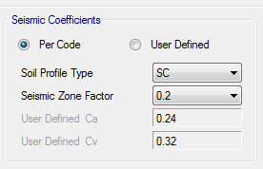
Seismic coefficient Ca, Seismic coefficient Cv could be obtained from Etabs

Slide 41
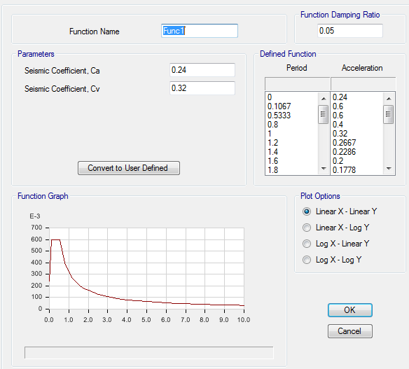
response spectrum function

Slide 42
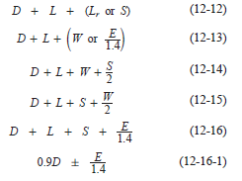
Load combinations
Service combinations

Slide 43
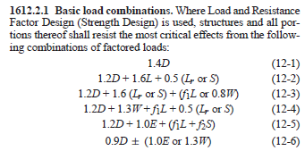
Load combinations
Ultimate Combinations

Slide 44
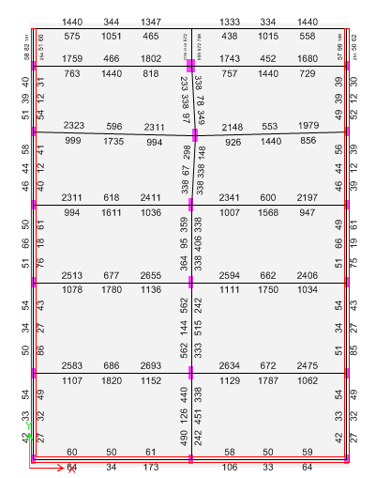
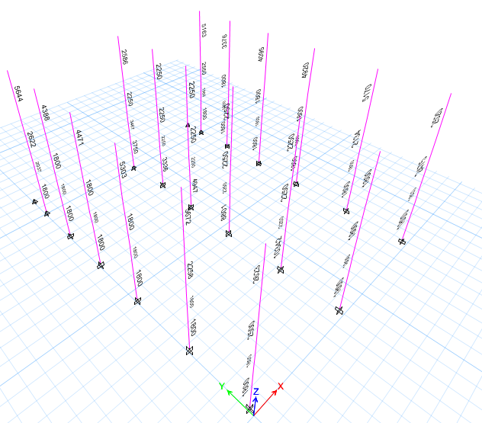
check the designed member

Slide 45
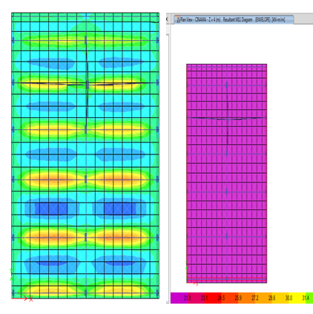
Slab design
ɸMn = 21.75/0.55=39.6 KN.m/m. (minimum limit)

Slide 46
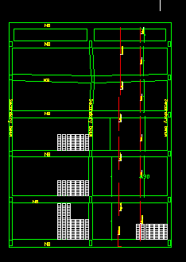
Slab design

Slide 47
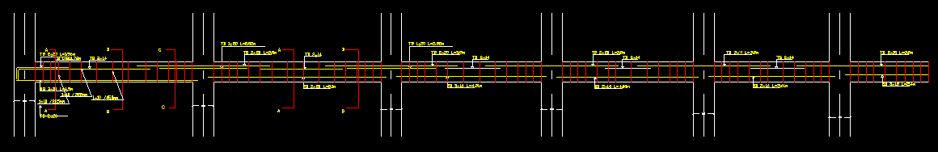
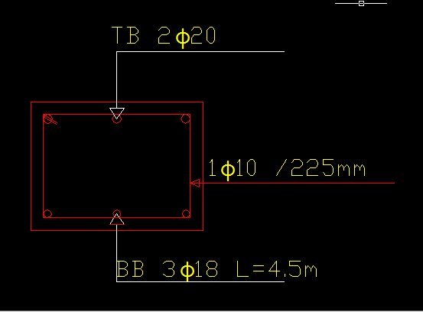
beams design

Slide 48
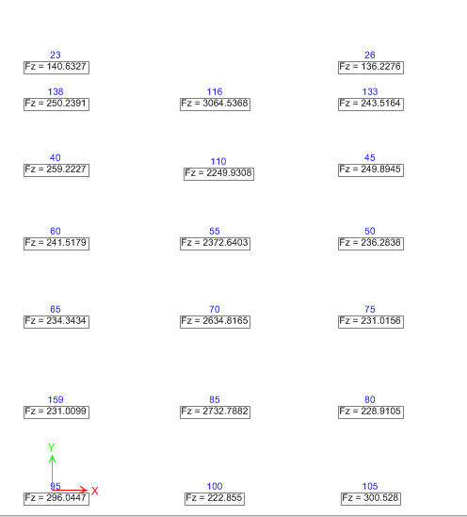
Footing design:-

Slide 49
Footing design:-
Edge and corner columns
Q_{allowable}=200MPa
P_{service} =300.5KN
Area needed for the foundation =1.5m²
for interior column
P_{service} = 3064.5
Area needed for the foundation =15.4m²
square foundation with dimension of 4*4

Slide 50
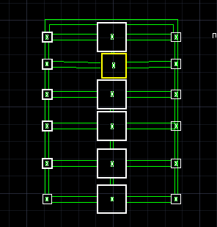
Footing design:-
P_{service} = 2249 (at joint 110 as shown in previous figure)
Area needed for the foundation =11.25m²
square foundation with dimension of 3.4*3.4 m²

Slide 51
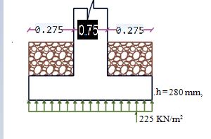
Footing design:-
Edge columne
d = 200mm, h = 280 mm, with cover = 80 mm.

Slide 52
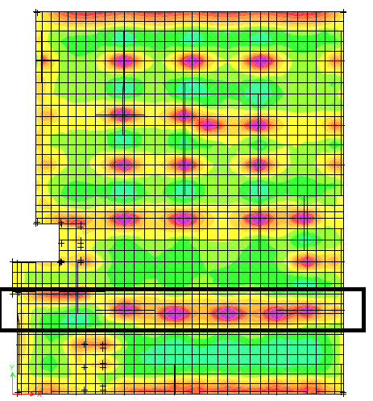
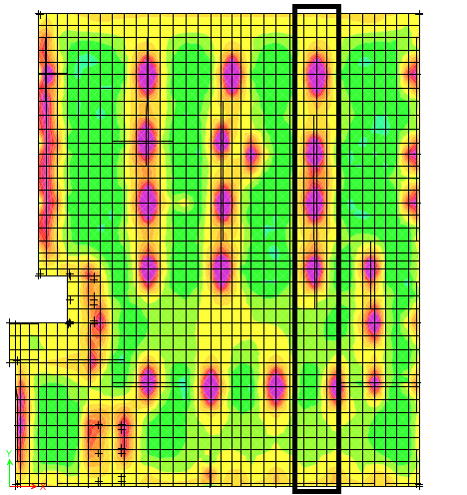
FOUNDATION
Mat foundation solid slab with depth of 0.5m.
As _{y-direction}= 1233.333mm
Use 5Φ18/m
As _{x-direction}= 1233.333mm
Use 5Φ18/m

Slide 53
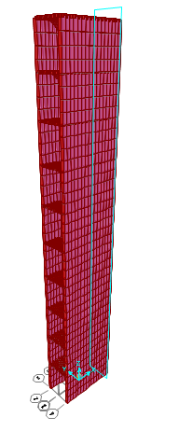
stair cases design

Slide 54
Design of stair
Moments | ρ | As | As min | As required | # of bars
44 | 0.008745 | 1049.36 | 400 | 1049.36 | 6Φ16
34.2 | 0.006664 | 799.7327 | 400 | 799.7327 | 4Φ16
39.6 | 0.0078 | 935.968 | 400 | 935.968 | 5Φ16
23 | 0.004388 | 526.5953 | 400 | 526.5953 | 3Φ16
3.1 | 0.000571 | 68.57344 | 400 | 400 | 4Φ12
6.5 | 0.001205 | 144.5954 | 400 | 400 | 4Φ12

Slide 55
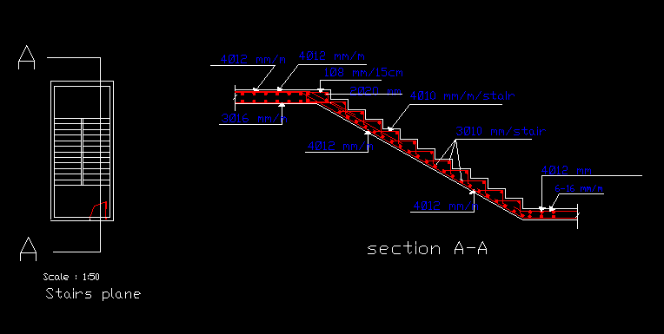
Design of stair

Slide 56
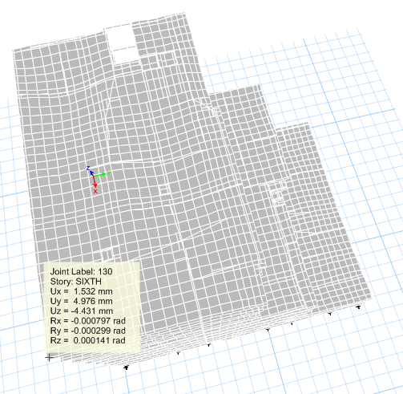
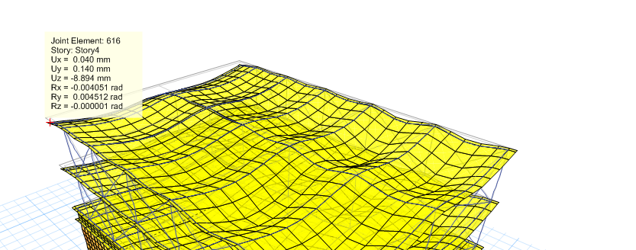
Structural separations
Width of joint
=5.3mm

Slide 57
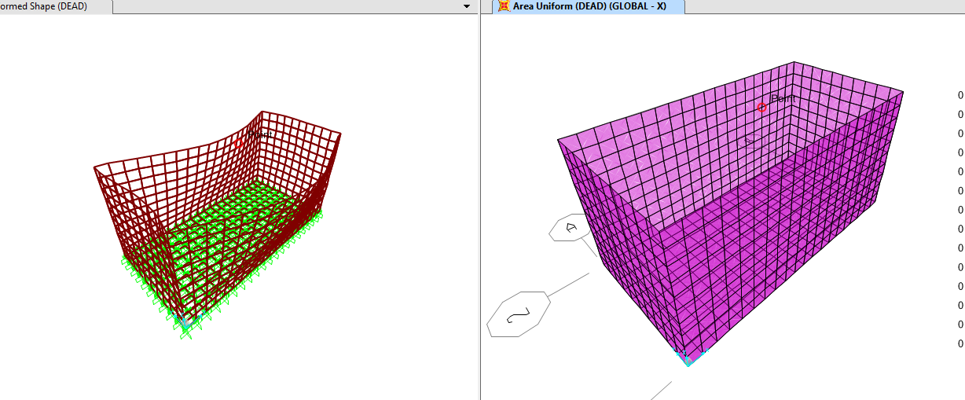
Water tank design
Moment from sap indicate that minimum steel is required

Slide 58
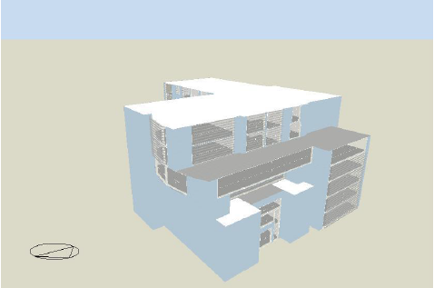
Environmental Design
Software:
DesignBuilder

Slide 59
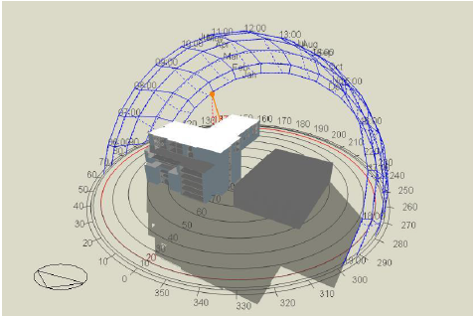
Sun Path & Shadow
21Dec. at 9 AM

Slide 60

Sun Path & Shadow
21Dec. At 12 PM

Slide 61

Sun Path & Shadow
21Dec. At 3 PM

Slide 62

Sun Path & Shadow
21 June at 9 AM

Slide 63

Sun Path & Shadow
21 June at 12 PM

Slide 64

Sun Path & Shadow
21 June at 3 PM

Slide 65


Shading System
Shutters (Louvers)

Slide 66


Materials Properties
External Walls
U-Value=0.387W/m²-K

Slide 67


Materials Properties
Glass Windows
Type of glass used: double glass Low E (e2=0.1) Clr. 6mm air space and 13 mm argon as shown in the figure.

Slide 68

Natural Lighting
Offices
D.F avg.=5.2%
D.L= 315 Lux

Slide 69
Acoustic Design
Reverberation Time(RT60):
We used ECOTECT Analysis Program in the calculation and testing of the reverberation time.

Slide 70


Reverberation Time
For Restaurant:

Slide 71


Reverberation Time
For Office:RT60 range for offices (0.6 – 0.8), so we achieve the requirements.

Slide 72


Reverberation Time
For Cinema:

Slide 73

Reverberation Time
We used decorative sound absorption materials such as Acoustical panels in cinema to meet the requirements.

Slide 74
Acoustic Plaster
For sound insulation in cinema we used material that insulate sound known as Acoustic Plaster.

Slide 75


Sound Transmission Class(STC)
STC For external walls: 60-65 dB
Improvements in STC rating of stud partition
STC ratings of Masonry walls

Slide 76


Sound Transmission Class(STC)
STC For Internal walls:60-65dB

Slide 77



Loud Speakers
CS 26T plus speakers

Slide 78

Speaker layout distribution in cinema

Slide 79

Heating and Cooling Loads
For cooling load:
Cooling load:697.89KW

Slide 80

Heating and Cooling Loads
For heating load:
Heating load:169.260KW

Slide 81


Heating and Cooling Loads
Simulation:

Slide 82

Artificial Lighting Design

Slide 83


Artificial Lighting Design
Restaurant Design

Slide 84

Artificial Lighting Design

Slide 85

Artificial Lighting Design

Slide 86

Artificial Lighting Design

Slide 87


Artificial Lighting Design
Office Design

Slide 88

Artificial Lighting Design

Slide 89

Artificial Lighting Design

Slide 90

Artificial Lighting Design

Slide 91
Electrical Design
Rated current for circuit
breaker (lighting): 10 Amp
Rated current for circuit
breaker (sockets): 16 Amp
One Branch for (4-5) 2Amp
sockets.
Branches for lighting:1 branch
for each 50 m²
Room | watt | N | power
Retail shop 1 | 72 | 15 | 1080
Retail shop 2 | 72 | 12 | 864
Retail shop 3+4+5+6 | 38.5 | 46 | 1771
Retail shop 7 | 41 | 13 | 533
Retail shop 7 | 35 | 6 | 210
Retail shop 8 | 41 | 9 | 369
Retail shop 9 | 41 | 9 | 369
bathroom | 38.5 | 10 | 385
bathroom | 18 | 8 | 144
corridor | 41 | 2 | 82
corridor | 35 | 40 | 1400
Room | 41 | 9 | 369
stairs | 41 | 4 | 164
toltal |  | 7740

Slide 92


Electrical Design

Slide 93
Mechanical design
1- Water Supply System
2-Drainage System
3-H-VAC System

Slide 94

Mechanical design
Water supply design
Each unit has its own tanks and meter

Slide 95

Mechanical design
Water supply design
12 psi pump used for 6th
and 7th floor
 | Pipe Diameter | loss
Vertical | 2.5 | 6
Horizontal | 2 | 1.5
Branch | 1 | 0.072
 |  | 7.5

Slide 96

Mechanical design
Drainage design
-Horizontal line (lavatory ) is 2”
-Horizontal line (W.C) is 4”

Slide 97


Mechanical design
Drainage design

Slide 98


Mechanical design
Drainage design

Slide 99

Mechanical design
H-VAC system
variable refrigerant flow (VRF) system :
The basic idea is that a large outdoor unit serves multiple indoor unites

Slide 100

Mechanical design
H-VAC system
-Main Unit
TOSHIBA, 2 pipe smmsi VRF model number ap4824ht8-e
-With Following Properties:
·Cooling capacity up to 135kw , heating capacity up to 150 kw
· Connection of up to 48 indoor units capacities of 8 to 42hp to be combined with up to
135% of the outdoor unit
· Ultra low noise level

Slide 101


Mechanical design
H-VAC system
-Indoor Units
1-TOSHIBA VRF Indoor Unit – High-Wall code 32 and 50
Used for offices and retail shops

Slide 102


Mechanical design
H-VAC system
-Indoor Units
2-TOSHIBA VRF Indoor Unit fresh air intake
Used in cinema and restaurant

Slide 103


Mechanical design
H-VAC system

Slide 104



Safety
Fire Fighting System
-Fire extinguishers
-Sprinklers
-Emergency exit
-Fire hose

Slide 105
Quantities surveying
 | $ | NIS | JD
Total cost | 4690991.18 | 18294864.9 | 3326339
cost of 1m² =360 $/m²

