Slide 1
Transmission line fault detection

Slide 2
INTRODUCTION
When fault occurs on transmission lines, detecting fault is necessary for power system in order to clear fault before it increases the damage to the power system. When any fault occurs in cable, then it is difficult to locate fault. So, we will move to find the exact location of fault

Slide 3
main objectives of PROJECT
To design an efficient and robust automatic fault detection and location system for overhead and underground power transmission lines.
To reduce response time needed to rectify and save expensive transformers from damage or theft which usually occurs during longer power outages.
To increase productivity of technical crews since the time needed to locate faults will be minimized.
To ensure stability and reliability of the power supply system in the country to boost economic growth

Slide 4
Working Principle
In this paper, we have two cables i.e. underground cable and overhead cable. We make the fault in cables by switching the buttons.
The project uses four sets of resistances in series representing cables i.e. R4, R5, R7, R8 and R9, R10, R11, R12 then R13, R14, R15, R16 then R17, R18, R19, R20. One set for each phase.
Each series resistors represent the resistance of the underground cable for a specific distance (200m), 3 relays are used to common point of their contacts are grounded while the points of input resistance R9, R13, R17are connected to the 3phase supply as an input, the common point of R6 & R4 is connected to pin of A0 which is ADC (Analog to digital) pint of Arduino.

Slide 5
Two switches are connected with Arduino digital pin 0 and 1 for overhead cable, they are pulling down by the 10K resistor while any of the 12 switches (representing as fault switches) are operated they impose conditions like line to ground (LG), line to line (LL), line to line to line(3L) fault as per the switch operation.
The program while executed continuously scans by operating the relays in sequence of 1sec interval.

Slide 6
Thus, any point while driven to GND through the common contact point of the 3relays, the current flows and if any of the fault switch pressed the fault is occurs, depending on the created fault. Thus, the voltage drop at the analog to digital (ADC) pin varies depending on the current flow which is inversely proportional to the resistance value representing the length of cable in meters, This varying voltage is fed to the ADC to develop an 8-bit data to the microcontroller Analog port.

Slide 7
Program while executed displays an output in the LCD display depend upon the distance of the fault occurring in meter’s When no fault occurs in underground and overhead line the LCD display shows that:
When the fault occurs in R phase on 100 meters then LCD display :
R:NF, Y:NF, B:NF, span1:NF, span2:NF
R:100m, Y:NF, B:NF, span1:NF, span2:NF

Slide 8
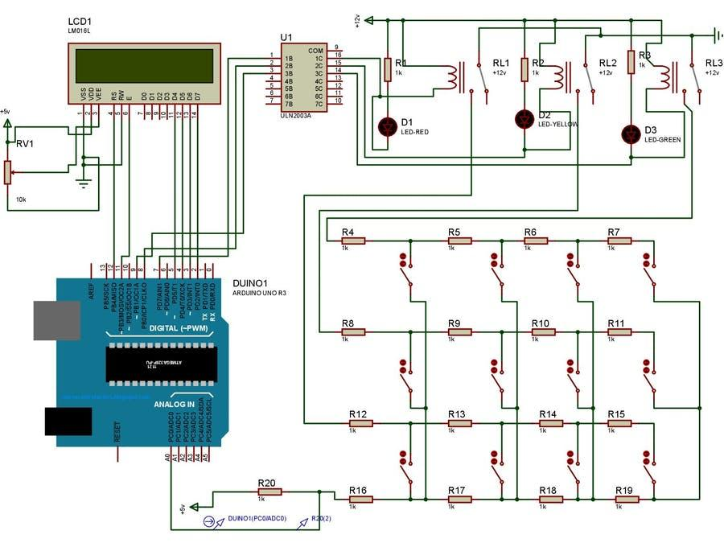

Slide 9
CODE

Slide 10
int analogPin= 0;
int raw1,raw2,raw3= 0;
int Vin= 5;
float Vout,buffer = 0;
int R1= 1000;
int R2,R3,R4= 0;
#include <LiquidCrystal.h>
LiquidCrystal lcd (12, 11, 5, 4, 3, 2);
const int buttonone = 0;
const int buttontwo = 1;
int bs1, bs2 = 0;
void setup () {
pinMode (7, OUTPUT);
pinMode (8, OUTPUT);
pinMode (9, OUTPUT);
pinMode (buttonone, INPUT);
pinMode (buttontwo, INPUT);
lcd. begin (16, 2);}

Slide 11
void loop (){
bs1 = digitalRead(buttonone);
bs2 = digitalRead(buttontwo);
lcd.clear();
digitalWrite(7, HIGH);
delay (500);
raw1= analogRead(A0);
delay(500) ;
if(raw1){
buffer= raw1 * Vin;
Vout= (buffer)/1024.0;
buffer= (Vin/Vout) -1;
R2= R1 * buffer;
lcd.setCursor(0, 0);
lcd.print("R:");

Slide 12
lcd.print(R2);
lcd.print("m");}
else
{
lcd.setCursor(0, 0);
lcd.print("R:");
lcd.print("NF ");
}
digitalWrite(7, LOW);
delay (500);
digitalWrite(8, HIGH);
delay (500);
raw2= analogRead(A0);
delay (500);
if(raw2) {

Slide 13
buffer= raw2 * Vin;
Vout= (buffer)/1024.0;
buffer= (Vin/Vout) -1;
R3= R1 * buffer;
lcd.setCursor(8, 0);
lcd.print("Y:");
lcd.print(R3);
lcd.print("m");}
else
{
lcd.setCursor(8, 0);
lcd.print("Y:");
lcd.print("NF ");
}

Slide 14
digitalWrite(8, LOW);
delay (500);
digitalWrite(9, HIGH);
delay (500);
raw3 = analogRead(A0);
delay (500);
if(raw3){
buffer= raw3 * Vin;
Vout= (buffer)/1024.0;
buffer= (Vin/Vout) -1;
R4= R1 * buffer;
lcd.setCursor(0, 1);
lcd.print("B:");
lcd.print(R4);
lcd.print("m");}
else

Slide 15
{
lcd.setCursor(0, 1);
lcd.print("B:");
lcd.print("NF ");}
digitalWrite(9, LOW);
delay (500);
if (bs1 == HIGH) {
lcd.clear();
lcd.setCursor(0, 0);
lcd.print("Span1: NF");
delay}; (500)
else{
lcd.clear();
lcd.setCursor(0, 0);
lcd.print("Span1: OC");
delay (500);}
if (bs2 == HIGH) {
lcd.clear();

Slide 16
lcd.setCursor(0, 1);
lcd.print("Span2: NF");
delay (500);
}
else {
lcd.clear();
lcd.setCursor(0, 1);
lcd.print("Span2: OC");
delay(500);}}

Slide 17
RESULT
This paper represents that the fault location scheme for transmission systems consisting of an overhead line and underground cable. The Arduino system has the ability to locate the fault whether it is in the overhead line or in the underground power cable. In addition to, the proposed scheme gives an accurate estimation of the fault resistance at fault location

Slide 18
CONCLUSION
This paper proposed a fault location scheme for transmission systems consisting of an overhead line in combination with an underground power cable. In this method, the short circuit fault at a particular distance in the underground cable can be located using simple concepts of OHM’s law enables to rectify fault efficiently feeder end in meters by using Arduino. For this we use simple concept of OHM’s law so fault can be easily detected and repaired. By using Arduino controller, we can find out exact fault location. Once faults occur in the cable, the display unit displays the exact fault location that displays which phase is affected in the cable and how long it’s affected.

Slide 19
THE END

