Slide 1

An-Najah National University
Telecommunications Engineering Department
Smart Tracking System using Bluetooth , GPS and GSM Technologies
Submitted by:
Hala Sayegh
Anwar Samarah
Rawan Othman
Supervisor:
Dr. Saed Tarapiah.

Slide 2
Outlines
Inspiration.
Definition of the problem.
Our Solution.
System Overview.
Hardware Overview.
About Bluetooth Technology.
Summary and Future Work.

Slide 3



Inspiration

Slide 4
Definition of The Problem
People spend ten minutes every day rummaging for lost items, from books and door keys to car keys and even the cars themselves.
The study of 3,000 adults, carried out for ensure home insurance, also found that four out of ten often argue with their partner about lost items.

Slide 5
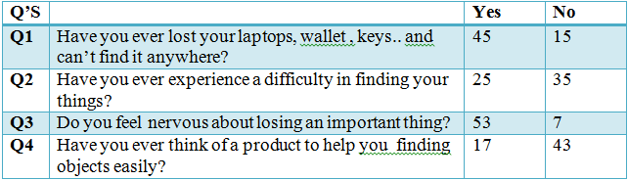
The survey
To make sure of the importance of our work we asked the following questions to a sample of 60 persons :

Slide 6
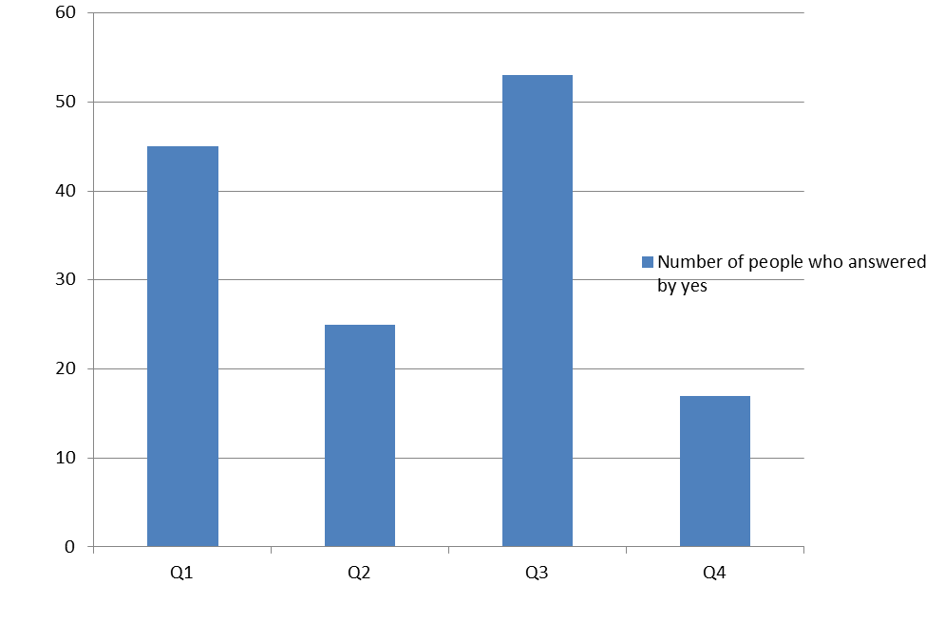
Results of survey

Slide 7
Our Solution
Since the beginning of time and the idea of finding a missing object fastly and easily is a kind of fiction. However, as the technology advances in our days this idea is no more a dream.
Depending on many useful technologies as Bluetooth , GPS and GSM we were able to solve the mentioned problems.

Slide 8



Hardware overview
Main Hardware :
Arduino
Bluetooth
Android

Slide 9
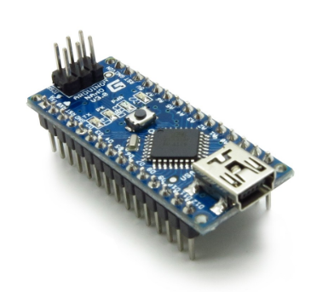
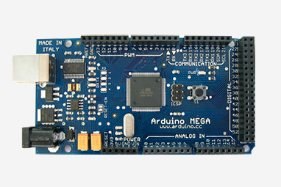
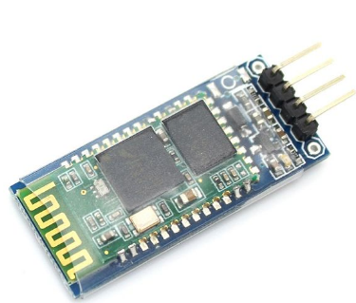
Secondary Hardware :
ArduinoNano
ArduinoMega
Bluetooth HC-06

Slide 10
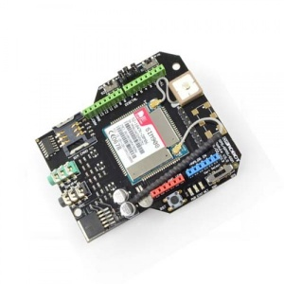
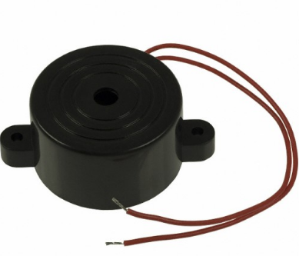
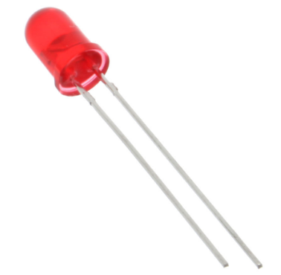
Secondary Hardware : cont..
GPS/GSM Module
Buzzer
Led

Slide 11
Bluetooth Technology
Bluetooth is a wireless technology for transferring data between two devices that are in close proximity with each other ,so create Personal Area Networks (PAN)
Operating frequency is 2.4 GHz
It has truly changed the world.
Employs frequency hopping spread spectrum
These connections are as secure as they come and offer no risk of intrusion or theft of data.

Slide 12
Advantages of Bluetooth Technology
Wireless
Inexpensive
Standardized ::: 802.15.1
Has low interference.
Low energy ::: 1mW
Transfer speed around 25 Mbps.

Slide 13
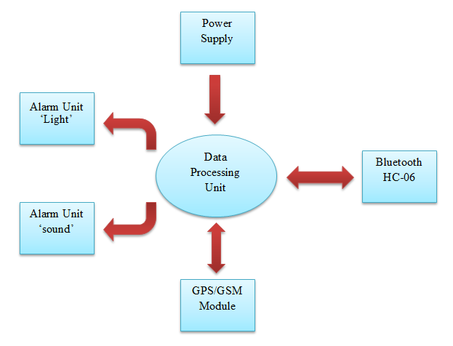
Block Diagram

Slide 14
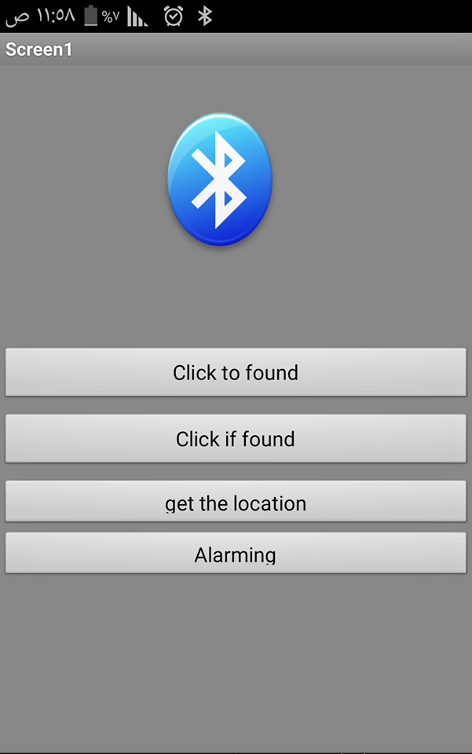
Layout of the application

Slide 15
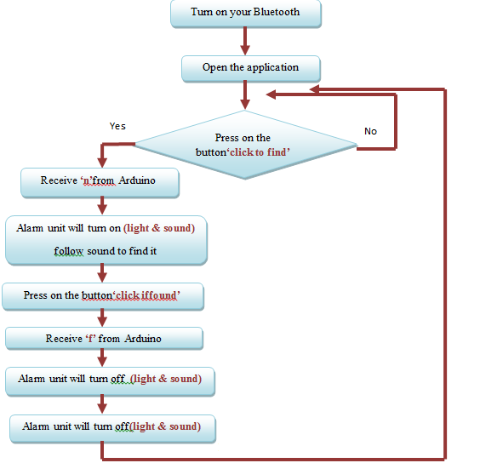
Flow chart of the first part of the application

Slide 16
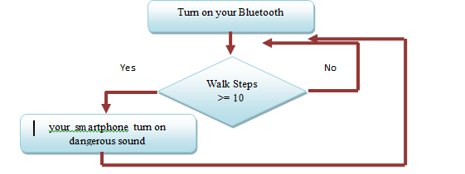
Flow chart for the second part of the application

Slide 17
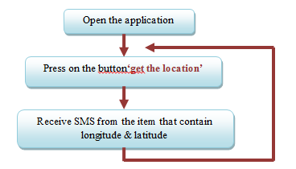
Flow chart for the third part of the application

Slide 18
Future work
Indoor positioning system using BLE technology.
Building the Pixie.

Slide 19
Conclusion
In the first semester, we succeed in implementing Bluetooth system by using Bluetooth module, Arduino, Alarm units and GPS/GSM Module, and sending AT commands serially to programming the HC-06 Bluetooth and GPS/GSM Module , Arduino programming ,and builds an android application.

Slide 20



Slide 21


