Slide 1


PACK CARBURIZING PROCESS OF LOW CARBON STEEL USING PEAT AND DATE SEEDS
Dr.Ihab Alsurakji
Saleh Aziz
Motaz Abu Mwies
Fares Abu Mustafa

Slide 2
OUTLINE
Introduction
Pack carburizing process
Carbon source
material
method
result
conclusion

Slide 3
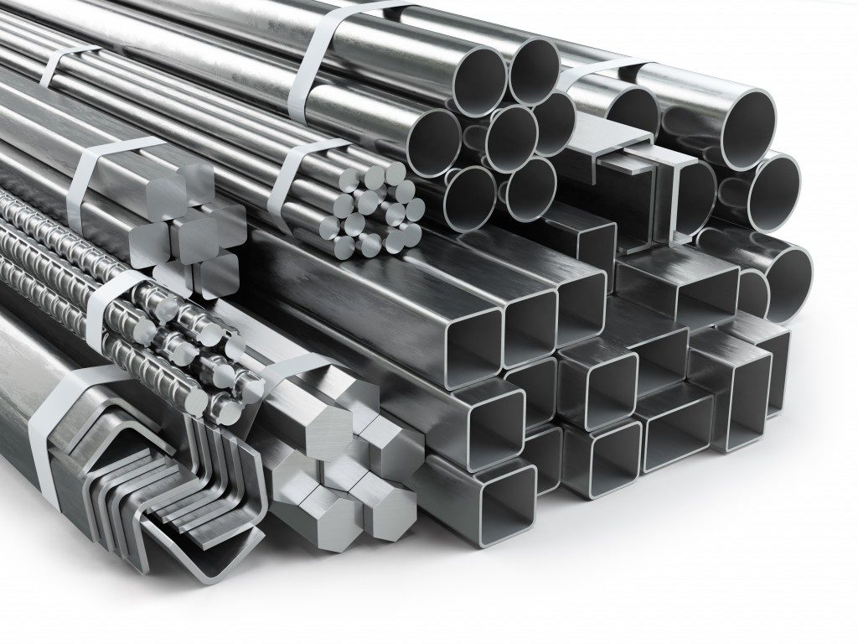
introduction
In recent years, steel has been widely used in many applications that are manufactured
using Medium carbon steel as in the field of buildings, transportation and machinery.
Low carbon steels are not suitable for use in these applications
due to their lack of mechanical properties.
The properties of low carbon steels are improved by
the use of surface hardening processes.
Carburizing and nitriding are the most common processes
used to harden the surface of low carbon steel.

Slide 4
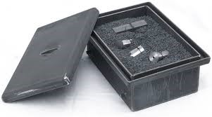
Introduction
Pack Carburizing process is a heat treatment process used
to increase the mechanical properties of low carbon steel.
This is done by increasing the percentage of carbon in the
surface through the diffusion process
Diffusion occurred between low carbon steel and carbon
rich surroundings to increase the carbon content of the steel.
Carbon content and surface hardness increase When
the percentage of carbon in the steel surface increases.

Slide 5
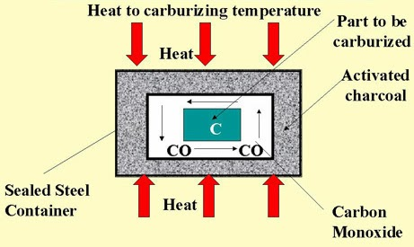
Pack carburizing process

Slide 6
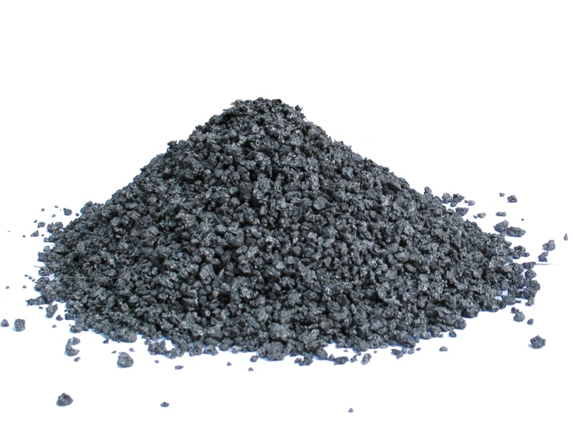
carbon sources
In recent years, researchers have worked to find
agricultural and animal waste to convert them to
carbon sources.
In Palestine Approximately 39 tons of olive oil are
produced annually.
Also, 17 tons of palm dates are produced annually
according to the stats for the year 2019.
This results in a large amount of waste .

Slide 7
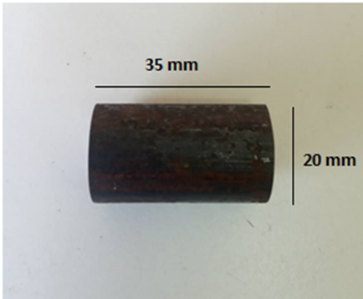
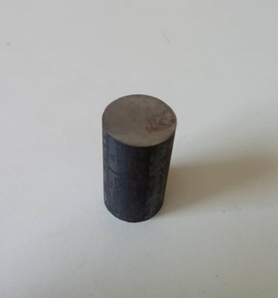
MATRIAL
Low carbon steel specimen
In this project AISI 1010 steel cylindrical specimen with diameter of 20 mm and length of 35 mm was used .

Slide 8
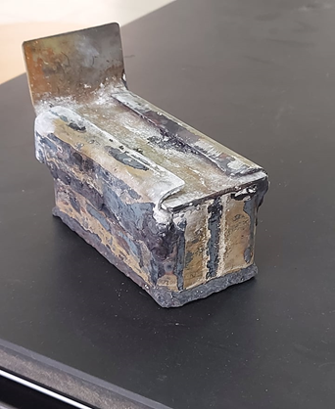
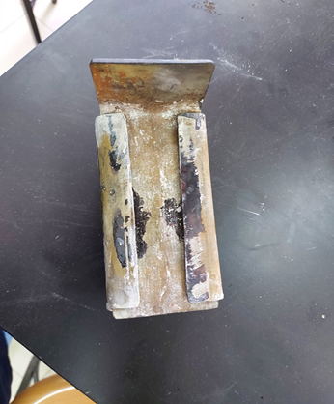
MATRIAL
Pack carburization container
A container made of 5 mm thick steel plate was used that was cut and welded with dimensions of 120 mm L x 50 mm W x 60 mm H as shown.

Slide 9
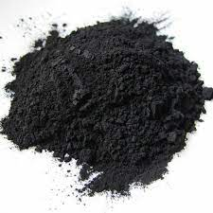
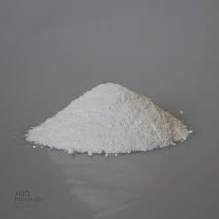
MATRIAL
Charcoal
In this project, two different sources of coal were used, the first is olive peat charcoal and the second is date palm seed charcoal Mixed with activator (Na₂CO₃) with each percentage of charcoal 80% activator was 20% by weight.

Slide 10
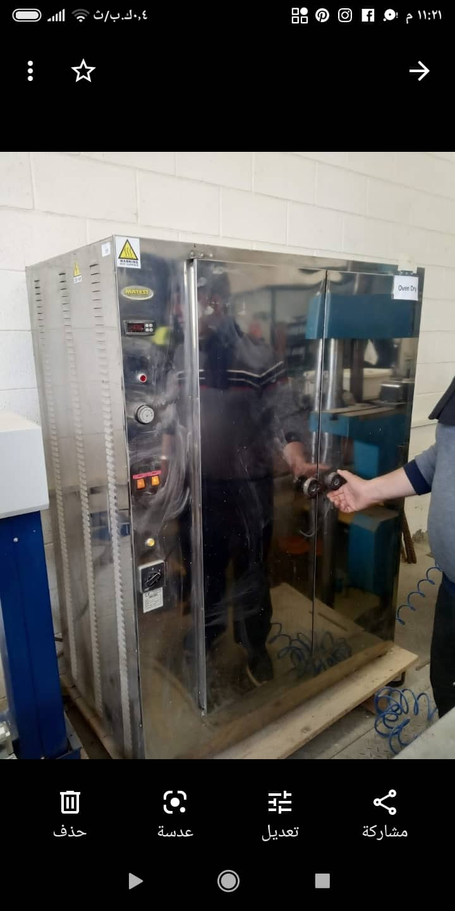
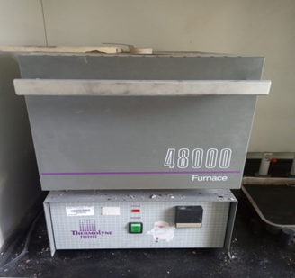
MATRIAL
Electric furnace
We used two types of electric furnace: a matest A008-07 KIT furnace for draying and a thermolyne 48000 furnace for carburizing process.

Slide 11
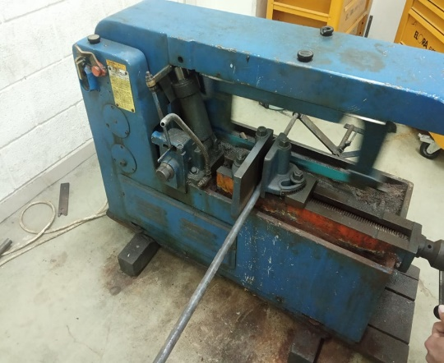
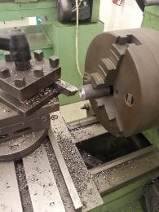
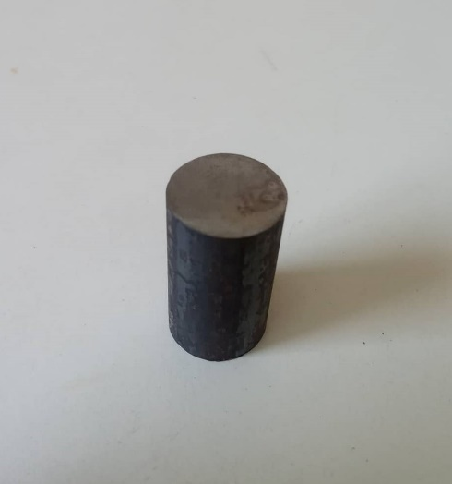
Method
Spaceman preparation
A steel rod of type ASI 1010, with a diameter of 20 mm was cut into small pieces with a length of 35 mm using an electric saw.
Cutting scraped final shape

Slide 12
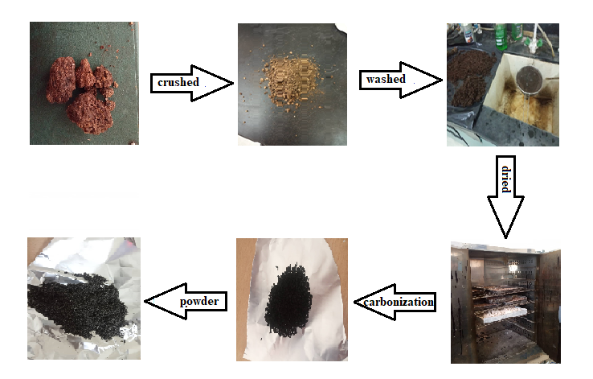
Method
Charcoal Preparation

Slide 13
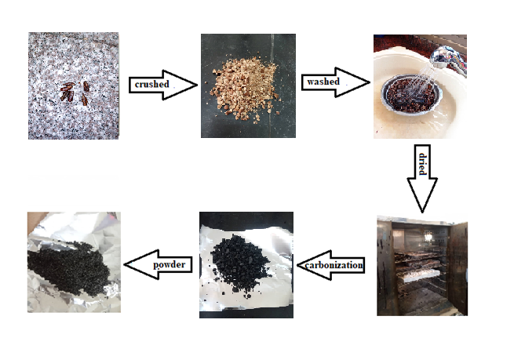
Method

Slide 14
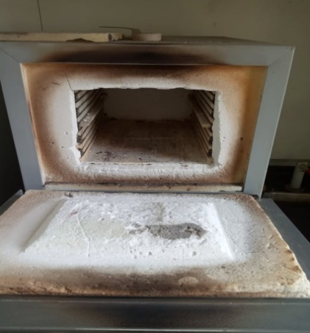
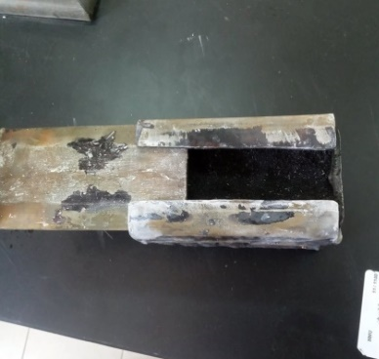
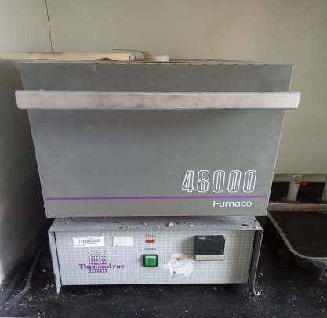
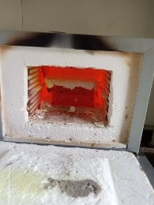
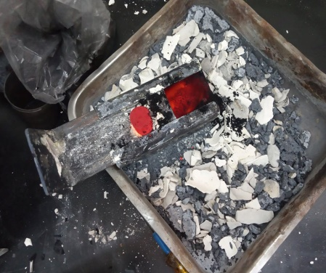
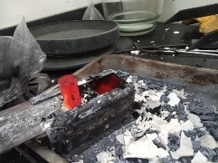
Method
Pack carburizing process

Slide 15
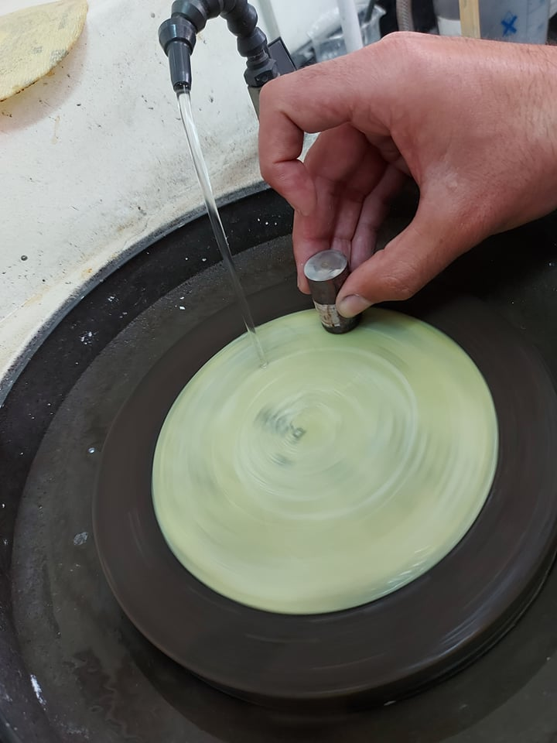
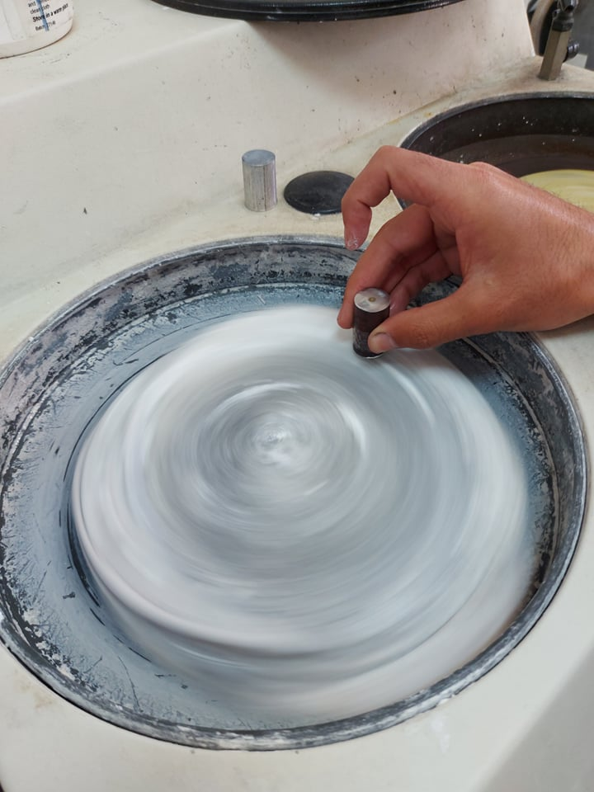
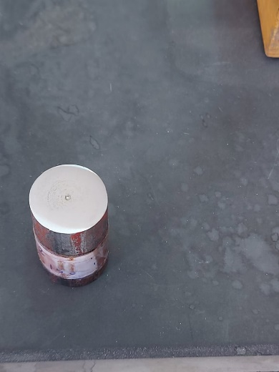
Method
Specimen sanding and polishing
The surface of the samples will be sanded using a Digital Grinder and Polishing Machine (METASERV 2000).

Slide 16
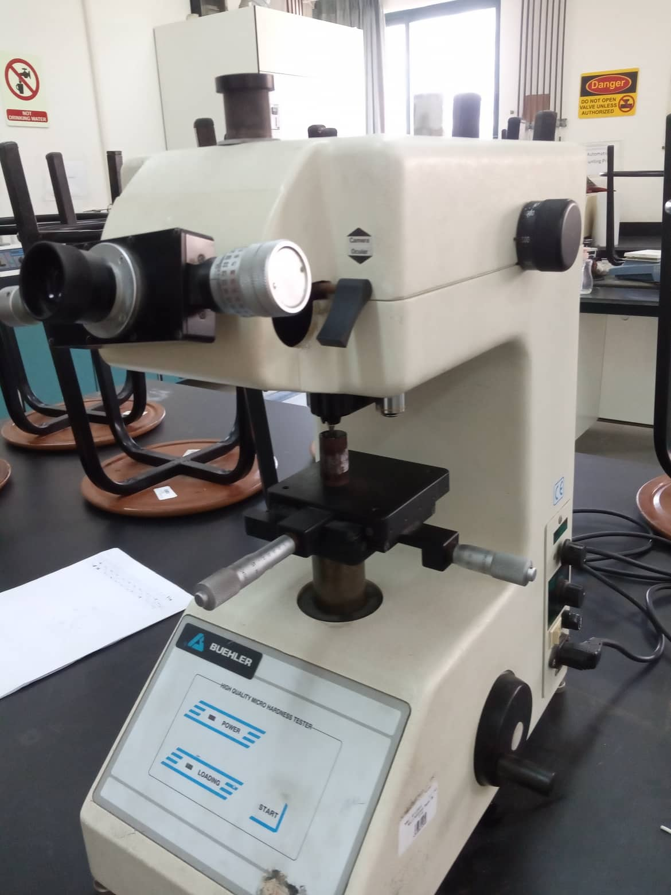
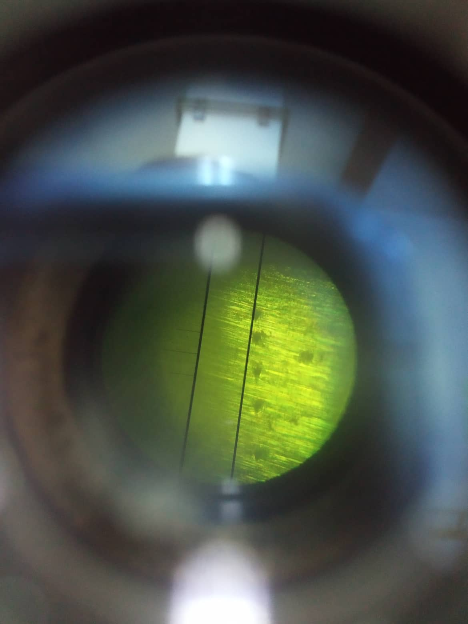
Method
Hardness test
A hardness test was conducted using LM700 Spec Leco micro-hardness tester.

Slide 17
Results
Charcoal Making
Table below shows what we have obtained from the process of carbonization the peat and dates seeds.
Burning | Initial Wight (Kg) | Charcoal Product (Kg) | Time (min) | Yield (%)
peat | 1 | 0. 707 | 120 | 29.22
date seeds | 1 | 0.691 | 120 | 30.88

Slide 18
Results
viker Hardness Test
Table below shows the result of viker hardness number of the carburized steel samples
Temperature (ᴼC) | Time (min) | Charcoal Composition | viker Hardness Number of case (VHN) | viker Hardness Number of core (VHN)
Rw | _ | _ | 93.561 | 79.84
850 | 90 | 100% Pe | 342.83 | 158.48
 |  | 100% Ds | 468.3 | 157.11
 | 120 | 100% Pe | 384.58 | 207.44
 |  | 100% Ds | 453.77 | 242.55
 | 150 | 100% Pe | 318.64 | 176.18
 |  | 100% Ds | 449.75 | 288.19
900 | 90 | 100% Pe | 421.93 | 203.49
 |  | 100% Ds | 507.29 | 223.97
 | 120 | 100% Pe | 425.93 | 196.2
 |  | 100% Ds | 469.72 | 241.4
 | 150 | 100% Pe | 421.93 | 260.18
 |  | 100% Ds | 398.48 | 203.76
950 | 90 | 100% Pe | 468.12 | 356.81
 |  | 100% Ds | 466.43 | 260.33
 | 120 | 100% Pe | 453.77 | 318.23
 |  | 100% Ds | 398.99 | 391.57
 | 150 | 100% Pe | 479.01 | 332.22
 |  | 100% Ds | 404.45 | 411.41

Slide 19
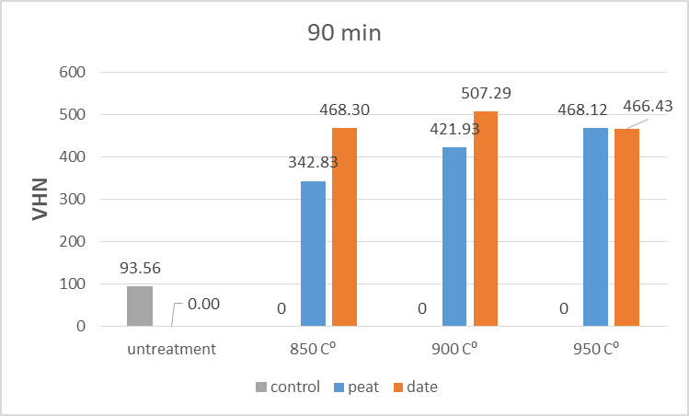
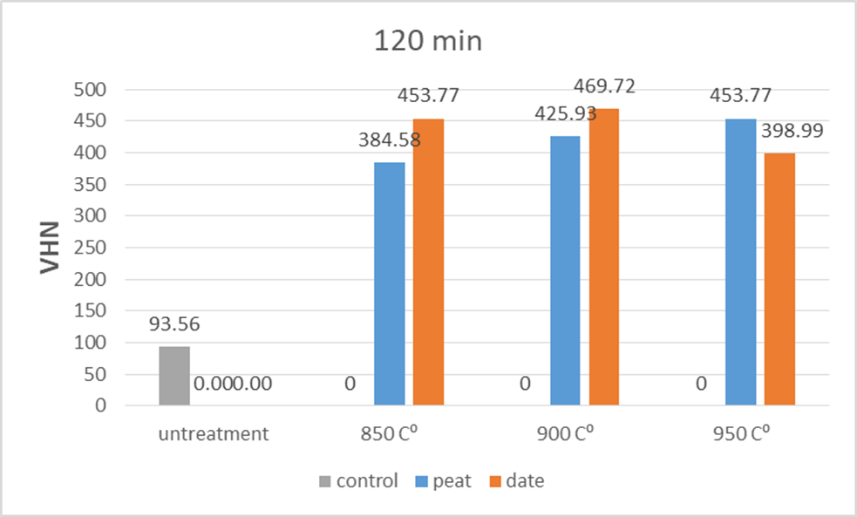
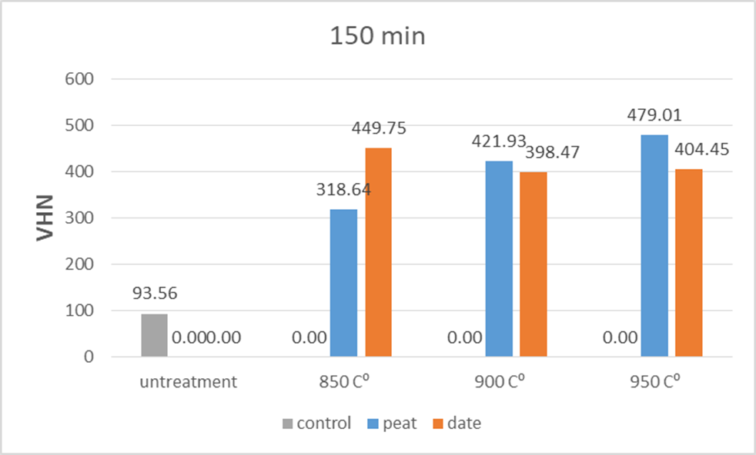
Results

Slide 20
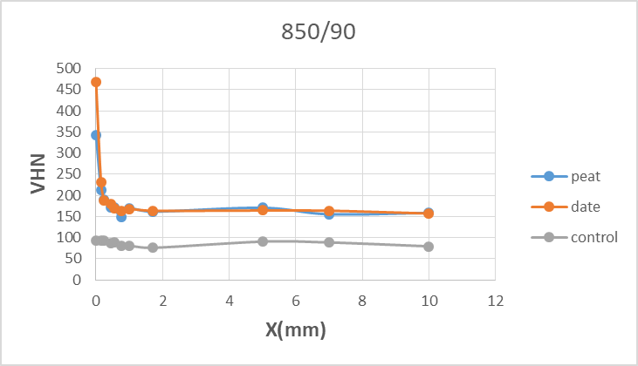
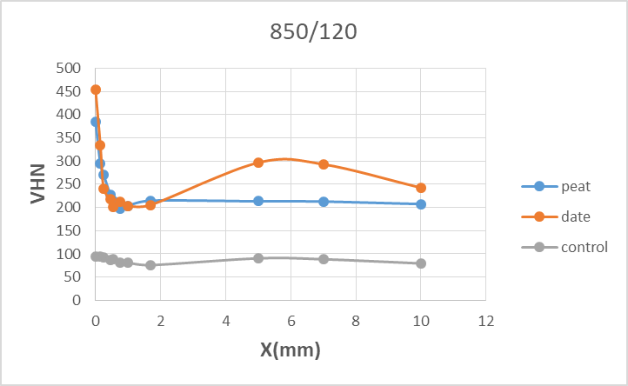
Results
Hardness distribution of carburized low carbon steels.

Slide 21
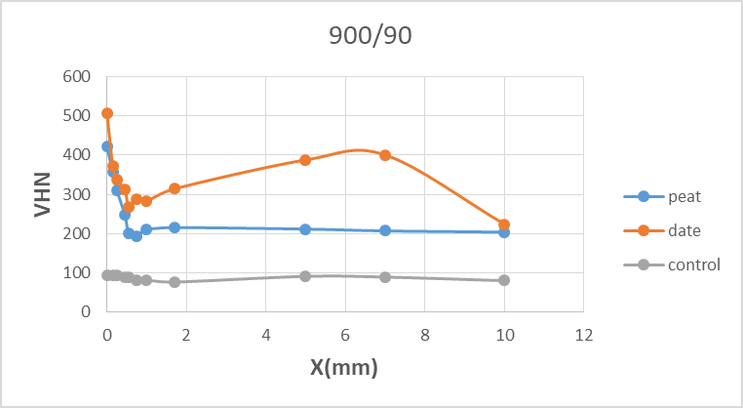
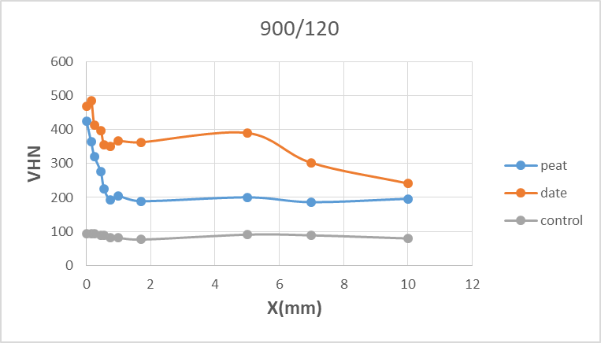
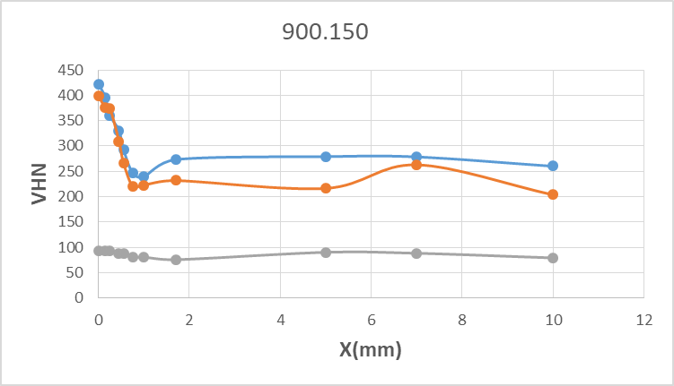
Results

Slide 22
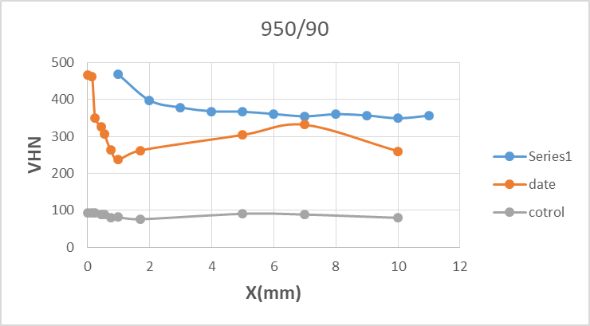
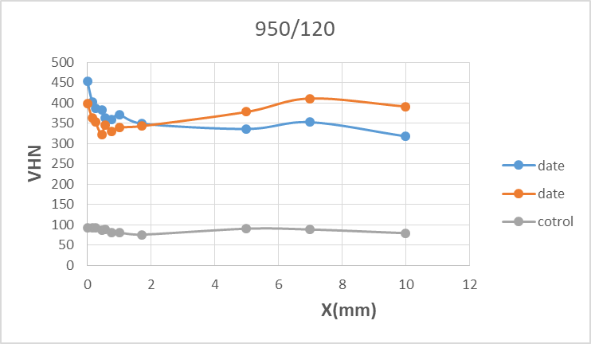
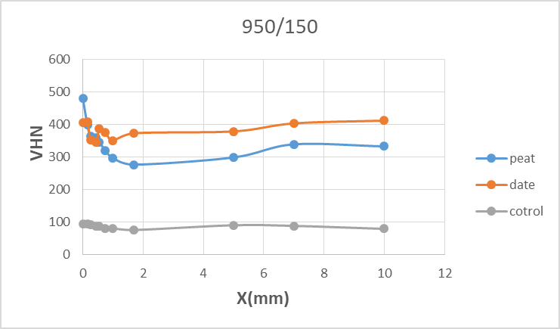
Results

Slide 23
conclusion
In this research, we concluded that the peat powdered charcoal and dates seed powder charcoal has a significant and close effect on improving surface hardness and carbon case depth of steel 1010.the highest value of surface hardness up to (479.01 HV) with 1.7 mm case depth by using peat charcoal, and the highest value obtained by using dates seeds up to (507.29 HV) with 1mm case depth , while the hardness value for steel before treatment was (93,561 HV). This project can solve the problems of agricultural waste accumulation and use it in the process of improving low carbon steel.

