Slide 1

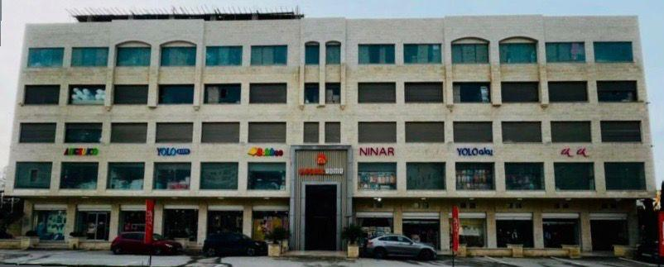
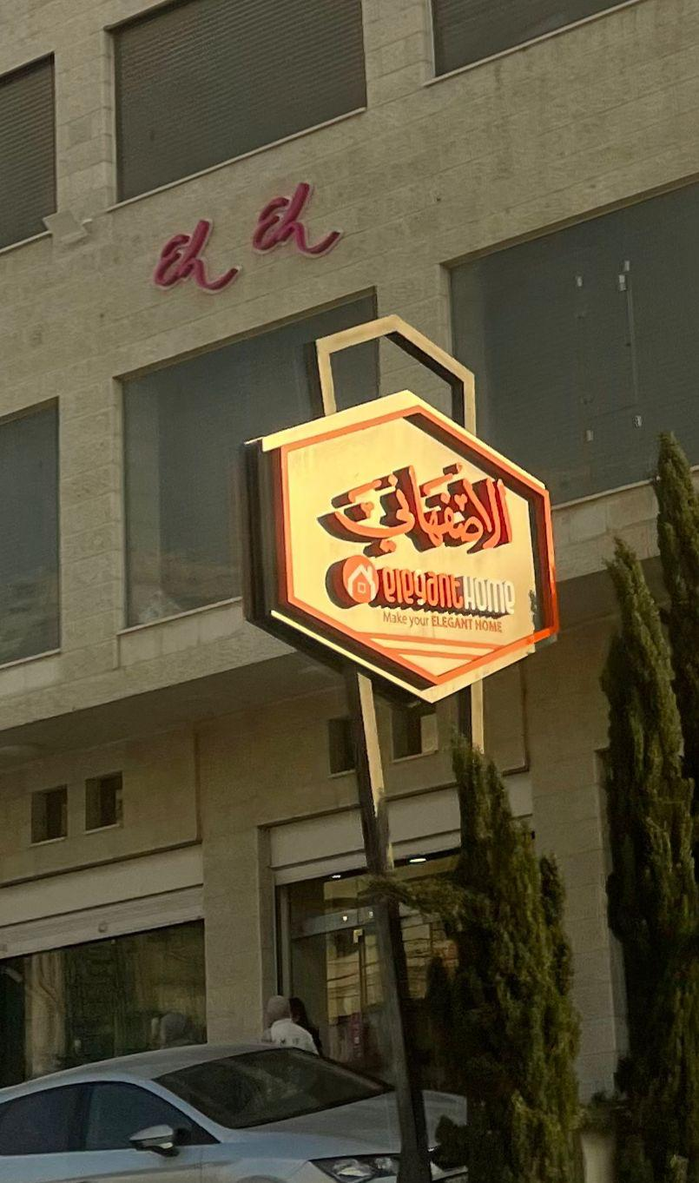
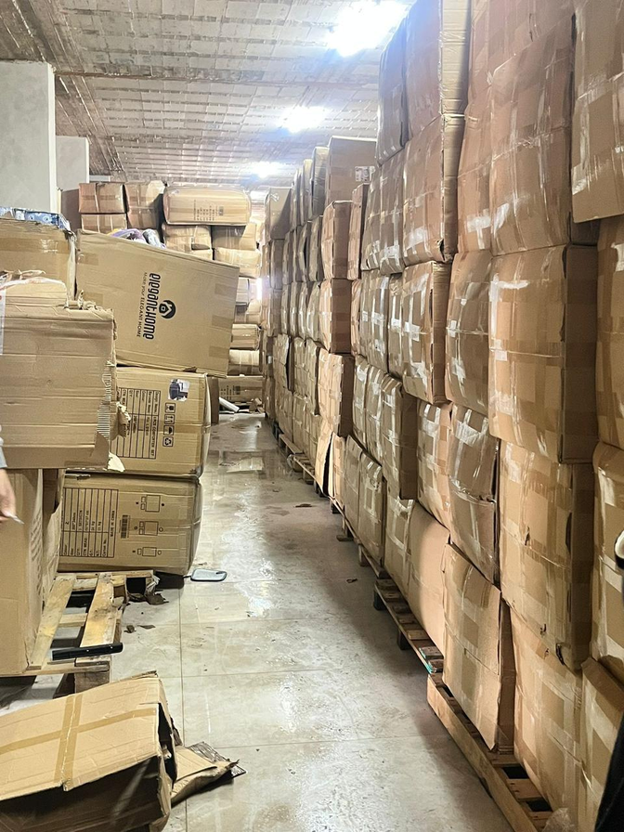

  GRADUATION PROJECT 1
  Enhancing Operational Performance: A Warehouse Management Solution For Elegant Home Company.
  An-Najah National University
Prepared by:
Raghd Atatri
Dina Fahed
Alaa Shalash
Sadeel Khalil
Supervised by : Dr. Suleiman Daifi
1

Slide 2

Purpose Beyond the Process: Blueprints of Survival
Engineering in Palestine is not merely the application of systems and processes — it is the practice of resilience. It is about designing for survival under siege, preserving dignity in the face of destruction, and building structures, systems, and communities that refuse to be broken.
2

Slide 3

Enhancing Operational Performance: A Warehouse Management Solution For Elegant Home Company.
3

Slide 4

ELEGANT
  HOME COMPANY
4

Slide 5
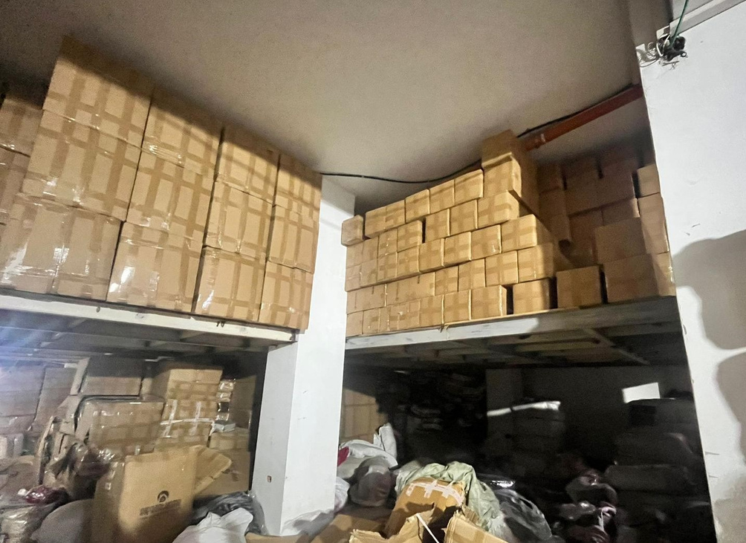
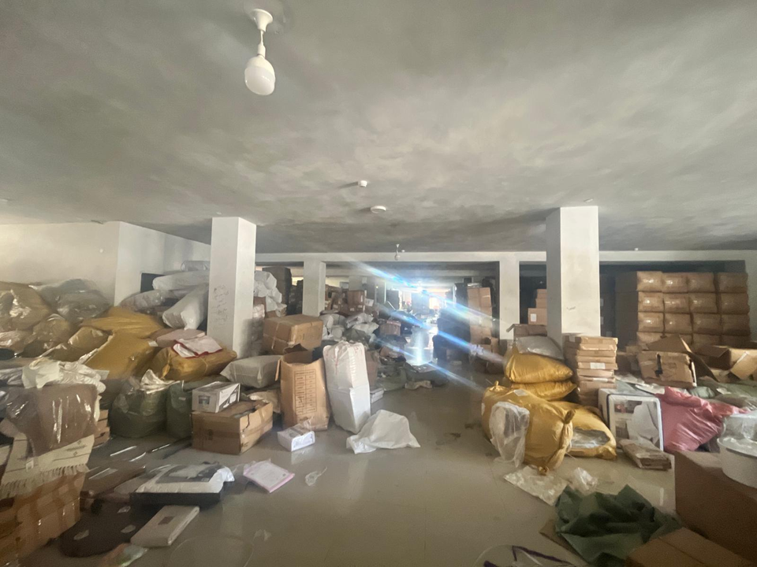
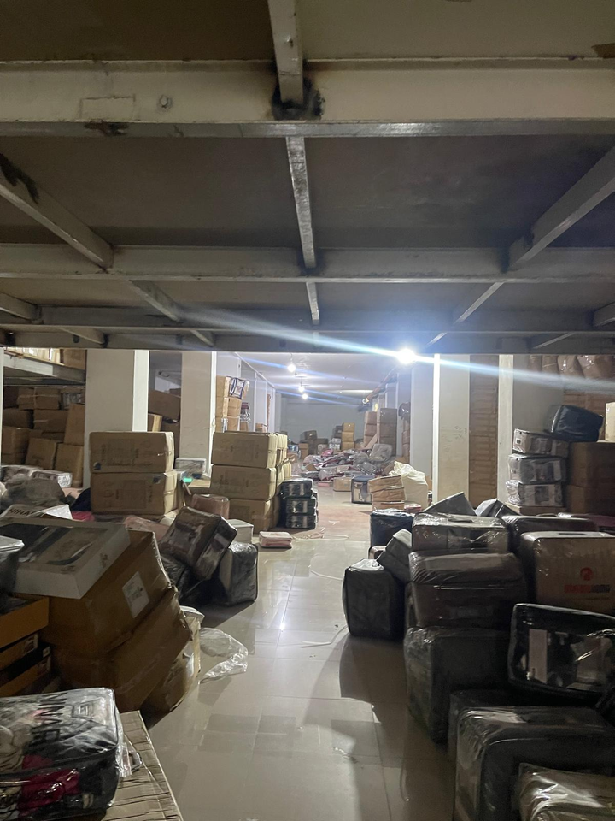
Problem Statement
Inefficient Warehouse Layout and Space Utilization
Lack of Effective Inventory Management and Control
Safety and Compliance Deficiencies in Warehouse Operations
5

Slide 6

Project Description
This project aims to develop and implement a comprehensive warehouse management system for Elegant Home Company, focusing on efficiency, safety, and operational optimization.
Key areas include warehouse layout improvement, the establishment of standard operating procedures (SOPs), safety enhancement, the implementation of
simulation software to analyze and streamline both current and proposed operations, and the conception of an IoT system to ensure structured and efficient warehouse management.
6

Slide 7






Implementation Methodology
  Literature Review
  Data Collection
  Data Evaluation and Interpretation
  Assessment Checklist
  SWOT Analysis
  Priority Listing
  Solution Design and Development
  Final Report Preparation and Strategic Recommendations
7

Slide 8
Literature Review
Safety
Case studies
Inventory
case studies
Layout
Case studies
Material handling case studies
8

Slide 9



  DATA COLLECTION
9

Slide 10



Data Collection Process
  Obtained formal approval through the university to initiate field-based data collection at the warehouse site.
  Conducted preliminary online meetings with warehouse management to present project objectives and coordinate logistics.
  Executed a series of structured on-site visits, each focused on a specific operational zone or warehouse floor.
  Engaged directly with warehouse staff to observe workflows, understand system operations, and identify procedural challenges.
  Collected comprehensive inventory data, including item classifications, quantities, storage methods, and system accuracy.
  Captured photographic and visual documentation to support spatial analysis and inform subsequent simulation modeling.
  All collected data were systematically categorized to support targeted analysis and solution development.
10

Slide 11


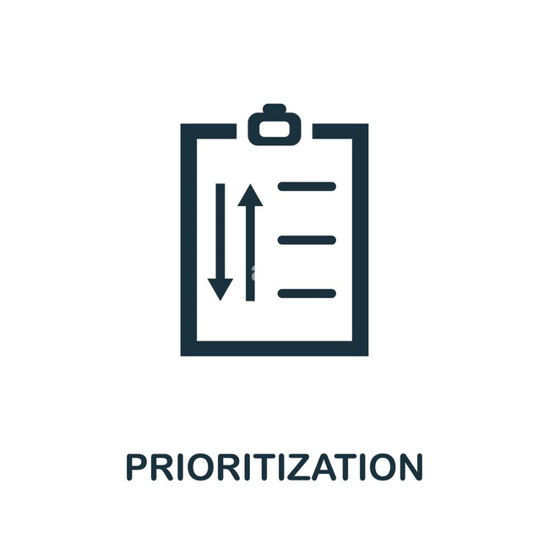
System Analysis and Evaluation Tools
Assessment Checklist
SWOT Analysis
Priority List
11

Slide 12
Assessment Checklist
  Systematic warehouse evaluation tool
  Identifies inefficiencies and risks
  Targets key areas for improvement
01
02
03
04
05
Warehouse
Inventory
Layout
Logistics
Safety
12

Slide 13
S
W
STRENGTHS
WEAKNESSES
  Large storage capacity
  Inefficient space utilization
  Flexible workforce
  No clear labeling
  High-volume capacity
  No formal documentation
  Open to system upgrades.
  Inefficient receiving & packing
0
T
OPPORTUNITIES
THREATS
  Improve space utilization
  Regional challenges
  Layout redesign
  Lack of documentation
  Warehouse Management System
  Experiencing goods losses
  Modern equipment
13

Slide 14
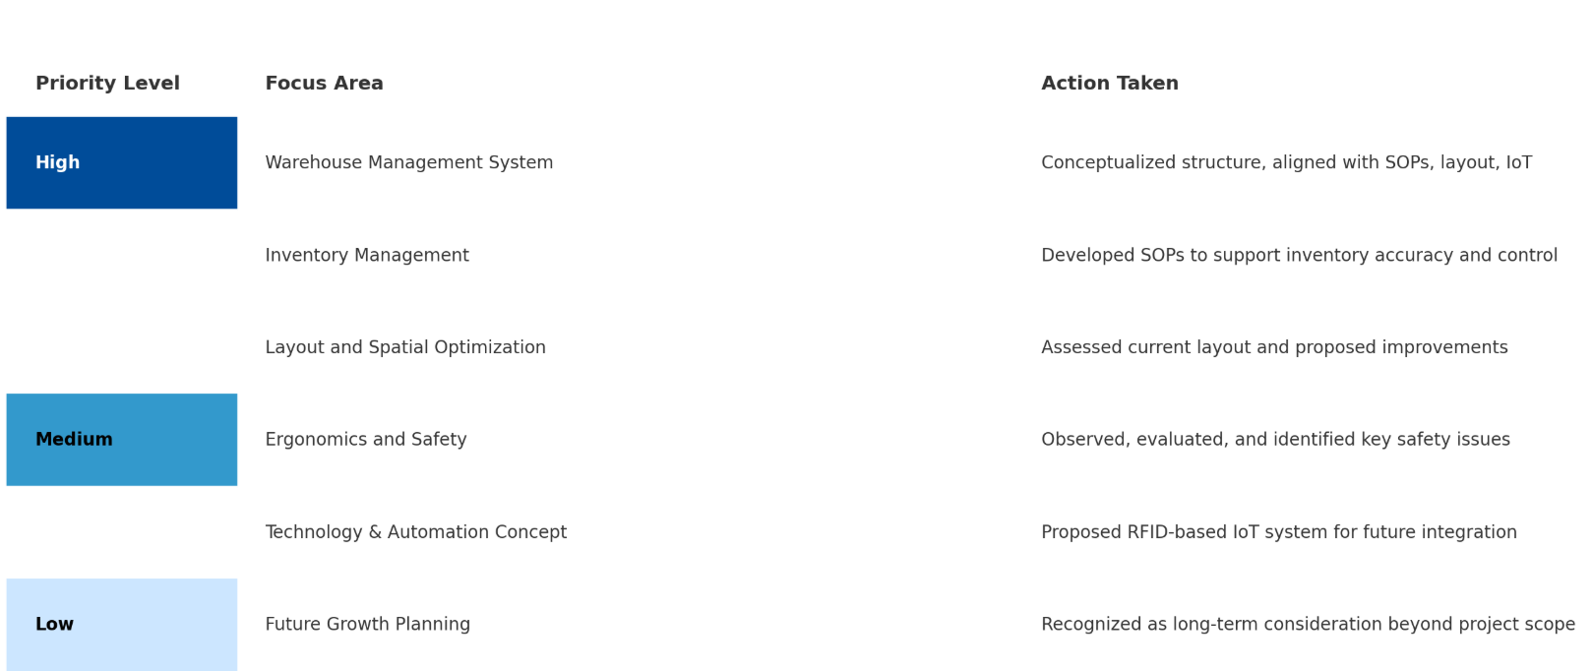
Priority Listing
14

Slide 15
Strategic Workflow: From Layout Assessment to Process Simulation
01
02
03
04
05
Layout Optimization
SOP Development
Safety Regulations Review
IoT
Concept Design
Process Simulation & Efficiency Evaluation
15

Slide 16



  WAREHOUSE OVERVIEW
16

Slide 17
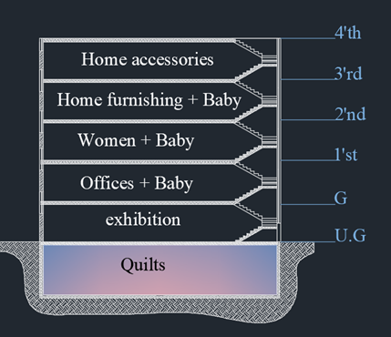
Warehouse Layout Overview
  Multi-floor storage system.
  Designated functions per floor.
  Floor-based product categorization.
  Having multiple challenges .
17

Slide 18


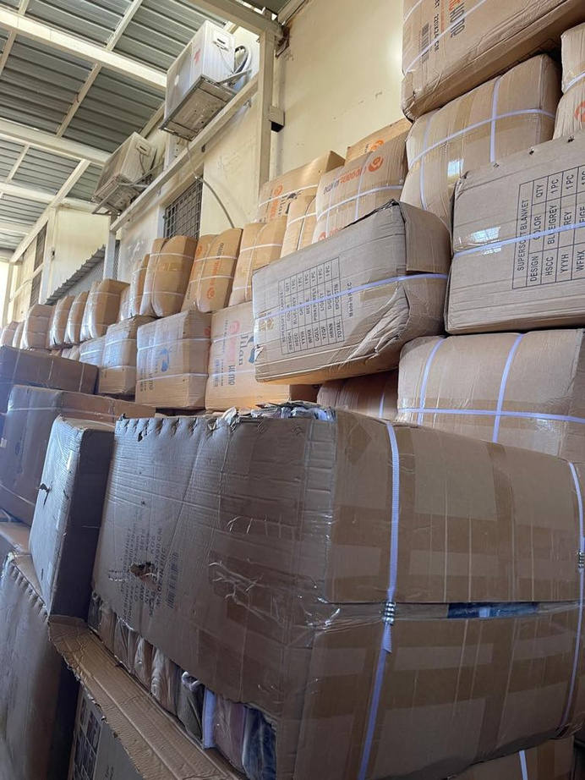


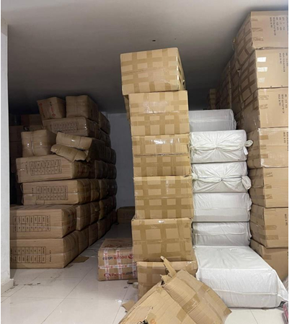
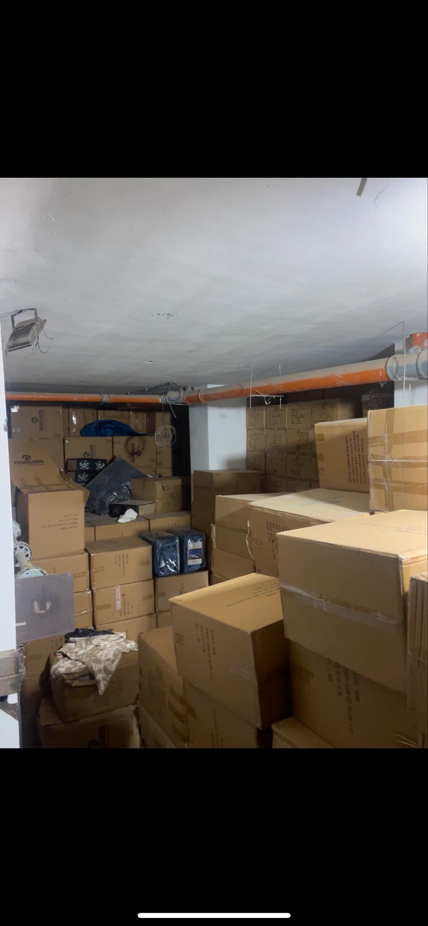
DEFINED SCOPE OF ANALYSIS:
  3RD, 4TH, AND UNDERGROUND FLOORS
18

Slide 19

Underground Floor
Primarily used for quilt storage, along with other inventory.
400m^2 Mezzanine
About 900 m^2
Total Usable Area
3.5 m
Total Usable Height
19

Slide 20
3rd and 4th Floors
Inventory is Distributed through the 4 and 3 as individuals and in cartoons
Primarily used for home furnishing and accessories.
About 900 m^2 Total Usable Area
3.5 m
Total Usable Height
20

Slide 21
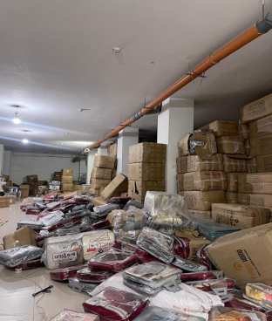

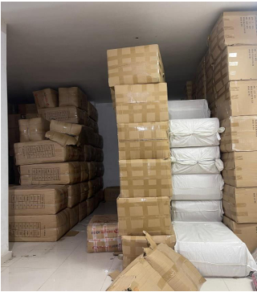


  DESIGNATED AREA FOR PREPARING OR PACKAGING ORDERS
  ABSENCE OF CLEAR PATHWAYS AND UNIFORM AISLE WIDTHS
  INEFFICIENT USE OF SPACE
  RELIANCE ON MANUAL HANDLING
21

Slide 22
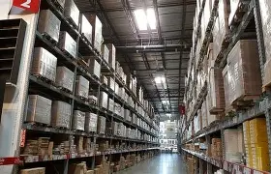
  PROPOSED IMPROVEMENTS AND OPERATIONAL ENHANCEMENTS
22

Slide 23
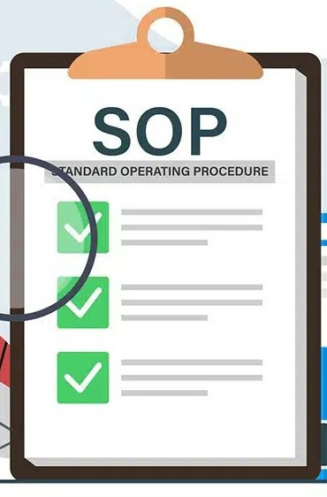
  STANDARD OPERATING PROCEDURES (SOPS)
23

Slide 24
Standard Operating Procedures (SOPs)
  Step-by-step instructions for daily warehouse tasks
  Ensure consistency, safety, and efficiency
  Reduce human error and miscommunication
  Support employee training and accountability
  Simple, practical forms were created
24

Slide 25
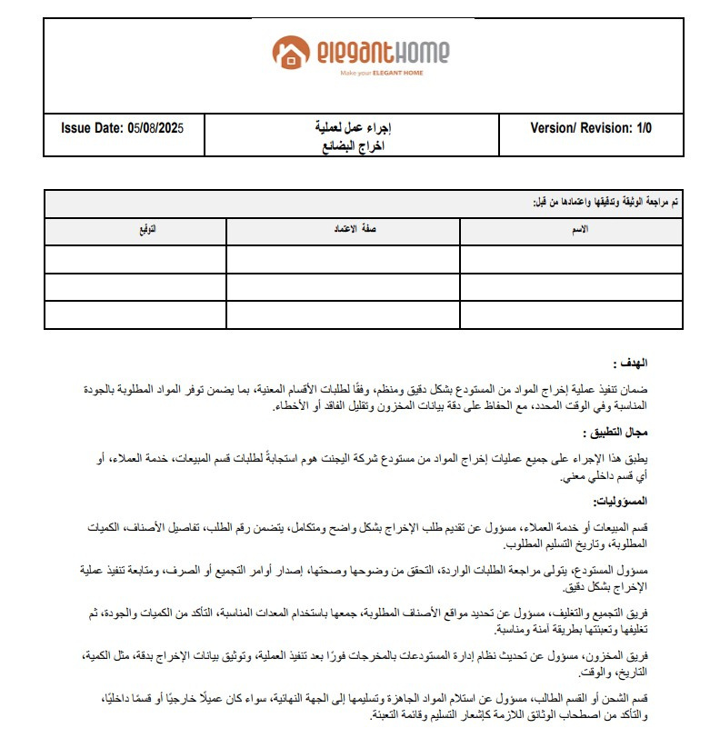
Standard Operating Procedure for Releasing Goods from the Warehouse
25

Slide 26
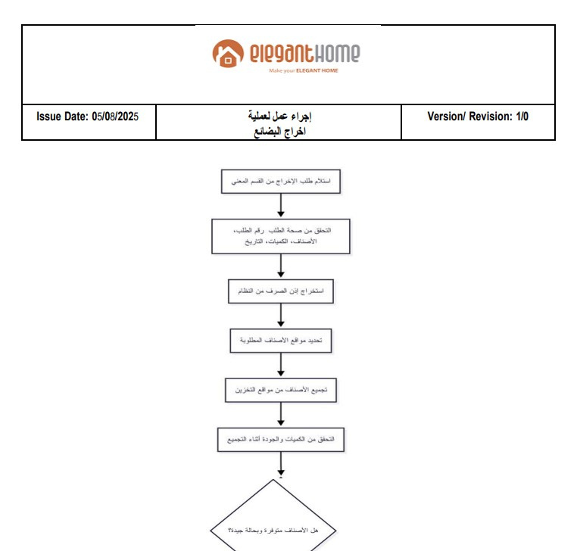
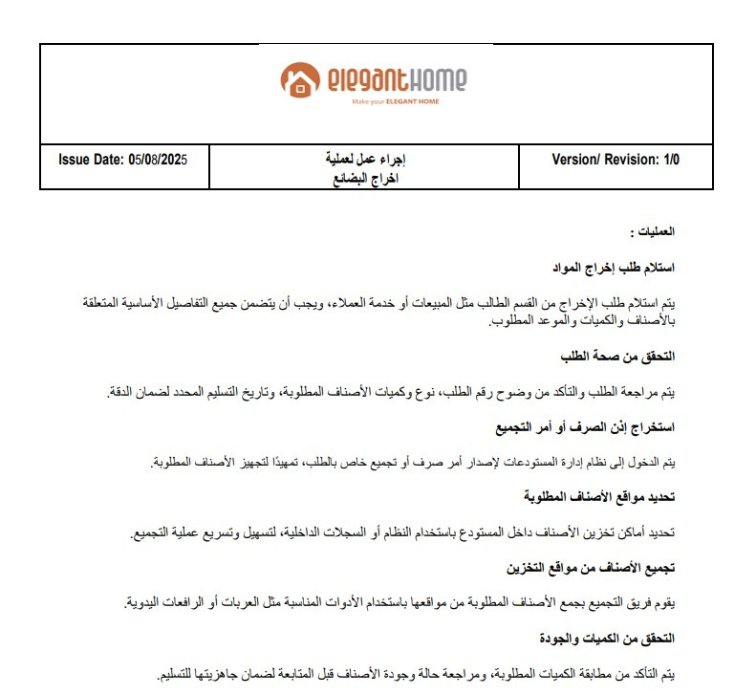
Standard Operating Procedure for Releasing Goods from the Warehouse
26

Slide 27
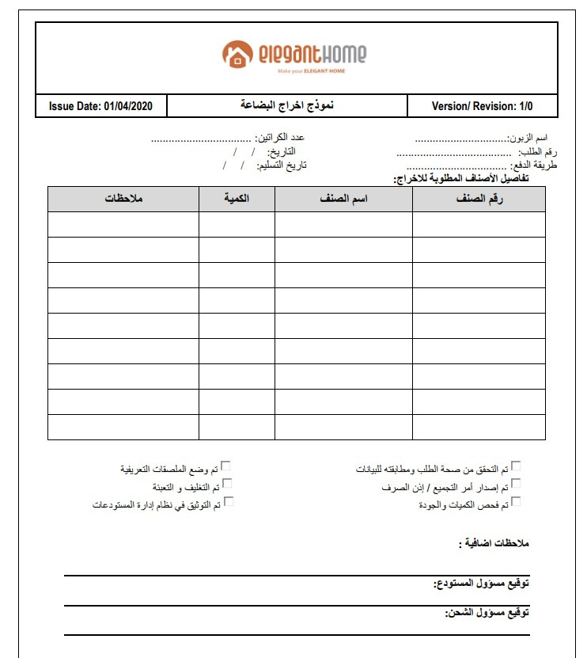
Standard Form for Releasing Goods from the Warehouse
27

Slide 28

  SAFETY AND EMERGENCY PROCEDURES
28

Slide 29
Overview of Safety Measures
  Emergency Exit Accessibility
  Safety Signage
  Enhanced Lighting
  Temperature & Ventilation Control
  Cleanliness & Housekeeping
29

Slide 30
Emergency Exit Accessibility
  2 exits per floor, placed mid-left and mid-right
  Connected to the central corridor for fast evacuation
  Panic bars and emergency lighting installed
30

Slide 31
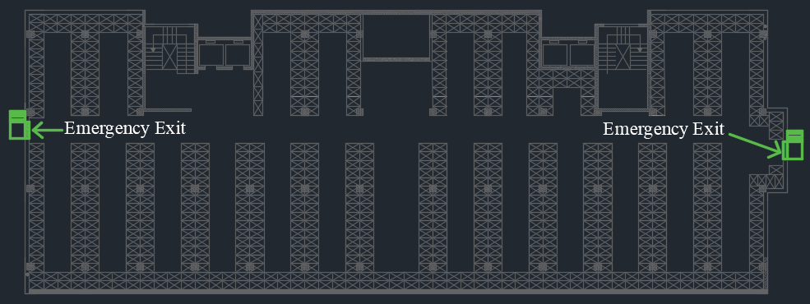
Emergency Exit Accessibility Layout
31

Slide 32
Lighting & Safety Signage
  76 linear LED lights (3300 lumens each)
  Even distribution, no dark zones
  Clear signage at exits, fire zones, and hazards
  Standardized symbols and colors for quick recognition
32

Slide 33
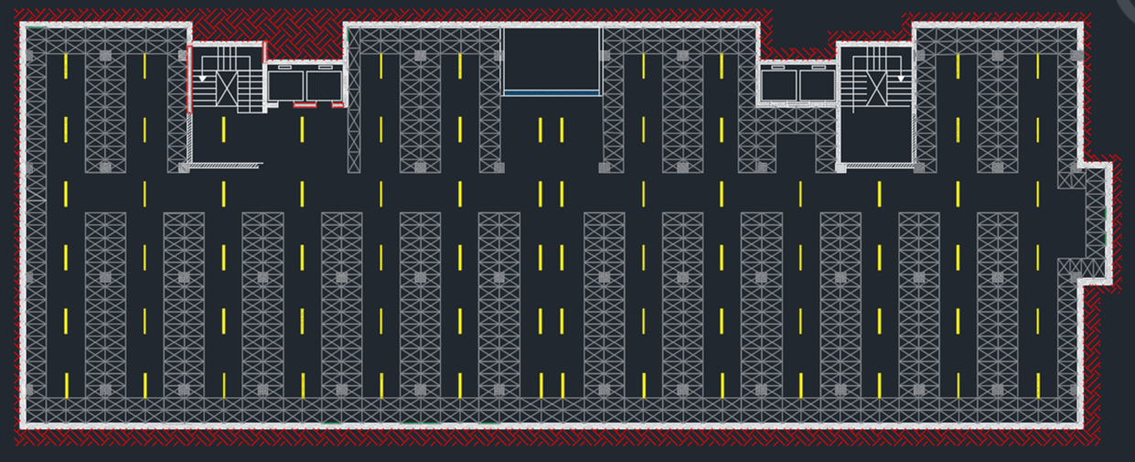
Warehouse Lightning Layout
33

Slide 34





Safety Signage Example
34

Slide 35
Ventilation & Environmental Control
  Wall-mounted fans installed in poorly ventilated zones
  Supported by natural airflow
  Dehumidifiers placed in textile storage areas
  Routine checks to monitor temperature and humidity
35

Slide 36
Cleanliness & Housekeeping Standards
  Regular cleaning schedules to reduce clutter and dust
  Clear floor markings to define storage and walking areas
  Removal of obstacles from aisles and emergency paths
36

Slide 37
Final Impact of Safety Improvements
1
2
Faster and safer emergency evacuation
Improved lighting, visibility, and air quality
SAFETY IMPROVEMENTS RESULTS
3
4
Better working conditions and safety compliance
Reduced risk of accidents, fire, and product damage
37

Slide 38
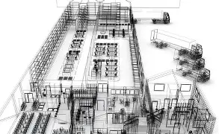
  PROPOSED LAYOUT
38

Slide 39
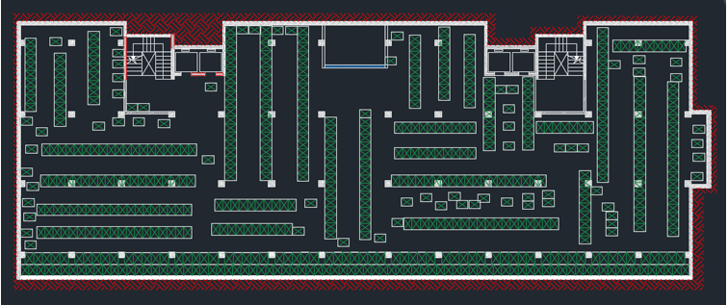
Existing Floor Plan and Layout
39

Slide 40
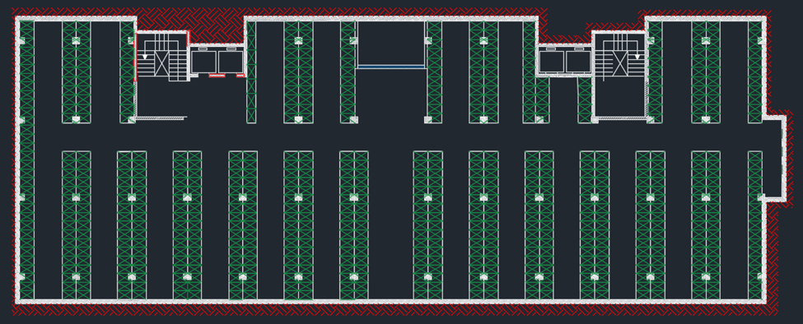
Traditional Vertical Layout
40
Capacity: 3770 boxes

Slide 41
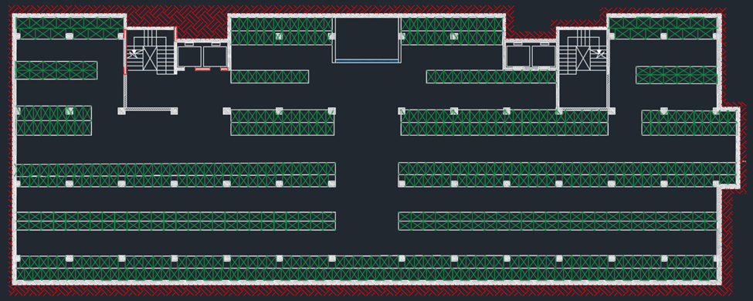
Traditional Horizontal Layout
41
Capacity: 3780 boxes

Slide 42
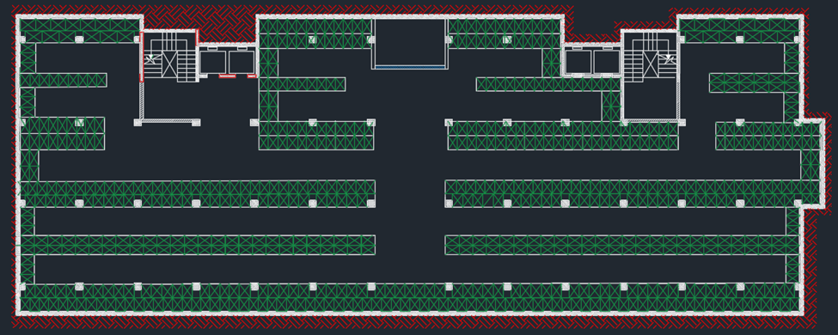
Customized Horizontal Layout
24
Capacity: 4070 boxes

Slide 43
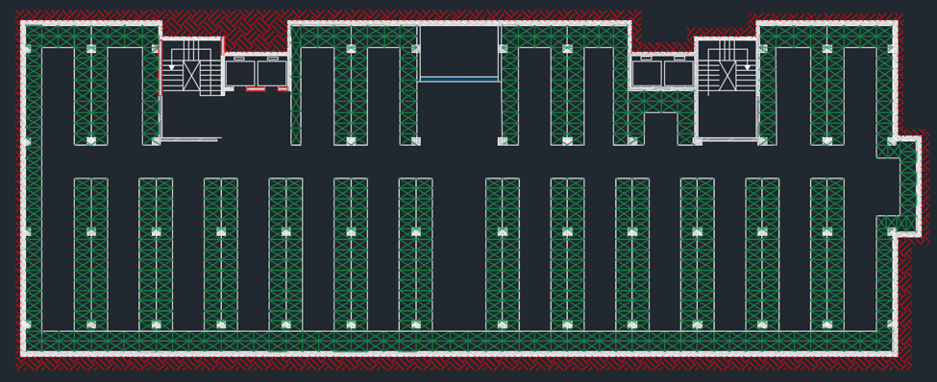
Customized Vertical Layout
(chosen option)
Capacity: 4230 boxes
43
48% increase

Slide 44
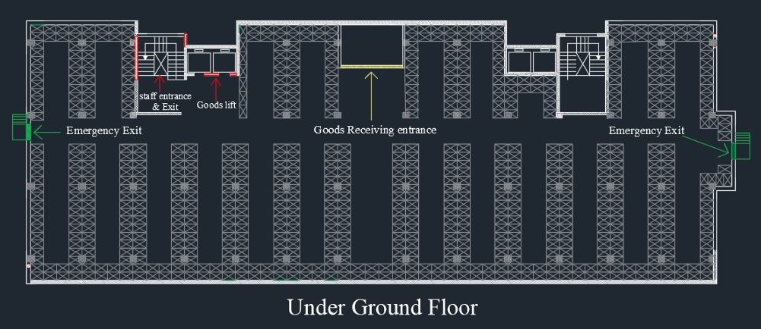
Proposed Floor Plan and Layout
Underground Floor
44

Slide 45
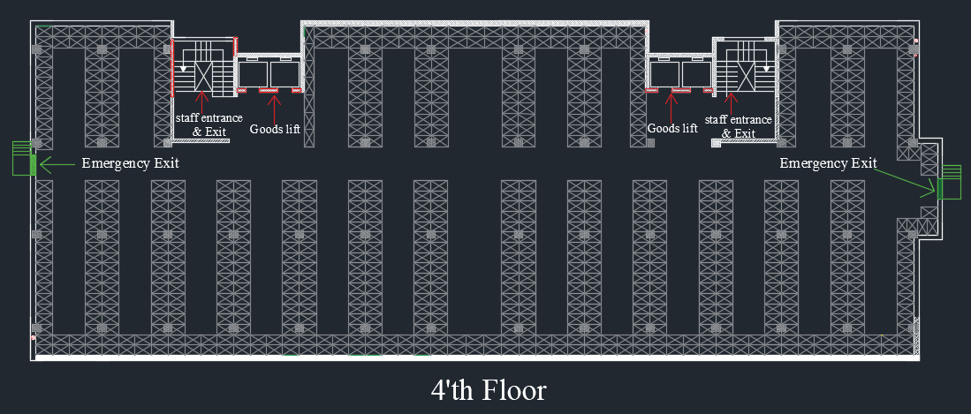
Proposed Floor Plan and Layout
3'rd & 4'th Floors
45

Slide 46
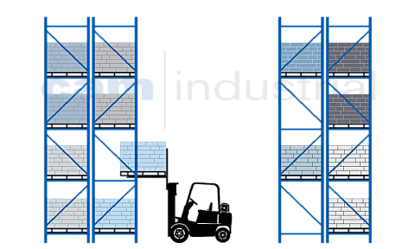
Proposed SelectiveRack system
46

Slide 47
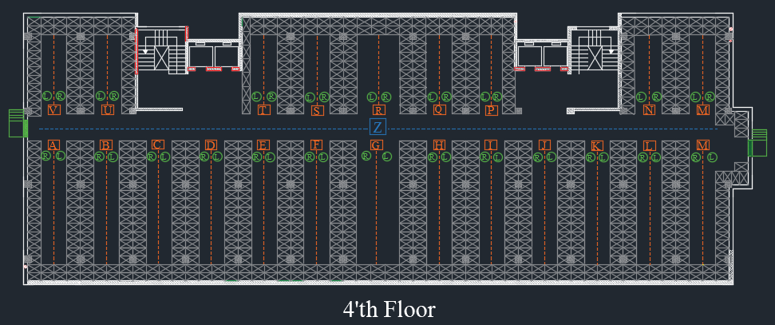
Warehouse Labeling
47

Slide 48
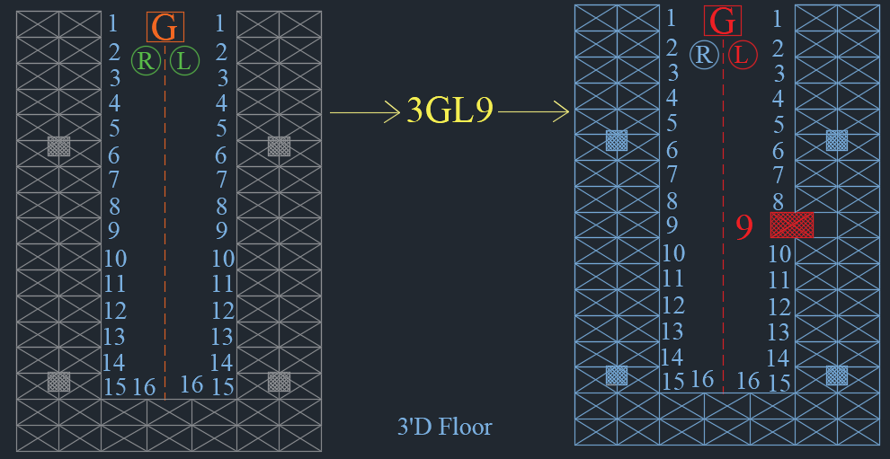
Warehouse Labeling
48

Slide 49

IOT
  CONCEPT DESIGN
49

Slide 50
Implementing IoT in Smart Warehouse Operations
  What is IoT?
  Why it's useful in warehouses?
  What is the Goal?
50

Slide 51
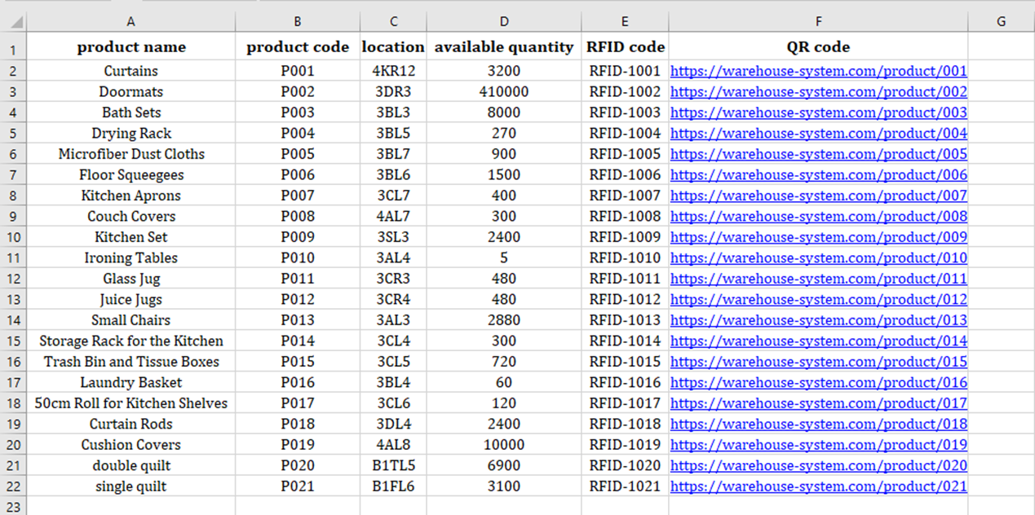
Digital Representation of Products and Storage Locations
51

Slide 52
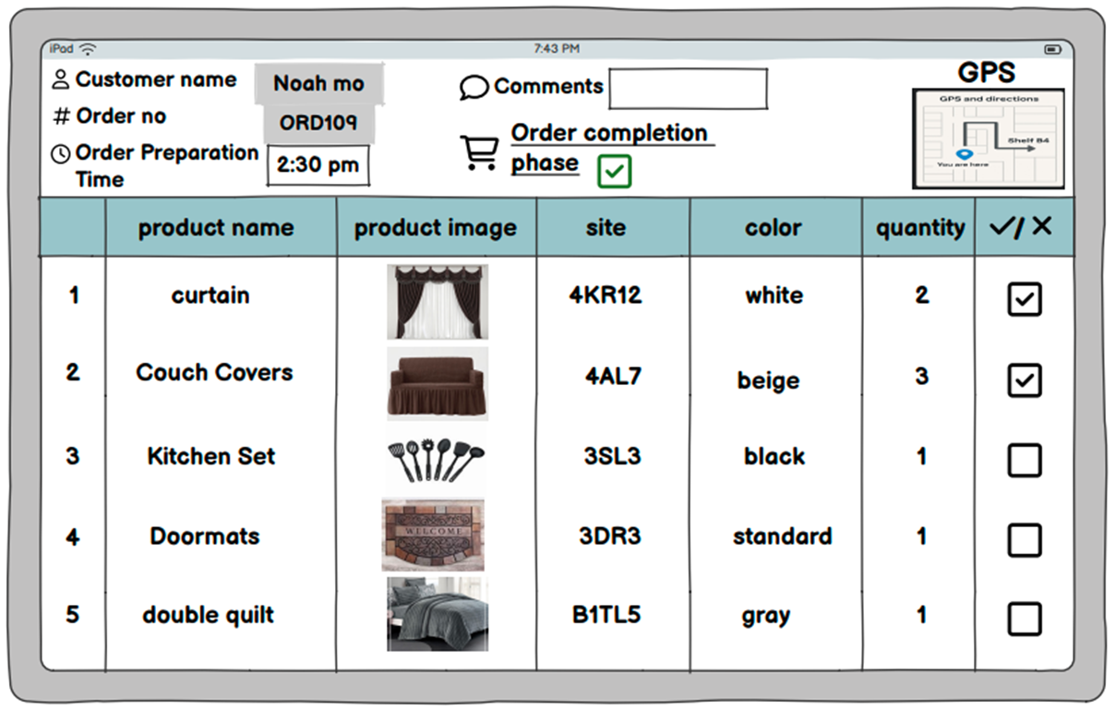
Worker–System Communication via Smart Tablet Interface
52

Slide 53
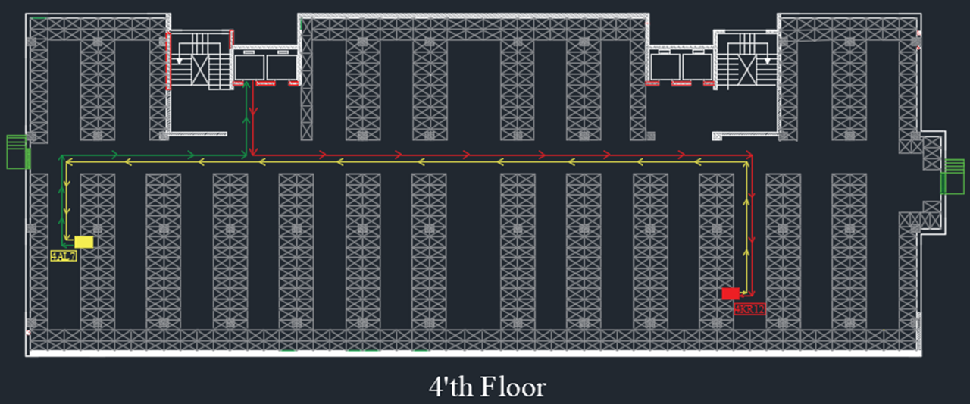
Smart Navigation and Route Optimization Logic
53

Slide 54
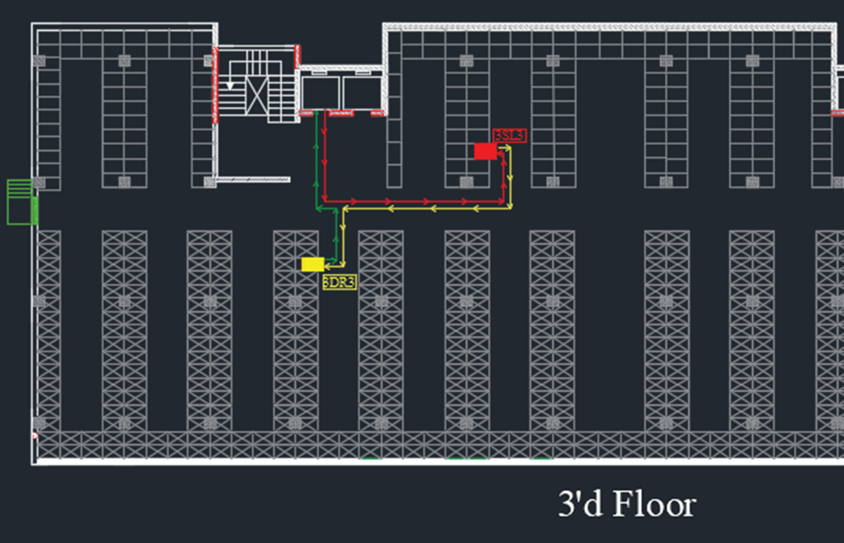
Smart Navigation and Route Optimization Logic
54

Slide 55
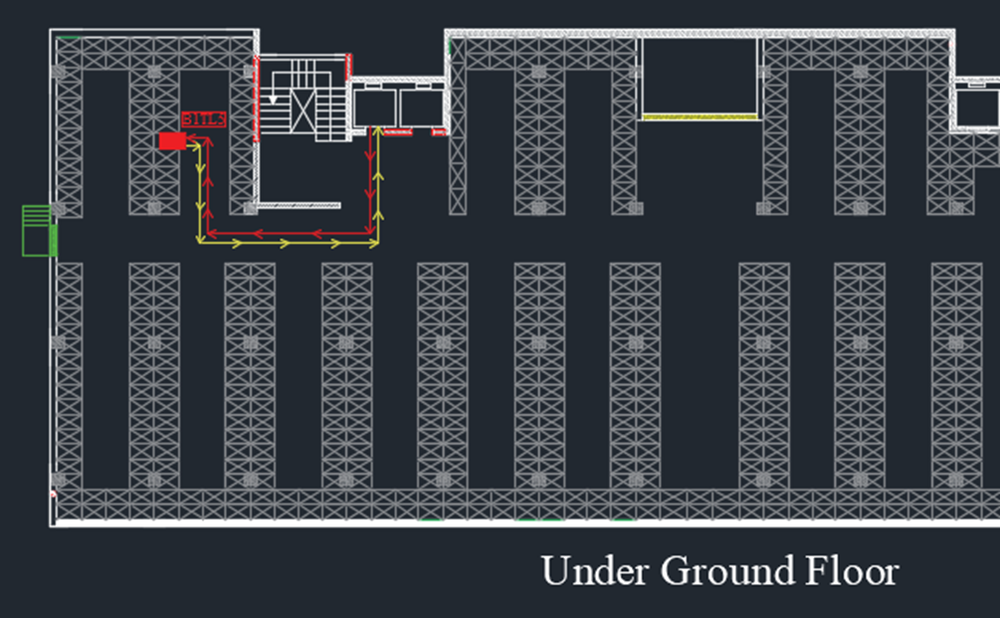
Smart Navigation and Route Optimization Logic
55

Slide 56
Performance Evaluation via
Simulation
56

Slide 57





Simulation Assumptions & Model Inputs
Order Interarrival Time Every 20 minutes
Simulation Scope: order Fulfillment process only
Shipping : 15 minutes in shipping area
Processing Times Source: Collected from warehouse staff
Inventory Scope: 1 ordered product
57

Slide 58
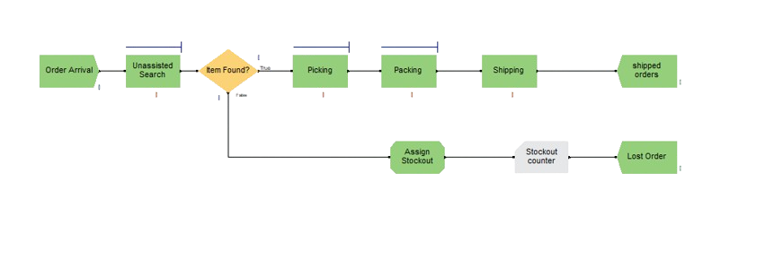
Current Order Fulfillment Process
58

Slide 59
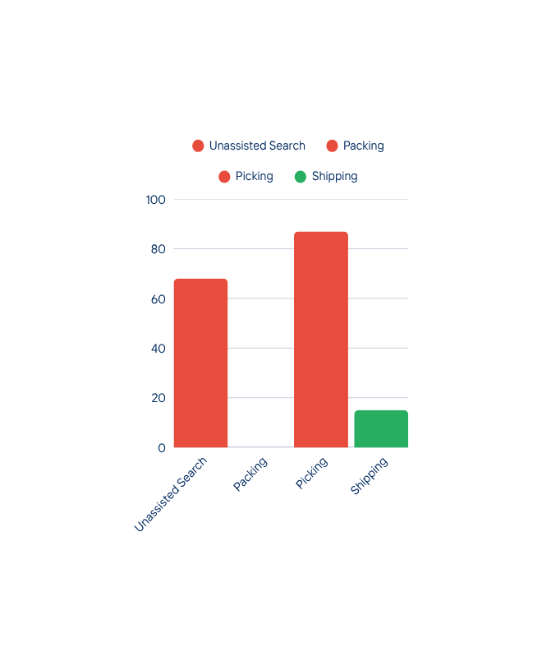
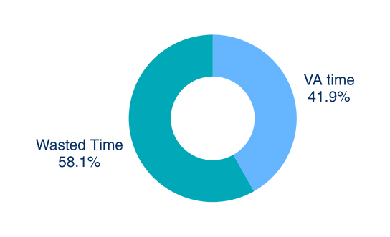
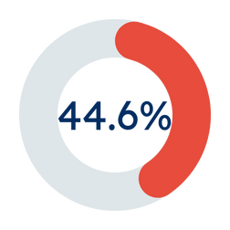




Current System Overview
WAITING TIME IN QUEUE
VALUE ADDED VS WASTED TIME
OPERATIONAL PERFORMANCE
Orders Received : 25 orders
Total Time in System 172 minutes
Orders Fulfilled: 11 order
Stockouts During Process 7 orders
FULFILLMENT RATE
RESOURCE UTILIZATION
96%
12%
Overloaded Pickers
Underutilized Packer
59

Slide 60
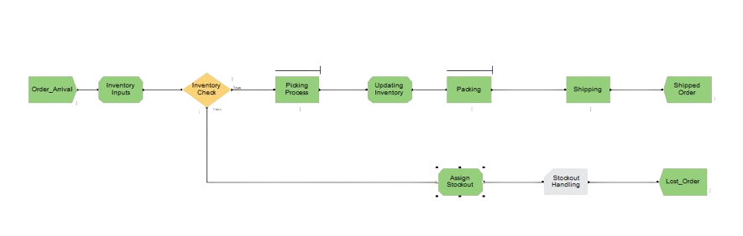
Proposed Order Fulfillment Process
60

Slide 61
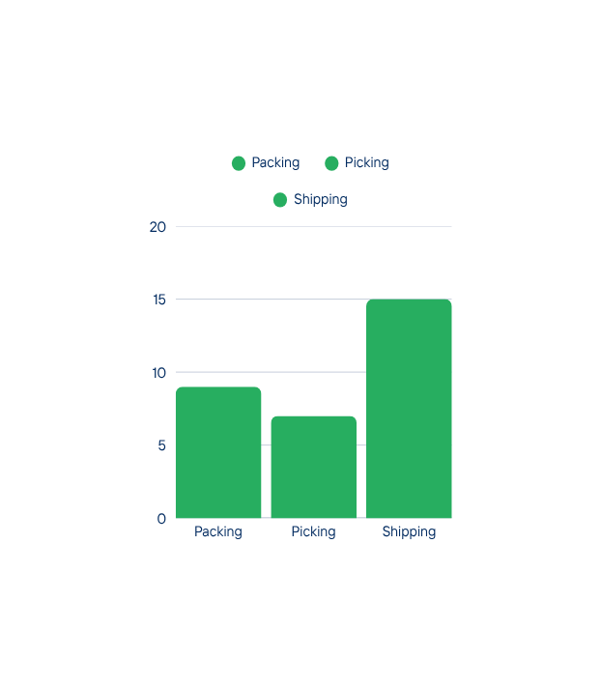
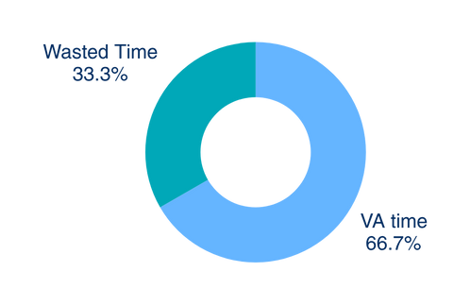



Proposed System Overview
WAITING TIME IN QUEUE
VALUE ADDED VS WASTED TIME
OPERATIONAL PERFORMANCE
Orders Received : 25 orders
Total Time in Sytem 45 minutes
Orders Fulfilled: 23 order
Stockouts During Process 0 orders
FULFILLMENT RATE
RESOURCE UTILIZATION
71%
Warehouse Worker
61

Slide 62
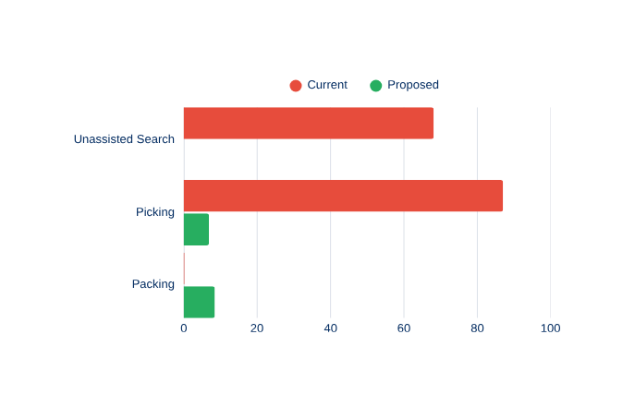
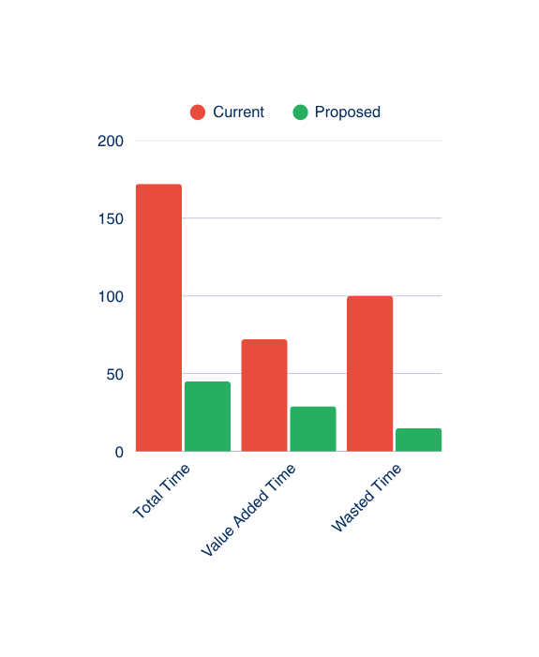
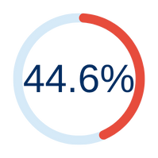
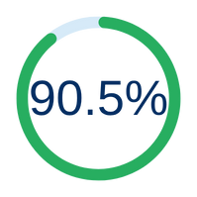
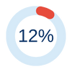




WAREHOUSE PERFORMANCE COMPARISON – CURRENT VS. PROPOSED
ORDER FULFILLMENT SUMMARY
OREDR TIME COMPARISON
TIMES IN QUEUES
ORDERS RECEIVED: 25 ORDER
REDUCTION IN TOTAL,VA, WAITING TIMES
CURRENT SITUATION
PROPOSED SITUATION
ORDERS FULFILLED 11 ORDER
ORDERS FULFILLED 25 ORDER
ORDER FULFILLMENT RATE
ORDER FULFILLMENT RATE
RESOURCE UTILIZATION COMPARISON
CURRENT PROCESS
PROPOSED PROCESS
STOCKOUT DURING PROCESS
STOCKOUTS PREVENTED
7 ORDERS
0 ORDERS
Packer
Pickers
62
Warehouse Operator

Slide 63
Conclusion
This project optimized Elegant Home’s warehouse with improved layouts and SOPs , validated by simulation.
It introduced IoT-based smart concepts and a safety framework,
These solutions provide a sustainable foundation supporting the company’s productivity, safety, and digital transformation goals.
57

Slide 64
Recommendations
1. Introduce a Digital Inventory Management System
2. Integrate a Smart Interface (IoT-Based Concept)
3. Invest in Automated or Semi-Automated Handling Equipment
4. Establish a Centralized Warehouse Management System (WMS)
57

Slide 65
Thank You

Slide 66
STANDARD OPERATING PROCUDERS
  RECEIVING CUSTOMER ORDERS,
2. PREPARING ORDERS,
3. DELIVERING ORDERS,
4. OPERATING THE WAREHOUSE MANAGEMENT SYSTEM,
5. RECEIVING MATERIALS,
6. RELEASING MATERIALS,
7. CONDUCTING INVENTORY COUNTS,
8. DISPOSING OF MATERIALS.

