Slide 1
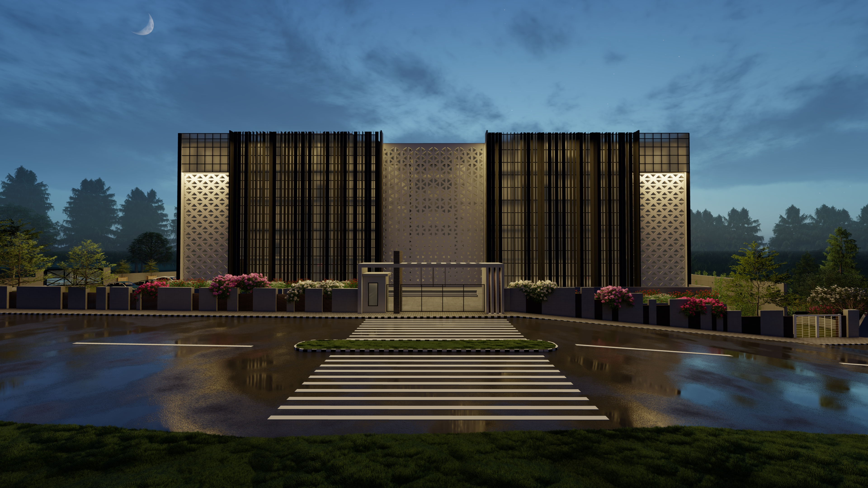
An-Najah National University
Faculty of Engineering & Information Technology
Building Engineering Department
Graduation Project 2
Prepared by:
Ghroob Suwan
Mayas Dawod
Rusul Maqboul
Walaa AbuSoad
Automated Student Hostel
Supervised by:
Dr. Mutassem Baba

Slide 2
Outline
Introduction
Architectural Design Chapter
Structural Design Chapter
Environmental Design Chapter
Mechanical Design Chapter
Electrical Design Chapter

Slide 3
INTRODUCTION

Slide 4
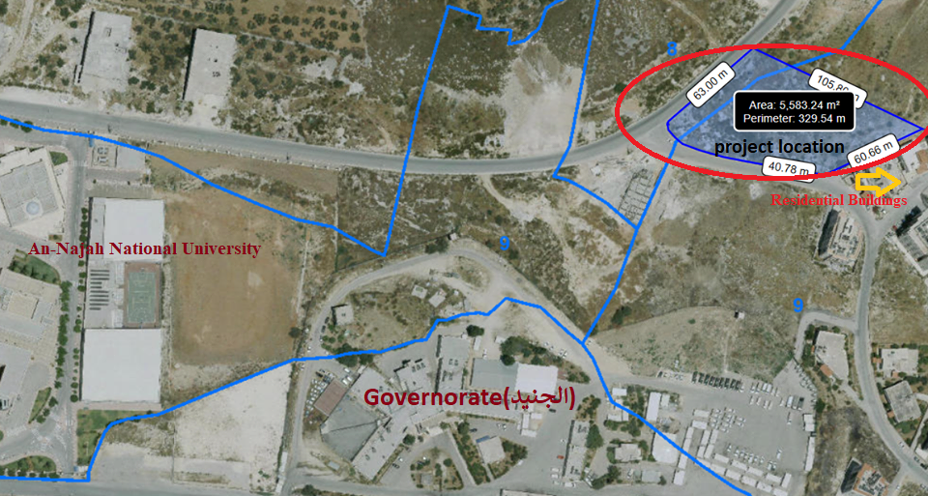
1. Introduction
1.1 Site Location:
The land of the project is located at the south-east of an An-Najah National University (the new campus), in the western part of the city of Nablus. The site of the project it is far from the city center about 5 km, and about 300 m from the main streets (RAFEDIA). The building is surrounded by the Residential Buildings from the east, bystreets from south west and west, and surrounded by nothing from the north .

Slide 5
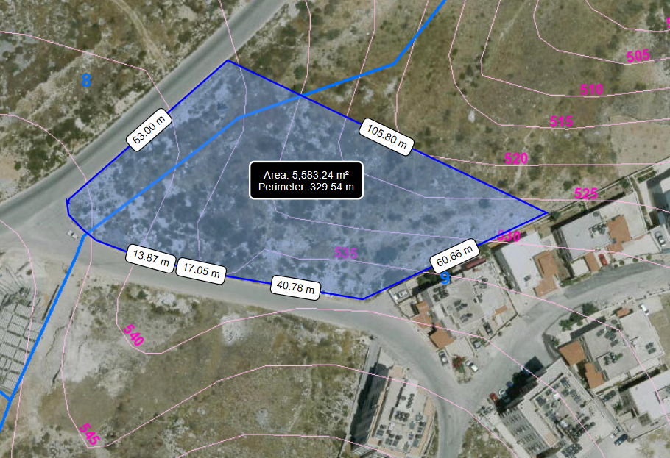
1. Introduction
1.2 Site Location:
About (530-540)m above sea level and 5 kilometers away from city center.
Site has a total area of 5583m²
Near Serviceable streets width equals 10 m.

Slide 6
1. Introduction
1.2 Site Location:
Environmental Site Analysis depends on many variables:
Solar analysis.
Noise analysis.
Wind analysis.
Climate analysis

Slide 7
1. Introduction
1.2 Site Location:
Summary of annual temperatures
average monthly temperature in the summer | (21-24) ° C.
average monthly temperature in the winter | (9.5-11.5) ° C.
maximum temperature reaches | (39-40.5) ° C.
lowest temperature reaches | (-1-1.4) ° C.)
Environmental Site Analysis depends on many variables:
Noise analysis.
Most of the noise is towards the street.
Highest value doesn’t exceed 59 dB.
Climate analysis

Slide 8
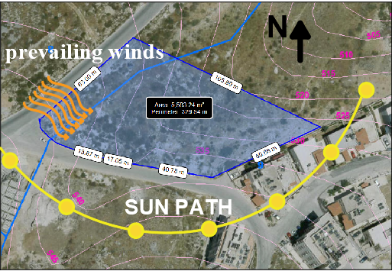
1. Introduction
1.2 Site Location:
Environmental Site Analysis depends on many variables:
Solar analysis.
Sun path as shows in picture
Wind analysis.
Wind direction is mostly to the north-west.

Slide 9
1. Introduction
1.2 Site Location:
1.2 Site Analysis :
Site Advantages :
The slop of land can be handled.
Away from traffic rush.
Has a quiet surrounding environment.
Very close to An-Najah National University (the new campus), that may increase number of coming students.
Good Northern view.
Site Disadvantages :
Bit away from the public transportation, so poor accessibility.

Slide 10
ARCHITECTURAL Design CHAPTER

Slide 11
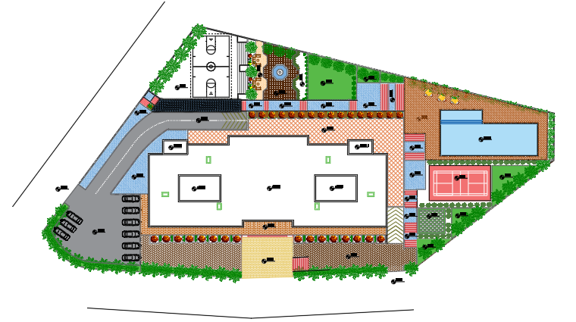
1. Architictula
2.1 Site Plan for the project:

Slide 12
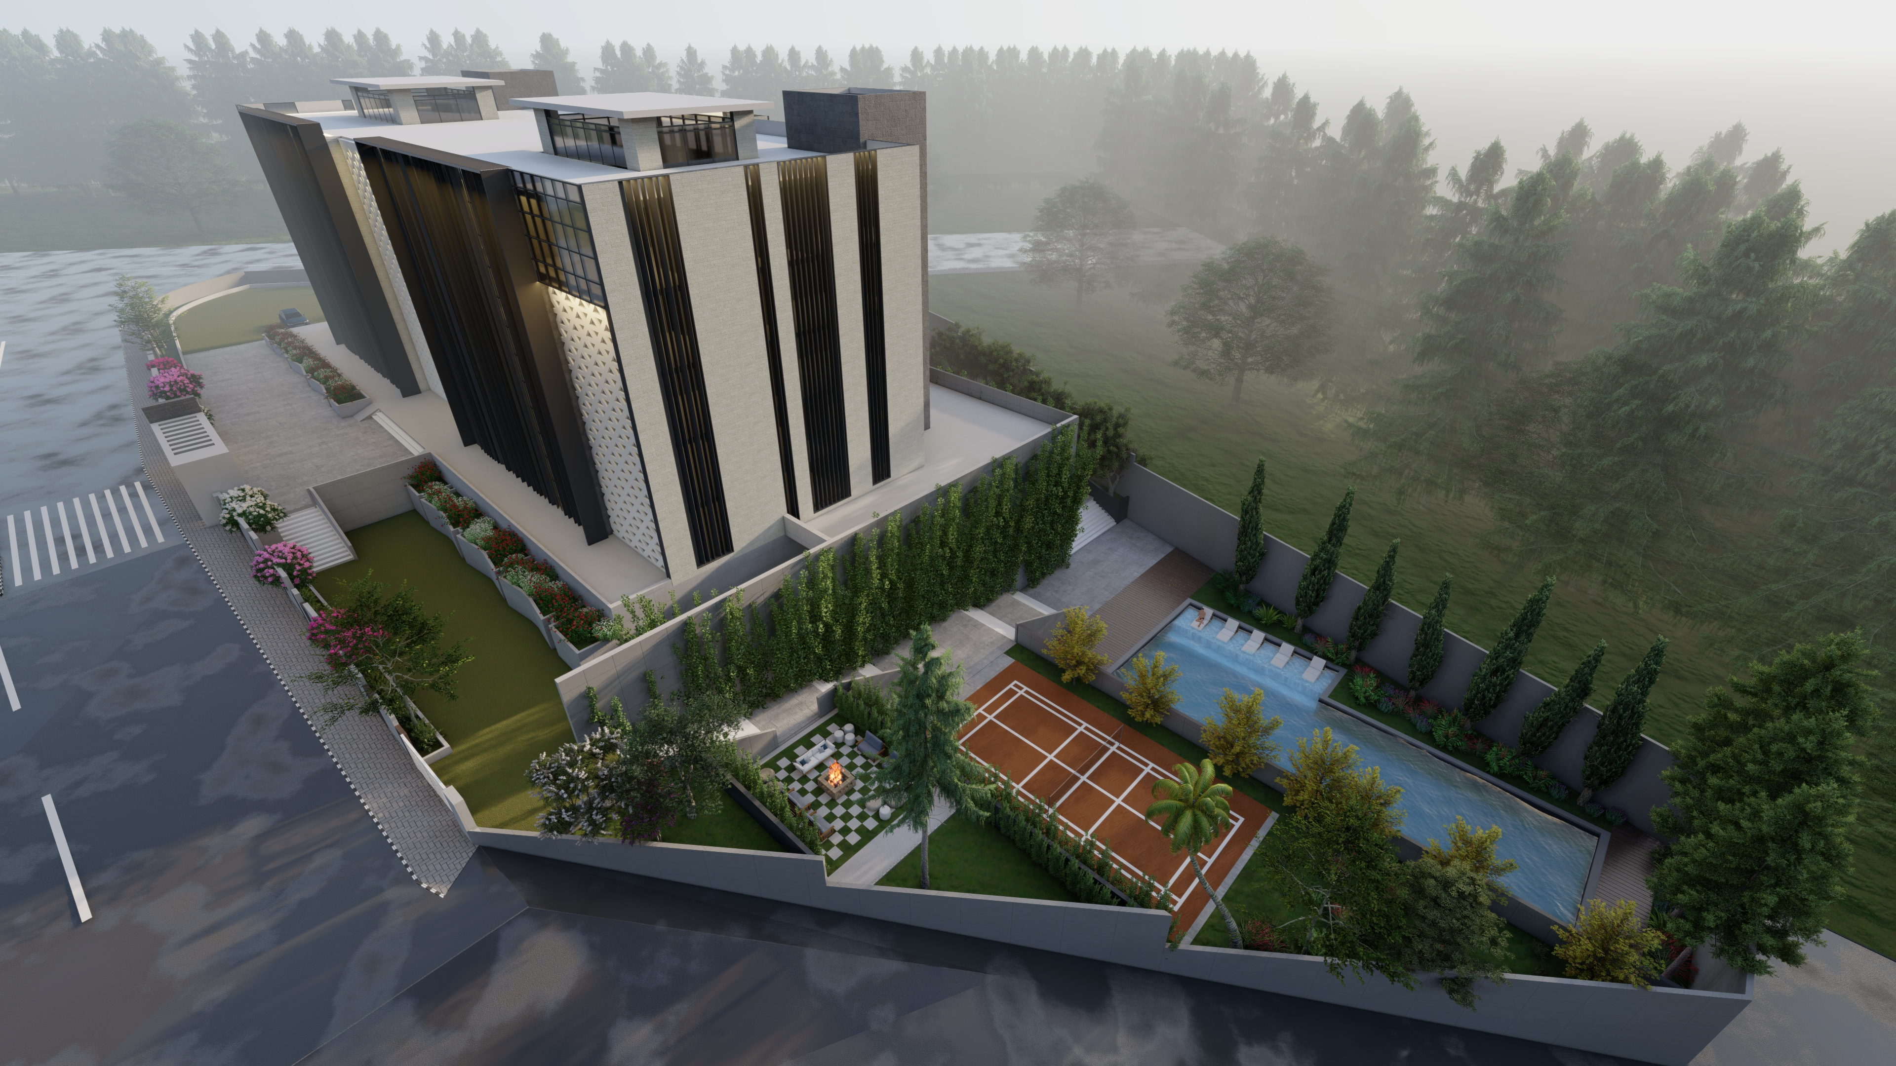
2. Architectural Design
2.1 Site for the project:

Slide 13
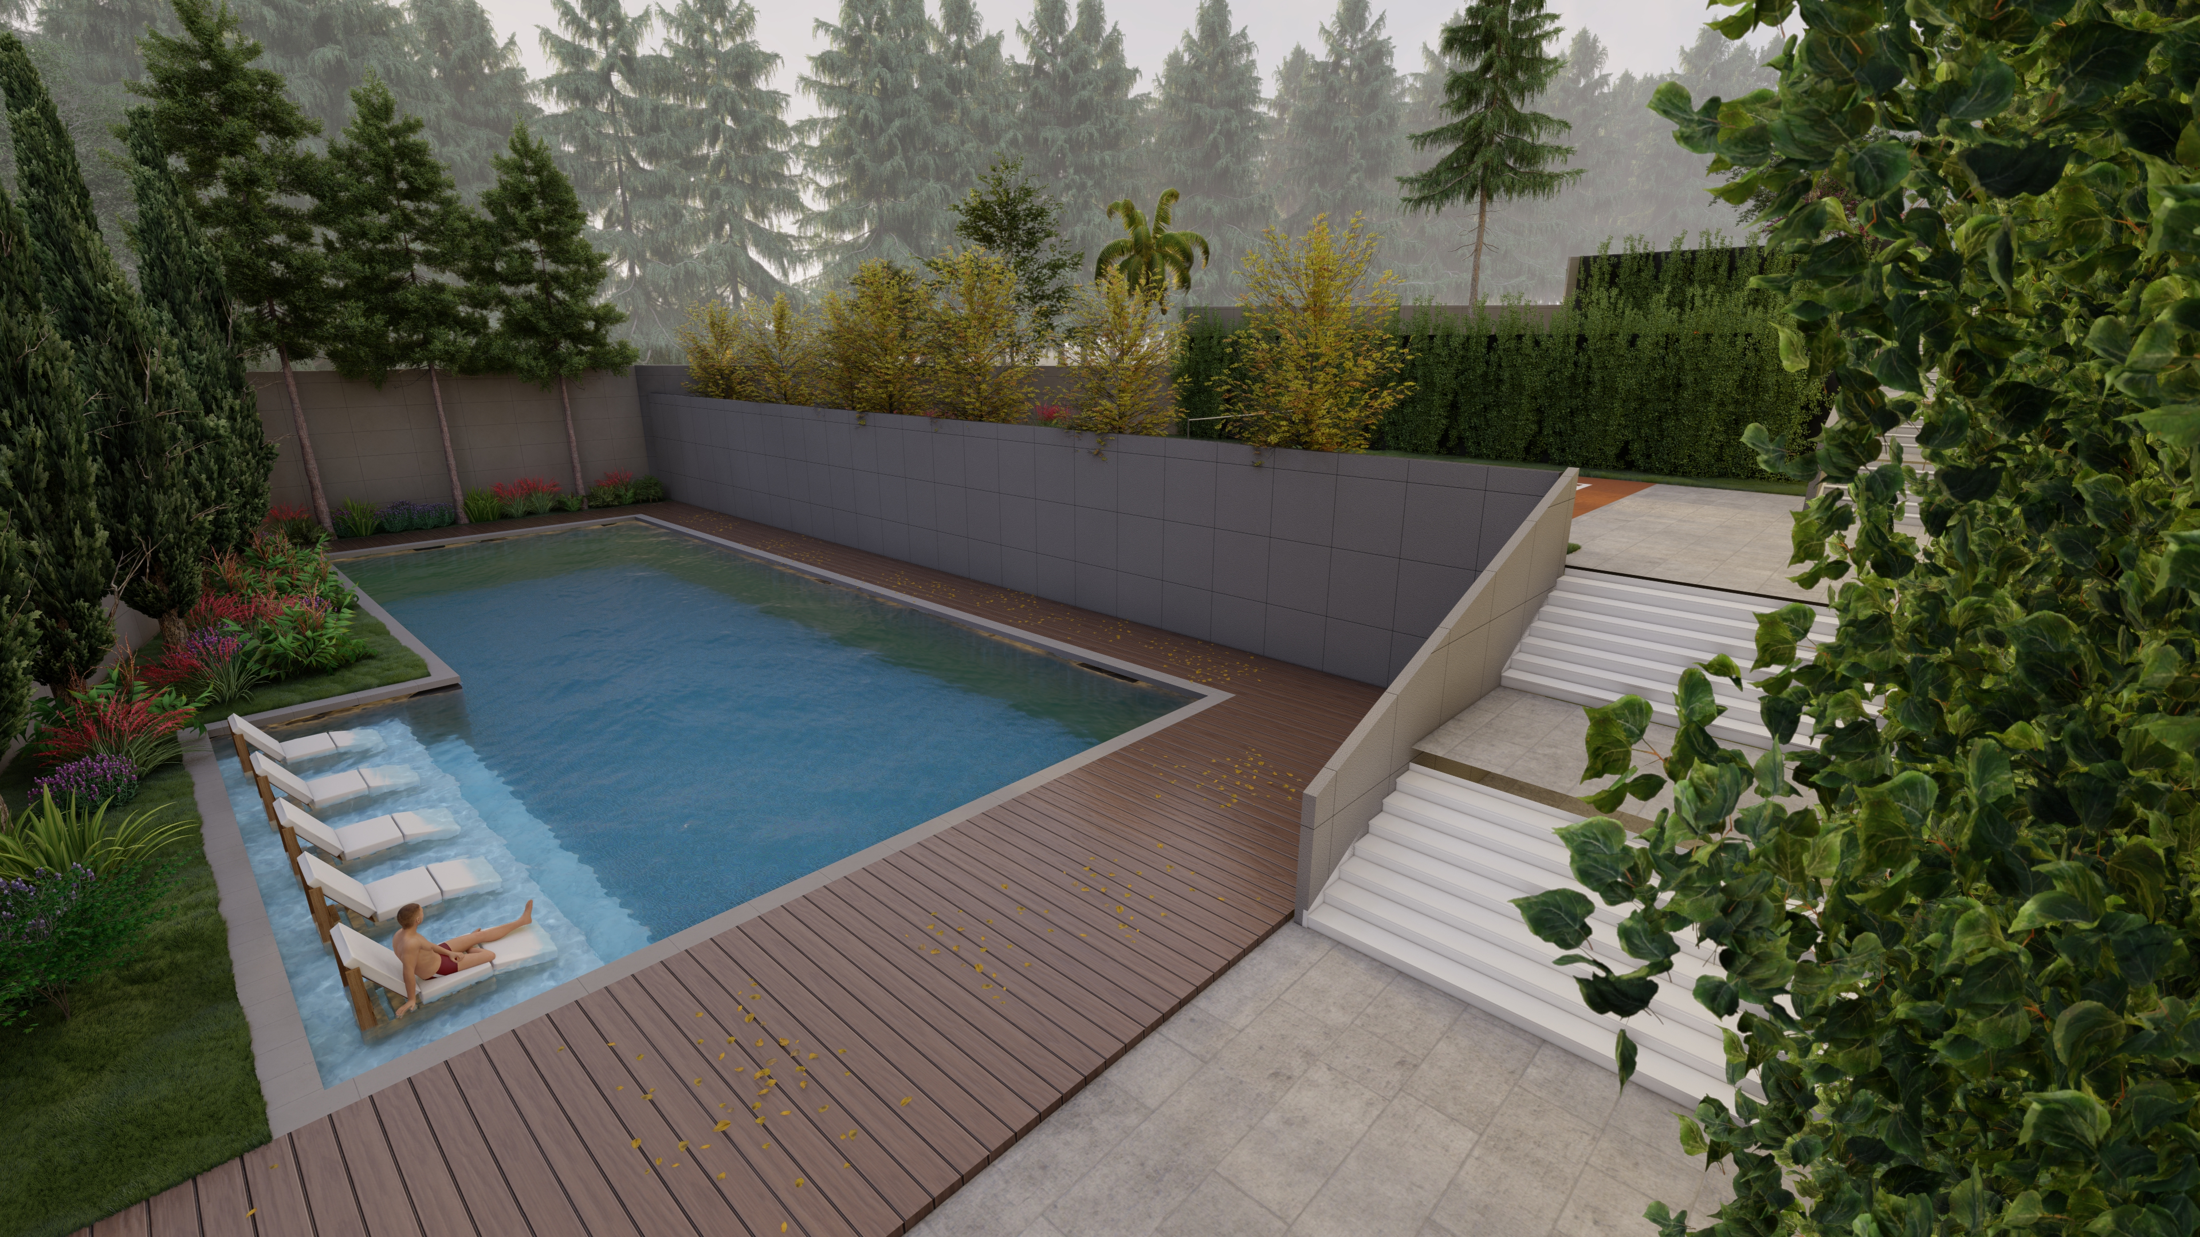
2. Architectural Design
2.1 Site for the project:
    2.1.1 Swimming pool
A swimming pool with an area of 230 m²
was built on the north east side of the land and was about 10 meters below the 0.0 level

Slide 14
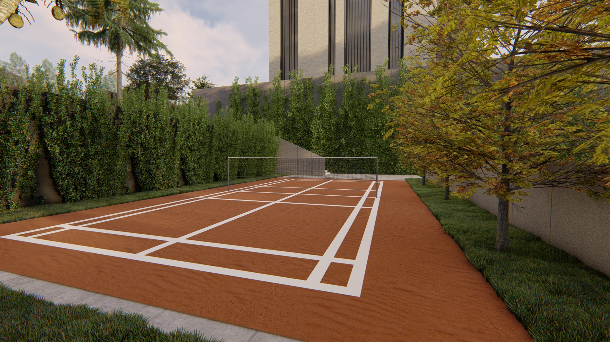
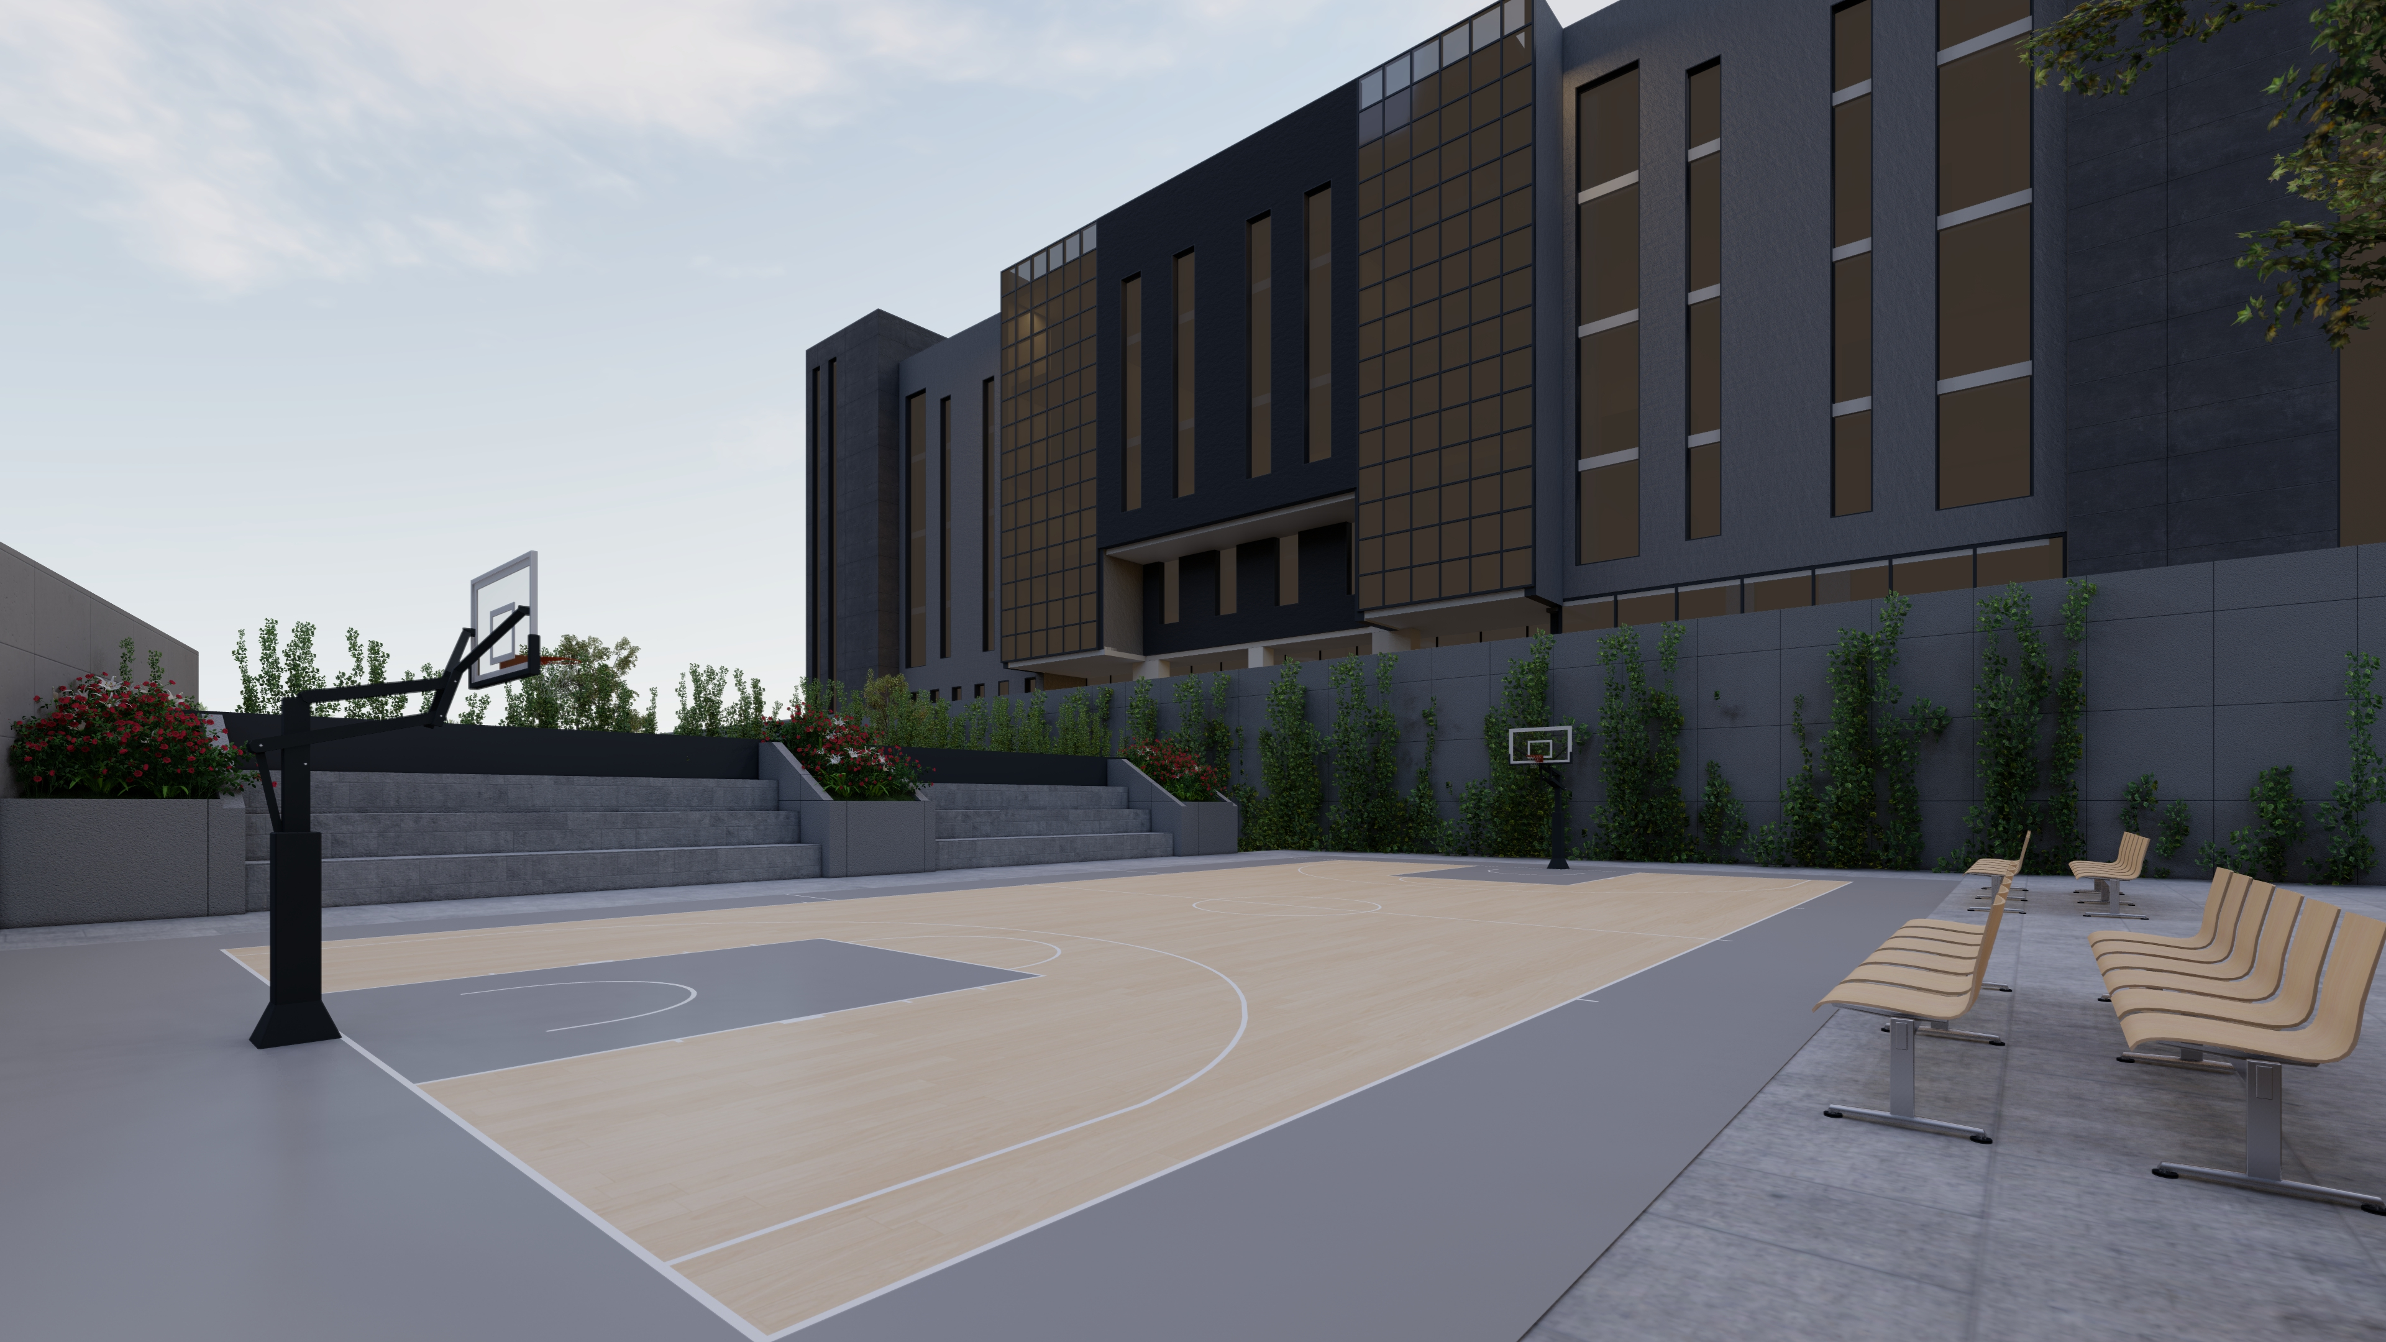
2. Architectural Design
2.1 Site for the project:
    2.1.2 Playgrounds
Basketball and the other for Tennis, with an area of 140 m² for each.

Slide 15
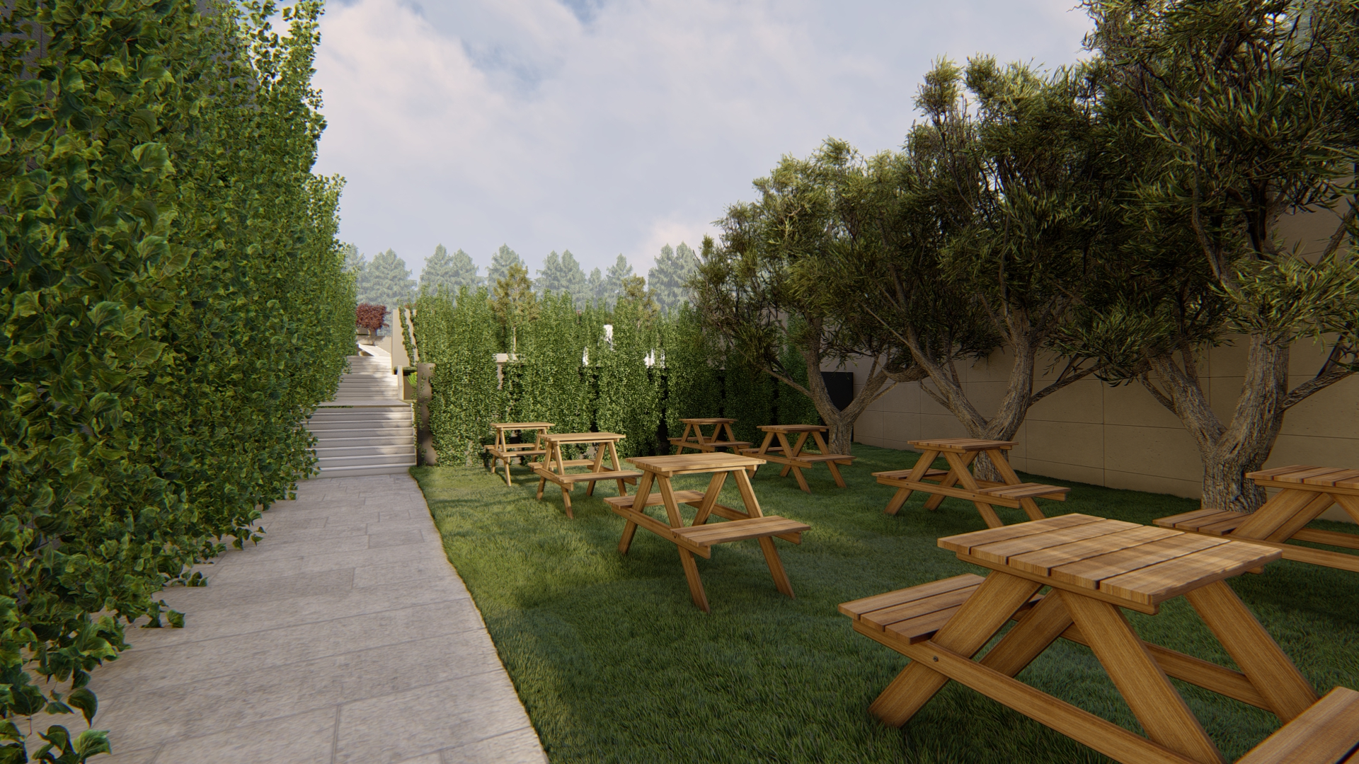
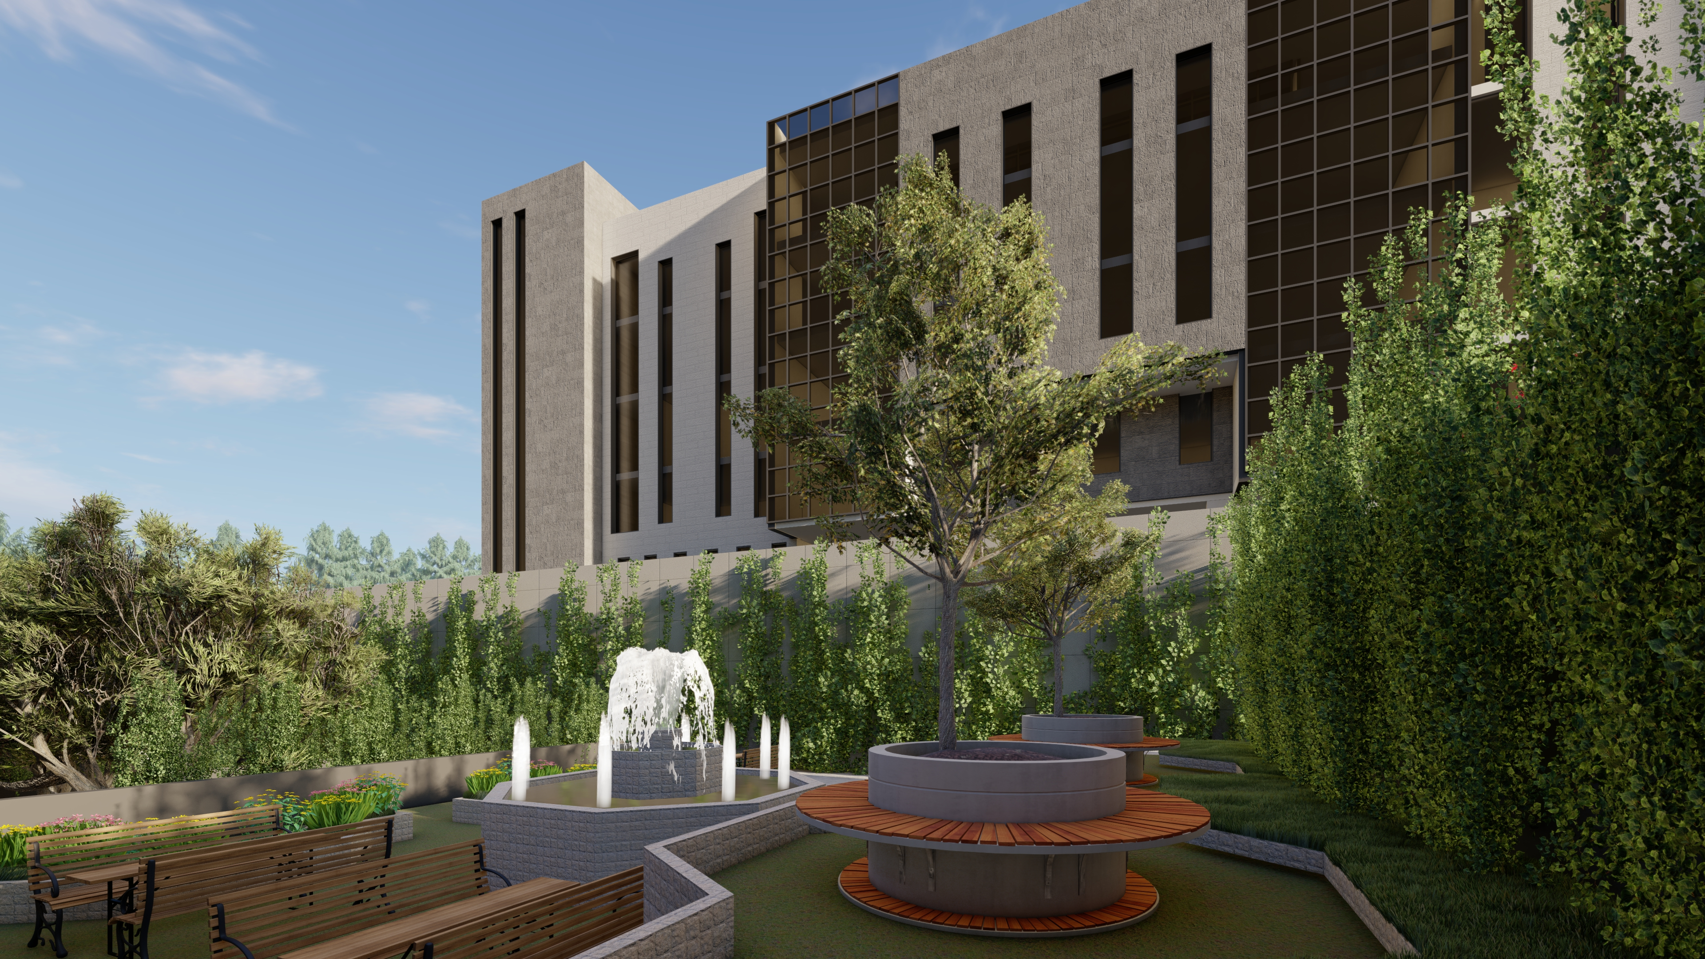
2. Architectural Design
2.1 Site for the project:
    2.1.3 Seating area
The site was also provided with 120 m² of outdoor seating

Slide 16
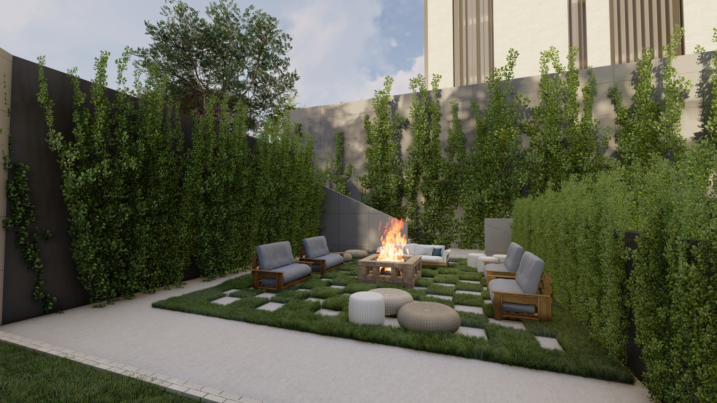
2. Architectural Design
2.1 Site for the project:
    2.1.3 Seating area

Slide 17
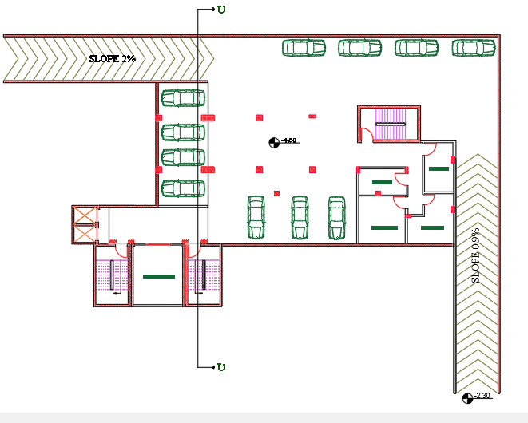
2. Architectural Design
2.2 Basement Floor
Basement Floor
( AREA = 700 SM )
The basement Floor includes a car parking with two ramps and service rooms

Slide 18
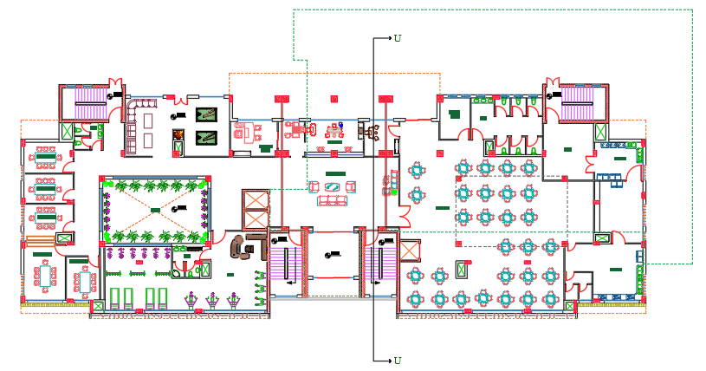
2. Architectural Design
2.3 Ground Floor
Ground Floor
( AREA = 1230 SM )
The ground floor includes the public facilities
reception, secretarial, waiting room,
cafeteria, gym, Study rooms, lounge and services.

Slide 19
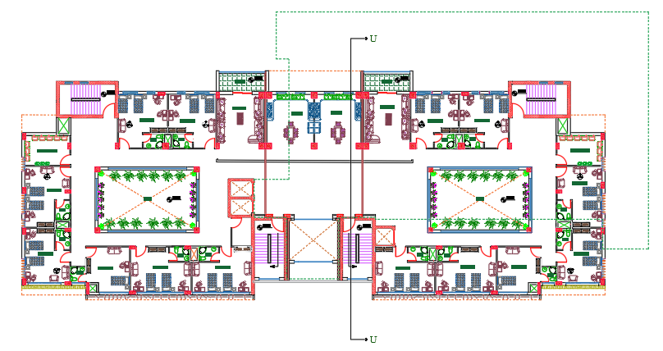
2. Architectural Design
2.4 First Floor
First Floor
( AREA = 1253 SM )
The first floor is symmetry
It contains shared student rooms, two living rooms, two kitchens and services.

Slide 20
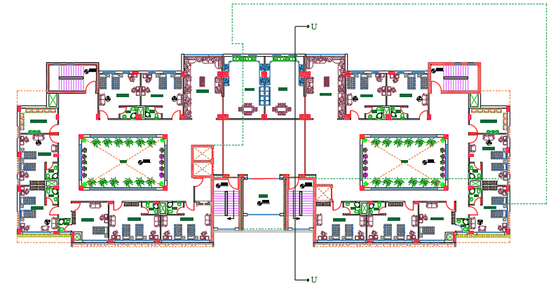
2. Architectural Design
2.5 Second Floor
Second Floor
( AREA = 1273 SM )
The first floor is symmetry
It contains shared student rooms, two living rooms, two kitchens and services.

Slide 21
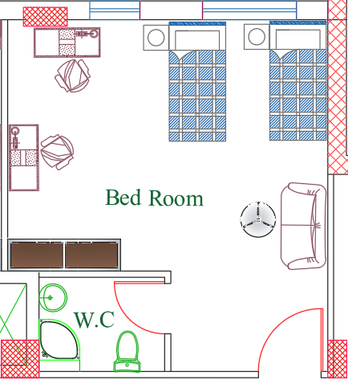
2. Architectural Design
  2.8 Spaces and Functions
    2.8.4 Students’ Bed Rooms:
1st Floor & 2nd Floor
Average Rooms Area = 28 SM

Slide 22
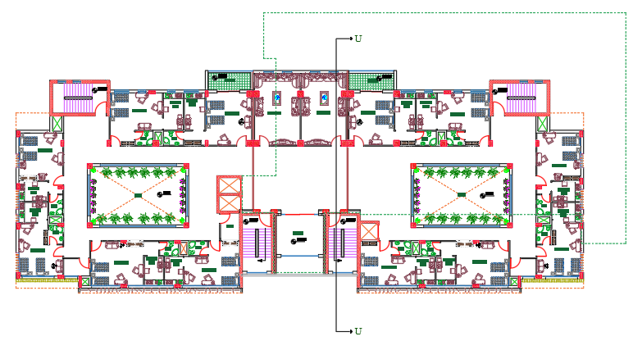
2. Architectural Design
2.6 Third Floor
Third Floor
( AREA = 1273 SM )
The third floor consists of suites, each suite has a bedroom in addition to a cooking area and a private bathroom.
Each one accommodates two students
The floor is also symmetrically divided

Slide 23
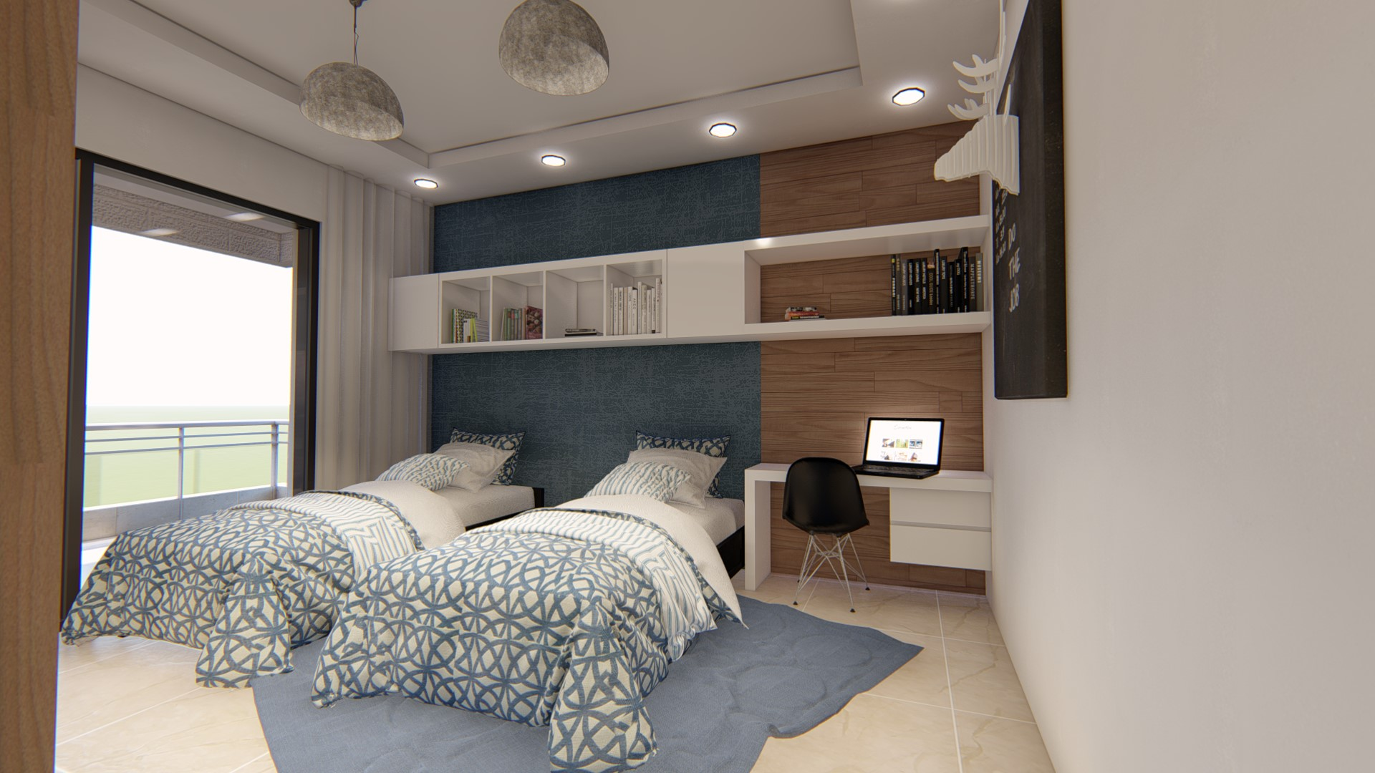
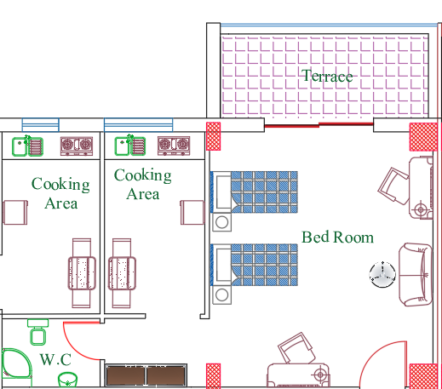
2. Architectural Design
  2.8 Spaces and Functions
    2.8.5 Students’ Bed Rooms:
3rd Floor
Average Rooms Area =37 SM
Area = 8 SM
Area = 26 SM
Area =3 SM

Slide 24
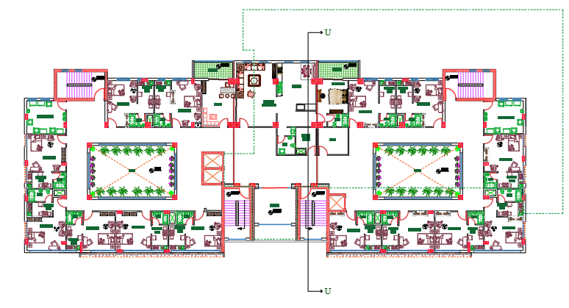
2. Architectural Design
2.7 Fourth Floor
Fourth Floor
( AREA = 1300 SM )
The third floor consists of suites, each suite has a bedroom in addition to a cooking area and a private bathroom.
Each one accommodates two students
The floor is also symmetrically divided

Slide 25
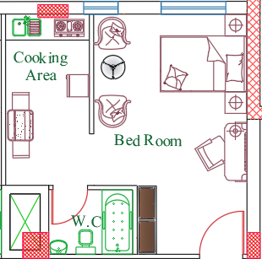
2. Architectural Design
  2.8 Spaces and Functions
    2.8.6 Students’ Bed Rooms:
4th Floor
Area = 7 SM
Average Rooms Area = 30 SM
Area = 20 SM
Area = 4 SM

Slide 26
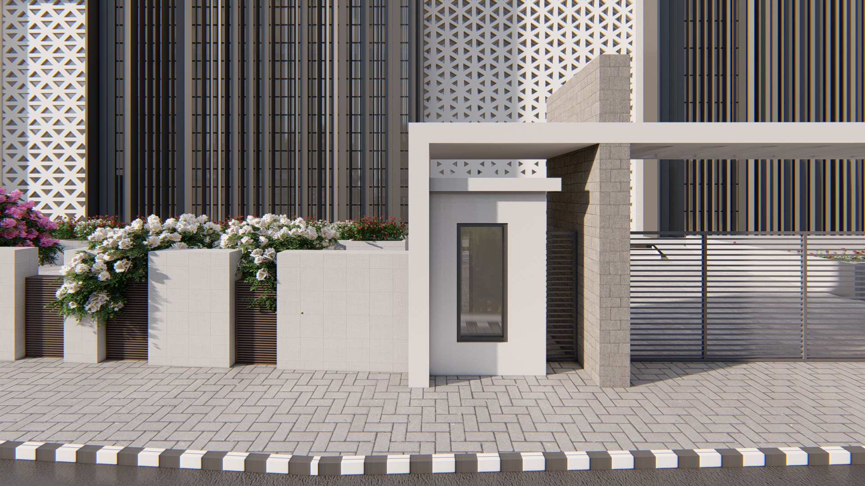
2. Architectural Design
  2.8 Spaces and Functions
    2.8.1 Main Entrance

Slide 27
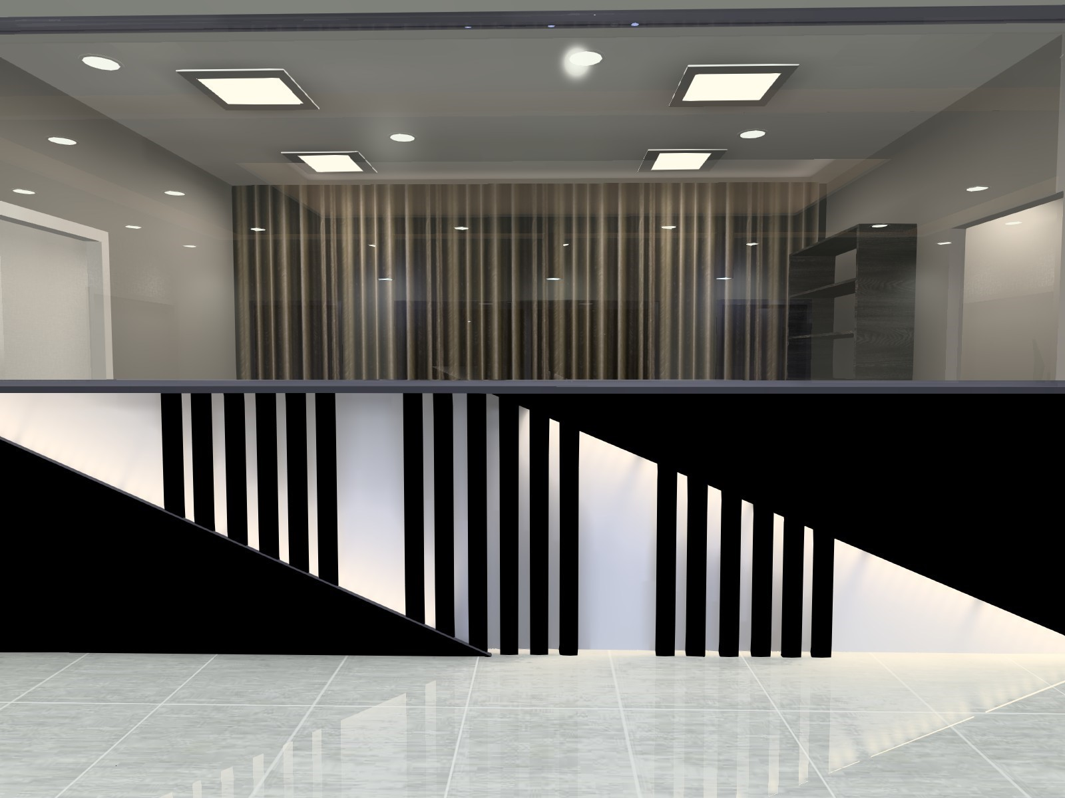
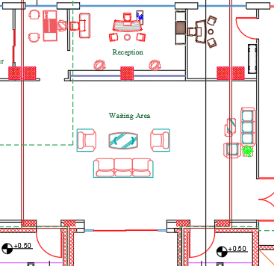
2. Architectural Design
  2.8 Spaces and Functions
    2.8.2 Main Lobby
Space | Area (m²)
Reception | 19.5
Secretary | 8.7
Guard room | 15.3
Waiting Area | 76.35

Slide 28
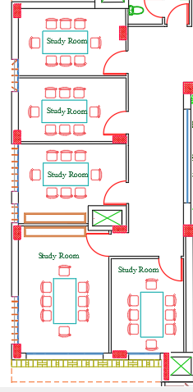
2. Architectural Design
  2.8 Spaces and Functions
    2.8.3 Study Rooms
Study rooms are designed in hostel for group study or student projects, five rooms located on the west side of the ground floor
With an area of ​​15.5 m² per room

Slide 29
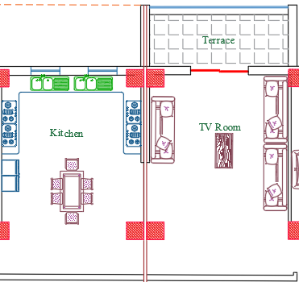
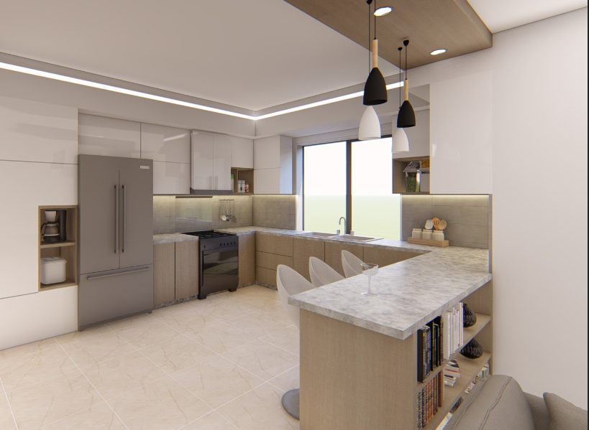
2. Architectural Design
  2.8 Spaces and Functions
    2.8.7 Living rooms & kitchens in 1st Floor
Kitchen Area = 36 SM
Living Room Area = 38 SM

Slide 30
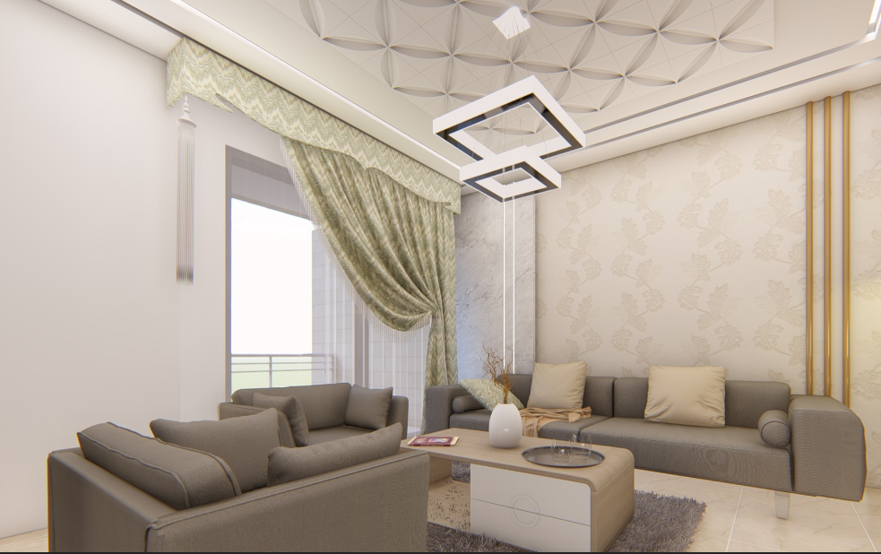
2. Architectural Design
  2.8 Spaces and Functions
    2.8.7 Living rooms & kitchens in 1st Floor
Kitchen Area = 36 SM
Living Room Area = 38 SM

Slide 31
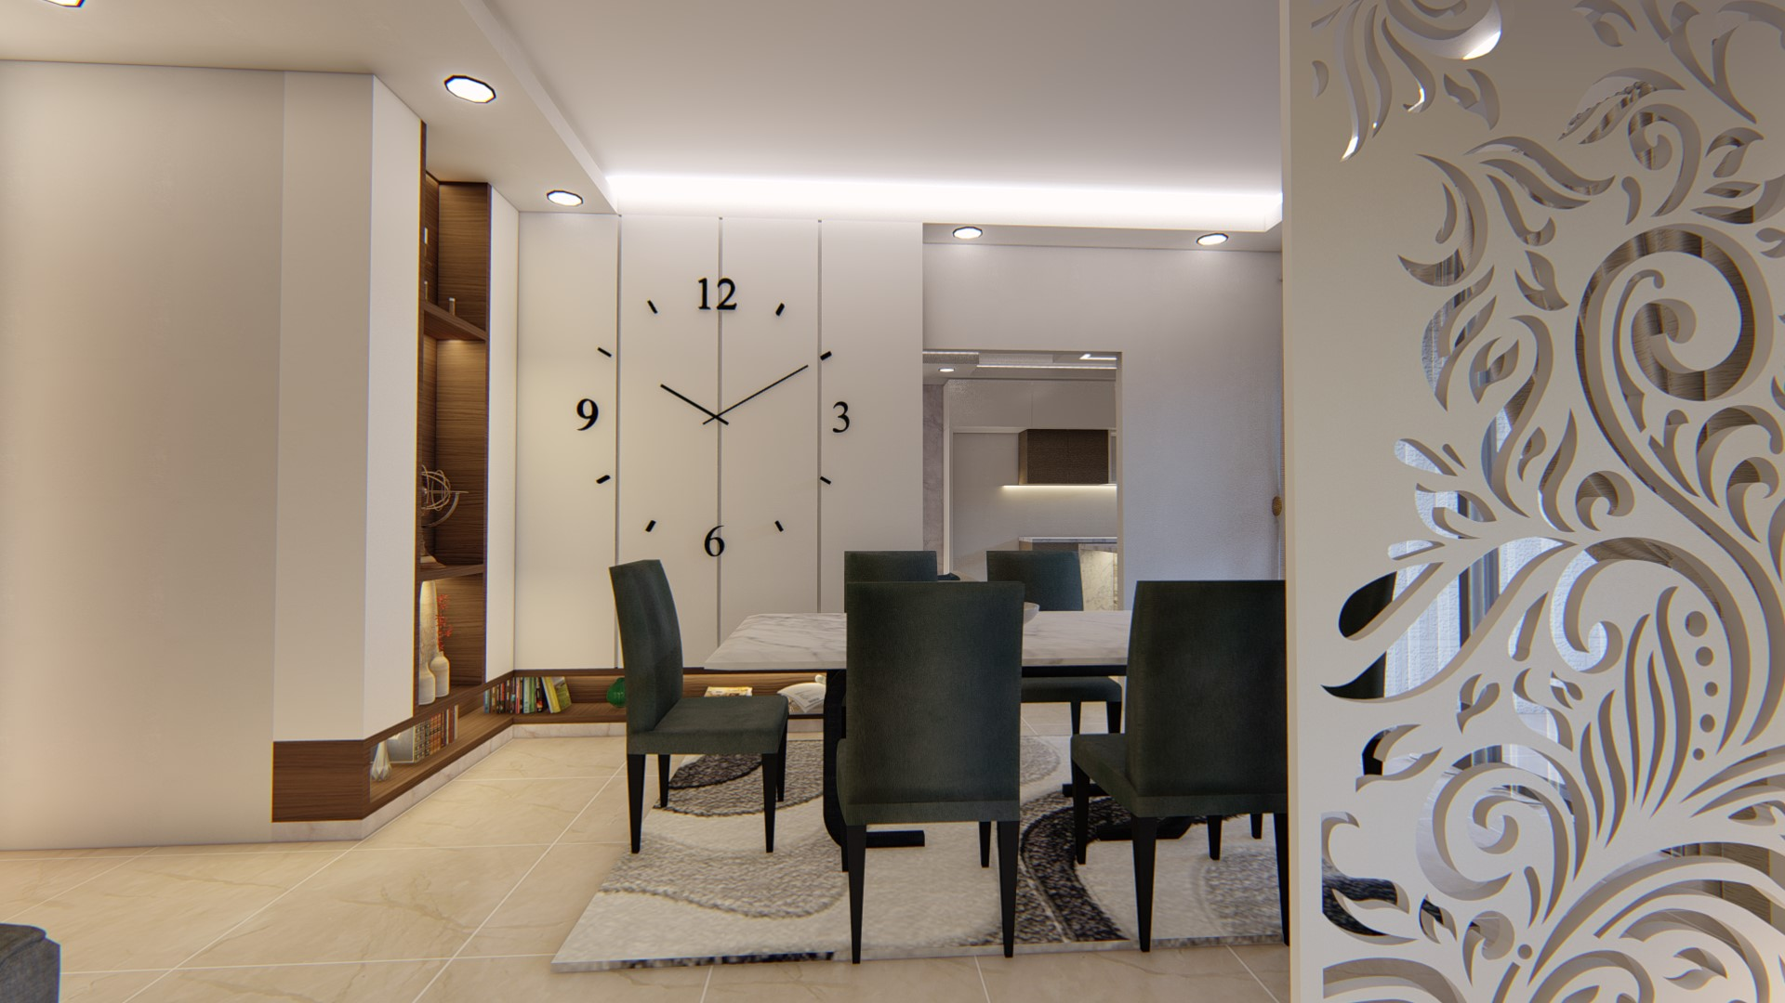
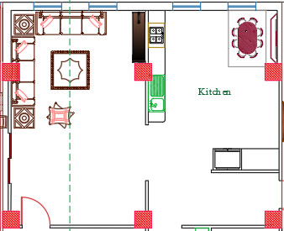
2. Architectural Design
  2.8 Spaces and Functions
    2.8.7 Living rooms & kitchens in 4th Floor

Slide 32
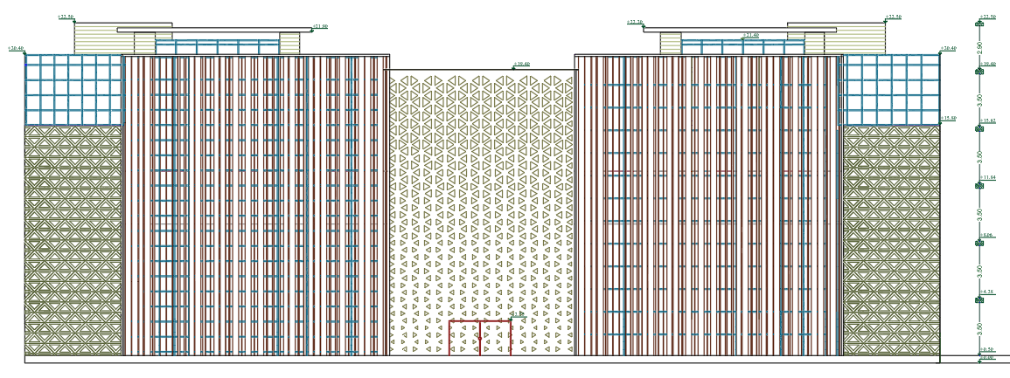
2. Architectural Design
  2.9 Elevations
    2.9.1 South elevation
Smart facade

Slide 33
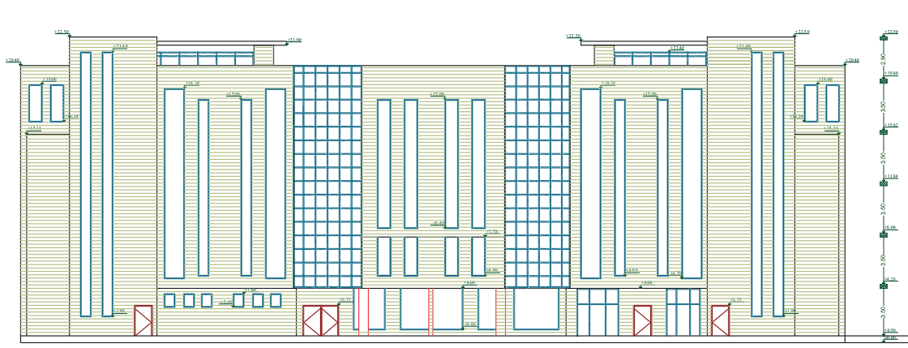
2. Architectural Design
  2.9 Elevations
    2.9.2 North elevation

Slide 34
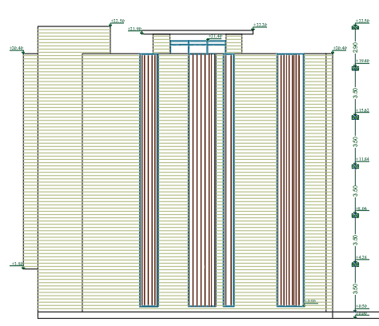
2. Architectural Design
  2.9 Elevations
    2.9.3 West elevation
Smart facade

Slide 35
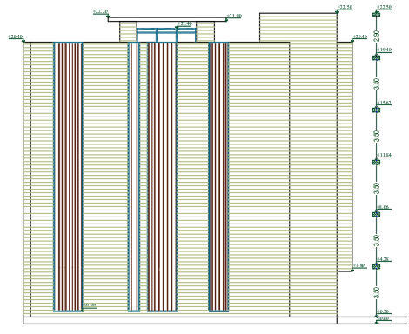
2. Architectural Design
  2.9 Elevations
    2.9.4 East elevation
Smart facade

Slide 36
STRUCTURAL CHAPTER

Slide 37
3.Structurtural Design
The structural design for the automated hostel, consisting of five floors and a basement/parking.
The building is separated into 3 blocks for the seismic design by expansion joints, with the left and right blocks being almost identical.

Slide 38
3.Structurtural Design
Design codes used :
Building code requirements for reinforced concrete – ACI 318M-11
Uniform building code – UBC 97 – for the earthquakes loads
Material used:
Reinforced concrete B300- for structural elements, with concrete compressive strength fć=24 Mpa
Plain concrete B200 for blinding's
Reinforcement – deformed high yielding steel Fy=420 Mpa
Bearing capacity for soil: The bearing capacity for soil is 300 KN/m²

Slide 39
3.Structurtural Design
Design loads:
SID load from filling materials is 4 KN/m² + 1.5 KN/m² block = 5.5 KN/m²
Live load is for residential buildings is 2.5 KN/m² and 5 KN/m² for large spaces and halls
Slab load:
Slab load coming from own weight of one way ribbed slab 32 cm is approximately = 8.5 KN/m²
Slab load coming from own weight of two way ribbed slab 32 cm is approximately = 10 KN/m²

Slide 40
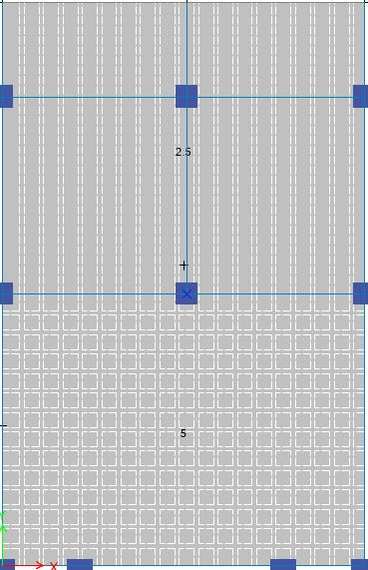
3.Structurtural Design
Structural system for center block:
Two system used for the center block slabs
One way ribbed slab
Two way ribbed slab
Thickness of slabs
For one way ribbed slab L*/21 = 4600/21 = 22 cm
For two way ribbed slab ((L1 + 0.76XL1) + (2XL2))/ 140 = 24
Cantilever one way ribbed slab L / 8 = 2500/8 = 31.2
Use slab thickness of 32 cm
* Where L is the longest span

Slide 41
Structural design
Beam dimension for center block:
Columns:
Type | Dimension
Main beam | Beam 300 x 700
Secondary beam | Beam 800 x 320
Internal column | C 600 x 600
Edge column | C 700 x 300

Slide 42
Structural design
Footings dimension for center block:
for the center block there are multiple footings used, example mentioned in the table below
Type | Dimension (M)
Isolated footing | F16- 3.40 X 3.40 X 0.70
Combined footing | Comb1- 3.70 x 2.0 x 0.50

Slide 43
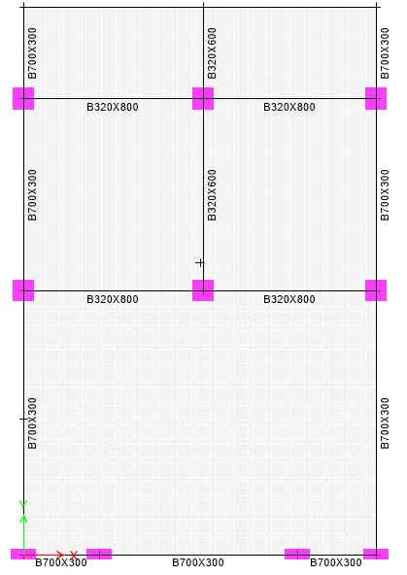
3.Structurtural Design
Beam sections and column
distribution for centered block
Is shown in the figure

Slide 44
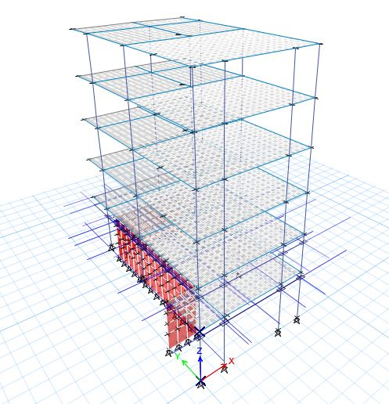
3.Structurtural Design
3D model for the
centered block using
ETABS

Slide 45
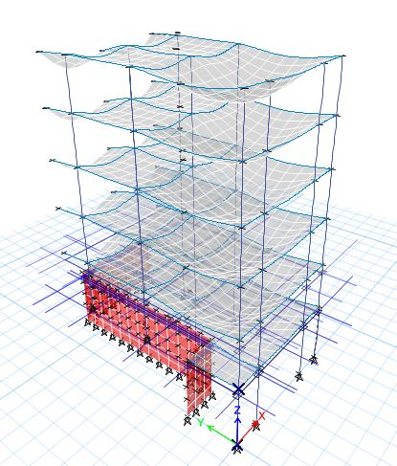
3.Structurtural Design
Checks
Compatibility check

Slide 46
Checks for structural analysis
Equilibrium check
Manual | Approximately 2032 Kn
ETABS | Approximately 2772 Kn

Slide 47
3.Structurtural Design
Checks:
Seismic design - W total seismic load
Soil type is SB
Ct = 0.0731 for reinforced concrete moment resisting frames
Z= 0.2 , I = 1, R = 8.5
Cv= 0.2, Ca = 0.2
T = Ct (hn)^3/4 = 0.0731 x (22)^3/4 = 0.74
V = Cv * I * W / R * T = 0.0376 W

Slide 48
Checks for structural analysis
Natural period – T
 | T in seconds
Manual | 0.74
From ETABS | 1.9

Slide 49
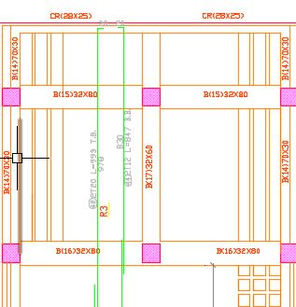
3.Structurtural Design
Slab design
The slab design for the center
Block for the one way ribbed
Slab section

Slide 50
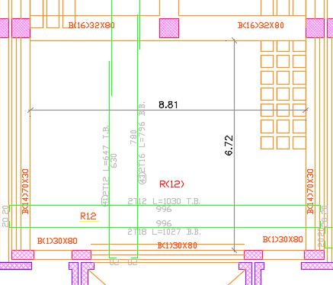
3.Structurtural Design
Slab design
Slab design for the center
Block for the two way ribbed
Slab section

Slide 51
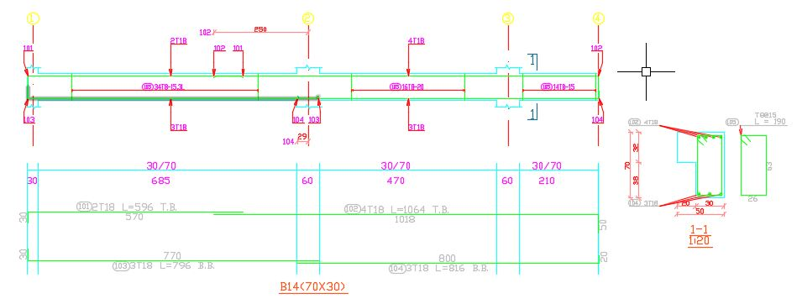
3.Structurtural Design
Main Beam design

Slide 52
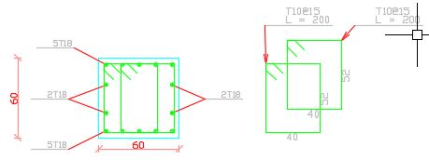
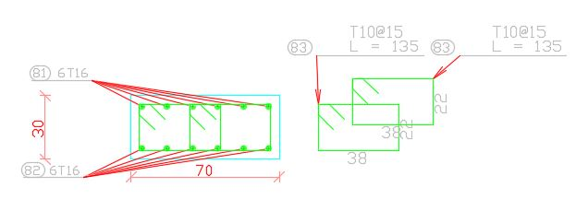
3.Structurtural Design
Column design for internal column
Column design for edge column

Slide 53
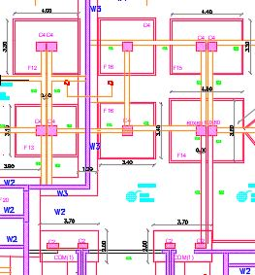
3.Structurtural Design
Footings design for
center block

Slide 54
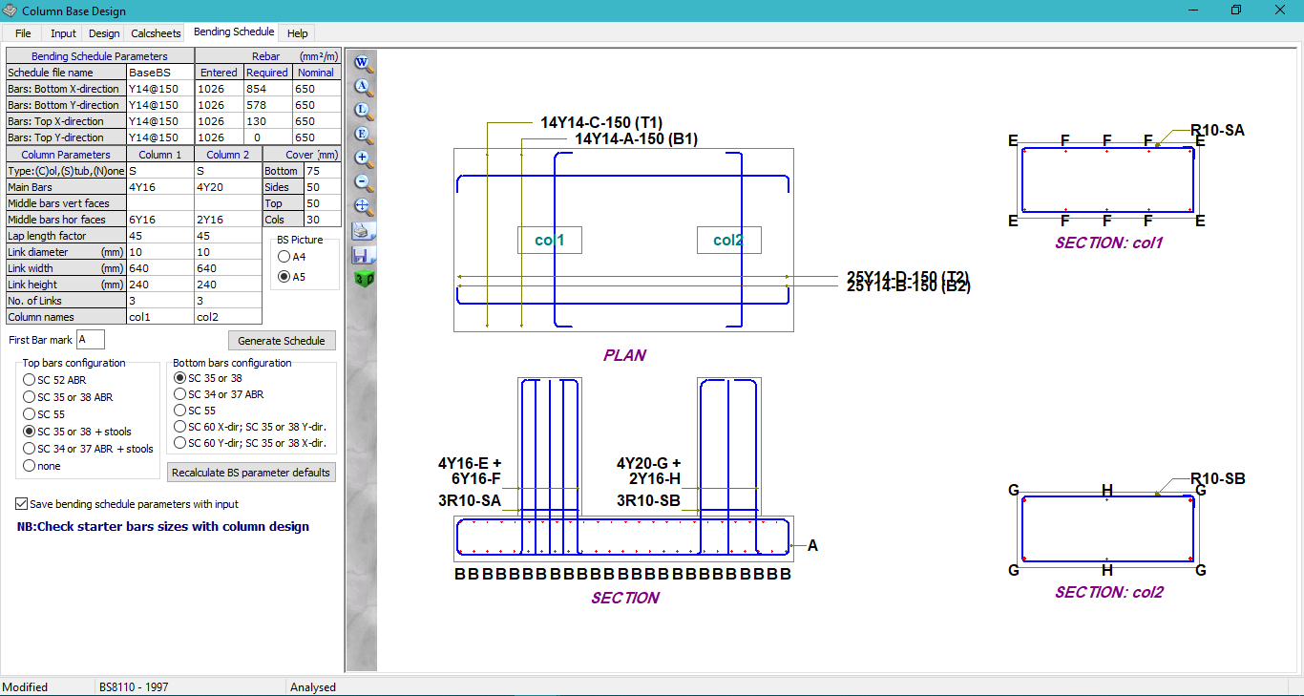
3.Structurtural Design
Footings
design
– comb1

Slide 55
ENVIROMENTAL CHAPTER

Slide 56
4.Environmental CHAPTER
Orientation:
Orientation of the building is very important for all environmental aspects of:
Ventilation
Daylight
Passive heating and cooling.

Slide 57
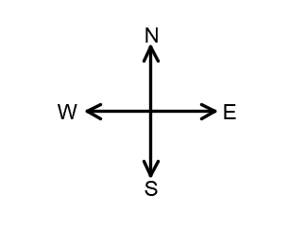
4.Environmental CHAPTER

Slide 58
4.Environmental CHAPTER
Sun Path
Sun Path is very important factor affects on all environmental aspects:
Daylight
Passive Heating and Cooling
And affects on PV system that will be illustrated on next slides.

Slide 59
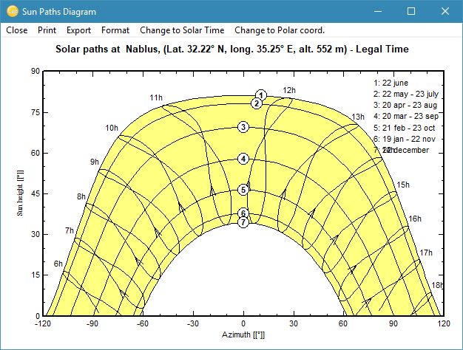
4.Environmental CHAPTER
Sun Path Diagram at Nablus(Lat.32.22N,Long.35.25E,Alt.552m)

Slide 60
4.Environmental CHAPTER
Shading
Design Builder SOFTWARE was used to view sun path and its effect on the hostel.
The two design days of year was taken (21/January and 21/June), with three different times during the day (8:00 am,12:00 pm and 4:00 pm)

Slide 61
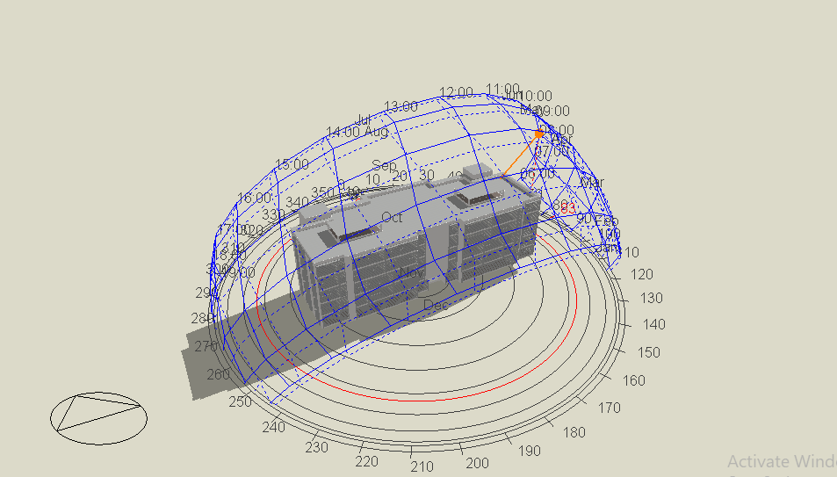
4.Environmental CHAPTER
Summer (21/June)
At 8:00 am:

Slide 62
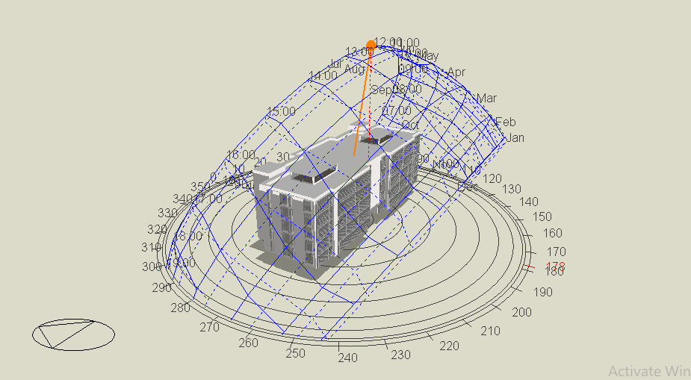
4.Environmental CHAPTER
At 12:00 pm:

Slide 63

4.Environmental CHAPTER
At 4:00 pm:

Slide 64

Winter (21/January)
4.Environmental CHAPTER
At 8:00 am:

Slide 65

4.Environmental CHAPTER
At 12:00 pm:

Slide 66

4.Environmental CHAPTER
At 4:00 pm:

Slide 67
Acoustics
4.Environmental CHAPTER
Reverberation Time (RT₆₀)
Sound Transmission Class (STC)
Loudspeaker System.

Slide 68
Reverberation Time (RT₆₀)
4.Environmental CHAPTER
Students’ Bedrooms: Recommended RT₆₀ → 0.5 - 0.9 second.
Study Rooms: Recommended RT₆₀ → 0.8 – 1.0 second.
GYM: Recommended RT₆₀ → 1.2 – 1.6 second.
Cafeteria: Recommended RT₆₀ → 0.8 – 1.2 second.

Slide 69

Sound Transmission Class (STC)
4.Environmental CHAPTER
INSUL Software Results:
Exterior Wall: STC = 28 dB

Slide 70

4.Environmental CHAPTER
2. Interior Wall: STC = 48 dB

Slide 71

4.Environmental CHAPTER
3. Floor : STC = 68 dB

Slide 72

Loudspeaker System
4.Environmental CHAPTER
EXTRON company was chosen to select a suitable audio system.
CS1226T PLUS loud speaker system was selected.
The Calculations and Results are shown below:

Slide 73


4.Environmental CHAPTER

Slide 74

4.Environmental CHAPTER

Slide 75

Photovoltaic system design
4.Environmental CHAPTER
This system was very effective due to the large area of the roof and the first large building consumption.
This part is a passive solar system made to save energy consumption in the Hostel.

Slide 76


4.Environmental CHAPTER
PVSYST6.7 Software was used to design the system for the hostel.
Use LG Company to select PV cells, with a capacity of 300 WP and 36 V.
used Sofa Solar Company to Select Inverter for system, the system need 10 inverters with 30KW capacity

Slide 77
4.Environmental CHAPTER
The module for design PV cell is (1640*1000) mm.
Active area = # of modules * Area of module = 609 × (1.64*1.00) = 998.76 m²
    Cost of the system:
Total Capacity = 183 KWp
Initial Cost = 609* 1200$ = 304500$
Operation Cost = 0.015* 304500 = 4567.5 $
Electricity Production = 337300 KWh/yr.
Annual Saving = 337300* 0.17 = 57341 $/yr.
Payback Period = 309067.5/57341 = 5 years.

Slide 78

4.Environmental CHAPTER
System Layout:

Slide 79

Thermal Analysis
4.Environmental CHAPTER
Heating load and losses in the building:

Slide 80

4.Environmental CHAPTER
Cooling load for the building in 15 July

Slide 81

4.Environmental CHAPTER
Simulation of thermal comfort in the building.

Slide 82
MECHANICAL CHAPTER

Slide 83

5.Mechanical CHAPTER
Water Supply System
Water demand= 23 m3/day

Slide 84
5.Mechanical CHAPTER
Water Supply tank
4 tanks for cold water(cap= 6m3)
4 tanks for hot water(cap= 2m3)
2 tanks for Firefighting system(cap= 5m3)

Slide 85

5.Mechanical CHAPTER

Slide 86

Grey and rainwater system
5.Mechanical CHAPTER
Rain Water Tank size = 1000 m3
grey Water Tank size = 20 m3

Slide 87

(SHAKTI-Pressure Booster Pump – SH Series), with P_{o} = 60Psi.
5.Mechanical CHAPTER

Slide 88

5.Mechanical CHAPTER
Drainage system

Slide 89

5.Mechanical CHAPTER
Drainage system

Slide 90

Drainage system
5.Mechanical CHAPTER

Slide 91

5.Mechanical CHAPTER
Rain Water Drainage
Slope= 1%

Slide 92

Building management system (BMS):
5.Mechanical CHAPTER
  .
BMS: intelligent microprocessor to monitor and control a building systems.
Benefits of BMS:
1- Energy saving.
2- comfort and healthy environment.
3- efficient maintenance.
4- work effectively with other building systems.

Slide 93



Mechanical sensors
5.Mechanical CHAPTER
1- ADT water leak detector

Slide 94



5.Mechanical CHAPTER
2- leak smart valve:
3- water level sensor:

Slide 95

5.Mechanical CHAPTER
4- Faucet with motion sense:

Slide 96

5.Mechanical CHAPTER
HVAC System
Variable Refrigerant Flow (VRF) system was chosen for the hostel
VRF system consists of:
Outdoor unit
Collectors
indoor unit

Slide 97


5.Mechanical CHAPTER
Cassette unit
Wall mounted split unit

Slide 98

Cassette units in the bedrooms:
5.Mechanical CHAPTER

Slide 99

Wall mounted units in the offices:
5.Mechanical CHAPTER

Slide 100
5.Mechanical CHAPTER
Using Design Builder Software:
Inputs: Internal Temperature in the summer = 22 °C
Internal Temperature in the summer = 24 °C
Relative Humidity = 50%
Outputs: Heating load capacity =109.8KW
Cooling load capacity=254.83KW

Slide 101
5.Mechanical CHAPTER
Room description | Cooling load (TR) | Q (KW) | ύ
Dining Area | 22 | 6.2 | 0.41
GYM | 4 | 1.12 | 0.075
Kitchen | 1.5 | 0.43 | 0.028
Waiting Area | 3 | 0.85 | 0.056
Office 1 | 1 | 0.28 | 0.018
Office 2 | 2 | 0.57 | 0.038
Office 3 | 1 | 0.28 | 0.018
Office 4 | 1 | 0.28 | 0.018
Entrance area | 4.5 | 1.27 | 0.084
Study room 1 | 1 | 0.28 | 0.018
Study room 2 | 1 | 0.28 | 0.018
Study room 3 | 1 | 0.28 | 0.018
Study room 4 | 2 | 0.57 | 0.038
Study room 5 | 1 | 0.28 | 0.018
Total | 46 | 12.9 | 0.86
Q= ύ*ρ*Cp*(Ti-Ts)

Slide 102
5.Mechanical CHAPTER
Room description | Cooling load (TR) | Q (KW) | ύ
All Bed room have two person Hint: number of room = 12 | 2 Total = 24 TR | 6.7 | 0.45
All Bed room have one person Hint: number of room = 2 | 1 Total = 2 | 0.56 | 0.038
Kitchen1 | 3 | 0.84 | 0.056
Kitchen 2 | 3 | 0.84 | 0.056
Waiting room 1 | 4 | 1.12 | 0.075
Waiting room 2 | 4 | 1.12 | 0.075
Total | 40 | 11.23 | 0.75

Slide 103

Ventilation
5.Mechanical CHAPTER
Ventilation has been done for bathrooms, kitchens and laundry rooms.
The following equation used to calculate the air ventilated in every space:
$$ACH=\frac{V∗ACH}{1.7}$$

Slide 104
ACH for each spaces
5.Mechanical CHAPTER
Application | ACH
Bathroom | 10
Kitchen | 20
Coffey bar | 12
Laundry room | 5
Room description | ACH (CFM)
Eating Hole | 6375
Kitchen 1 | 850
Kitchen 2 | 850
Bathroom 1 | 700
Bathroom 2 | 260
Bathroom 3 | 190
Total | 46

Slide 105
ELICTRICAL CHAPTER

Slide 106
Electrical System Design
Power sockets design and distribution
Low voltage
Occupancy sensors
Lighting design and distribution

Slide 107
End – User Accessories
Switches
Power sockets
Fused connection units
Distribution box

Slide 108

Power distribution
Power Sockets Distribution
C.B. for lighting = 10 Amp.
C.B. for sockets = 16 Amp.

Slide 109

Power distribution
Distribution Box

Slide 110

Power distribution
Main Distribution Box

Slide 111

Power distribution
Main Distribution Box

Slide 112
Power consumption from sockets usage

Slide 113

Power distribution
Low voltage

Slide 114
Power distribution
Occupancy sensors:
Passive infrared ( RIP)
Ultrasonic technology
Duel technology

Slide 115



Artificial lighting
DIALux evo 8.0 software was used to design lighting
Bedroom in 4th Floor
Sleeping Area

Slide 116



Artificial lighting
DIALux evo 8.0 software was used to design lighting
Bedroom in 4th Floor
Reading Area

Slide 117



Artificial lighting
DIALux evo 8.0 software was used to design lighting
Bedroom in 4th Floor
      Cocking Area:

Slide 118


Artificial lighting
DIALux evo 8.0 software was used to design lighting
      Study Room:

Slide 119



Artificial lighting
DIALux evo 8.0 software was used to design lighting
      Main Lobby:

Slide 120
Artificial lighting
DIALux evo 8.0 software was used to design lighting
Room | Power (KWh/Year) | Number of rooms | Total Power(KWh/Y)
Bedroom | 800 | 54 | 43200
Study Room | 1000 | 5 | 5000
Main Lobby | 5100 | 1 | 5100
Corridors | 1700 | 9 | 15300
Cafeteria | 3200 | 1 | 3200
GYM | 2500 | 1 | 2500
others | 500 |  | 500
Total consumption |  |  | 74,800 KWh/Y
      approximate amount of annual energy consumption for lighting :

Slide 121
FIREFIGHTING CHAPTER

Slide 122



Fire alarm system

Slide 123






Fire extinguishing System

Slide 124

Means of escape

Slide 125

Escape plan
Escape Plan for fourth Floor

Slide 126

Escape plan
Escape Plan for Ground Floor

Slide 127
BELL OF QUANTITY
”BOQ”

Slide 128
Building Cost
Total Building Cost = 7,987,188 NIS
Unit Building Cost = 985.8 NIS

