Slide 1


Faculty of Engineering and Information Technology
Department of Civil Engineer
Graduation Project II
Prepared By :
Omar Daragmeh – Reg. No: 11643099
Mohammad Tammam – Reg. No: 11642560
Mohammad Odeh – Reg. No: 11610499
Under supervision of : Dr. Imad AL-Qasem

Slide 2
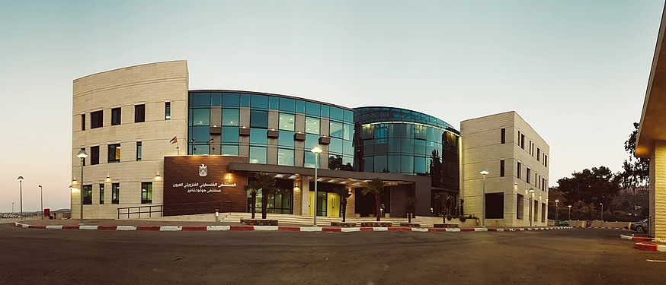
Design Of Hugo Chavez Hospital

Slide 3
Definition of the project
The Palestinian Venezuelan Ophthalmic Hospital - Hugo Chavez Hospital is a medical building , which is located in Turmousaya– Ramallah.
The project consists of a three blocks with a total area of 8100 m².
Each block consists of four floors (basement , ground , first , second).
Average area for each floor in block 1 is 1250 m².
Average area for each floor in block 2 is 400 m².
Average area for each floor in block 3 is 400 m².

Slide 4
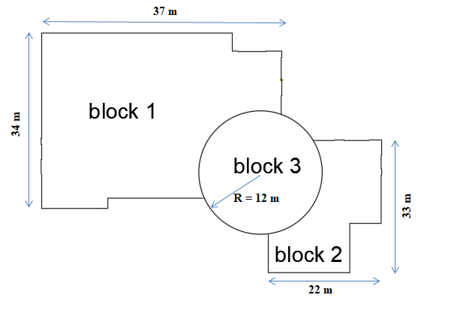
Definition of the project

Slide 5
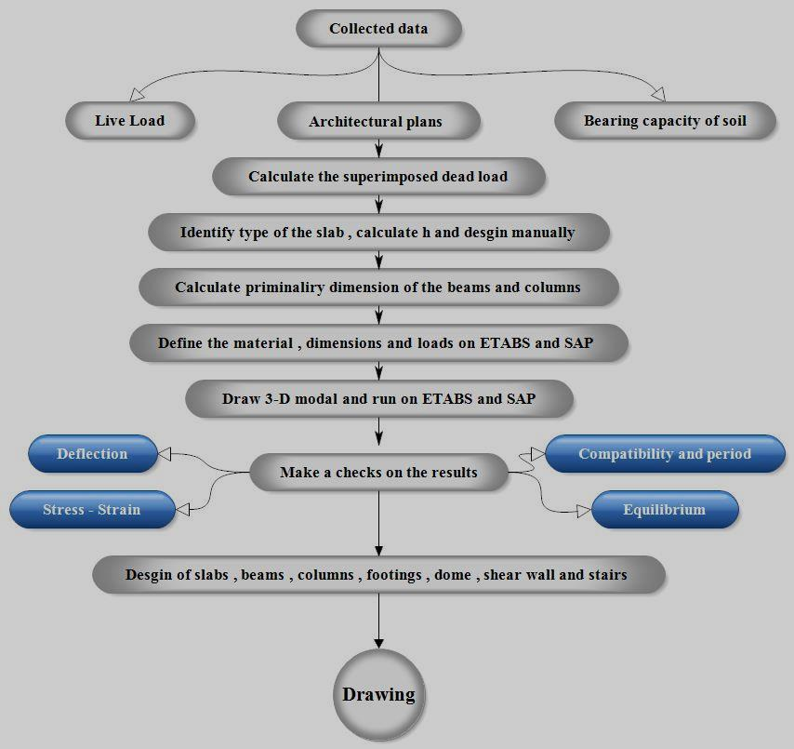
Methodology

Slide 6
Codes & Materials
Codes: Materials:
Concrete 𝑓′ 𝑐 = 28MPa (B350)
ACI 318-14 Reinforcing Steel Fy= 420MPa
UBC-97
Soil Bearing Capacity = 300 KN/m^2
Materials | Unit Weight γ kN/m3
Block | 12
Tiles | 26
Plastering | 23
Masonry stone | 26
Aggregate | 18
Concrete mortal | 23

Slide 7
Loads:
(1)Dead Load: consist of the own weight of the structure.
Block 1
•Beams weight = 11015.25 kN
•Columns weight = 6863kN
•Shear wall weight = 11866.61 kN
•Slab weight = 25204.3kN
Total weight due to dead loads = 54949.16 kN
Block 2
•Beams weight = 4634.097kN
•Columns weight = 2733.3kN
•Shear wall weight = 5859.1 kN
•Slab weight = 9772.5kN
Total weight due to dead loads = 23003.99 kN

Slide 8
(2)Live Load:
The same for block 1&2
Total live load for Block one
=30087.20 KN
Total live load for Block two
=10626.31 KN
Usage | Live Load (KN/m2)
Roof | 10

Slide 9
(3)Superimposed Load:
come from the weight of all non-structural elements.
Item | Unit weight Ɣ (KN/m3) | Thickness (mm) | Calculations | Weight per m2 (KN/m2)
W Tile | 26 | 30 | 0.03*26 | 0.78
W mortar | 23 | 20 | 0.02*23 | 0.46
W fill (sand or grand) | 18 | 10 | 0.1*18 | 1.8
W plastring | 23 | 15 | 0.015*23 | 0.345
𝑊𝑝𝑎𝑟𝑡𝑖𝑡𝑖𝑜𝑛𝑠= ((H block * 𝛾block) + (H 𝑝𝑙𝑎𝑠𝑡𝑒𝑟𝑖𝑛𝑔 on both faces of the wall * 𝛾𝑝𝑙𝑎𝑠𝑡𝑒𝑟𝑖𝑛𝑔))* H wall * the length of all block wall) / area of the slab
𝑊𝑝𝑎𝑟𝑡𝑖𝑡𝑖𝑜𝑛𝑠 =Weight of block walls, which has (10 cm) block thickness + weight of block walls, which has (20 cm) block thickness

Slide 10
:Distribution of super impose dead load and live load on the slabs
 | WSD block 1 (𝑘𝑁/𝑚 2 ) | WSD block 2 (𝑘𝑁/𝑚 2 ) | live load (𝑘𝑁/𝑚 2 )
ground floor | 5 | 4.5 | 5
first floor | 5.5 | 5.5 | 5
second floor | 5.5 | 6 | 5
roof | 0 | 0 | 10

Slide 11
Load Combinations
U = 1.4D
U = 1.2D + 1.6L + 0.5(Lr or S or R)
U = 1.2D + 1.6(Lr or S or R) + (1.0L or 0.5W)
U = 1.2D + 1.0W + 1.0L + 0.5(Lr or S or R)
U = 1.2D + 1.0E + 1.0L + 0.2S
U = 0.9D + 1.0W U = 0.9D + 1.0E
Where:
U: ultimate load
D: dead load
L: live load
W: wind load
E: earthquake Load
H: load due to weight or pressure of soil

Slide 12
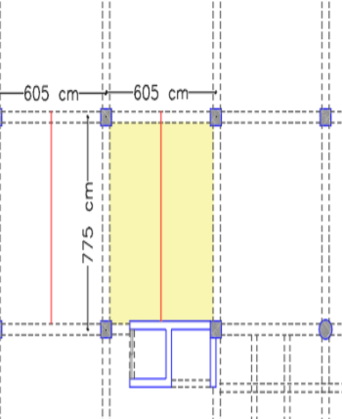
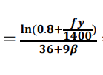
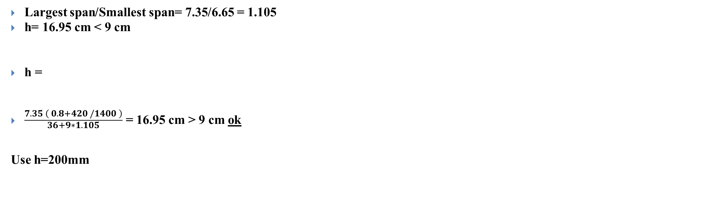
Slab
For Block 1
We decide to use Two-Way Solid Slab.
Largest span/Smallest span= 7.35/6.65 = 1.105
h= 16.95 cm < 9 cm
h =
$\frac{7.35 \left( 0.8+420 /1400 \right)}{\begin{aligned}36+9∗1.105 \\ \end{aligned}}$ = 16.95 cm > 9 cm ok
Use h=200mm

Slide 13
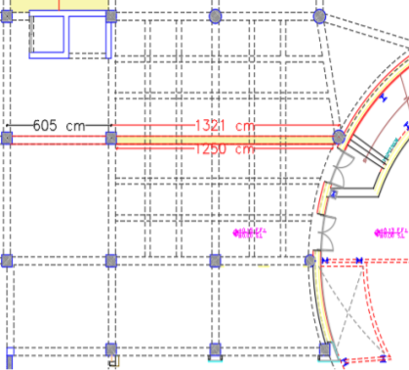
Beams:
Beam in block1: we choose the beam have long span h = L/ 18.5 = 0.676
Try h = 800mm (using longer span) bw = 12.5/20 = 625 mm then the preliminary dimensions are
(h = 1100 mm) and (bw = 700mm)

Slide 14
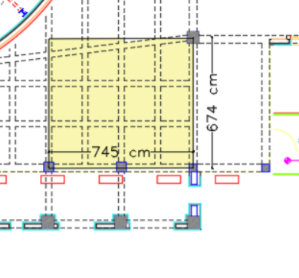
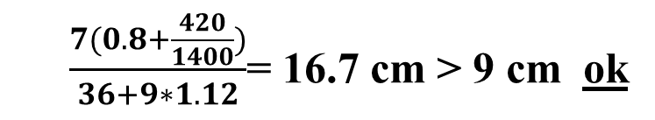
For Block 2
We decide to use Two-Way Solid Slab.
Largest span/Smallest span = 7/6.25 = 1.12 h = 16.7cm < 9cm h
Use h=200mm
$\frac{7(0.8+\frac{420}{1400})}{36+9∗1.12}$= 16.7 cm > 9 cm ok

Slide 15
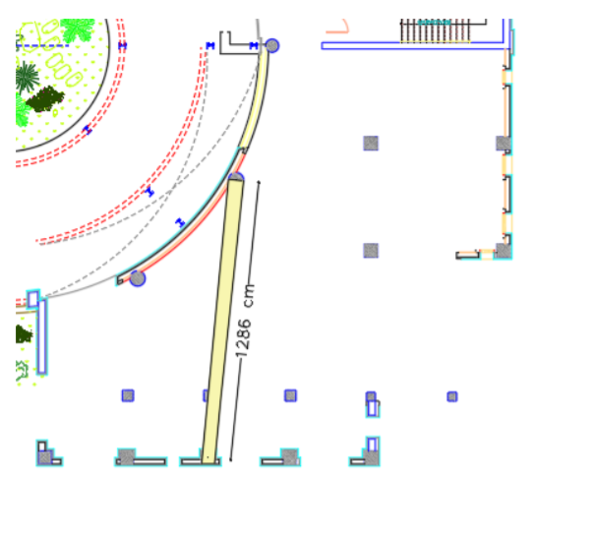
Beams:
Beam in block2: we choose the beam have long span h = L/ 18.5 = 0.676
Try h = 800 mm (using longer span) bw = 12.5/20 = 625mm then the preliminary dimensions are
(h = 1100 mm) and (bw = 700mm)

Slide 16
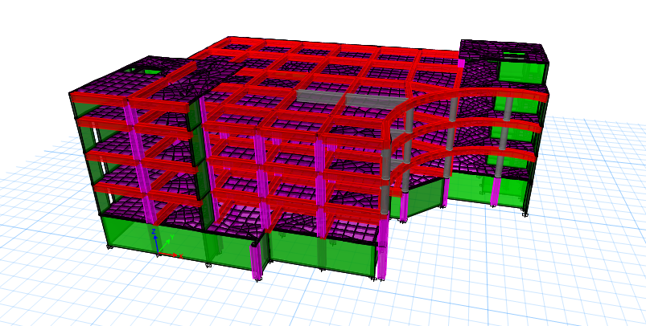
3-D modal

Slide 17
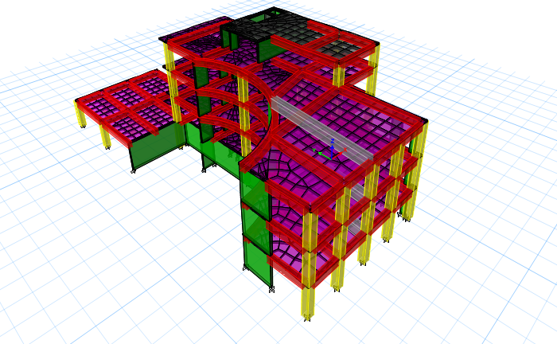
3-D modal

Slide 18
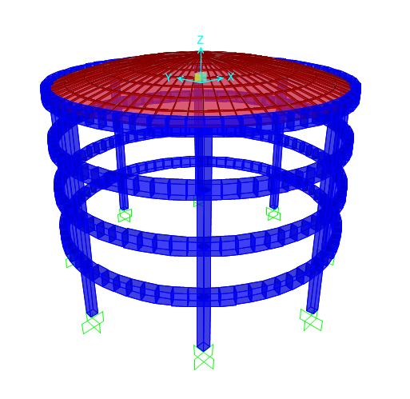
3-D modal

Slide 19
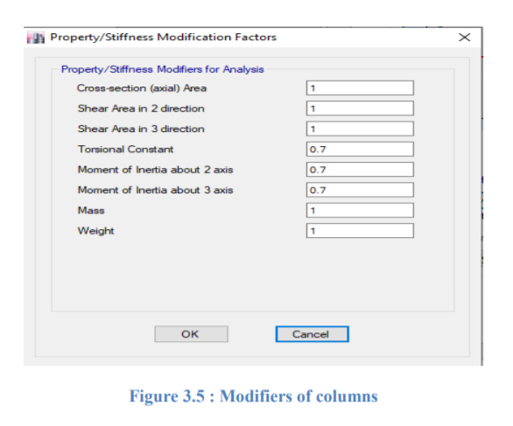
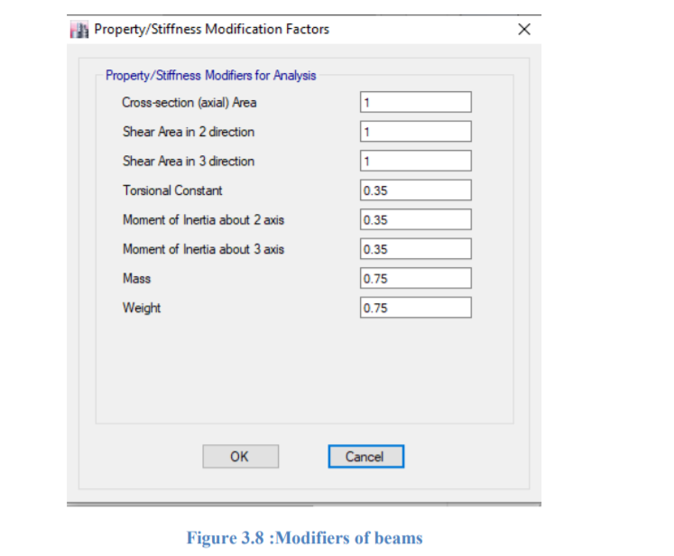

Slide 20
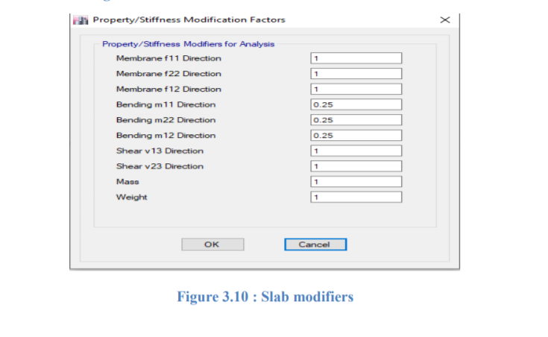
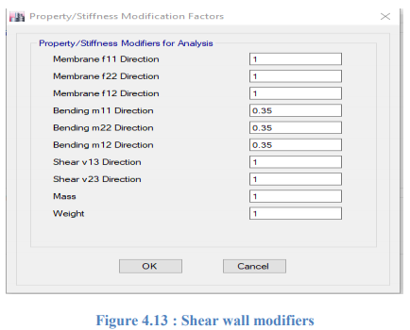

Slide 21
Model Checks
1-Compatibility check
2-Equilibrium check
3-Internal force check ( stress – strain check )
4-Deflection check.

Slide 22
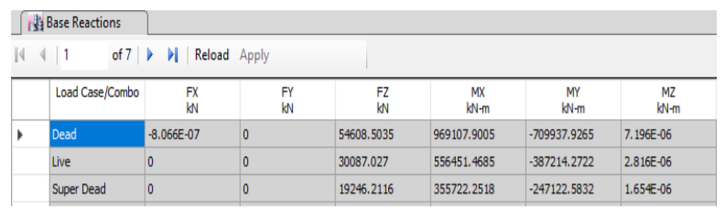
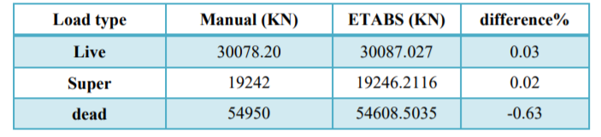
Equilibrium check:
This check is to compare reaction results from ETABS with hand calculations .
For block 1
Dead, live, and super imposed loads from ETABS in block 1
Dead, SD, and live load from hand calculation and ETABS for block 1
All of them less than 5 %, then it’s ok

Slide 23
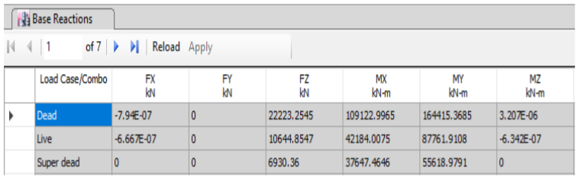
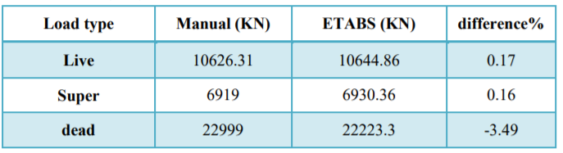
For block 2
Dead, live, and super imposed loads from ETABS in block 2
Dead, SD, and live load from hand calculation and ETABS for block 2
All of them less than 5 %, then it’s ok

Slide 24
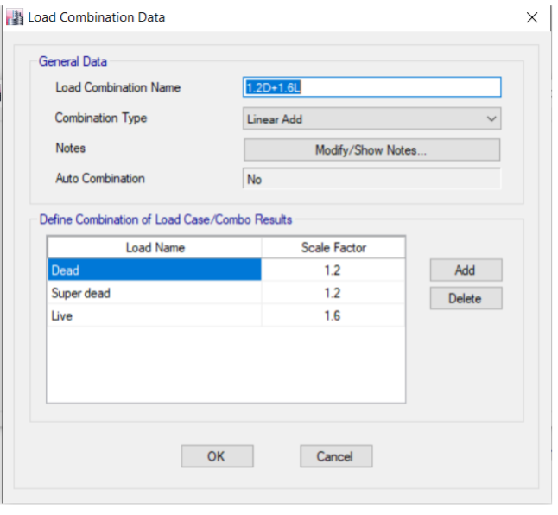
Internal force check ( stress – strain check ):
This check is to compare internal force results from ETABS with hand calculations .
calculate the moment from live and dead and super dead load on the beam 46 for block 1
Shows the define load combination = 1.2D + 1.6 L

Slide 25
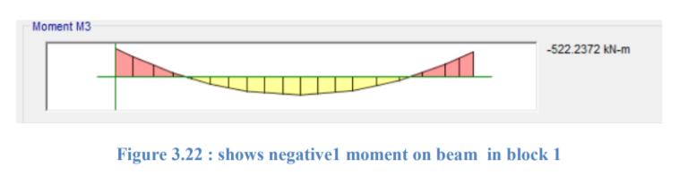
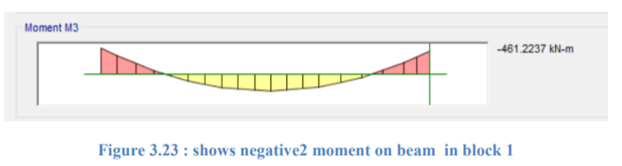
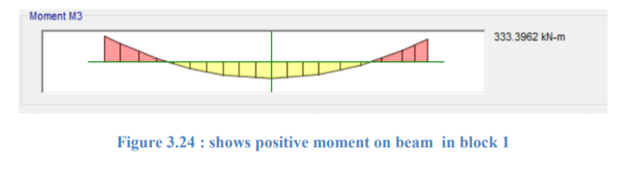
For ETABS results, see the following figures:
M ETABS = (522.3 +461.2) * 0.5 + 333.3 = 824.5 kN.m.
%difference = ((830-824.5)/830) *100 = 0.7% < 10% → OK

Slide 26
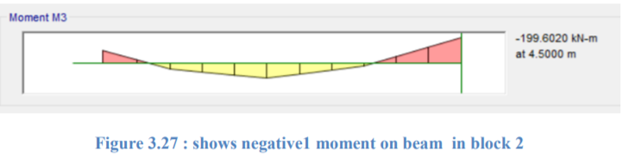
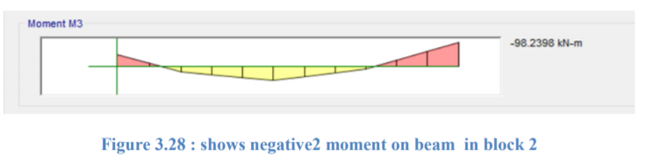
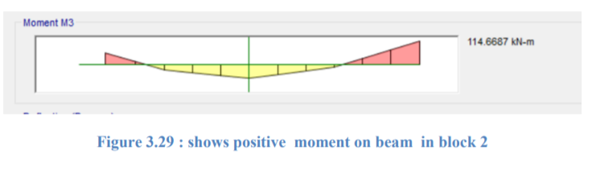
Calculate the moment from live and dead and super dead load on the beam 16 for block 2
For ETABS results, see the following figures:
M ETABS = (199 +98.5)* 0.5 + 114= 262.5kN.m.
%difference = ((265.7-262.5)/265.7) *100 = 1.2% < 10% → OK

Slide 27
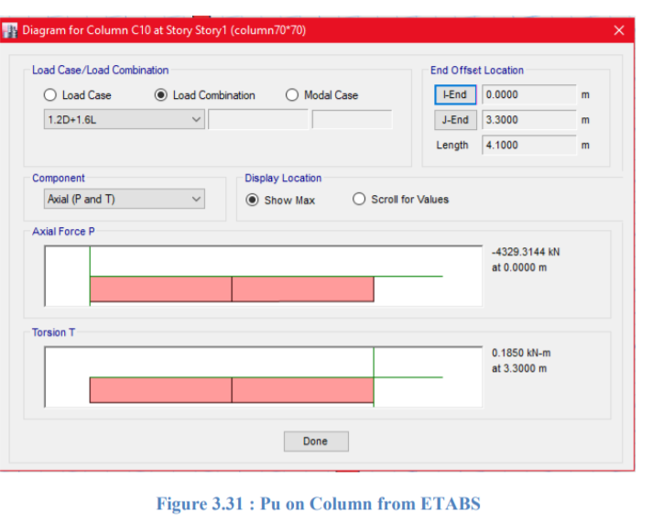
Block 1, Column .. Manual
Wu on column from floor 1=0.2*25*1.2+1.25*5+1.6*5=20 𝐾𝑁/𝑚2
Wu on column from floor 2=0.2*0.25*1.2+1.2*5.5+1.6*5=20.6 𝐾𝑁/𝑚2
Wu on column from floor 3= 0.2*0.25*1.2+1.2*5.5+1.6*5=20.6 𝐾𝑁/𝑚2
Wu on column from floor 4=0.2*25*1.2+1.6*10=22 𝐾𝑁/𝑚2
Final Wu =83.2 𝐾𝑁/𝑚2
Pu on column from slab=83.2*7.15*6.05=3599 KN
Pu on column from beam =11.8*0.5*0.6*25*1.2*4=424.8 KN
Weight of column = 15.5*0.7*0.7*25*12=227.85 KN
Final Pu on column=4251.7 KN
From ETABS :
Pu=4311.3 KN
Error= 4311.3−4251.7\4311.3 ∗ 100% = 1.38 %

Slide 28
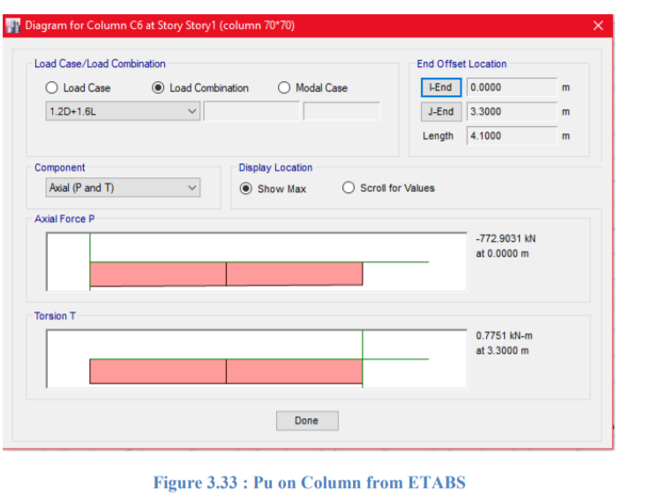
Block 2, Column.. Manual
Wu on column from floor 1=0.2*25*1.2+1.25*4.5+1.6*5=19.4 𝐾𝑁/𝑚2
Final Wu =19.4 𝐾𝑁/𝑚2
Pu on column from slab=19.4*3.98*7.2=555.35 KN
Pu on column from beam =9.7759*0.5*0.6*25*1.2=87.983 KN
Weight of column = 4.1*0.7*0.7*25*1.2=60.27 KN
Final Pu on column=703.6 KN
From ETABS :
Pu=773 KN
Error= 773−703.6\773 ∗ 100% = 9 %

Slide 29
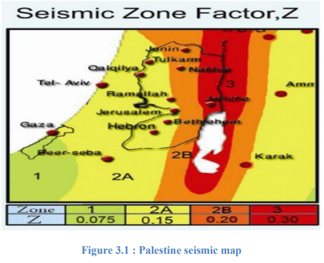
Seismic load calculations
Seismic load will be calculated depending on UBC-97. According to the location of this project (Ramallah), soil type (SOFT ROCK) and according to Palestine seismic map that is shown in Figure (3.1) and the project location, seismic zone is 2B thus the value of zone factor is (Z= 0.2).

Slide 30
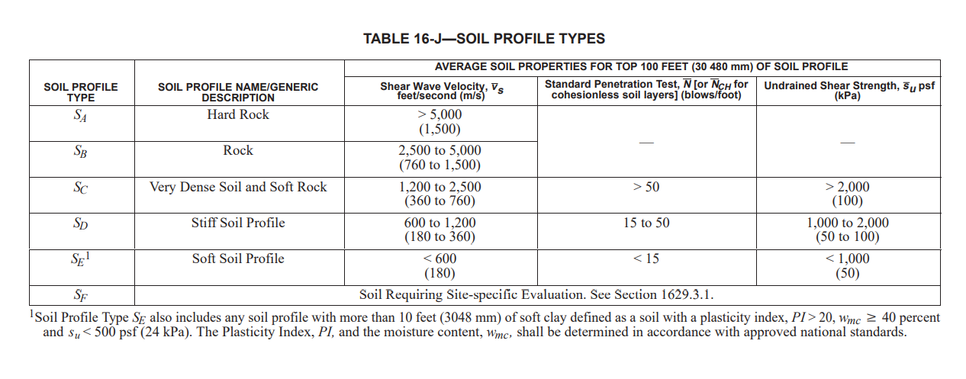

Slide 31
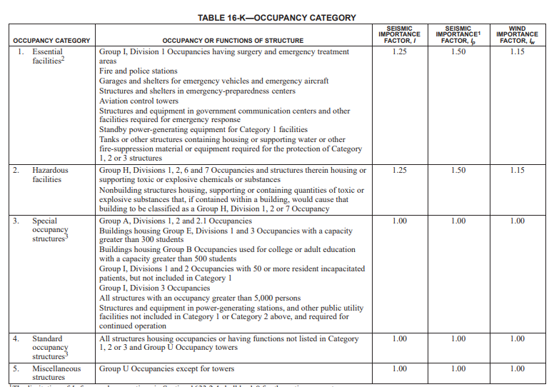

Slide 32
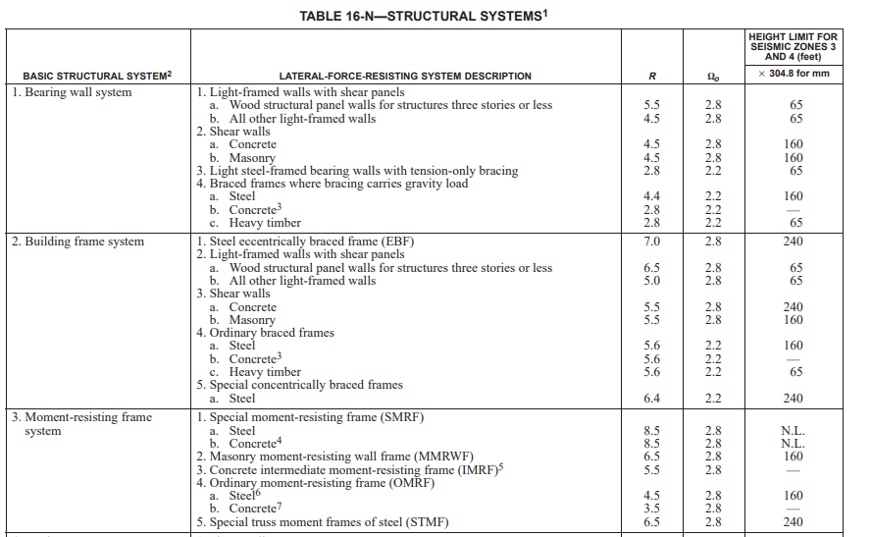

Slide 33
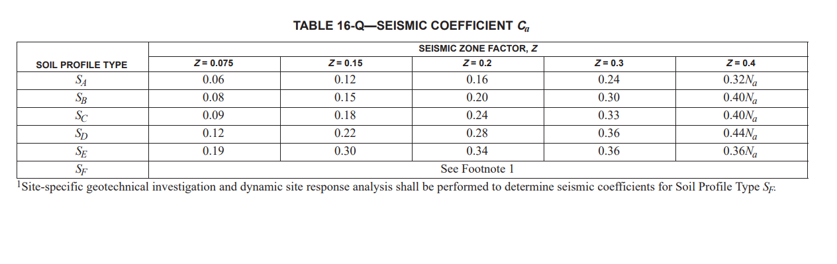

Slide 34
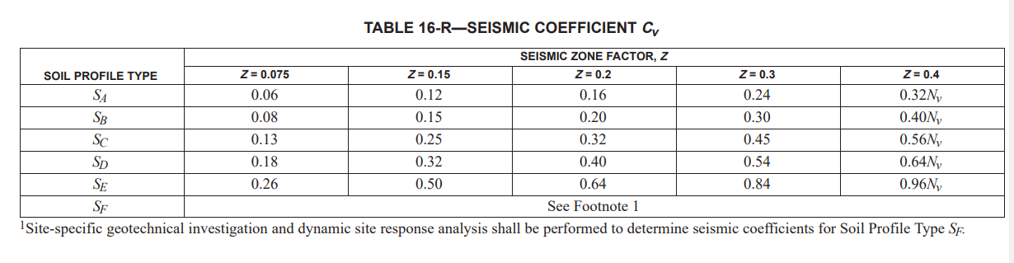




Slide 35



Determination of structure period:
ℎ𝑛 = 18.1 m
𝐶𝑡 = 0.0488
𝑇 = 0.0488*${(18.1)}^{0.75}$ = 0.428 sec
Determinations of base shear using static lateral force procedure:
V = 0.17 * W

Slide 36

The total design base shear need not exceed the following:-
V = 0.1364 * W
V = 0.17 * W > V = 0.1364 * W
Then V = 0.1364 * W
The total design base shear shall not be less than the following:-
𝑉 = 0.11 * 𝐶𝑎 * I * W
𝑉 = 0.033 * W
𝑉 = 0.1364 ∗W > 0.033 ∗ W → 𝑂𝐾
Then base shear based on UBC (97) is 𝑉 = 0.1364 * W

Slide 37
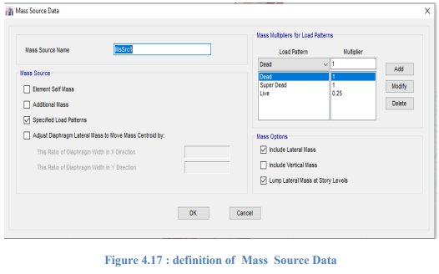
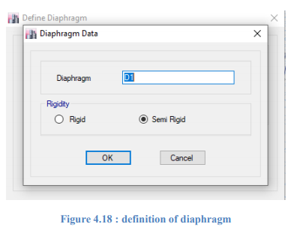

Slide 38
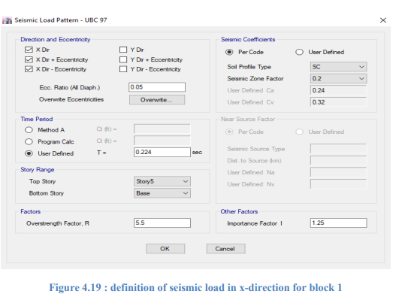
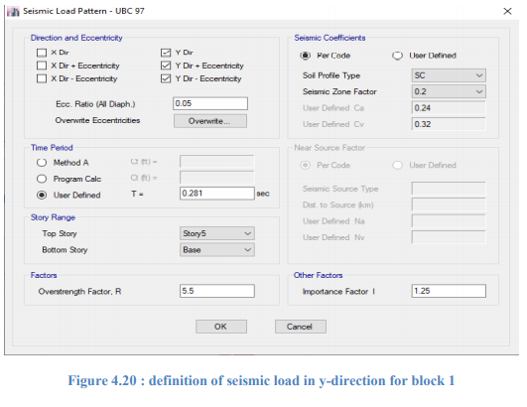

Slide 39
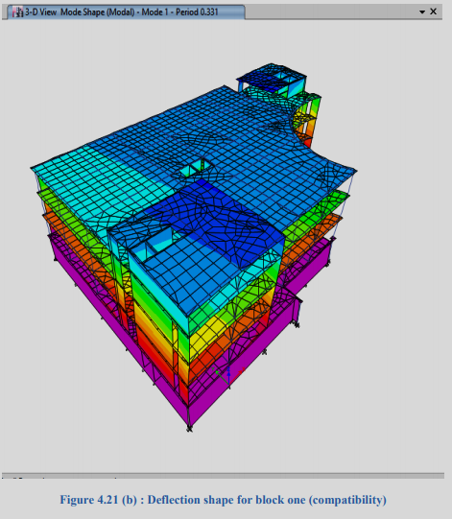
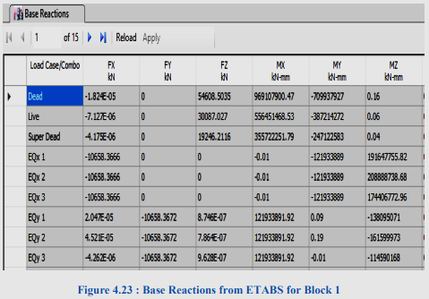
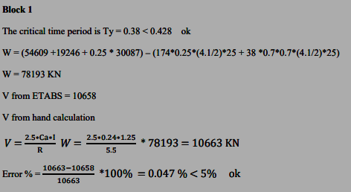
Compatibility check and period:
To ensure that the whole structure is acting as a one single unit.

Slide 40
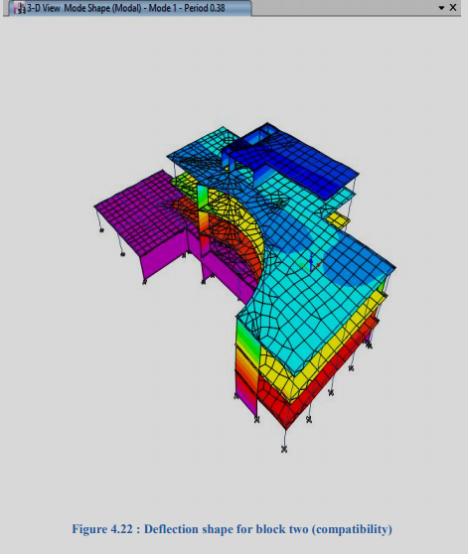
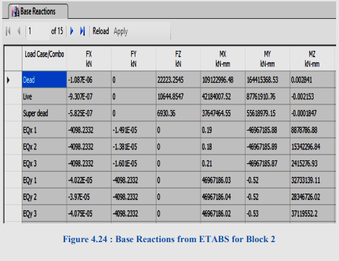
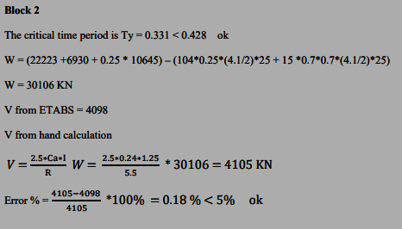

Slide 41
Check deflection for slab
To ensure that the max. deflection in the structure not exceed the allowable deflection .
Long-term deflection
No compression steel (ρ compression = 0).
Assume 25% sustained live load.
The long-term deflection is given by the following equation:
∆ Long term = ∆ L + λ∞ x ∆ D + λt x ∆ Ls
λt = λ∞ , since we assumed that the live load will sustained .
λ = T / (1+ 50ρ′) (such that ρ ′ is the compression steel ratio, T is a multiplier for long term deflection) . Figure (4.45) shows the multipliers for long-term deflections) is used to find T from ACI 318

Slide 42
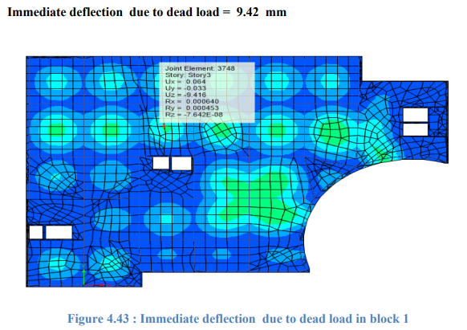
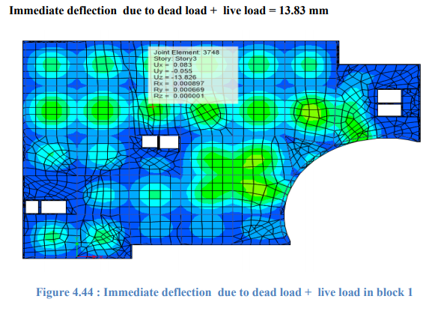

Slide 43
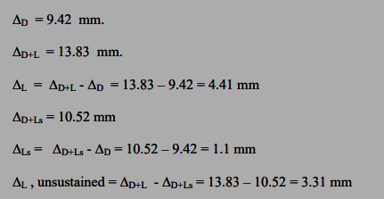




Slide 44





Design of dome in block 3
Block 3 is a coverage for the building as spherical dome of concrete with thickness 10 cm , γconcrete 25 KN/m2 , radius 11.5 m , live load 2 KN/m2 and height 2 m .
Nø and Nθ from dead load
Nø @ ø = 0.0= - 42.5 KN/m
Nø @ ø = 20= - 44 KN/m
Nθ @ θ = 0.0 = - 42.5 KN/m
Nθ @ θ = 20 =- 36.1 KN/m
Nø and Nθ from live load
Nø @ ø = 0.0 = - 34 KN/m
Nø @ ø = 20 = - 34 KN/m
Nθ @ θ = 0.0 = -34 KN/m
Nθ @ θ = 20 = -26.1 KN/m

Slide 45
Nø max Ultimate = 1.2* 44 + 1.6 *34 = 107.2 KN/m (compression)
Nθ max Ultimate = 1.2* 36.1 + 1.6 *26.1 = 85.1 KN/m (compression)
∅ Pn = ∅ λ (0 .85 f'c (Ag-As) + As (fy))
∅ Pn = 0.65* 0.8 *(0 .85 *28 * (Ag-As) + As (420))
Assume As = 0.0
∅ Pn = 0.442* f'c *Ag
= (0.442*28*1000*100)/1000
= 1237.6 KN >> 107.2 KN
Use minimum reinforcement
As = 0.003 * 1000 *100 = 300 mm2
Use 1 ∅ 12 mm / 250 mm

Slide 46



Slide 47



Slide 48



Dome supported by ring beam ( 60*100 cm ) and the beam supported by 8 column (60*60 cm ) the definition as shown below :

Slide 49



Slide 50

checks
1. Compatibility Check.
By making start animation for the deformed shape of SAP2000 model, it can be noticed that the structural elements are compatible and all of them are moving together. Figure 4.76 shows the deformed shape of block 3

Slide 51



2. Equilibrium Check.

Slide 52
3. Internal Stresses
a) The meridian and hoop stresses at the middle of the dome from the dead load:
From SAP2000: Nθ = 42.93 KN/m (Compression).
By hand: Nθ = 42.5 KN/m (Compression).
% Error = (42.93−42.5) / 42.5 ∗ 100% = 1 % < 10 % OK
From SAP2000: Nø = 43.3 KN/m (Compression).
By hand: Nø = 42.5 KN/m (Compression).
% Error = (43.3−42.5) /42.5 ∗ 100% = 1.88 % < 10 % OK

Slide 53
b) The meridian and hoop stresses at the middle of the dome from the Live load:
From SAP2000: Nθ = 33.7 KN/m (Compression).
By hand: Nθ = 34 KN/m (Compression).
% Error = (33.7−34) / 34 ∗ 100% = 0.88 % < 10 % OK
From SAP2000: Nø = 34.1 KN/m (Compression).
By hand: Nø = 34 KN/m (Compression).
% Error = (34.1−34) / 34 ∗ 100% = 0.3 % < 10 % OK

Slide 54





Design of ring beam
Vu = 225 KN
M+ = 180 KN.m
M- = 400 KN.m
Tu = 25 KN-m
T = 905 KN

Slide 55



Design of columns
∅ Pn = ∅ λ (0 .85 f'c (Ag-As) + As (fy))

Slide 56


Slide 57



Slide 58
Column design for block 1
Group # | Critical column # | Pu (kN) | Ag (mm²) | Dimension (mm) | As (mm² ) | Reinforcement | Ties (mm)
1 | C30 | 1450 | 160000 | 400*400 | 1600 | 8 φ 16 | 1 φ 10 mm @ 25 cm c/c
2 | C12 | 2812 | 250000 | 500*500 | 2500 | 10 φ 18 | 3 φ 10 mm @ 25 cm c/c
3 | C26 | 4587 | 360000 | 600*600 | 3600 | 16 φ 18 | 2 φ 10 mm @ 25 cm c/c

Slide 59
Column design for block 2
Group # | Critical column # | Pu (kN) | Ag (mm²) | Dimension (mm) | As (mm² ) | Reinforcement | Ties (mm)
1 | C15 | 996 | 90000 | 300*300 | 900 | 8 φ 16 | 1 φ 10 mm / 25 cm c/c
2 | C13 | 1966 | 160000 | 400*400 | 1600 | 8 φ 18 | 1 φ 10 mm / 25 cm c/c
3 | C22 | 3036 | 250000 | 500*500 | 2500 | 10 φ 18 | φ 10 mm / 25 cm c/c3

Slide 60


Example

Slide 61

Design of shear wall and stairs
Shear wall
∅ Pn = ∅ λ (0 .85 f'c (Ag-As) + As (fy))
∅ Pn = 0.65*0.8 (0 .85*28* (0.99Ag) + 0.01Ag (420)) = 2000 ∗ 1000
14.44 Ag = 2000*1000
Ag = 138540 mm2 → (372 x 372) mm
Wall dimensions are (1000 x 250) mm
Check ρ
2000 ∗ 1000 = 0.65*0.8 (0 .85*28* (250000 - As) + 420 As ) → As = - 5310 mm2
Use ρ min = 0.0018 → As= 0.0018*Ag
As = 0.0018 * (1000*250) = 450 mm2
Use 1 φ 12 mm / 25cm

Slide 62


Stairs

Slide 63
Mat Foundation
Footings are the substructure elements that transmit the concentrated column load or wall reactions safely to the soil. The transmitted load develop a uniform stress on the soil, the applied stress should be less than or equal to the bearing capacity of the soil.
The soil in the site area is mainly rocky and the bearing capacity of the soil is 300 𝑘𝑁/𝑚 2

Slide 64
Design of footing
Step1 : select type of foundation
The service load taken by ETABS
Calculate the area of footing as single by used :
Area = Pa / q all
Percentage of total single area from area of mat = 270/1500 ∗ 100% = 18 % < 50 %
add the area of foundations which shear walls need the percentage will increase
Taking into account the site investigation report
So , select Mat foundation

Slide 65
Step 2 : calculate thickness of mat foundation
Assume the depth of the footing = 1000 mm and the effective depth = 900 mm on the soil.
Vu = 4531.5 KN
∅ Vc punching = ∅ (𝟏 /𝟑) √f′c bo d
bo is the perimeter of the critical section
then: bo= 2(C1+d) +2(C2+d)= 2*(0.6+0.9+0.6+0.9) = 6 m = 6000 mm
So, ∅ Vc punching = (0.75 *(𝟏 /𝟑) √28 *6000*0.9 = 7144 KN
Vu < ∅ Vc punching So it’s okay
d=0.9 m and h=1 m.

Slide 66


Step 3 : definition

Slide 67

Step 4 : checks
1- Check the Bearing Capacity:
As shown above, all the mat foundation have soil pressure less than 300 KN/m2 and in compression.

Slide 68

2- Check the Deflection:
The max deflection from ETABS = 4.966 mm nearly equal 5 mm and this displacement less than 10 mm so, is ok .

Slide 69

3- Punching Shear Check:
As picture shows there is no Punching shear in foundation so its ok.

Slide 70


4- Wide Beam Shear:
The max shear forces at distance d = 0.9 m from envelope combination in X and Y direction are 545 KN and 550 KN respectively from ETABS as shown below:
By hand: bw= 1000 mm, d=1000-100 = 900 mm and the max Vu = 550 KN.
∅ 𝑉𝑐 = ∅ (𝟏/ 𝟔) √f′c bw d *1.1 = 0.75 * (𝟏 /𝟔 )√28 * 1000*900*1.1/1000 = 655 KN
∅ Vc = 655 KN > Vu = 550 KN so no need for shear reinforcement.

Slide 71


Step 5 : Design
For both negative and positive moments in X and Y direction, As min will be used.
bw = 1000 mm, h=1000 mm and d= 1000-100 = 900 mm
As min = ρ min * bw *h = 0.0018*1000*1000 = 1800 mm2….. use ( 6 Ø20 mm/m )
So , any zones have As more than 1800 mm2 /m the reinforcement bars will be found for it.

Slide 72



Slide 73


We have zones in both X and Y direction at column need reinforcement more than the minimum. will design the max zone as one sample calculation for the zone that needs reinforcement more than the minimum. and Generalization for all zones.

Slide 74



Slide 75

Thanks for your good listening
We are ready to answer your questions

