Slide 1

Graduation Project II
Structural Analysis and Design of Indonesian Rehabilitation Hospital in Nazareth city -Palestine.
An-Najah National University
Faculty of Engineering
Civil Engineering Department
جامعة النجاح الوطنية
كلية الهندسة ونكنولوجيا المعلومات
By
Ahmad Shammout
Deema Safadi
Masa Awad
Rahaf Abu Omar
Zaid Abu Zahra
Under supervision of: Ibrahim Arman.

Slide 2
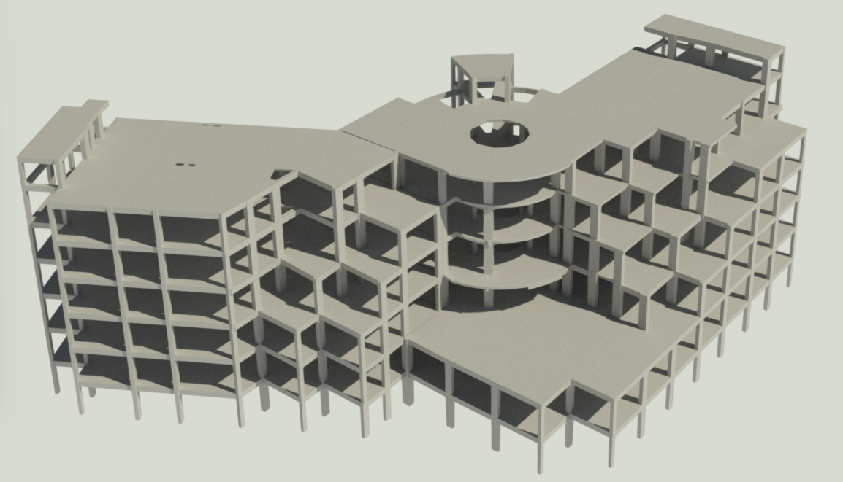
Outline:
1. General Description
2. Preliminary Design
3. 3-D Modeling and Analysis
4. Verification of Structural Design
5. Structural Design

Slide 3


Slide 4
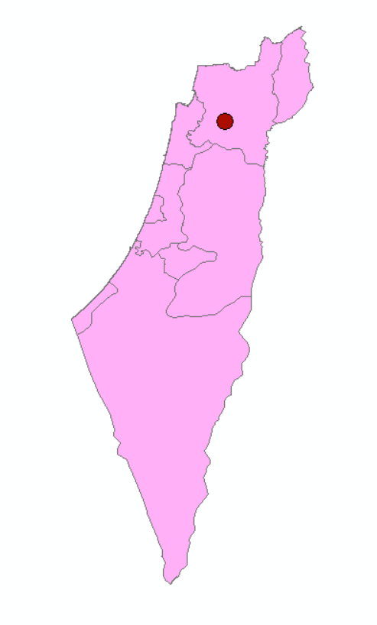

General Description
Location
It is located in Nazareth – Palestine, and the coordinates of the project according to the global coordinate system WGS are 32°42′08″N, 35°17′52″E. Location elevation (site level) is +347m AMSL (above mean sea level).

Slide 5
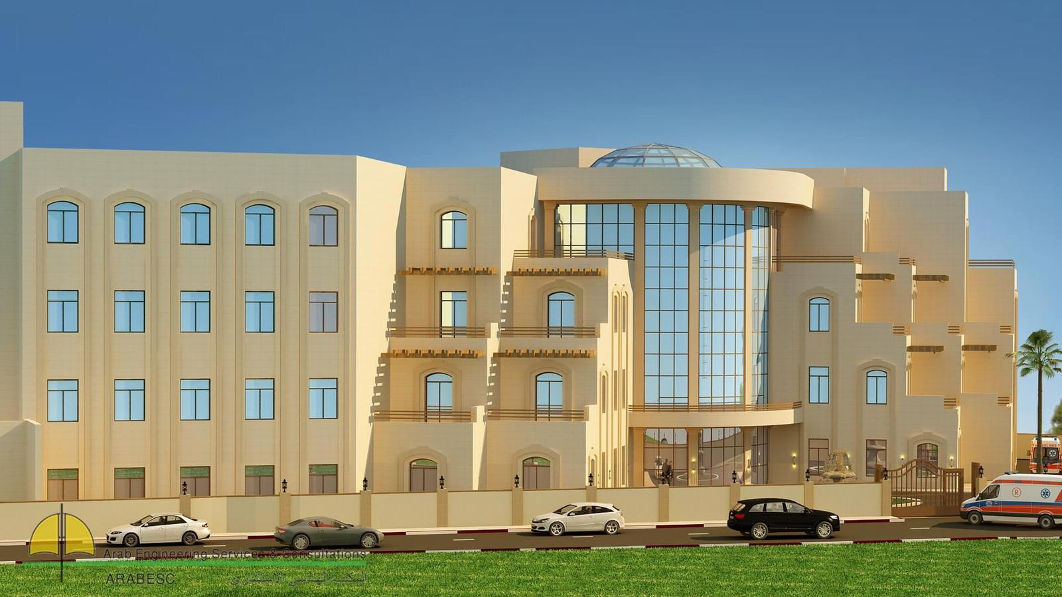

Slide 6
General Description
Height and Area For Each Floor
Floor Number | High of each floor (m) | Area of each floor (m²)
B2 | 4 | 1853.65
B1 | 4 | 1853.65
GF | 4 | 1387
F1 | 4 | 1308.96
F2 | 4 | 1230.05
Roof | 4 | 1137.11
Stair-Case | 3 | 28.84

Slide 7
General Description
Assumptions
All supports are fixed supporter in the 3D.
As for the external walls, part of them are made of glass walls and the other part are stone walls, and they are added as dead loads on the external beams.
The slab system is two-way solid slab with drop beams .
In preliminary design chapter, a quick preliminary was performed, so the thicknesses of retaining and shear walls were taken from architectural plans.
Eight checks were made include compatibility check, equilibrium check, stress-strain check, time period, base shear ,story drift , story forces , structural irregularity and P-delta.

Slide 8
Floor Plans

Slide 9
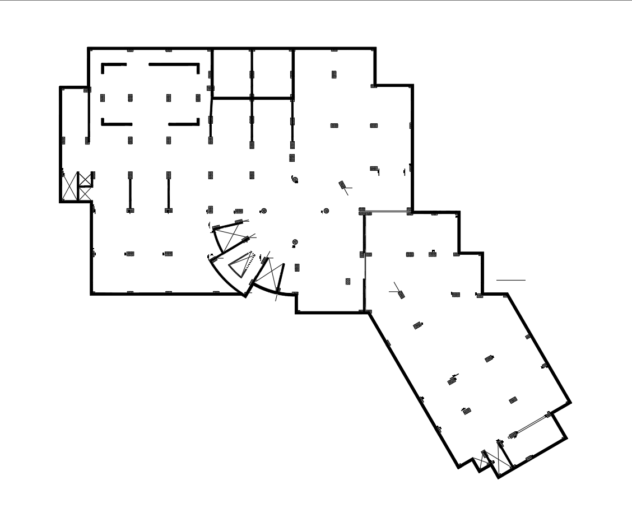
Besement two

Slide 10

Besement One

Slide 11

Ground Floor

Slide 12
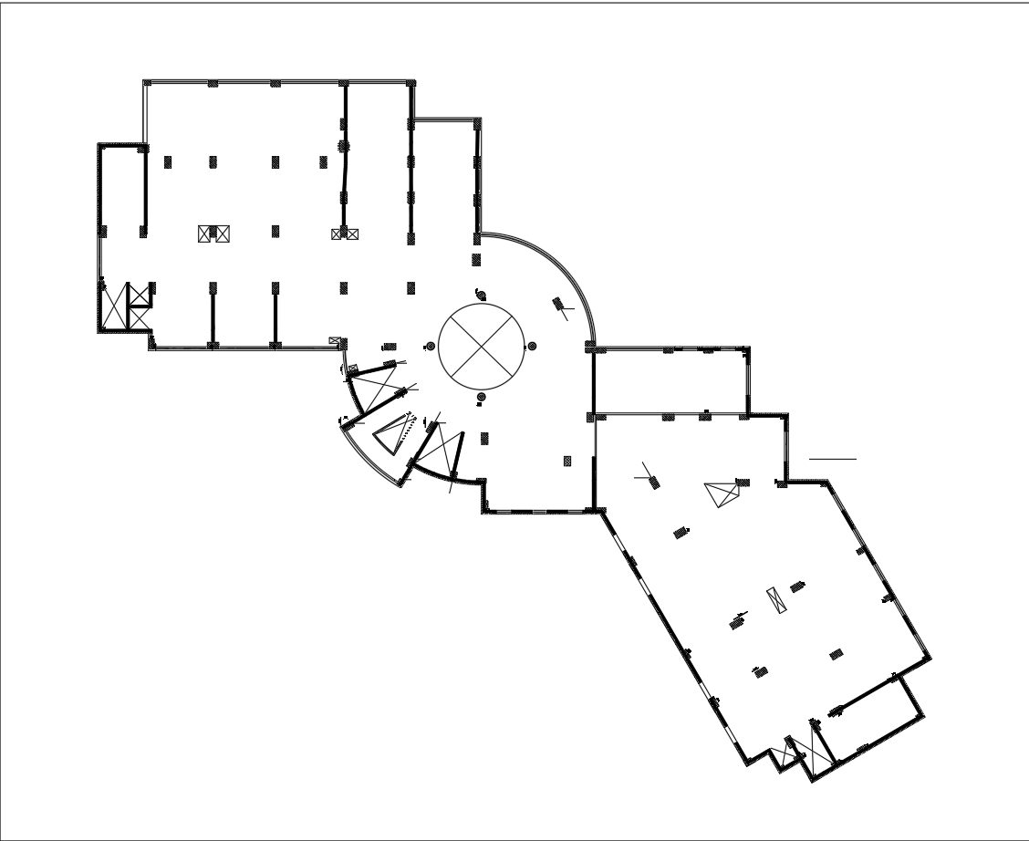
Floor One

Slide 13
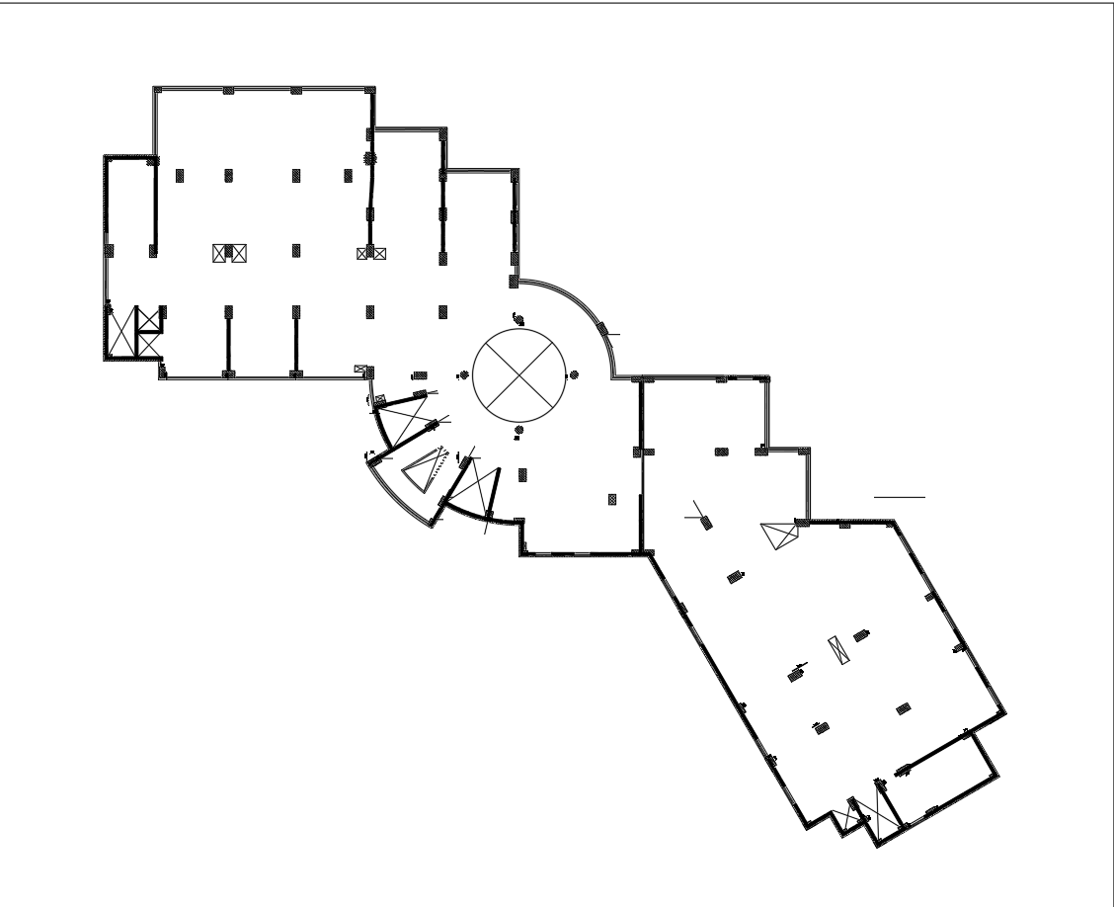
Floor Two

Slide 14
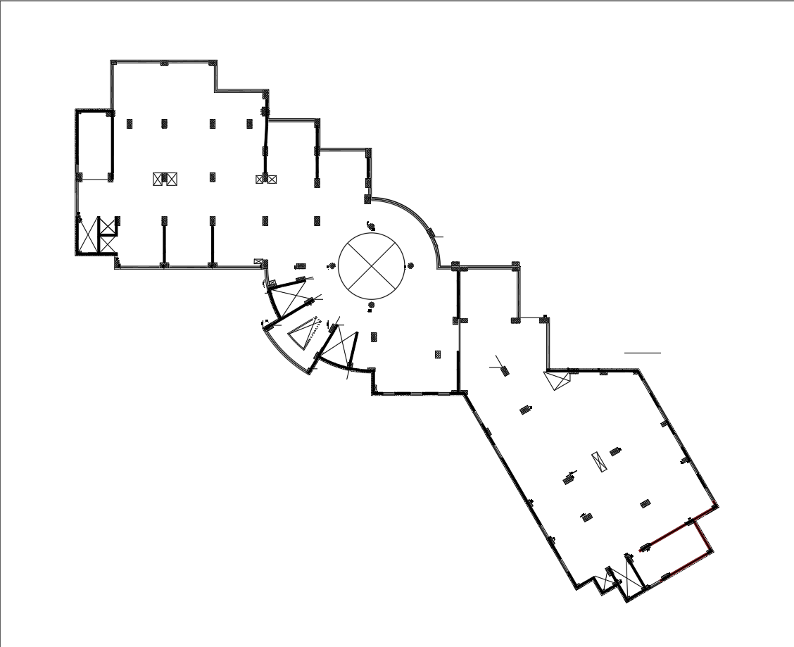
Roof Floor

Slide 15
General Description
Codes and Standard.
ASCE 7-22 (American Society of Civil Engineers
ACI 318-19 (American Concrete Institute)
ASTM 2016 (American Society for Testing and Materials)

Slide 16
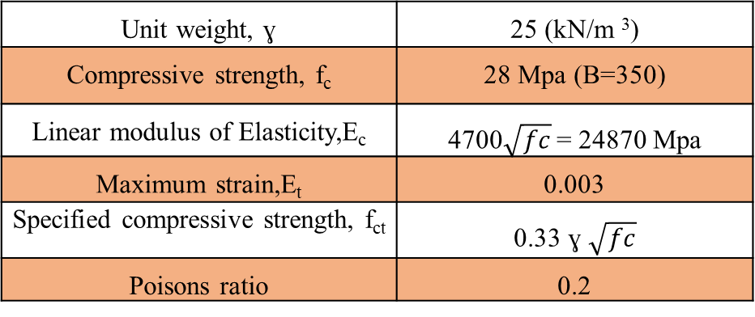
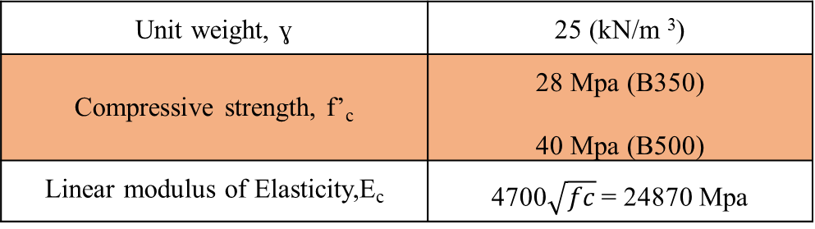
General Description
Construction Materials
Structural Materials:
Unit weight, ɣ | 25 (kN/m ³)
Compressive strength, f’_{c} | 28 Mpa (B350) 40 Mpa (B500)
Linear modulus of Elasticity,E_{c} | 4700$\sqrt{fc}$ = 24870 Mpa

Slide 17
General Description
Construction Materials.
Non- Structural Materials:
Material | Unit weight ɣ(KN/m³)
Masonry stone | 26.5
Cement mortar &Plaster | 23
Partition blocks | 15
Filing material aggregate | 18
Glass | 25
Marble Tiles | 27
Aluminium | 26
False celling | 0.2 (KN/m²)
Sand | 23
Reinforce concrete | 25

Slide 18
General Description
Loads
Gravity loads :
Dead load
Super dead load
Live load
Snow load
Lateral loads :
Soil load
Seismic load
Water load

Slide 19
General Description
Superimposed dead load
Floor Number | Super-imposed load (KN/m² ) on the slab
Basement 2 | 4.1
Basement 1 | 4.5
Ground Floor | 7
Floor 1 | 7.5
Floor 2 | 7.5
Roof | 7

Slide 20
General Description
Live Load
Snow Load
Occupancy | Live Load (KN/m² )
Parking | 3
Store 1st Floor | 5
Store under 1st Floor | 6
Store above 1st Floor | 4
W.C | 2
Audiology room | 6
X-Ray room | 6
Stairs | 5
Gym | 5
Laboratories | 3
Balconies | 5
Patient room | 2
Office use | 2.5
Kitchen | 5
Pharmacy | 6
Clinic room | 5
Corridor at GF | 5
Corridor above 1st Floor | 4
Roof live Load( L_{r}) | 1
1.92 KN/m²

Slide 21
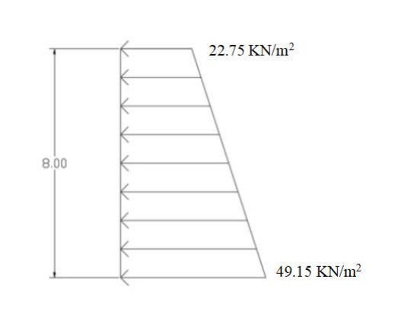
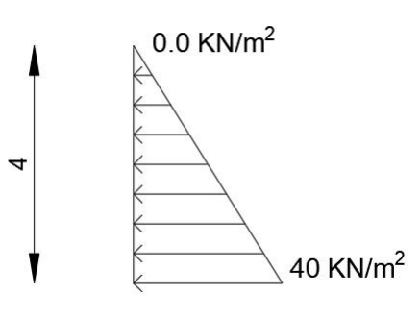
General Description
Lateral Load
Soil Load:
Water Load:

Slide 22
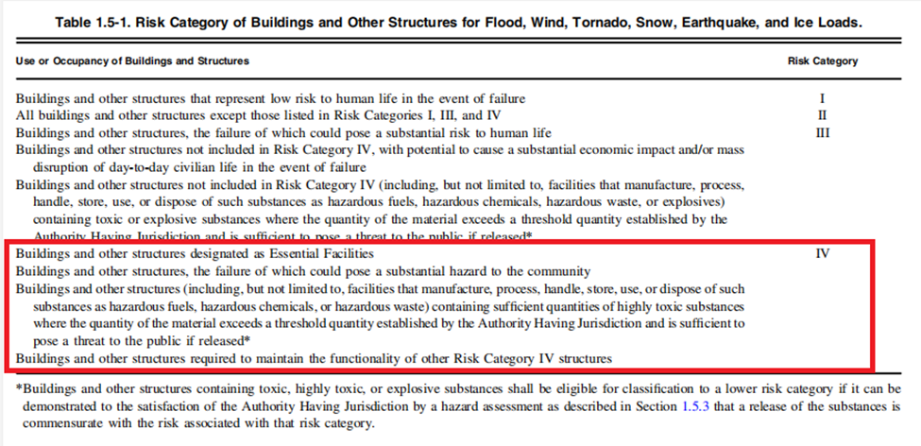
General Description
Lateral Load
Seismic loads:
According to ASCE 7-22 code to seismic analysis for this structure:
- Risk category: risk category of the building is IV

Slide 23
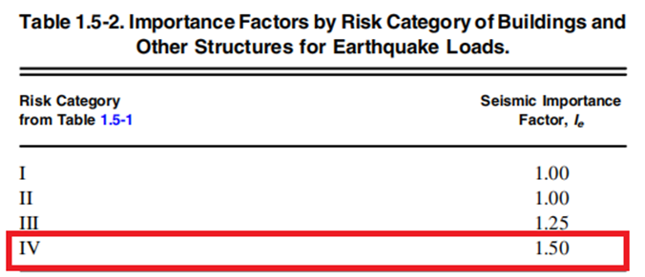
General Description
Lateral Load
Importance factor : (Ie) = 1.5

Slide 24
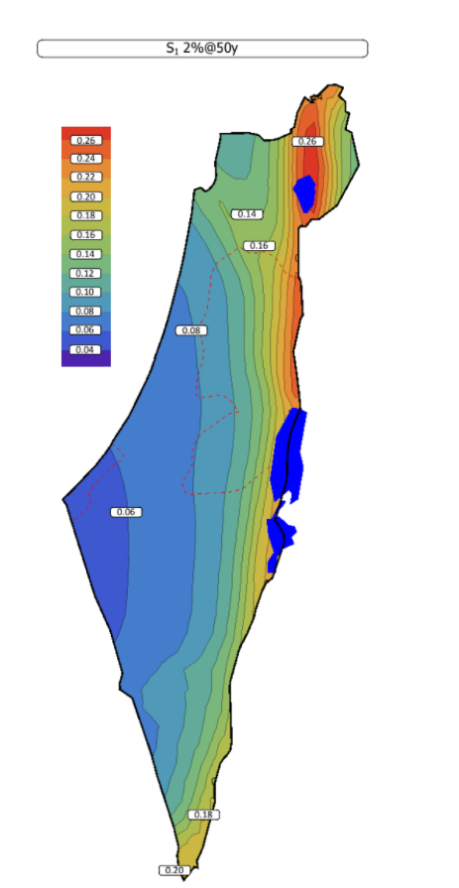
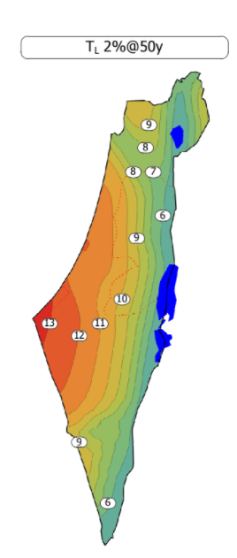
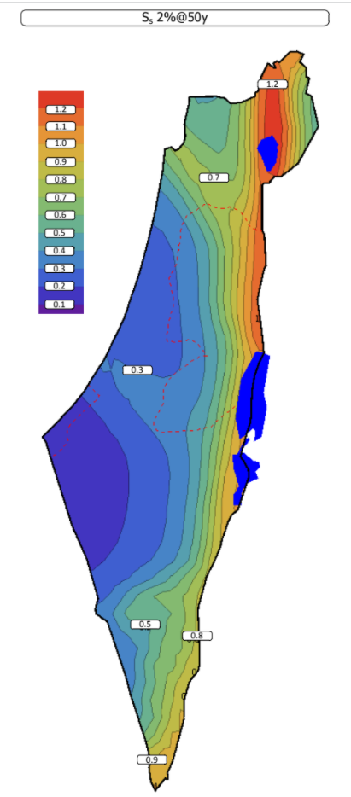
General Description
Lateral Load
- Mapped acceleration parameters Ss & S1 :
From Palestine seismic map:
Ss = 0.7 g
S1 = 0.14 g
TL = 8 sec

Slide 25
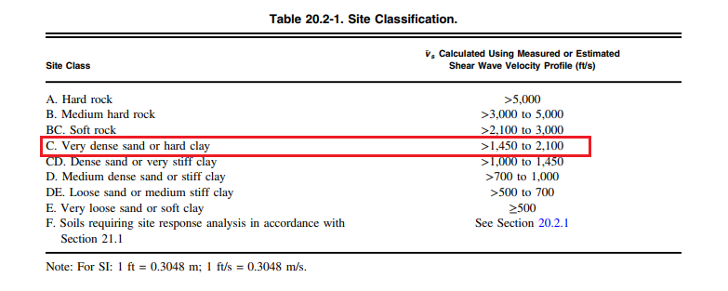
General Description
Site Class
Site classification is C

Slide 26
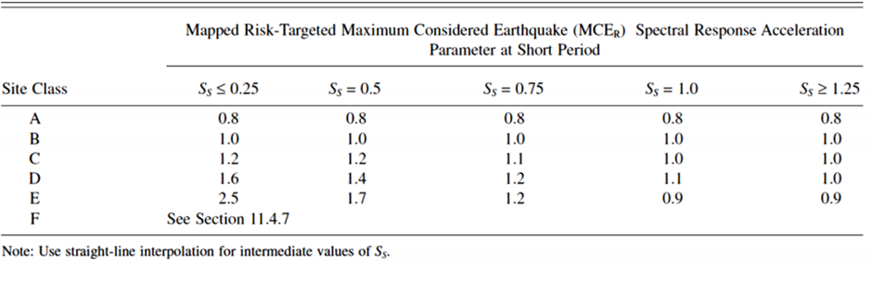
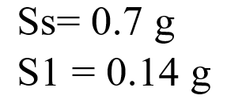
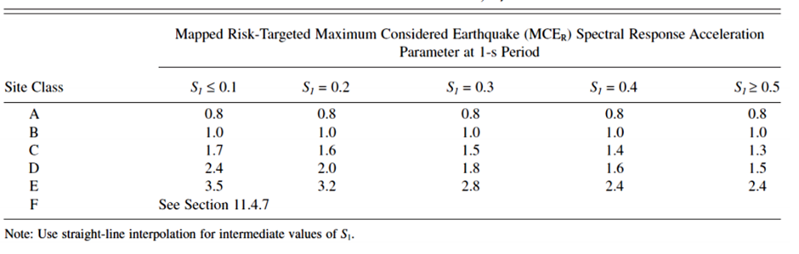
General Description
Site Coefficients
- The values of Fa and Fv According to the site class in this project are 1.12, 1.66, respectively.

Slide 27
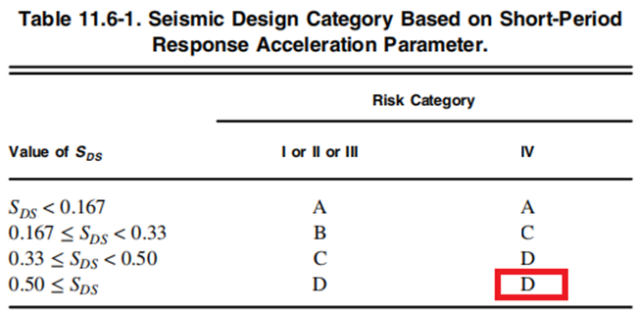
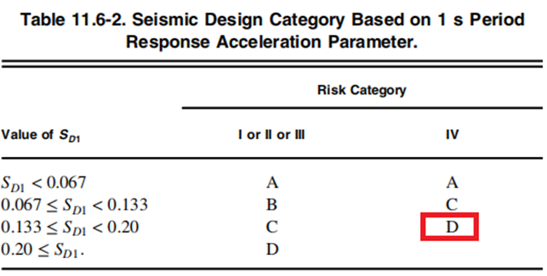
General Description
Seismic Design Category
-The maximum considered earthquake Spectral Response Acceleration
Parameters SMS and SM1:
SMS =Fa SS = 1.12 × 0.7 = 0.784
SM1 = Fv S1= 1.66 × 0.14= 0.2324
Design spectral acceleration :
S_{DS}= S_{MS} ×1.0 = 0.784
S_{D1}= S_{M1}× 1.0 = 0.2324
Seismic Design Category :
Seismic design category D

Slide 28
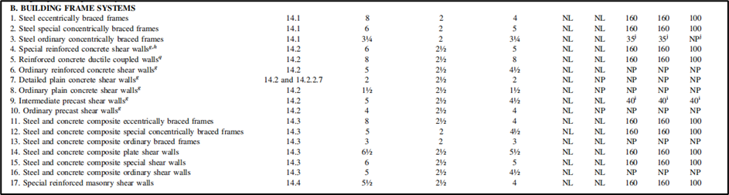
General Description
Lateral Force Resisting System
Type of the lateral forces resisting system :
Building frame system: special shear walls .
Response Modification Factor (R) = 6
Over-strength Factor (Ω_{o}) = 2.5
Deflection Amplification Factor (C_{d}) = 5

Slide 29
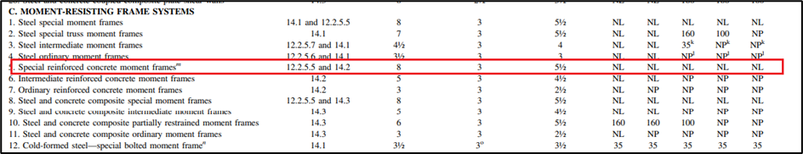
General Description
Lateral Force Resisting System
Type of the lateral forces resisting system :
Moment – resisting frame: special reinforced concrete moment frames.
Response Modification Factor (R) = 8
Over-strength Factor (Ω_{o}) = 3
Deflection Amplification Factor (C_{d}) = 5.5

Slide 30
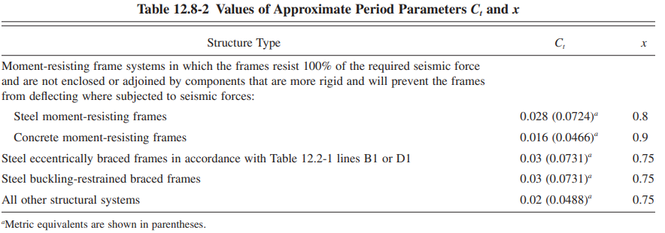
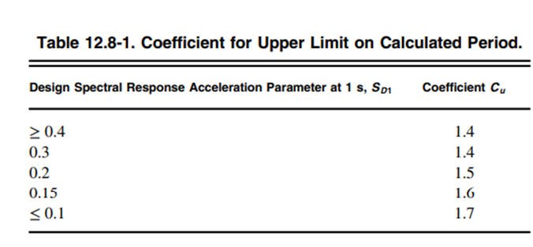
General Description
Structural Period
for building frame system :
T_{a} = C_{t} h_{n} ^{x} = 0.0488 × 16 ^{0.75} = 0.39 sec
T from ETABS ≤ T_{a} C_{u}
The period is limited to T_{a} C_{u}= 0.3904 × 1.4676= 0.57 sec

Slide 31
General Description
Structural Period
for Moment – resisting frame:
T_{a} = C_{t} h_{n} ^{x} = 0.0466 × 16 ^{0.9} = 0.565 sec
T from ETABS ≤ T_{a} C_{u}
The period is limited to T_{a} C_{u}= 0.565× 1.4676= 0.83 sec

Slide 32
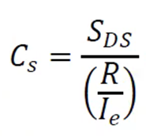

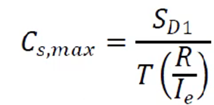
General Description
Seismic base shear
For building- frame system :
V = Cs W
Cs= 0.17
Cs min = 0.0517
Cs max = 0.101 → V = 0.101 W
For Moment – resisting frame:
V = Cs W
Cs= 0.147
Cs min = 0.0517
Cs max = 0.052 → V = 0.052 W

Slide 33



General Description
Computer Programs

Slide 34
Structural Preliminary Design

Slide 35
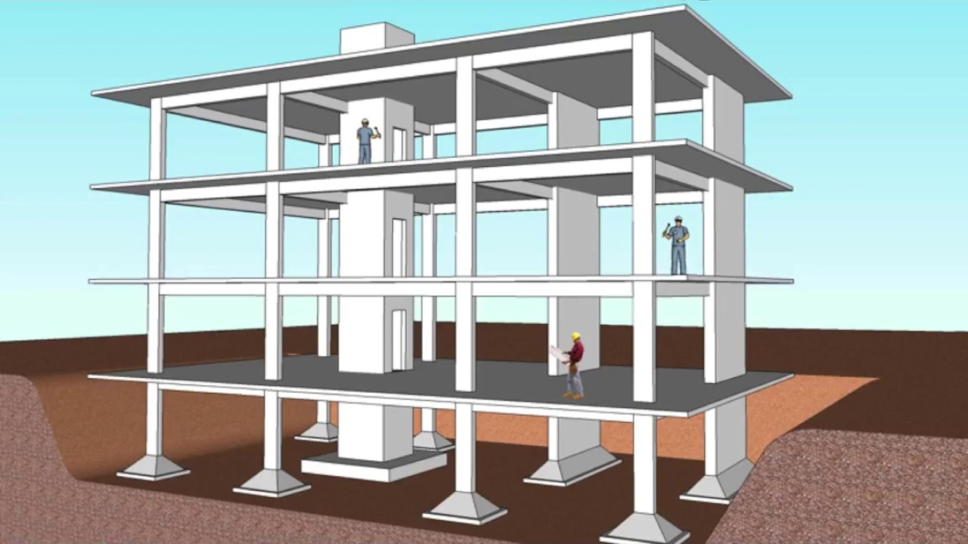
1. Slab System
2.Beam System
3. Column System
4. Wall System
Preliminary Design
Structural Systems for analysis and design

Slide 36
Slab Layout

Slide 37
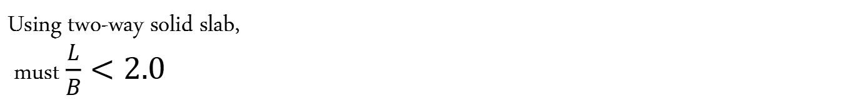
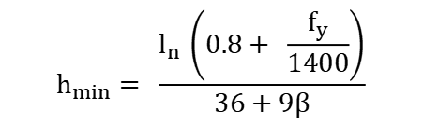
Using two-way solid slab, must $\frac{L}{B}<2.0$
Preliminary Design
Slab System
By referring to Table 8.3.1.2 in ACI-318-19,
Assuming αfm > 2:
$$h_{min}= \frac{l_{n }\left(0.8+ \frac{f_{y}}{1400}\right)}{36+9β}$$
h min = 200mm

Slide 38
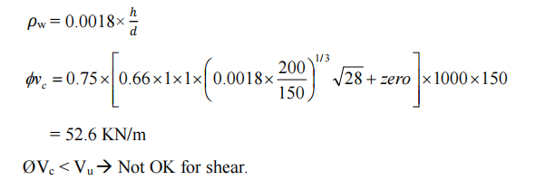
Preliminary Design
Slab System
Check Slab for shear

Slide 39
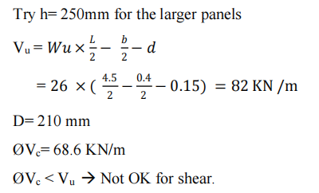
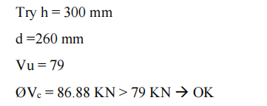
Preliminary Design
Slab System
Check Slab for shear

Slide 40
Beam Layout

Slide 41
Preliminary Design
Beam Layout

Slide 42
Preliminary Design
Beam System
Beam number | Height (mm) | Width (mm)
B1 | 600 | 200
B2 | 600 | 400
B3 | 600 | 800

Slide 43
Column Layout

Slide 44
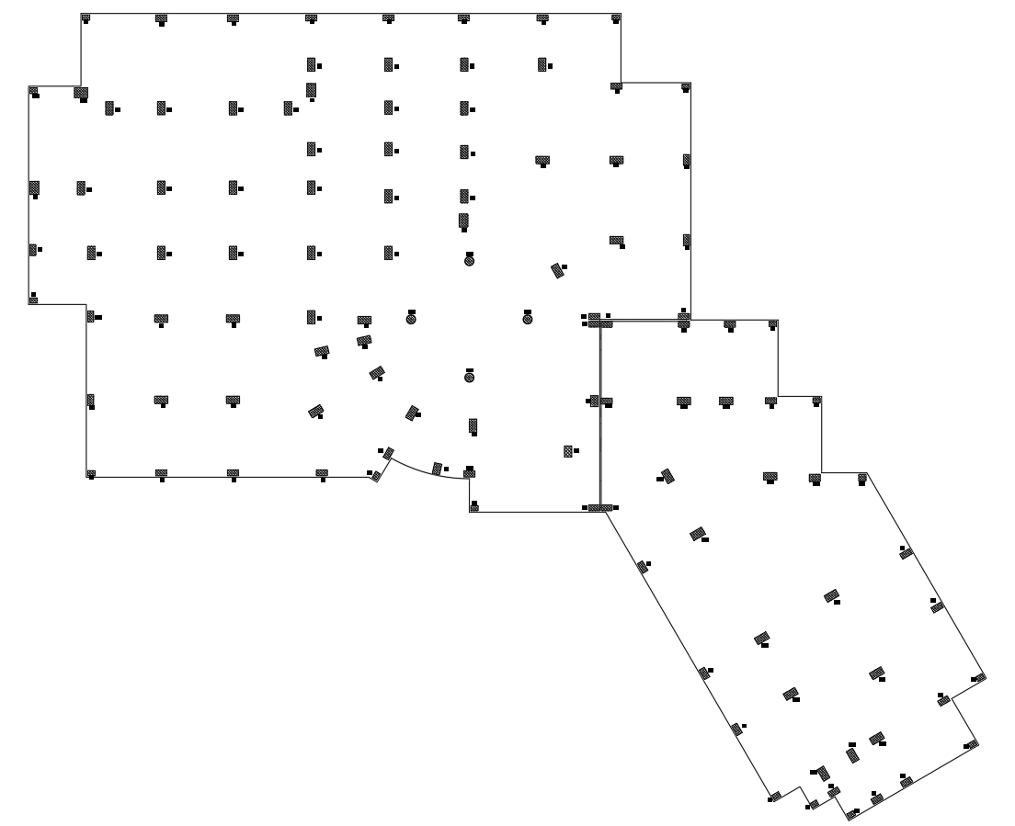

Slide 45
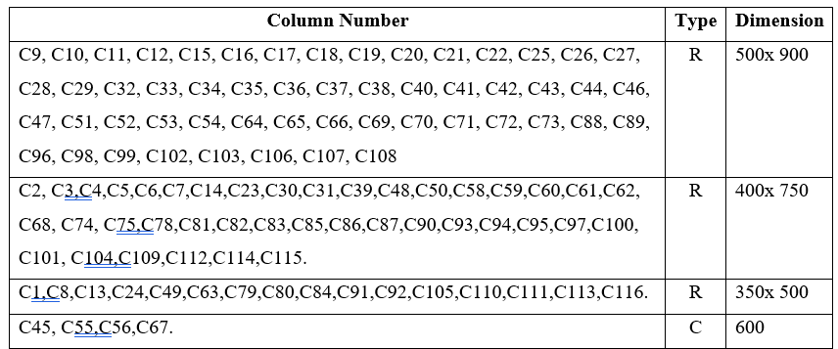
Preliminary Design
Column System
R: Rectangular column
C: Circular column

Slide 46
Wall Layout

Slide 47
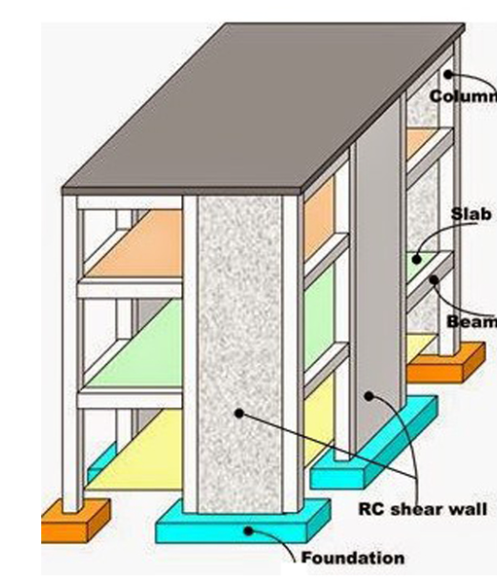
Preliminary Design
Wall System
Two types of walls in this structure will be used:
1. Basement retaining walls.
2. Elevators and staircase walls. (Shear walls).
From architectural plans, elevators and staircase walls have an initial thickness equal to 200 mm. In contrast, retaining walls have an initial thickness equal to 300 mm.
Wall name | Wall thickness (mm)
SW 200 | 200
SW 300 | 300

Slide 48
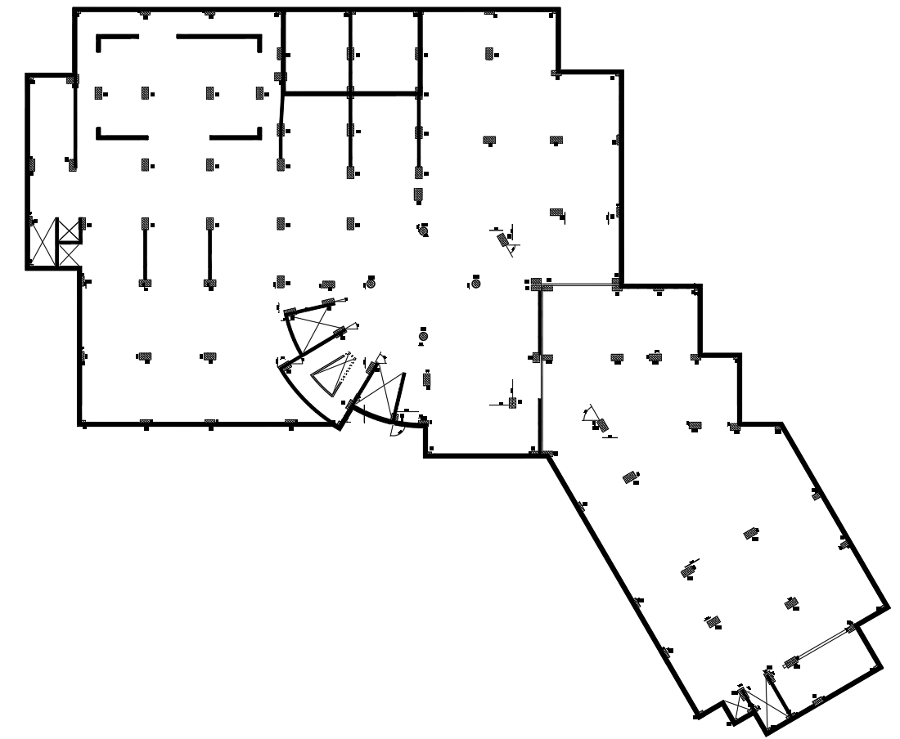

Slide 49
3D-Modeling and Analysis

Slide 50
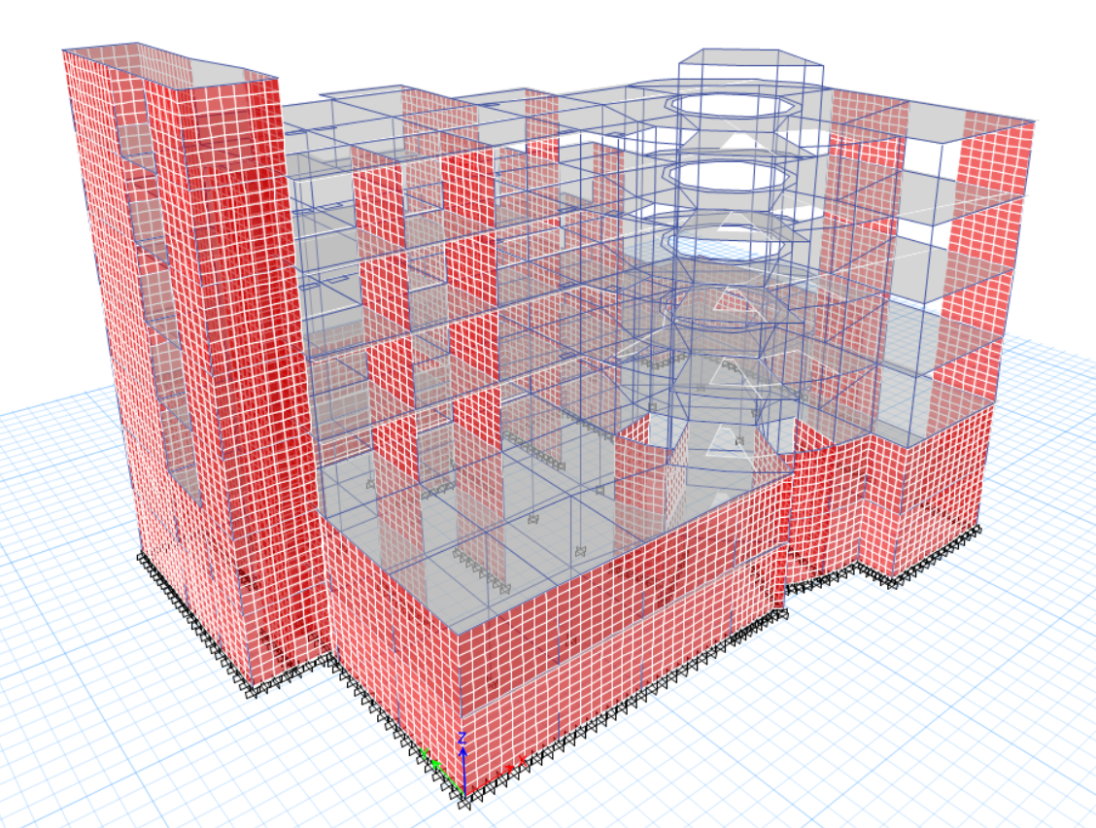
3D-Modeling and Analysis

Slide 51
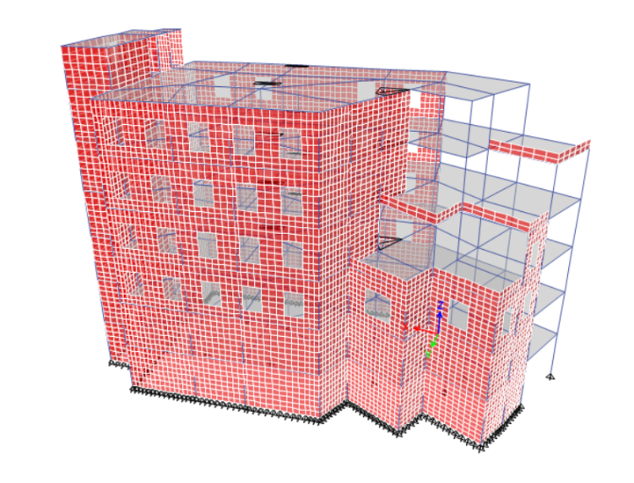
3D-Modeling and Analysis

Slide 52
3D-Modeling and Analysis

Slide 53
3D-Modeling and Analysis
Load Combinations
Basic ultimate load combinations:
1.4D
1.2D + 1.6L + 0.5(Lr or S or R)
1.2D + 1.0E + L + 0.2S
0.9D + 1.0E
0.9 D+ 1.0 W
1.2D+1.6 (Lr or S or R )+(L or 0.5W )
1.2 D+1.0 W+L +0.5 (Lr or S or R )
Basic service load combinations:
D
D + L
D +(0.6W or 0.7E)
D + 0.75L + 0.75(0.7E) + 0.75S
0.6D + 0.7E

Slide 54
3D-Modeling and Analysis
Load Combinations
Ultimate load combinations:
1.4DL+1.4SID
1.2DL+1.2SID+1.6LL + 0.5S
1.2DL+1.2SID+1.0 LL + 1.6 S
1.36 DL + 1.36 SID + 1.0 LL + 1.3 E_{qx} + 0.39 E_{qy} + 0.2S
1.36 DL + 1.36 SID + 1.0 LL + 1.3 E_{qy} + 0.39 E_{qx} + 0.2S
0.9DL+0.9SID
0.74 DL+ 0.74 SID + 1.3Eqx + 0.39E_{qy}
Service load combinations:
1.0 DL + 1.0 SID
1.0 DL + 1.0 SID + 1.0 LL
1.0 DL + 1.0 SID + 1.0 S
1.0 DL +1.0 SID +0.75 LL + 0.75 S
1.1 DL + 1.1 SID + 0.91Eqx + 0.273Eqy
1.1 DL + 1.1 SID + 0.91Eqy + 0.273Eqx
1.0 DL + 1.0 SID +0.75 LL + 0.75 S

Slide 55
3D-Modeling and Analysis
Load Combinations
Ultimate load combinations:
1.4DL+1.4SID
1.2DL+1.2SID+1.6LL + 0.5S
1.2DL+1.2SID+1.0 LL + 1.6 S
1.36 DL + 1.36 SID + 1.0 LL + 1.3 E_{qx} + 0.39 E_{qy} + 0.2S
1.36 DL + 1.36 SID + 1.0 LL + 1.3 E_{qy} + 0.39 E_{qx} + 0.2S
0.9DL+0.9SID
0.74 DL+ 0.74 SID + 1.3Eqx + 0.39E_{qy}
Service load combinations:
1.0 DL + 1.0 SID
1.0 DL + 1.0 SID + 1.0 LL
1.0 DL + 1.0 SID + 1.0 S
1.0 DL +1.0 SID +0.75 LL + 0.75 S
1.1 DL + 1.1 SID + 0.91Eqx + 0.273Eqy
1.1 DL + 1.1 SID + 0.91Eqy + 0.273Eqx
1.0 DL + 1.0 SID +0.75 LL + 0.75 S

Slide 56
Verification of Structural Analysis

Slide 57
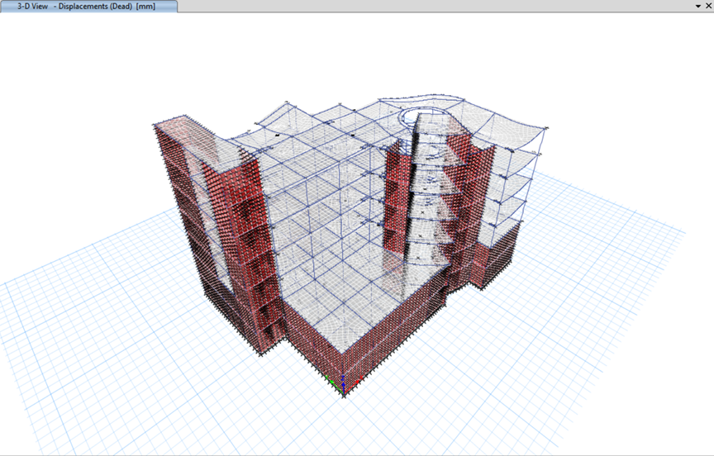
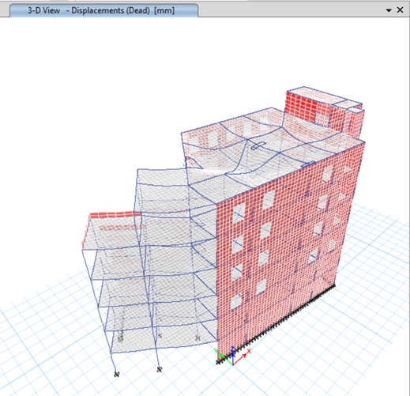
3D-Modeling and Analysis
Compatibility Check

Slide 58
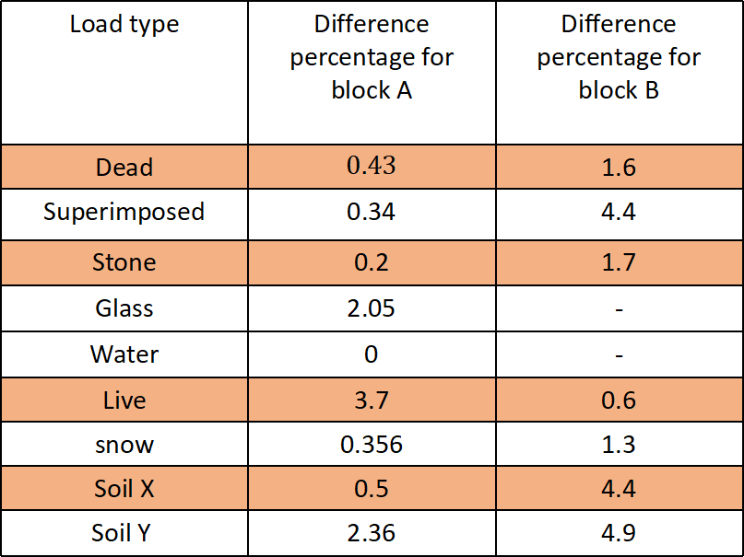
3D-Modeling and Analysis
Load type | Difference percentage for block A | Difference percentage for block B
Dead | $$0.43$$ | 1.6
Superimposed | 0.34 | 4.4
Stone | 0.2 | 1.7
Glass | 2.05 | -
Water | 0 | -
Live | 3.7 | 0.6
snow | 0.356 | 1.3
Soil X | 0.5 | 4.4
Soil Y | 2.36 | 4.9
Equilibrium Check
All the differences are < 5% → ok.

Slide 59
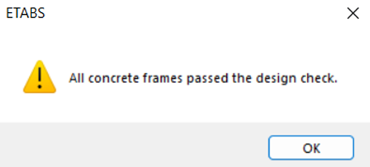
3D-Modeling and Analysis
Verification of the preliminary design

Slide 60
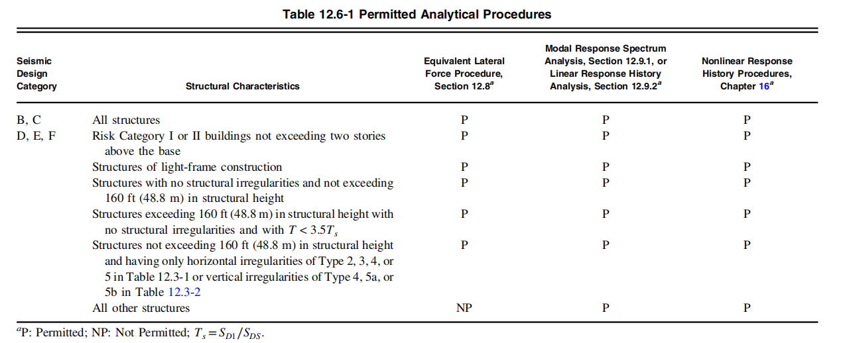
3D-Modeling and Analysis
Permitted Analytical Procedures
→In this project, the seismic design category is D and the structure characteristics is all other structures.
→The permitted analytical procedures is response spectrum and seismic response history.
→The equivalent lateral force method using response spectrum analysis was used in this project to check the base shear.

Slide 61
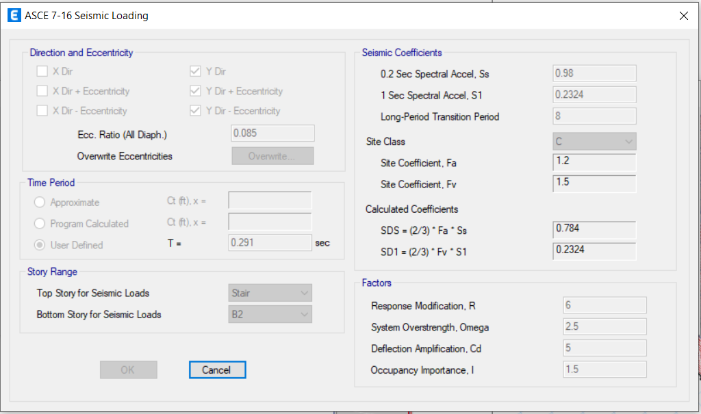
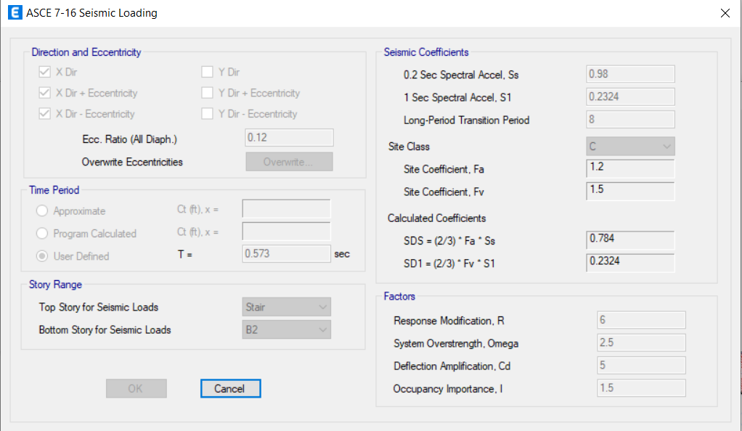
3D-Modeling and Analysis
Seismic Analysis Methods
1.Equivalent lateral force method (ELF).
Seismic loading in Y-direction
Seismic loading in X-direction

Slide 62
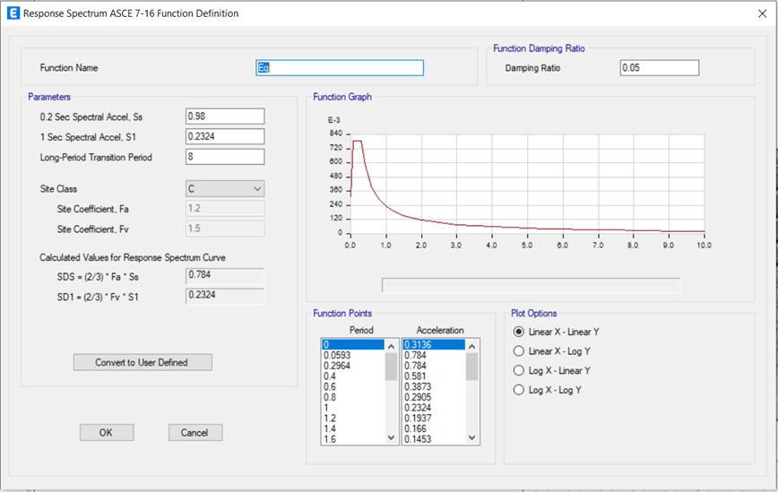
3D-Modeling and Analysis
Seismic Analysis Methods
  2.Modal response spectrum method (MRS).
Definition of MRS in ETABS

Slide 63
3D-Modeling and Analysis
Base Shear
The values of dynamic earthquakes forces must be approximately equal to the value of earthquakes forces in the static method. However, the values were not equal, which led to change the scale factor for each of the dynamic earthquake forces in X and Y.
Load case | Difference percentage A | Difference percentage B
EQX static | 3.85 | 1.5
EQY static | 4.7 | 1.8
V manually = Cs final * Building weight
-Where W = D+ SD+ 0.25 L
Different Percentage Between Manual and Static

Slide 64
3D-Modeling and Analysis
Base Shear
Modification factor in X direction = 1.35
Modification factor in Y direction = 1.82
Modification factor in X direction = 1.414
Modification factor in Y direction = 1.378
Block A →
Block B →
Load case | Block | Old | New
EDX | Block A | 2451.75 | 3432.45
EDY |  | 2451.75 | 4315.08
EDX | Block B | 2451.75 | 3430.57
EDY |  | 2451.75 | 3344.24

Slide 65
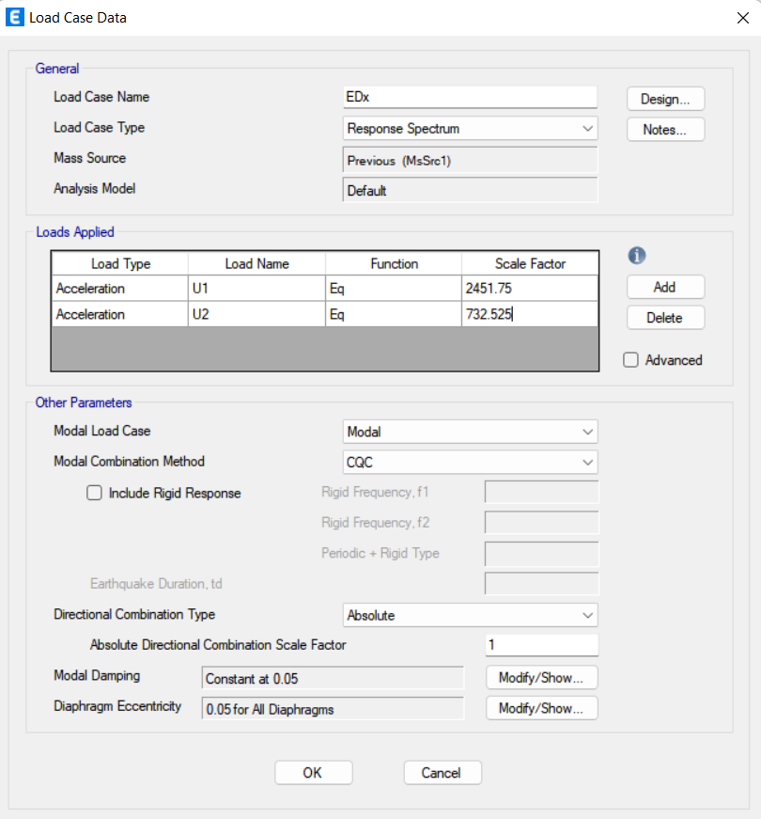
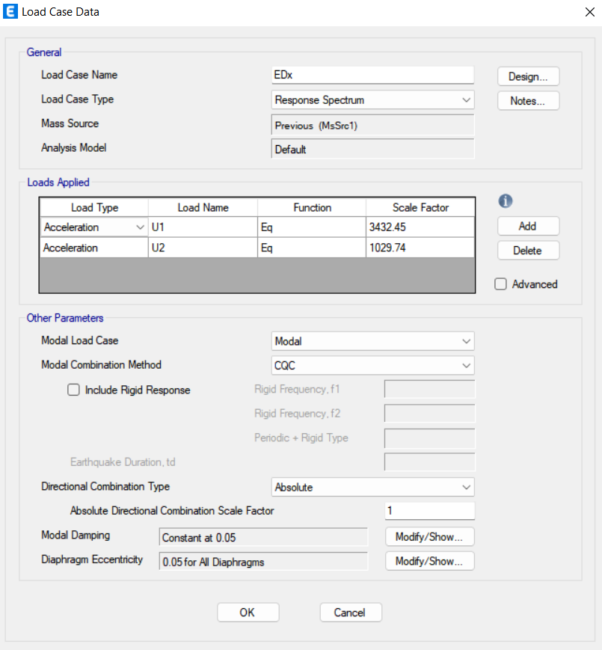
3D-Modeling and Analysis
Scale factor modification in X-dir

Slide 66


3D-Modeling and Analysis
Scale factor modification in Y-dir

Slide 67


3D-Modeling and Analysis
Story Forces
Story | K | H(m) =hx | Weight Accumulative | Weight for Individual Floor (KN) Wx | Wx*(hx)^k | Cvx | Csx final | Vx = Csx * Total W kN | F(X) Force (KN)
StairCase | 1.1745 | 27.03 | 1066.394 | 1066.39 | 51241.4 | 0.03859 | 0.196 | 12231.06 | 471.975
Roof | 1.1745 | 24 | 7252.902 | 6186.51 | 258526 | 0.19469 | 0.196 | 12231.06 | 2381.23
F2 | 1.1745 | 20 | 17122.16 | 9869.25 | 332923 | 0.25071 | 0.196 | 12231.06 | 3066.49
F1 | 1.1745 | 16 | 27775.7 | 10653.5 | 276524 | 0.20824 | 0.196 | 12231.06 | 2547.01
GF | 1.1745 | 12 | 39318.93 | 11543.2 | 213710 | 0.16094 | 0.196 | 12231.06 | 1968.45
B1 | 1.1745 | 8 | 51398.77 | 12079.8 | 138912 | 0.10461 | 0.196 | 12231.06 | 1279.49
b2 | 1.1745 | 4 | 62403.35 | 11004.6 | 56065.2 | 0.04222 | 0.196 | 12231.06 | 516.406
Sum |  |  |  | 62403.4 | 1327902 | 1 |  |  | 12231.1
For X-dir:
story | output case | Vx(KN) accumulative | Force(KN)
StairCase | Eqx static | -313.9961 | -313.9961
Roof | Eqx static | -2327.7166 | -2013.7205
F2 | Eqx static | -5454.7112 | -3126.9946
F1 | Eqx static | -8151.7722 | -2697.061
GF | Eqx static | -10336.5546 | -2184.7824
B1 | Eqx static | -11756.0812 | -1419.5266
b2 | Eqx static | -12411.5922 | -655.511
sum |  |  | 12411.592

Slide 68
3D-Modeling and Analysis
Story Forces
Story | K | H(m) =hy | Weight Accumulative | Weight for Individual Floor(KN) Wx | Wy*(hy)^k | Cvy | Csy | Vy kN | F(y) Force(kN)
Staircase | 1.1745 | 27.03 | 1066.394 | 1066.39 | 51241.4 | 0.03859 | 0.136385 | 8510.88 | 328.42
Roof | 1.1745 | 24 | 7252.902 | 6186.51 | 258526 | 0.19469 | 0.136385 | 8510.88 | 1656.96
F2 | 1.1745 | 20 | 17122.16 | 9869.25 | 332923 | 0.25071 | 0.136385 | 8510.88 | 2133.79
F1 | 1.1745 | 16 | 27775.7 | 10653.5 | 276524 | 0.20824 | 0.136385 | 8510.88 | 1772.32
GF | 1.1745 | 12 | 39318.93 | 11543.2 | 213710 | 0.16094 | 0.136385 | 8510.88 | 1369.73
B1 | 1.1745 | 8 | 51398.77 | 12079.8 | 138912 | 0.10461 | 0.136385 | 8510.88 | 890.325
B2 | 1.1745 | 4 | 62403.35 | 11004.6 | 56065.2 | 0.04222 | 0.136385 | 8510.88 | 359.337
sum |  |  |  | 62403.4 | 1327902 | 1 |  |  | 8510.88
For Y-dir:
story | output case | Vy(KN) acummulative | Force(KN)
Staircase | Eqy Static | -219.1716 | -219.17
Roof | Eqy Static | -1624.7636 | -1405.592
F2 | Eqy Static | -3807.4292 | -2182.66
F1 | Eqy Static | -5689.9979 | -1882.56
GF | Eqy Static | -7214.9923 | -1524.99
B1 | Eqy Static | -8205.8325 | -990.8402
B2 | Eqy Static | -8663.384 | -457.5515
sum |  |  | 8663.384

Slide 69
3D-Modeling and Analysis
Story Forces
Story | Force X Manually kN | Force X ETABS kN | Force Y Manually | Force Y ETABS
Staircase | 471.975 | -313.9961 | 328.42 | -219.1716
Roof | 2381.23 | -2013.7205 | 1656.96 | -1405.592
F2 | 3066.49 | -3126.9946 | 2133.79 | -2182.6656
F1 | 2547.01 | -2697.061 | 1772.32 | -1882.5687
GF | 1968.45 | -2184.7824 | 1369.73 | -1524.9944
B1 | 1279.49 | -1419.5266 | 890.325 | -990.8402
b2 | 516.406 | -655.511 | 359.337 | -457.5515
Sum | 12231.1 | 12411.592 | 8510.88 | 8663.384
Difference error % | 1.45 |  | 1.76

Slide 70

3D-Modeling and Analysis
Period
T limit = Cu*Ta,
Ta = C_{t} (hn)^{x}
Tx final is the Min of Ta and Tx
Ty final is the Min of Ta and Ty
T_{x} ETABS | 0.233
T_{y} ETABS | 0.426
T Manually | 0.84901
T_{x} Final | 0.233
T_{y} Final | 0.426
Sample Calculation For Block B

Slide 71
3D-Modeling and Analysis
Type of Lateral structural system
Percentage of Loads Resisting by Walls | Type
Less than 25% | Moment Resisting Frame System
25% to 75% | Dual System
More than 75% | Shear wall Resisting System

Slide 72


3D-Modeling and Analysis
Type of Lateral structural system
Sample calculation For Block A in X-Direction
Total vertical reactions in X direction
Walls vertical reactions in X direction

Slide 73


3D-Modeling and Analysis
Type of Lateral structural system
Sample calculation For Block B in Y-Direction
Total vertical reactions in Y direction
Walls vertical reactions in Y direction

Slide 74
3D-Modeling and Analysis
Type of Lateral structural system
Percentage of Loads Resisting by Walls | Type
Less than 25% | Moment Resisting Frame System
25% to 75% | Dual System
More than 75% | Shear wall Resisting System
Block A | Difference in X %
 | Difference in Y %
Block B | Difference in X %
 | Difference in Y %
59 | Dual System
81 | Shear Wall Resisting System
91 | Shear Wall Resisting System
91 | Shear Wall Resisting System

Slide 75
3D-Modeling and Analysis
Case | Mode | SumUX | SumUY
Modal | 1 | 0.4566 | 0
Modal | 2 | 0.4598 | 0.0546
Modal | 3 | 0.4601 | 0.5238
Modal | 4 | 0.4837 | 0.5296
Modal | 5 | 0.5704 | 0.5319
Modal | 6 | 0.5721 | 0.5331
Modal | 7 | 0.5795 | 0.5422
Modal | 8 | 0.6057 | 0.5602
Modal | 9 | 0.6124 | 0.5697
Modal | 10 | 0.6129 | 0.5897
Modal | 11 | 0.6166 | 0.6742
Modal | 12 | 0.6167 | 0.6861
Modal | 13 | 0.6392 | 0.7712
Modal | 14 | 0.6583 | 0.8177
Modal | 15 | 0.6585 | 0.8197
Modal | 16 | 0.9156 | 0.82
Modal | 17 | 0.9162 | 0.82
Modal | 18 | 0.9268 | 0.8366
Modal | 19 | 0.928 | 0.8396
Modal | 20 | 0.9316 | 0.8694
Modal | 21 | 0.9324 | 0.8895
Modal | 22 | 0.9324 | 0.8896
Modal | 23 | 0.9328 | 0.9084
Modal | 24 | 0.9332 | 0.9302
Modal | 25 | 0.9365 | 0.9329
Modal | 26 | 0.9387 | 0.9342
Modal | 27 | 0.9401 | 0.9353
Modal | 28 | 0.9401 | 0.9442
Modal | 29 | 0.9434 | 0.9445
Modal | 30 | 0.9478 | 0.9452
Model Participation
Case | Mode | SumUX | SumUY
Modal | 1 | 0.0003 | 0.6613
Modal | 2 | 0.6907 | 0.6617
Modal | 3 | 0.6937 | 0.6974
Modal | 4 | 0.6938 | 0.872
Modal | 5 | 0.8468 | 0.8733
Modal | 6 | 0.8488 | 0.919
Modal | 7 | 0.8633 | 0.9382
Modal | 8 | 0.8742 | 0.9384
Modal | 9 | 0.877 | 0.9554
Modal | 10 | 0.904 | 0.9624
Modal | 11 | 0.9156 | 0.9628
Modal | 12 | 0.9362 | 0.963
Number of modes required is the one where 90% must be achieved from both X and Y direction
Block B
Block A

Slide 76
Structural irregularity:

Slide 77


Structural irregularity:
Horizontal irregularity:

Slide 78

Structural irregularity:
Vertical irregularity:

Slide 79
Verification of structural design

Slide 80


Verification of structural design
Beam design verification
* Flexural design verification:
Beam cross section 1100*600
Beam length = 15.7 meter
located in the second floor.
ETABS result :
The area of steel for this beam due to the ultimate negative moment = 2124 mm².

Slide 81

Verification of structural design
Beam design verification
Manual calculation:
Mu =419.95 KN.m
Cover =60 mm
d=600-60 =540 mm
b=1100 mm
Difference percentage equal to 0.16% < 5%...OK

Slide 82



Verification of structural design
Beam design verification
* Shear design verification:
Beam cross section 400*600
Beam length = 5.35 m
located in the second floor.
ETABS result :

Slide 83



Verification of structural design
Beam design verification
Manual calculation:

Slide 84
Verification of structural design
Beam design verification
 | ETABS result | Manual result | Different percentage
ΦV_{c} | 142.35 | 142.4 | 0.035%
ΦV_{s} | 3.62 | 3.6 | 0.56%
V_{p} | 85.12 | 85.2 | 0.093%
A_{v}/s | 21.65 | 21.16 | 2.31%

Slide 85
Verification of structural design
Column design verification
Axial load capacity :
cross section =600*900
length = 4m
located in the third floor.

Slide 86
Verification of structural design
Column design verification

Slide 87

Verification of structural design
Column design verification

Slide 88

Structural design
Walls design verification
Shear Wall
Pier
Spandrel

Slide 89



Structural design
Walls design verification
Spandrel- Coupling beam:

Slide 90









Structural design
Walls design verification
Spandrel- Coupling beam:

Slide 91




Structural design
Walls design verification
Spandrel- Coupling beam:
Design of section:

Slide 92
Structural design

Slide 93


Structural design
Design of slabs

Slide 94


Structural design
Design of slabs
Manual calculation:
(Roof slab)

Slide 95

Structural design
Design of slabs

Slide 96




Structural design
Design of beams
* Area of steel from ETABS: (mm²)
* Shear area of steel from ETABS:(mm²/mm)
* Longitudinal reinforcement:
* Shear reinforcement:

Slide 97



Structural design
Design of beams

Slide 98


Structural design
Design of beams
* Longitudinal section:
* Cross section:

Slide 99





Structural design
Design of columns
* Weak beam – strong column concept:

Slide 100



Structural design
Design of columns
* ETABS results:

Slide 101

Structural design
Design of columns
Cross section:

Slide 102

Structural design
Design of Walls
Spandrel- Coupling beam:
Flexural Design:
As Top = 3014 mm
As Bot = 3014 mm
As final = 3014 mm
Use 4Փ32 Top and Bot
Shear Design:
Ah Left = 1000 mm
Ah Right = 1000 mm
As final = 1000/2 = 500 mm
Use Փ12/200 mm
Av Left = 3050 mm
Av Right = 3200 mm
As final = 3.2 mm /mm
Use 2legs Փ12 Stirrups/70mm
Diagonal reinforcement:
Adia Left = 3050 mm
Adia Right = 3200 mm
As final = 3.2 mm /mm
Use 6Փ32

Slide 103

Flexural Design:
As Top = 3014 mm
As Bot = 3014 mm
As final = 3014 mm
Use 4Փ32 Top and Bot

Slide 104

Shear Design:
Ah Left = 1000 mm
Ah Right = 1000 mm
As final = 1000/2 = 500 mm
Use Փ12/200 mm

Slide 105

ShearDesign:
Av Left = 3050 mm
Av Right = 3200 mm
As final = 3.2 mm /mm
Use 2legs Փ12 Stirrups/70mm

Slide 106

Diagonal reinforcement :
Adia Left = 3050 mm
Adia Right = 3200 mm
As final = 3.2 mm /mm
Use 6Փ32

Slide 107


Structural design
Design of Walls
Spandrel- Coupling beam:
Cross section

Slide 108


Structural design
Design of Walls
Pier Design:
Design of section:

Slide 109







Structural design
Design of Walls
Pier Design:
Design of section:
Development length:
Transverse reinforcement:
Smax, is min of:
<
<
<

Slide 110

Structural design
Design of Walls
Pier Design:
Cross Section

Slide 111
Structural design
Design of Footing:
Mat foundation:
Thickness = 1000 mm
Wide beam shear(One-way shear ):
Maximum shear (at distance d from face of wall) = 3430.4 KN/m

Slide 112
Structural design
Design of Footing:
Shear design:

Slide 113

Structural design
Design of Footing:
Mat foundation:
Check punching shear
Maximum punching shear =0.46 .
Max. Punching shear demand /capacity ration equal to 0.46 < 1

Slide 114
Structural design
Design of Footing:
Mat foundation:
Check stresses under footings
Max. Stress equal to 530 KN/m²which larger than
bearing capacity (350KN/m²), so piles will be used in this Zonee.

Slide 115
Structural design
Design of Footing:
Piles :
A 0.8 m diameter pile with two different depths was used piles 8 m deep and 12 m deep.
Deeper piles have been used in the central area where loading is higher, so larger capacities are required .
After put the piles, Max. Stress under the mat foundation is equal to 290KN/m², which smaller than 350 KN/m².

Slide 116

Structural design
Design of Footing:

Slide 117


Structural design
Design of stairs
Stairs :
Flight Slab :
Riser height = 170 mm
Width of Tread =300 mm
Loads :
SD =3.96 KN $/m^{2}$
LL = 5 KN $/m^{2}$

Slide 118


Structural design
Design of stairs
Stairs :
Flight Slab:
Preliminary thickness of concrete :
H = $\frac{L}{20 }$ = $\frac{3.6}{20 }$ = 180 mm
Try H = 180 mm

Slide 119


Structural design
Design of stairs
Stairs :
Flight Slab :
Live load on stairs = 5 KN $/m^{2}$
Sd load on stairs = 3.96 KN $/m^{2}$
Dead Load = .18 X 25 = 4.5 KN $/m^{2}$
Wu = 1.2 x DL + 1.6 x LL
Wu = 1.2 x ( 4.5 + 3.96) + 1.6 x 5 = 18.15 KN \$m^{2}$

Slide 120


Structural design
Design of stairs
Stairs :
Flight Slab :

Slide 121

Structural design
Design of stairs
Flight Slab:
Shear Check :

Slide 122

Structural design
Design of stairs
Stairs :
Landing Slab:

Slide 123


Structural design
Design of stairs
Stairs :
Landing :

Slide 124

Structural design
Design of stairs
Stairs :
Landing:

Slide 125

Structural design
Design of stairs
Stairs :
Landing :

Slide 126

Structural design
Design of diaphragms and collectors:

Slide 127


Structural design
Design of diaphragms:

Slide 128

Structural design
F_{px} Calculation:

Slide 129

Structural design
F_{px} Calculation:

Slide 130


Structural design
Modeling:

Slide 131


Structural design
Modeling:
Maximum bending moment
Maximum shear force

Slide 132


Structural design
Diaphragm width calculation:

Slide 133

Structural design
Design of collector:
Axial force in the collector

Slide 134

Structural design
Design of collector:

Slide 135





Structural design
Non-Structural Elements
Exterior walls:
The exterior walls contain 3cm of stone and 7cm of unreinforced concrete, the stones must be attached and fixed in the horizontal and vertical directions.
It was decided to stack four rows of stone units vertically together. Each stone is 25 cm high.

Slide 136









Structural design
Non-Structural Element
Exterior walls:

Slide 137






Structural design
Non-Structural Materials
Partition walls:

Slide 138
The End

Slide 139

Finally, I’m an engineer now

