Slide 1
Advisor :
Dr. adel juaidi
(PPO)
The Pyrolysis Plastic to Oil:
Experimental
Results &Analysis
Committee members :
Dr. Ramiz Abdullah
Dr. basheer alnoure
Presented by :
Abd Alkareem Saleem
Mohammed salamah

Slide 2

Outlines
Introduction
Literatures review
Methodology
Experimental
Cost Estimation
Future Work

Slide 3

Introduction

Slide 4
introduction
Plastic Waste
Pyrolysis
Biodiesel
Catalyst
Tires Waste

Slide 5
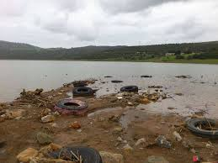
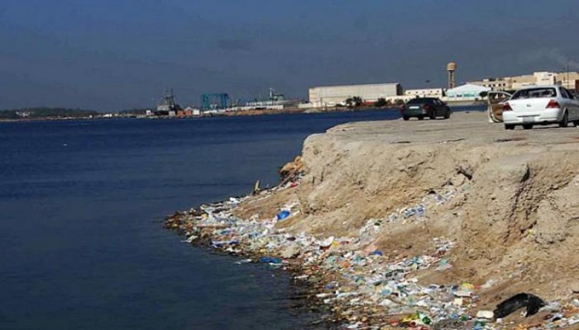
Introduction effect of scrape on the environment

Slide 6
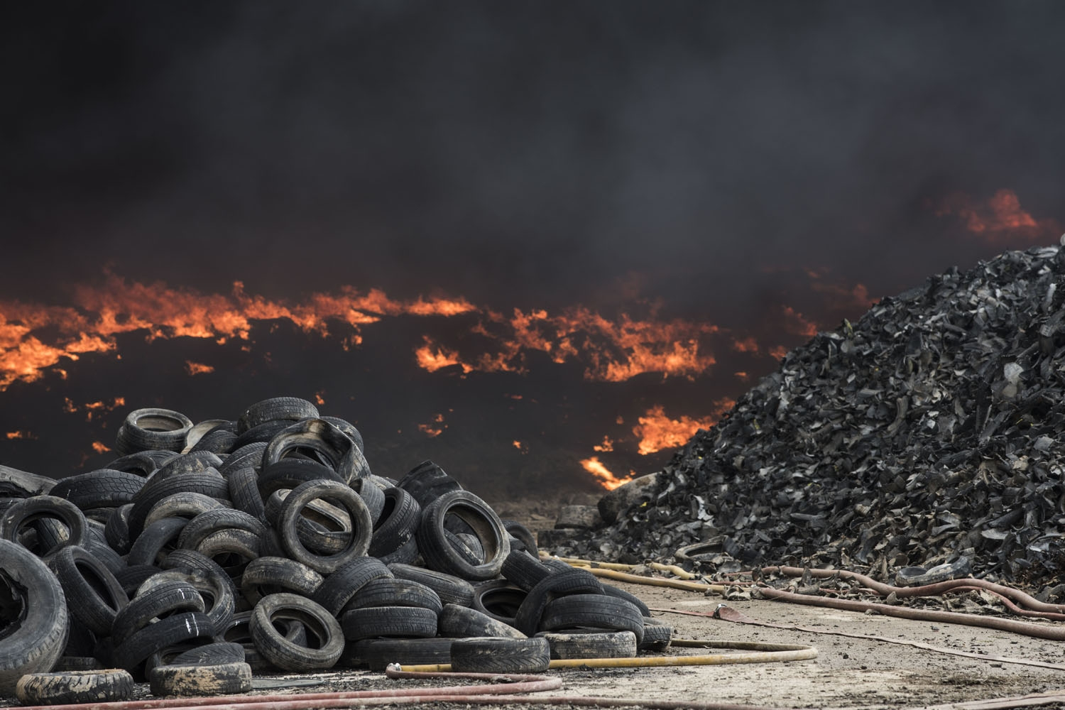
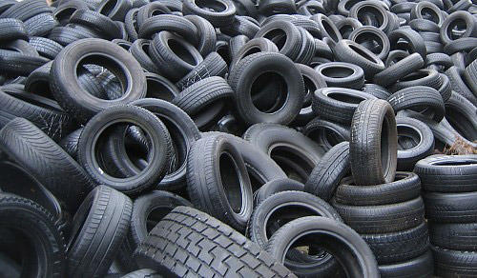
Introduction effect of scrape on the environment

Slide 7
Introduction scrap Ratio

Slide 8
Introduction over view
pyrolysis
char
oil
gas

Slide 9
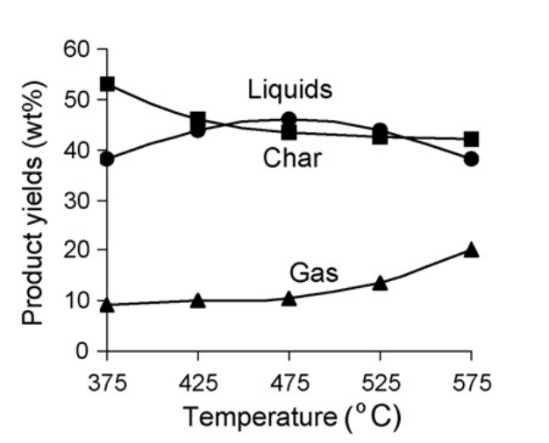
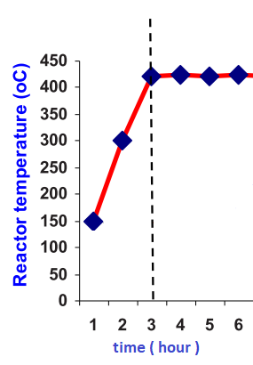
Introduction over view

Slide 10
Literatures Review

Slide 11
Literatures review
Alkhatib R. ,2015 , Development of an alternative fuel from waste of used tires by pyrolysis pp.30.
its objective is to get alternative fuel comparable with the available diesel in the market.
The optimum values are 465°C.
The obtained product is comparable with the diesel as it has energy of 45 KJ/kg, low density of 0.85 and 7% of the tar content

Slide 12
Literatures review
K. Januszewicz , M. Klein , E. Klugmann-Radziemska, D. Kardas , 2017. Thermogravimetric analysis/pyrolysis of used tyres and waste rubber ,pp.802.
To investigate the process of pyrolysis, the pyrolysis results of two samples of waste tyres and rubber were compared at different heating rate .
It was shown that the maximum of samples degradation of rubber and tyres was at (650–750) K

Slide 13
Literatures review
Abdul Aziz M.,Rahman M.A., Molla H.,2018, Design,fabricationand performance test of a fixed bed batch type pyrolysis plant with scrap tire in Bangladesh, pp.1.
The reactor is further used for the production of pyro oil from scrap tire
The result shows that reactor yields a maximum pyro oil of 42 wt% at the temperature of 400⁰C
The produced pyro oil has a higher viscosity of 4.5 (cst) and heating value of 42.5 MJ/kg
The char is potential for using as a fertilizer

Slide 14
Methodology

Slide 15

methodology
Experimental

Slide 16
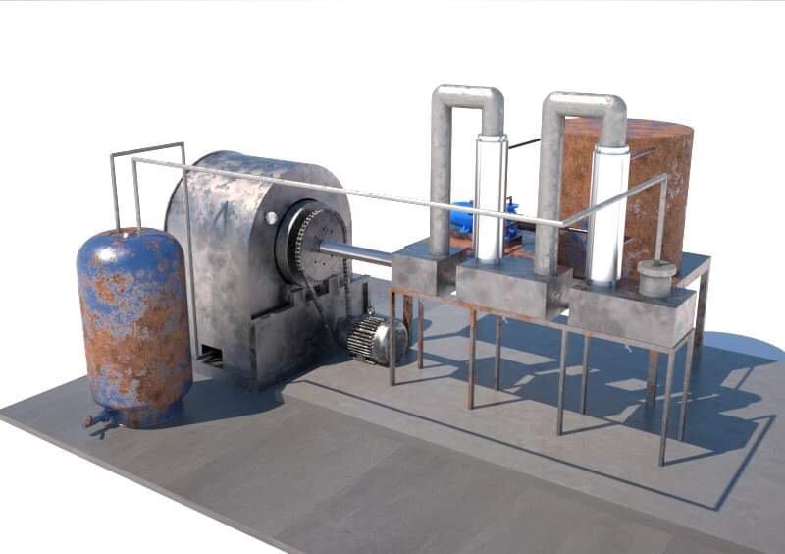
Experimental : setup design

Slide 17
Experimental : setup design
Component | Length (cm) | Thickness (cm) | Diameter (cm) | Hight (cm) | Width (cm) | Material
Furnace | 70 | 1 | 45 | 45 | 45 | Steel 1030
Holleber Shaft (pipe) | 15 | 1 | 10.5 | 10.5 | 10.5 | Steel 1030
Rotating Ring | 47.5 | 1 | 47.5 | 1 | 1 | Steel 1030
Rotating Groove Wheels | 4.5 | 4.5 | 9 | 9 | 4.5 | Steel 1030
Groove | 7.25 | 1.8 | 7.25 | 7.25 | 1.8 | Steel 1030
Outer Cover (half cylinder) | 77.5 | 0.3 | 76.5 | 38.25 | 38.25 | Steel 1030
Chimney | 30 | 0.4 | 11.5 | 30 | 11.5 | Steel 1030
Door | 85.75 | 4 | 63.5 | 85.75 | 63.5 | Steel 1030
Insolate (wool, mud) | 77.5 | 4 | 76.5 | 4 | 76.5 | Steel 1030
Outer Cover | 77.5 | 0.3 | 78.5 | 38.25 | 76.5 | Steel 1030
Back Side Door | 49 | 4 | 49 | 49 | 49 | Steel 1030

Slide 18
Experimental : setup design
Component | Length (cm) | Thickness (cm) | Diameter (in) | Hight (cm) | Width (cm) | Material
Condensed Oil Tank | 40 | 0.2 | 4 | 20 | 30 | Cast Galvanized Iron
Oil Reserve | 40 | 0.2 | N/A | 20 | 30 | Cast Galvanized Iron
Heavy Oil Tank | 15 | 0.2 | 4 | 20 | 15 | Cast Galvanized Iron
Heat Exchanger Cooling Unit | 90 | 0.2 | 4 | 90 | 10.16 | Cast Galvanized Iron
Condensig Pipe | 90 | 0.2 | 4 | 90 | 10.16 | Cast Galvanized Iron
Final Tank | 35 | 0.2 | N/A | 35 | 20 | Cast Galvanized Iron
Final Tank Chimney | 35 | 0.2 | 2 | 35 | 5.08 | Cast Galvanized Iron

Slide 19
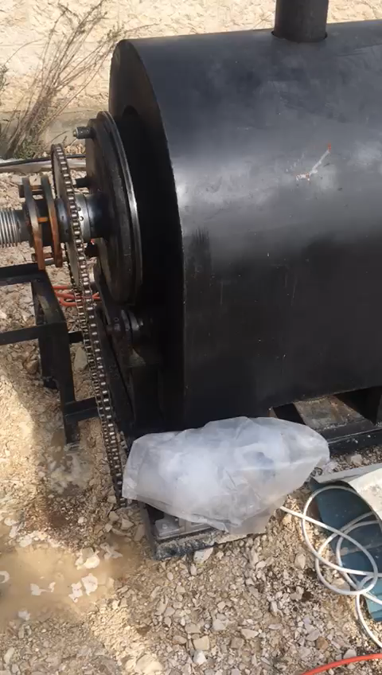
Experimental :
How the process happened

Slide 20
Experimental :
Runs: Conducted experiment (first exp. )
4 kilo of tires
1.5 L fuel
1.4 kilo black carbon
0.6 kilo wires
0.4 kilo gas

Slide 21
Experimental :
Runs: Conducted experiment (first exp. )
6 kilo of tires
2.4 L fuel
2.6 kilo black carbon
0.8 kilo wires
0.5 kilo gas

Slide 22
Cost estimation
$ & ILS

Slide 23
Cost estimation initial cost
Content | Cost (ILS)
Main Structure | 12000
Water pump | 120
Water tank | 30
Connection pipe and fittings | 50
casket | 150
Screws | 50
Gas gar | 100
Compressor | 500

Slide 24
Cost estimation running cost
Content | Cost (ILS)
Tires (1) | 5
Gas (1 gar ) | 70
Electric (1 kilo ) | 0.6

Slide 25
Future Work

Slide 26
Future work
Isolation
Increase isolation
Increase the thickness of isolation to save heat inside the reactor .
Heat exchanger
cooler
Put cooling unit in the water tank to cool the water to increase exchange efficiency .
heating
Put a heater coil around the reactor to accurate the temperature degree .
Amounts
Heater coil
Smooth iron
Plating the condensing containers with smooth surface , so that the quantities are more accurate .

Slide 27
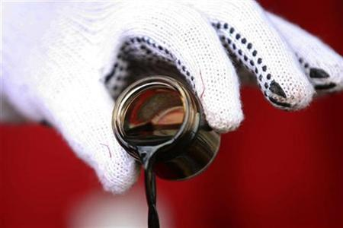
Thank You

