Slide 1




An-Najah National University
Graduation Project
MANAGEMENT INFORMATION SYSTEM DEPARTMENT
Design HiCar Application
Nawal Abdallah
Walaa Barham
Supervised by : Dr. Ahmad Shraideh

Slide 2




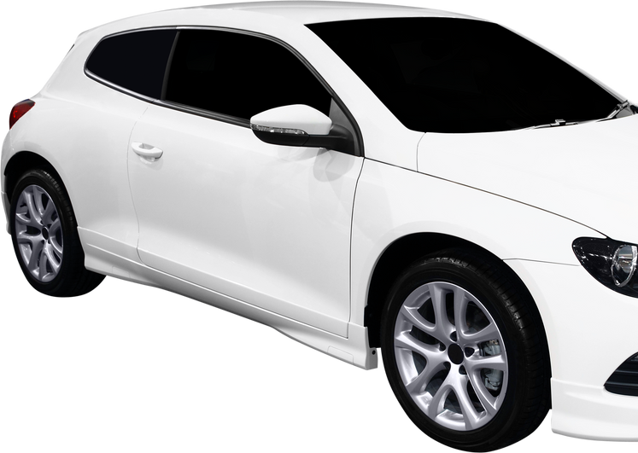
Introduction
The crisis on the laundries, especially in times of holidays and occasions, has become a real problem, as the crisis hinders the work of both the customer and the owner of the laundromat, hence the idea of our project HiCar

Slide 3
PROJECT IDEA
Design an application that includes a group of traditional car washers. Through the application, the customer communicates with the washers that suits his geographical location and also the costs, and the time that suits the customer is determined and he goes to wash the car without the need to wait.

Slide 4
Goals
1- Saving time for the customer
2- helping customer to choose the right time to wash his car
3- facilitating the washer car in booking appointments
4- reducing the crisis in the washing

Slide 5
WORK DONE
1- Designing application interfaces on Adobe XD
2- Prototype user interfaces on Kodular software to implement the program

Slide 6






TOOLS USED

Slide 7
FUTURE WORK :
Develop the program and publish it on Google Play and the Appstore

Slide 8

THANK YOU

