Slide 1

AN-Najah National University
Faculty of Engineering
Civil Engineering Department
Structural Design of a Hotel Building
Prepared by:
Mohammed Qawariq
Faris Kojok
Supervisor:
Dr. Sameer Al- Helo &
Dr. Riad Awad

Slide 2
Outlines:
Introduction
Design of Slabs
Design of Columns
Design of Footings
Design of Shear walls and Basement walls

Slide 3
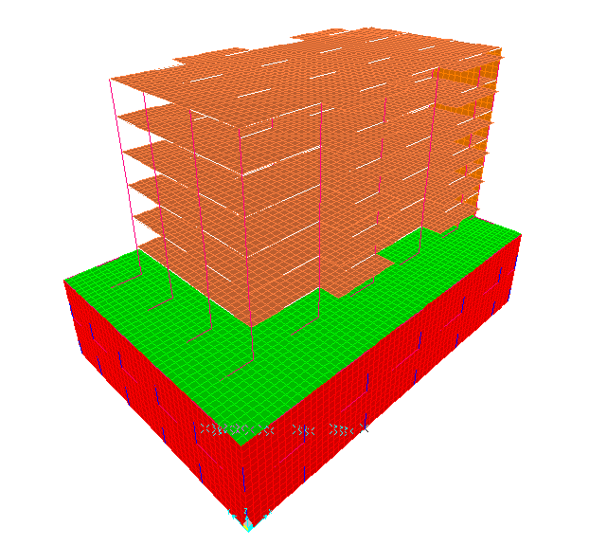
3D structure

Slide 4
Chapter One
Introduction

Slide 5
Project Description
The building consist of eight floors.
Five main floors and Three Garages floor.
The project have two axes of symmetry.

Slide 6
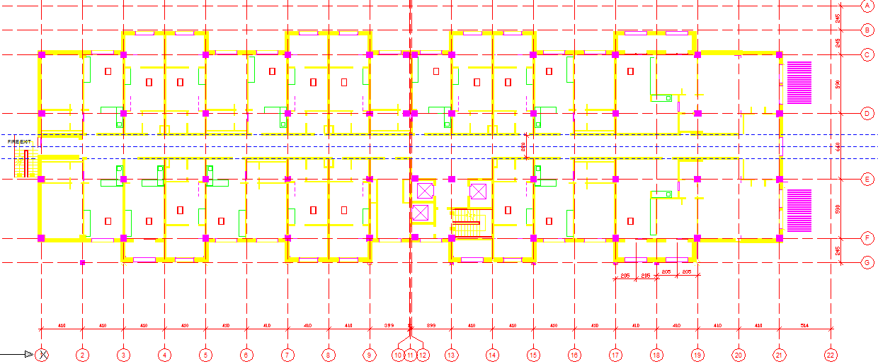
Plan of Ground Floor

Slide 7
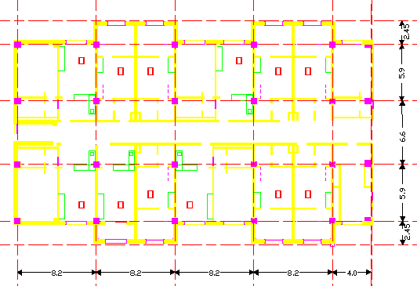

Slide 8
Area of the building
Area (m²) | Floor
2050 | Garages floor
1510 | Main floor
Height of each floor is 3m.
Soil Bearing capacity = 25 MPa

Slide 9
Program analysis: SAP2000.
Code: ACI-318 code (American Concrete Institute code).
Material:
Concrete with 𝒇'c = 25 Mpa , for main floors
Concrete with 𝒇'c = 30 Mpa , for garage floors
Steel with ℱy = 420 Mpa

Slide 10
Loads:
Ultimate load:
Wu = 1.2*(DL + SID) +1.6*LL
Super Imposed Dead Load(SID):
a. For the upper floors = 4.5 KN/m²
b. For garages = 4 KN/m²
Live Load(LL):
Live Loads (KN/m²) | Types of occupancy
1.9 | Guest rooms
5 | Garages
3.8 | Corridor

Slide 11
Chapter Two
Design of Slabs

Slide 12
Design of ribbed slab
(in Y direction)
ACI 318-08 table 9.5(a): minimum thickness(hmin)
member | simple | One end continuous | cantilever | Two end continuous
One way ribbed slab and beam | L/16 | L/18.5 | L/8 | L/21
one way solid slab | L/20 | L/24 | L/10 | L/28

Slide 13
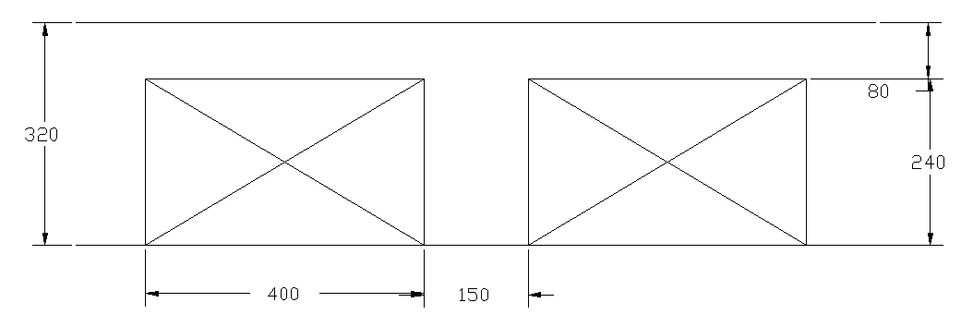
Design of ribbed slab
(in Y direction)
  Thickness of slab:
hmin1=5.9/18.5 = 0.32 m
hmin2=6.6/21 = 0.31 m
hmin3=2.45/8 = 0.31 m
use h= 0.32 m d= 0.28m

Slide 14
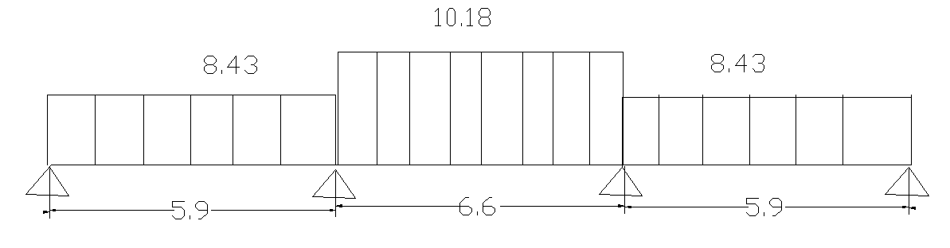
  Loads on slab:

Slide 15
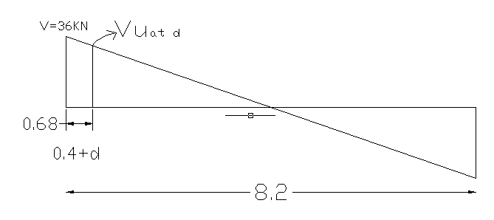
Design of slab for shear:
Using: 1 Ф 8mm/140mm

Slide 16
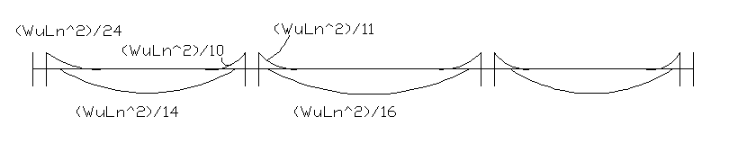
    Design of ribs for flexure:
    Using ACI coefficient
    Moment Envelop
ρ = (0.85*Fc / Fy)*[1 - (1 – (2.61*Mu/ b*d²*Fc))^{1/2}]
As= ρ * b*d

Slide 17
Shrinkage Steel:
As= 0.0018 *b*h = 0.0018*1000*80 = 144mm2
3Ф8mm/m
 | As (mm² ) | Mu (KN.m) | Moment Envelop
2 Ф 10 | 139.86 | 10.63 | Mu- =Wu₁ *Ln² /24
2 Ф 14 | 256 | 25.5 | Mu- =Wu₁ *Ln² /10
2 Ф 16 | 364 | 35.29 | Mu- =Wu₂ *Ln² /11
2 Ф 20 | 512.82 | 17.56 | Mu+ =Wu₁ *Ln² /14
2 Ф 20 | 512.82 | 24.27 | Mu+ =Wu₂ *Ln² /16

Slide 18
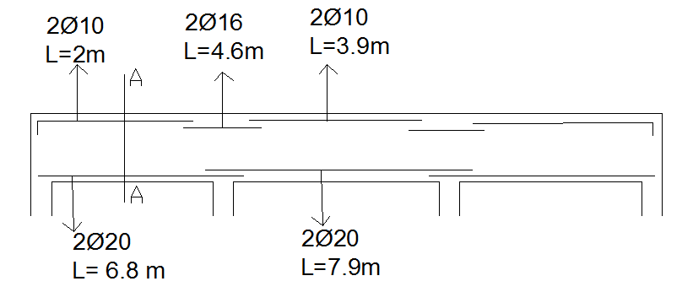
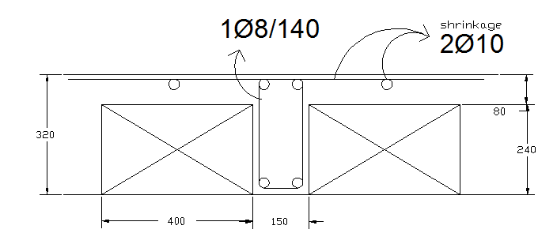

Slide 19
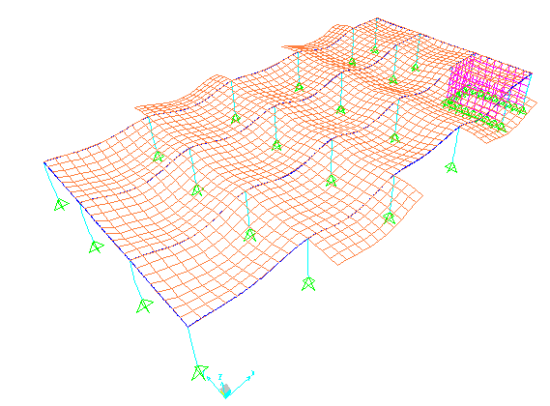
  Sap 2000 Model:
Checks:
compatibility check: Ok

Slide 20
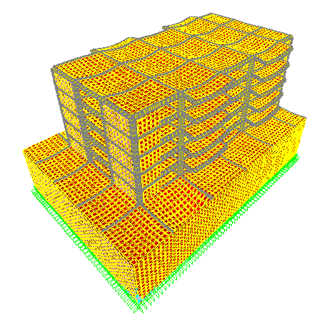

Slide 21
2. Equilibrium check:
Error% | Sap | Manual
0.00% | 1900.684 | 1900.684 | Live
0.00% | 3408.66 | 3408.66 | Superimposed
2.5% | 6198.789 | 6044 | Dead
Acceptable error

Slide 22
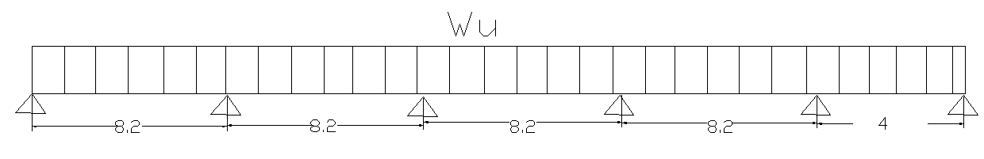
  Design of beams for ribbed slab:
    Thickness of beam:
h1 = 8.2 / 18.5 = 0.44 m
h2 = 8.2 / 21 = 0.39 m
h4 = 4 / 18.5 = 0.22 m
Use h = 0.6 m, d = 0.54 m, b = 0.4 m

Slide 23
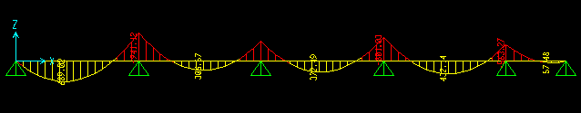
    Loads on beam:
    Wu = 125 KN/m
Design of beam for flexure:
Bending moment diagram from sap:
Design of beam for shear:
1 Ф 10/60 mm

Slide 24
Chapter Three
Design of Columns

Slide 25
Strength of axially loaded columns:
The nominal compressive strength of axially loaded
column(Pn).
Pn =0.65*0.8*[0.85*Fc*(Ag – As) + As*Fy]
Ag: gross area of column
As: area of steel
As =0.01 Ag
Ag = a*b (dimensions for column)

Slide 26
Strength of axially loaded columns:
Dimensions | 800*800 (mm) | 600*600 (mm) | 550*550 (mm) | 500*500 (mm) | 450*450 (mm) | 400*400 (mm) | 350*350 (mm) | 300*300 (mm)
Ag(mm²) | 640000 | 360000 | 302500 | 250000 | 202500 | 160000 | 122500 | 90000
As(mm²) | 6400 | 3600 | 3025 | 25000 | 2025 | 1600 | 1225 | 900
Pn,max (KN) | 9799 | 5512.1 | 4631.7 | 3827.9 | 3100.6 | 2449.8 | 1875.6 | 1378
Columns group
group | C1 | C2 | C3 | C4 | C5 | C6 | C7 | C8
# of columns | 6 | 6 | 2 | 2 | 2 | 2 | 2 | 2

Slide 27
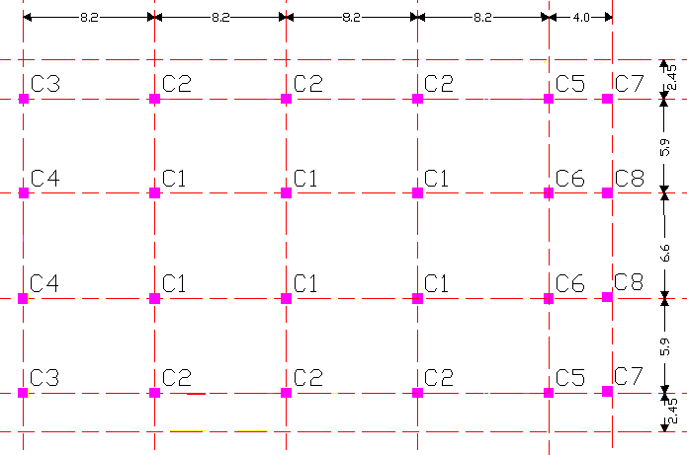

Slide 28
Ultimate load and dimensions of columns
Column | C1 | C2 | C3 | C4 | C5 | C6 | C7 | C8
Ultimate load from SAP | 8621.3 | 6590 | 4362.6 | 5989.3 | 4887.3 | 6328.8 | 1700.6 | 2521.7
Suitable dimensions of column (mm) | 800*800 | 700*700 | 550*550 | 650*650 | 600*600 | 650*650 | 400*400 | 450*450

Slide 29
Check of slenderness ratio
Column | C1 | C2 | C3 | C4 | C5 | C6 | C7 | C8
K Lu/r | 12.5 | 14.29 | 18.18 | 154 | 16.66 | 15.4 | 25 | 25
34-12(M1/M2) | 32.99 | 32.5 | 28.2 | 28.2 | 28.24 | 282 | 28 | 27.9
Type of column | short | short | short | short | short | short | short | short
Design of columns
Column | As (mm² ) | # of bars | Spacing between bars (mm) | Tie spacing (mm)
C1 | 6400 | 22 Ф 20 | 90 | 320
C2 | 4900 | 16 Ф 20 | 150 | 320
C3 | 3025 | 16 Ф 16 | 110 | 250
C4 | 4225 | 22 Ф 16 | 110 | 250
C5 | 3600 | 18 Ф 16 | 125 | 250
C6 | 4225 | 22 Ф 16 | 110 | 250
C7 | 1600 | 12 Ф 14 | 100 | 220
C8 | 2025 | 14 Ф 14 | 100 | 220

Slide 30
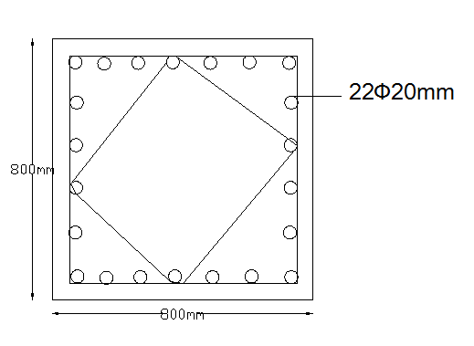
Cross section in column C1

Slide 31
Chapter Four
Design of Footings

Slide 32
  Selection of footing system :
The axial forces in all columns in the building and the corresponding single footing area.
Qall =(PDL+PLL)/L*B
Column# | c1 | c2 | c3 | c4 | c5 | c6 | c7 | c8
Service load (KN) | 6687 | 5201.22 | 3513 | 4718.4 | 3864.2 | 4902.8 | 1356.3 | 1978.4
Footing area (m²⁾ | 26.748 | 20.8048 | 14.052 | 18.8736 | 15.4568 | 19.6112 | 5.4252 | 7.9136
  Total area =474.9821 m² < area of building/2
  use single footing

Slide 33
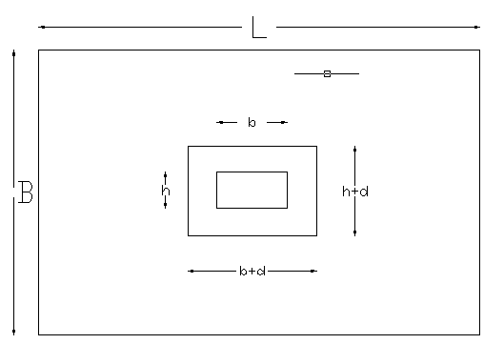
Design of Isolated footings

Slide 34
The following table shows the all footing in the building and dimensions for it:
Footing for Column group No. | service load (KN) | footing area (m²) | L for Square footing (m) | Pu KN | σu KN/m² | Effective depth d (mm) | Footing depth h (mm)
F1 | 6687 | 26.748 | 5.2 | 8640.8 | 319.5562 | 870 | 950
F2 | 5201.22 | 20.80488 | 4.6 | 6590 | 311.4367 | 750 | 830
F3 | 3513 | 14.052 | 3.8 | 4362.6 | 302.1191 | 620 | 700
F4 | 4718.4 | 18.8736 | 4.4 | 5989.3 | 309.3647 | 770 | 850
F5 | 3864.2 | 15.4568 | 4 | 4887.3 | 305.4563 | 700 | 780
F6 | 4902.8 | 19.6112 | 4.5 | 6328.8 | 312.5333 | 800 | 880
F7 | 1356.3 | 5.4252 | 2.4 | 1700.6 | 295.2431 | 400 | 480
F8 | 1978.4 | 7.9136 | 2.9 | 2521.7 | 299.8454 | 500 | 580

Slide 35
The following table shows the reinforcement for each footing:
Footing for Column group No. | Mu KN.m / m | ρ | As | Number of bars in each direction
F1 | 773.326004 | 0.00276117 | 2623.114951 | 9 Ф 20mm/m
F2 | 592.119026 | 0.00284688 | 2362.914384 | 8 Ф 20mm/m
F3 | 398.891624 | 0.00280545 | 1963.818174 | 7 Ф 20mm/m
F4 | 543.805137 | 0.00247273 | 2101.822535 | 7 Ф 20mm/m
F5 | 441.384354 | 0.00242757 | 1893.502391 | 7 Ф 20mm/m
F6 | 579.065605 | 0.00243859 | 2145.957374 | 7 Ф 20mm/m
F7 | 147.62155 | 0.00248771 | 1194.100729 | 4 Ф 20mm/m
F8 | 224.977752 | 0.00242516 | 1406.595391 | 5 Ф 20mm/m

Slide 36
Chapter Five
Design of Shear walls and Basement walls

Slide 37
Design of Shear walls:
As = ρ *b*h
= 0.0025 *200*1000 = 500 mm²/m → Use 5ϕ12 mm/m .
Other direction (horizontal):
As = As,min = 0.0018 *b*h
= 0.0018 * 200 * 1000 = 360 mm²/m → Use 4ϕ12 mm/m.

Slide 38
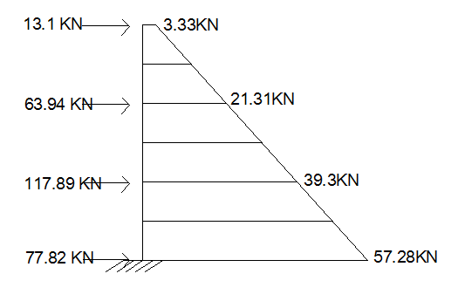
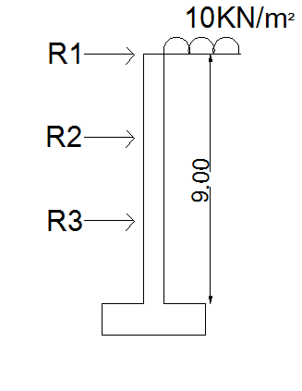
Design of Basement walls:
f’_{c} = 30 MPa , f_{y} = 420 MPa , Ф = 30º , γ = 18 KN/m³ , live load= 10 KN/m²
Stem design:
Ka = (1-sin Ф) / (1+sin Ф) = 0.333
This figure shows structural model of basement wall

Slide 39
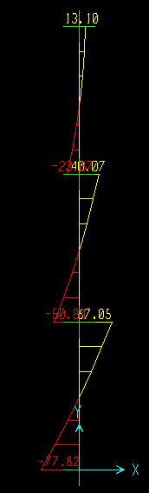
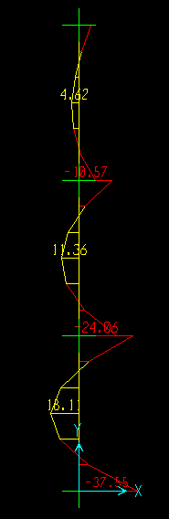
Shear force diagram Bending moment diagram

Slide 40
Assume Vu = Pu = 1.4 * 77.82 = 108.95 KN
Vu = Ф Vc 108.95 = 0.75*(1/6)* (30)^{1/2} *1000*d/1000
d = 160 mm
Use h = 250 mm , d = 170 mm
This table shows the reinforcement for each moment.
Mu KN.m/m | Ρ | As mm²/m | A_{s,use} mm²/m | # of bars
34.88*1.4 = 48.832 | 0.00464 | 788.8 | 788.8 | 7 Ф12
-18.1* 1.4 = 25.34 | 0.00236 | 401.2 | 566 | 5 Ф12
-11.36*1.4 =15.904 | 0.0014 | 238 | 566 | 5 Ф12
21.4*1.4 = 29.96 | 0.0028 | 476 | 566 | 5 Ф12
-4.62*1.4 = 6.468 | 0.0006 | 102 | 566 | 5 Ф12
7.91*1.4 = 11.074 | 0.00102 | 173.4 | 566 | 5 Ф12

Slide 41
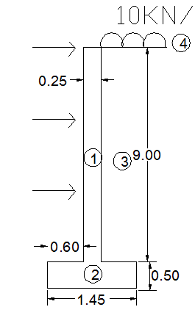
Reinforcement in other direction (horizontal):
Two layers each layer has
As = ½ *0.002 * b*h
= ½ * 0.002 * 1000 *250 = 250 mm²/m
Use 5 Ф8 mm/m. for each layer

Slide 42
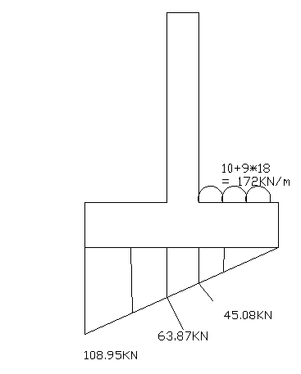
Heal design:
ρ = 6.36*10⁻⁴
As = 6.36 *10⁻⁴ * 1000* 420 =267.12 mm²/m
As_{min} = 0.0018*1000*500 = 900 > As
Use A_{smin} = 8φ12/m
Toe design:
A_{S} = 900 = 8φ12/m

Slide 43
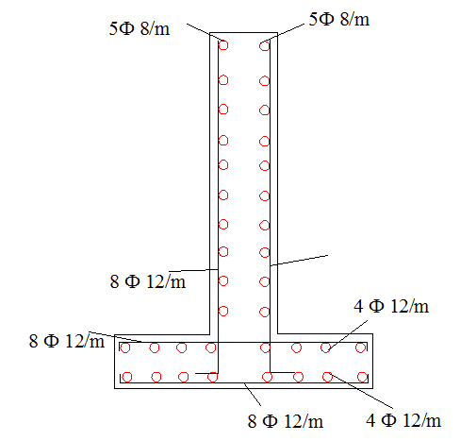
Longitudinal steel in footing:
As = A_{smin} = 0.0018*1000*500 = 900 mm2/m
= 8φ12/m for two layers
Each layer 4φ12/m
Cross section in basement wall

Slide 44
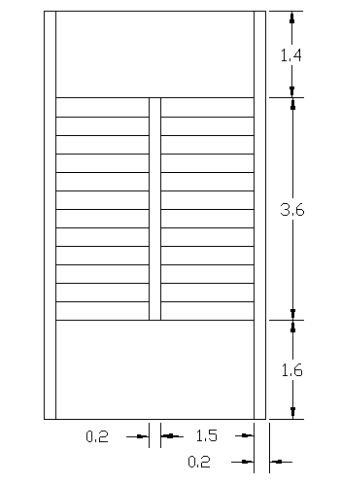
Design of stairs:
The thickness of the flight and
landing can be calculated as follows:
Flight span = 4.0 m
hmin = 4/20 = 0.20 m
d= 0.16 m
Loads on stairs:
Live load = 4.8 KN/m²
Dead load = 0.2 * 25 = 5 KN/m²
Super imposed dead load = 4.5 KN/m²

Slide 45
reinforcement for flight:
As = 0.0041 * 1000 * 160 = 656.5mm²/m
Use 5 Ф14 mm/m (8 Ф14 in 1.5 m)
Load on landing = landing direct loads + loads form flight
= 19.08 + 19.08 * (4/2)
= 57.24 KN/m
As = 0.01 * 1000 * 140 = 1600 mm²
Use 10 Ф14 mm/m

Slide 46
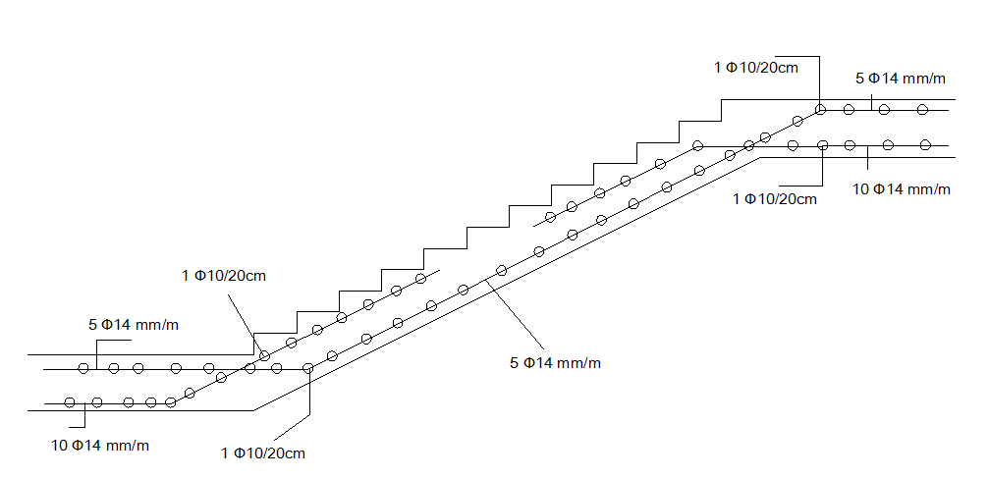
This Figure shows cross section in stairs

Slide 47
Thank you

