Slide 1

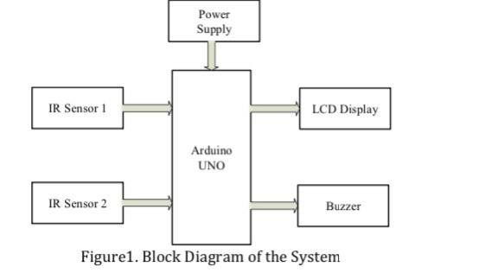
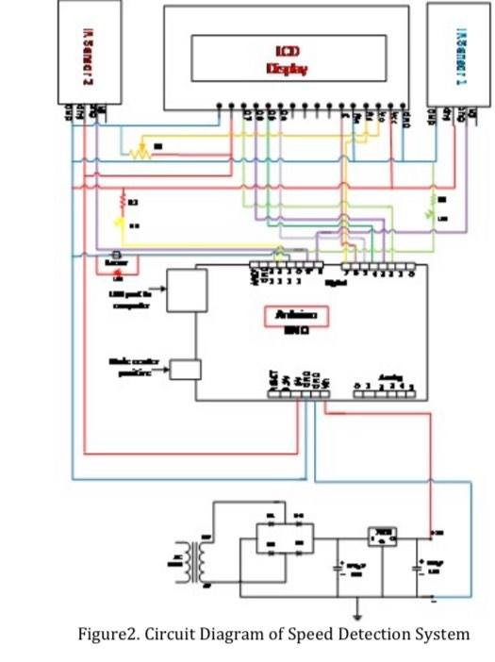
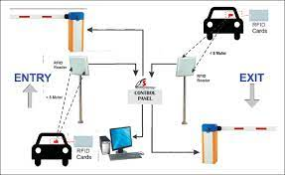
shows the results of the simulation to tracking saliency under the healthy operating conditions as given in table 1 and in cases of single-phase open-circuit fault as given in tables 2, and
Car speed Detection
Mohammed Khader , Yassir Abu-Zeinah , Dr-Falah Hassan
Objectives
Road accidents have been very common in the present world and the main cause of them is reckless driving. The necessity to verify this was very necessary and different methods have been used so far. But with the advancement in technology, various governing bodies are demanding some kind of computerized technology to quickly control the problem of excessive driving. In this scenario, we propose a system to detect a vehicle being driven above the specified speed limit set by roads or highways. The speed detector works on the principle of the effect of comparing the speed with the preset limit
Problem Statement
Principle of the Project:
RFID Card is not available in the area we are in and we searched on the
internet to get the product, but it needs a long delivery period as it is not suitable for us to complete the project on time.
When a car travelling reaches the first sensor, the IR Sensor gets activated. From this moment onward, a timer is initiated and will continue to keep time until the car reaches the second IR Sensor..By simulating the distance between the two sensors to be 20 CM, Speed Speed = Distance ÷ Time We We made a limiter for the speeds of the cars using the Arduino Anno and the sensors, where when the speed exceeds 0.5 km / hr and does not exceed 0.7 km / hr, then the yellow light is ignited, and also when the speed exceeds 0.7 km / hr and does not exceed 0.1 km / hr, the red light is lit and when the speed exceeds 0.1 km/hr The servo is turned to 180 degree position where the car obstacles are placed in the street.
Block Diagram&Components
How to connect the project circuit
Breadboard
Arduino Uno
IR Sensor x 2
16×2 LCD Display
1k Resistor
Male to Male Jumper Wires
Male to Female Jumper Wires
Car
servo motors
RGB LED
improvement for the project
  1- Smart Radar
  The speed is compared with the preset threshold and camera is triggered if the speed limit exceeds. Acquisition and transfer of image is done by a HD camera interfaced with raspberry pi.
  2- RFID Card
  RFID Vehicle SolutionMetal shell Compatible Output Interface: Wiegand26 bits 3 color LED display shockproof
Conclusion
The designed detection system continuously monitors the speed of the approaching vehicle. It minimizes the difficulties of traffic department and make ease to control the rash driving / over speed vehicles on highways.
  l

