Slide 1
Evaluation of Service Quality in Hotel Industry
Prepared by :
Anas Abadi Aseel ayyoub Fatima Bsharat Qais Aydi
Presented to:
Eng. Tamer Haddad Dr. Ramiz Assaf Dr. Yahya Saleh

Slide 2
Outline
Statement of work
Review
Methodology
Questionnaire
Results and Analysis
Discussion
Conclusion
Recommendations

Slide 3
Statement of work
The TQM at hotels sector should be studied.
The significance of quality management of this sector should be displayed.
The factors of quality management should be determined.
Informing the hotel of the results and trying to focus on weakness points.

Slide 4
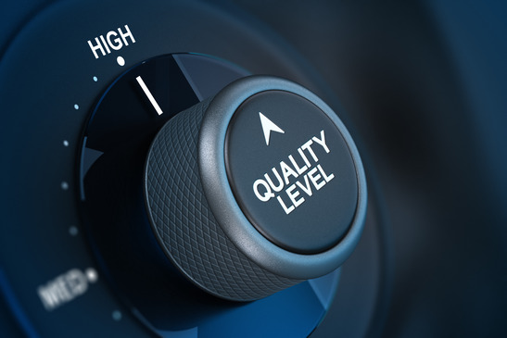
Review

Slide 5
Methodology
Data Collection
Data Analysis
Results
Conclusion & Recommendations

Slide 6
Questionnaires
Likert Scale
SERVQUAL Scale

Slide 7
Likert Scale
1. The support of senior management for the application of Total Quality Management.
2. Education and training and continuous improvement.
3. Create a business climate and culture of the organization and form working groups for quality.
4. The effective management of human resources.
5. Capable leadership to implement the TQM.
6. Performance Measurement and establish an information system for TQM

Slide 8
SERVQUAL Scale
Tangibles
Reliability
Responsiveness
Assurance
Empathy
Customer satisfaction

Slide 9
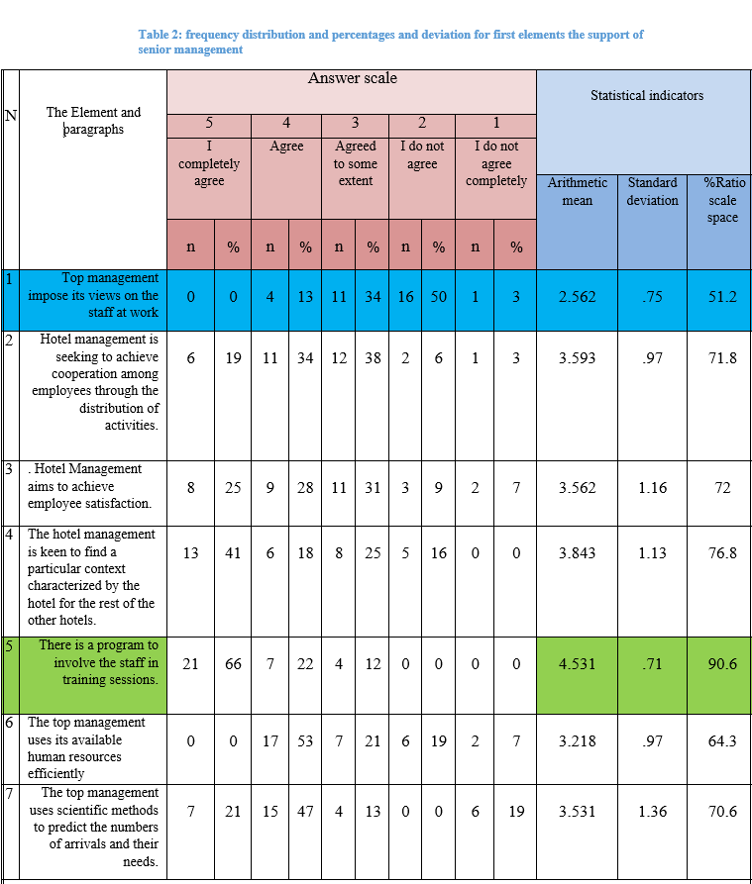
Results and Analysis

Slide 10
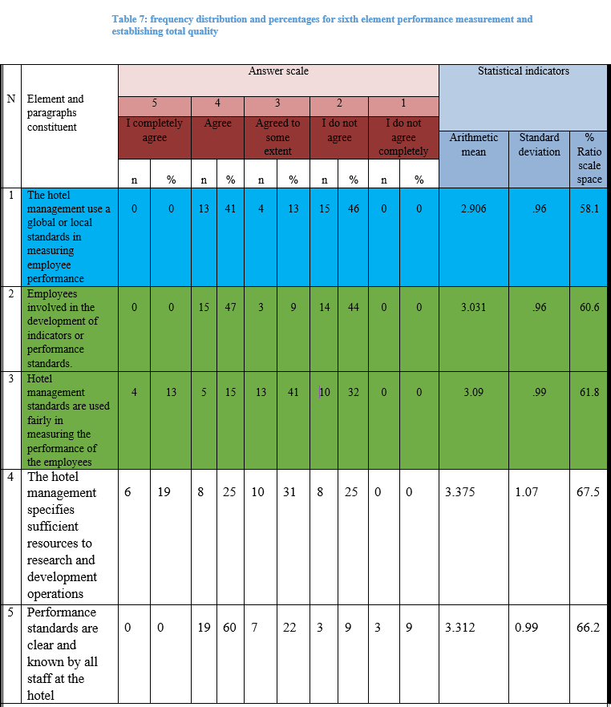

Slide 11
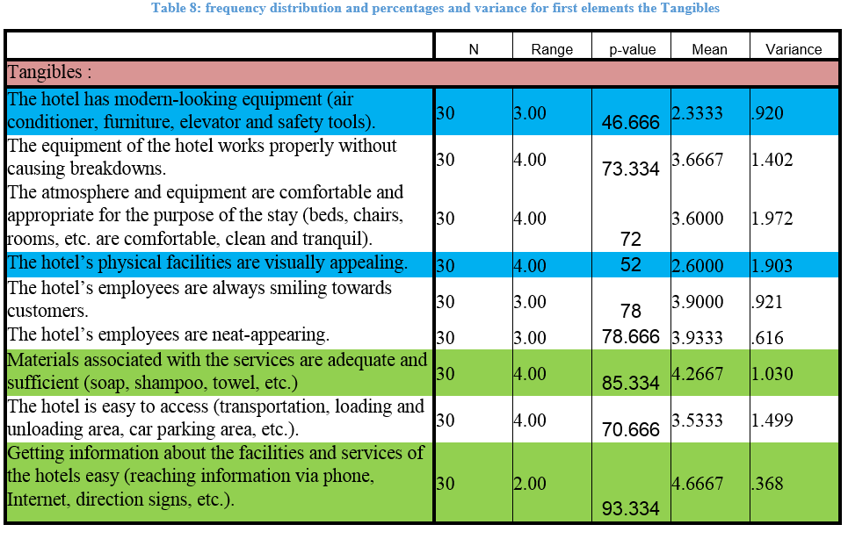

Slide 12
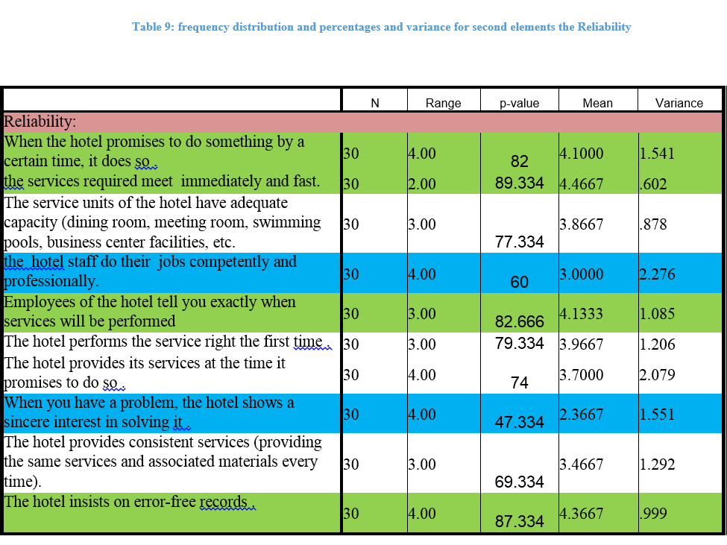

Slide 13
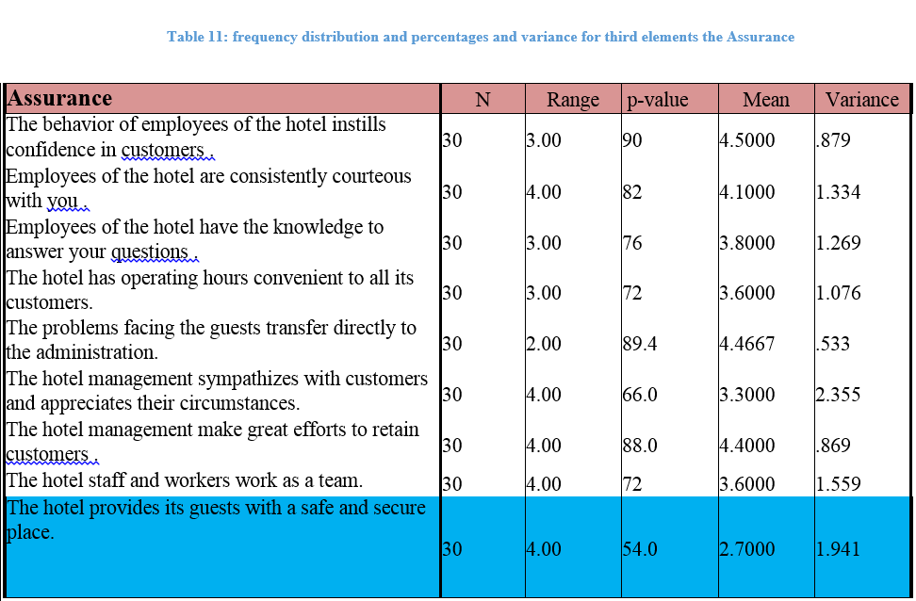

Slide 14

Discussion

Slide 15
The Staff Questionnaire
“Top management impose its views on the staff at work”
The hotel management should give their employees the role when there is decision making by inviting them to the meetings, taking their suggestions and opinions, and motivate the employee who has good ideas.
“The hotel management use a global or local standards in measuring employees performance”
Attendance at work and collaboration between them.
Use a relatively large number of criteria when evaluating performance, not focusing on one criteria when measuring.

Slide 16
The Customer Questionnaire
Tangibles:
The hotel has modern-looking equipment (air conditioner, furniture, elevator and safety tools)
Upgrading the equipment more rapidly or maintaining the outer look of the equipment more.
Tangibles:
The hotel’s physical facilities are visually appealing
Changing the look of the hotel to a more modern one and by performing maintenance operations more frequently.
Reliability:
When you have a problem, the hotel shows a sincere interest in solving it
Inviting the workers to workshops in order to improve their knowledge of the hotel and the way services are properly performed.
Assurance:
The hotel provides its guests with a safe and secure place
The hotel should consider adding a shelter to its facility and provide more secure windows and doors.

Slide 17
Conclusion
The support of the hotel management.
Education and training and continuous improvement.
Creation of a suitable environment to work.
Effective management of human resources.
Capable leadership of applying TQM.
Performance measurement and establishing Total Quality Management Information System.

Slide 18
Recommendations
Adopt TQM approach in its work by focusing on the entire internal customer (the employee) and external customer (guest).
Increase the attention to management practices that create better integration of employees as customers interns.
Construction and management of a good information system

Slide 19
Recommendations (Contd.)
A support from Authority of tourism.
To improve the external appearance of the hotel.
A continuous maintenance for every each hotel property.
Give greater importance to the side of the safety.

Slide 20


