Slide 1


An-Najah National University
  Faculty of Engineering and Information Technology
Mechanical Engineering Department
Utilizing Solar Energy for Extracting Fresh Water in Palestine
By
Ahmad Zabadi
Wael Ibrahim
Mohammad Omar
Under supervision of: Dr. Ramez Khaldi

Slide 2
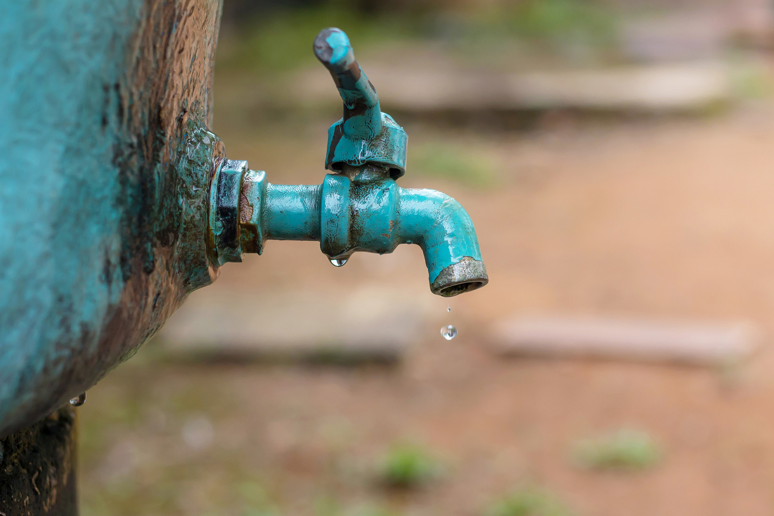
Introduction
Introduction
  General Background
  Water in Palestine

Slide 3
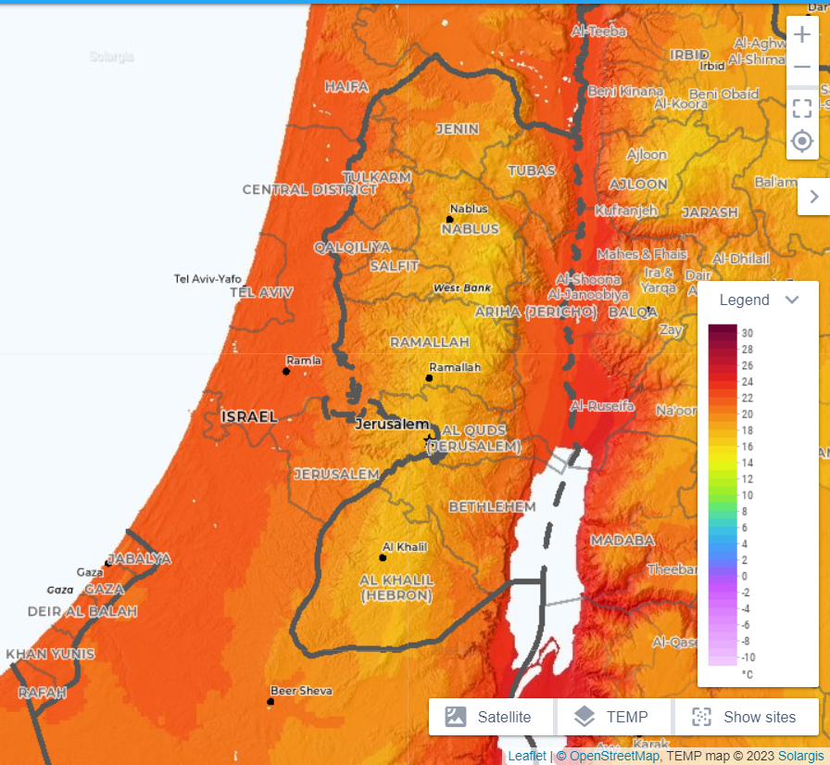
Temperature
In summer:
25-30 °C
50-70% RH
In winter:
5-15°C
60-80% RH

Slide 4
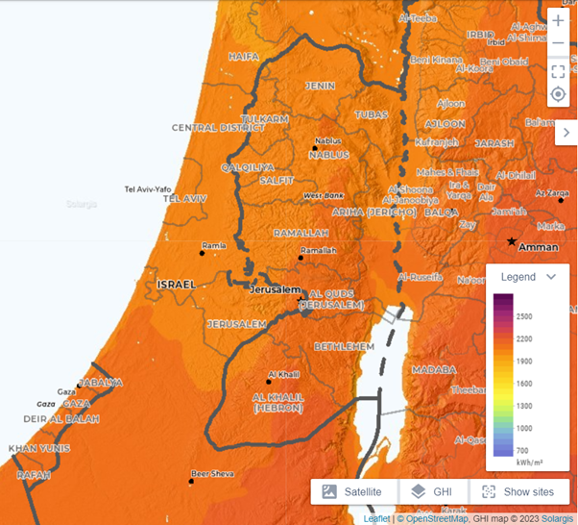
Irradiance
(3000) HOURS YEARLY
(5.4-6) KWH/m2

Slide 5

Solar Energy

Slide 6
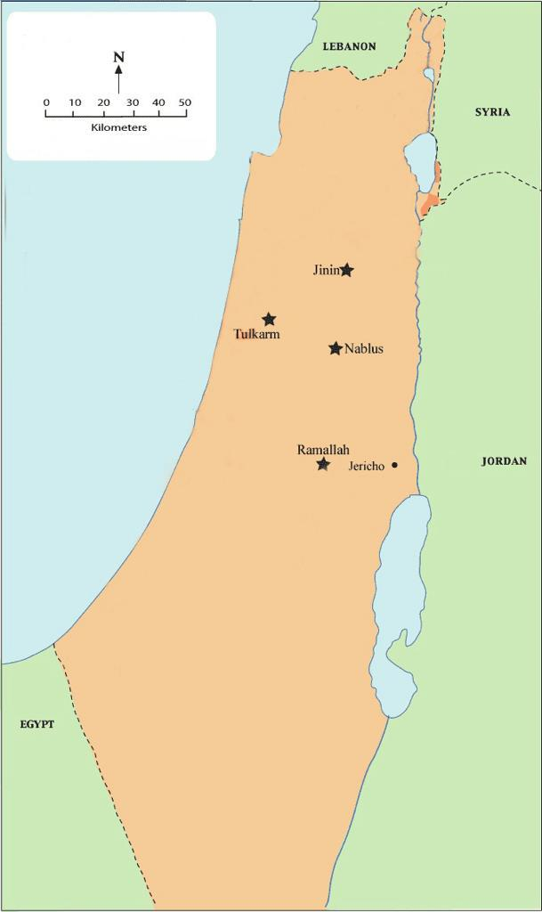
  Methodology
Location of study:

Slide 7
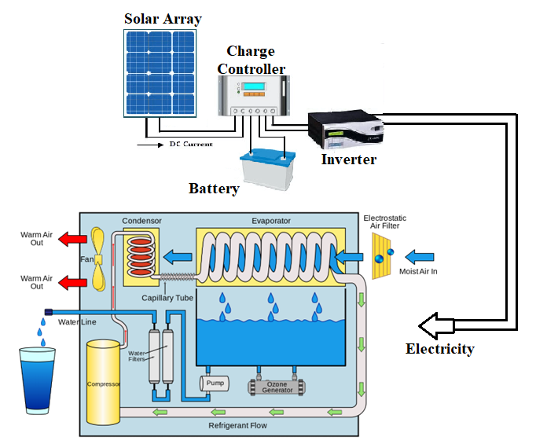
Description of the AWG System:

Slide 8
  The Procedure of the Experimental Study:
G air = 1/(X1-X2) [Kg air / Kg h2o]
Qo = Gair. (h1-h2) [KJ / Kg h2o]
P = Qo / (EER. 3600) [kwh electricity / Kg h2o]
C= Pp. [NIS / Kg h2o]
Size of solar energy = P / Power Generation Factor for Palestine [kW/ 1 liter]

Slide 9
The properties of moist air at the outlet of the evaporator
17 | 16 | 15 | 14 | 13 | 12 | 11 | 10 | 6 | (℃) | t
100 | 100 | 100 | 100 | 100 | 100 | 100 | 100 | 100 | (%) | Φ
0.0121 | 0.0113 | 0.0106 | 0.0099 | 0.0093 | 0.0087 | 0.0081 | 0.0076 | 0.0058 | (kgH20/kgair) | x
47.73 | 44.78 | 41.94 | 39.21 | 36.58 | 34.04 | 31.60 | 29.24 | 20.59 | (kJ/kgair) | h

Slide 10
Results and Analysis
  Cooling load needed to produce 1 liter of water
Ramallah

Slide 11
  Cooling load needed to produce 1 liter of water
Jenin

Slide 12
  Cooling load needed to produce 1 liter of water
Tulkarm

Slide 13
  Cooling load needed to produce 1 liter of water
Nablus

Slide 14
  Cooling load needed to produce 1 liter of water
Jericho

Slide 15
  2.Energy consumption (Electricity) for the production of 1 liter of water

Slide 16
  3.Cost of producing 1 liter of water

Slide 17
  4.Size PV Modules

Slide 18
Conclusions
Potential Benefits of Atmospheric Water Generators (AWGs).
Study on AWG Efficiency in Tulkarm, Palestine.
AWGs as a Promising Solution for Water Scarcity in Palestine, Considerations and Future Research.

Slide 19


