Slide 1
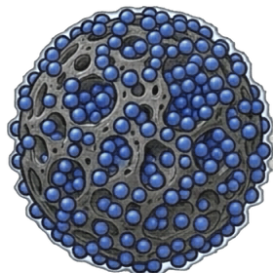

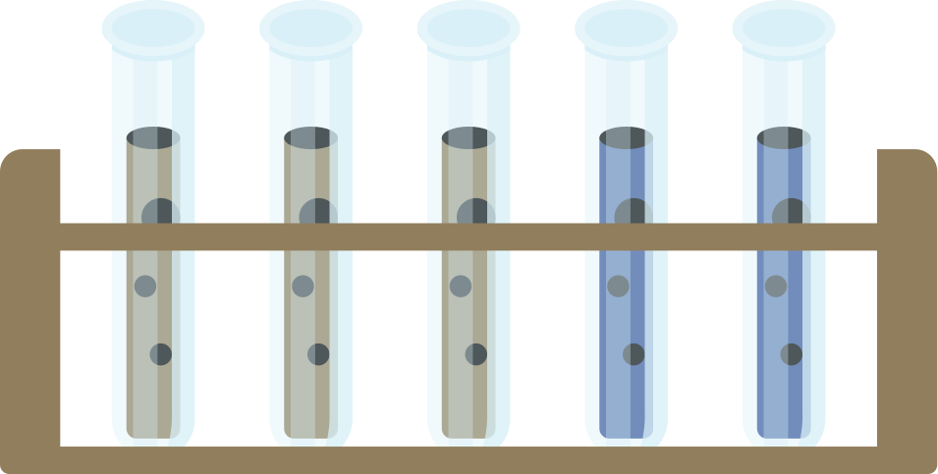
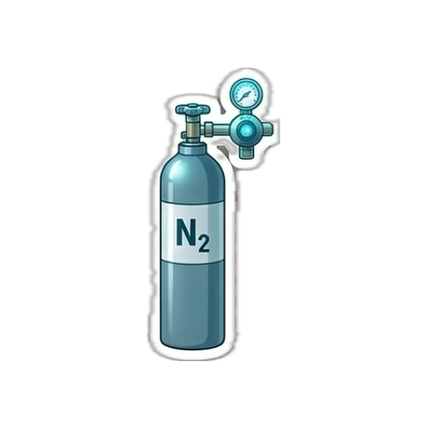
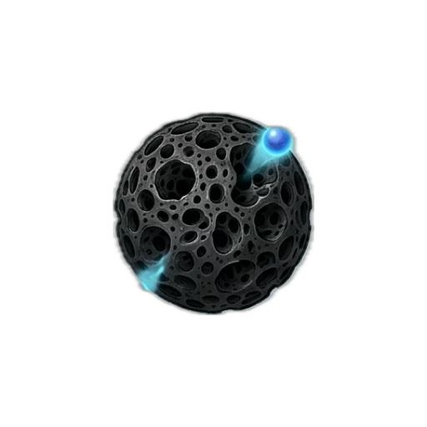
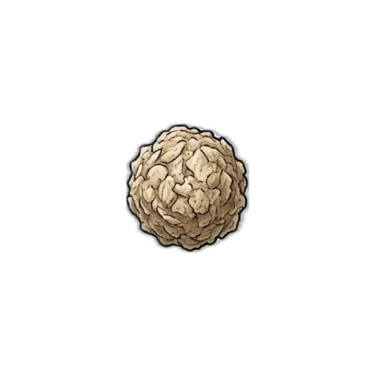
Faculty of Engineering
Chemical Engineering program
Graduation Project (2)
Biochar Production and Characterization from Sesame Husk Waste for Environmental Application: Methylene Blue Adsorption
Prepared by:
Khalid Owies Sarah Al-Heeh Shayma’ Sulaiman
Supervised by:
Prof. Amer El-Hamouz

Slide 2




Problem Statement
Methodology
Biochar Characterization
What is Biochar?
Contents
Project Objectives
Activation
Why Sesame Husk?
Adsorption Experiment
Results Analysis
Conclusions
2

Slide 3
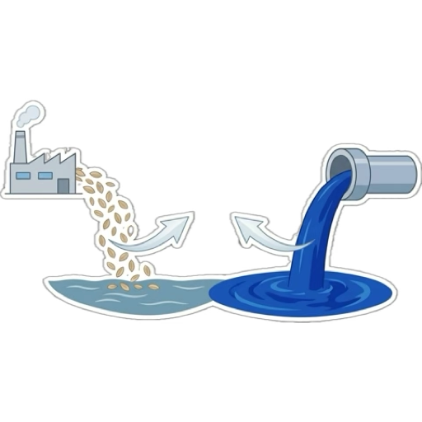
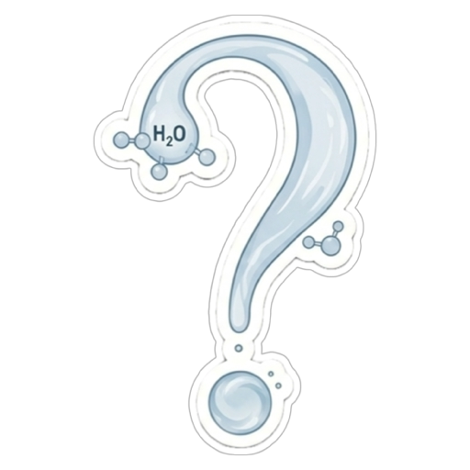
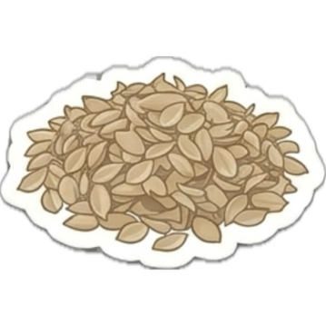
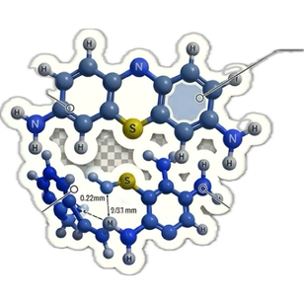
The Problem ?
3

Slide 4
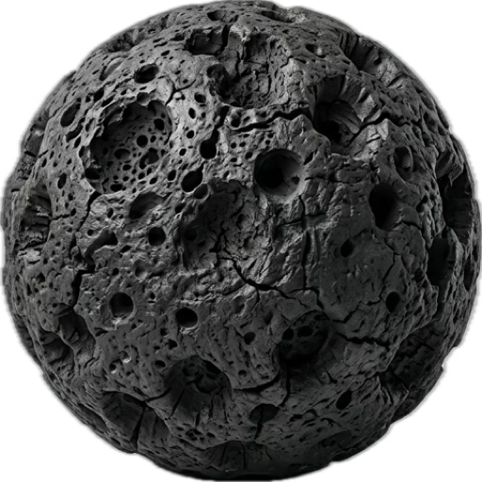
Biochar

Slide 5
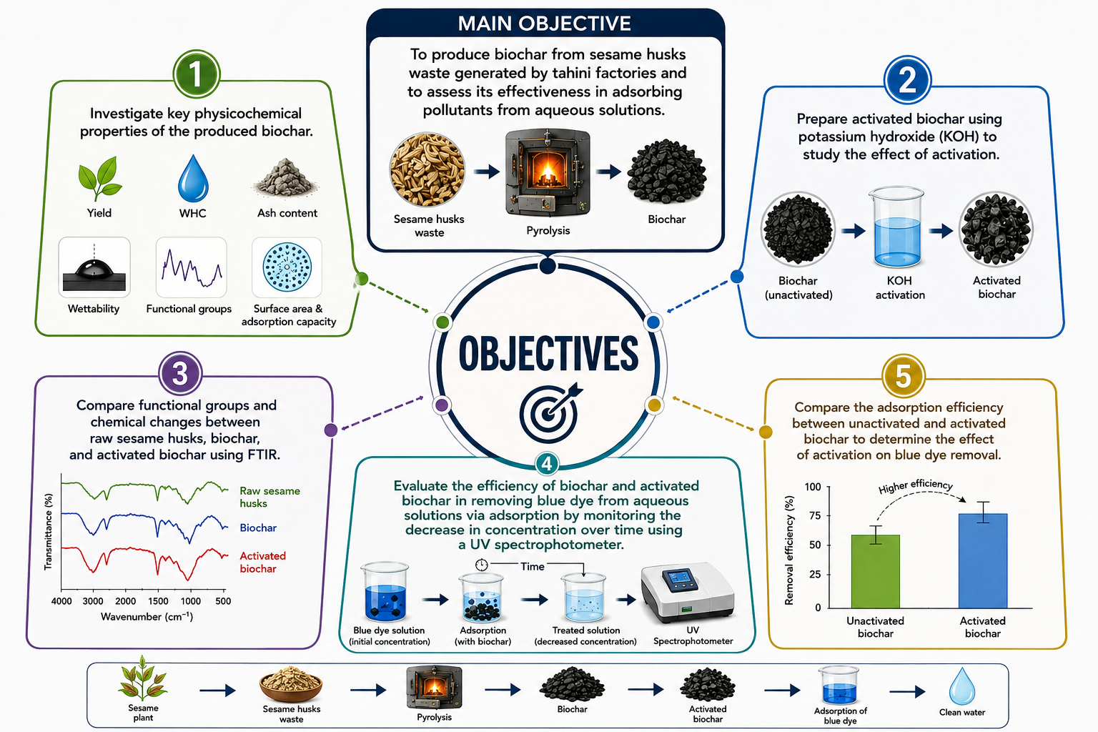

Slide 6
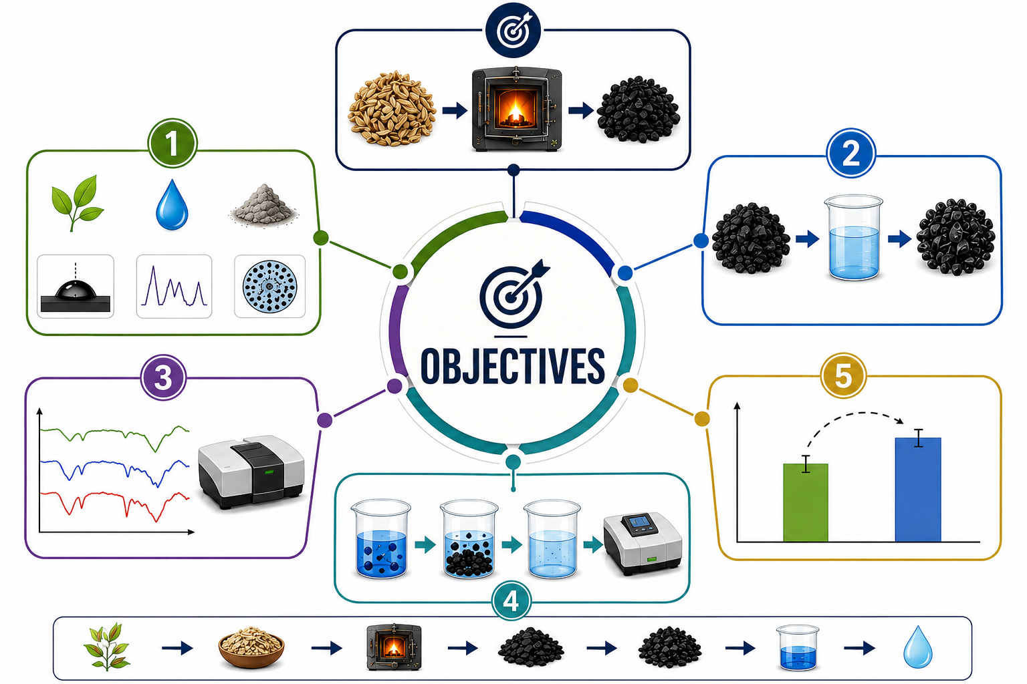

Slide 7
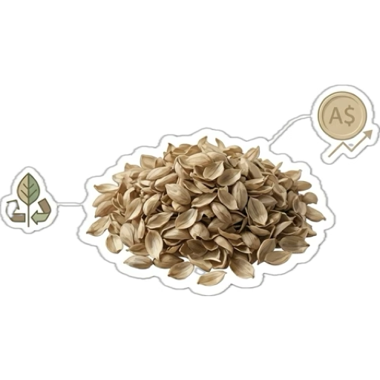
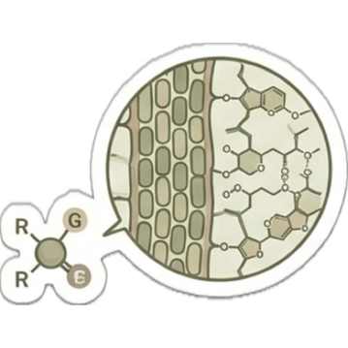
Why Sesame Husk ?
Low Cost
Agricultural Waste
Rich Lignocellulosic Compounds

Slide 8


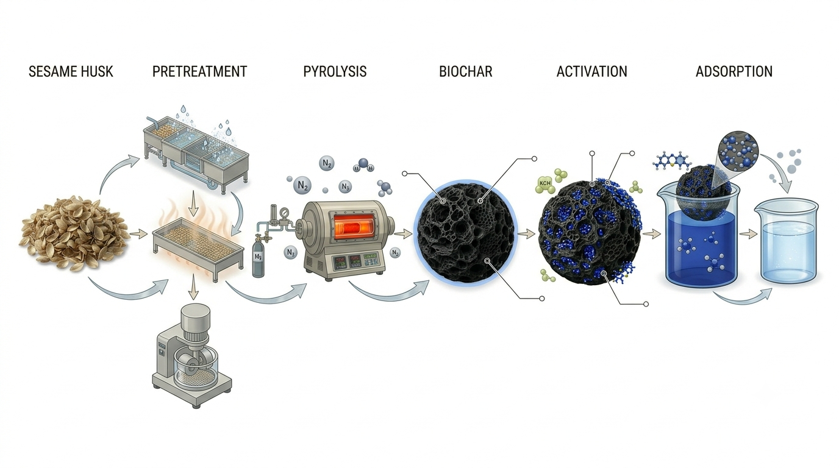
Transformation Journey
Sesame Husk
Pretreatment
Pyrolysis
Biochar
Activation
Adsorption

Slide 9
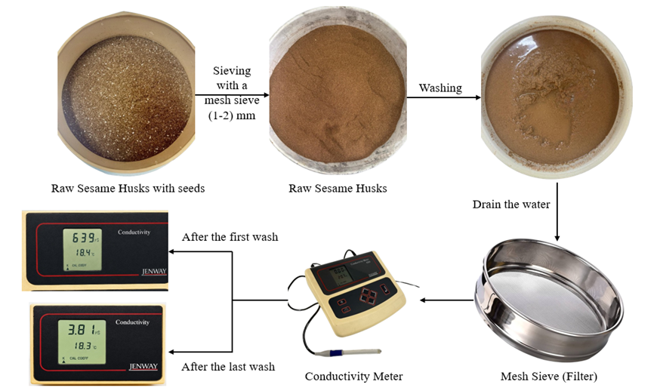
  Pre- Treatment

Slide 10
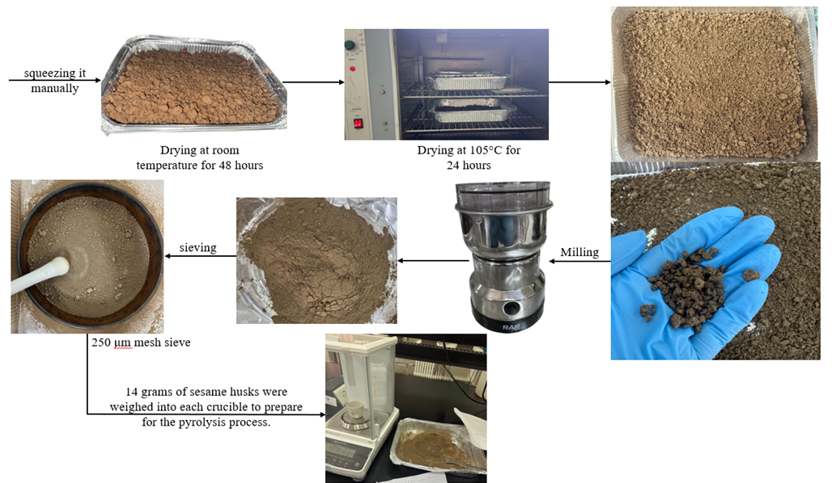
  Pre- Treatment of the Raw Husks

Slide 11
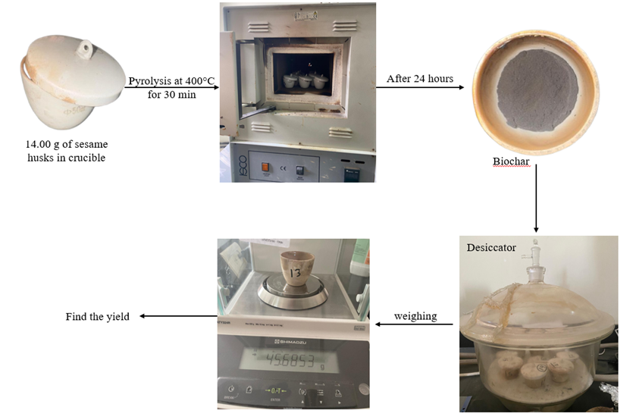
  Pyrolysis

Slide 12
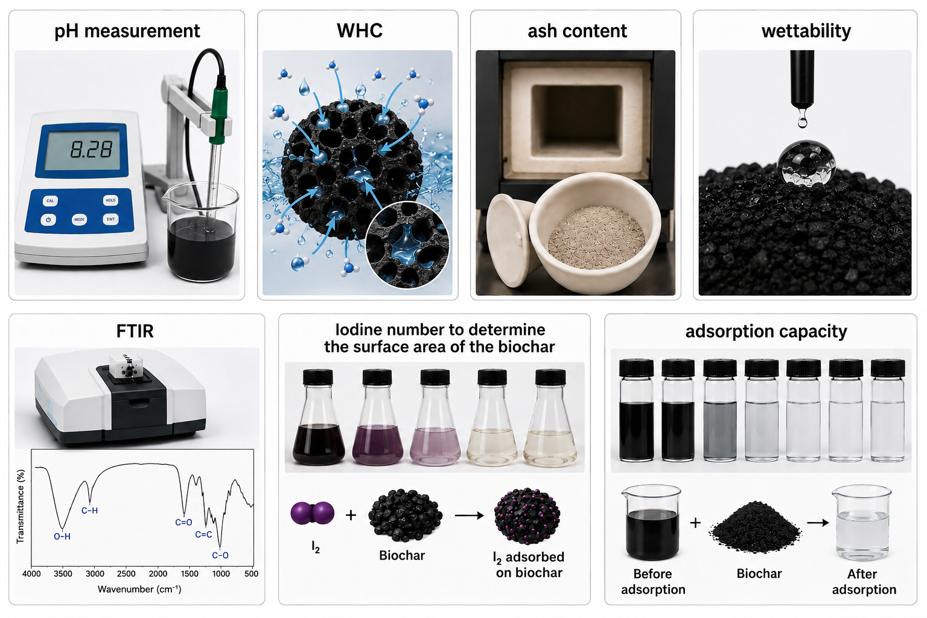
  Physiochememical Characterizations

Slide 13
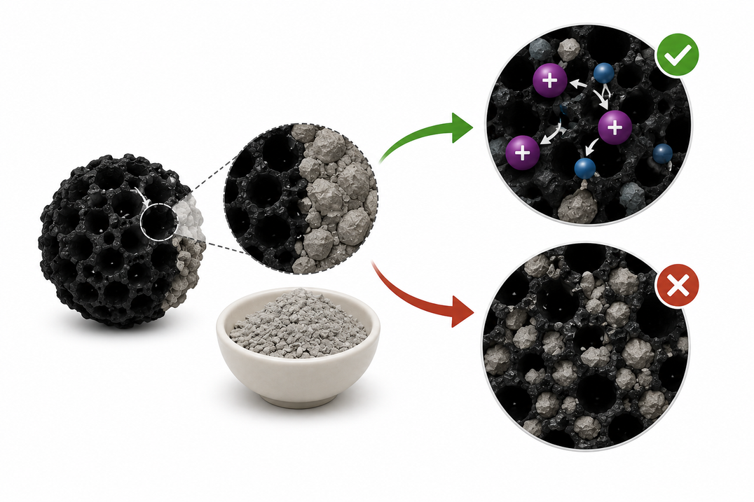
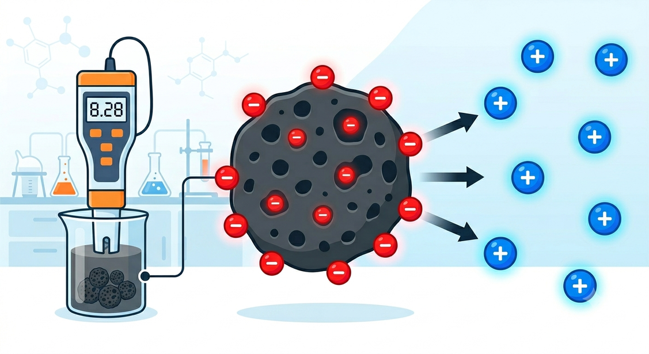
pH =8.28
Ash Content = 49.3%
To predict the behavior of biochar with the pollutant in terms of charge.

Slide 14
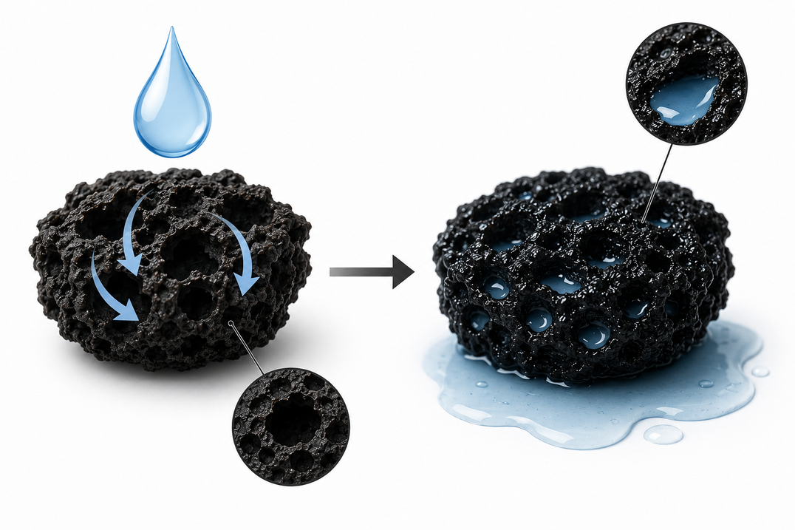
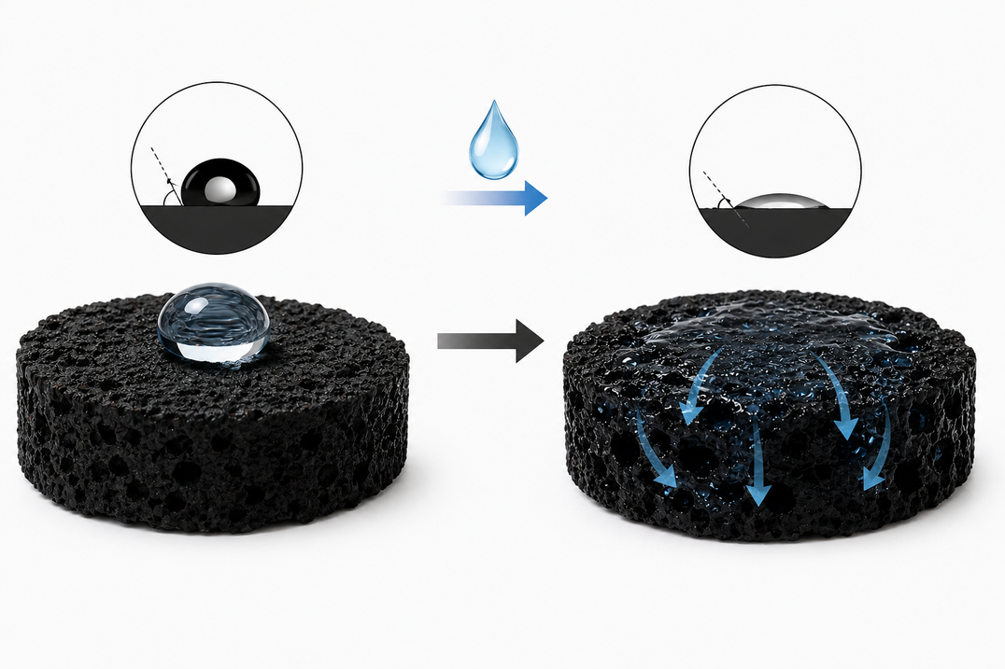
WHC = 268%
Wettability: Hydrophilic
It affects the accessibility of pollutants to adsorption sites and influence their retention within the pores.
It affects the ability of water and pollutants to enter the pores easily or not.

Slide 15
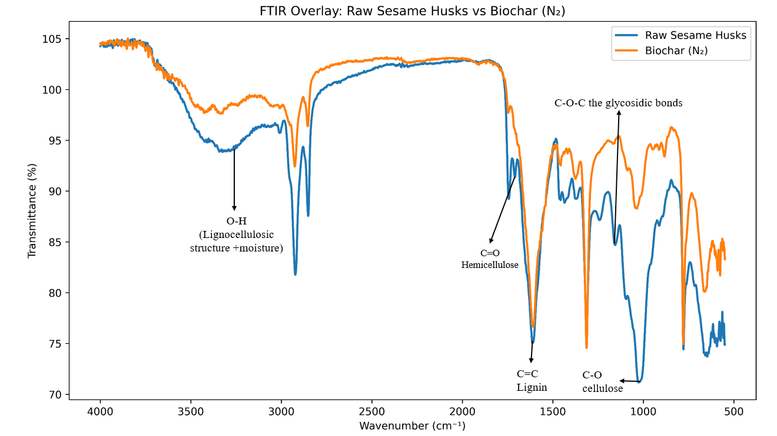

Slide 16
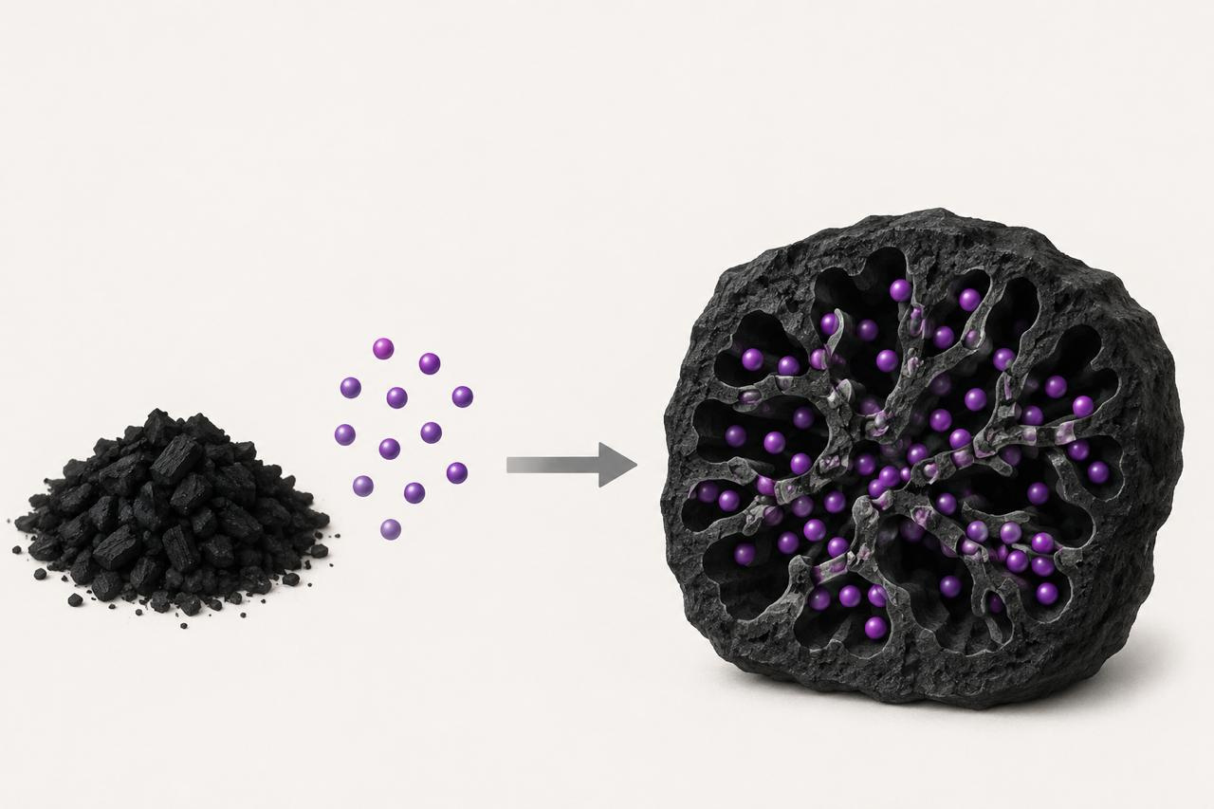
Iodine Number =699 mg/g
I₂
It determines the number of accessible adsorption sites and thus significantly affects the adsorption performance.

Slide 17
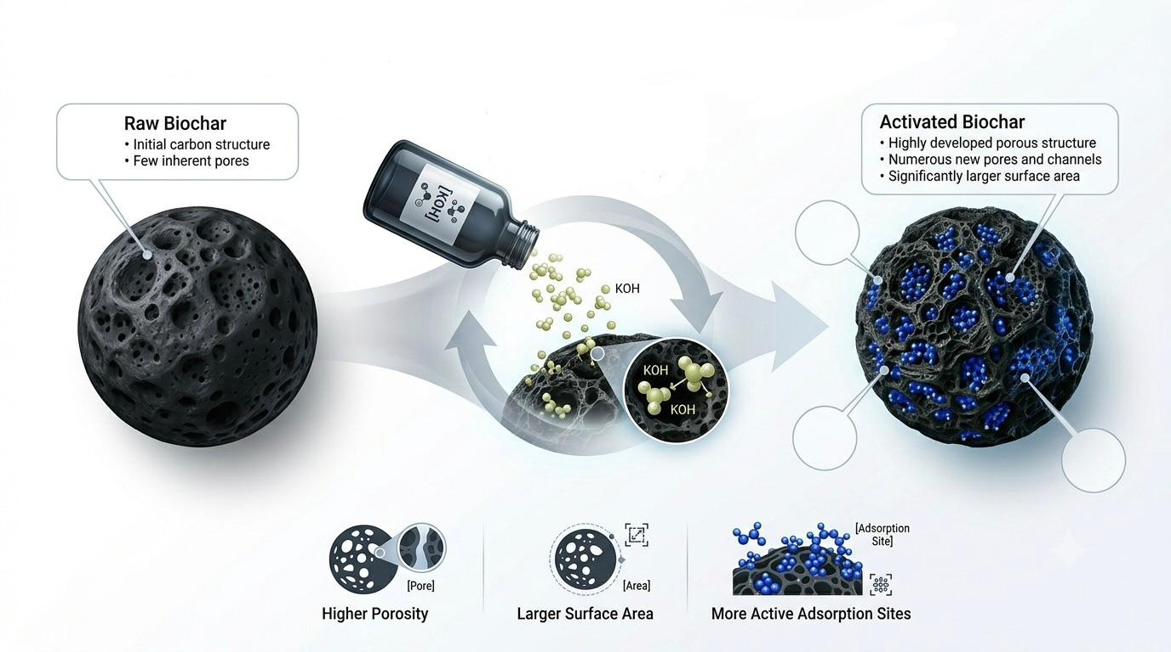
Biochar Chemiacl Activation

Slide 18
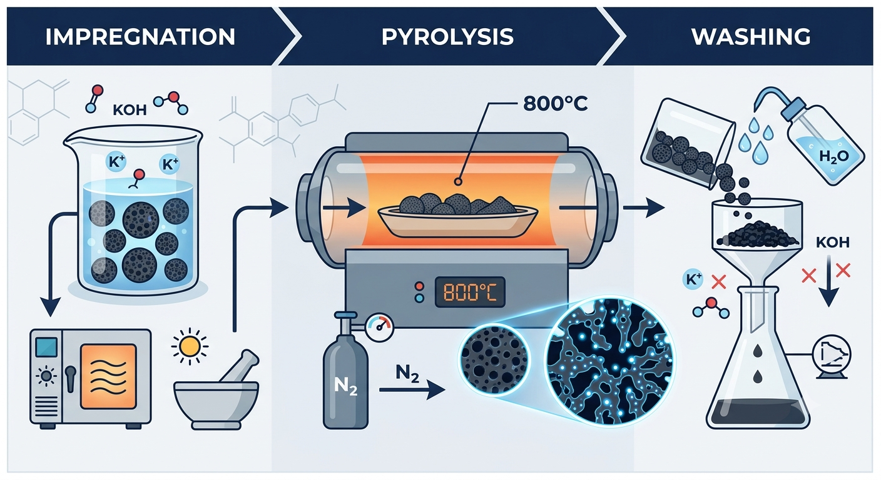

Slide 19
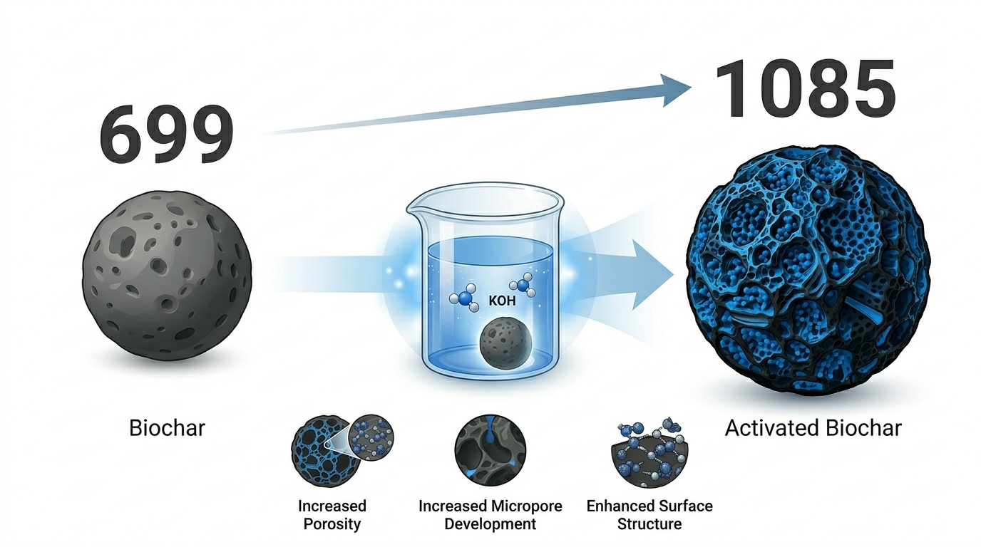
Iodine Number

Slide 20
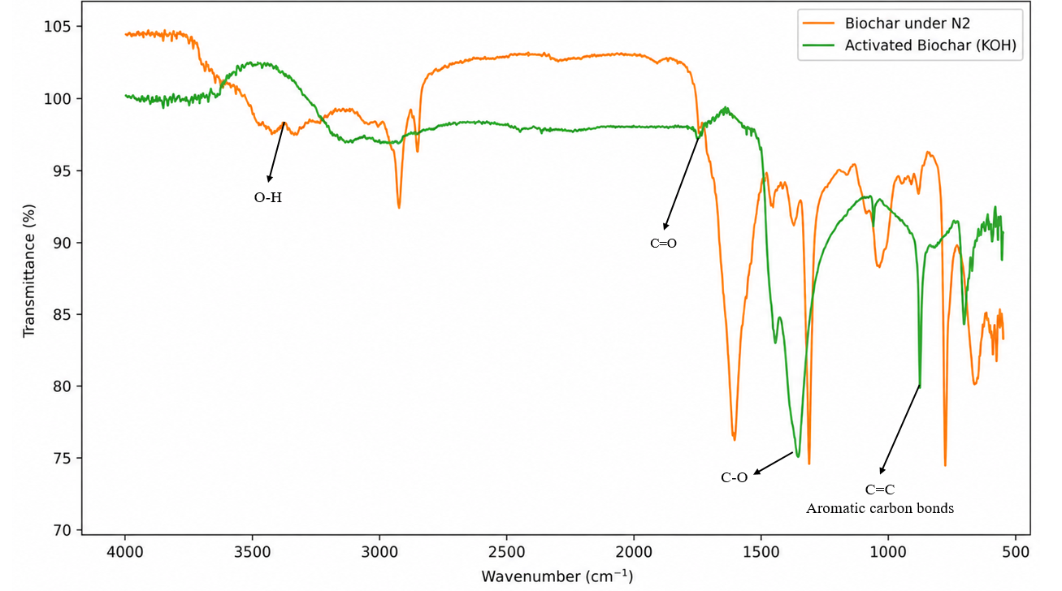

Slide 21
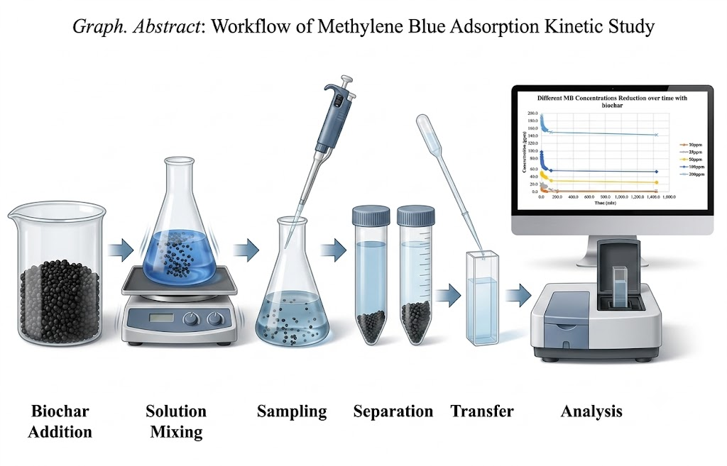
Adsorption study
0.2 g
Biochar
addition
Solution
Mixing
Sampling
Separation
Transfer
Analysis

Slide 22
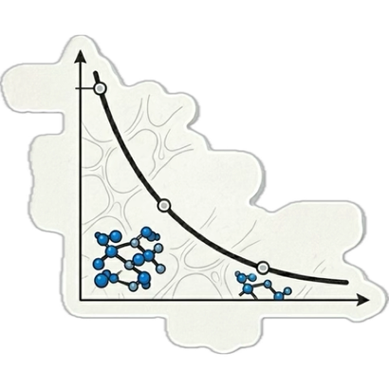

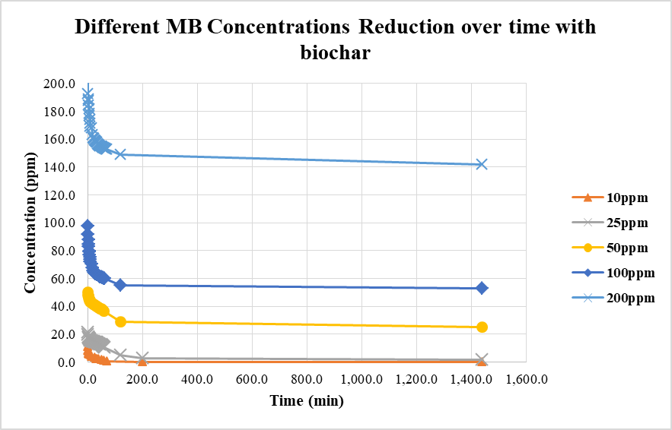
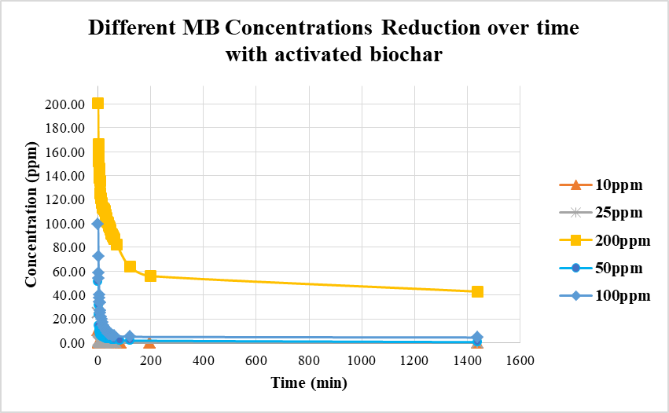
Methylene Blue Concentration Reduction Over Time
Raw Biochar
Activated Biochar

Slide 23
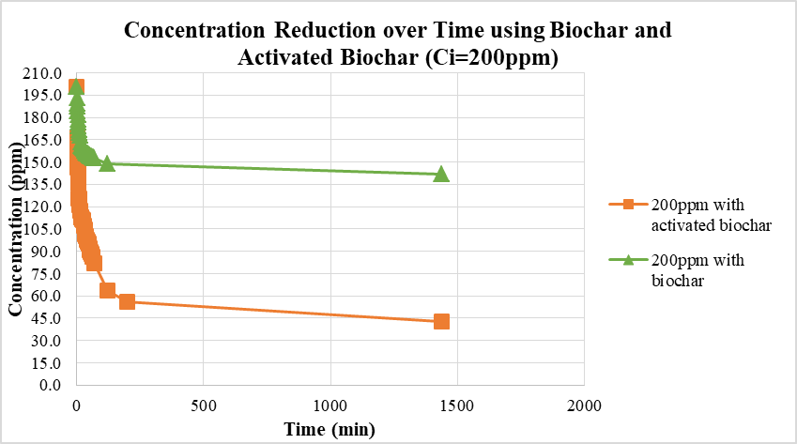
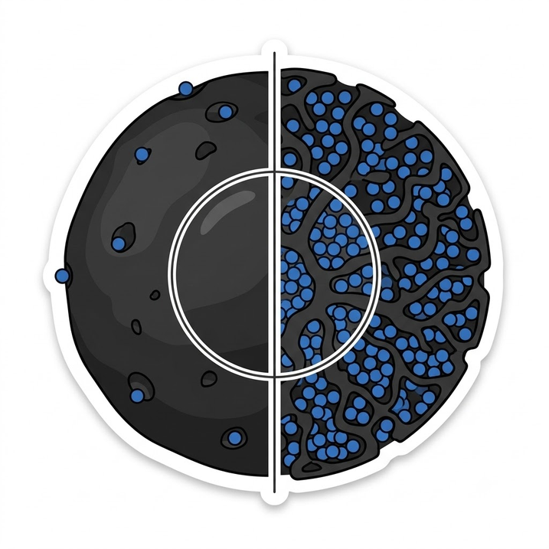
Comparison between raw biochar and activated biochar

Slide 24


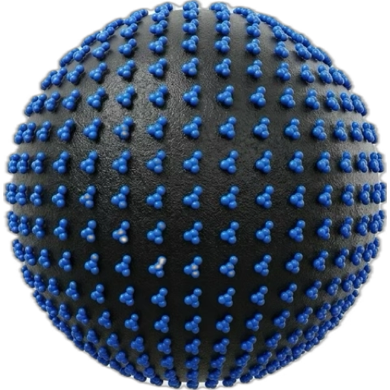
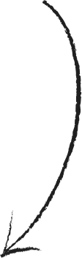
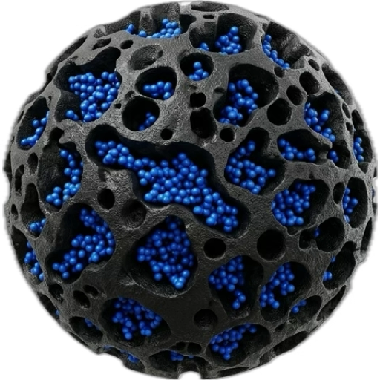


Adsorption Isotherm Models
Langmuir Model
Freundlich Model
Multilayer adsorption
Monolayer adsorption
Heterogeneous surface
Homogeneous surface
Different adsorption
energies
Uniform adsorption sites

Slide 25
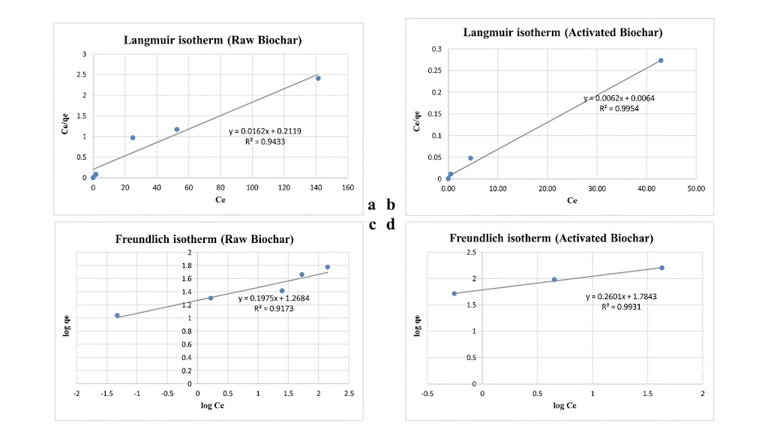
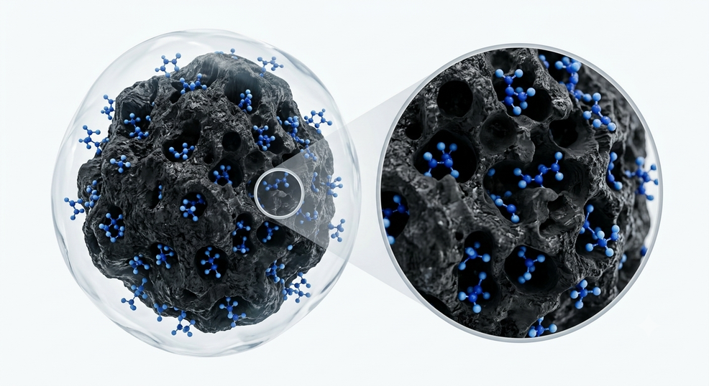
✓ Best Fit Model
Freundlich Isotherm
Adsorbent | Model | R² | RMSE
Raw Biochar | Langmuir | 0.9433 | 32.48
Raw Biochar | Freundlich | 0.9173 | 6.28
Activated Biochar | Langmuir | 0.9954 | 19.68
Activated Biochar | Freundlich | 0.9931 | 12.57

Slide 26
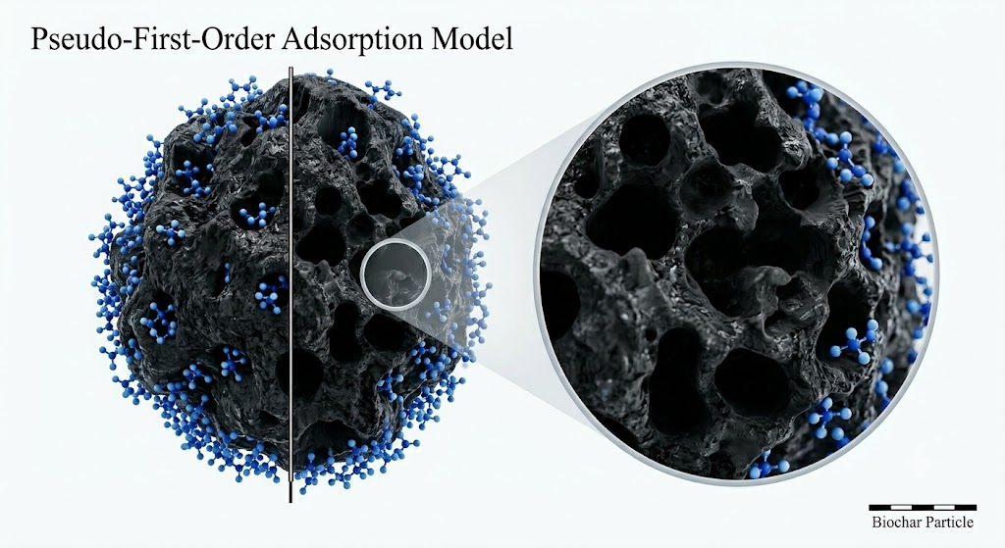
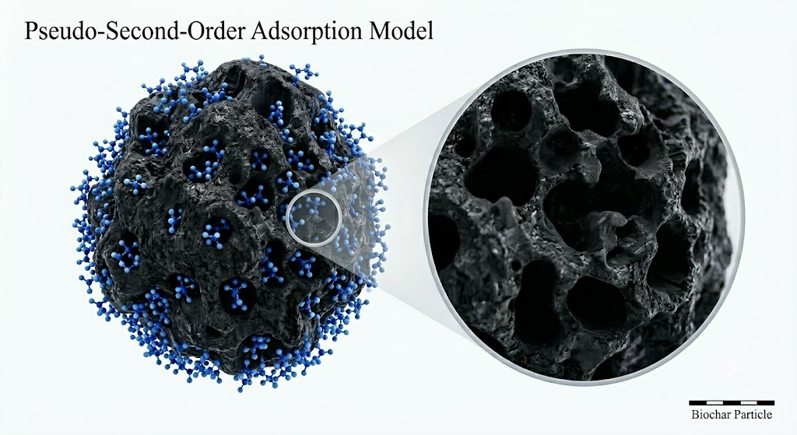
Adsorption Kinetic Analysis
pseudo-first-order model
Pseudo-Second-Order model
Surface adsorption dominated
Surface interactions dominated

Slide 27
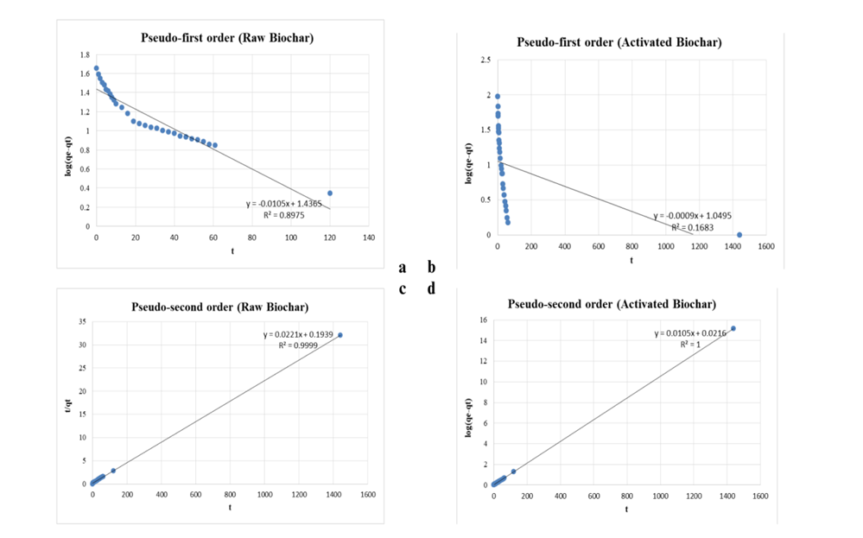
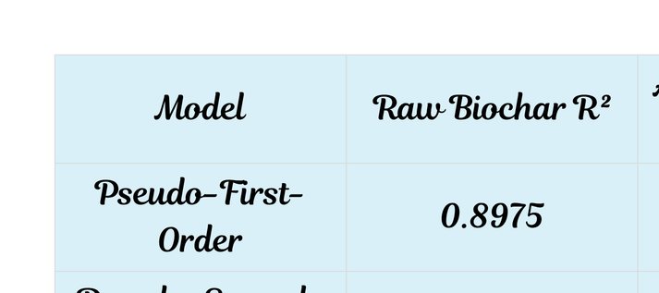
Best Fit: Pseudo-Second-Order Model

Slide 28
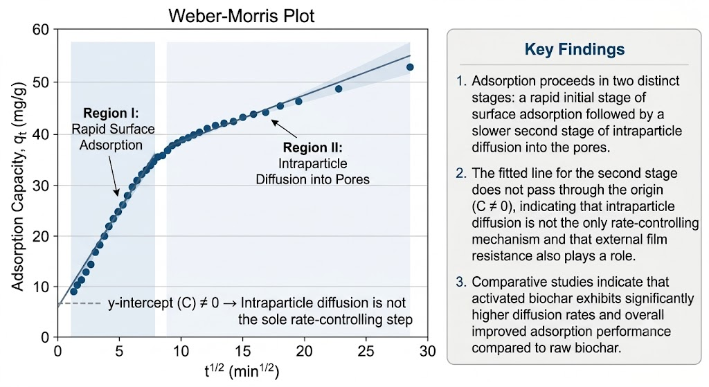
Intraparticle Diffusion Analysis
Rapid surface adsorption followed by pore diffusion.
The plot did not pass through the origin (C ≠ 0).
Activated biochar exhibited superior adsorption efficiency.

Slide 29
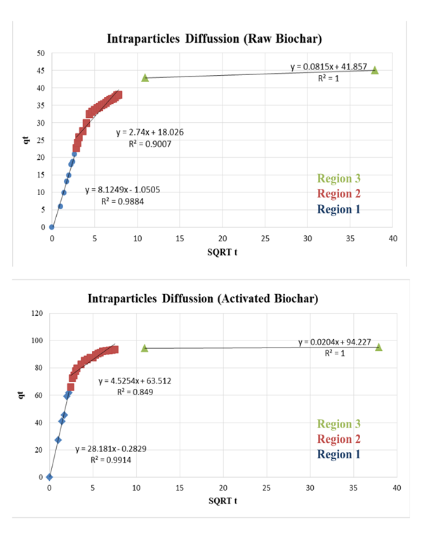
Raw biochar
Activated biochar
Activated biochar showed enhanced diffusion and adsorption performance

Slide 30
Recomendations & Future waork
  Investigations of the biochar performance with other types of dyes, as well as a mix of dyes.
  Testing the biochar adsorption on other types of pollutants (heavy metals, organic contaminants).
  Evaluation of the regeneration potential of the activated biochar.
  Exploring other activation methods and comparing them.

Slide 31
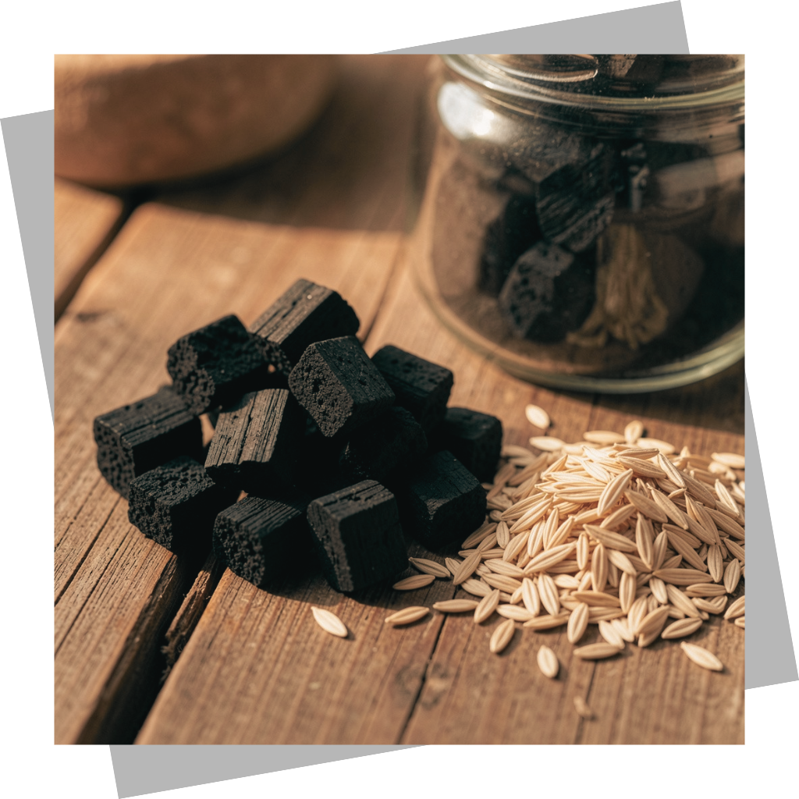
Conclusion
  Sesame husk waste is an optimum feedstock for biochar production.
  KOH activation significantly improved the adsorbent properties of the biochar.
  Best described by the Freundlich isotherm and the Pseudo-Second Order kinetic model.
  Sesame husk waste has promising applications in wastewater treatment.

Slide 32
Thank you

