Slide 1

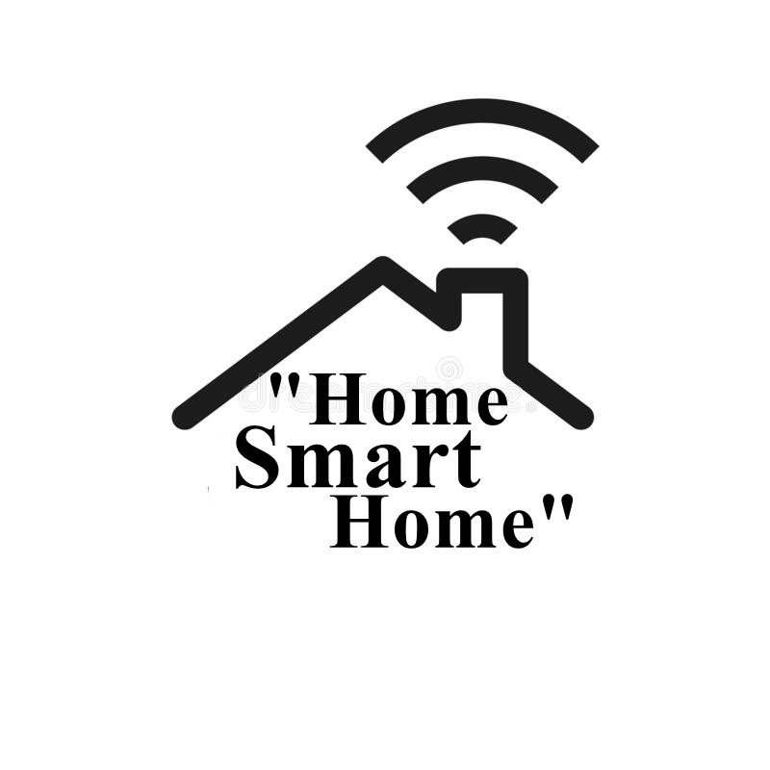




Slide 2
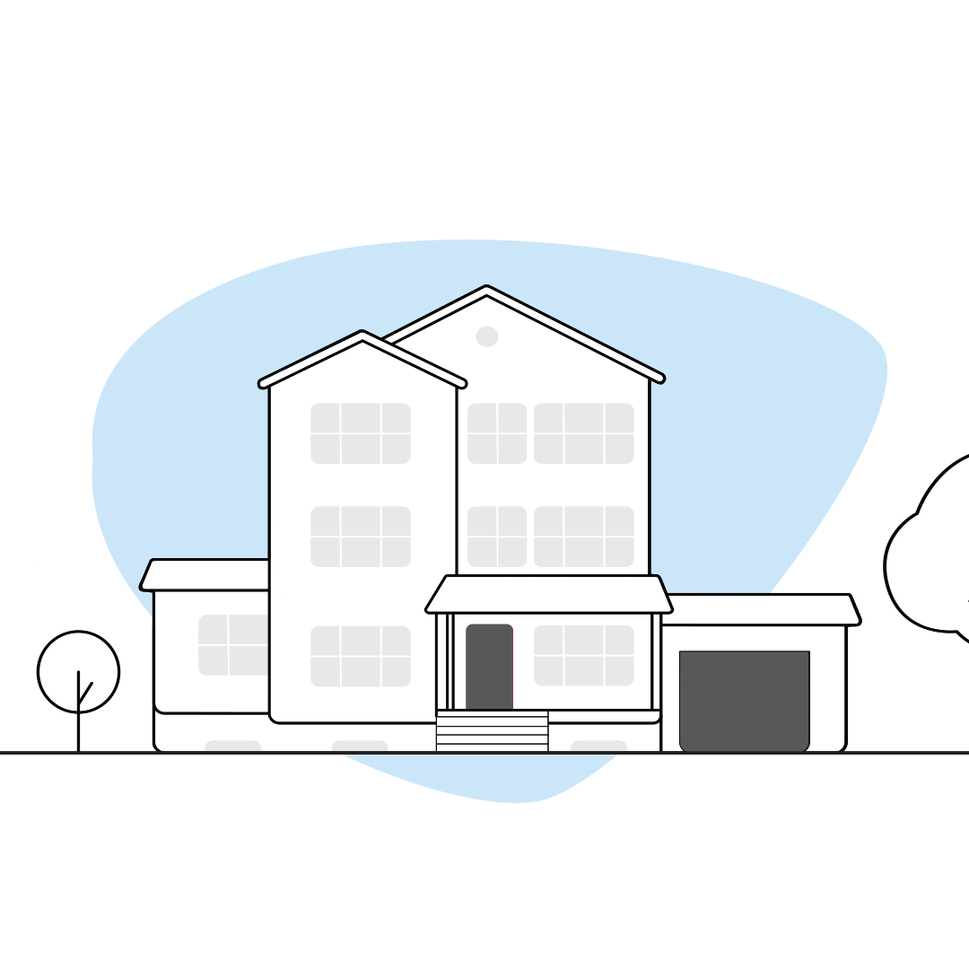
What is “Home smart Home” ?
Our project is about a house that we can control using our mobile phones .
We can connect it with the phone via Bluetooth so we can control lights and devices in the house using a software app.

Slide 3
What is “Home smart Home” ?
We added some sensors (gas, motion and flame) . If these sensors start working a buzzer will start and massage will be sent to the user mobile to alert him.
At the end , we can secure the house using a specific password.

Slide 4

Motivation and importance :
The importance of our project is to reduce accidents in our houses and make it more secure to live in .
It can help to reduce gas leak ,fire and prevent security breaches. It is also important to make life easier specially for disabled people and elderly as they can control everything using their mobile phone .

Slide 5
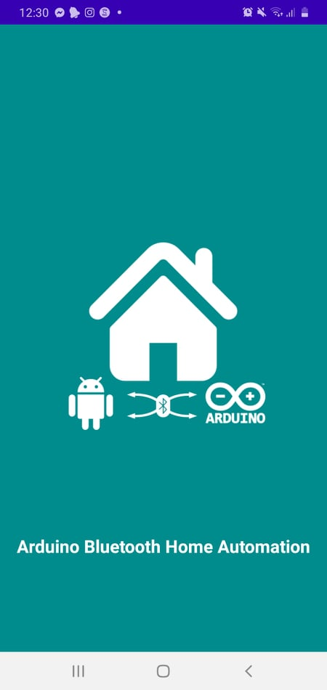
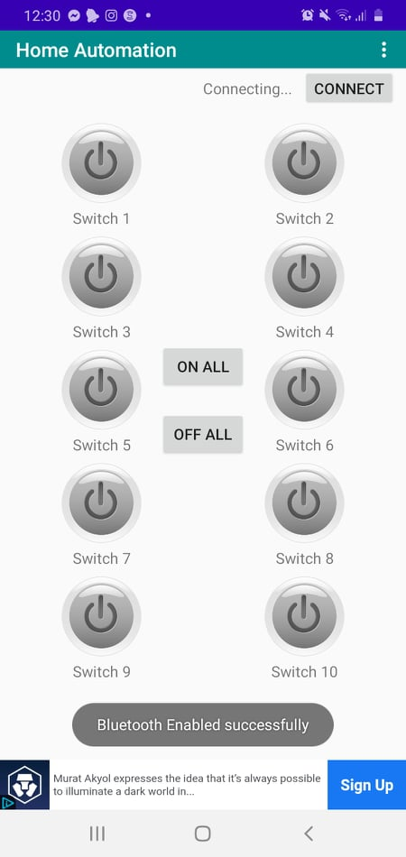
Features we have:
1. control all lights and electronic devices on the house using a software app on mobile phones.

Slide 6

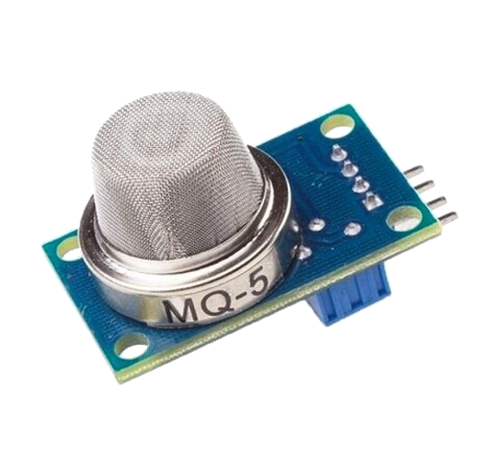
Features we have:
2. detect any gas leak on the home using a gas sensor (MQ-5) and give an alarm on the house.

Slide 7

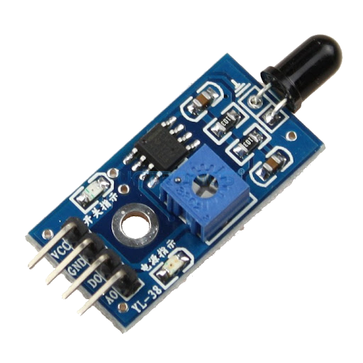
Features we have:
3. detect any fire on the house using a flame sensor and give an alarm on the house.

Slide 8
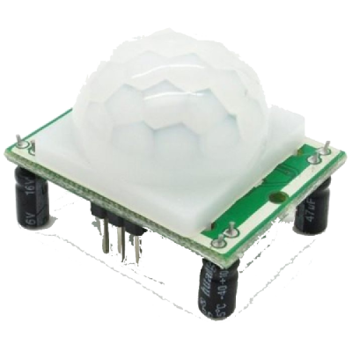

Features we have:
4. secure the house using a password and detect any move on the house using motion sensor(PIR) and give alarm.

Slide 9

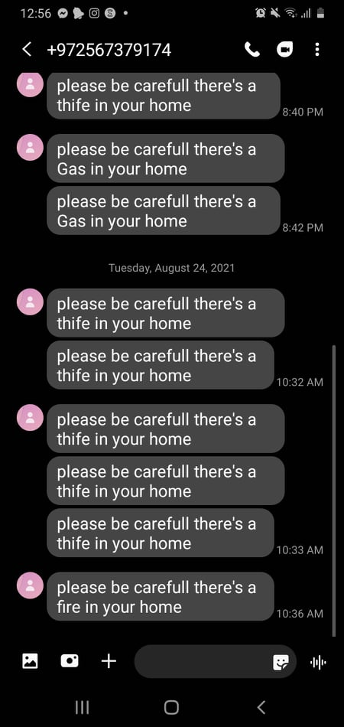
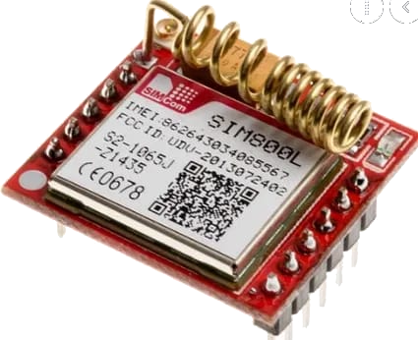
Features we have:
5. Using Gsm to send messages to the phone when any detection happens.

Slide 10
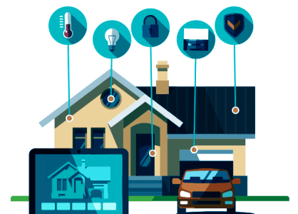
Future work:
We believe that there is lot of features we can add to our smart home project to improve it and make it more efficient , these features can be :
Add more features like : Control the temperature of the house ,Opening and closing windows and doors of the house and turn the music on and off and spread the sound in any room.
Add AI system.

Slide 11
This presentation has been done by students :
Shima’a Zabin
Raneen Othman
Supervised by :
Dr.luai Malhis

Slide 12
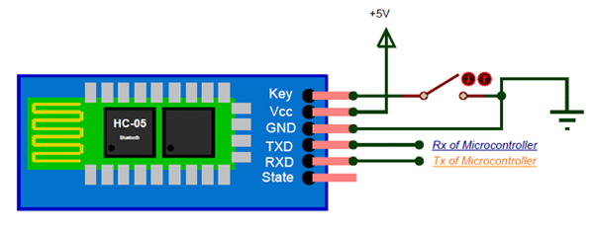
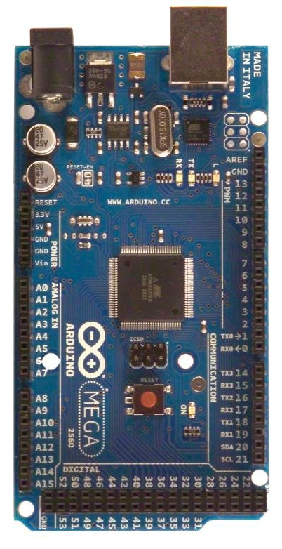

Bluetooth HC-05:
HC-05

Slide 13
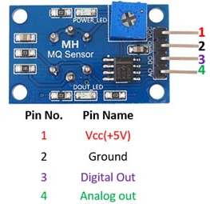
MQ5:

Slide 14
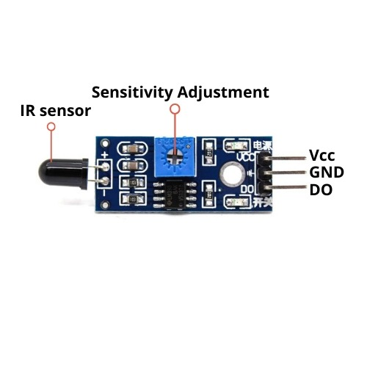
Flame sensor:

Slide 15
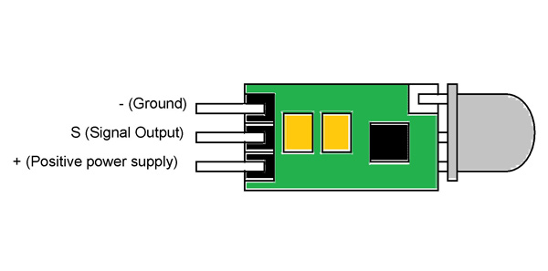
PIR:

Slide 16
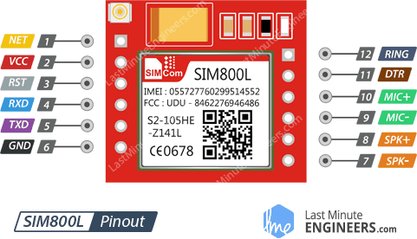
GSM:

