Slide 1


BURGER
STATION
Jana Khammash & Zain Abubaker

Slide 2


01
Main Idea
05
02
Future Work
Hardware Components
WHAT WE WILL COVER
04
03
Constrains
Features

Slide 3
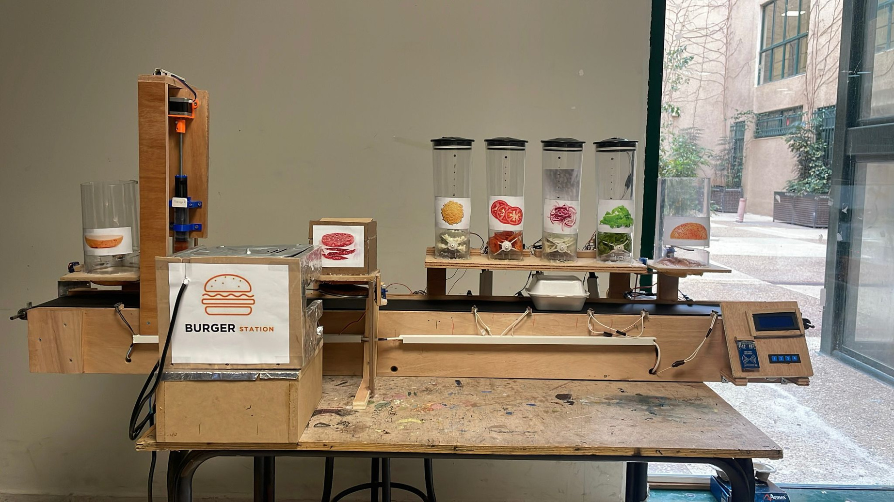
Our Project

Slide 4
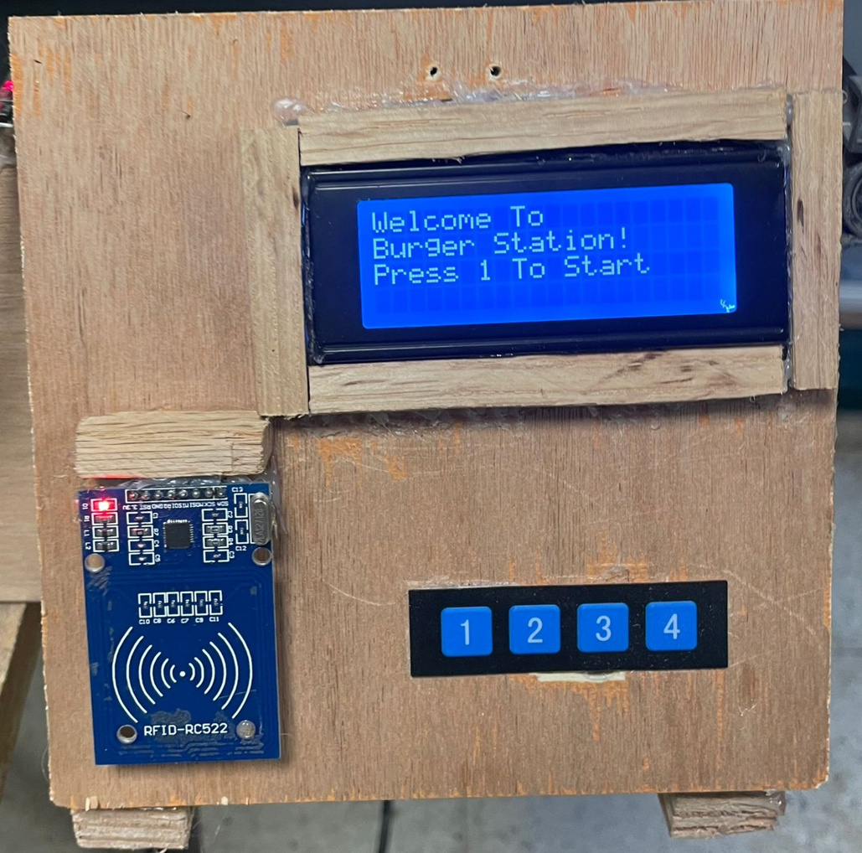
System Input

Slide 5
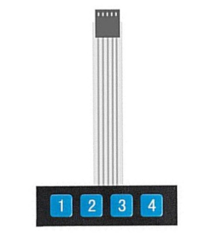
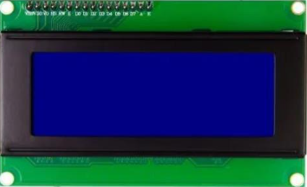
Hardware Interface
20x4 LCD with I2C
4x1 Keypad

Slide 6
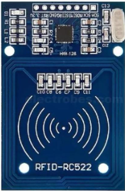

Payment
RFID
Admin Card
Customer Card

Slide 7
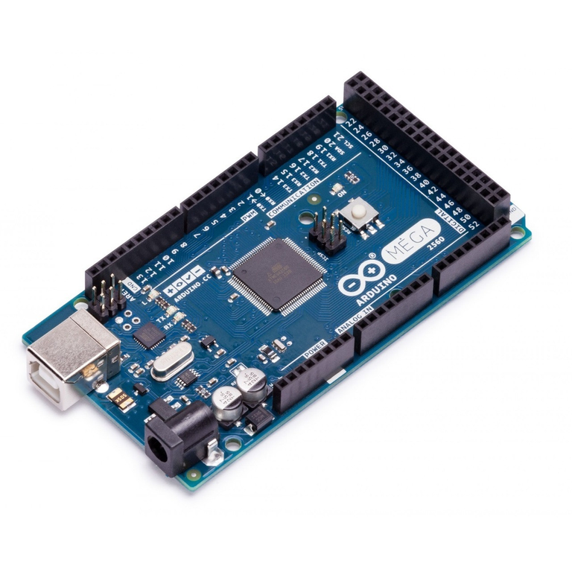
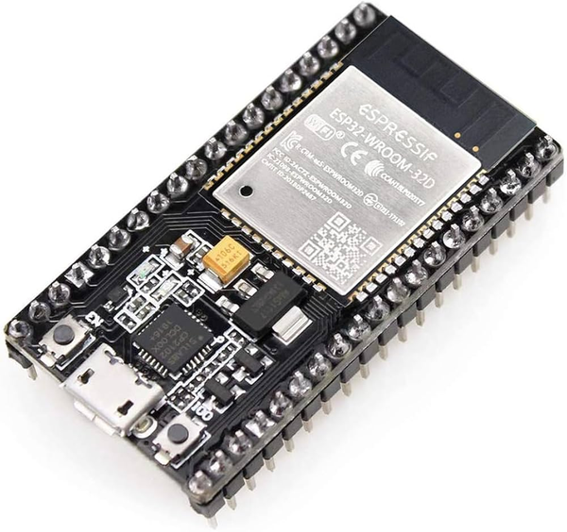


Control Unit
Arduino Mega 2560
ESP-WROOM-32
Software environments:
Arduino IDE
Blynk

Slide 8


Libraries
SPI.h:
Wire.h
Servo.h
Stepper.h
Keypad.h
Wifi.h
MFRC522.h
BlynkSimpleEsp32.h
LiquidCrystal_I2C.h

Slide 9
Machine Process Of Work
Start
Final Result
Ordering and Customization
Adding the top Bread
Application
LCD & Keypad
Ultrasonic sensor to check the quantity
Notify Admin To Refill
Handle Payment
(RFID)
2:00 min Timer To cook the meat
Machine Begins
Adding Bread and Sauces
Starting the oven
Adding ingredients upon user request

Slide 10
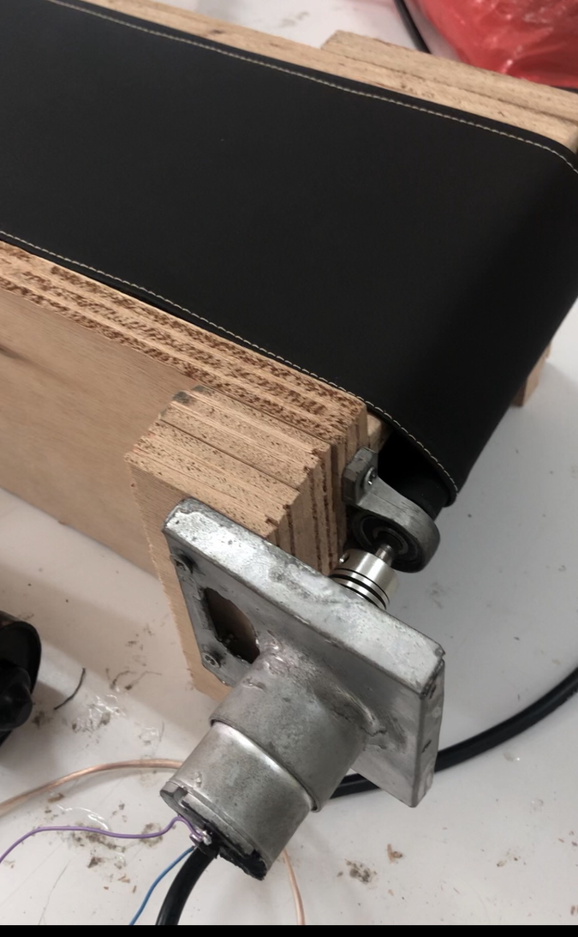
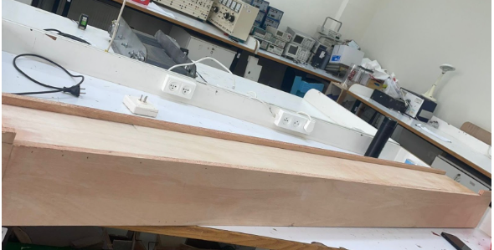
Conveyor Belt

Slide 11

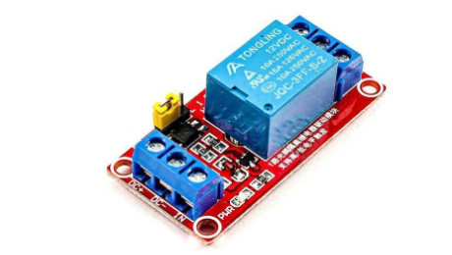
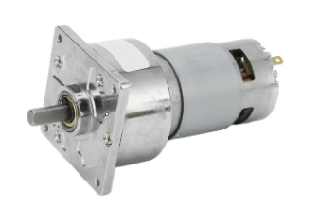
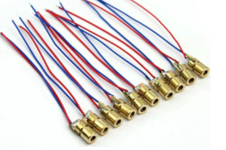
Hardware Components
LDR Sensor
DC Motor
Single Channel Relay Module
Laser

Slide 12
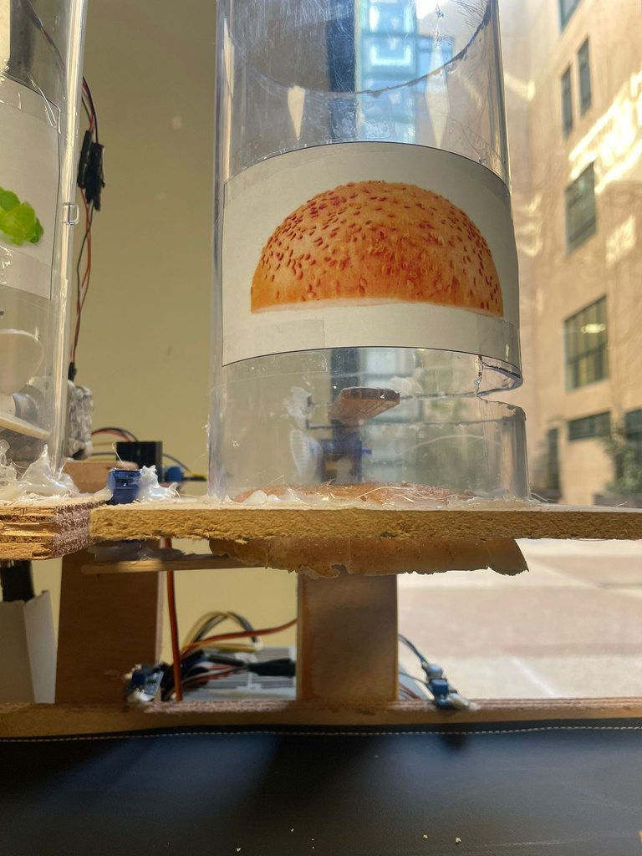
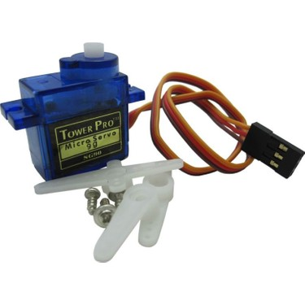
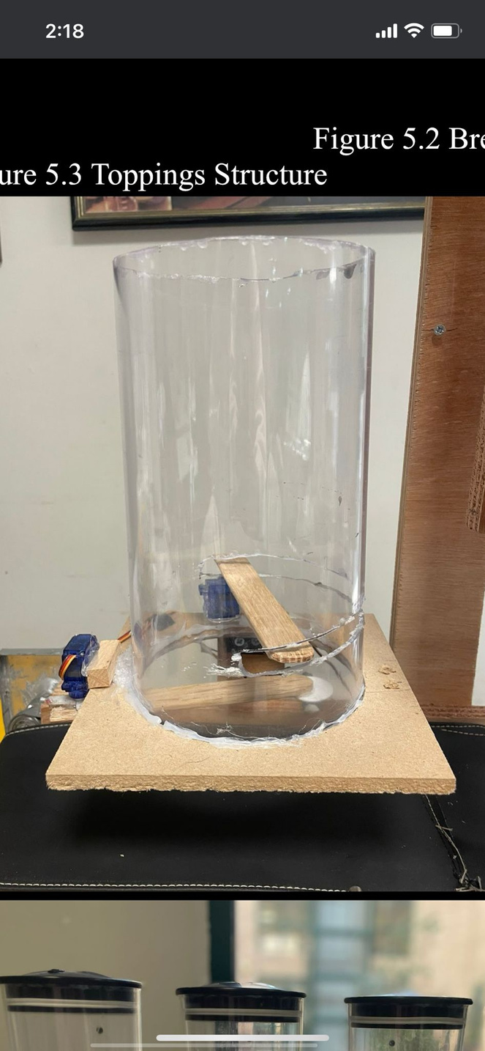
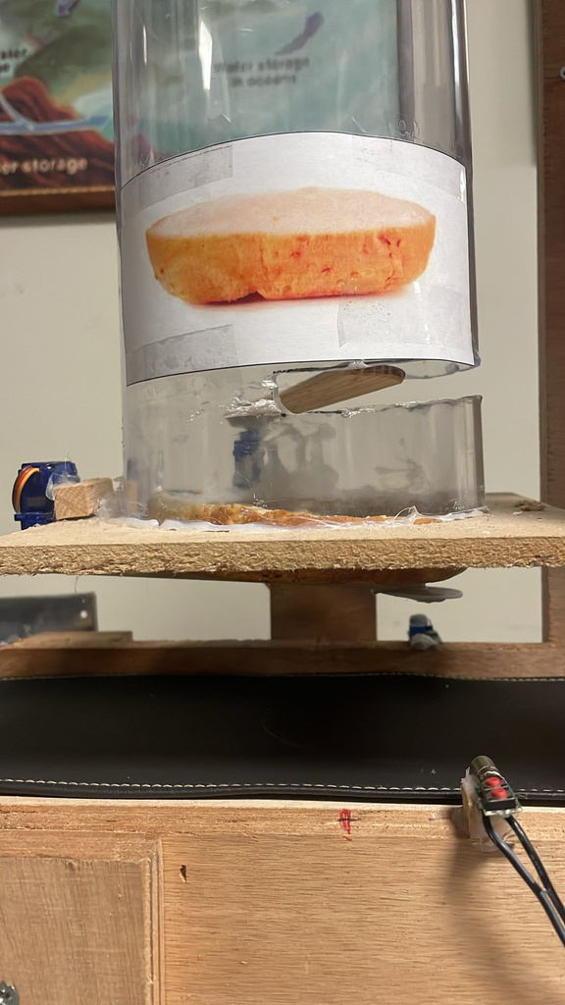
Bottom and Top Bun
Hardware Components:
TowerPro TS90A Servo Motor

Slide 13
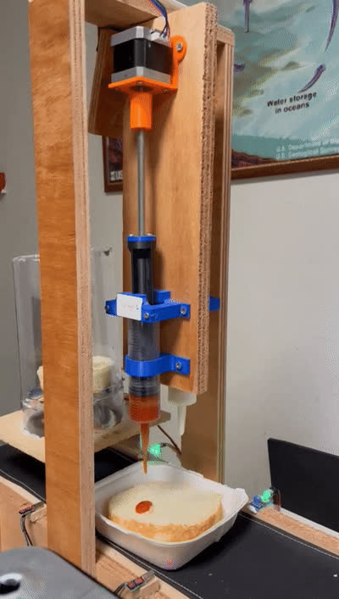
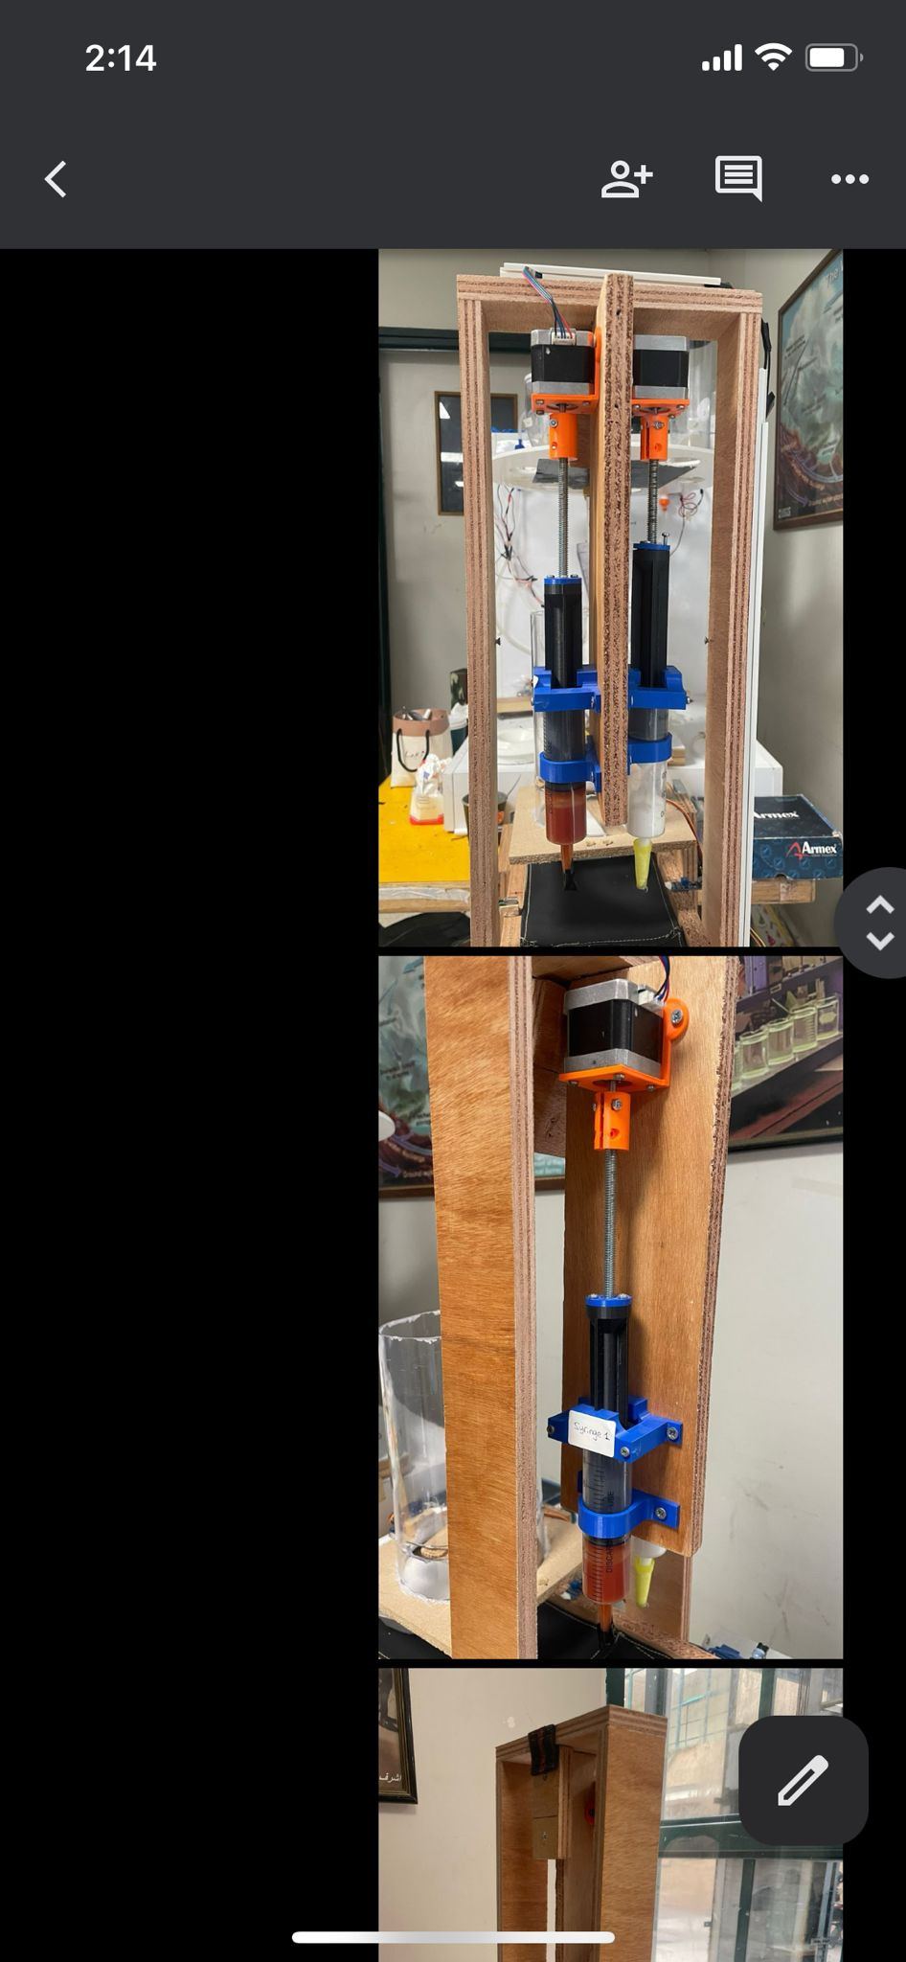
Syringes

Slide 14
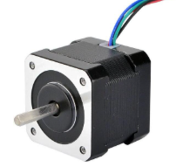
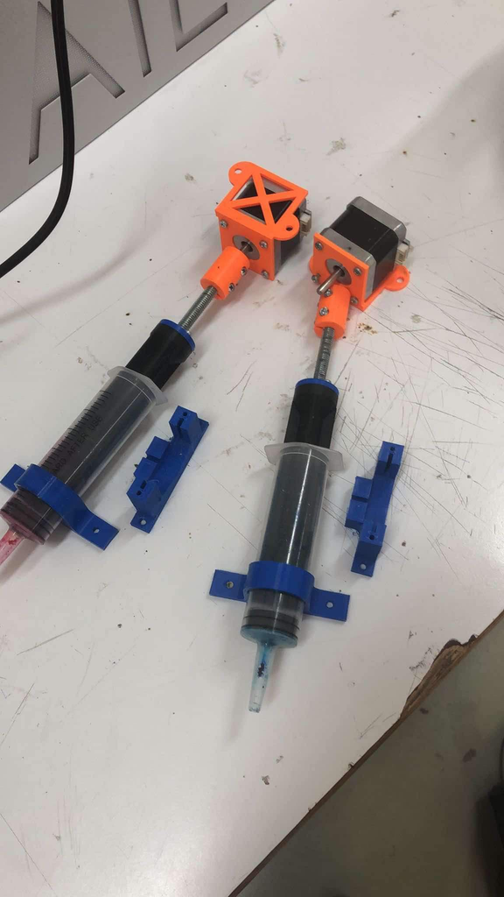
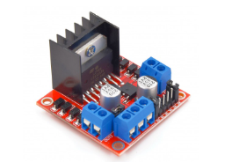
Hardware Components
Stepper Motor (Nema 17)
H-bridge
3D Printing

Slide 15
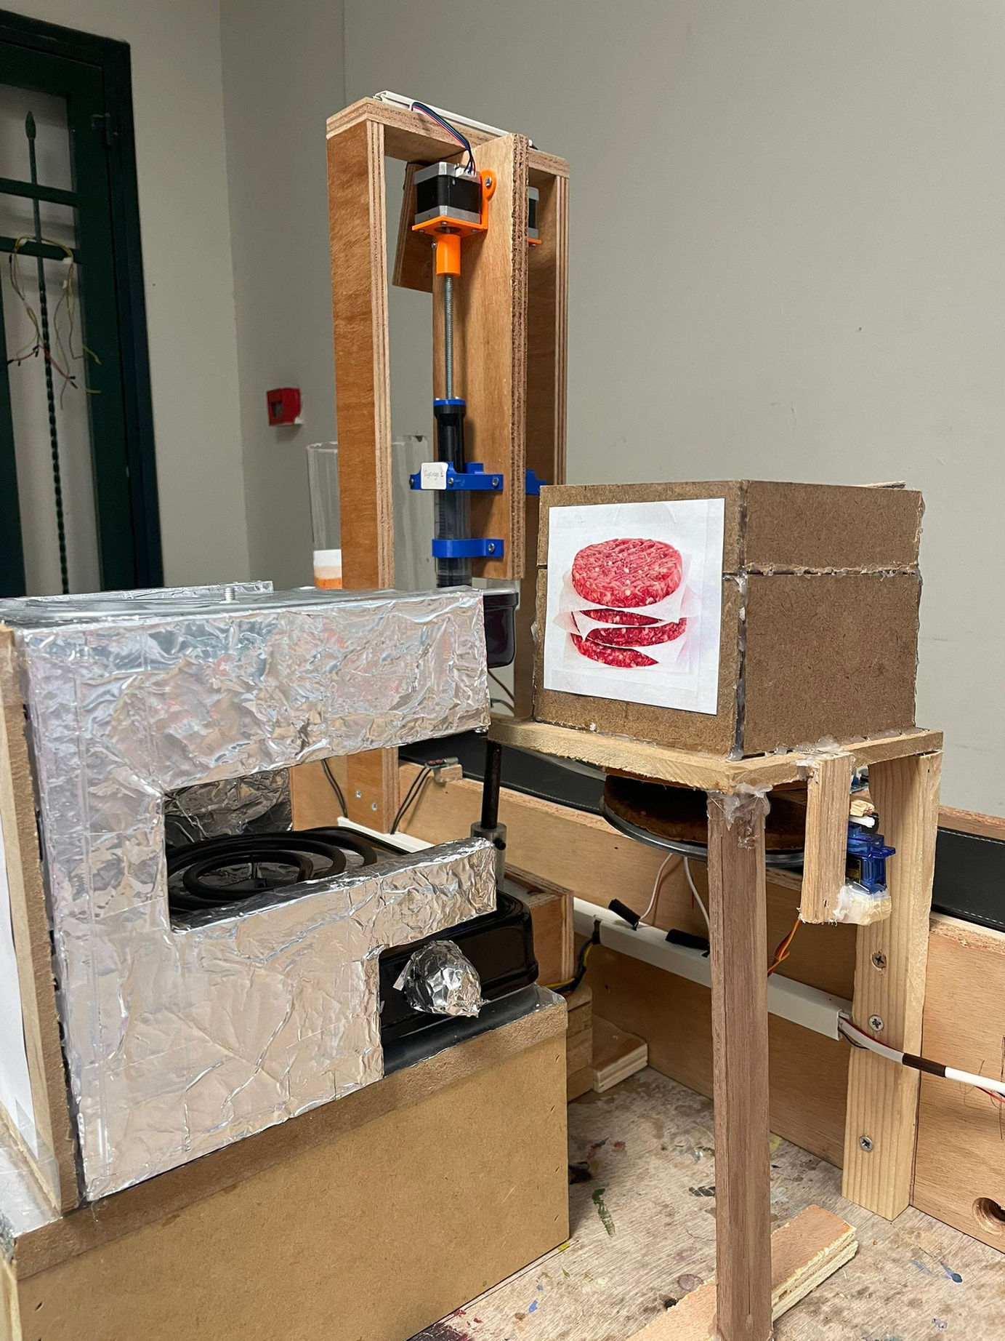
Meat Placement
Hardware Components:
TowerPro TS90A Servo Motor

Slide 16
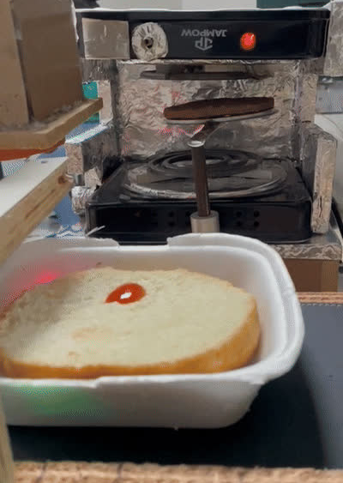
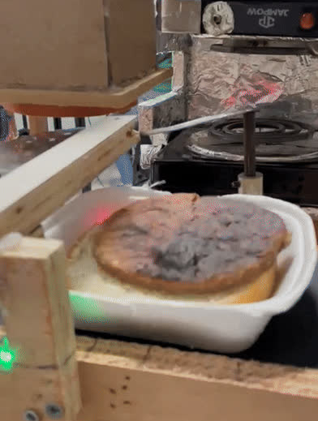
Burger Arm

Slide 17
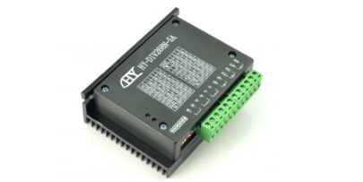
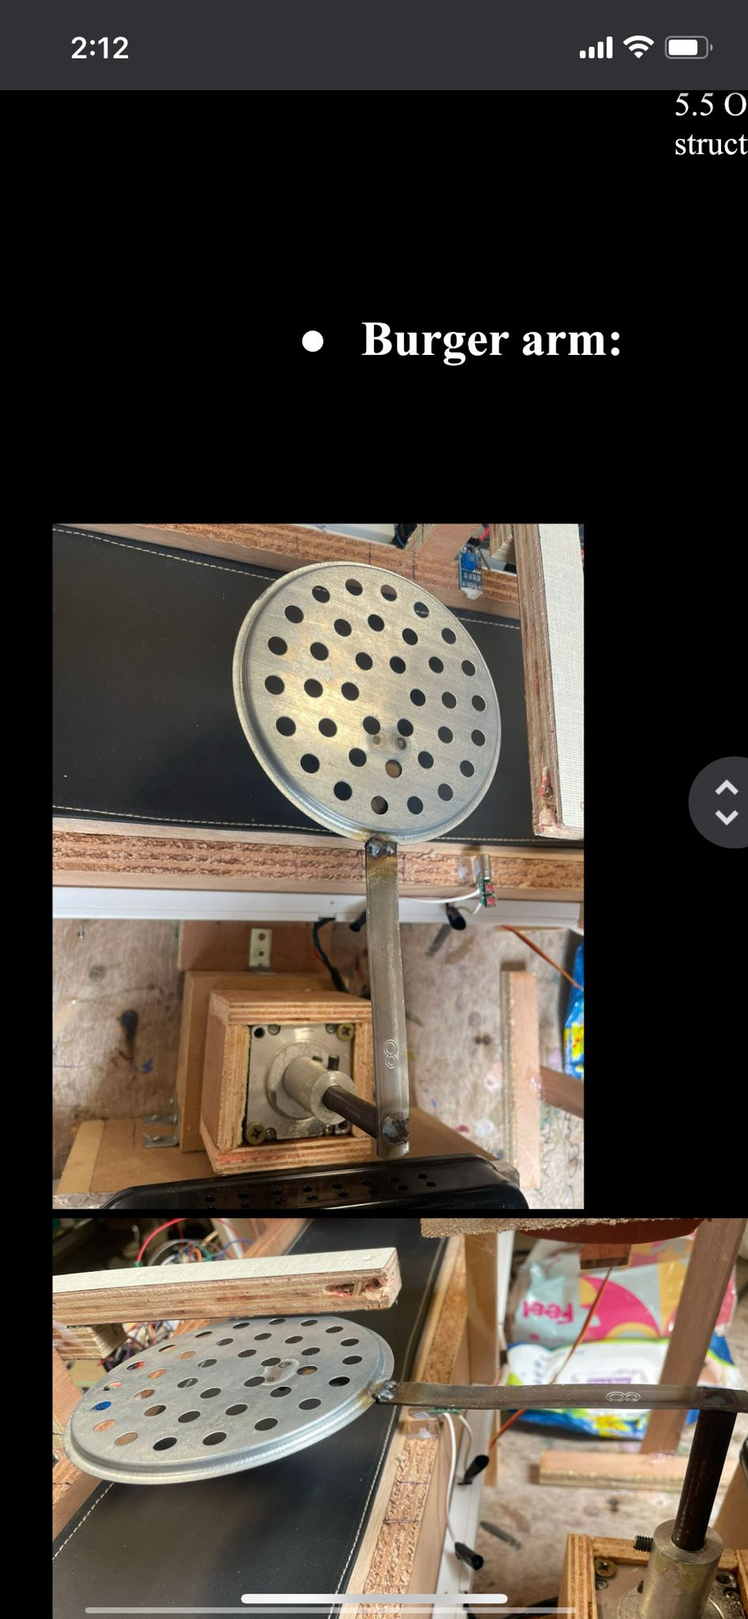
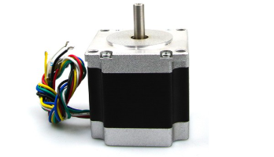
Burger Arm
Hardware Components:
Stepper Motor (Nema 23)

Slide 18
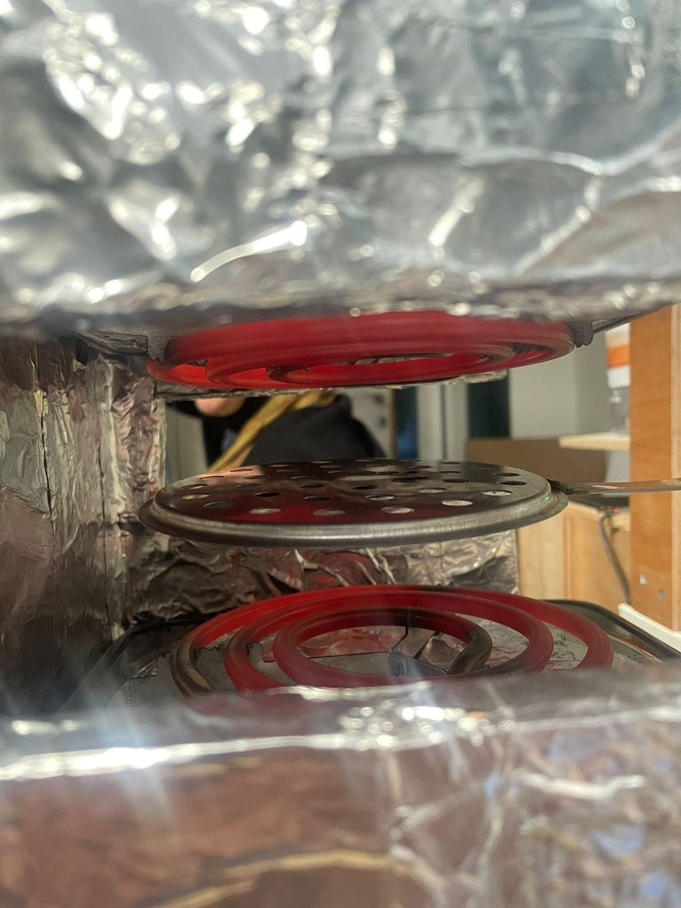
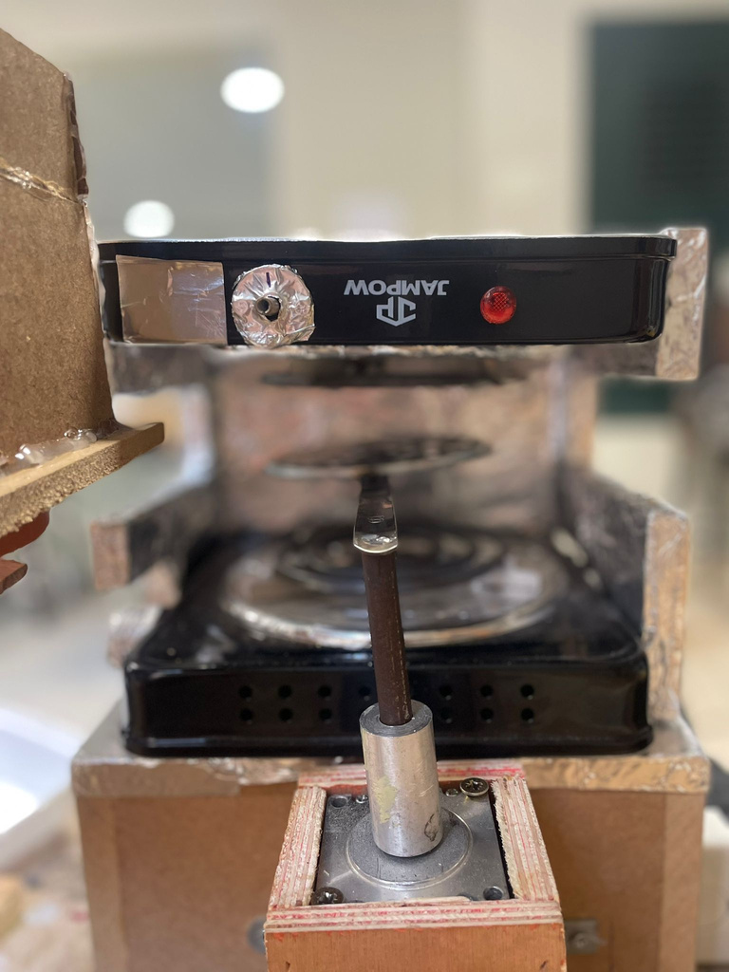
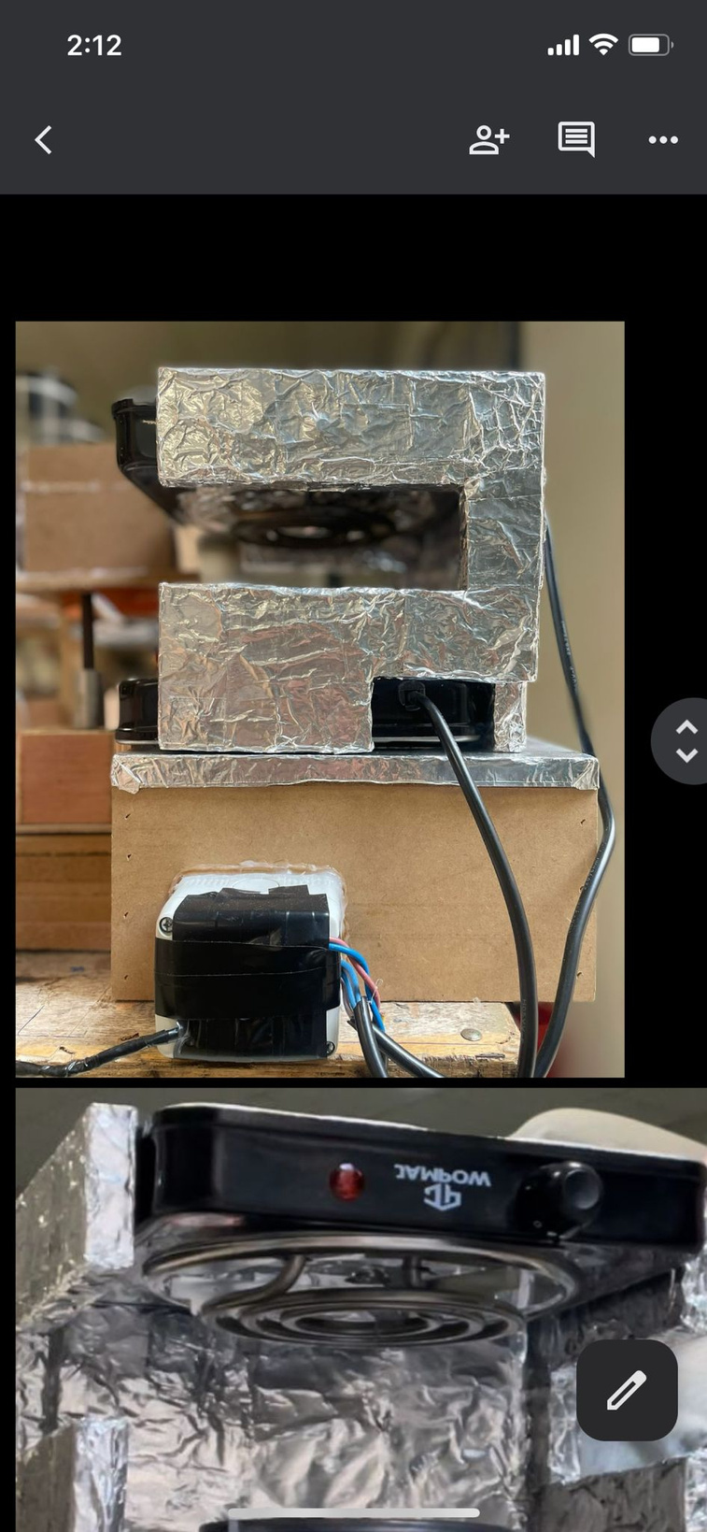
Oven

Slide 19
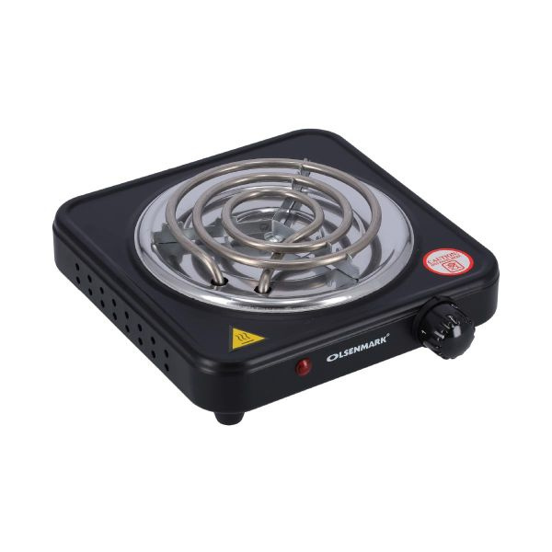
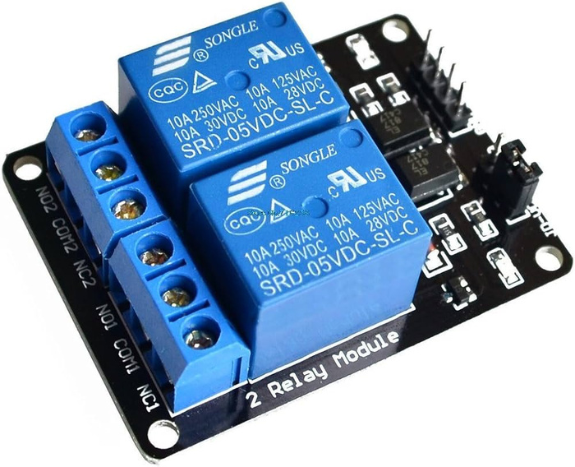
Hardware Components
Two Channel Relay Module

Slide 20
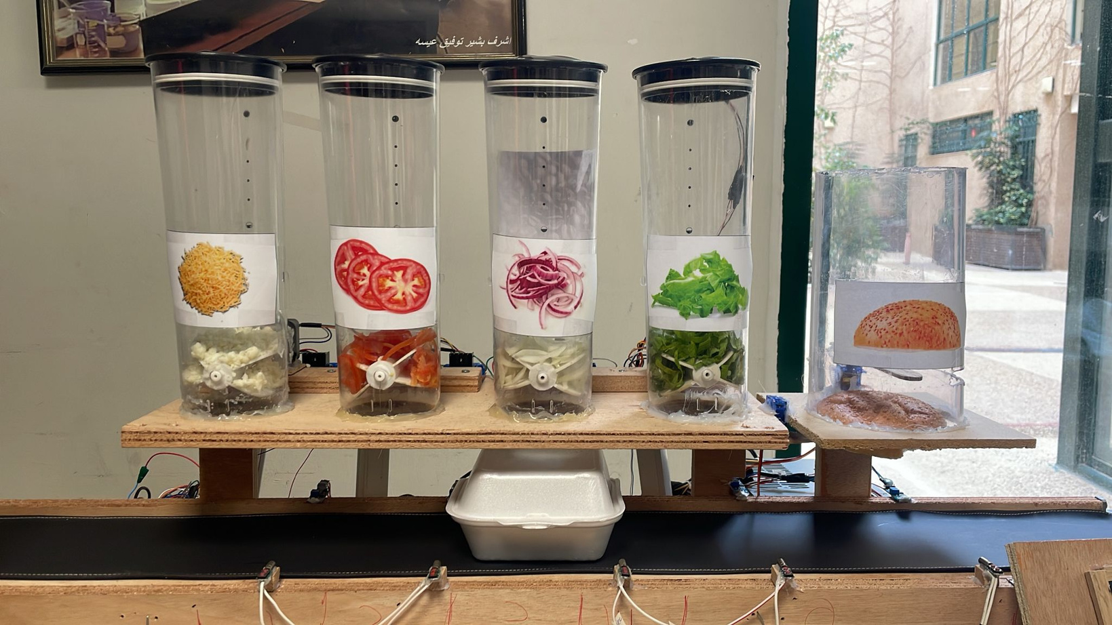
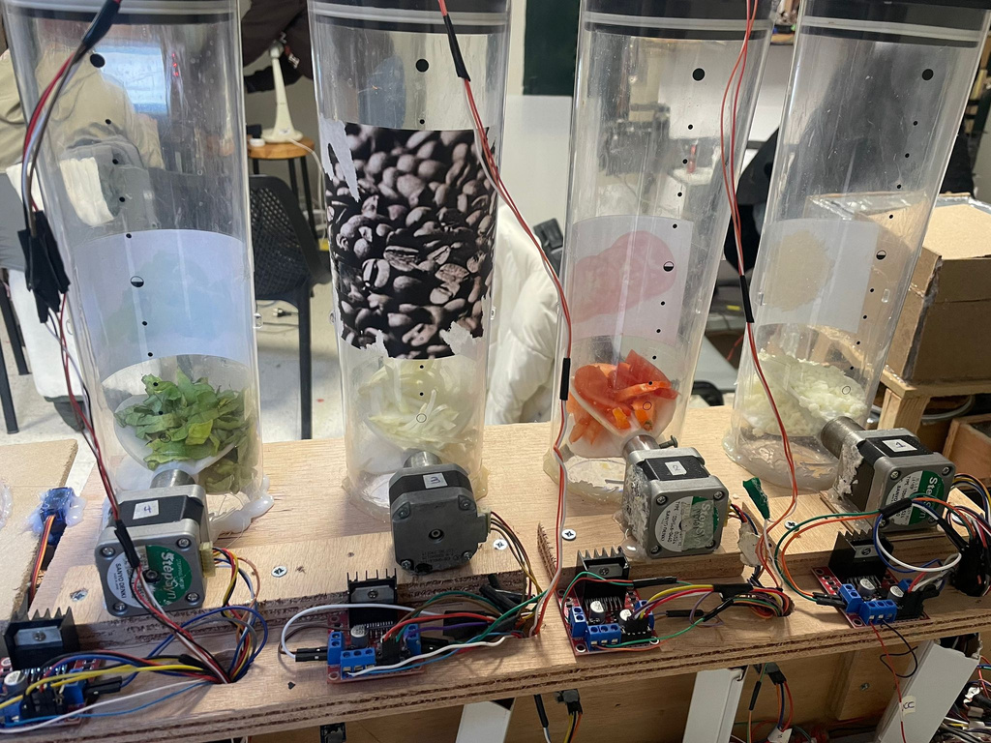
Ingredients Containers
Front View
Back View

Slide 21
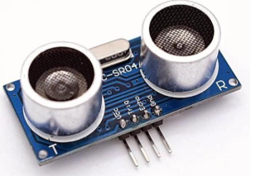
Hardware Components
Stepper Motor (Nema 17)
H-bridge
Ultrasonic Sensor

Slide 22
Constrains
Project Structure
Lack of Mechanical Knowledge
Hardware Fragility and Component Failure
Ingredient Handling and Waste Management Challenges

Slide 23
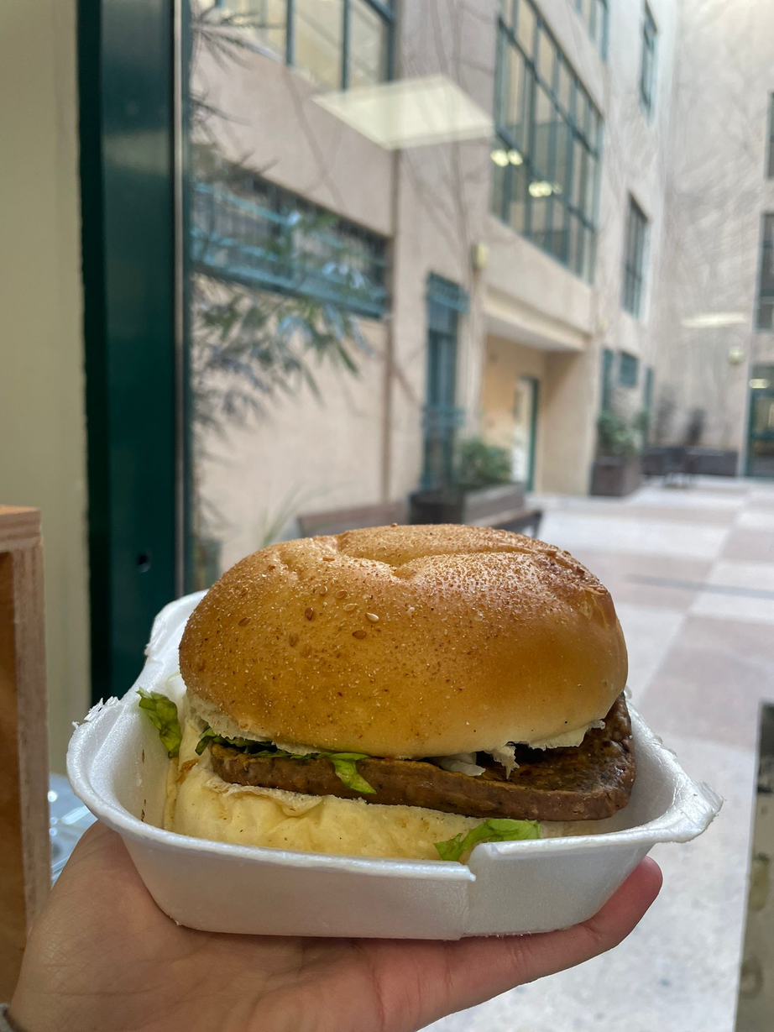
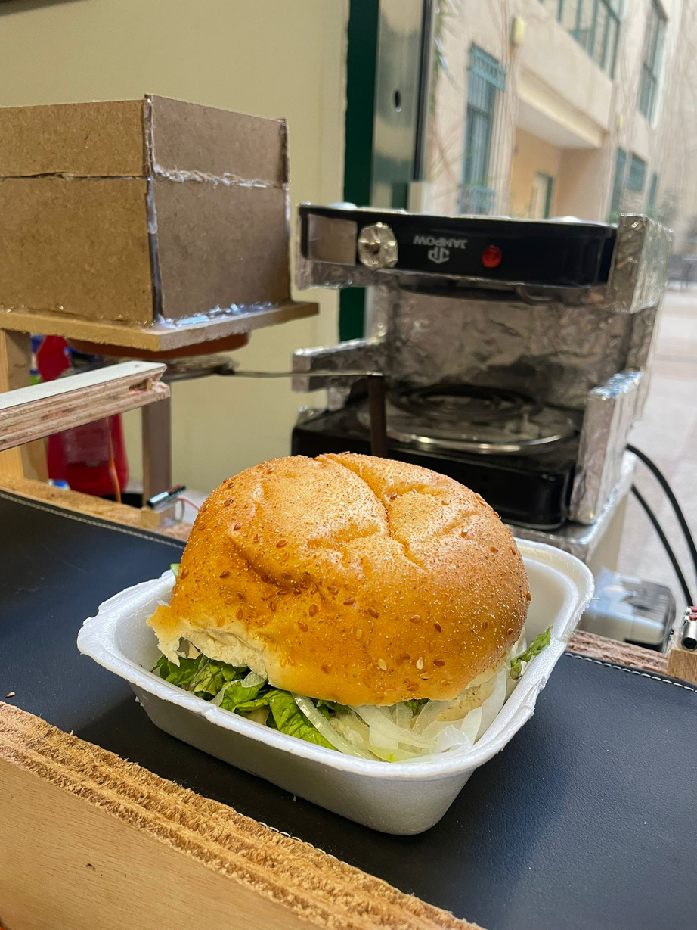
Final Result:

Slide 24
Future Work
Expanding Ingredient Options
Ingredient Cooling System
Adding More Sauces
Automated Cleaning System
Different Burger Types

Slide 25
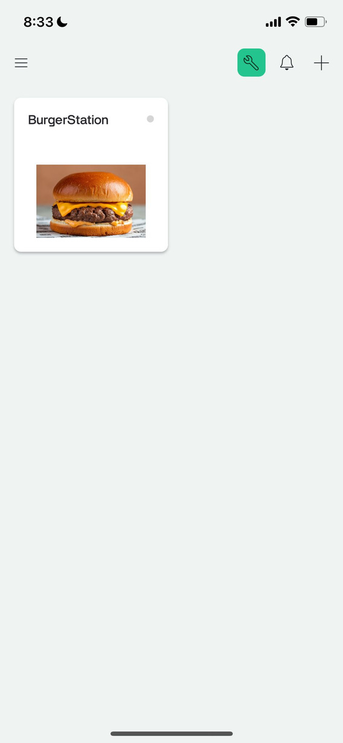
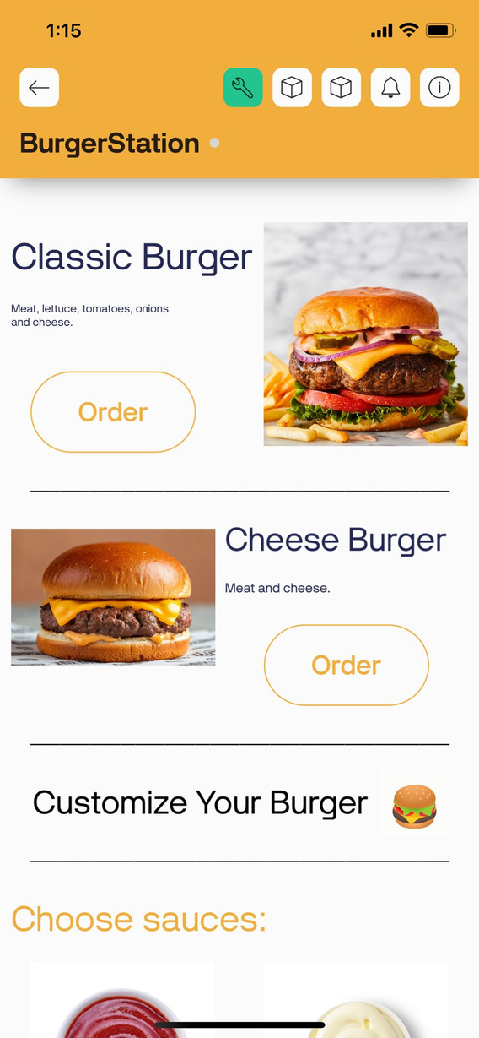
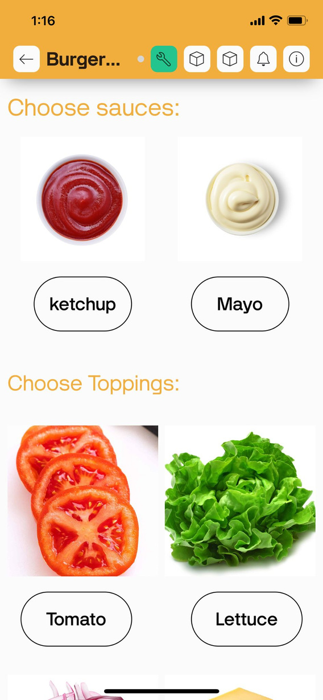
Our Application

Slide 26
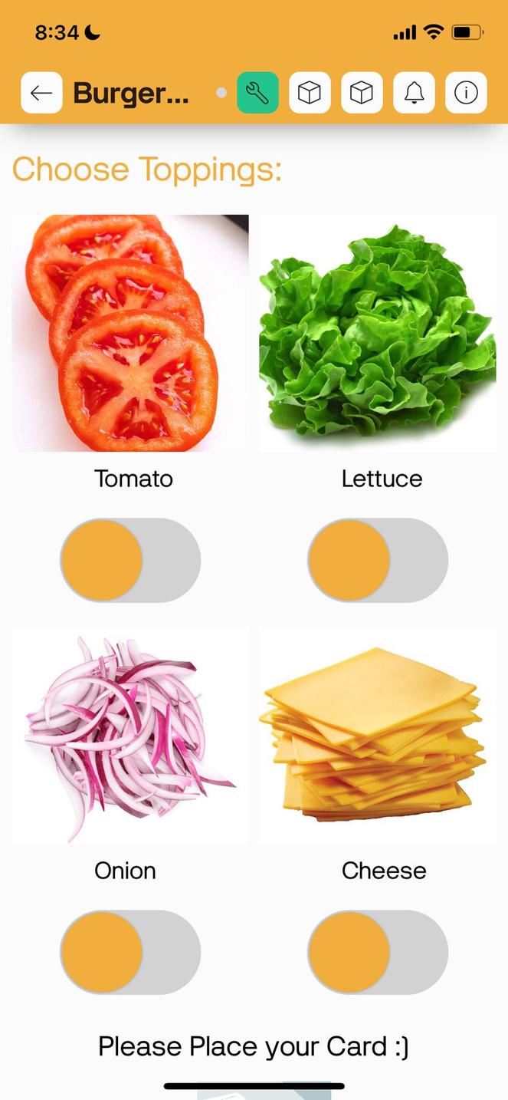
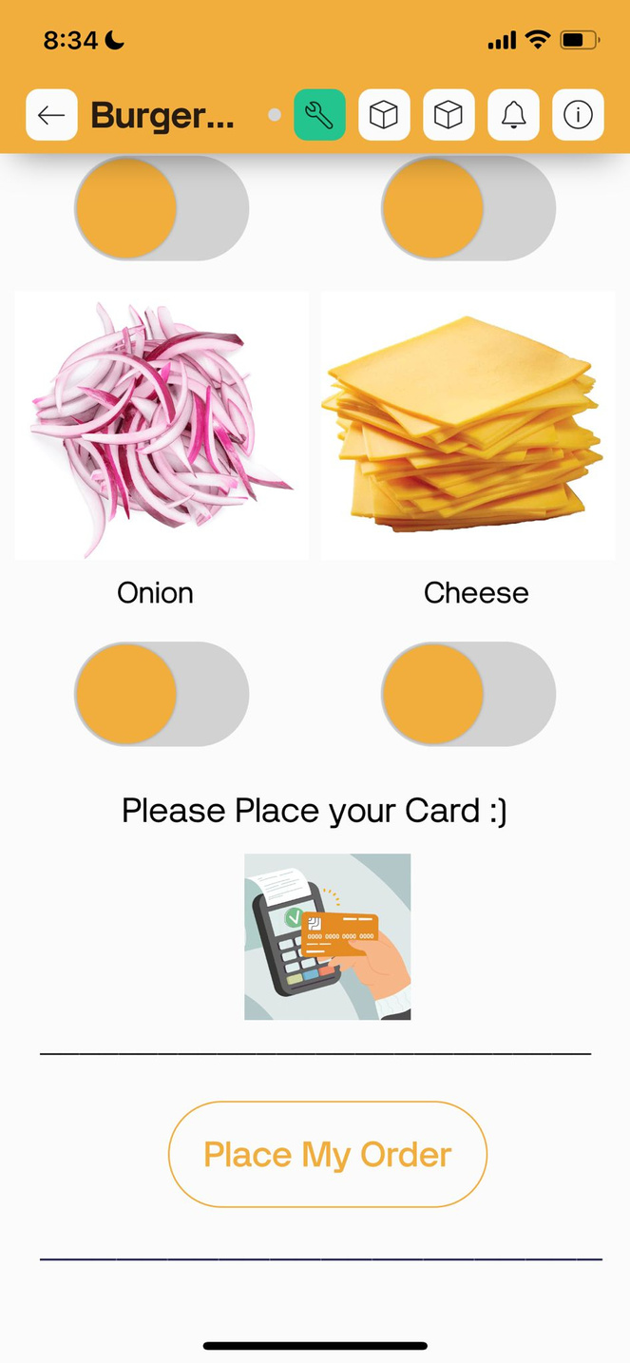

Slide 27
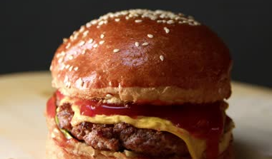
ANY QUESTIONS?
Live Demo

