Slide 1
TOOLGO
(HARDWARE PROJECT)​
Areen Ateeq
&
Eyad Al Hasan

Slide 2
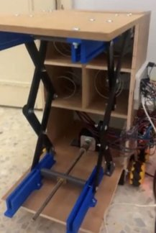
MAIN IDEA​
We think that hospitals suffer from a lack of organization in the use of medical tools in emergency rooms, and because human life and health are the most important things that can be thought of, we decided to make a machine that carries medical tools. The nurse calls the machine while he is in the patient’s room instead of going by himself and bringing the necessary tools, and thus we save time and effort for the nurse.

Slide 3
HOW IT WORK​
We have two main parts:
Movement part.
Vending machine .

Slide 4
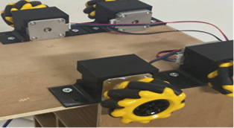
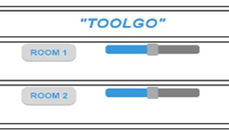
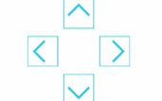



Movement part
OBJECT AVOIDANCE
ESP32-CAM​
Ultra sonic sensor​
SAVE PATH
PRIORITY
Using:

Slide 5

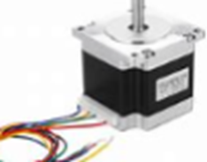
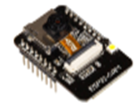
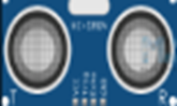
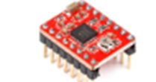
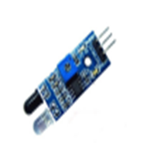
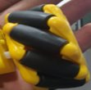
Movement Component
ESP32-CAM
Ultra sonic sensor
Stepper Motor
A4988 Driver
Mecanum Wheel​
IR Sensor

Slide 6
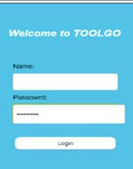
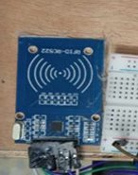
Vending machine
More secure

Slide 7
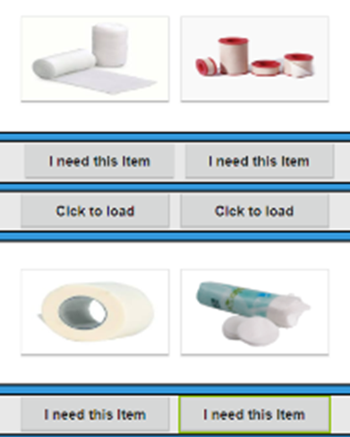
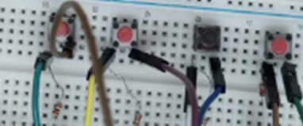
Vending machine
Buttons, Application

Slide 8
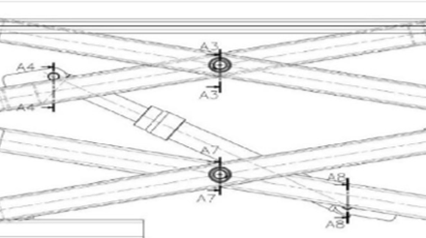
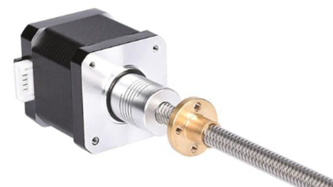
Vending machine
Scissor lift mechanism

Slide 9
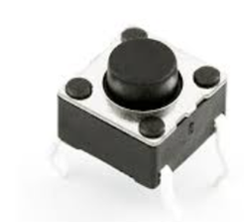
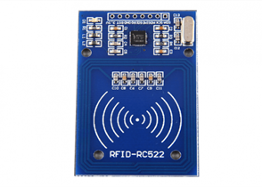

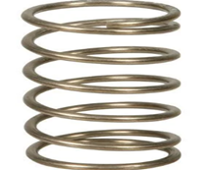
Vending Machine Component
RFID
Push Button
Stepper Motor
A4988 Driver
a coupler, and a square-tooth bolt.
Helical Spring

Slide 10
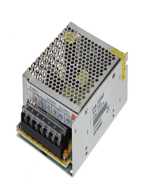
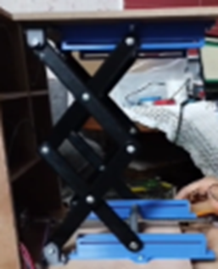
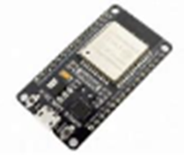
Other component
Power supply
3D Printed piece
Scissor Lift
ESP32

Slide 11
Constraints
limited mechanical expertise.
limited access to some components.
platform organization .
insufficient budget.

Slide 12
Future Work
Design vending machine with better features may be able to chat with the user (like a waiter in a restaurant) and the application will be available on iOS and Android.
Employ artificial intelligence (AI) for determine the shortest path and select new path in case there are obstacle.

Slide 13
Thank you

