Slide 1

Indoor Propagation Modeling
Prepared by:
Ashraf Zetawe
Derar Mu’alla
Osama Dragmeh
Supervisor:
Dr. Yousef Dama

Slide 2
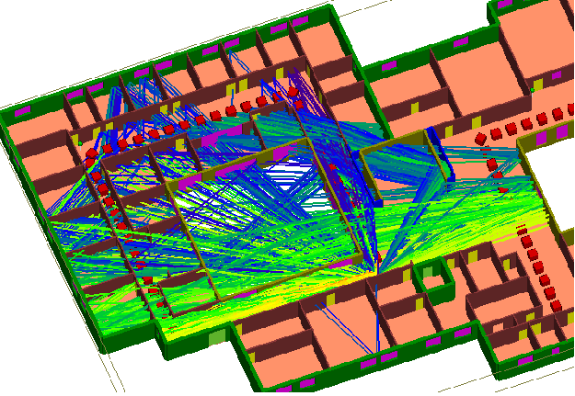
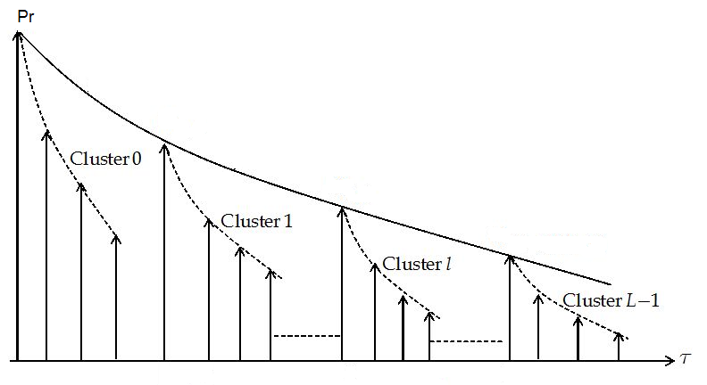
Outlines
1- Why Project
2- Literature Review
3- Measurements Procedure
4- Clustering.
5- Channel Capacity.
6- Authentication Of Data
7- INDOOR RADIO PROPAGATION MODEL

Slide 3
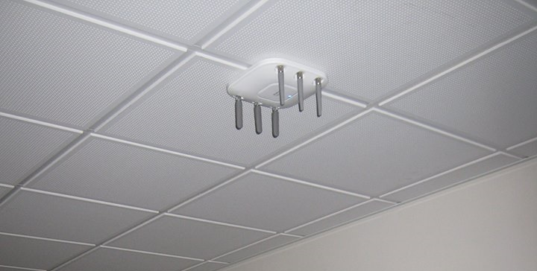
Why???
Number of research
Design propagation model in an indoor environment.
How to plan for reliable wireless system
Number of companies in middle east

Slide 4
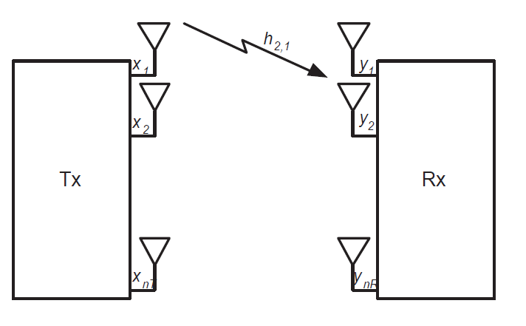
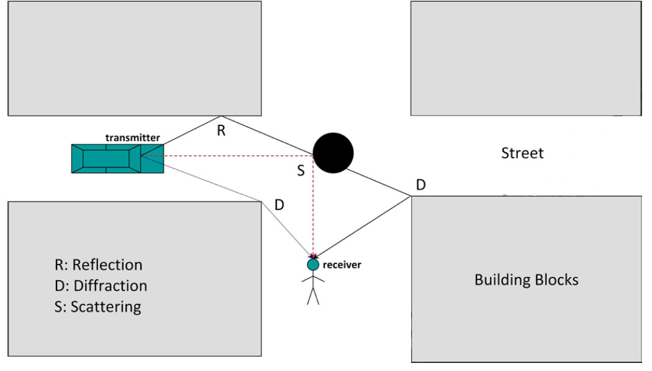
Literature Review
802.11n is a IEEE standard .
MIMO System
PROPAGATION MODELS.
Multipath propagation

Slide 5
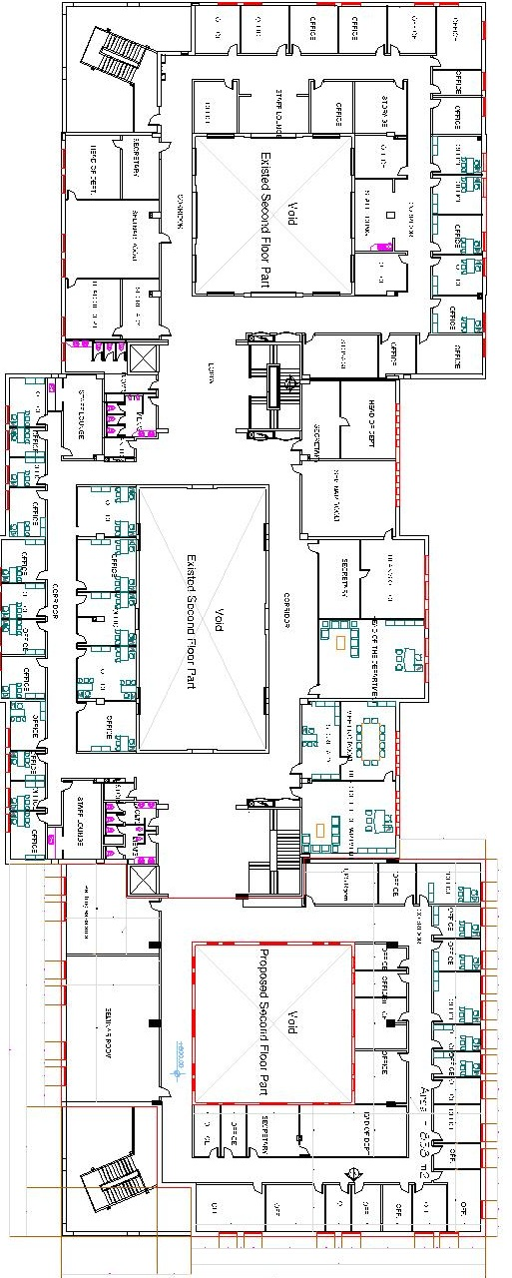
Study Area

Slide 6
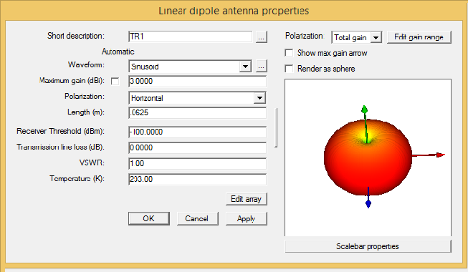

Wireless Insite

Slide 7
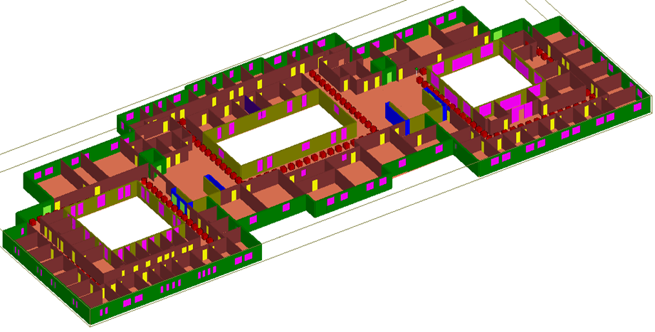
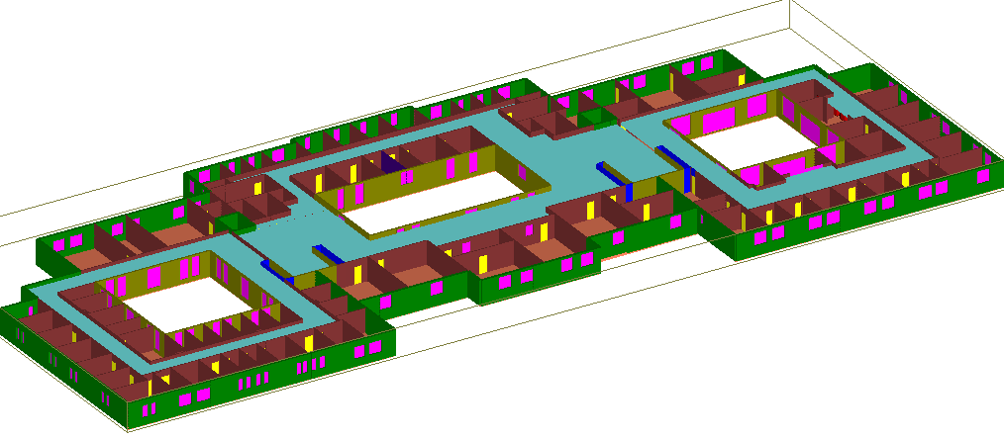
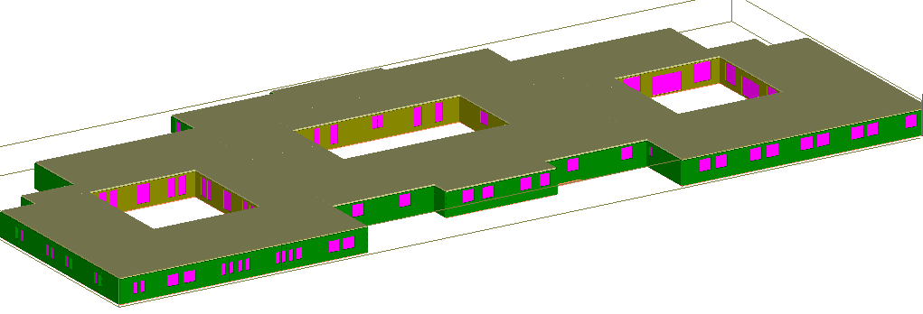
Implemented model

Slide 8
Site Description
Material type | thickness | Used in | Height
concrete | 35 Cm | floor and ceiling | 3m
dielectric material | 3 Cm | second ceiling | 2.5m
concrete | 35 Cm | Out walls | ____
concrete | 22 Cm | inner walls | ____
concrete | 15 Cm | inner walls | ____
brick | 12.5 Cm | inner walls
wooden and metal door | 3 Cm | door | ____
one-layer glass | 0.3 Cm | windows | ____

Slide 9
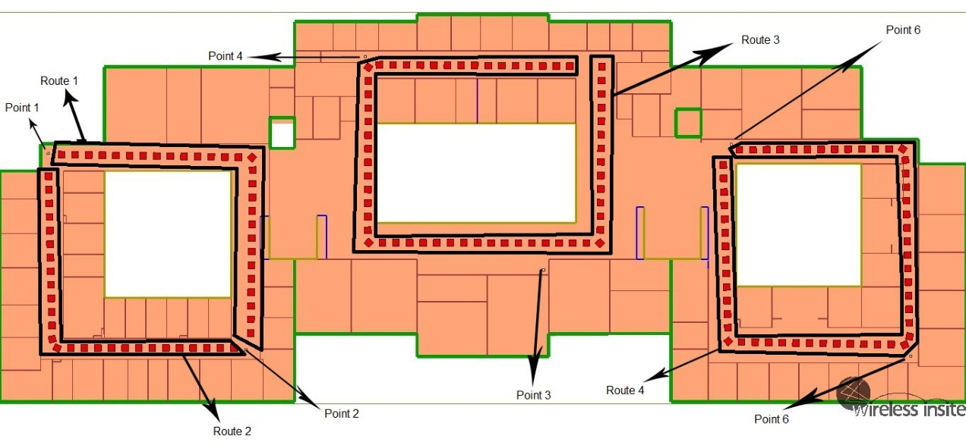
Transmitter and receiver locations

Slide 10
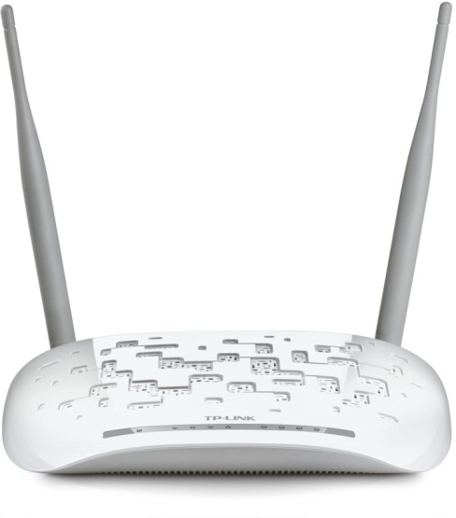
MIMO Equipment
Transmitter
The transmitter used is TP-link TD-W8961n access point MIMO system.
Number of antenna | 2
Transmission power | 20dBm
Antenna gain | Antenna 1 3dBi Antenna 2 3dBi
Type of the antenna | external
Maximum bitrate | 300Mbit/s

Slide 11
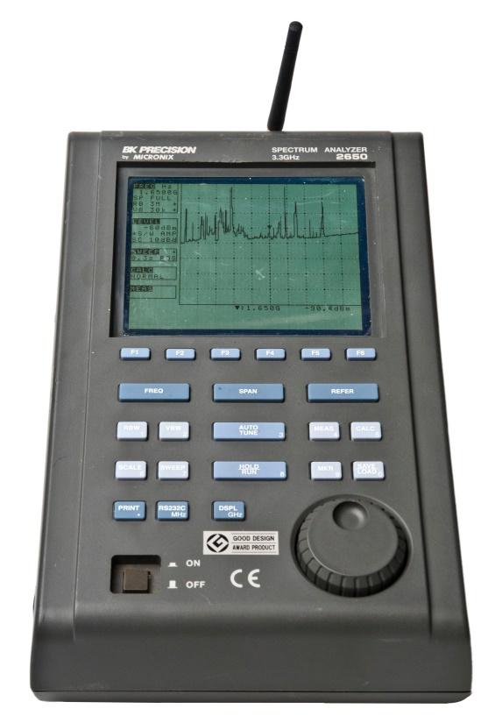

MIMO Equipment
Receiver
We use two receiver
Cisco Mimo receiver
Spectrum Analyzer
Number of antenna | 2
Transmission power | 15dbm
Antenna gain | Antenna 1 gain ≤3dbi Antenna 2 gain ≤4dbi
Type of the antenna | Internal
Maximum bitrate | 300Mbit/s

Slide 12
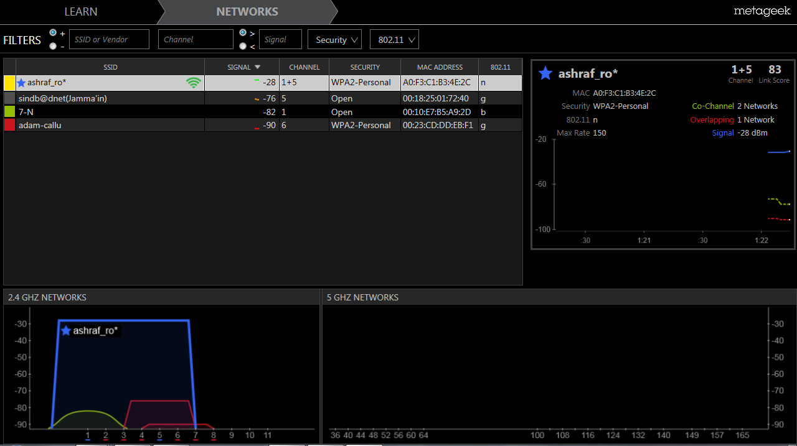
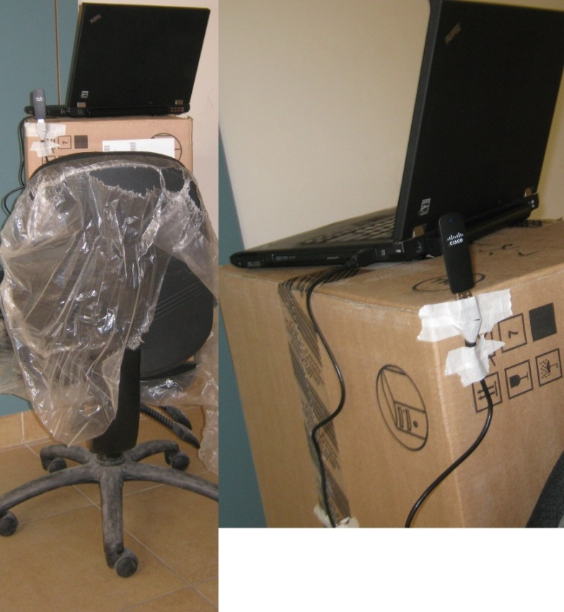
RSSI Measurement Setup
Receiver
insider 2.0

Slide 13
RSSI simulation
Running number | High of the transmitter (m) | Transmitting power (dBm) | Number of reflection | Number of transmissions | Number of diffraction
1 | 0.5 | 11dbm | 6 | 6 | 0
2 | 1 | 11dbm | 6 | 6 | 0
3 | 1.5 | 11dbm | 6 | 6 | 0
4 | 0.5 | 17dbm | 6 | 6 | 0
5 | 1 | 17dbm | 6 | 6 | 0
6 | 1.5 | 17dbm | 6 | 6 | 0
7 | 0.5 | 20dbm | 6 | 6 | 0
8 | 1 | 20dbm | 6 | 6 | 0
9 | 1.5 | 20dbm | 6 | 6 | 0
10 | 1.5 | 20dbm | 6 | 6 | 1
Notes:
Received Signal Strength Indicator

Slide 14
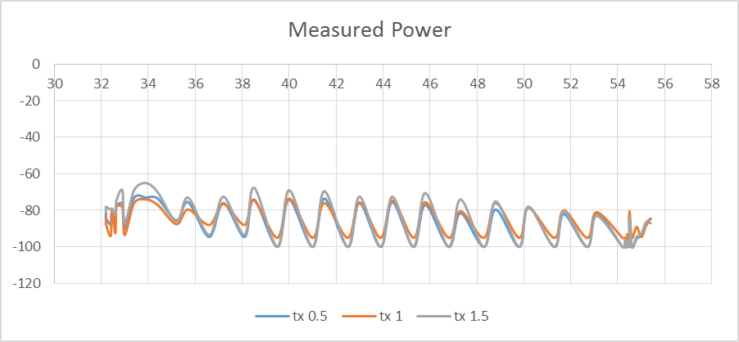
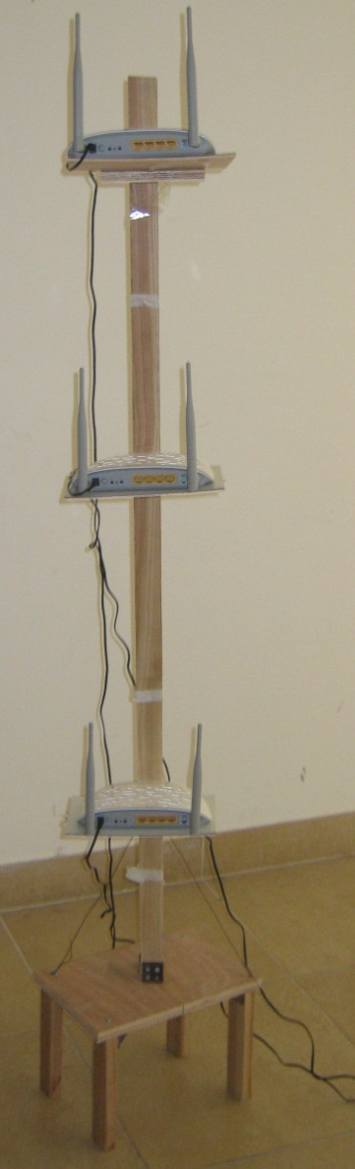
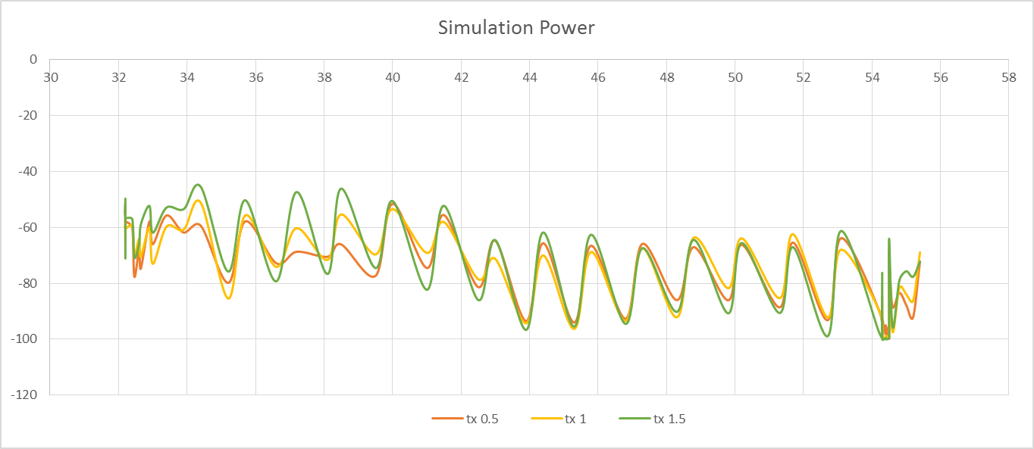
TX Height selection
Transmitters
Notes:
Thank u osama
As osama said we performed many simulations to our study area using wireless insite tool
We performed the simulation on three tx heights 0.5 1 and 1.5 m to see the effect of height on the received signal power
We can see clearly that the received power is in its highest value when the tx is on height of 1.5m
Based on that for the rest of our work we will be using the 1.5m tx height

Slide 15
RSSI ANALYSIS FOR SIMULATED AND MEASURED VALUES
Notes:
We then plotted the simulated received power against tx-rx distance along with the measured power to compare between them we got these results
Its clear that there is a good agreement between the simulation results and the measured results
But still, we have a difference that can reach 20 dB which is too much
So we decided to change the parameters of the materials in the simulator to enhance the results

Slide 16
Measurements vs. Simulation after Modification
Notes:
And so we did
We can see that after modifying the parameters the results has became more close and the difference became around 8 db which is acceptable

Slide 17
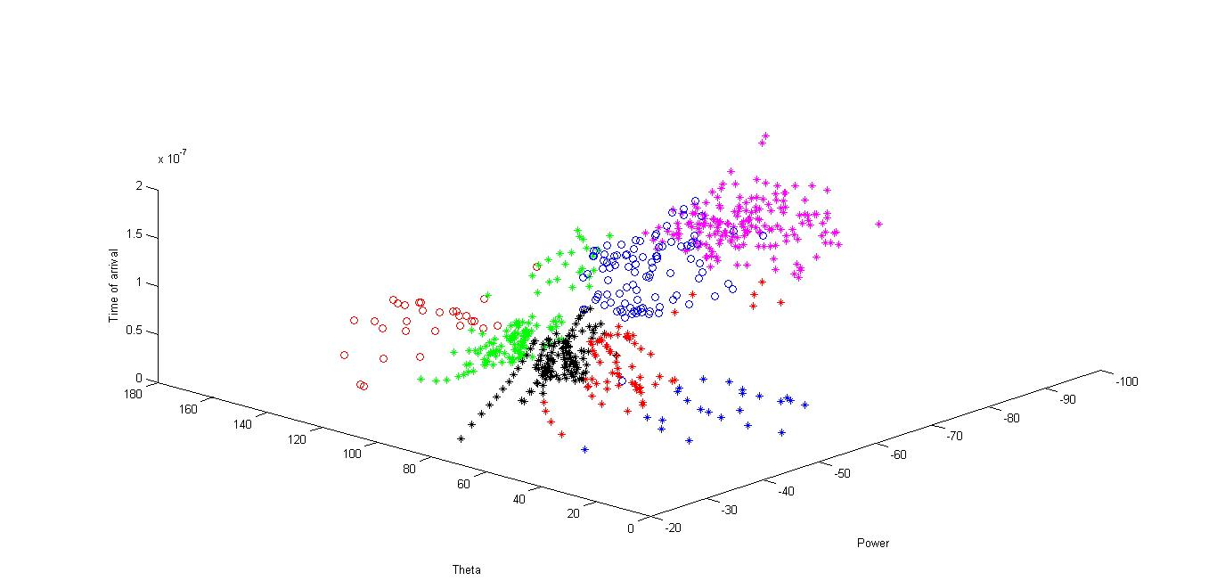
Clustering
Notes:
In order to make sure that our simulation results are reasonable we want to link the simulation results to an existing indoor propagation model called Saleh venzuela model…
In this model the multipath components are received in groups called clusters or in rays within a cluster.
This model indicates that If we plot the power received against time of arrival for each cluster the power will decay exponentially for each cluster and the power of the ray also will decay exponentially as u can see here
So we first plotted the received power against ToA and AoA then used the k-means method to find the clusters as shown here.

Slide 18

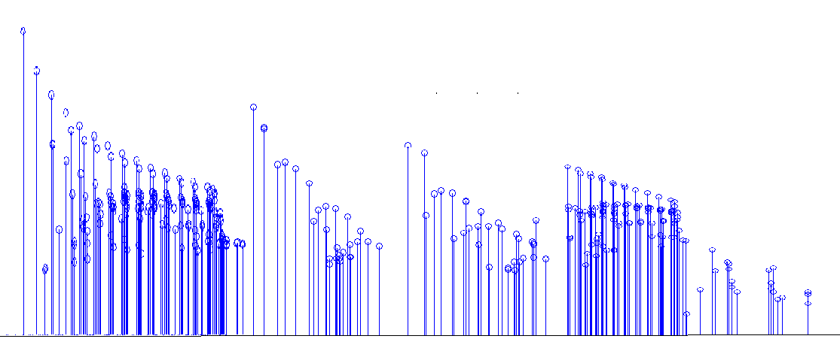
Applying Saleh-Valenzuela to our simulation
c1
c2
c3
c4
Received power
Time of arrival
Notes:
Now for each cluster we plotted the received power against time to get these results
We can see that the simulation satisfy saleh venzuela model
Now we know that our simulation is reasonable

Slide 19
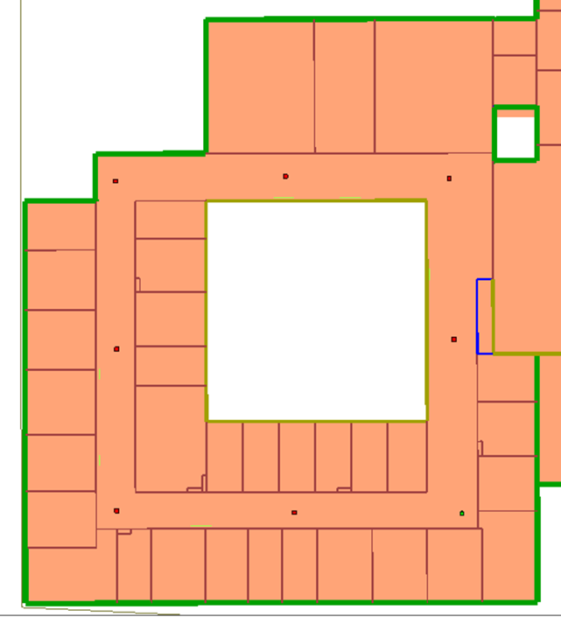
Channel Capacity
Find the channel matrix (c)
Apply Shannon formula to find the capacity
Notes:
Now we want to find the channel capacity for our model
to find the channel capacity we first need to find the channel matrix for each receiver
so for simplicity we reduced the number of receivers to 7 distributed as shown
and then to apply Shannon formula to find the capacity.

Slide 20
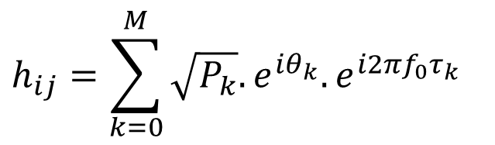

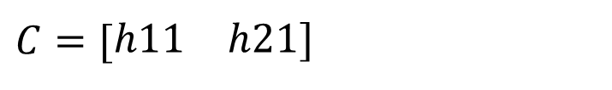
Channel Matrix
Receiver | Impulse response from Tx1 | Impulse response from Tx2
Rx1 | -7.40093056075077 - 34.6670097082566i | -7.65846296427752 - 69.8691692718261i
Rx2 | 28.1743154669248 + 26.9513899296517i | -30.6190873871329 - 4.56461270998886i
Rx3 | 10.6921361812571 - 13.1170984207187i | 3.09790836802025 - 42.7003439250243i
Rx4 | -32.8817540839863 + 5.31237602910812i | -20.2232527602618 + 26.8334011113775i
Rx5 | 10.4563509419887 - 28.8690152926596i | -48.7581299569394 - 22.4828547780491i
Rx6 | 15.9382117568367 + 38.0980291519978i | 70.2075964238675 - 22.6445746986406i
Rx7 | -37.2976965132879 - 28.5465557836052i | 16.6591355583433 - 32.6566288477936i
$$C=[\begin{matrix}h11 & h21]\end{matrix}$$
$$h_{ij}=\sum_{k=0}^{M}{\sqrt{P_{k}}.e^{iθ_{k}}.e^{i2πf_{0}τ_{k}}}$$
Where
  hij : Complex impulse response
  M: the number of paths that reach the receiver
  Pk: Received power
  $$θ_{k} :Angle of arrival$$
  $$f_{0} :Operating frequency$$
  $τ_{k}$ : Time of arrival
Notes:
Since were dealing with a 2x1 MIMO system the dimension of the channel matrix should be 2x1 for each receiver and it should be on this form
Where h11 is the complex impulse response from the 1st transmitter antenna to the receiver antenna
and h21 is the complex impulse response from the 2nd transmitter antenna to the receiver antenna
And they can be found by this formula
where M: is the no. of pathes
pk: is the received power for each path
Theta k : is the angle of arrival for each path
F0: is the operating frequency
And taw k: is the time of arrival for each path
We found the h matrix for our model it was like this

Slide 21
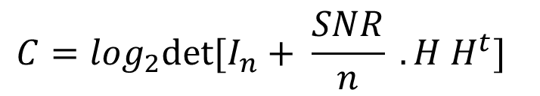
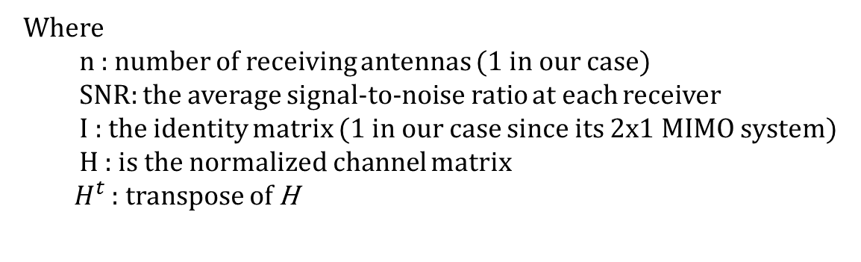
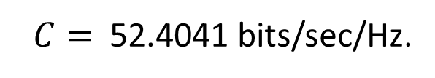
Channel Capacity
$$C=\log_{2}det⁡[I_{n}+ \frac{SNR}{n} . H H^{t}]$$
Where
  n : number of receiving antennas (1 in our case)
  SNR: the average signal-to-noise ratio at each receiver
  I : the identity matrix (1 in our case since its 2x1 MIMO system)
  H : is the normalized channel matrix
${ H}^{t}$ : transpose of H
$C=$52.4041 bits/sec/Hz.
Notes:
Now we want to apply this formula to find the capacity this is call Shannon formula
we applied it to get of capacity 52.4 bits\sec\hz
we will continue with ashraf

Slide 22
INDOOR RADIO PROPAGATION MODEL
The aim of this part
Indoor propagation model
Keenan Motley model
Saleh-Venezuela model
Choose the model
Keenan Motley model

Slide 23
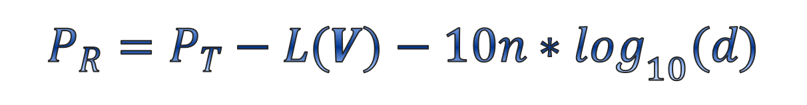
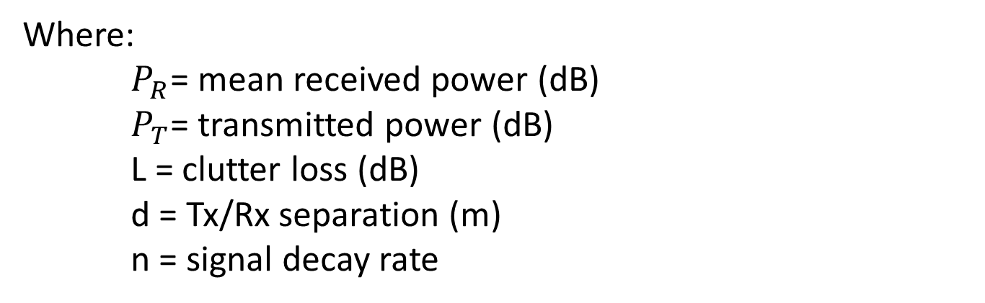
Keenan Motley model
$$P_{R}=P_{T}−L(V)−10n∗\log_{10}(d)$$
$$Path loss=L\left(V\right)+10n∗\log_{10}(d)$$
Where:
$P_{R}$= mean received power (dB)
$P_{T}$= transmitted power (dB)
L = clutter loss (dB)
d = Tx/Rx separation (m)
n = signal decay rate

Slide 24
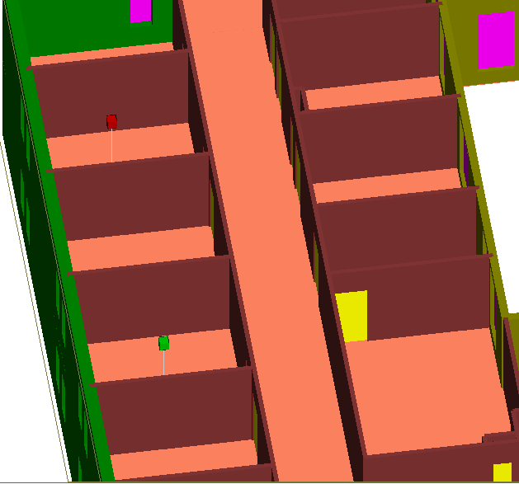
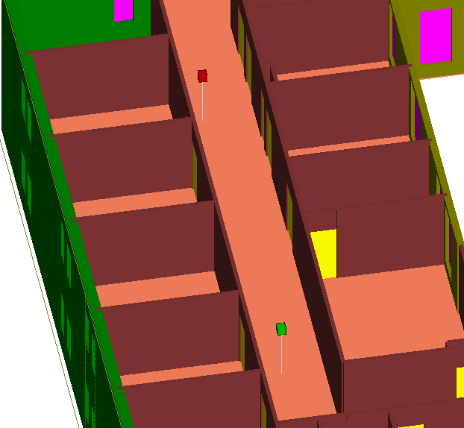
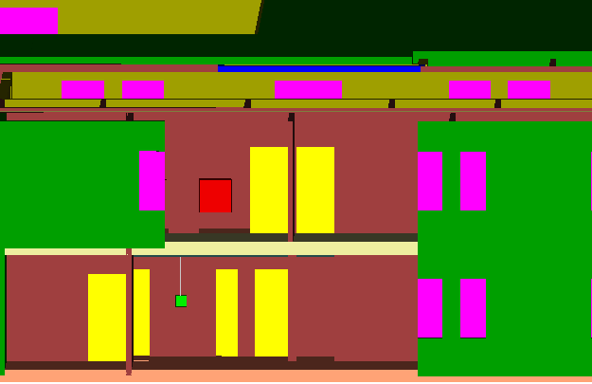
Indoor Environment scenarios
Line of sight
Non Line of sight (Tx and Rx in the same floor)
Non Line of sight (Tx and Rx in different floor)

Slide 25
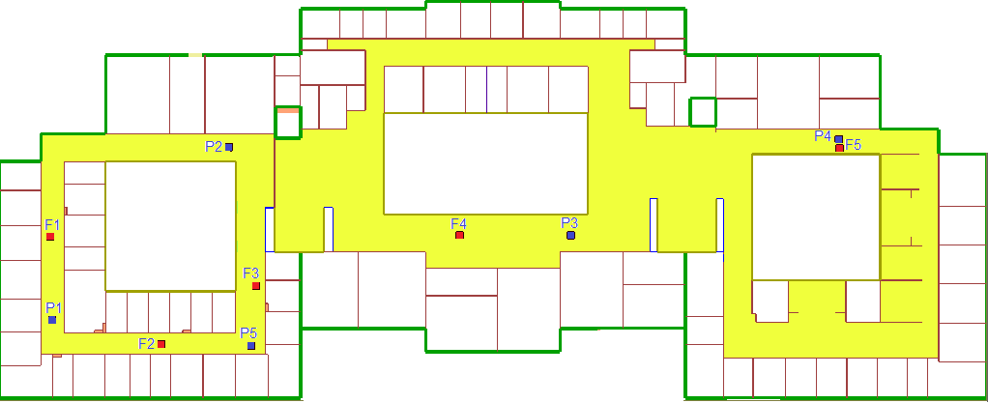
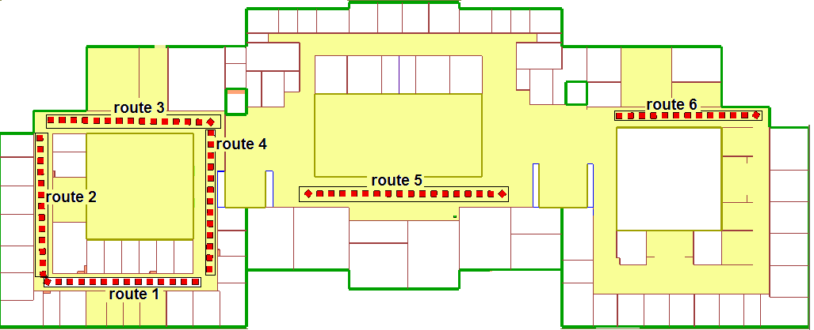
Measurements setup
Transmitter | Route number
P1 , F1 | Route 2
F2 | Route 1
P2 | Route 3
F3 | Route 4
P3 , F4 | Route 5
P4 , F5 | Route 6
P5 | Route 1 ,4

Slide 26
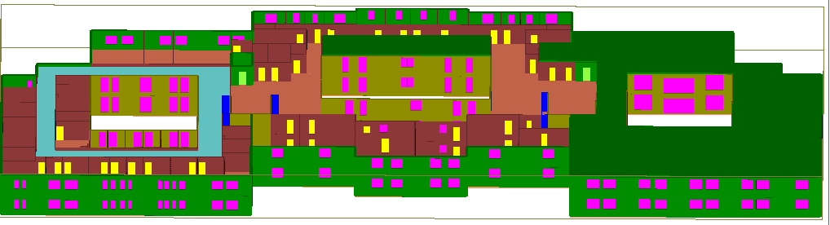
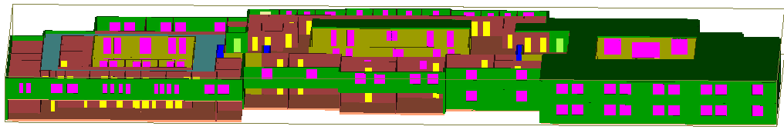
authentication

Slide 27

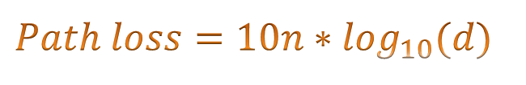


Free space attenuation factor
$$Path loss=10n∗\log_{10}(d)$$
Tx and Rx location | mean square error
TX(P5)*RX(route 1) | 4.661236828
TX(P5)*RX(route 4) | 4.790544655
TX(P1)*RX(route 2) | 5.451917858
TX(P2)*RX(route 3) | 4.904359128
TX(P3)*RX(route 5) | 4.240786069
TX(P4)*RX(route 6) | 4.706875779
TX(P5)*RX(route 1)
#rx | distance | Measurements | path los
1 | 1.3 | -26 | 46
2 | 2.8 | -32 | 52
3 | 4.3 | -34 | 54
4 | 5.8 | -39 | 59
5 | 7.3 | -38 | 58
6 | 8.8 | -41 | 61
7 | 10.3 | -43 | 63
8 | 11.8 | -41 | 61
9 | 13.3 | -43 | 63
10 | 14.8 | -48 | 68
11 | 16.3 | -47 | 67
12 | 17.8 | -49 | 69
13 | 19.3 | -48 | 68
$$Path loss=10n∗\log_{10}\left(d\right)+44$$
$$Path loss=10n∗\log_{10}\left(d\right)+L^{o}$$
Where $L^{o}$ = path loss at 1 meter

Slide 28
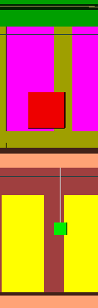
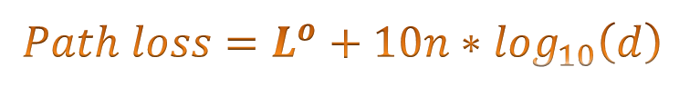

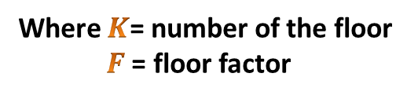

Floor factor
$$Path loss=L^{o}+10n∗\log_{10}\left(d\right)$$
$$Path loss=L^{o}+10n∗\log_{10}\left(d\right)+K∗F$$
Where $K$= number of the floor
$F$ = floor factor
The value of $F$ Based on our measurements is 42
Tx and Rx location | mean square error
TX(F2)*RX(route 1) | 8.19718704
TX(F1)*RX(route 2) | 7.469590457
TX(F3)*RX(route 4) | 122.6622818
TX(F4)*RX(route 5) | 132.7651097
TX(F5)*RX(route 6) | 324.5090622

Slide 29
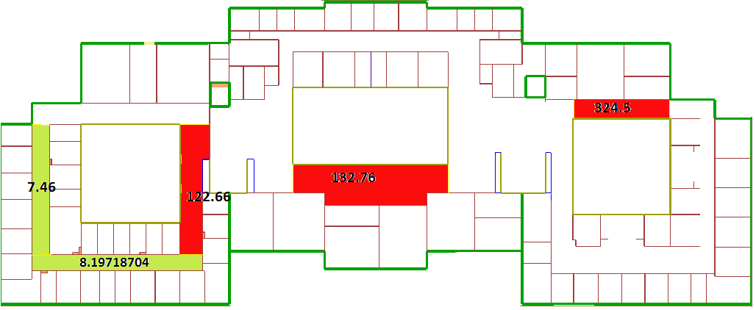
nearby building effect
Modeling the Effects of Nearby Buildings on Inter-Floor Radio-Wave Propagation.
Tx and Rx location | mean square error | mean square error
TX(F3)*RX(route 4) | 122.6622818 | 9.148314508
TX(F4)*RX(route 5) | 132.7651097 | 6.519320026
TX(F5)*RX(route 6) | 324.5090622 | 9.019084557

Slide 30
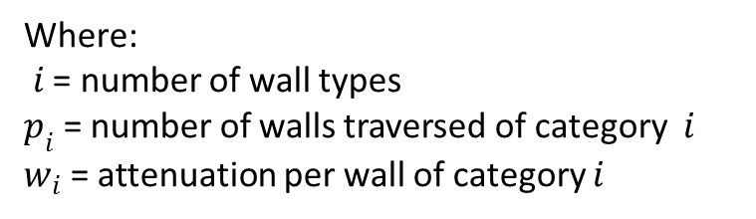
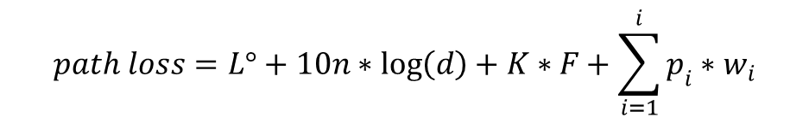
Wall factors
$$path loss=L°+10n∗\log\left(d\right)+K∗F+\sum_{i=1}^{i}{p_{i}∗w_{i}}$$
Where:
$i$ = number of wall types
$p_{i}$ = number of walls traversed of category $i$
$w_{i}$ = attenuation per wall of category $i$
Wall type | Attenuation due to wall
Brick | 8 dBm
Concrete | 12 dBm

Slide 31
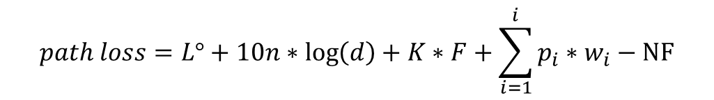
conclusion
$$path loss=L°+10n∗\log\left(d\right)+K∗F+\sum_{i=1}^{i}{p_{i}∗w_{i}}−NF$$
the benefit of the project
for the university
In general

Slide 32

Remember: Questions are the
main reason for world war II
So any Question

Slide 33


