Slide 1
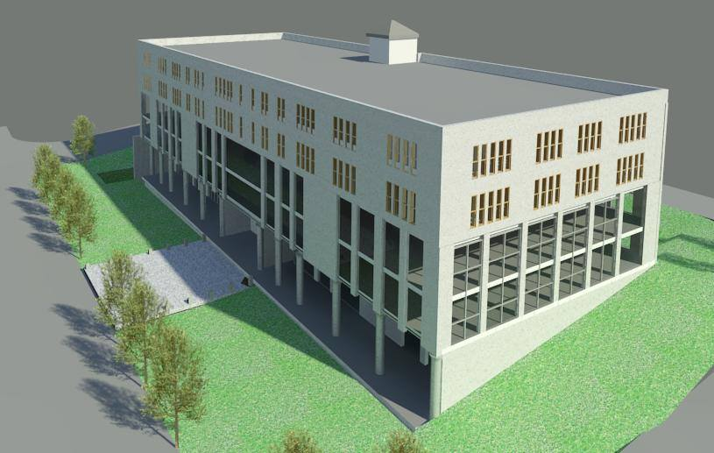
Mulit functional
Building design
Graduation Project “2”
Prepared by:
Orouba Abdullah
Qutaiba Yaseen
Ruba ammar
Yusra AbuMohsen
Supervisor :
Dr. Nermeen Al-barq

Slide 2
Outline:
Introduction
Structural Design
Quantity Surveying and Cost Estimation
Environmental Design
Mechanical Design
Electrical Design
Architectural Design
Safety Design

Slide 3
Architectural Design

Slide 4
Architectural Design:
1 site plan
2- the plans
3- sections

Slide 5
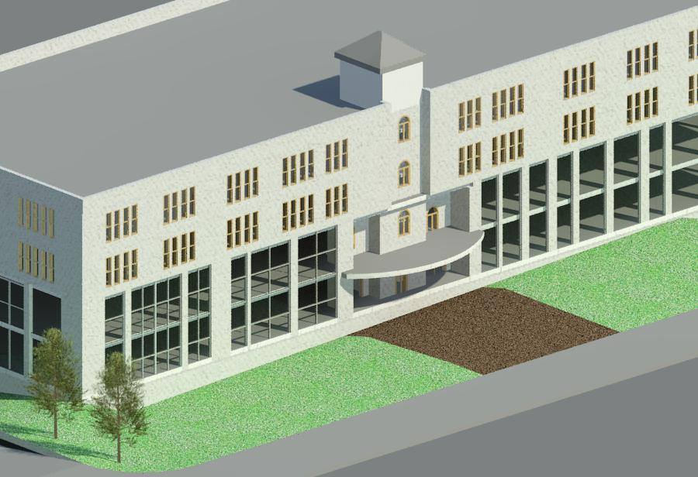

Slide 6
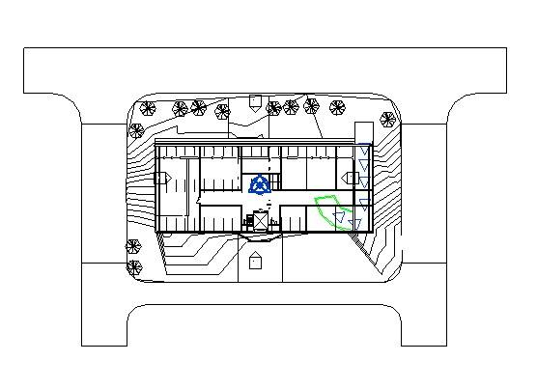
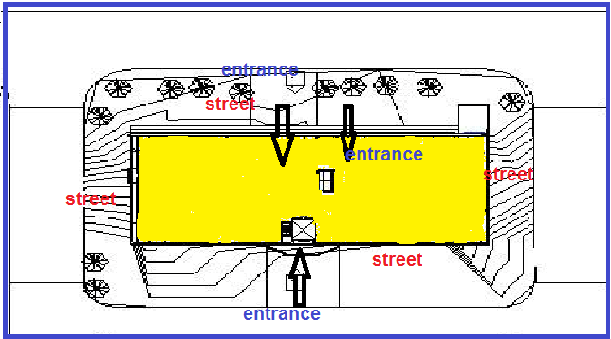
Site plan:
Notes:
The main entrance of the restaurant is from Jamal Abdel Nasser Park, the secondary entrance of parking, management, and services are from Yafa Street as shown in the figure below.
The site contains parking which the capacity of it about 36 car, and there are two ramps the first one for entrance, and the second one for exit

Slide 7
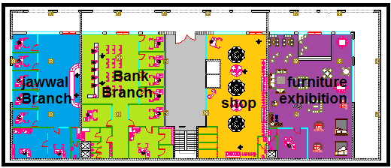
Architectural Design:
Ground Floor
Area=1025m^2
Notes:
The ground floor contains the reception and cashier, coat room, kitchen, dining area, mechanical and electrical rooms and storage

Slide 8
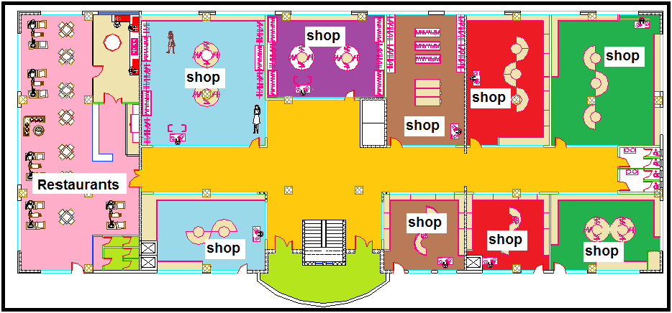
Architectural Design:
First Floor Area=1300m^2

Slide 9
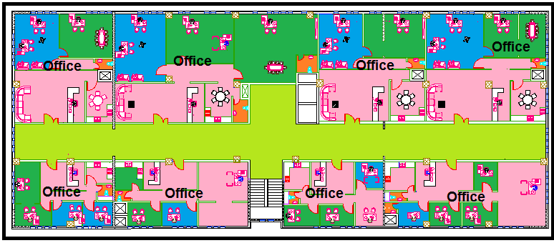
Architectural Design:
secand Floor Area=1300m^2

Slide 10
Architectural Design:
third Floor Area=1300m^2

Slide 11
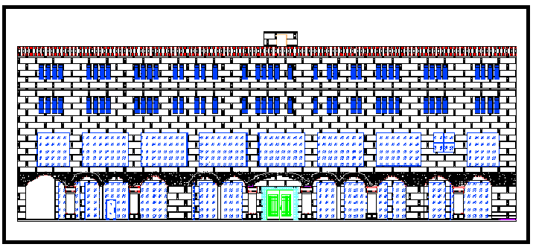
Elevation(North )

Slide 12
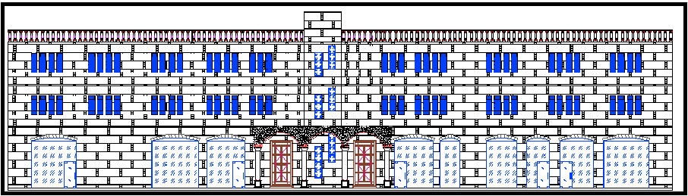
Architectural Design:
Elevation (suoth)

Slide 13
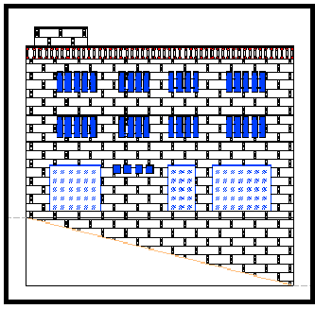
Elevation(east )

Slide 14
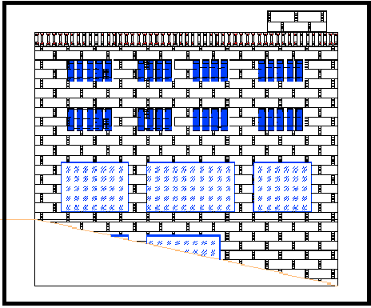
Elevation(North )

Slide 15
Structural Design

Slide 16
Structural Design:
1- Design codes
2- Loads
3-ETABS model and checks
4- Structural elements and detailing

Slide 17
Structural Design:
Design Codes:
ACI -318-08 (American Concrete Institution) for reinforced concrete structural design.
UBC-97 (Uniform Building Code) for earthquake load computations.
ASCE (American Society Of Civil Engineers) for design loads.

Slide 18
Structural Design:
Loads:
Type of loads | Load (KN/m2)
Live load | 5KN/m²
Super imposed | 6.1KN/m²
Exterior walls | 25KN/m

Slide 19
Seismic Design Data:
Location …Tubas
Zone ….2B
CV=0.4
CA=0.28
Z= 0.2
Soil type….SD

Slide 20
Structural System:
The system of the slab is one way ribbed slab(40 cm thickness ) with Drop beams.

Slide 21
ETABS models:

Slide 22
Checks for models :
1. Compatibility check and Deflection check :
U z from ETABS= 19mm < U max= 30mm
Notes:
compatibility had achieved as shown in the figure

Slide 23
2. Equilibrium check:
Load | Manual | ETABS | Error
Dead load | 48440.9 KN | 49000KN | 1.5 %
Live load | 20315.5 KN | 20316.5KN | 0.0043 %
Super imposed | 29502 KN | 29502.5 KN | 0.003 %

Slide 24
3. Internal Forces Check:
Difference | ETABS | Manual | Load
0.8% | 5028.2KN | 5071 KN | axial load for column
0.15% | 400.5 KN . m | 342 KN | Moment for beam
0.077%. | 83.2KN | 90kN.m | Moment for Slab (interior span)

Slide 25
4. Period Check:
ETAB < 1.3 T manual | ETABS | Manual
o.039<0.65 | 0.039 | 0.5
5. equivalent static check:
ETABS>MANUAL | ETABS | Manual
OK | EQ x= 10742 EQ y= 11742 | V max = 10637.7KN

Slide 26
· Drift CHECK:
∆(in elastic)=19mm …< 112.5mm

Slide 27
Design of Slab: One-Way Ribbed Slab

Slide 28
Beam Design:

Slide 29
Concrete Beam Scheduale :

Slide 30
Column Design:

Slide 31
Column Design:

Slide 32
Footing Design:

Slide 33
Shear Wall Design:

Slide 34
Environmental Design

Slide 35
Environmental Design:
1- The layers for the elements
2- Thermal analysis
3- Daylight factor
4- Shading design

Slide 36
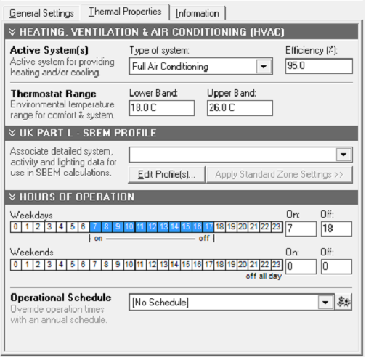
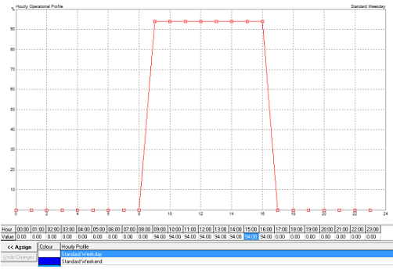
Thermal Analysis ( Jawwal )
Total floor area = 417 m2 – full occupancy – Full air conditioned

Slide 37
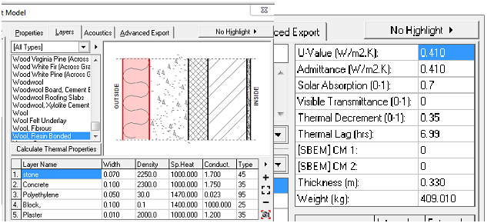
Materials :
External wall of U = 0.41 W/m2.K

Slide 38
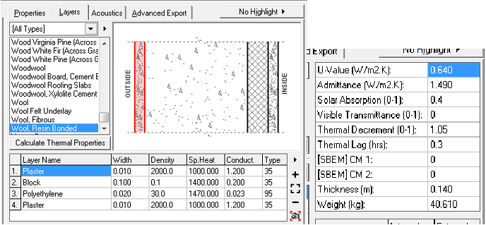
Internal wall of U = 0.64 W/m2.K

Slide 39
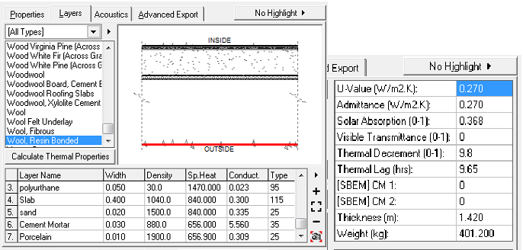
Ceiling: 0.27 W/m2.K

Slide 40
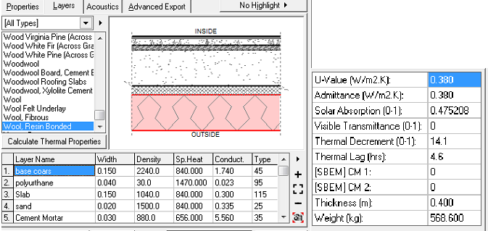
Ground floor : U-value = 0.38 W/m2.K

Slide 41
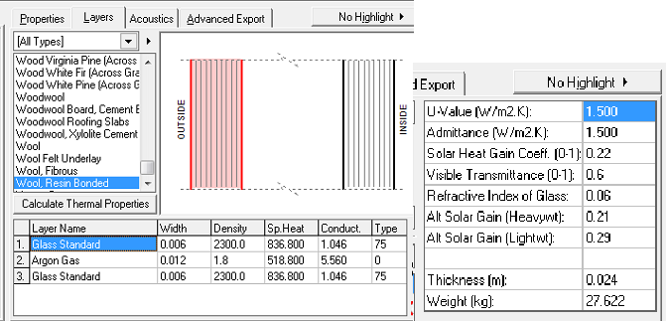
Glass material :
Glass in Jawwal and the Bank U = 1.5 W/m2.K

Slide 42
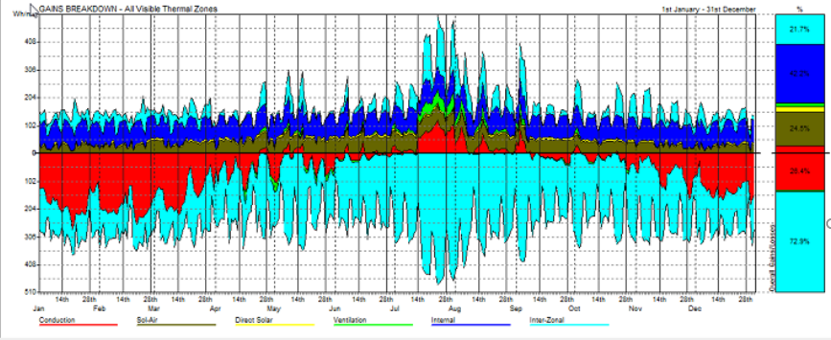
Jawwal
Breakdown analysis :

Slide 43
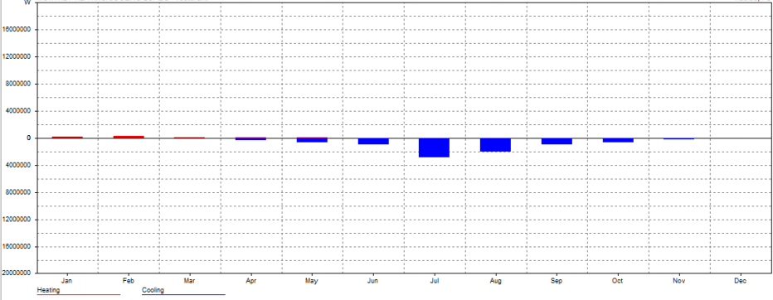
Heating/cooling loads (Jawwal)
Max Heating: 5.075 KW at 12:00 on 18th January
Max Cooling: 21.856 KW at 19:00 on 30th July

Slide 44
Outline
Site location
Architectural Design
Environmental Design
Structural Design
Water supply system
Mechanical Design
Drainage system
Safety Design
HVAC
Electrical Design
BOQ

Slide 45
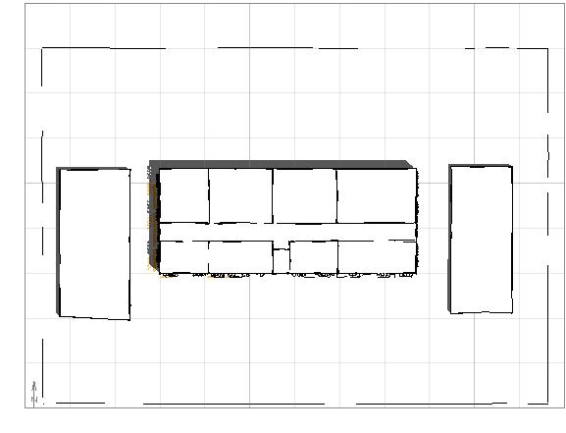
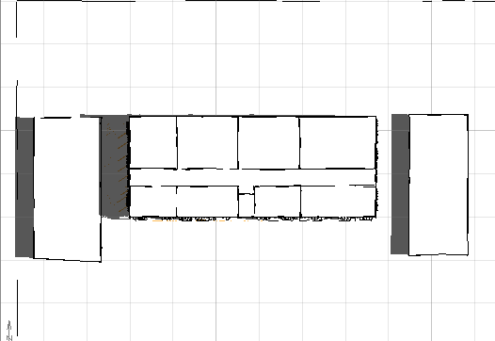
Shading Design
@
@11:00 AM
9:00 AM
@9:00 AM @11:00 AM

Slide 46
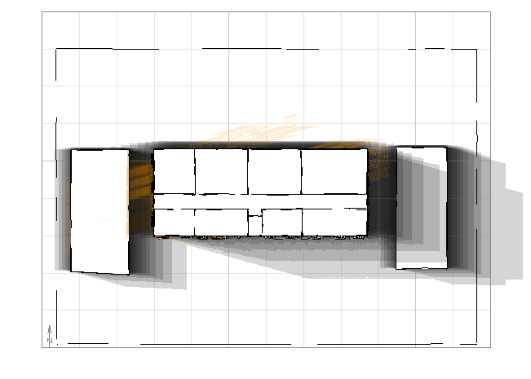
Shadow rang every
½ hour from 9:00-17:00 – June 21

Slide 47
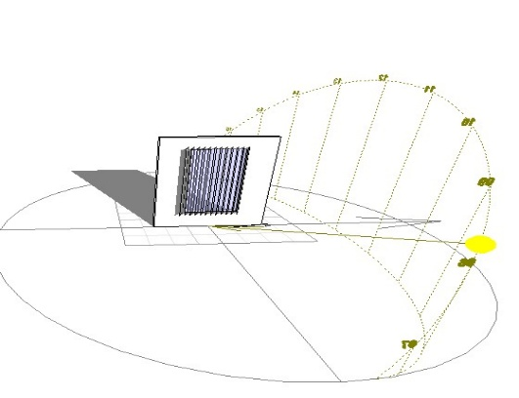
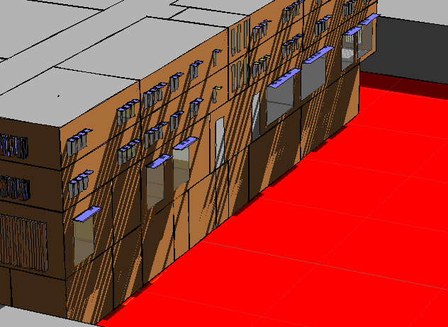
For east window we used Vertical adjustable louvers
Fixed-cantilever for south window

Slide 48


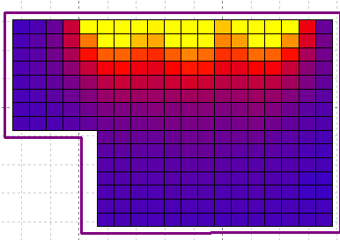

Average Daylight Values
Zone | Floor |  | DF-Value | Uniformity distribution | Picture
jawwal | Ground floor |  | 4.5% | 72%
bank | Ground floor |  | 3.7% | 64.6%
resturant | 1st Floor |  | 4.12% | 60.2%
shop | 1st floor |  | 3.7% | 60.4%
office | 2st floor |  | 5% | 65.7%

Slide 49
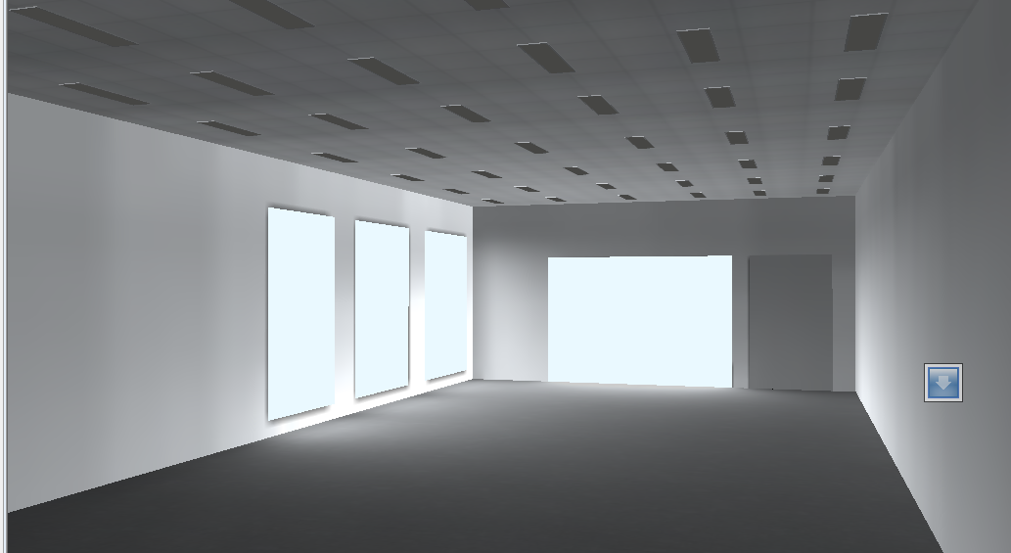
Figure : daylight bank(by daylox)

Slide 50
Mechanical design:
1. Water supply
2. Water drainage
3. Safety
5. HVAC system

Slide 51
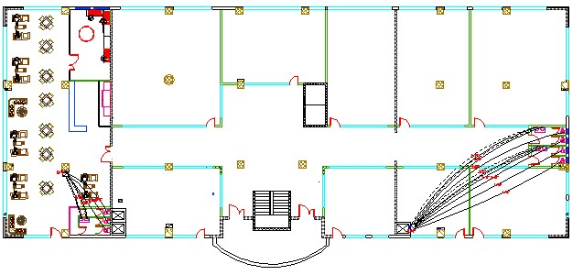
Water supply system:

Slide 52

Drainage water systems design:
The purpose of drainage lines design:
1-easy flow of sewage water.
2- no return of gases.

Slide 53
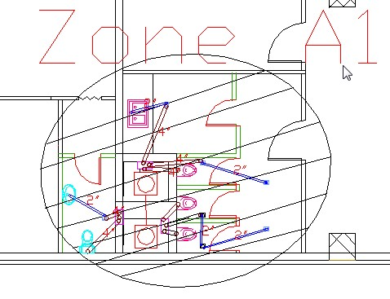
By dividing the building in to zones :
Drainage lines distribution in zoneA1

Slide 54
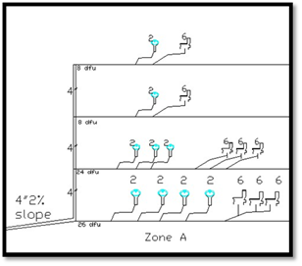
Number of dfu’s in zone A1 :
The total number of fixture units = 66 dfu
Stack diameter = 4"
Diameters of the pipes = 2 " , 3 " and 4" (horizontal).
Mechanical Design
      Black water: W.CS & Kitchen sink
      Grey water: Lavatory.

Slide 55
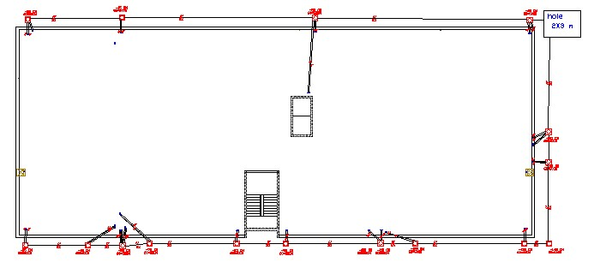
Drainage system roof shows manhole lines
Mechanical Design

Slide 56
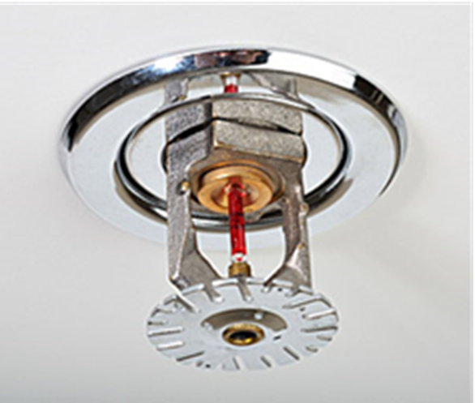
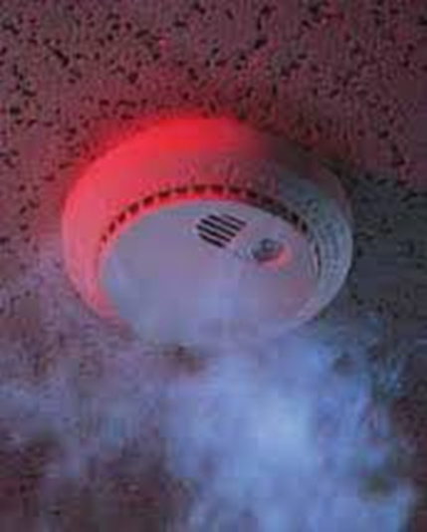



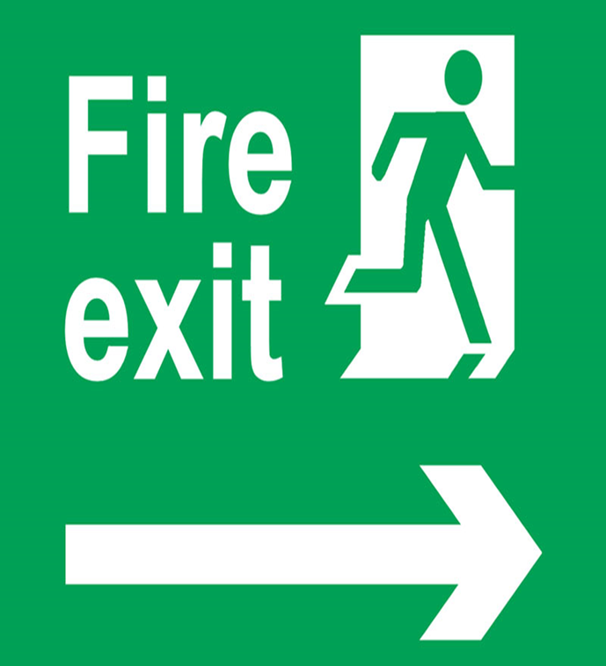
Mechanical Design
Safety system:
1.safety signs for fire
2.Manual Systems
3. Sprinkler system
4. Smoke detectors

Slide 57

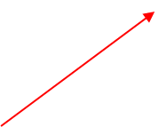
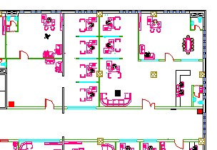
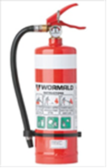


Safety system:

Slide 58
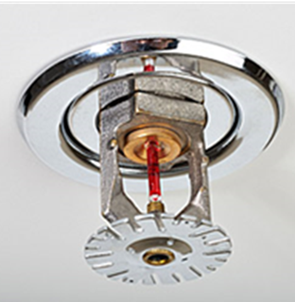
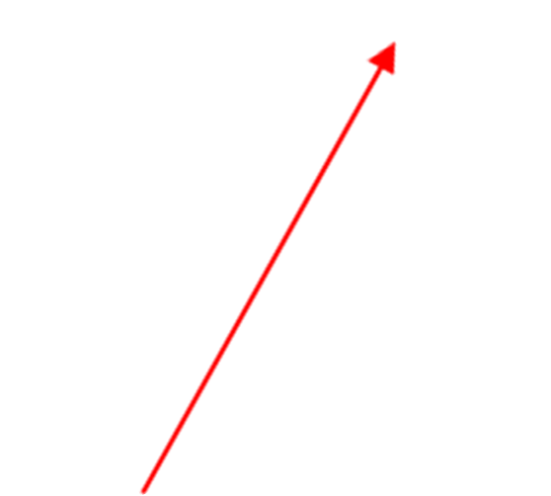
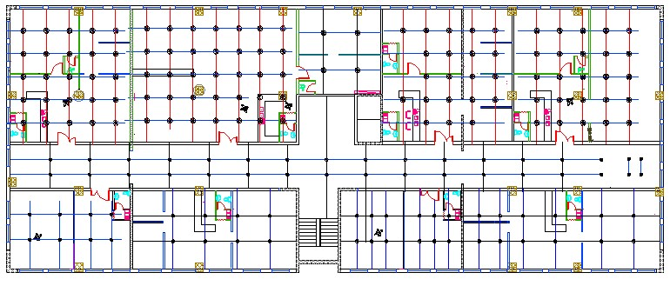
Sprinkler distribution-3rd floor

Slide 59
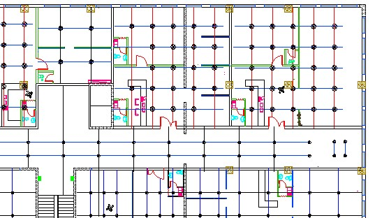


Slide 60
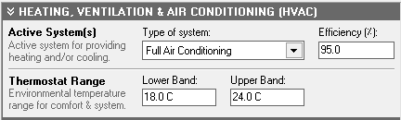
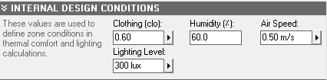
HVAC Design Data for (Jawwal ) :
Uw =0.410 W/m2.C
Uc =0.270W/m2.C
Uadj =0.640 W/m2.C
Ufloor =0.380 W/m2.C
Uglass =1.50 W/m2.C
Max Cooling: 21.856 KW@ 19:00 on 30th of July.

Slide 61
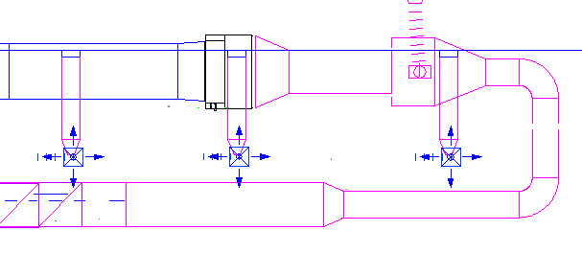
Main Duct sizing :
v=1.3 m3/s , vA-B=7 m/s ,then (Δ𝑝/𝐸𝐿)=1.1
Duct size | Volumetric flow rate | d | V m/s | ϪΡ/EL
A-B | 1.3 | .5 | 7 | 1.1
B-C | 1.021 | .45 | 6.5 | 1.1
C-D | .835 | .4 | 6.2 | 1.1
D-E | .649 | .4 | 6 | 1.1
E-F | .463 | .35 | 5.5 | 1.1
F-G | .279 | .3 | 4.9 | 1.1
G-H | .183 | .25 | 4.5 | 1.1
H-I | .093 | .2 | 2.5 | 1.1

Slide 62
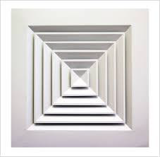
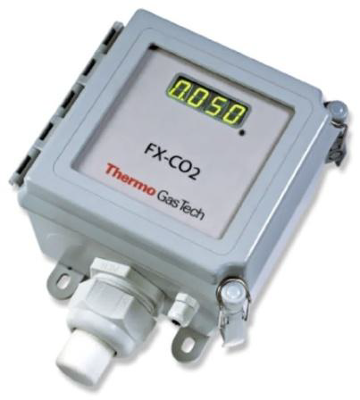
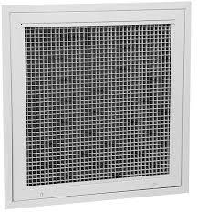
Diffuser selection :
23 x23 cm ceiling diffusers
such that the volumetric rate = 175 L/s and its throw 3-7.3m
Square diffusers (supply).
A fixed carbon
dioxide sensor
Diffusers (return).

Slide 63
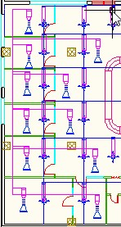
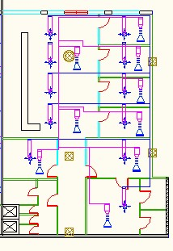
Diffusers distribution:
Jawwal
Bank

Slide 64
Electrical Design

Slide 65
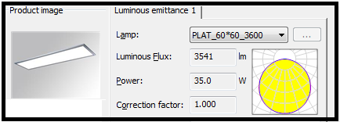


Artificial lighting for dinning
General Artificial Lighting used:
LAMP 6441213 PLAT LED 3600 LM LAMP 6442213 PLAT LED 3600 LM
LAMP 6444000 DINAMIC DECO 4X14/24W
Notes:
Dialux program were used in our analysis to get a helpful and useful allocation of the artificial lighting, two different spaces were chosen to test and those were, manager ,dinning, kitchen, employee area and storage.
a targeted value of U (uniformity) and (unified glare rating) UGR shall be achieved for each space where U >0.6 and UGR should not exceed 19, so to get these values suitable paint, tile, color of furniture and appropriate type of lamp have to be applied.[25]

Slide 66



Artificial lighting for some zone
*Bank Branch

Slide 67



Artificial lighting & socets for some zone
*jawwal Branch

Slide 68



Artificial lighting for some zone
*main hall in resturant

Slide 69

Acostical design
RT60 Values for bank in GF floor before modifications
Notes:
As it's shown in the standards, the reverberant time inside the Dining room does not match the specifications of restaurants that is ( 0.8 – 1.2 ) s

Slide 70


To improve RT60 we use

Slide 71


RT60 Values for resturant in first floor after modifications
RT60 Values for offeic
in secand floor after
modifications
Notes:
All values lies in the range (0.8-1.2) Which is suitable for Dining rooms.

Slide 72

STC Calculations
Required STC 50-55
80

Slide 73

STC Calculations
Required STC 50-55
51.63

Slide 74

Speakers:
Sound system calculations for the restaurant were only made for the dining halls.

Slide 75

The distribution of loudspeakers in resturant

Slide 76

The distribution of loudspeakers in Bank

Slide 77
Quantity surveying and cost estimation

Slide 78
Bill of Quantities
Bowling - Sample Structural
Total cost of structural elements per meter square = 150 JD
Total Cost of the Bowling center = 993,750 JD

Slide 79


