Slide 1


Amer Kobari & Tariq Marmash

Slide 2


01
Main Idea
05
02
Future Work
Hardware Components
WHAT WE WILL COVER
04
03
Features
Constrains

Slide 3

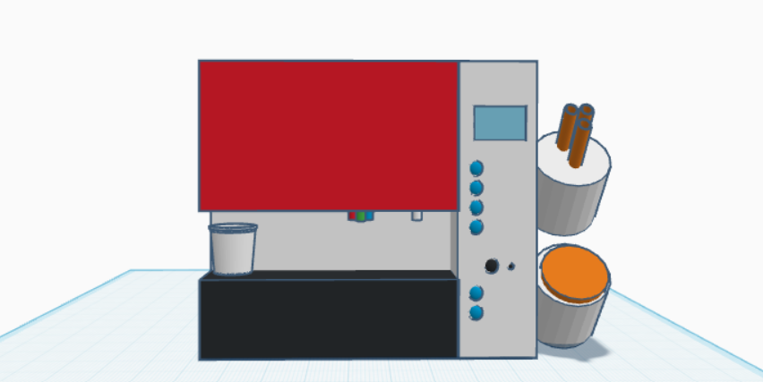
Our Design

Slide 4
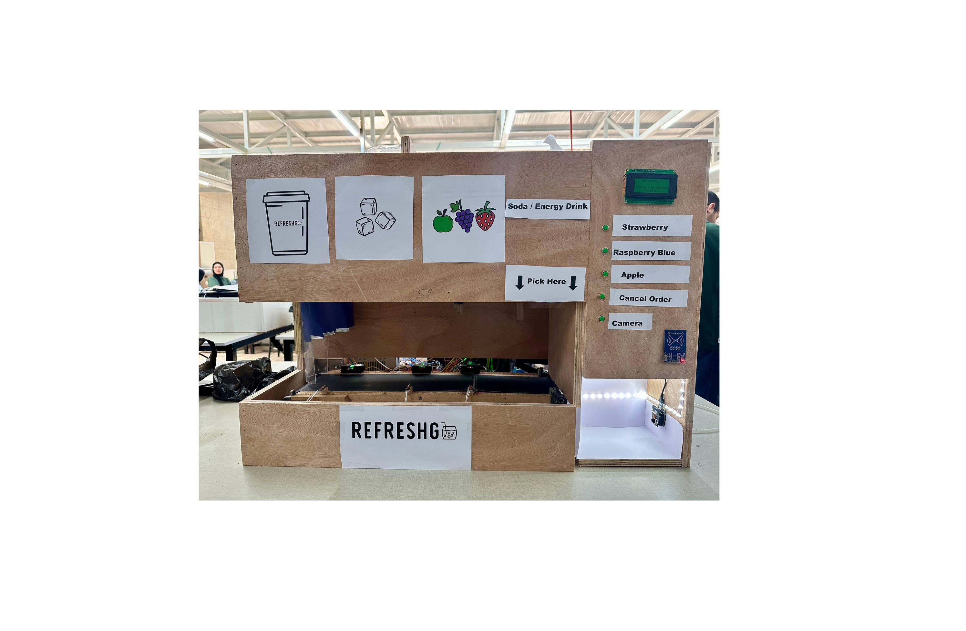
Our Project

Slide 5
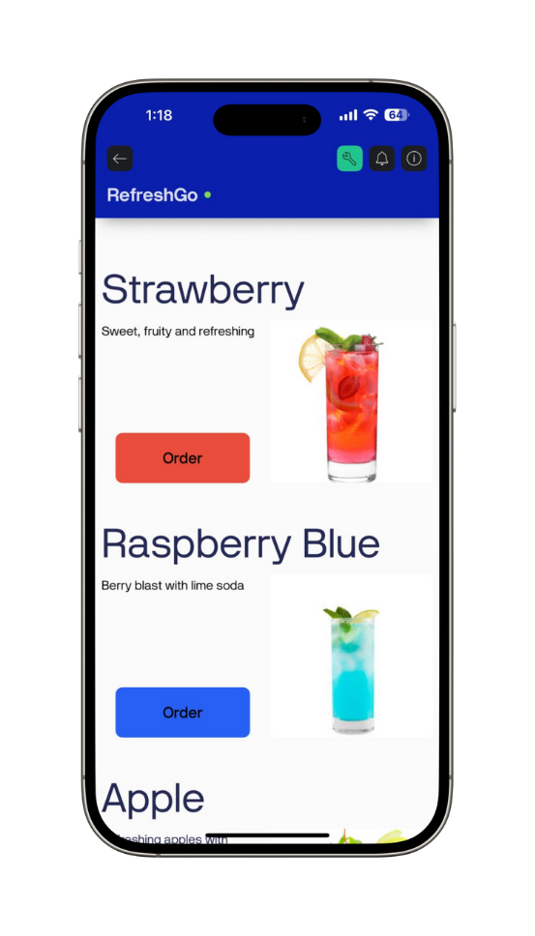
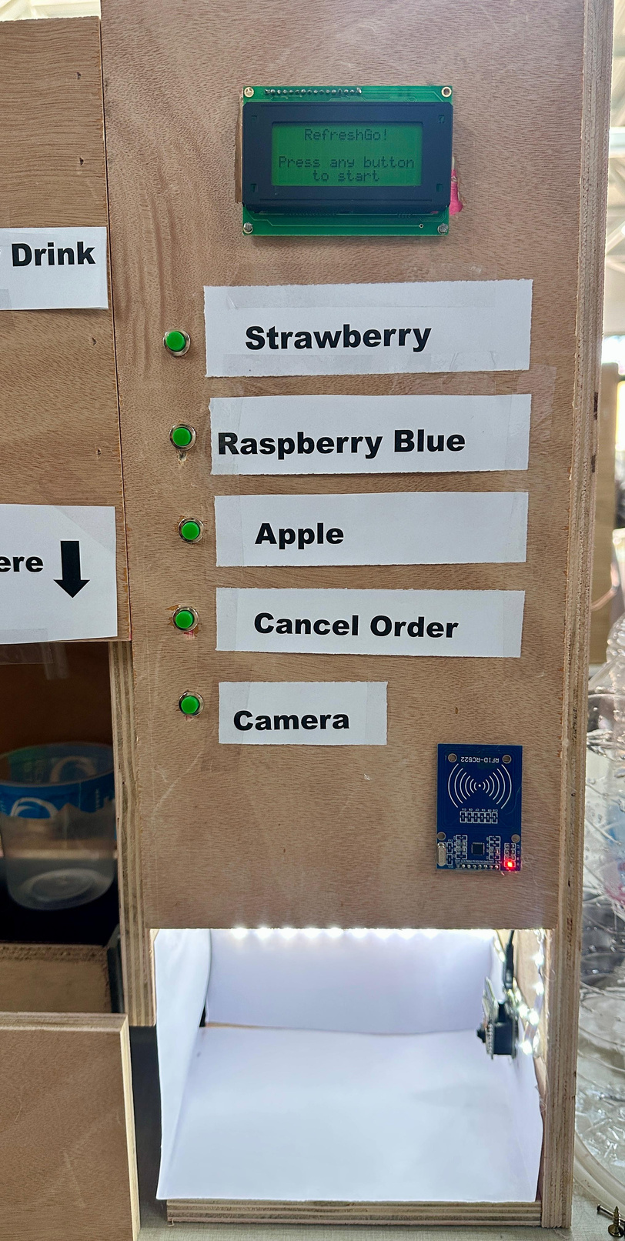
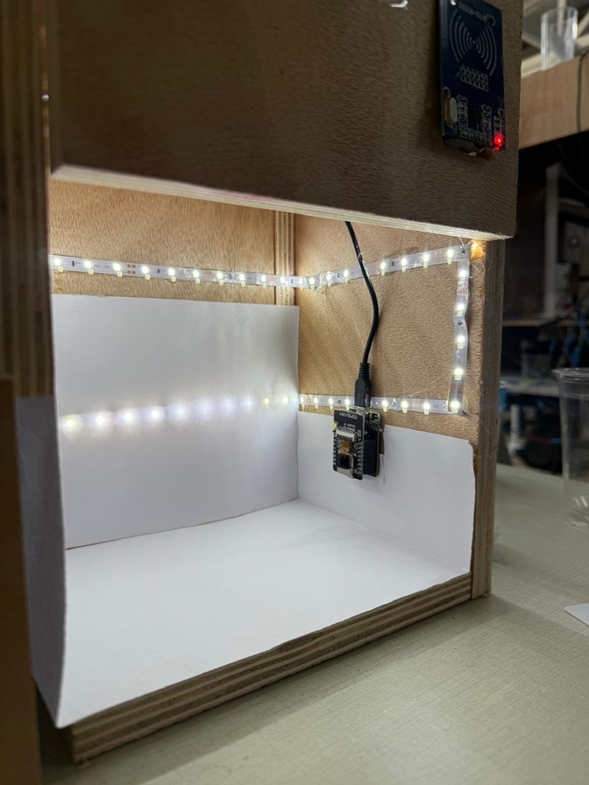
System Input

Slide 6
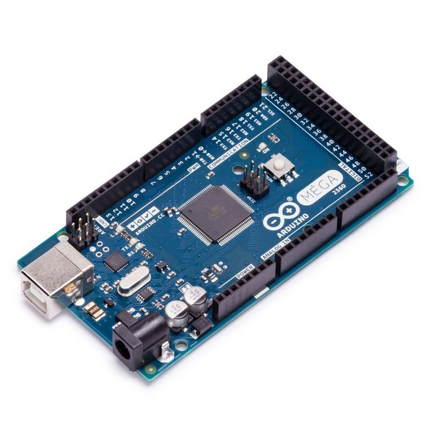

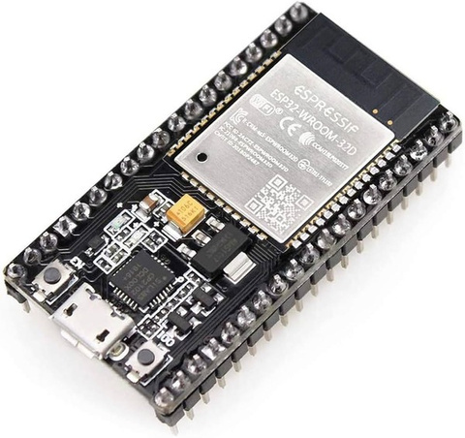


Control Unit
Arduino Mega 2560
Arduino IDE
ESP-WROOM-32
Blynk

Slide 7

Libraries
SPI.h:
Wire.h
Servo.h
Stepper.h
MFRC522.h
Wifi.h
LiquidCrystal_I2C.h
BlynkSimpleEsp32.h

Slide 8
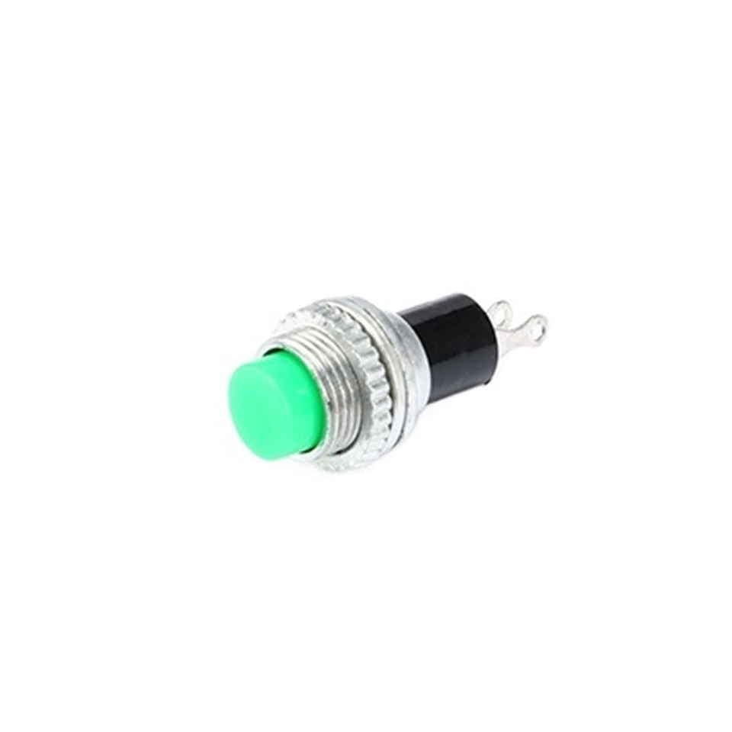
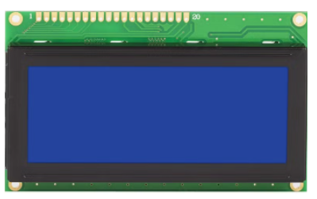
Hardware Interface
16x4 LCD
5 Push Buttons

Slide 9
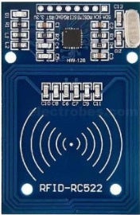
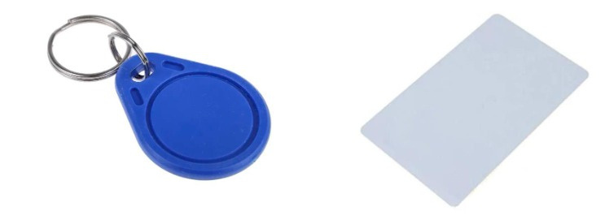
Payment
RFID
Admin Card
Customer Card

Slide 10
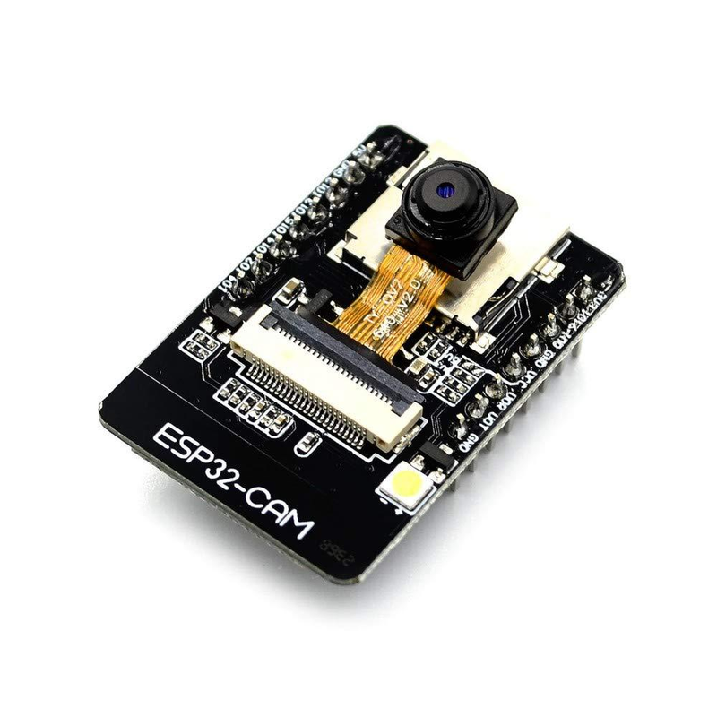
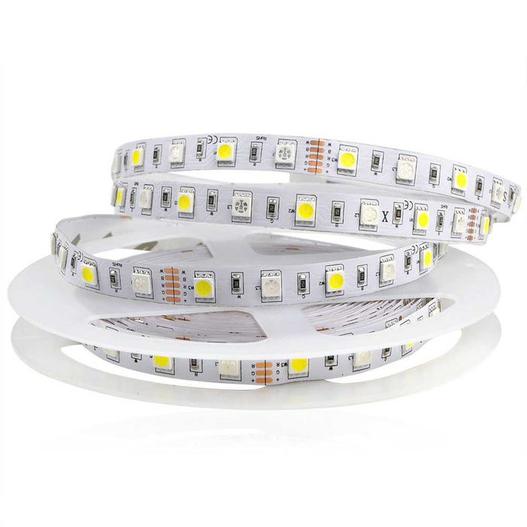
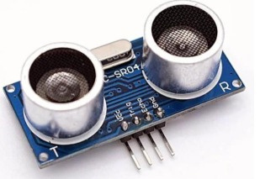
Hardware Components
Ultrasonic Sensor
1M LED Strip
ESP32 Camera

Slide 11
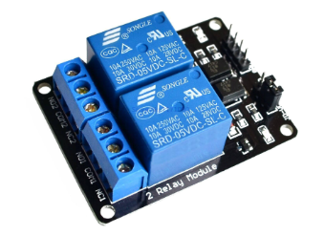

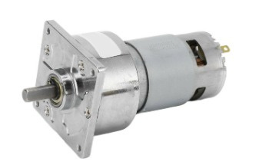
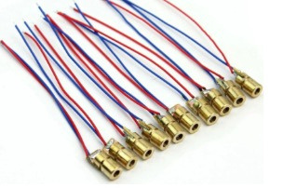
Hardware Components
LDR Sensor
DC Motor
3 TwoChannel Relay Module
Laser

Slide 12
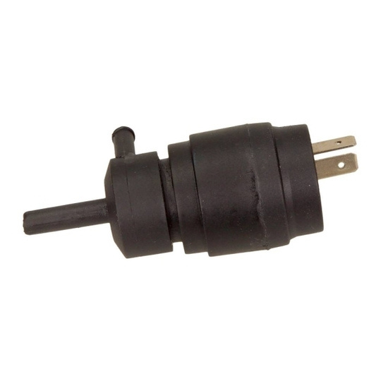
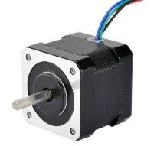
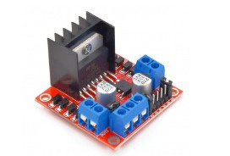
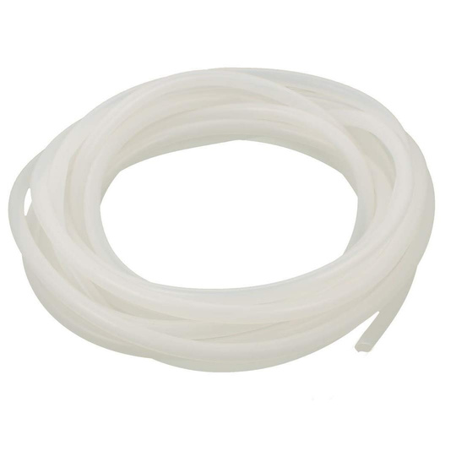
Hardware Components
2 Stepper Motor (Nema 17)
5 Pumps
2 H-bridge
5 Pipes

Slide 13
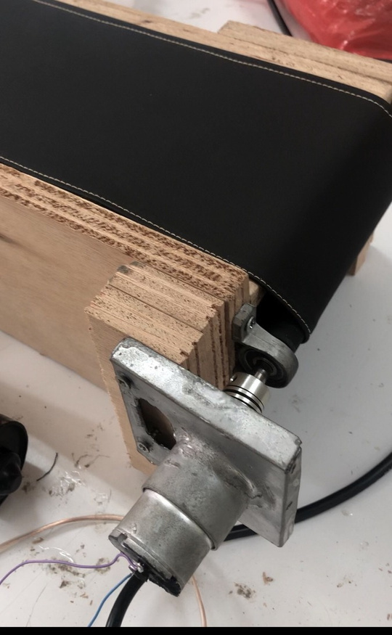
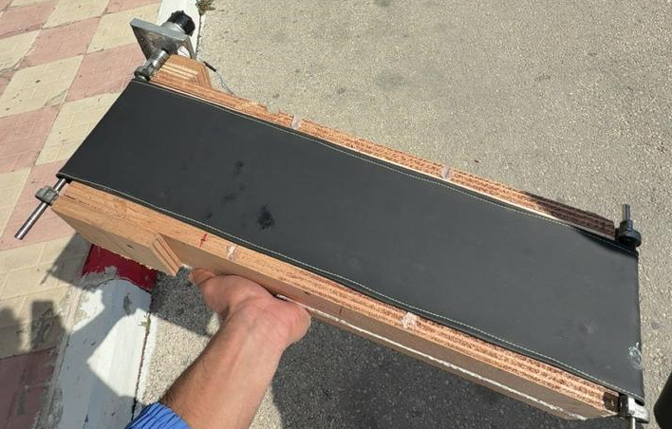
Conveyor Belt

Slide 14
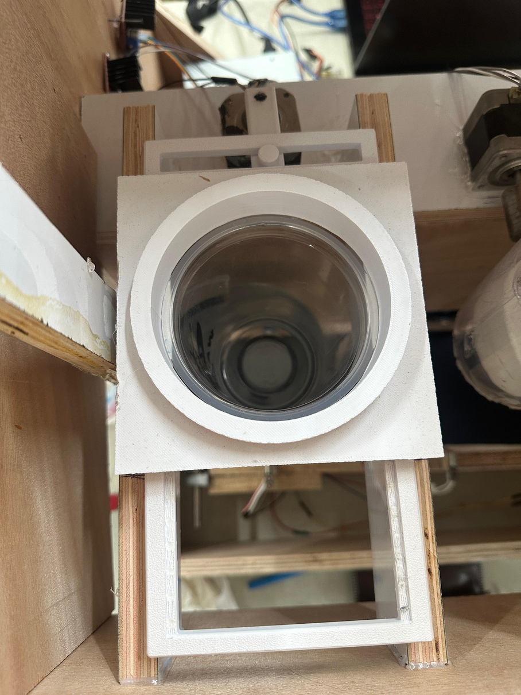
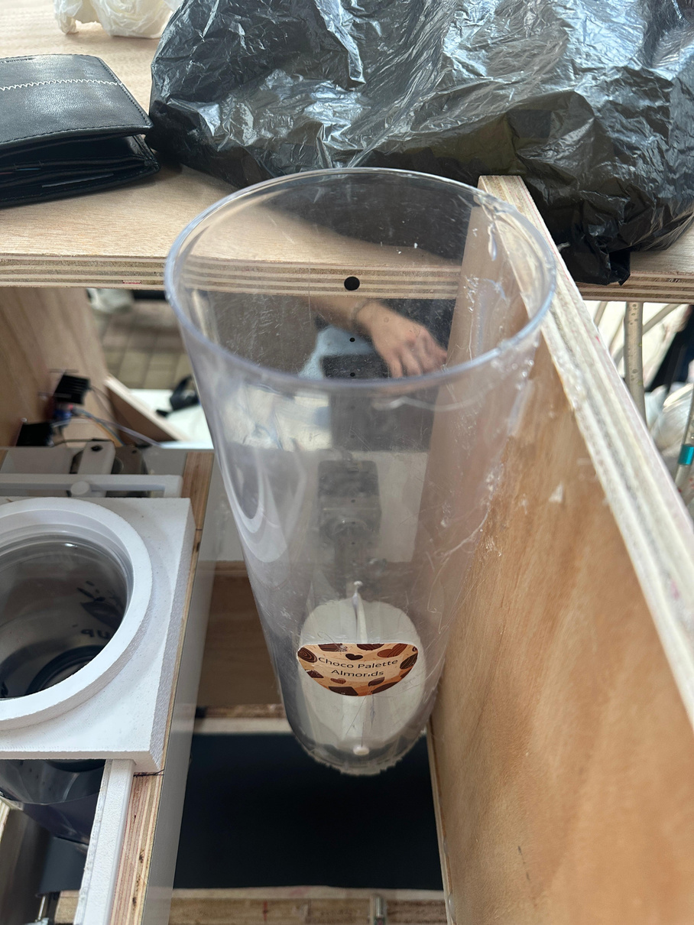
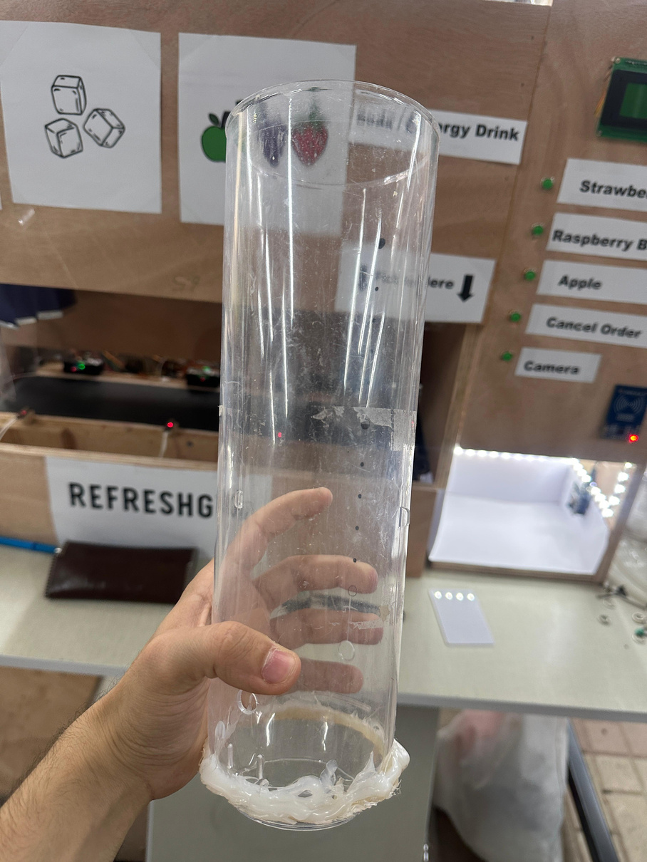
Cup & Ice Dispenser

Slide 15
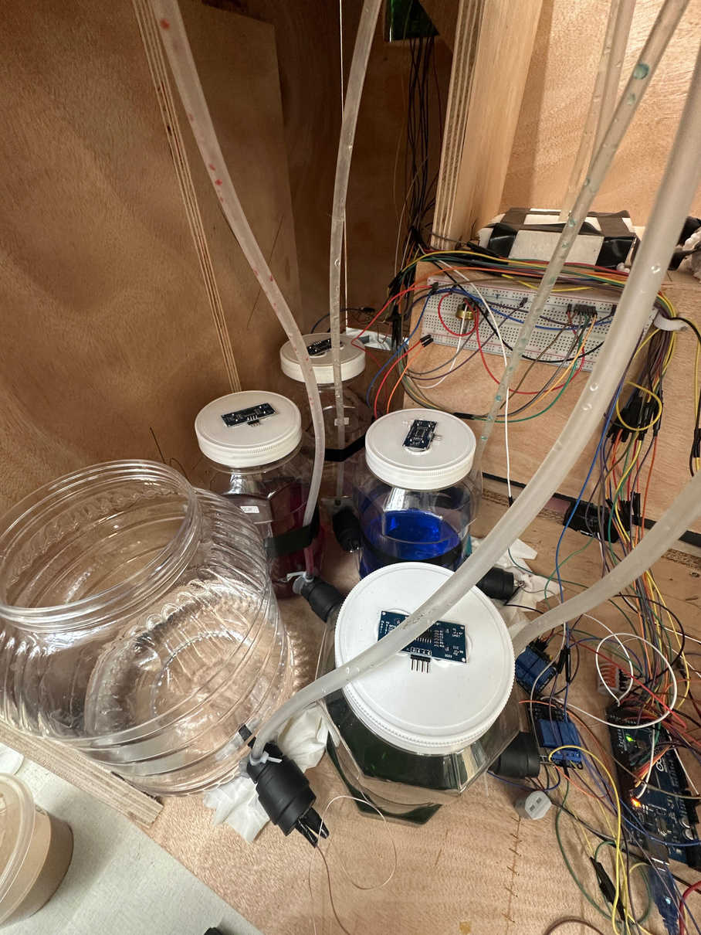
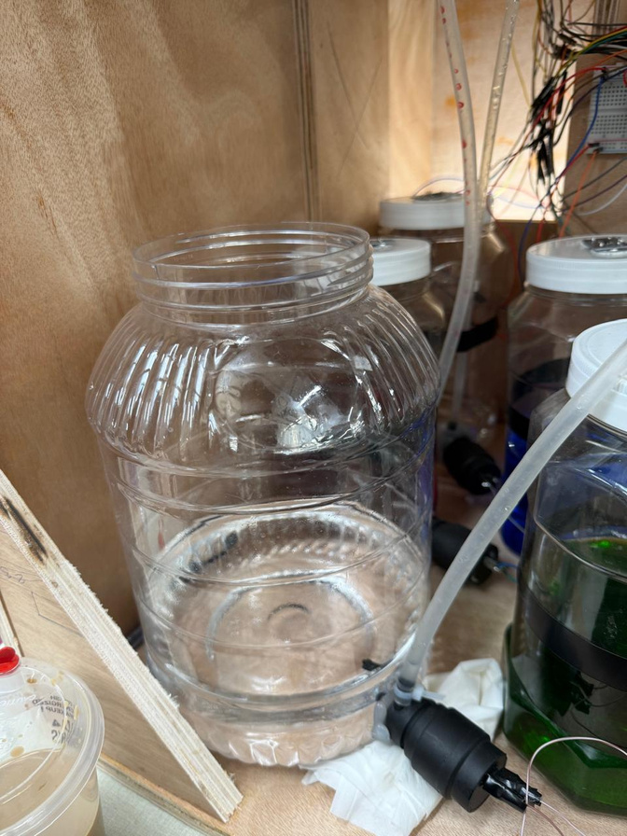
Flavors Tanks

Slide 16
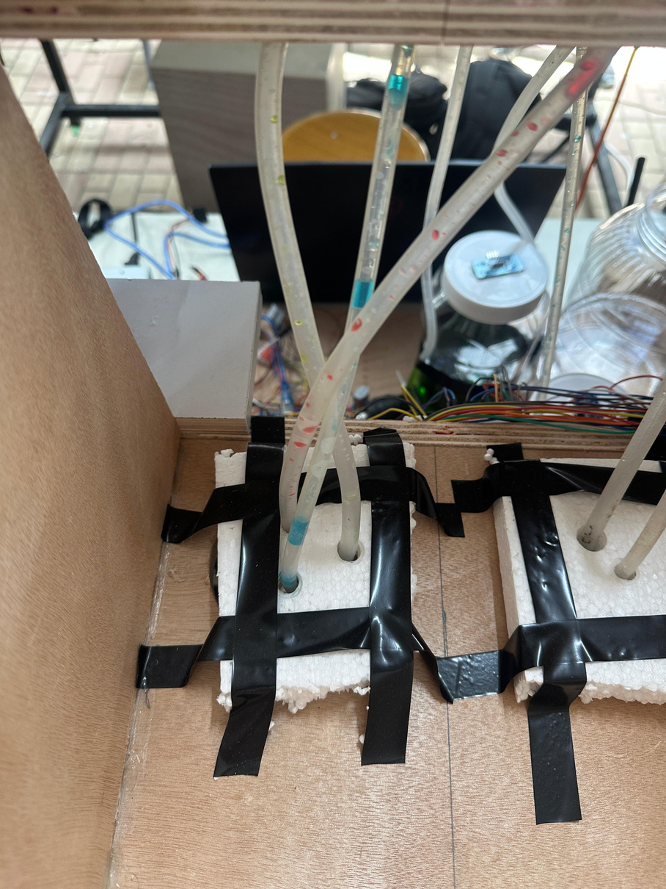
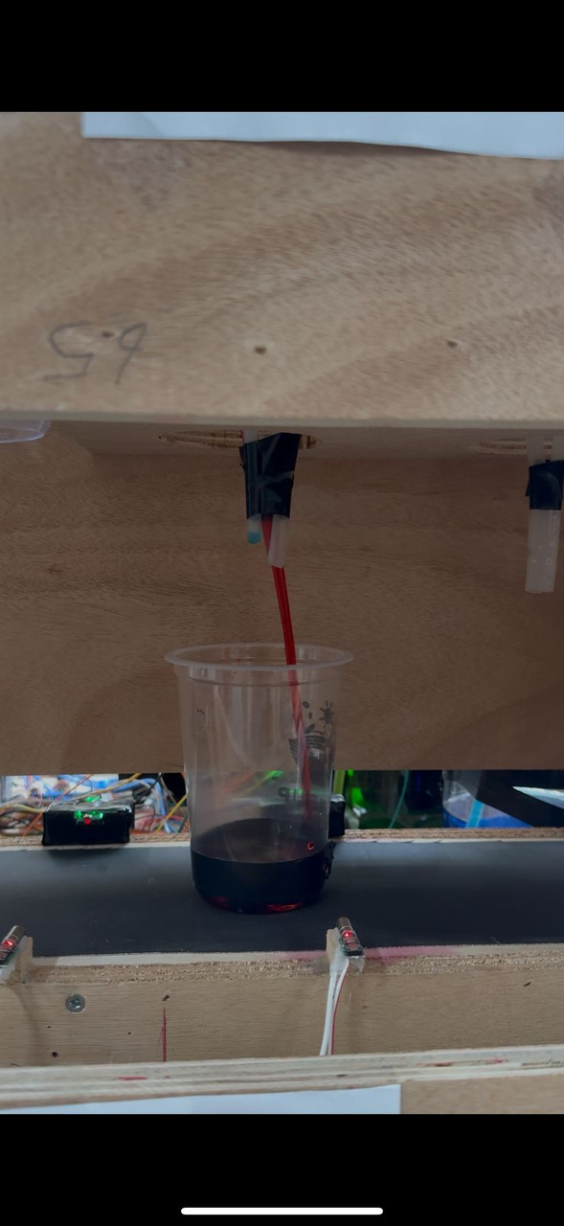
Flavor Dispensing

Slide 17
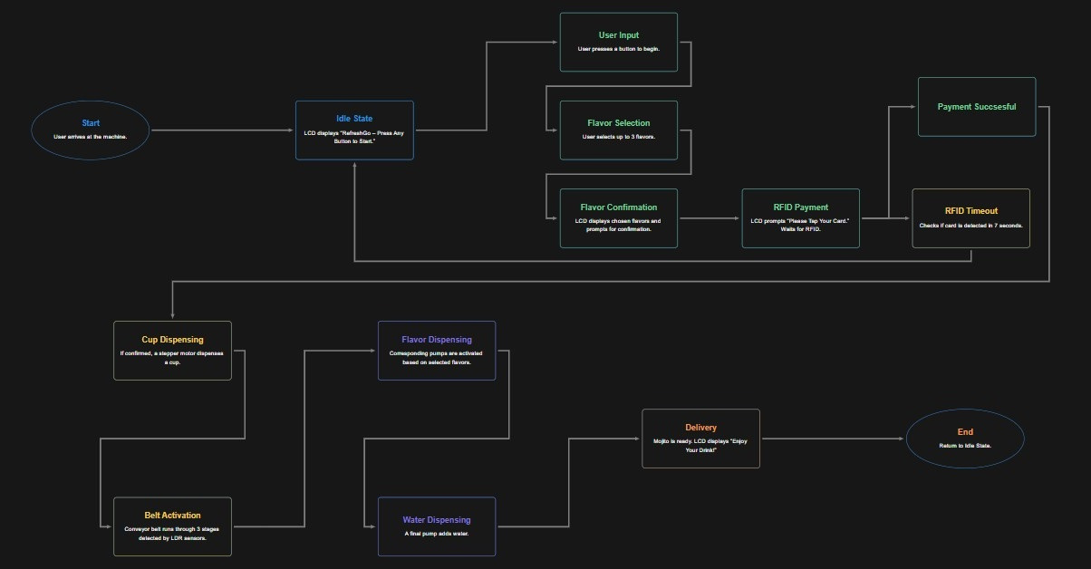
Machine Process Of Work

Slide 18
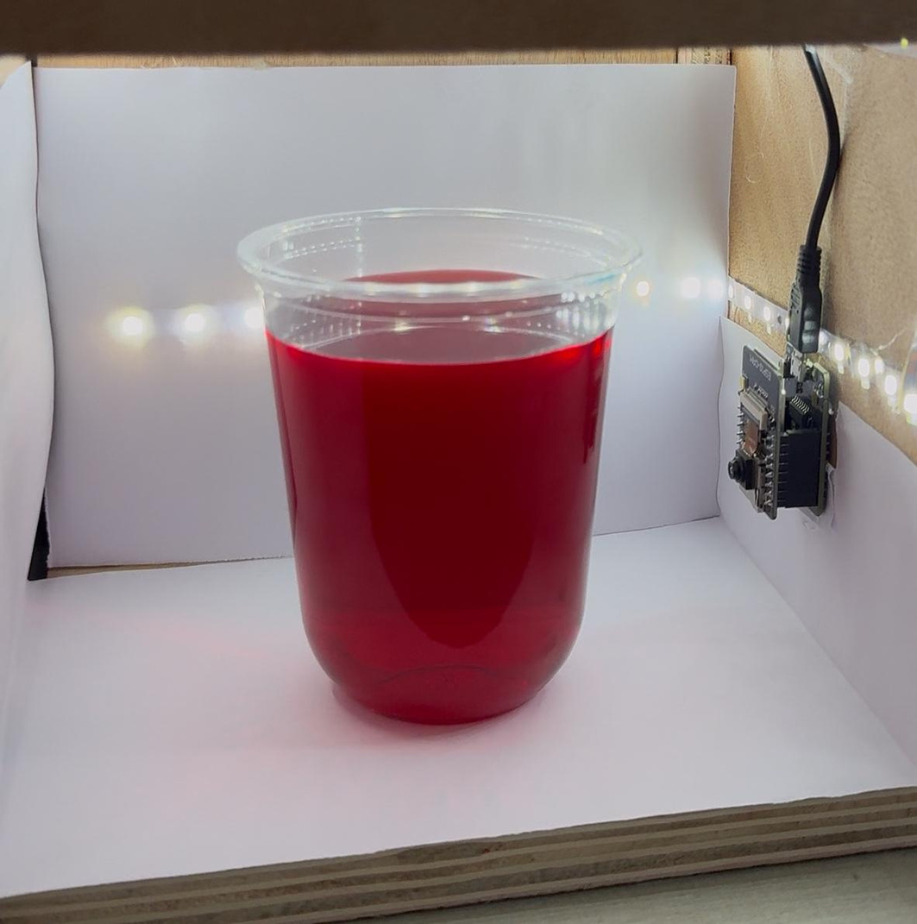
Final Result:

Slide 19

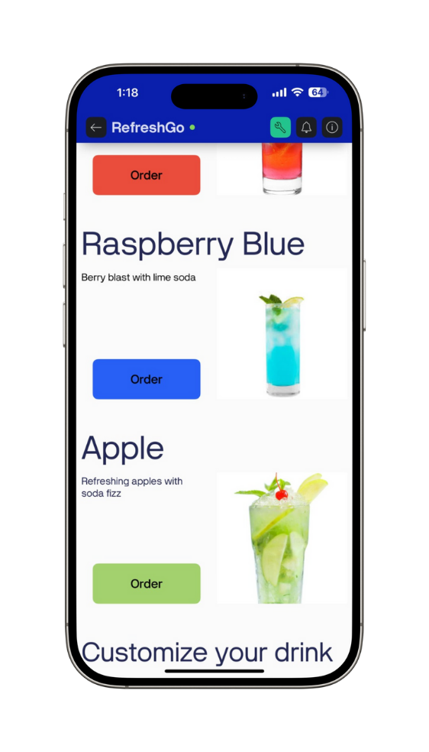
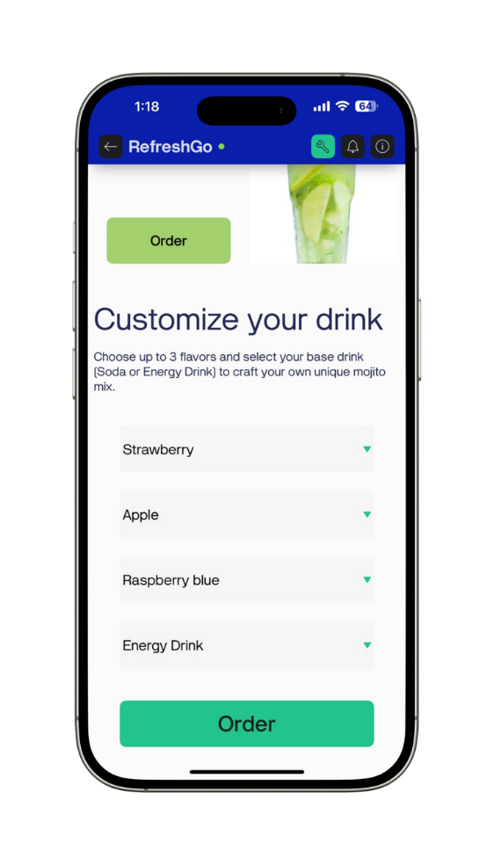

RefreshGo App

Slide 20
Future Work
Expanding Ingredient Options
Ingredient Cooling System
Adding More flavors
Camera System Improvement
Different Mojito Types

Slide 21
Constrains
Project Structure
Time Constraint
Hardware Fragility and Component Failure Ingredient Handling and Waste Management Challenges

Slide 22
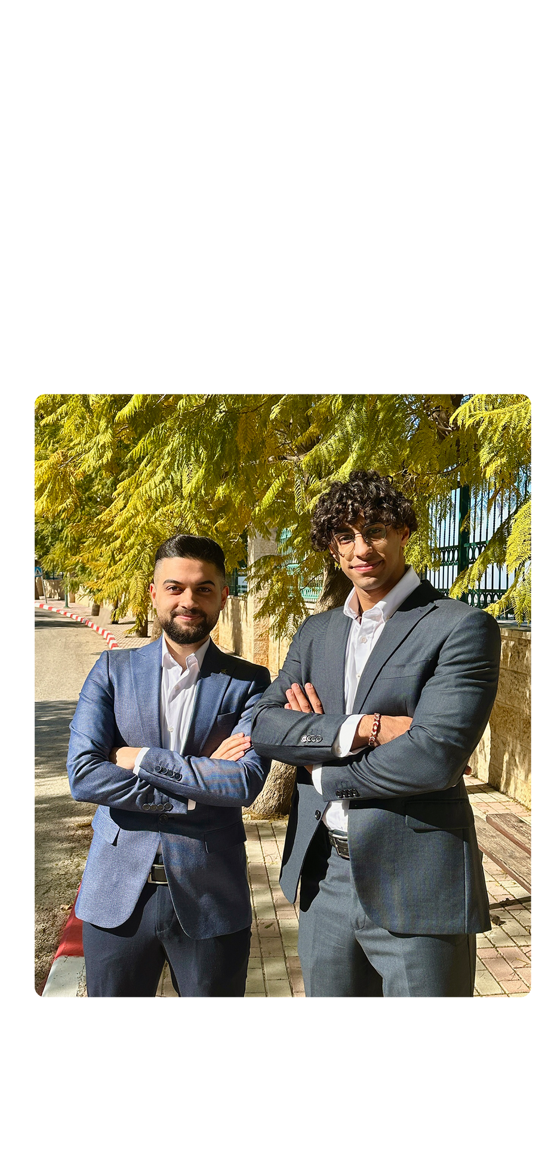
Thank You
Any Questions?

