Slide 1

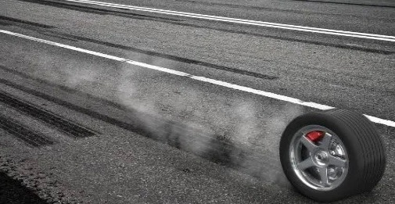
Al -Najah National University
Civil Engineering department
Graduation Project(2)
Skid Resistance Study of Black Spots in Selected Streets in Nablus City
Prepared by :-
Rasmya Nazzal
Areen Abu sheikh
Ahmad AL-Saify
Supervised by:-
Dr.Amjad Issa

Slide 2
Presentation outline
02
Literature Review
Introduction
01
05
Experimental work
Methodology
03
06
Analysis and calculation
04
Data Collection
Standard & specification
08
07
Conclusion and Recommendation
09
References

Slide 3

INTRODUCTION
What is skid resistance?
The force developed when a tire is no longer able to rotate on the pavement surface, and as a result loses traction and slides along the top of the surface. Skid resistance is an important parameter for evaluating pavement.

Slide 4
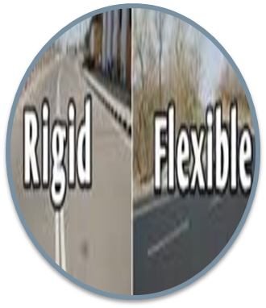
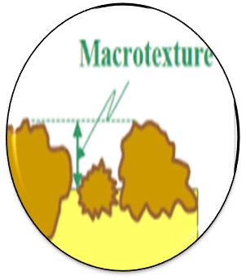


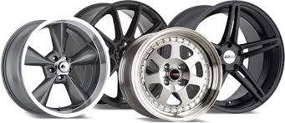
Factors affecting skid resistance
Type of pavement surface
Macrotexture of pavement
Percentage of bitumen
Humidity conditions and temperature
Type and condition of tires

Slide 5
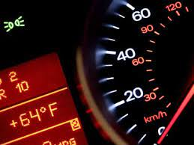

Factors affecting skid resistance
temperature of tire and pavement
Speed of vehicle
Load and tire pressure

Slide 6


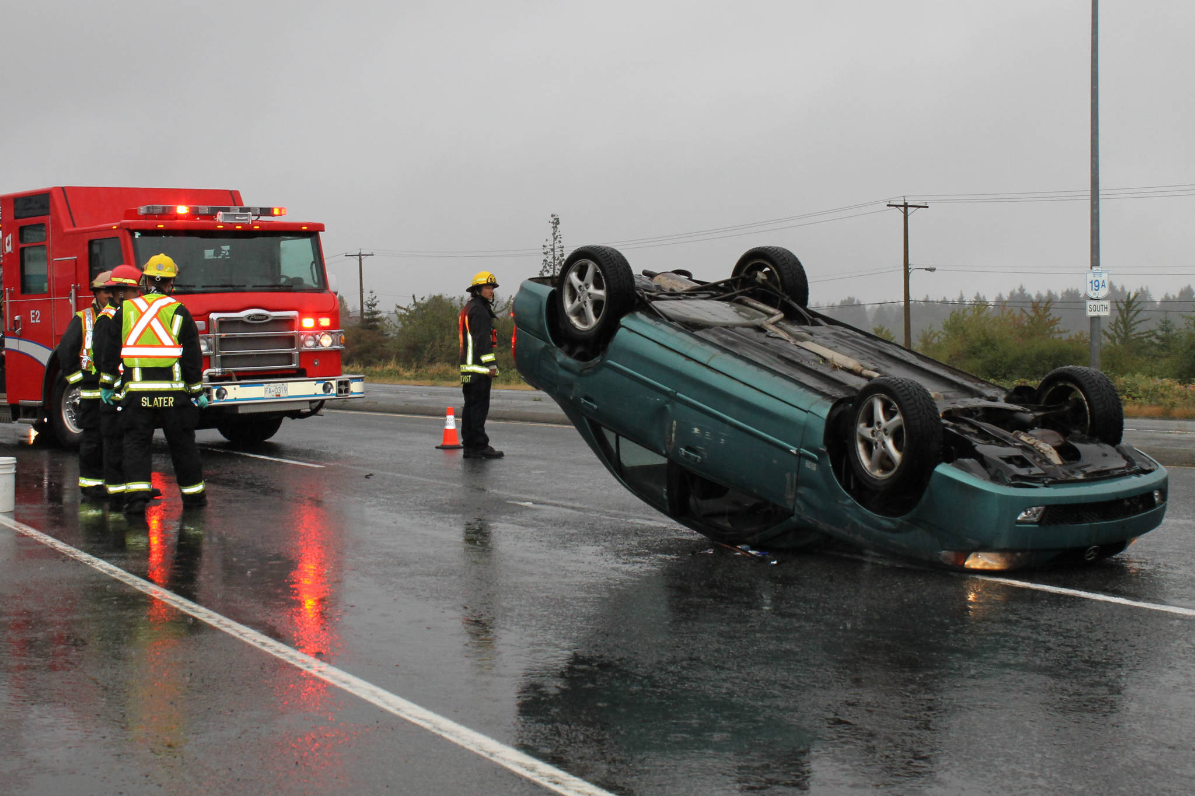
Accident causes by insufficient skid resistance of road

Slide 7
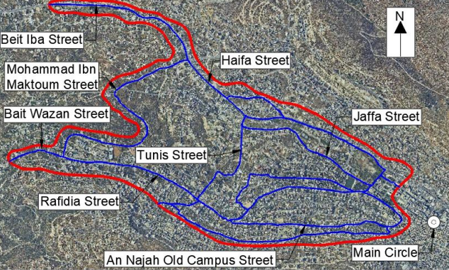
Review “Investigating Black Spots and Proposing Solutions for the Western Part of Nablus City study “
Study Area
The Western Part of Nablus City (Study area)

Slide 8

Black Spots
Streets that are classified as black spot when the number of injuries that have the same cause more than 3 injuries and the relative coefficient at least 0.8 or at least 5 crashes (including property damage only) of similar type within one year it may be consider as black spots

Slide 9
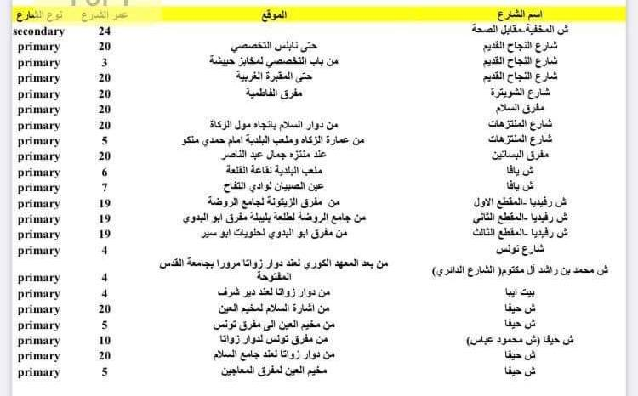
Classification for selected streets in Nablus

Slide 10
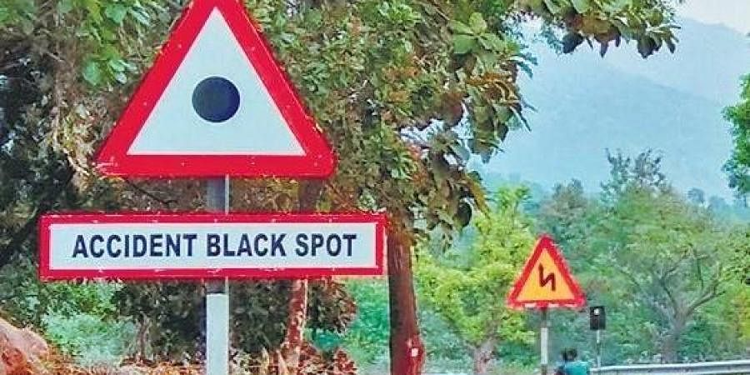

Slide 11

Purpose of study
Conducting a study to determine the extent of slip resistance in the streets of Nablus in order to keep the sidewalks safe in wet weather by determining the minimum value of slip resistance and proposing appropriate and economically feasible solutions.

Slide 12
Literature Review
Research Name | Year of Research | Researcher's Contribution
Parthiban P et Al | 2021 | Developed a model for skid resistance and texture depth using a regression approach for the best maintenance of urban road surfaces
Tien Fang Fwa | 2016 | suggested an approach to determine the lowest skid resistance in wet weather conditions
Milton et al | 2008 | used Washington State highway-injury data to calibrate a mixed (random parameters) logit model to predict the injury-severity distributions of accidents on highway segments they looked at three levels of severity
Jose M. and Rafael | 2009 | Analyzed collision data from more than 1,750 kilometers to determine the impact of pavement conditions on safety and to analyze safety effects to enhance pavement friction

Slide 13
Literature Review
Researcher’s Name | Year of research | Researcher’s contribution
(Hassan A. H. Mahdi et al | 2017 | conducted a comprehensive study to find the British pendulum's slid resistance number for a number of mixtures.
Tianchi Tang et al | 2018 | had developed a thermomechanical tire pavement interaction model that will allow for a more robust and realistic modeling of skid resistance using the finite element (FE) method.

Slide 14
Researcher’s Name | Year of research | Researcher’s contribution
Abdullah I. Al-Mansour | 2006 | The pavement skid resistance for the selected locations was determined from the pavement skid resistance records to investigate the effects of sidewalk skid resistance on traffic accidents.
Dolf Willigers | 2018 | this study offered various recommendations as present methods for measuring the amount of road friction do not satisfy the needs of motorcyclists since they use the entire width of the lane and because of their lower weight (not because of the tilting!).

Slide 15
Researcher’s Name | Year of research | Researcher’s contribution
Ibrahim M.Asi | 2007 | conducted a comprehensive study to find the British pendulum's slid resistance number for a number of mixtures. These mixes included, an asphalt concrete mixture using local aggregates with an optimal asphalt content from Marshall

Slide 16
The project contribution
This project is a study for skid resistance value of a part in a Palestinian city (the western part of Nablus City), no similar study has been done in Palestine before, and the study provides an assessment of streets in the study area and a classification streets that need maintenance, then propose solutions to the official authorities competent to carry out the necessary maintenance and all this for the most important goal, which is preserving the lives of citizens by trying to reduce the incidence of accidents which occurring due to low value of skid resistance.

Slide 17
At the roundabout, the lowest value was 46 on Tunis Street (Tunis roundabout from the side of the Malhees Factory).
As for the gradient, the lowest value was 43 at the beginning of Al-Ain camp
Based on the data available in the study of the previous team, these places are the most exposed to accidents

Slide 19
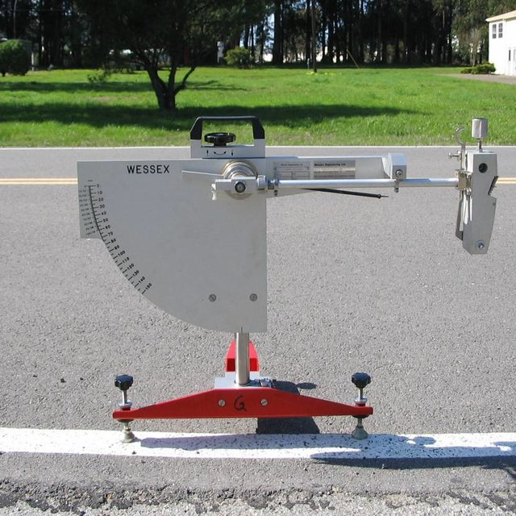
Field measurements
British pendulum tester
is a dynamic pendulum impact-type tester used to measure the energy loss when a rubber slider edge is propelled over a test surface. The tester is suited for laboratory as well as field tests on flat surfaces

Slide 20
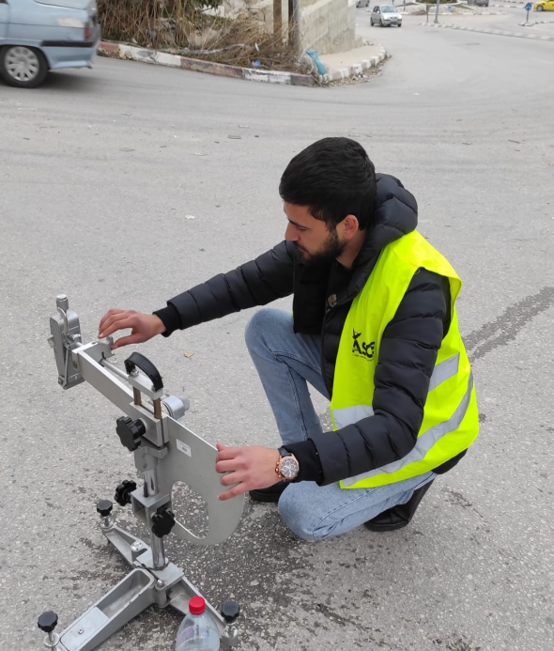
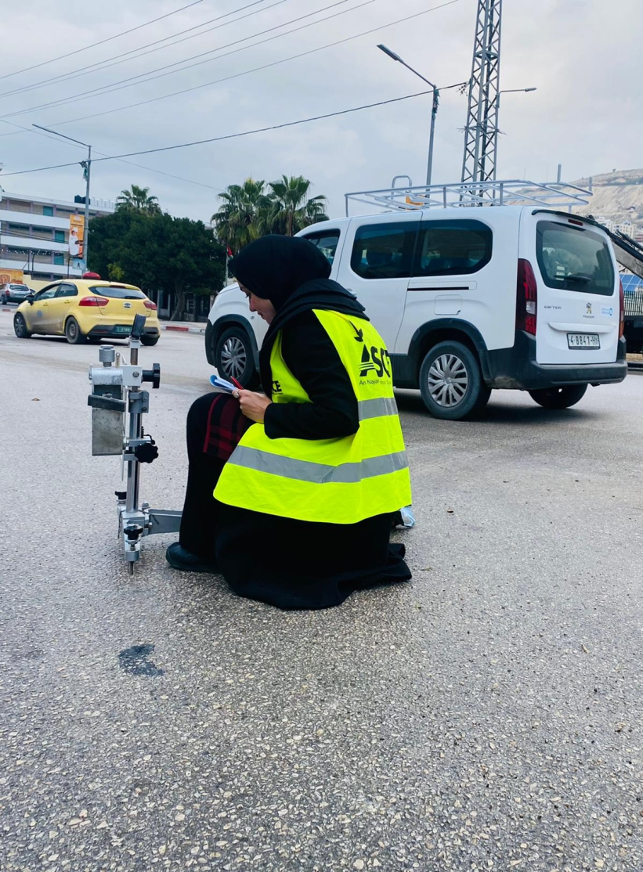
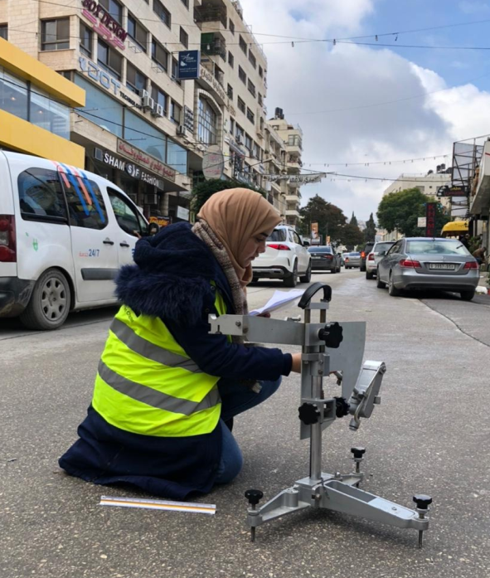
Data collection

Slide 21
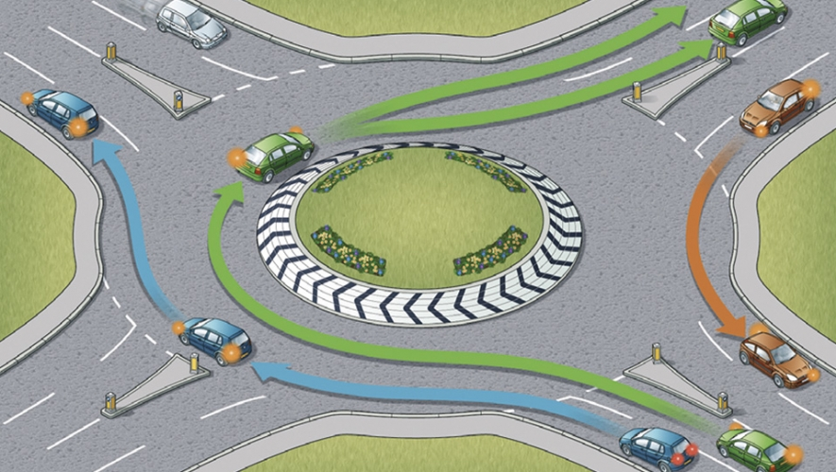

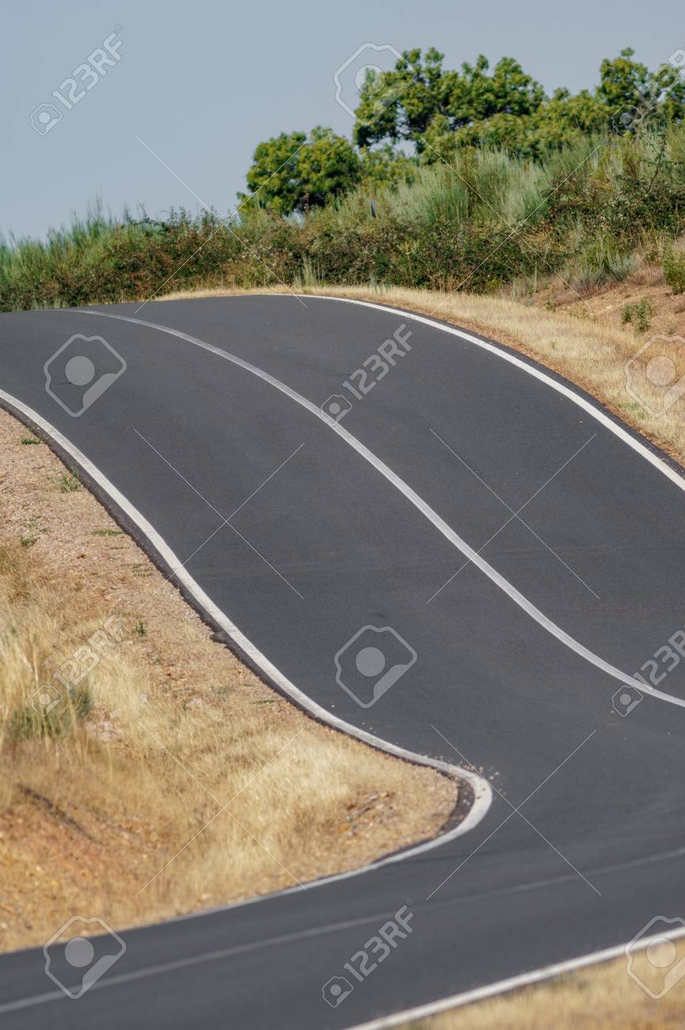
Results
According to the specification, the streets were classified according to the location in which the reading was taken.
Roundabout, Gradient, junction, etc.

Slide 22
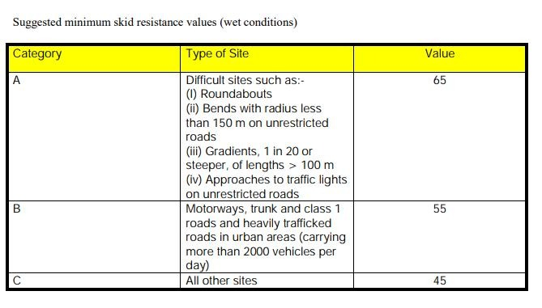
Standards and Specifications
After correction skid resistance value, The values must be compared with the standard, and the standard has been selected American Society for Testing and Materials ASTM E303:93 which shown in the table below.

Slide 23
Data collection
St Name | Location | Temperature | # Reading | British Pendulum Reading | Average | Correction
Rafidia Street first section | In front of Fareed Zamanoh café (Matab) | 13 | 1 | 43 | 44 | 42
 |  |  | 2 | 45
 |  |  | 3 | 44
 |  |  | 4 | 45
 |  |  | 5 | 43
Rafidia Street first section | Crossrods of 15 . Street (Descending from the intersection towards the city center) | 13 | 1 | 46 | 45 | 43
 |  |  | 2 | 45
 |  |  | 3 | 44
 |  |  | 4 | 44
 |  |  | 5 | 45
Rafidia Street first section | Crossrods of 15 . Street (From Rafidia to 15. Street) | 13 | 1 | 47 | 47 | 45
 |  |  | 2 | 48
 |  |  | 3 | 47
 |  |  | 4 | 46
 |  |  | 5 | 47
Rafidia Street first section | Al-Badawi crossroads | 13 | 1 | 49 | 50 | 48
 |  |  | 2 | 51
 |  |  | 3 | 50
 |  |  | 4 | 49
 |  |  | 5 | 50
Rafidia Street first section | Al-Badawi crossroads (At the traffic light coming off the old university campus) | 13 | 1 | 44 | 46 | 44
 |  |  | 2 | 45
 |  |  | 3 | 46
 |  |  | 4 | 45
 |  |  | 5 | 46
Rafidia Street first section | Al-Badawi crossroads (Traffic light in the direction of the city centre) | 13 | 1 |  | 49 | 51
50
48
50
49
49
2
3
45

Slide 24
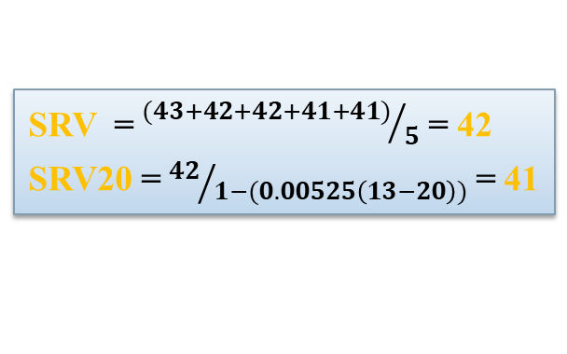
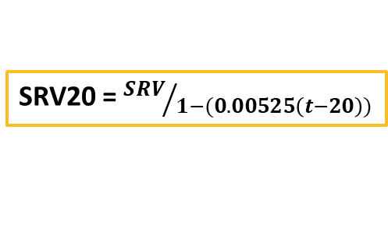
Sample calculation
At Rafidia Street first section (In front of Fareed Zamanoh café ), actual temperature =13
SRV20 = ${SRV}/{1−(0.00525\left(t−20\right))}$
#Reading | Skid Resistance value
1 | 43
2 | 42
3 | 42
4 | 41
5 | 41
SRV = ${(43+42+42+41+41)}/5$ = 42
SRV20 = ${42}/{1−(0.00525\left(13−20\right))}$ = 41

Slide 25
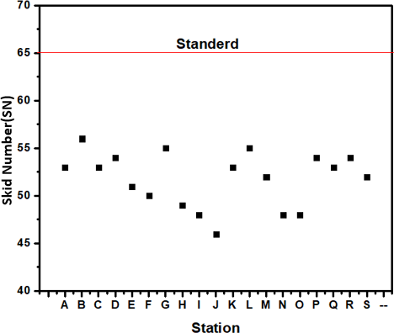
Roundabouts
Results
Result
Based on the first part of the specification, Roundabouts in this study where the skid resistance number SN must be 65 or more to satisfy the specification.
All SN value in roundabout is less than 65 ” not satisfy”.

Slide 26
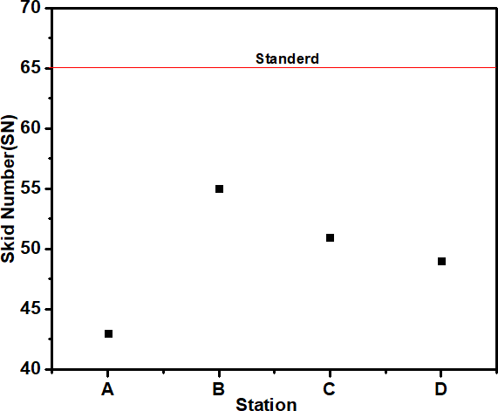
Gradients street
All SN value in gradients is less than 65 “not satisfy”.

Slide 27
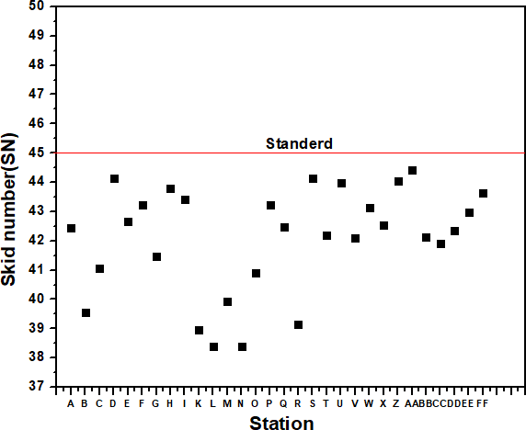
Junctions street
all values that does not satisfy the specification “ which has a skid resistance number SN less than 45”.

Slide 28
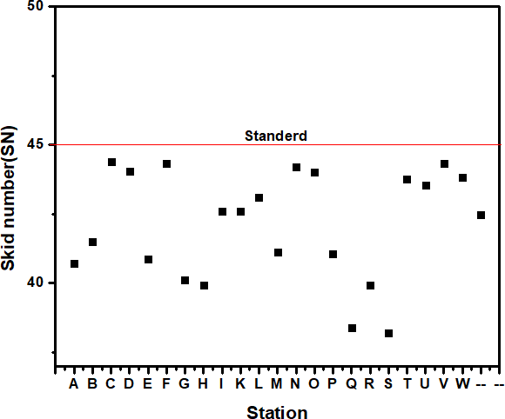
Skid number for rest stations

Slide 29
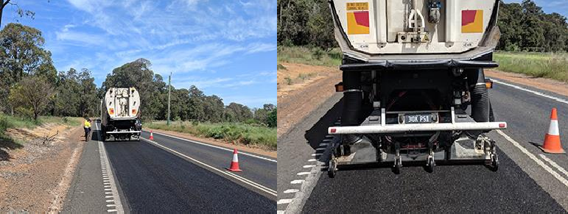
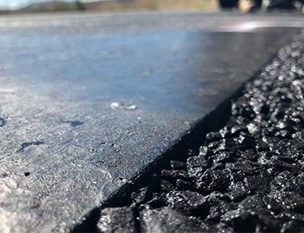
SOLUTION

Slide 30
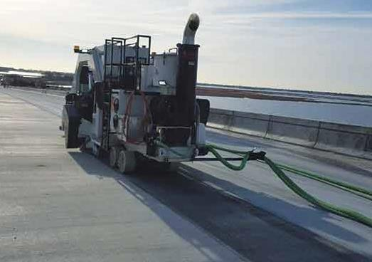
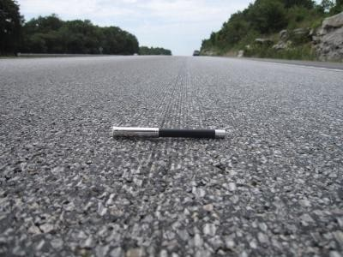

Slide 31
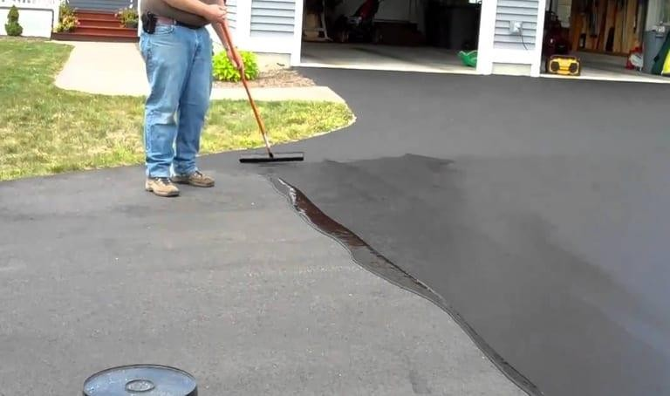

Slide 32


Slide 33
Conclusion
Our goal in this study to achieve the safety for passengers and cars on the streets in bad conditions, the values of skid resistance were compared with the American society for testing and materials (ASTM E303:93) specification.
If we want to summarize what we found in our study:-
1- The lowest value of skid resistance number(SN) was 38 for the following streets: Yaffa Street; specifically in two locations (Matab opposite Al-Saad Furniture) and Ain Al-Sabiyan near Al-Rashad School.
Al Montazahat Street got the same value and also in two locations; in front of (the family garden at the bend) and at the traffic light (near Annab Restaurant).

Slide 34
Recommendation
We have a number of recommendations that we hope to work on
To apply the same study on the eastern region in Nablus city .
Both Nablus municipality and Traffic Police Department adopt the study, and that the municipality follow up periodically the skid resistance of the city streets and carry out the necessary periodic maintenance
Training a specialized team on how to measure skid resistance to follow up on the topic.
To apply field measurements using modern techniques and tools

Slide 35
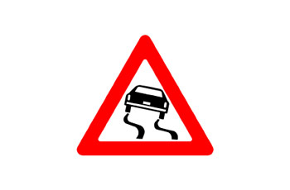


Completing the study and linking it to the surface texture by measuring it and conducting research on it.
The necessity of having signs on the streets of the city specifying the speed of vehicles to avoid a large number of accidents.
The necessity of maintaining a certain amount of tire inflation and checking the wheel rims of vehicles in the inspection departments, due to its great correlation with the anti-skid values
Ensuring that the asphalt mixture for the streets matches the specifications in terms of the quality of the aggregate and the optimal bitumen ratio, due to its significant impact on the skid values
The necessity of periodic inspection to ensure the health of the streets in terms of the quality of water drainage, especially in the winter season.

