Slide 1

An-Najah National University
Faculty Of Engineering
Civil Engineering Department
Graduation Project II
Evaluation of the water runoff and culvert structures at
Wadi AL-Teen in Tulkarm district
Prepared By :
Ahmad Amjad Rashid
Amr Barqawi
Mohammed Bayan Ali
Yazan Abu-Haniya
Supervision of Dr. Hamees Tubeileh

Slide 2
Evaluation of the water runoff and culvert structures at
Wadi AL-Teen in Tulkarm district.

Slide 3
Objectives :
Determine the amount of runoff in the Wadi AL-Teen .
Analyze the existing culverts and redesign a new one if needed .
Design a storm system for the adjacent road.
Estimate the cost of the project

Slide 4
Study Area

Slide 5
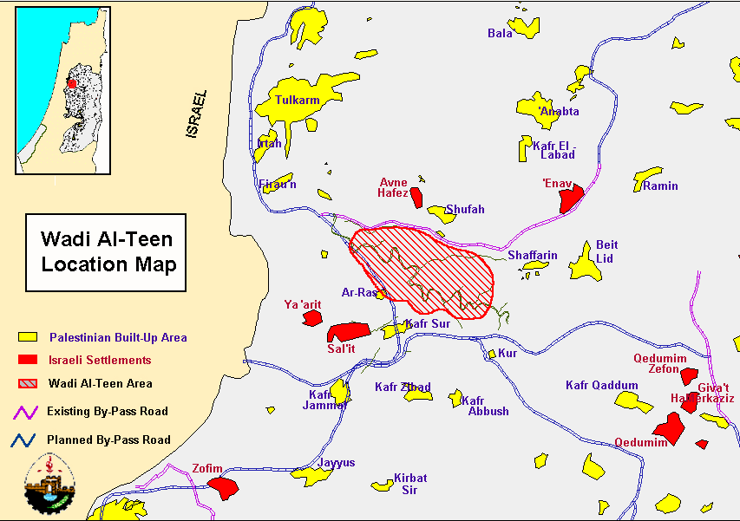
Wadi Al-Teen

Slide 6
Topography
According to given contour maps Wadi Al-teen lies on four mountains it has an average height of 65 m on sea level and reaches to 70 m on some regions with slow variance in elevation from site to site, with sharp slope.

Slide 7
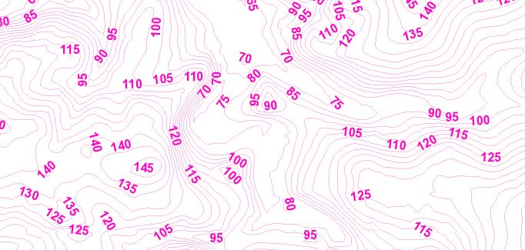
Contour map for Wadi Al-Teen.

Slide 8
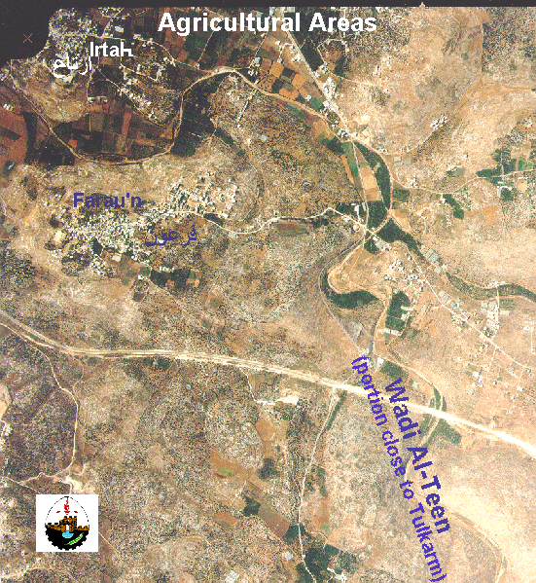
Area and Land Use
The size of Wadi Al-Teen catchment area is estimated at 80 km2, has a percent of impervious regions arrives 9.6 %.

Slide 9
Rainfall readings
The average annual rainfall in Wadi Al-Teen is 680 mm according to Palestinian Statistics center.
From Palestinian Metrologic Center :
year | 2013/2014 | 2014/2015 | 2015/2016 | 2016/2017 | 2017/2018
Annual depth(mm) | 460.5 | 720.3 | 427.5 | 418.7 | 547.3
Maximum day depth (mm) | 90 | 117 | 50 | 90 | 56

Slide 10
Analysis and evaluation of the existing situation of the drainage system (culvert)

Slide 11
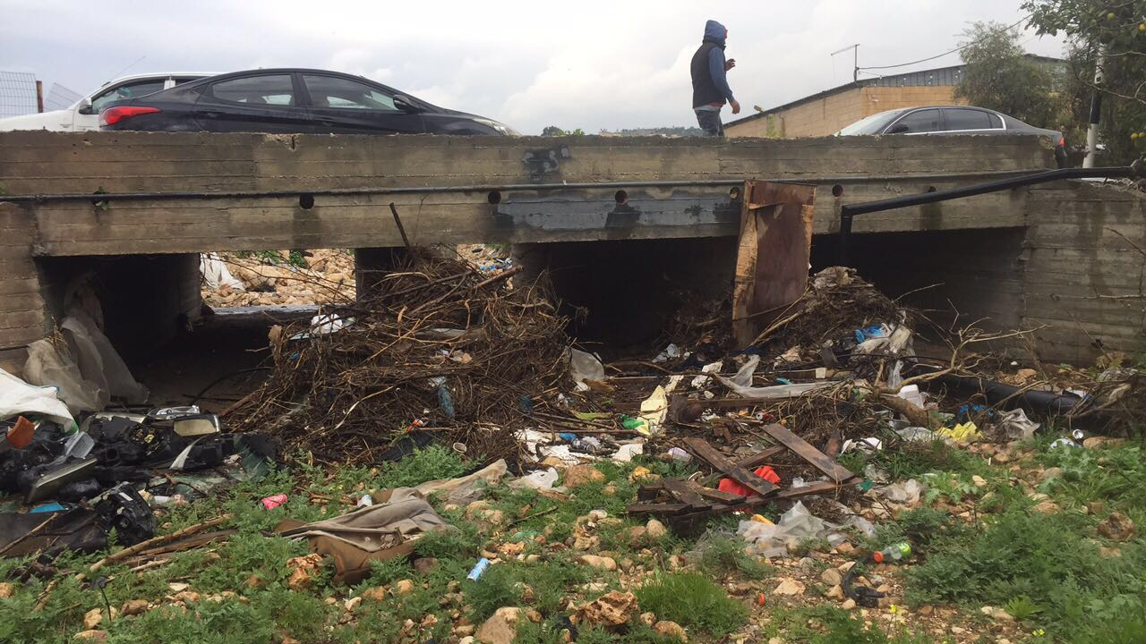
Existing situation of the drainage system:

Slide 12
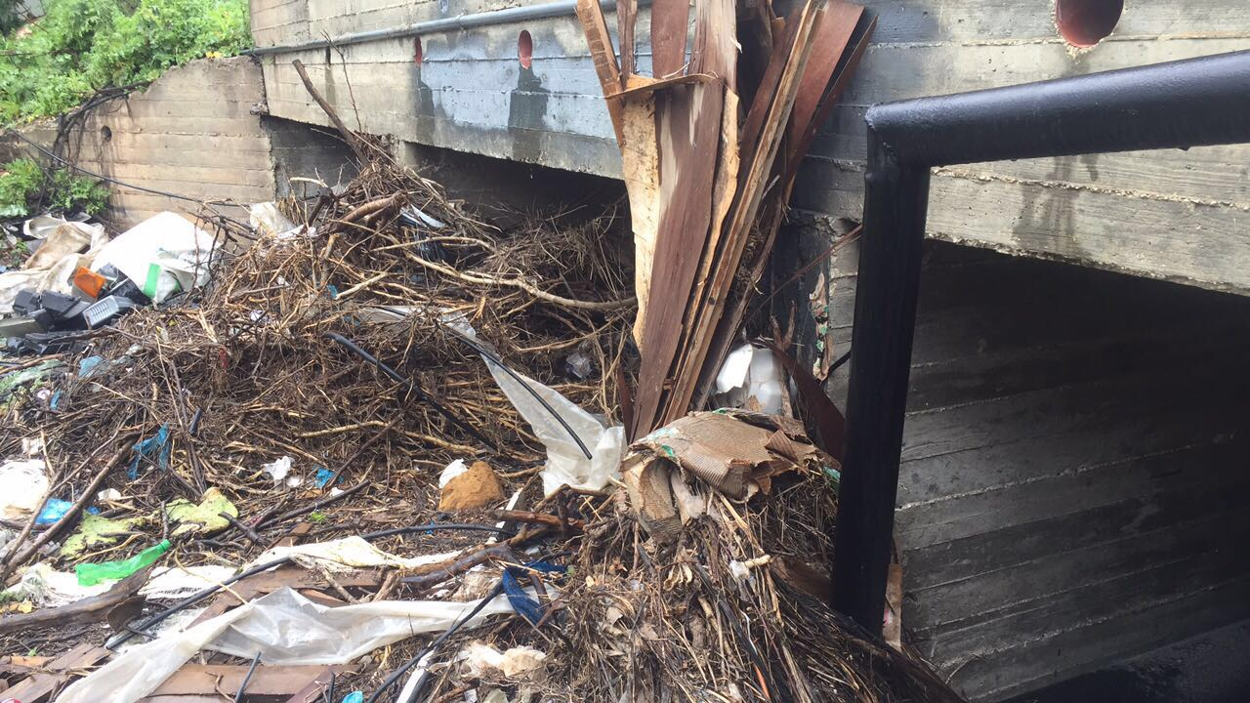
Existing situation of the drainage system:

Slide 13
Methodology
The following data is collected: the amount of rainfall for 10 years, information about culverts and location, data about the adjacent roads and their sections and coordinates , and the geographical nature of the surrounding area .
Then from these data we analyze, find the amount of runoff water in the Wadi AL-Teen by using HEC-HMS software, and analyze the current culverts and evaluate their efficiency by using HY-8 software .

Slide 14
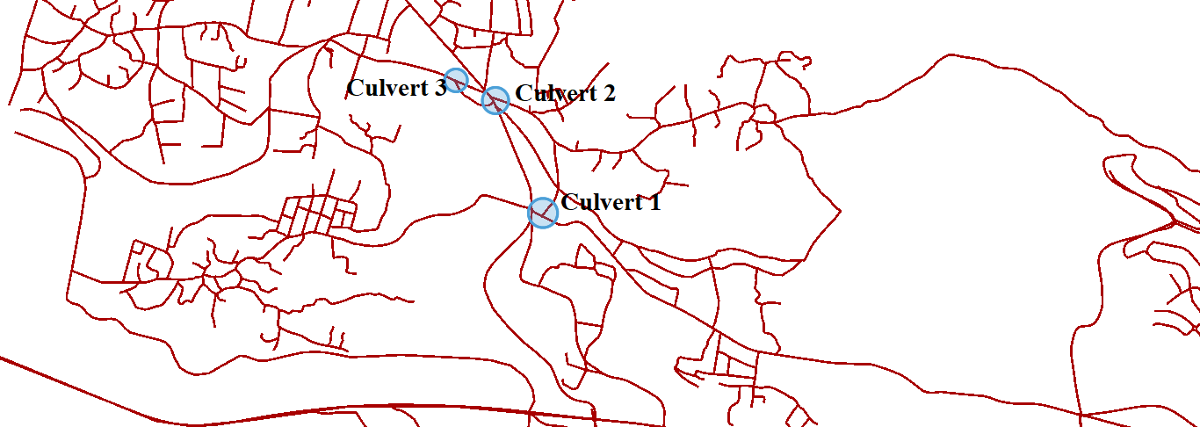
Steps of the work
Finding location of culverts by site visit and GIS .

Slide 15
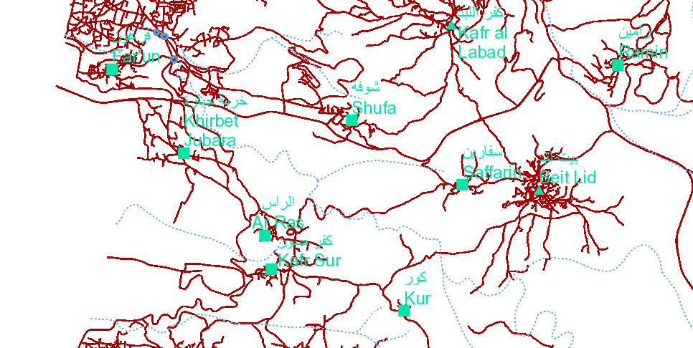
Determining the catchment regions and data for each catchment on each culvert Using GIS.

Slide 16
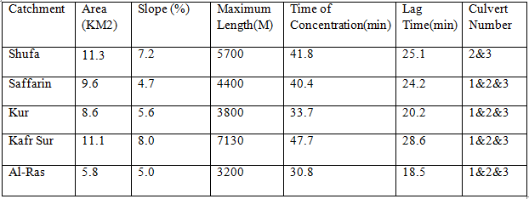
Catchments Data by GIS.

Slide 17

Sample Calculation for Lag Time.
*Lag time for catchment (Shufa).
Lag Time=0.6*Tc
Tc=0.01947*〖5700〗^0.77*〖0.072〗^(-0.385)=41.8min
Lag time=0.6*41.8=25.1 min

Slide 18
Using IDF curve for 10-year return period.
There were no data for Wadi Al-Teen to make IDF curve, Nablus taken for design.
Nablus city which is 20 KM eastern Wadi Al-Teen, has an annually rainfall of 660.1 mm which is very near of Wadi Al-Teen which is 680 mm, so it is acceptable to take this IDF curve for design

Slide 19
IDF Curve used.

Slide 20
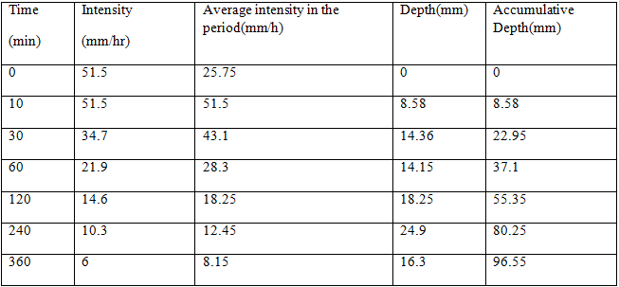
IDF Curve analysis.

Slide 21
Mass curve

Slide 22
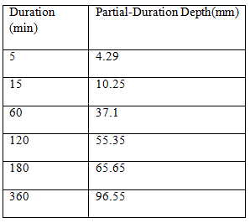
Partial duration depth required for HEC-HMS Inserting

Slide 23
Curve Number
Wadi Al-Teen Catchments have a clay soil so it has soil type of “C” ACCORDING TO Curve Number classification.
Wadi Al-Teen Catchments have an urban area with impervious < 12 % (the areas of buildings and paved roads).
According to this table it will have a curve number of 77.

Slide 24
Curve Number Table.

Slide 25
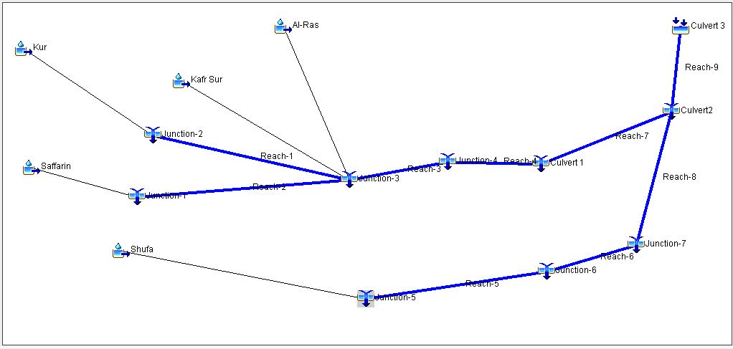
Simulation By HEC-HMS

Slide 26
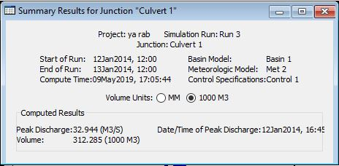
Results from HEC-HMS

Slide 27
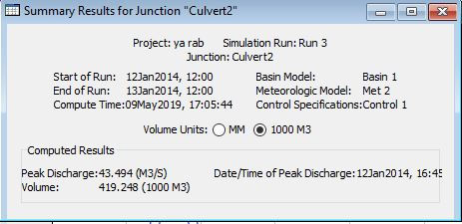
Results from HEC-HMS

Slide 28
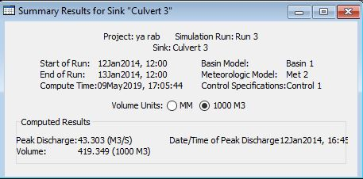
Results from HEC-HMS

Slide 29
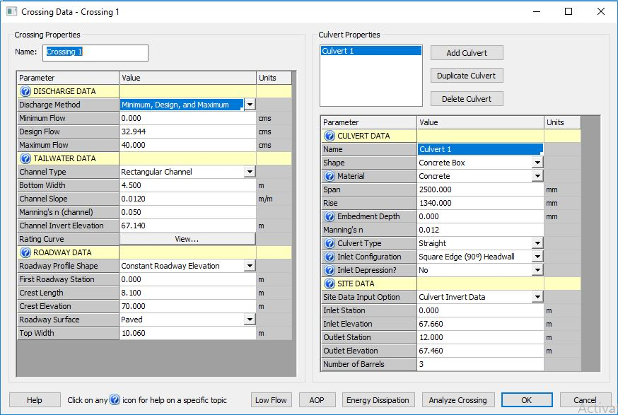
By HY-8 .
Culvert 1

Slide 30
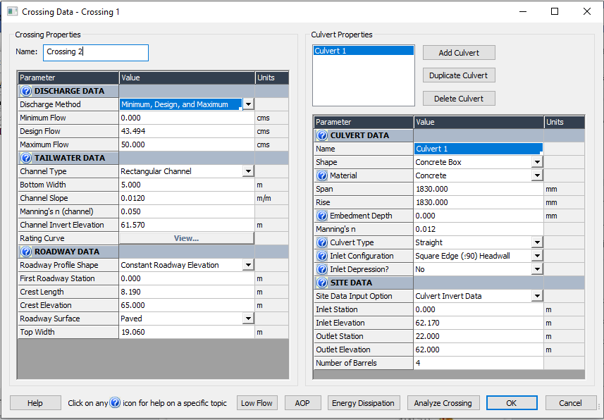
Culvert 2

Slide 31
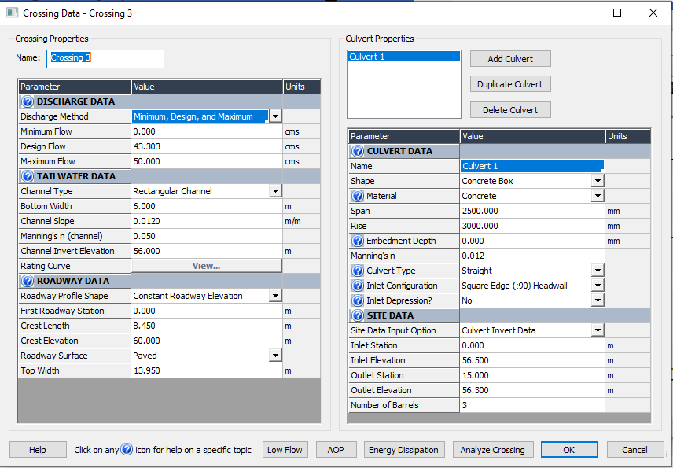
Culvert 3

Slide 32
Results From HY-8
Crossing Discharge Data For Culvert 1
Discharge Selection Method: Specify Minimum, Design, and Maximum Flow
Minimum Flow: 0 cms
Design Flow: 32.944 cms
Maximum Flow: 40 cms

Slide 33
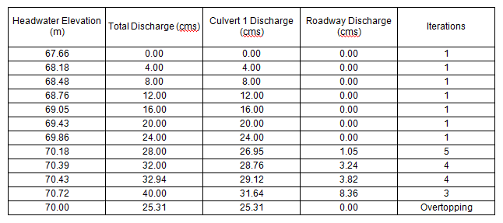
Summary of Culvert Flows at Crossing: Crossing 1

Slide 34
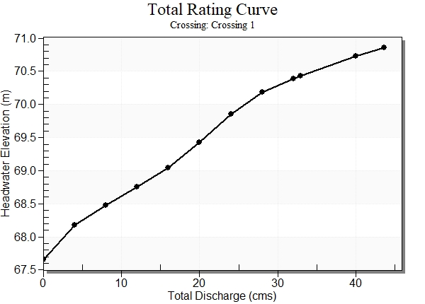
Rating Curve Plot for Crossing: Crossing 1

Slide 35
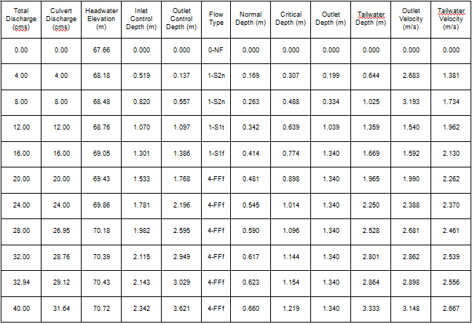
Culvert Summary Table: Culvert 1

Slide 36
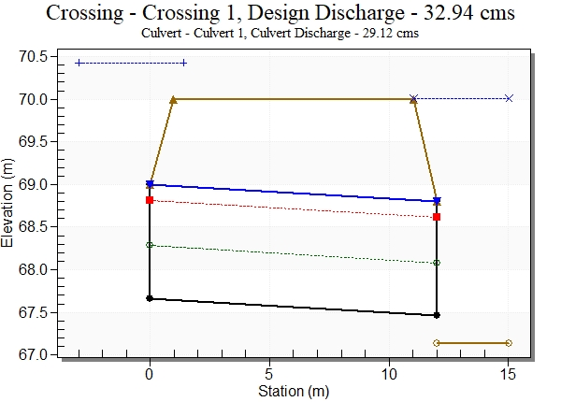
Water Surface Profile Plot for Culvert: Culvert 1

Slide 37
Summary of Culvert Flows at Crossing: Crossing 2
Headwater Elevation (m) | Total Discharge (cms) | Culvert 1 Discharge (cms) | Roadway Discharge (cms) | Iterations
62.17 | 0.00 | 0.00 | 0.00 | 1
62.79 | 5.00 | 5.00 | 0.00 | 1
63.15 | 10.00 | 10.00 | 0.00 | 1
63.44 | 15.00 | 15.00 | 0.00 | 1
63.75 | 20.00 | 20.00 | 0.00 | 1
64.05 | 25.00 | 25.00 | 0.00 | 1
64.39 | 30.00 | 30.00 | 0.00 | 1
64.84 | 35.00 | 35.00 | 0.00 | 1
65.25 | 40.00 | 38.34 | 1.66 | 4
65.47 | 43.49 | 39.08 | 4.43 | 3
65.84 | 50.00 | 39.34 | 10.66 | 4
65.00 | 36.72 | 36.72 | 0.00 | Overtopping

Slide 38
Culvert Summary Table: Culvert 2
Total Discharge (cms) | Culvert Discharge (cms) | Headwater Elevation (m) | Inlet Control Depth (m) | Outlet Control Depth (m) | Flow Type | Normal Depth (m) | Critical Depth (m) | Outlet Depth (m) | Tailwater Depth (m) | Outlet Velocity (m/s) | Tailwater Velocity (m/s)
0.00 | 0.00 | 62.17 | 0.000 | 0.000 | 0-NF | 0.000 | 0.000 | 0.000 | 0.000 | 0.000 | 0.000
5.00 | 5.00 | 62.79 | 0.617 | 0.204 | 1-S2n | 0.266 | 0.362 | 0.277 | 0.688 | 2.462 | 1.453
10.00 | 10.00 | 63.15 | 0.978 | 0.542 | 1-S2n | 0.425 | 0.575 | 0.455 | 1.095 | 3.000 | 1.827
15.00 | 15.00 | 63.44 | 1.273 | 0.957 | 1-JS1t | 0.563 | 0.754 | 1.020 | 1.450 | 2.009 | 2.069
20.00 | 20.00 | 63.75 | 1.537 | 1.576 | 1-S1t | 0.692 | 0.913 | 1.349 | 1.779 | 2.025 | 2.248
25.00 | 25.00 | 64.05 | 1.789 | 1.879 | 1-S1t | 0.815 | 1.059 | 1.662 | 2.092 | 2.054 | 2.390
30.00 | 30.00 | 64.39 | 2.042 | 2.223 | 4-FFf | 0.934 | 1.196 | 1.830 | 2.394 | 2.240 | 2.506
35.00 | 35.00 | 64.84 | 2.307 | 2.671 | 4-FFf | 1.050 | 1.326 | 1.830 | 2.689 | 2.613 | 2.604
40.00 | 38.34 | 65.25 | 2.496 | 3.075 | 4-FFf | 1.126 | 1.409 | 1.830 | 2.976 | 2.862 | 2.688
43.49 | 39.08 | 65.47 | 2.539 | 3.301 | 4-FFf | 1.142 | 1.427 | 1.830 | 3.175 | 2.917 | 2.740
50.00 | 39.34 | 65.84 | 2.555 | 3.675 | 4-FFf | 1.148 | 1.433 | 1.830 | 3.538 | 2.937 | 2.826

Slide 39
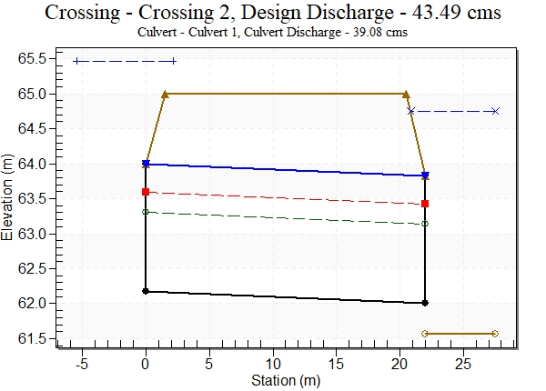
Water Surface Profile Plot for Culvert: Culvert 2

Slide 40
Summary of Culvert Flows at Crossing: Crossing 3
Headwater Elevation (m) | Total Discharge (cms) | Culvert 1 Discharge (cms) | Roadway Discharge (cms) | Iterations
56.50 | 0.00 | 0.00 | 0.00 | 1
57.10 | 5.00 | 5.00 | 0.00 | 1
57.46 | 10.00 | 10.00 | 0.00 | 1
57.76 | 15.00 | 15.00 | 0.00 | 1
58.02 | 20.00 | 20.00 | 0.00 | 1
58.26 | 25.00 | 25.00 | 0.00 | 1
58.52 | 30.00 | 30.00 | 0.00 | 1
58.77 | 35.00 | 35.00 | 0.00 | 1
59.01 | 40.00 | 40.00 | 0.00 | 1
59.16 | 43.30 | 43.30 | 0.00 | 1
59.48 | 50.00 | 50.00 | 0.00 | 1
60.00 | 61.00 | 60.99 | 0.00 | Overtopping

Slide 41
Culvert Summary Table: Culvert 3
Total Discharge (cms) | Culvert Discharge (cms) | Headwater Elevation (m) | Inlet Control Depth (m) | Outlet Control Depth (m) | Flow Type | Normal Depth (m) | Critical Depth (m) | Outlet Depth (m) | Tailwater Depth (m) | Outlet Velocity (m/s) | Tailwater Velocity (m/s)
0.00 | 0.00 | 67.66 | 0.000 | 0.000 | 0-NF | 0.000 | 0.000 | 0.000 | 0.000 | 0.000 | 0.000
4.00 | 4.00 | 68.12 | 0.459 | 0.076 | 1-S2n | 0.149 | 0.272 | 0.173 | 0.522 | 2.569 | 1.277
8.00 | 8.00 | 68.39 | 0.729 | 0.313 | 1-S2n | 0.230 | 0.432 | 0.290 | 0.817 | 3.061 | 1.631
12.00 | 12.00 | 68.62 | 0.955 | 0.585 | 1-S2n | 0.299 | 0.566 | 0.394 | 1.070 | 3.385 | 1.870
16.00 | 16.00 | 68.81 | 1.154 | 0.842 | 1-JS1t | 0.361 | 0.685 | 0.979 | 1.299 | 1.815 | 2.052
20.00 | 20.00 | 69.00 | 1.335 | 1.093 | 1-JS1t | 0.418 | 0.795 | 1.195 | 1.515 | 1.860 | 2.201
24.00 | 24.00 | 69.21 | 1.505 | 1.549 | 1-S1t | 0.471 | 0.898 | 1.400 | 1.720 | 1.904 | 2.325
28.00 | 28.00 | 69.40 | 1.667 | 1.745 | 1-S1t | 0.522 | 0.995 | 1.598 | 1.918 | 1.947 | 2.433
32.00 | 32.00 | 69.60 | 1.825 | 1.941 | 1-S1t | 0.571 | 1.088 | 1.790 | 2.110 | 1.986 | 2.527
32.94 | 32.94 | 69.65 | 1.862 | 1.987 | 1-S1t | 0.583 | 1.109 | 1.835 | 2.155 | 1.995 | 2.548
40.00 | 40.00 | 70.02 | 2.138 | 2.359 | 1-S1f | 0.665 | 1.263 | 2.000 | 2.481 | 2.222 | 2.687

Slide 42
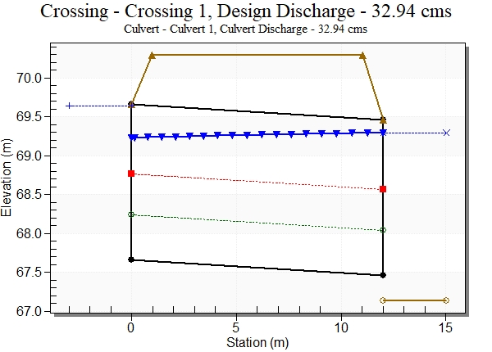
Water Surface Profile Plot for Culvert: Culvert 3

Slide 43
REDESIGN CULVERTS

Slide 44
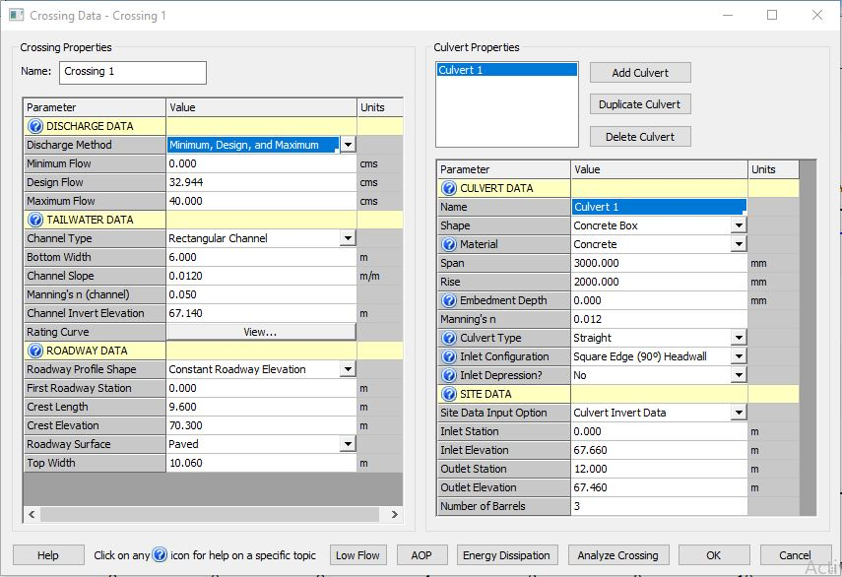
Culvert 1 :

Slide 45
Culvert Summary Table: Culvert 1
Total Discharge (cms) | Culvert Discharge (cms) | Headwater Elevation (m) | Inlet Control Depth (m) | Outlet Control Depth (m) | Flow Type | Normal Depth (m) | Critical Depth (m) | Outlet Depth (m) | Tailwater Depth (m) | Outlet Velocity (m/s) | Tailwater Velocity (m/s)
0.00 | 0.00 | 67.66 | 0.000 | 0.000 | 0-NF | 0.000 | 0.000 | 0.000 | 0.000 | 0.000 | 0.000
4.00 | 4.00 | 68.12 | 0.459 | 0.076 | 1-S2n | 0.149 | 0.272 | 0.173 | 0.522 | 2.569 | 1.277
8.00 | 8.00 | 68.39 | 0.729 | 0.313 | 1-S2n | 0.230 | 0.432 | 0.290 | 0.817 | 3.061 | 1.631
12.00 | 12.00 | 68.62 | 0.955 | 0.585 | 1-S2n | 0.299 | 0.566 | 0.394 | 1.070 | 3.385 | 1.870
16.00 | 16.00 | 68.81 | 1.154 | 0.842 | 1-JS1t | 0.361 | 0.685 | 0.979 | 1.299 | 1.815 | 2.052
20.00 | 20.00 | 69.00 | 1.335 | 1.093 | 1-JS1t | 0.418 | 0.795 | 1.195 | 1.515 | 1.860 | 2.201
24.00 | 24.00 | 69.21 | 1.505 | 1.549 | 1-S1t | 0.471 | 0.898 | 1.400 | 1.720 | 1.904 | 2.325
28.00 | 28.00 | 69.40 | 1.667 | 1.745 | 1-S1t | 0.522 | 0.995 | 1.598 | 1.918 | 1.947 | 2.433
32.00 | 32.00 | 69.60 | 1.825 | 1.941 | 1-S1t | 0.571 | 1.088 | 1.790 | 2.110 | 1.986 | 2.527
32.94 | 32.94 | 69.65 | 1.862 | 1.987 | 1-S1t | 0.583 | 1.109 | 1.835 | 2.155 | 1.995 | 2.548
40.00 | 40.00 | 70.02 | 2.138 | 2.359 | 1-S1f | 0.665 | 1.263 | 2.000 | 2.481 | 2.222 | 2.687

Slide 46
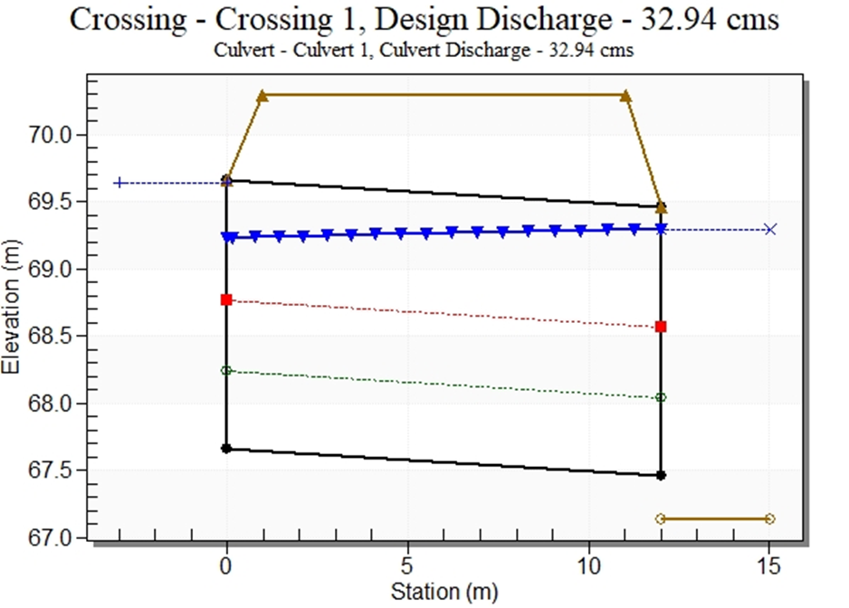

Slide 47
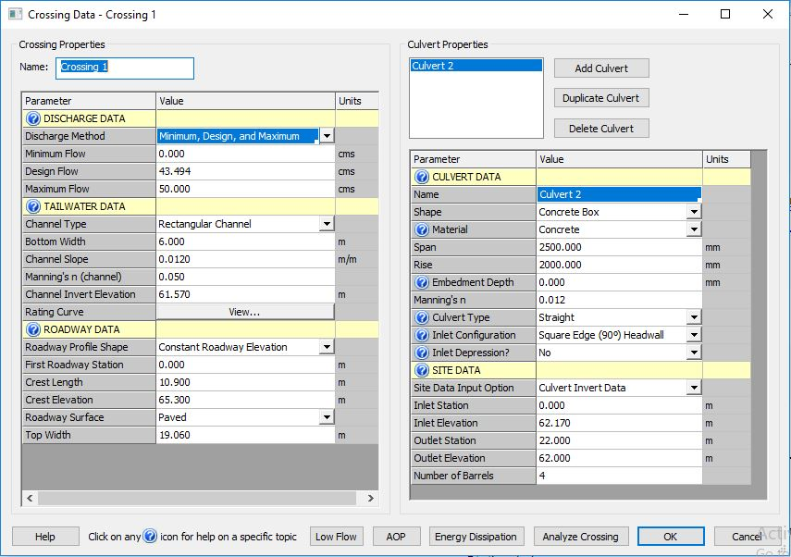
Culvert 2 :

Slide 48
Culvert Summary Table: Culvert 2
Total Discharge (cms) | Culvert Discharge (cms) | Headwater Elevation (m) | Inlet Control Depth (m) | Outlet Control Depth (m) | Flow Type | Normal Depth (m) | Critical Depth (m) | Outlet Depth (m) | Tailwater Depth (m) | Outlet Velocity (m/s) | Tailwater Velocity (m/s)
0.00 | 0.00 | 62.17 | 0.000 | 0.000 | 0-NF | 0.000 | 0.000 | 0.000 | 0.000 | 0.000 | 0.000
5.00 | 5.00 | 62.67 | 0.501 | 0.129 | 1-S2n | 0.207 | 0.294 | 0.220 | 0.602 | 2.274 | 1.383
10.00 | 10.00 | 62.97 | 0.796 | 0.368 | 1-S2n | 0.323 | 0.467 | 0.357 | 0.947 | 2.803 | 1.760
15.00 | 15.00 | 63.21 | 1.042 | 0.690 | 1-JS1t | 0.423 | 0.612 | 0.813 | 1.243 | 1.844 | 2.011
20.00 | 20.00 | 63.45 | 1.255 | 1.277 | 1-S1t | 0.514 | 0.741 | 1.085 | 1.515 | 1.844 | 2.201
25.00 | 25.00 | 63.67 | 1.452 | 1.500 | 1-S1t | 0.599 | 0.860 | 1.340 | 1.770 | 1.865 | 2.354
30.00 | 30.00 | 63.91 | 1.636 | 1.740 | 1-S1t | 0.680 | 0.972 | 1.585 | 2.015 | 1.893 | 2.482
35.00 | 35.00 | 64.15 | 1.814 | 1.978 | 1-S1t | 0.758 | 1.077 | 1.821 | 2.251 | 1.922 | 2.591
40.00 | 40.00 | 64.39 | 1.990 | 2.224 | 1-S1f | 0.834 | 1.177 | 2.000 | 2.481 | 2.000 | 2.687
43.49 | 43.49 | 64.60 | 2.113 | 2.433 | 4-FFf | 0.886 | 1.245 | 2.000 | 2.639 | 2.175 | 2.747
50.00 | 50.00 | 65.02 | 2.347 | 2.847 | 4-FFf | 0.980 | 1.366 | 2.000 | 2.927 | 2.500 | 2.847

Slide 49
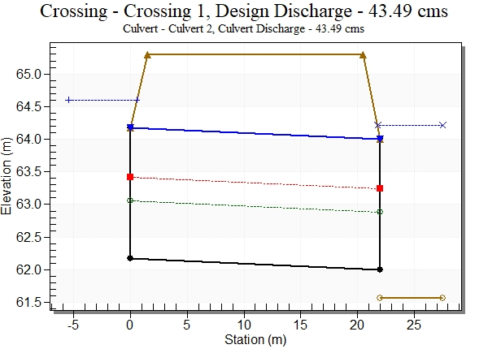

Slide 50
The difference before and after the design for culvert 1.
After Redesign | Before Redesign
3 | 3 | Number of Barrels
3000 | 2500 | Span (mm)
2000 | 1340 | Rise (mm)
70.30 m | 70.00m | Crest Elevation
69.65 m | 70.43m | Head Water Elevation

Slide 51
The difference before and after the design for culvert 2.
After Redesign | Before Redesign
4 | 4 | Number of Barrels
2500 | 1830 | Span (mm)
2000 | 1830 | Rise (mm)
65.30 m | 65.00m | Crest Elevation
64.60 m | 65.47 m | Head Water Elevation

Slide 52
STORM NETWORK FOR FAR'OUN STREET

Slide 53
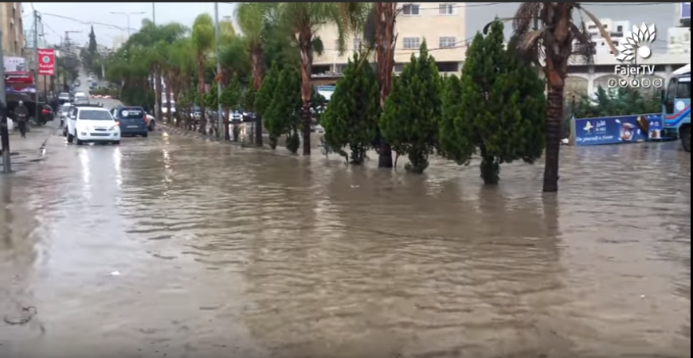
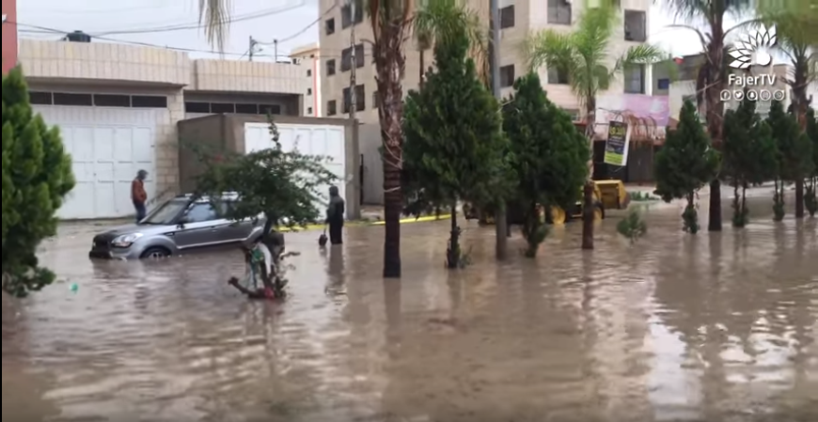
The problem of storm water on Far'oun street

Slide 54
Methodology
Finding the storm data
Preparing data as layers of the street
Using storm cad to design the network depending on layers of (contour ,and road)
Checking the design to admire the criteria of velocity and cover.

Slide 55
Criteria of design
Design period(years) | 20
Maximum velocity in conduits(m/s) | 3
Minimum velocity in conduits (m/s) | 0.6
Maximum allowable cover (m) | 5
Minimum allowable cover(m) | 0.8
Minimum allowable slope (%) | 1
Maximum allowable slope (%) | 15
Conduit Material | Concrete

Slide 56
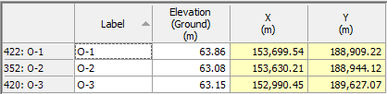
Suggested Outfalls

Slide 57
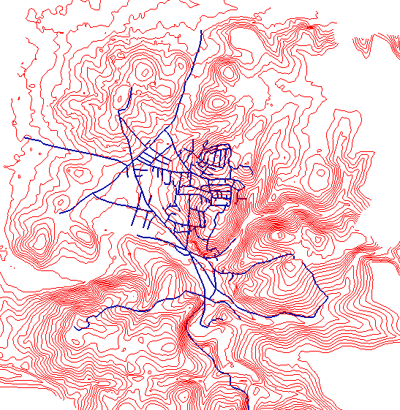
Steps Done
First: Adding Data

Slide 58
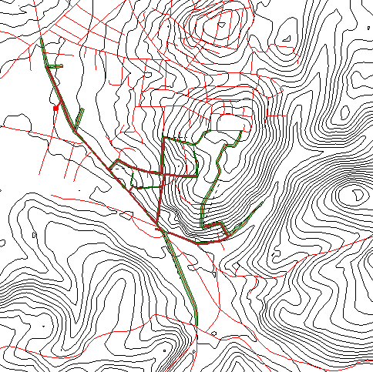
Second : Delineation the Catchments and Drawing manholes, Catch Basin, and conduits

Slide 59
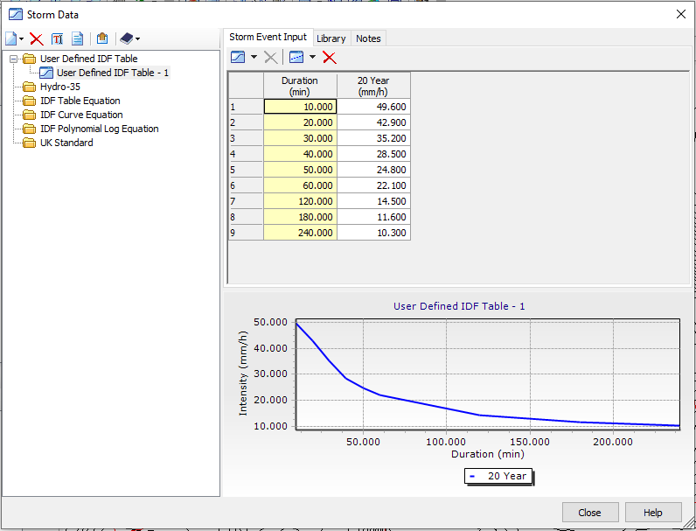
Third: Define storm data

Slide 60
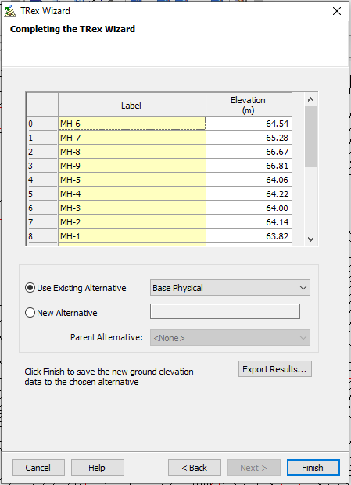
Fourth: Inserting Elevation for each Manhole and Catch Basin .

Slide 61
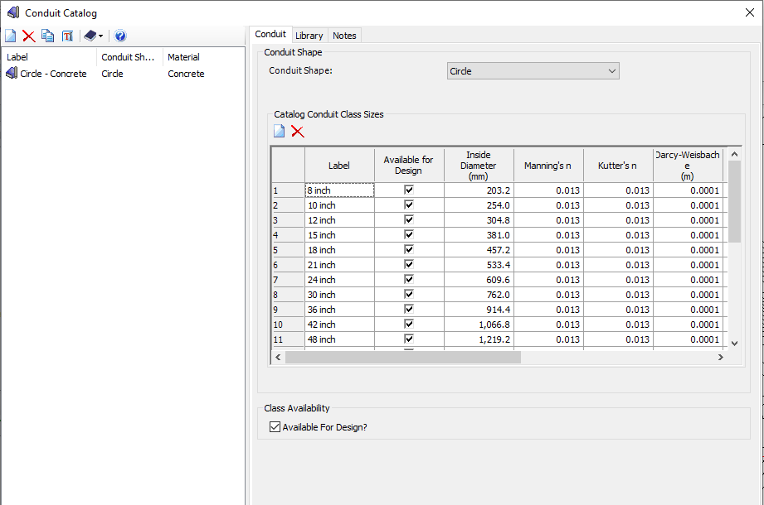
Fifth: Calling conduit catalog

Slide 62
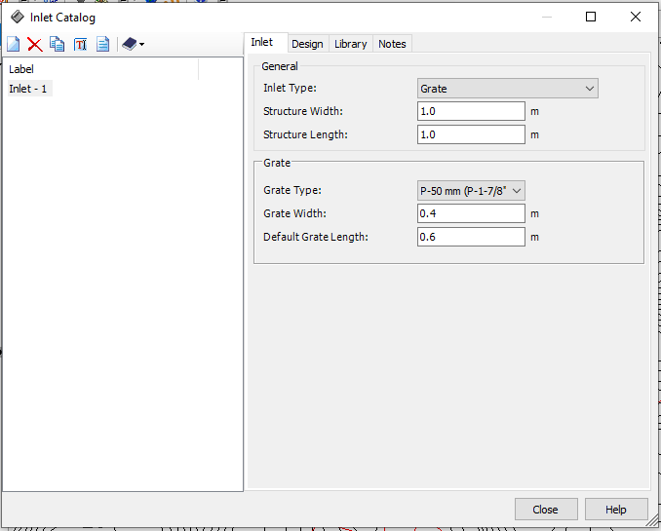
Sixth: Calling Inlet Catalog

Slide 63



Seventh: Defining design constrains

Slide 64
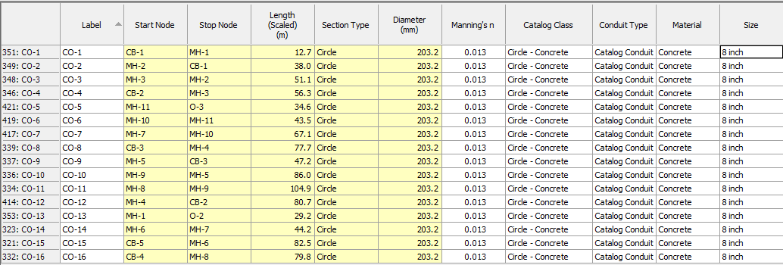
Eighth : Inserting Conduit Type ,Material and Size For Each conduit

Slide 65
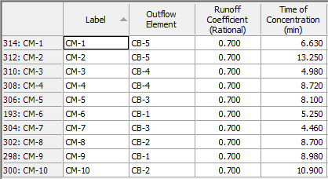
Ninth : Inserting Runoff Coefficient and Time of Concentration for each Catchment

Slide 66
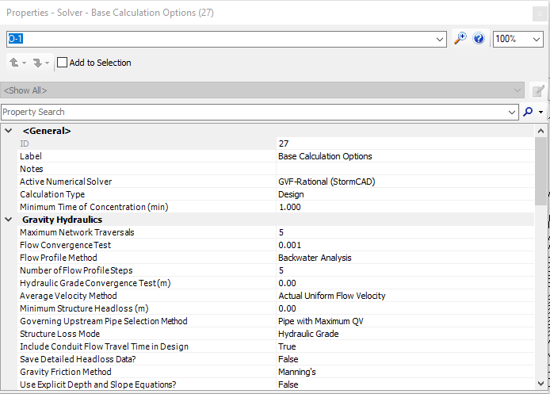
Tenth : Base Calculation Option

Slide 67
Results
The conduits we used .
Diameter (in) | Length (m)
8 | 1593.6
10 | 1313.6
12 | 614.4
15 | 193.8

Slide 68
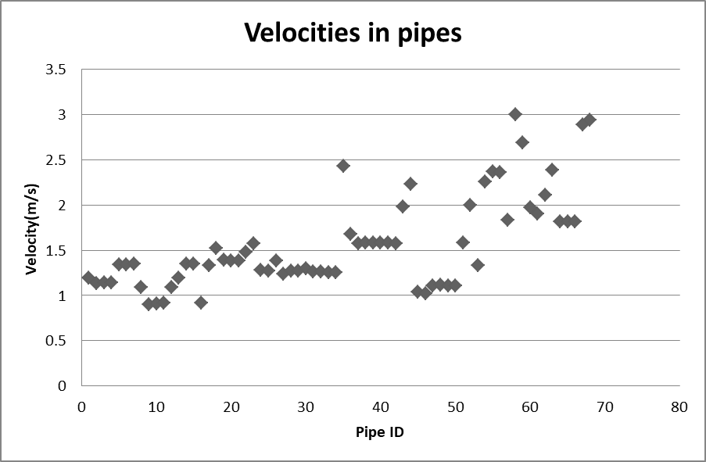
Velocities in pipes

Slide 69
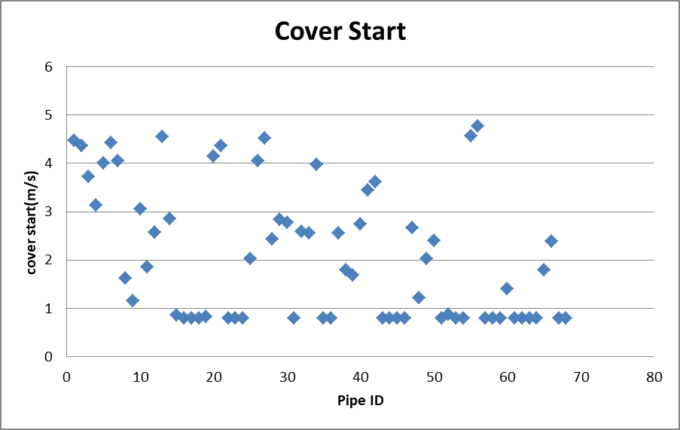
Cover Start

Slide 70
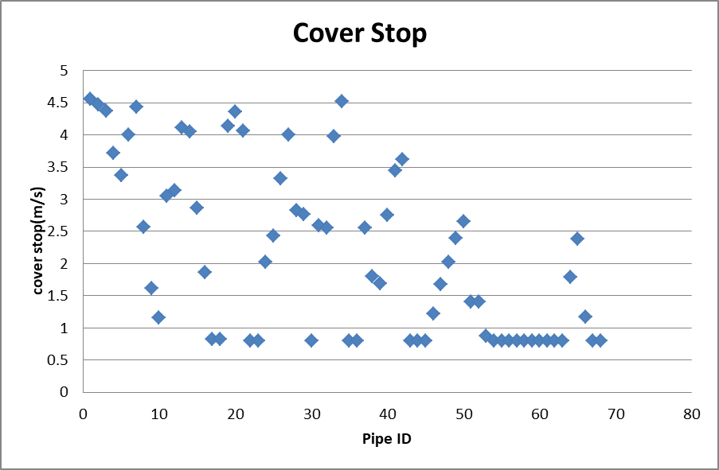
Cover Stop

Slide 71
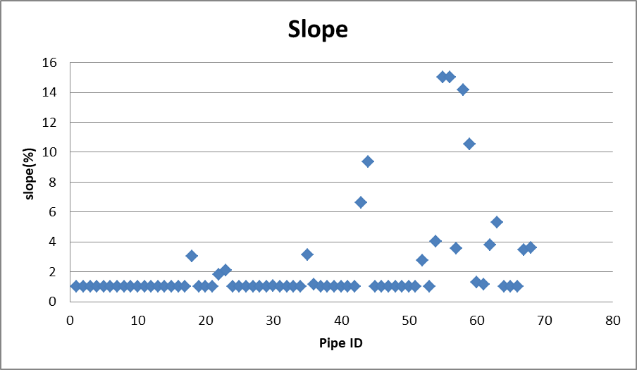
Slope

Slide 72
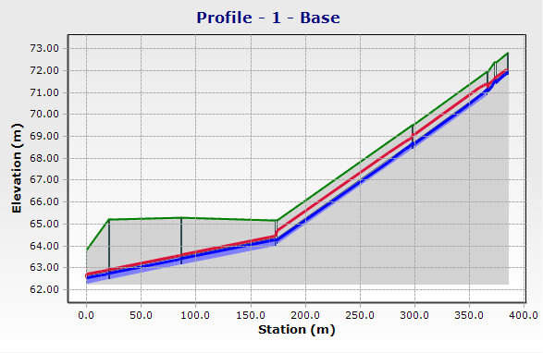
Profile of storm network

Slide 73
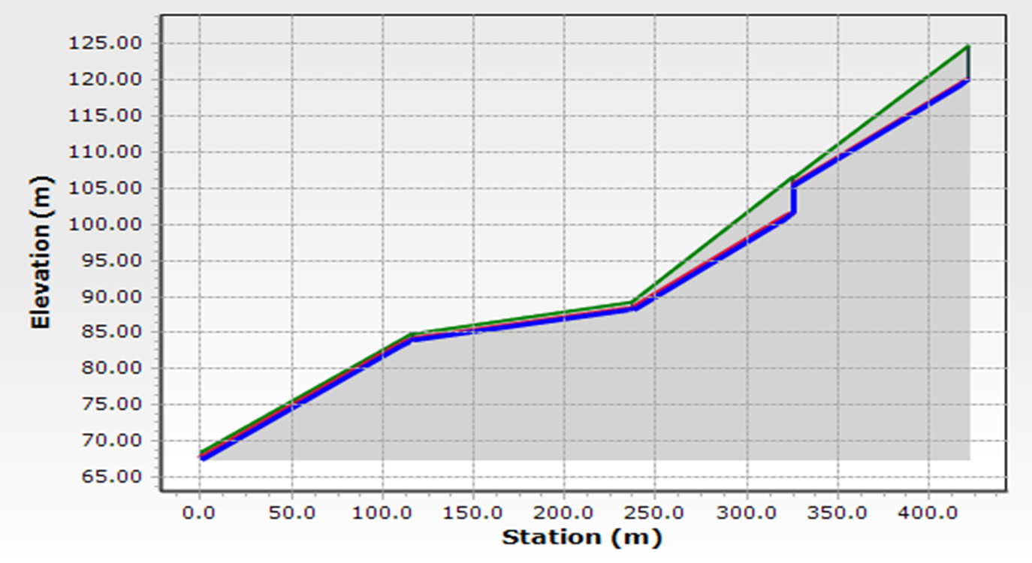
Profile of drop manhole .

Slide 74
Cost Estimate

Slide 75
Cost of project
The total cost = 590410 $
 | Unit price | Quantity | Cost
Manholes | 600$/unit | 46 unit | 27600$
Catch basin | 250$/unit | 22 unit | 5500$
Conduits | 150 $/m | 3715.4 m | 557310$

Slide 76
Discussions and Recommendations.

Slide 77
Discussions of Culverts Analysis
According to the results of analysis of culverts we noticed the efficiency of culvert 1 is very bad so that need to redesigned , also culvert 2 has a bad efficiency and need to redesigned , culvert 3 has a good efficiency .
The region of Wadi Al-Teen is very close to Nablus , it has a close annual rainfall depth.
The efficiency of culverts affected by the surrounding area as illustrated in image .

Slide 78
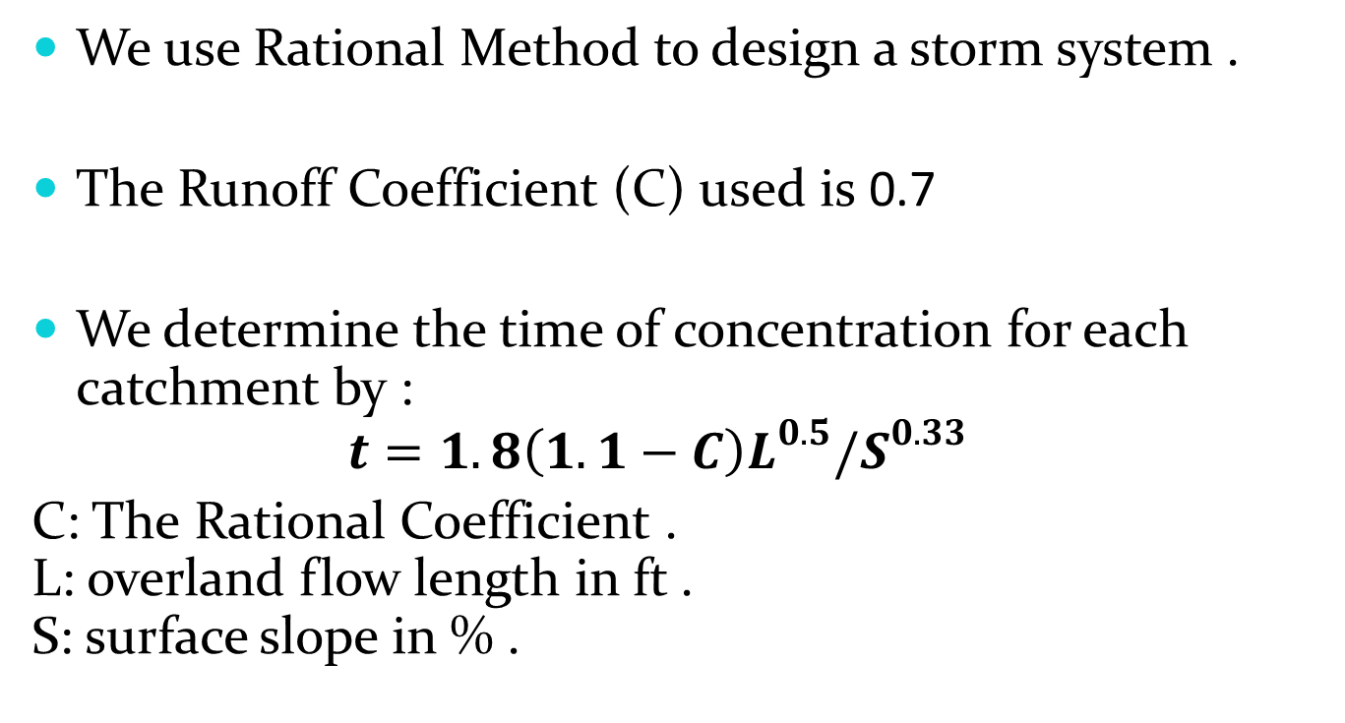
Discussions of Storm Network
We use Rational Method to design a storm system .
The Runoff Coefficient (C) used is 0.7
We determine the time of concentration for each catchment by :
$t=1.8\left(1.1−C\right)L^{0.5}/S^{0.33}$
C: The Rational Coefficient .
L: overland flow length in ft .
S: surface slope in % .

Slide 79
THANK YOU

