Slide 1

June 29, 2025
GRADUATION PROJECT 2
TABLET DISINTEGRATION DEVICE
PREPARED BY:
YAZAN ALTAWIL
ANAS SHAAR
ABDALQADER SHARIF
SUPERVISOR:
DR. BAHAA SHAQOUR

Slide 2

TABLE OF CONTENT
  ABOUT THE DEVICE
  WHY WE NEED THE DEVICE
  OBJECTIVES
  LITERATURE REVIEW
  SYSTEM DESIGN
  METHODOLOGY
  FINAL RESULT
  VIDEO
  CONCLUSION

Slide 3
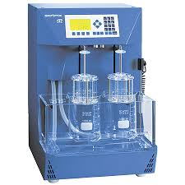
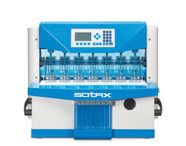
ABOUT THE DEVICE
The tablet disintegration device is crucial for ensuring the quality and effectiveness of oral medications. It simulates the human stomach to measure how tablets disintegrate under physiological conditions, ensuring proper drug absorption and effectiveness while meeting regulatory and quality standards.

Slide 4
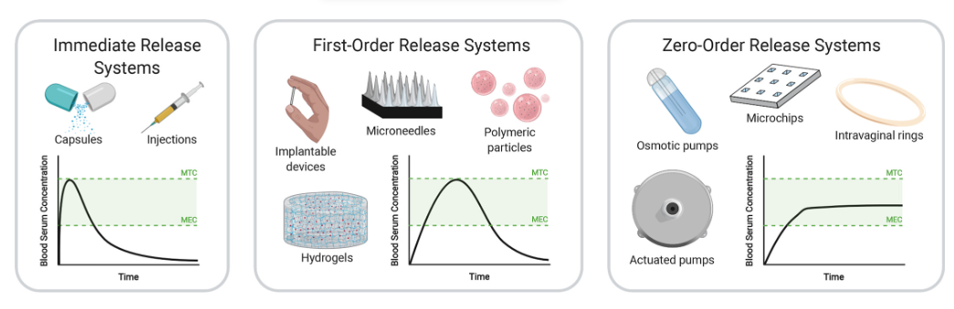
Why we need the device ?

Slide 5

Objectives of project
The main objective of the project is to design a device that simulates human physiological conditions for tablet disintegration. Additionally, it aims to develop a device capable of performing the task with high accuracy, despite using simple components and locally available parts in Palestine, and overcoming the limited resources caused by the occupation.
Sub-objectives include:
  Improving measurement accuracy
  Ensuring sustainability and cost-effectiveness
  Applying engineering standards.

Slide 6
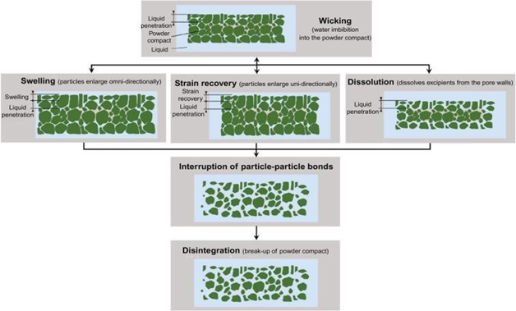

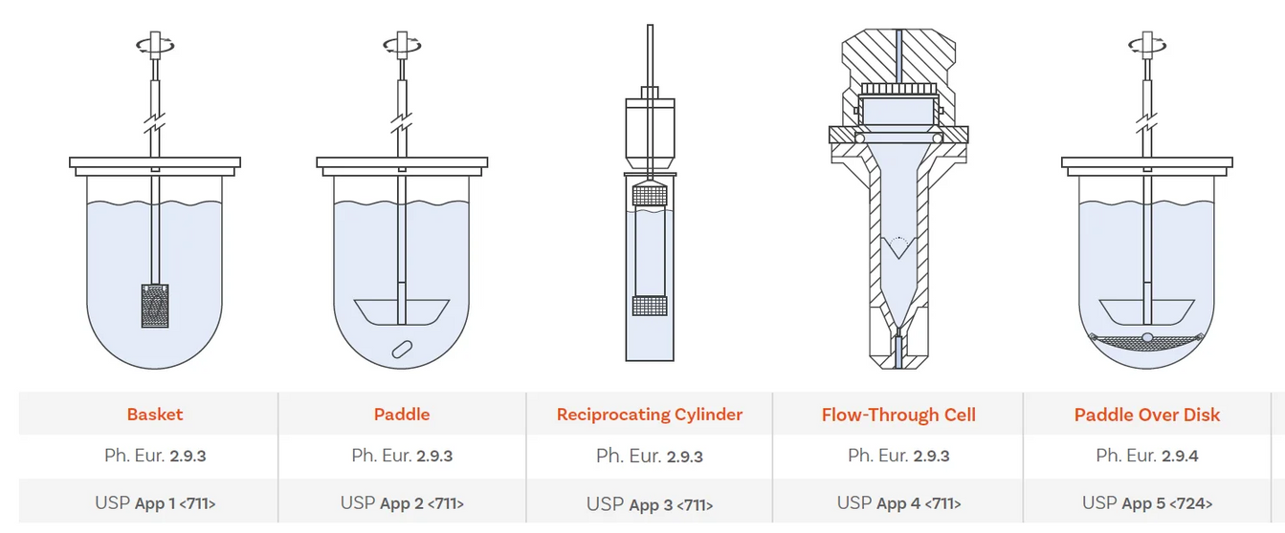
Literature Review
Mechanism of Tablet Disintegration:
USP methods for tablet disintegration include the Basket-Rack Assembly for submerged agitation, the Paddle and Reciprocating Cylinder Methods for simulating physiological conditions, and the Flow-Through Cell Method for continuous monitoring.

Slide 7
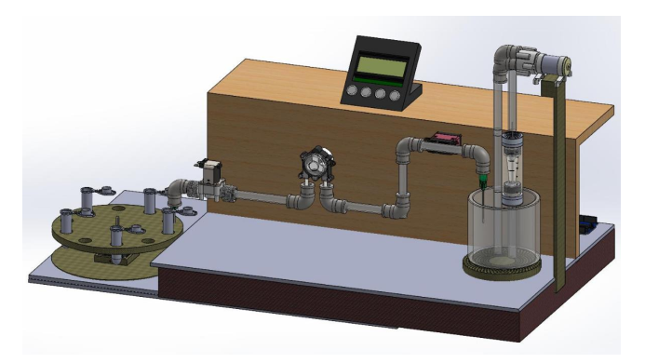
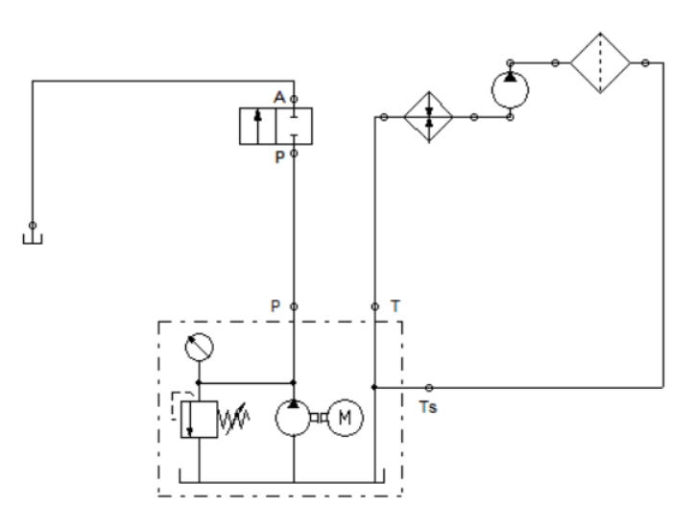
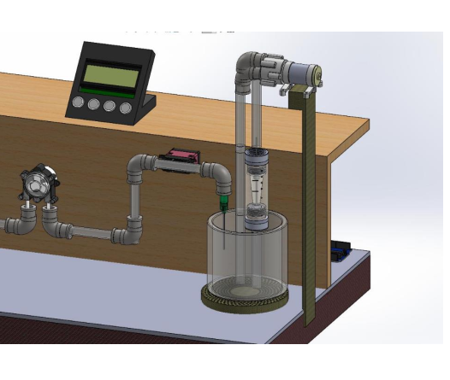
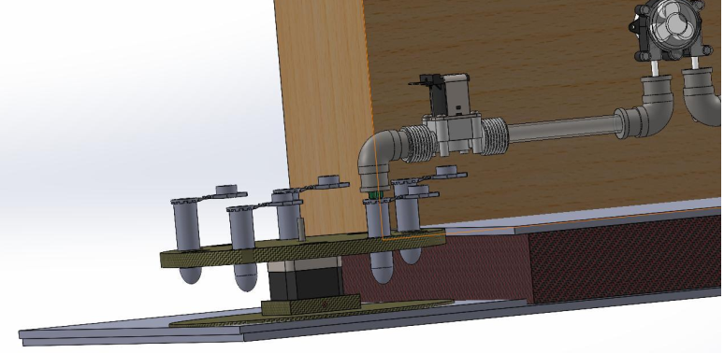
SYSTEM DESIGN
THE SYSTEM IS DESIGNED TO SIMULATE HUMAN STOMACH CONDITIONS FOR TABLET DISINTEGRATION TESTING. IT INCLUDES KEY COMPONENTS SUCH AS ARDUINO MICROCONTROLLERS FOR AUTOMATION, STEPPER MOTORS FOR PRECISE POSITIONING, SOLENOID VALVE FOR FLUID CONTROL, AND TEMPERATURE SENSORS (DS18B20) TO MAINTAIN A STABLE 37°C ENVIRONMENT. THE DEVICE ALSO FEATURES A MEDIA RESERVOIR, A FLOW CELL FOR TABLET PLACEMENT, AND A DC PUMP TO CIRCULATE THE TESTING FLUID. THE MODULAR DESIGN ENSURES FLEXIBILITY, EASE OF MAINTENANCE, AND COMPATIBILITY WITH VARIOUS TABLET FORMULATIONS.

Slide 8

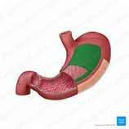

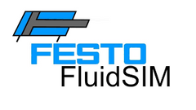
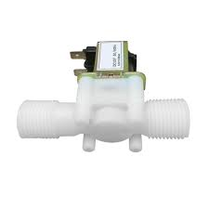
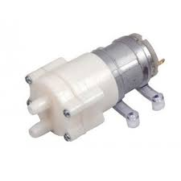
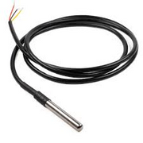
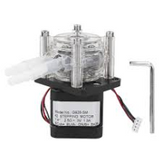

METHODOLOGY
  DESIGN & TESTING: FOCUSES ON DESIGNING, CONSTRUCTING, AND TESTING AN AUTOMATED TABLET DISINTEGRATION DEVICE SIMULATING HUMAN STOMACH
  SOFTWARE TOOLS: SOLIDWORKS: USED FOR CAD MODELING TO DESIGN THE PROTOTYPE FLUID SIM: USED TO DESIGN AND ANALYZE THE PNEUMATIC SYSTEM, INCLUDING VALVES AND PUMPS.
  MECHANICAL SYSTEM: INTEGRATES A PERISTALTIC PUMP ,DC PUMP, SOLENOID VALVES , AND SENSORS.
  AUTOMATION: USES ARDUINO FOR CONTROLLING OPERATIONS
  TESTING PROGRAM: ARDUINO COORDINATES THE PUMP, HEATING ELEMENTS, AND SENSORS TO ACCURATELY SIMULATE BODY CONDITIONS.

Slide 9
Final Result

Slide 10
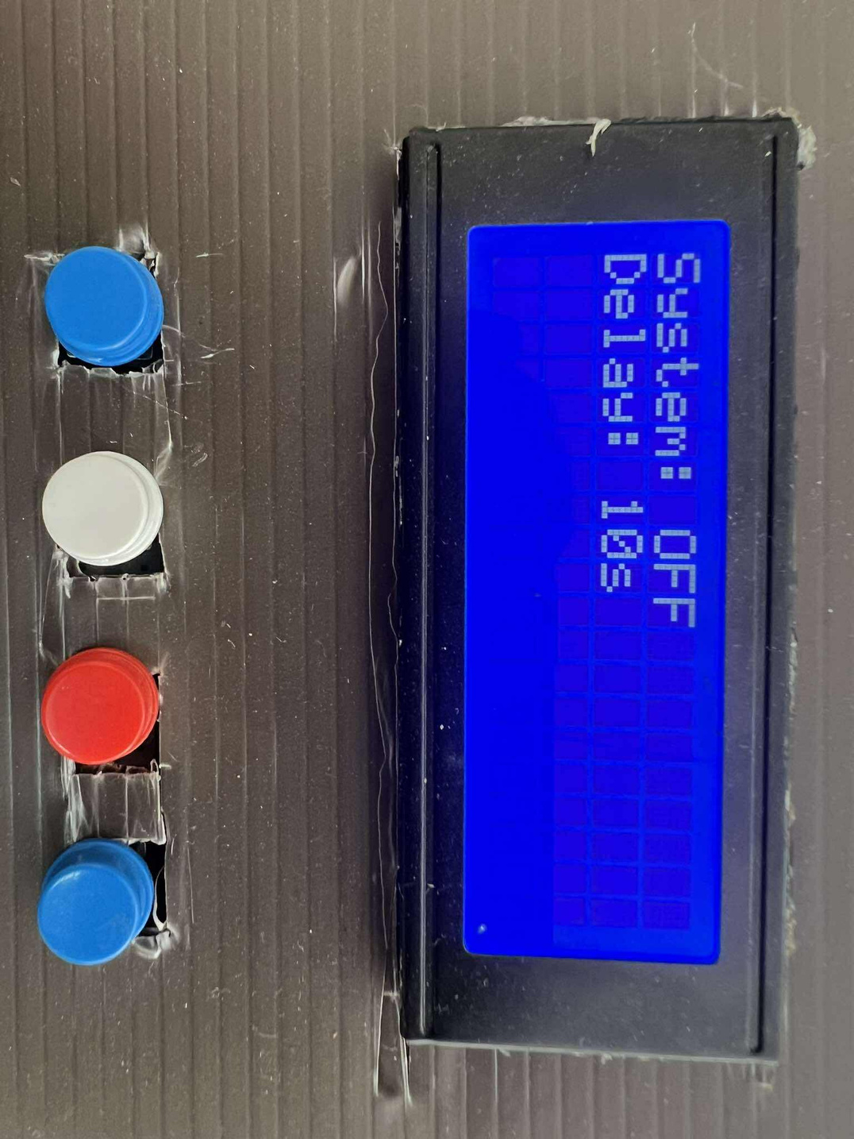
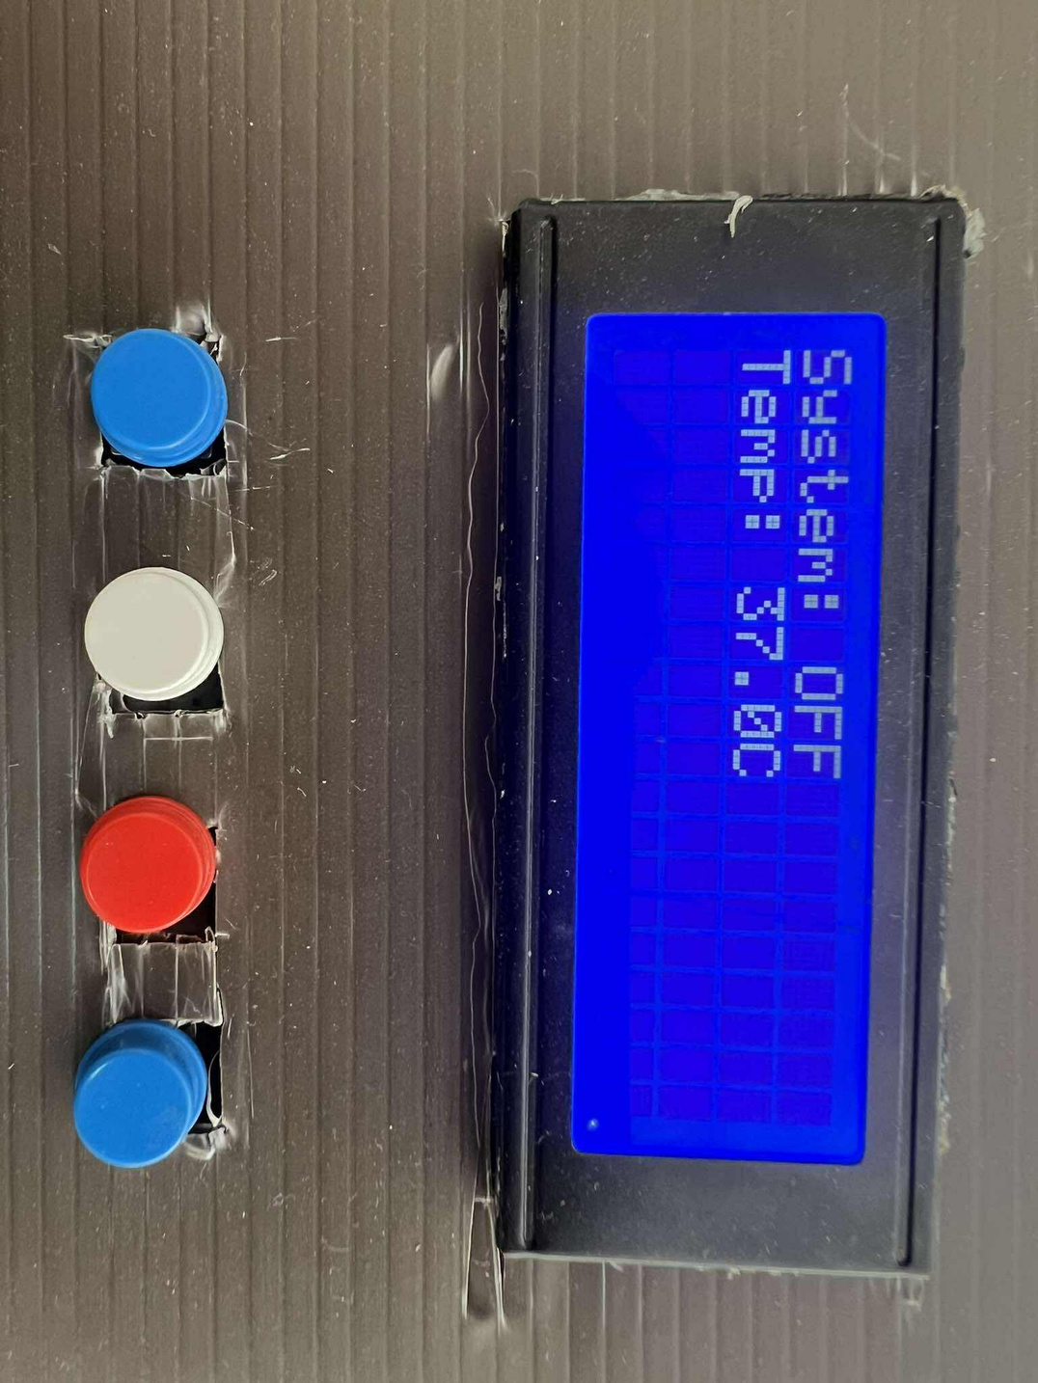
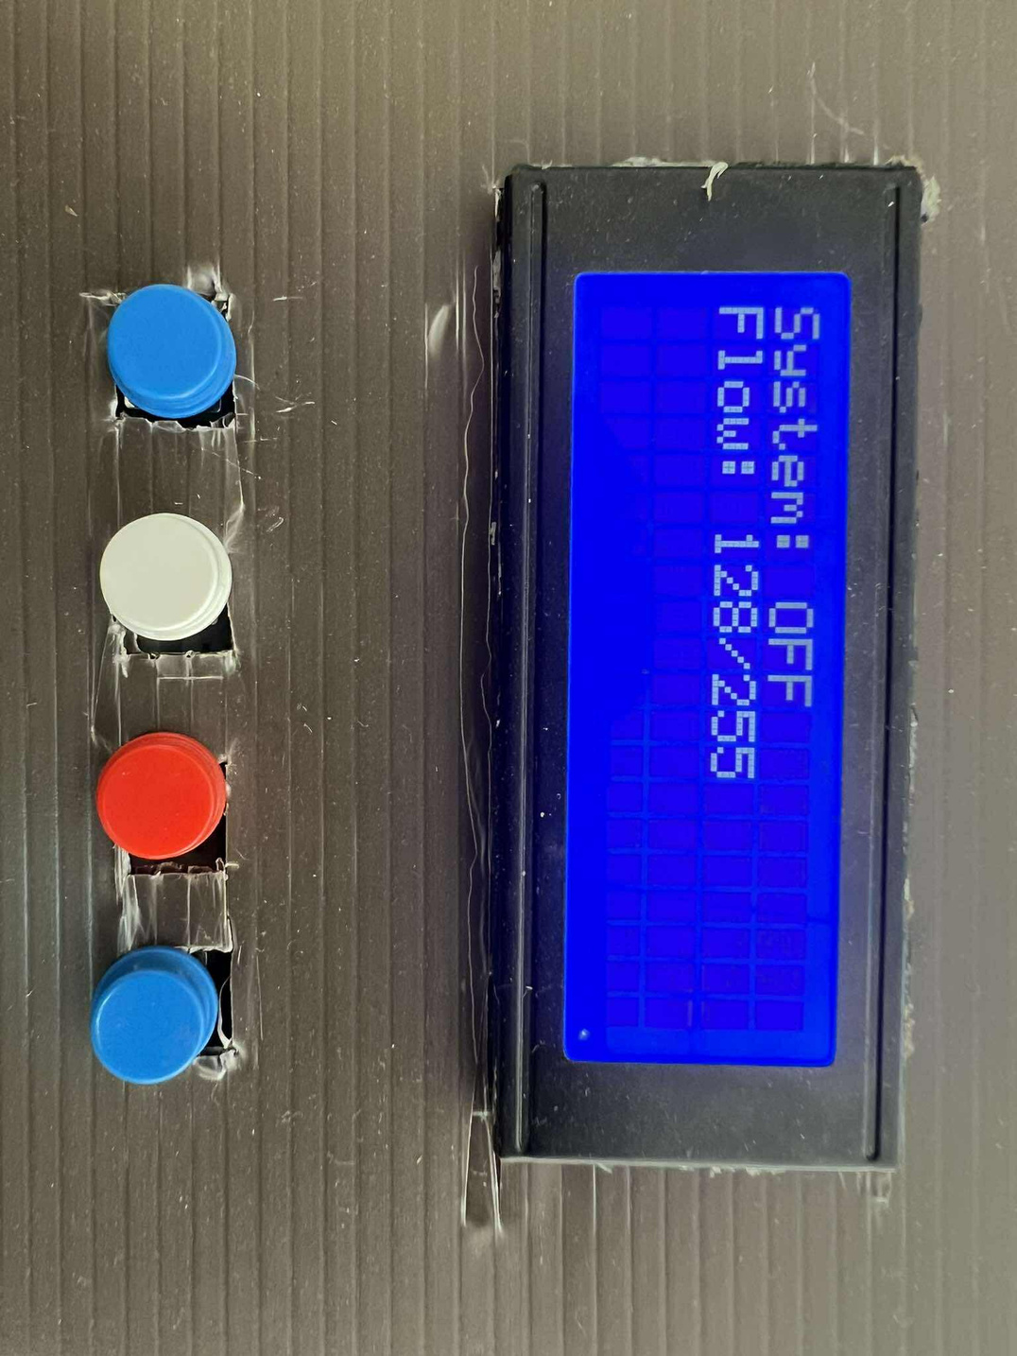
Modes selection (default settings)

Slide 11
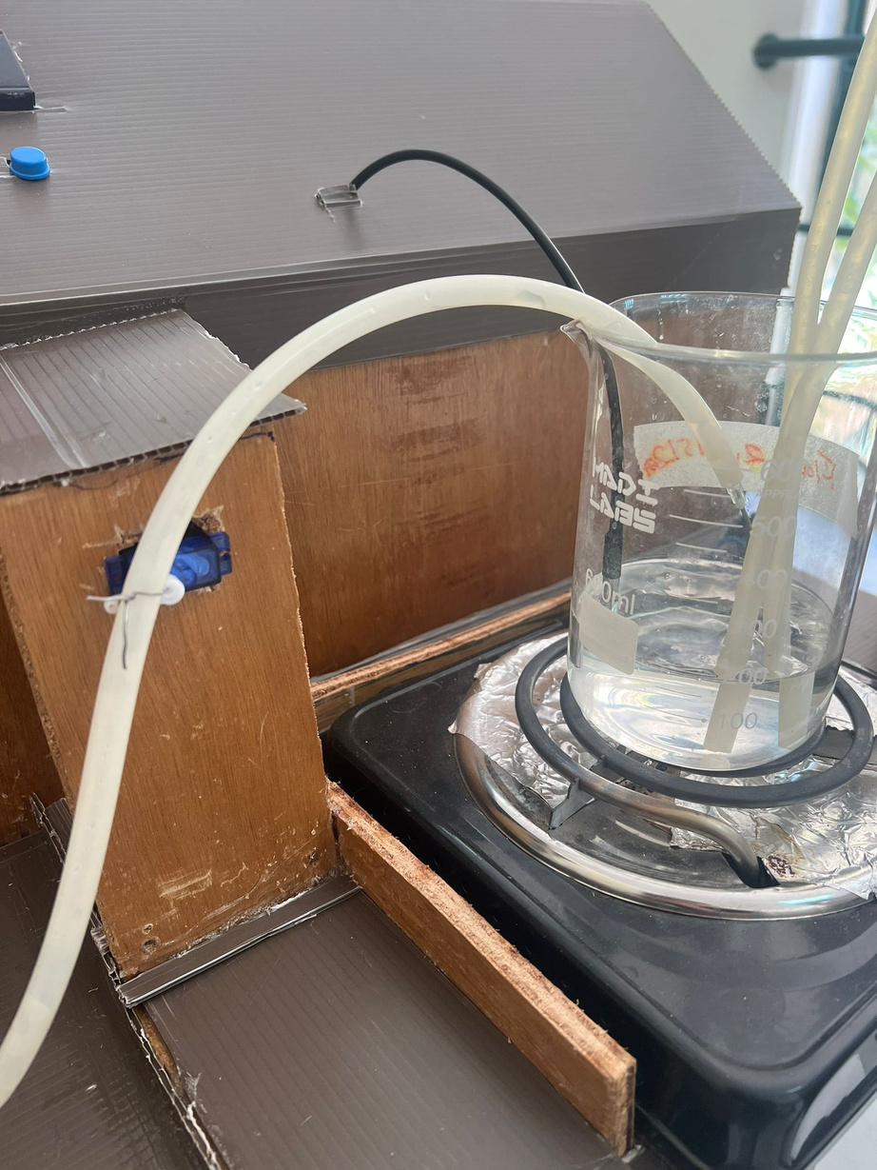
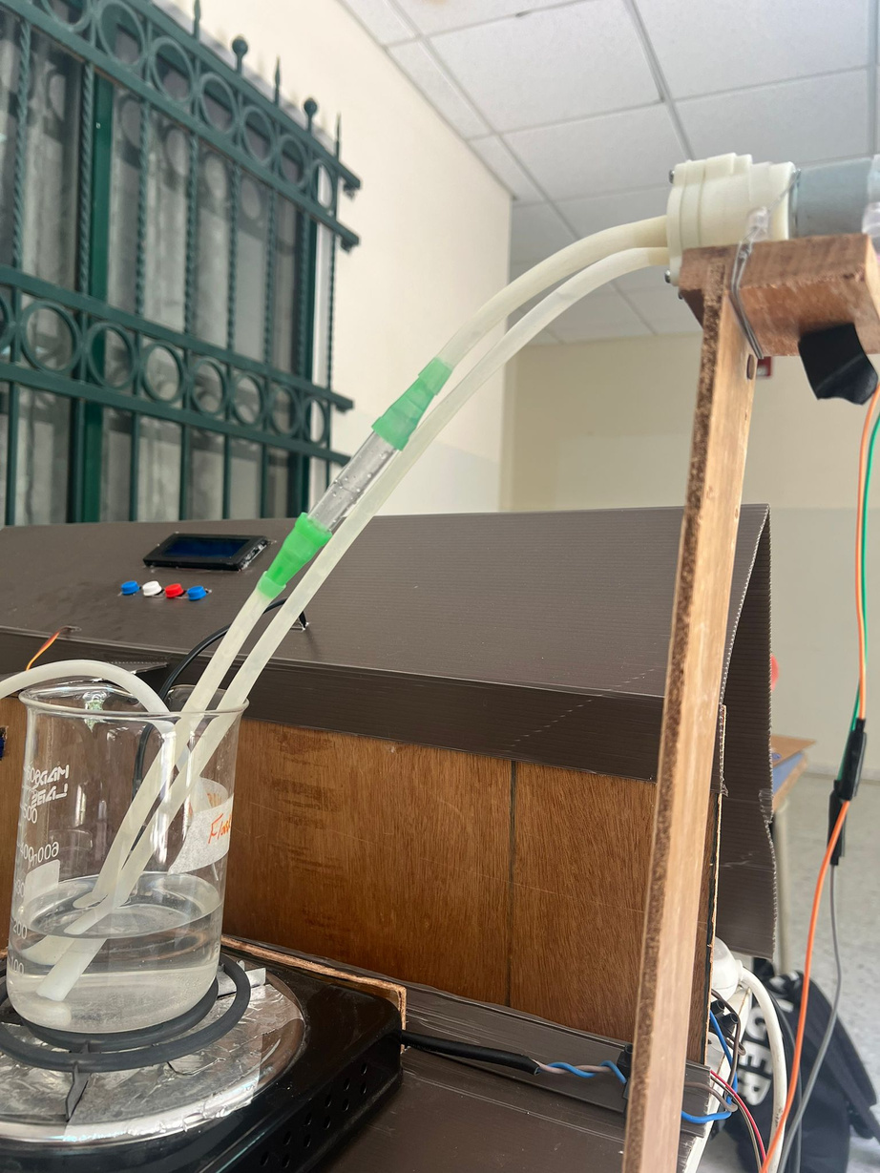
First part view

Slide 12
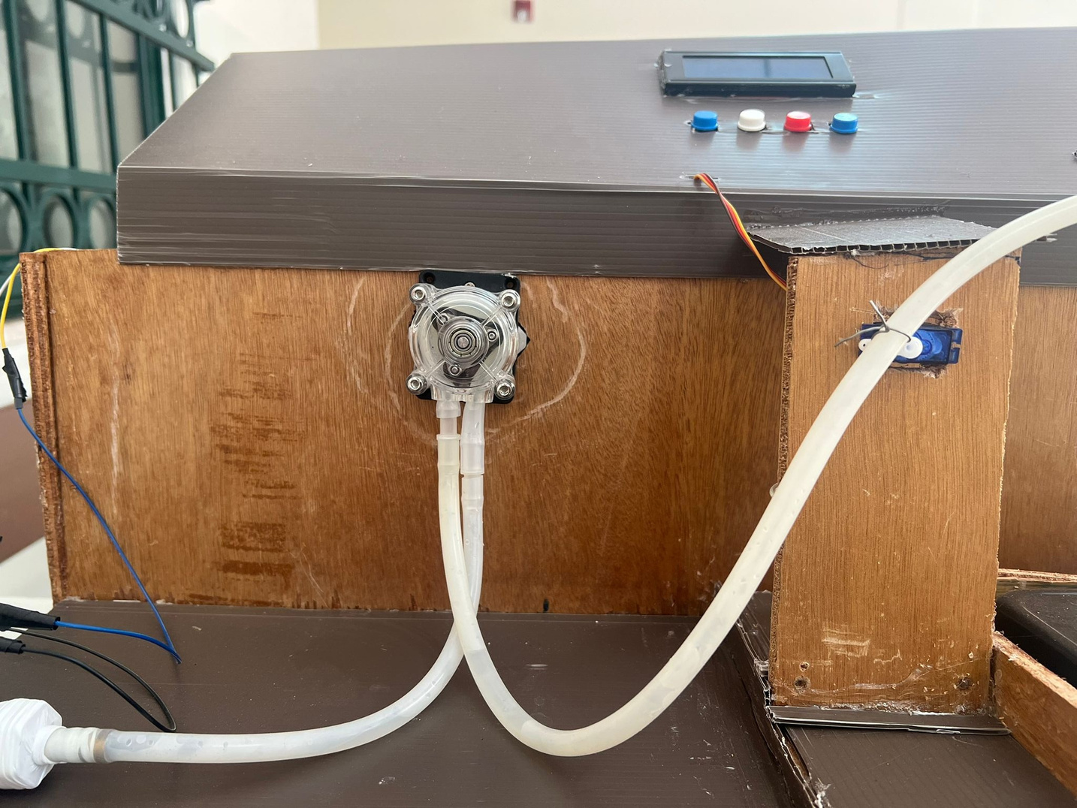
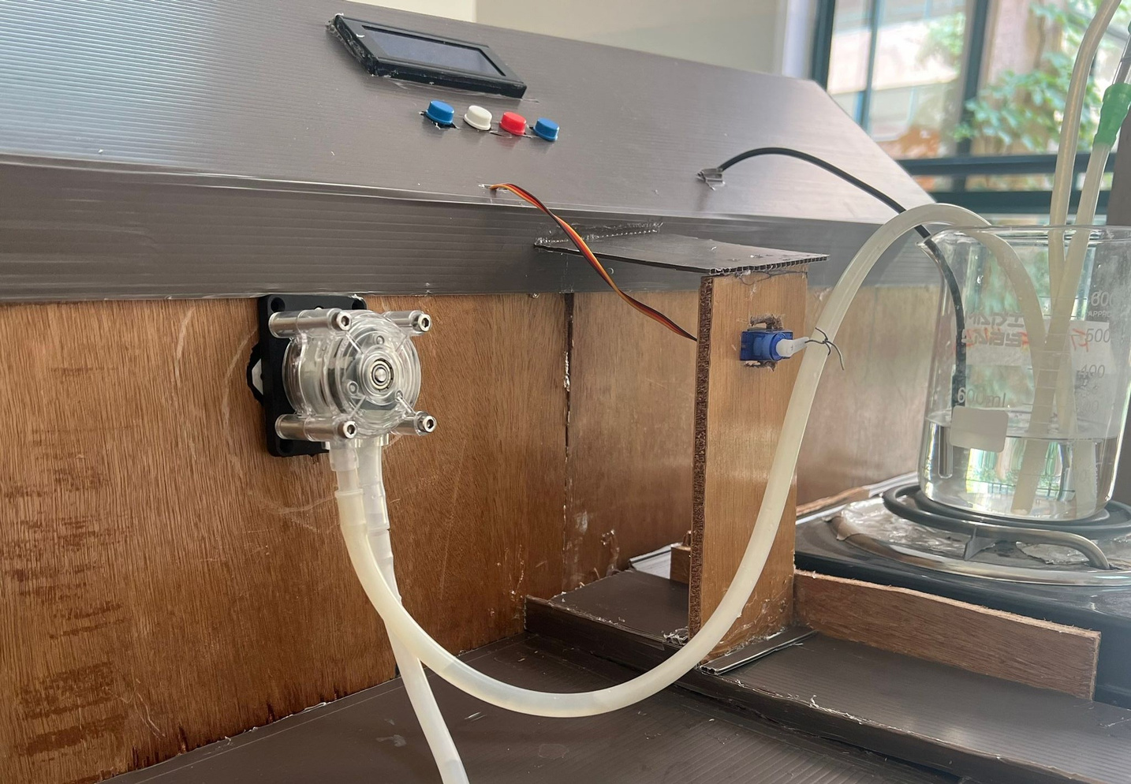
Second part view

Slide 13
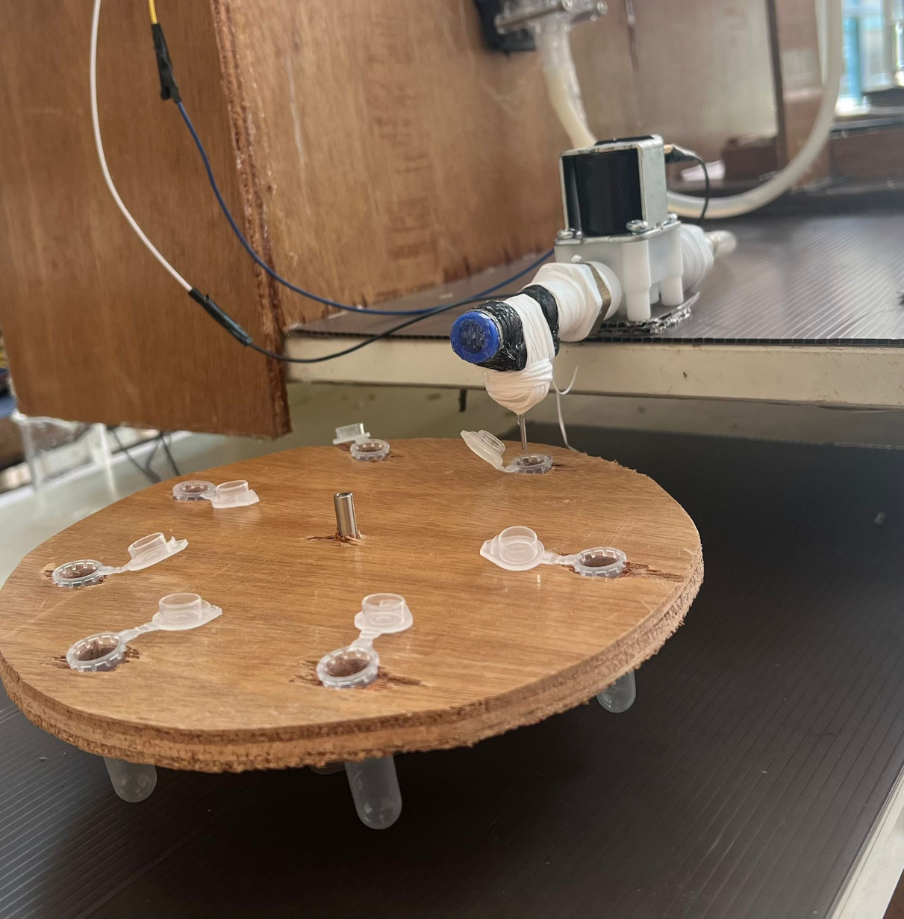
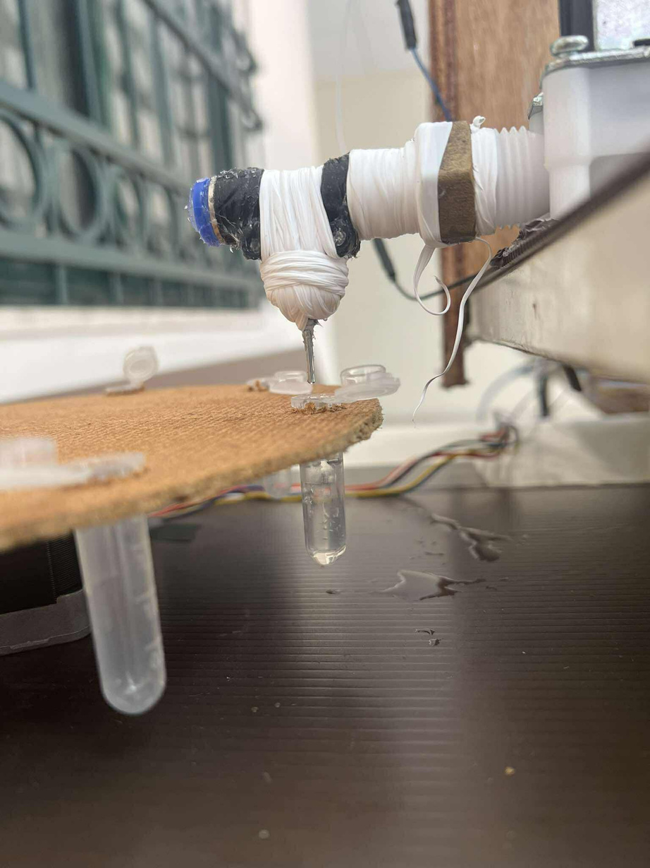
Third part view

Slide 14
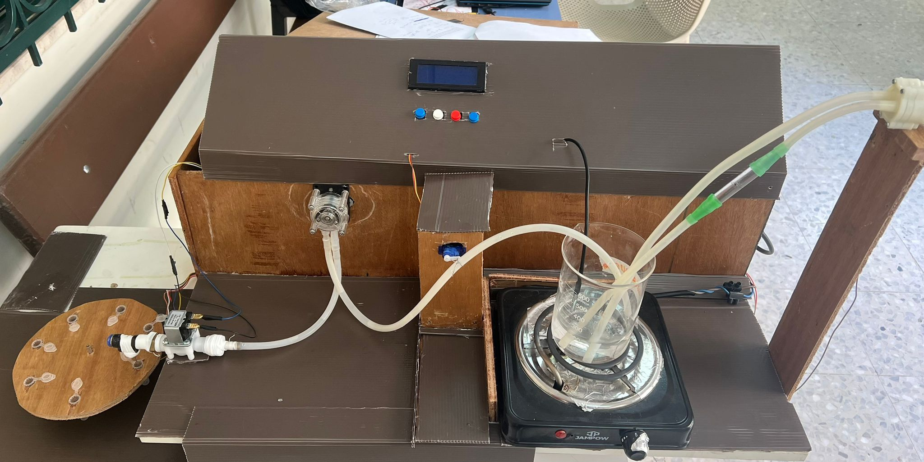
Final build view

Slide 15
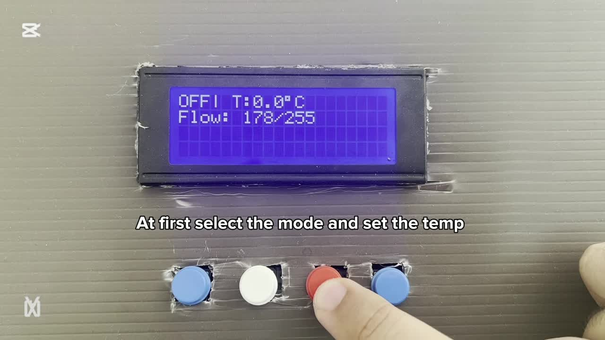

Slide 16


CONCLUSION
  FOCUSES ON COST-EFFICIENCY AND LOCALLY AVAILABLE COMPONENTS TO ADDRESS ECONOMIC AND POLITICAL CHALLENGES IN PALESTINE.
  DESIGNED FOR LOCAL MANUFACTURING, MAINTENANCE, AND SUSTAINABILITY.
  SUPPORTS HEALTHCARE, PHARMACEUTICAL QUALITY, AND SELFRELIANCE.

Slide 17
THANK YOU
ANY QUESTIONS ?

