Slide 1
Modern Women Association website
By:
Yasmeen Abd el-Haq
Rawzan Masood
Supervised By:
Dr.Sufyan Samara

Slide 2
Contents:
General Overview
Motivation
For whom
Tools and Technologies
Features
Challenges
Future work
Conclusion

Slide 3
Introduction
the internet has become one of the crucial things in our lives to get in touch with people along with important entities such as organizations, one of the factors that have helped the internet to become global its availability to everyone in any place.
the Association of Modern Women has to make a bridge between the recipient and the helpers on one hand and the administration on the other hand , a website can be the main cornerstone in communication.

Slide 4

Motivations
Many people face challenges and difficulties in finding associations and institutions to provide them with help. Moreover, if they find them, it is hard for them to contact with these institutions. By using this website, it facilitates this contacting by allowing them to reach the assistant and the employees.

Slide 5
For whom?
This website Would be helpful for:
1- Manager of the Association
2- Employees for the Association
3- Beneficiaries of the Society
4- Financiers who support the association

Slide 6
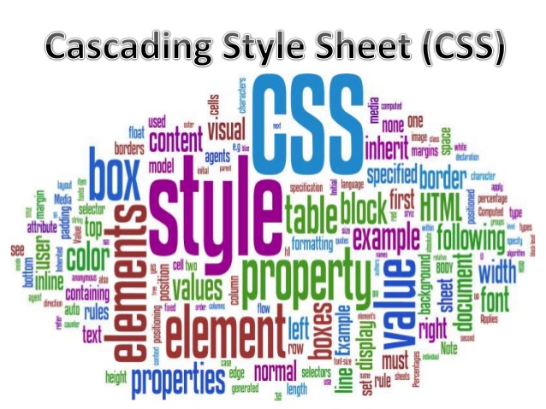
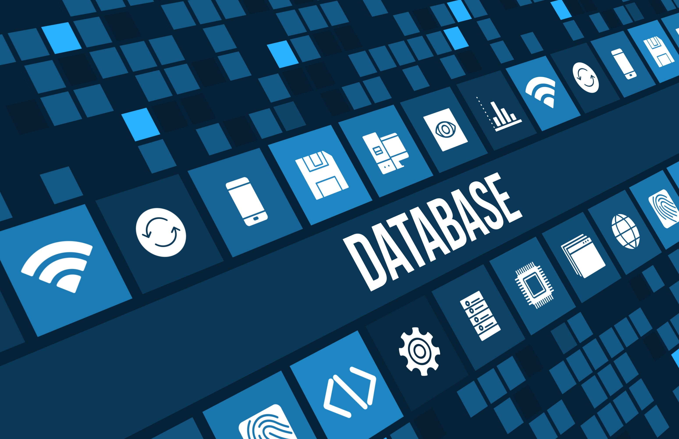
Tools and Technologies used
For Front-end we used :
HTML, JAVASCRIT, CSS, Bootstrap.
And we use phpMyAdmin database with xampp
server and Apatchi for backend issues.

Slide 7
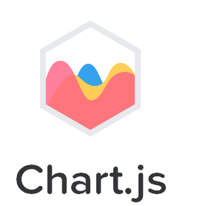

Tools and Technologies used(con…)
Also we used chart.js to draw statistical charts.
node.js server ,json , socket.io, redis and express package to make real time chatting between admin and beneficiaries.

Slide 8

Laravel Framework
The whole project was implementing by using LARAVEL 5.4 framework, which consist of Model , View , Controller (MVC).
MVC It divides a given application into three interconnected parts in order to separate internal representations of information from the ways that information is presented to and accepted from the user.

Slide 9
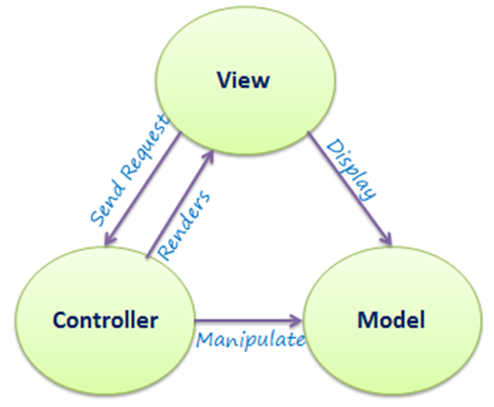
MVC architecture
MVC It divides a given application into three interconnected parts in order to separate internal representations of information from the ways that information is presented to and accepted from the user.

Slide 10
Features:
For Manager and Employees:
    Page for manager and employees to added new beneficiaries and assistants.
    Page for manager and employees to added new achievements for the Association.
    Page for manager and employees to view all users that have accounts in this website to make update for there information or delete any user.
    Page to search for any user manager want.
    Page for manager and employees to send notifications to beneficiaries and assistants.
    Page for manager to display Charts about Association data
    Page for Chatting between manager and employees.

Slide 11
Features (con…)
For Assistants and Beneficiaries:
    Page for Assistants and Beneficiaries to display the new achievements which is dynamically added by manager.
    Page for Beneficiaries to getting a Notification from manager or employee about new assistance
    Page for Assistants to getting a Notification from manager or employee if there was needed to submit any help or money.
    Page for each to update there information.

Slide 12
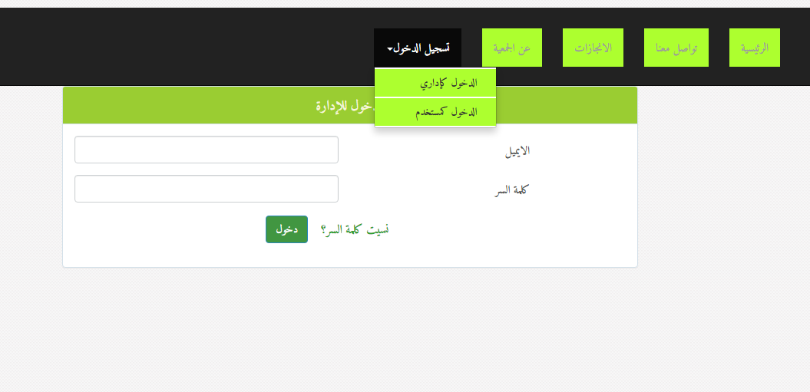
Multiple user Authentication system

Slide 13
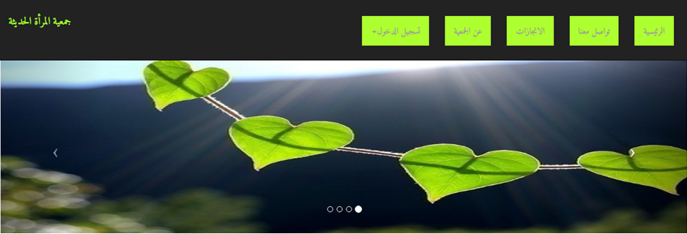
The pages for any person

Slide 14
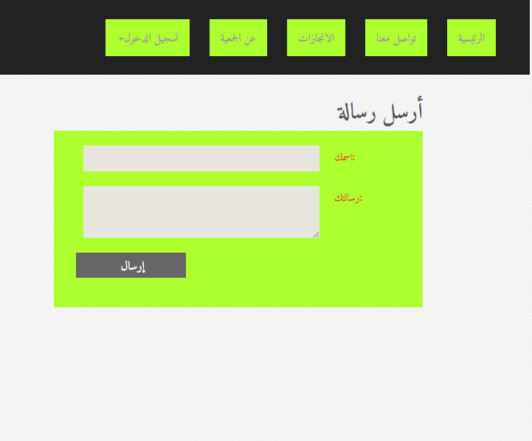
Anyone can send a suggestion to our website Admin by“تواصل معنا”

Slide 15
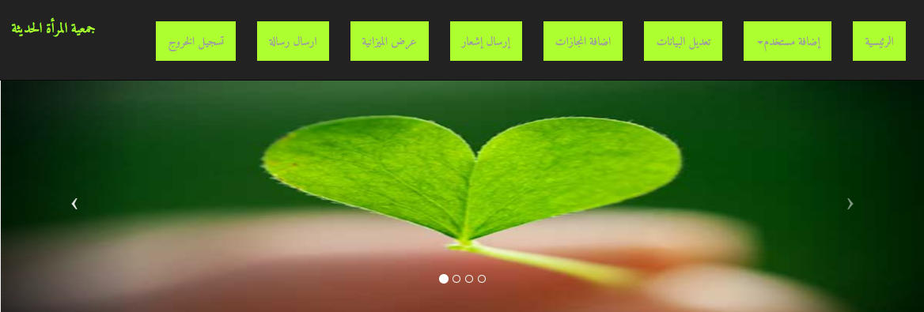
Admin pages:

Slide 16
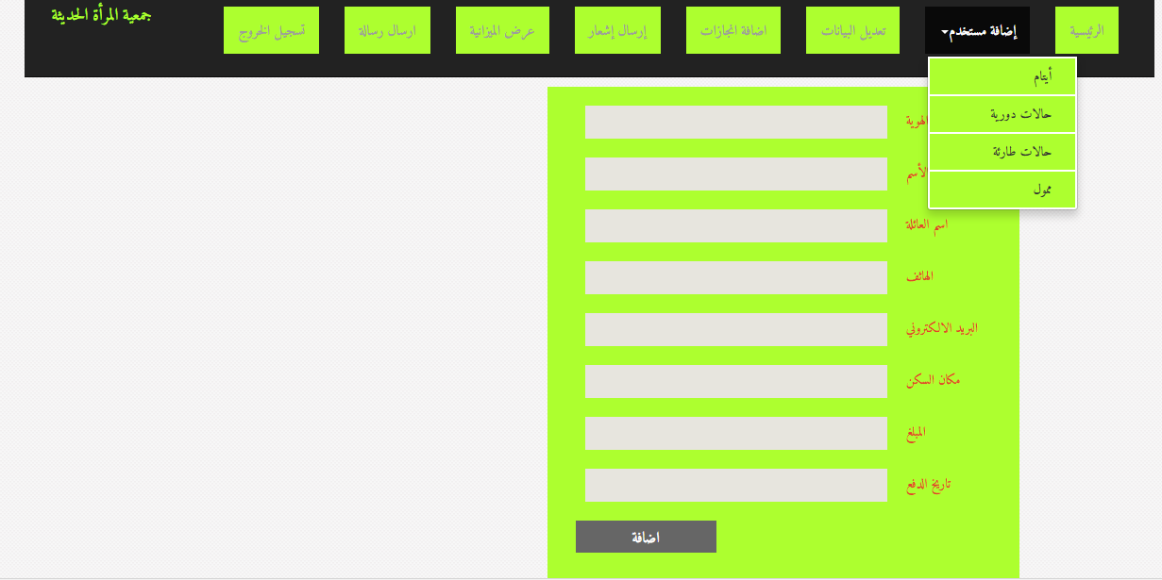
When admin add any user, Then he can use the information for authentication

Slide 17
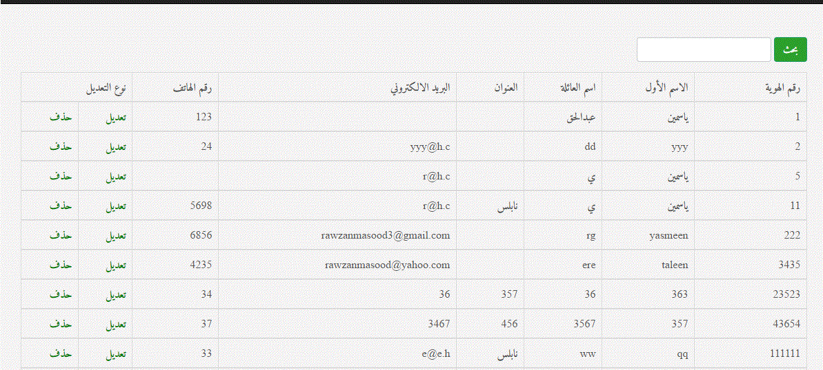
View users for update or delete

Slide 18
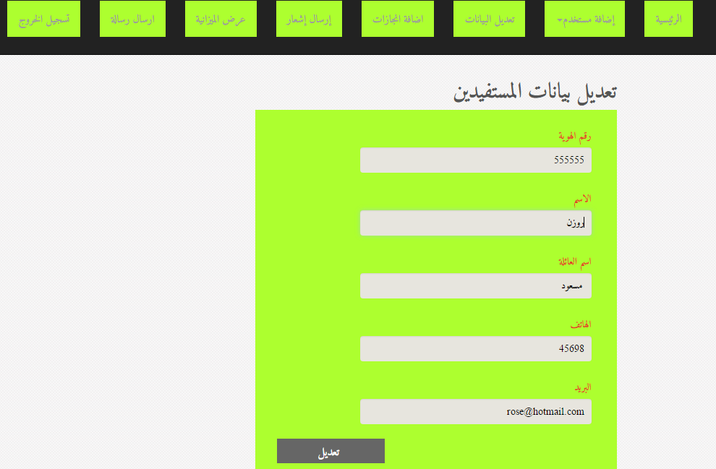
Update

Slide 19
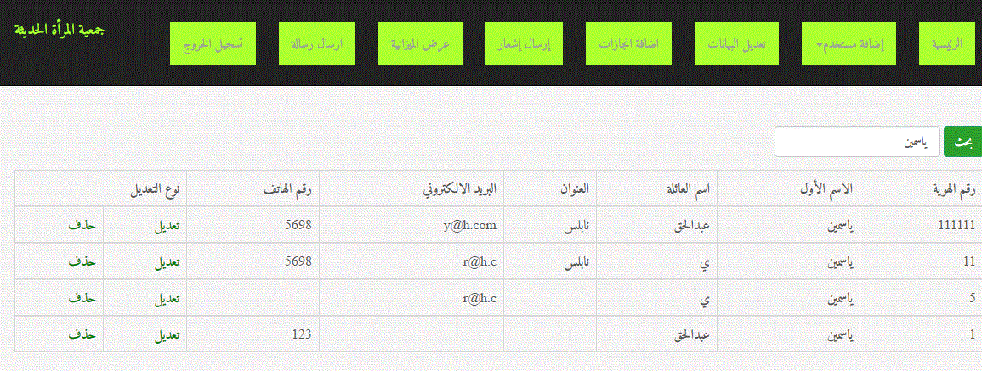
Search

Slide 20
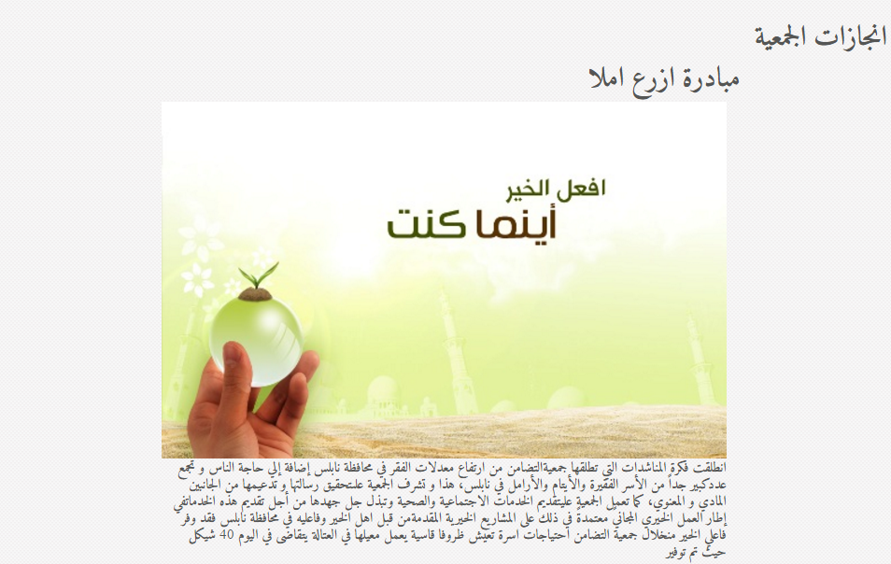
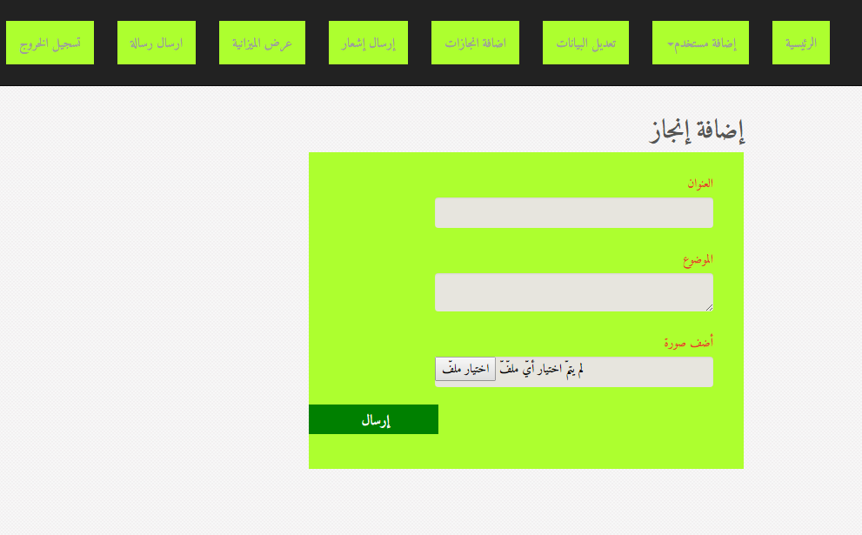
Add achievements
In admin page
In basic page and in user page

Slide 21
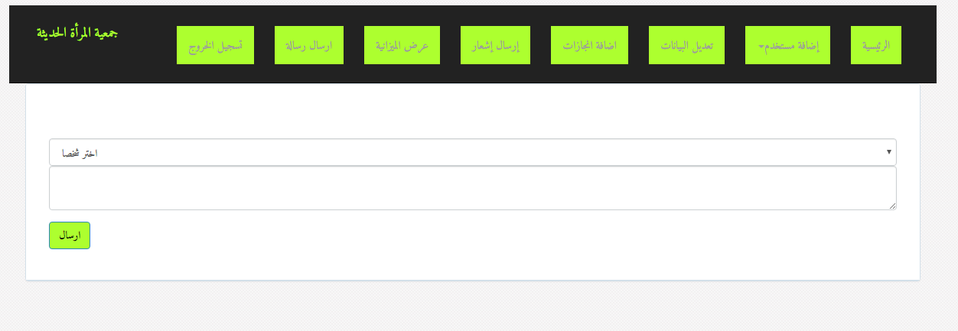
Send notification to users

Slide 22
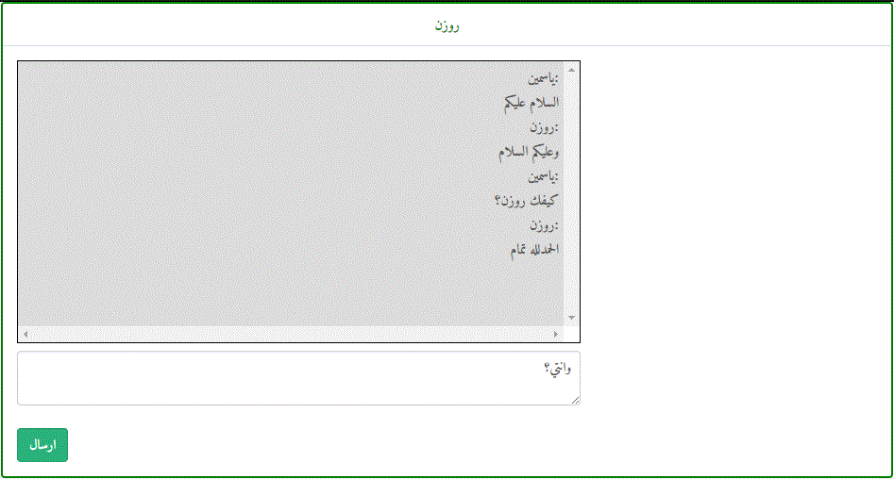
Real time chatting between employees

Slide 23
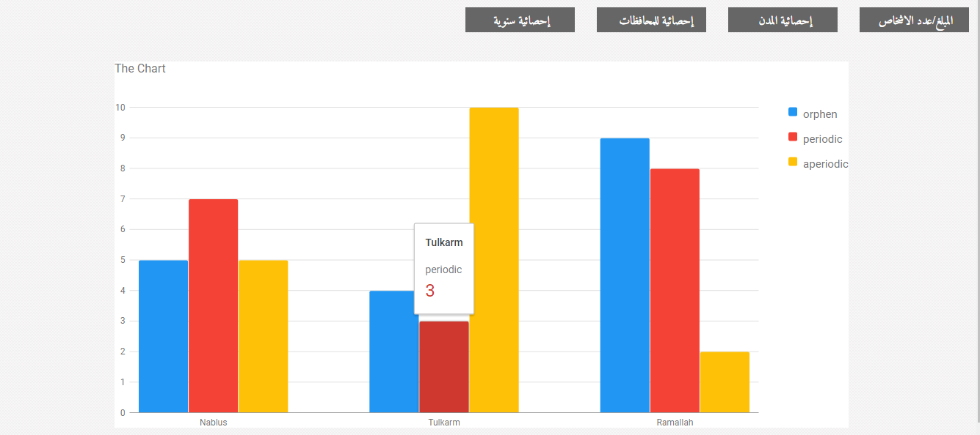
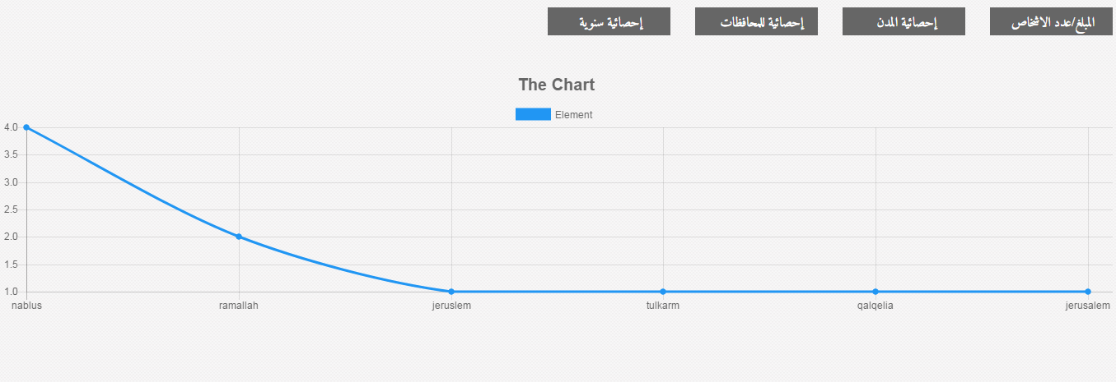
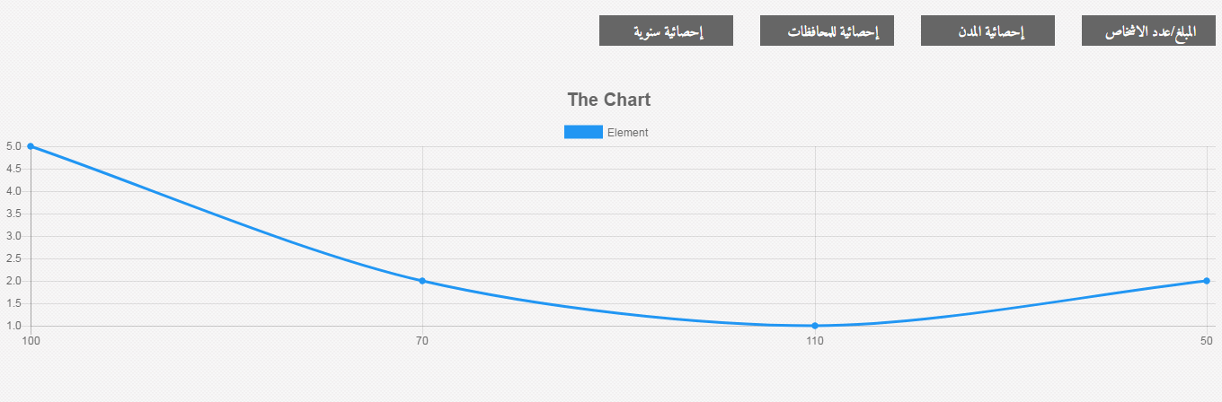
Show statistical charts

Slide 24
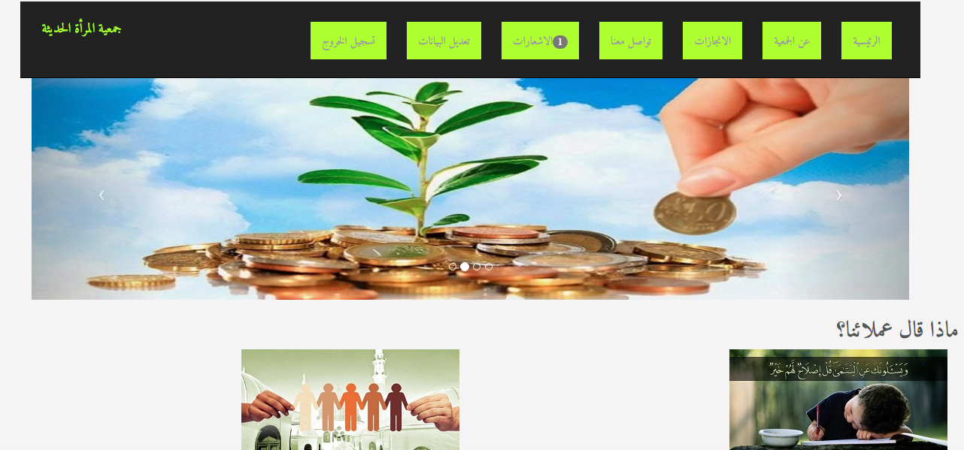
Beneficiaries Pages:

Slide 25
Show achievements

Slide 26
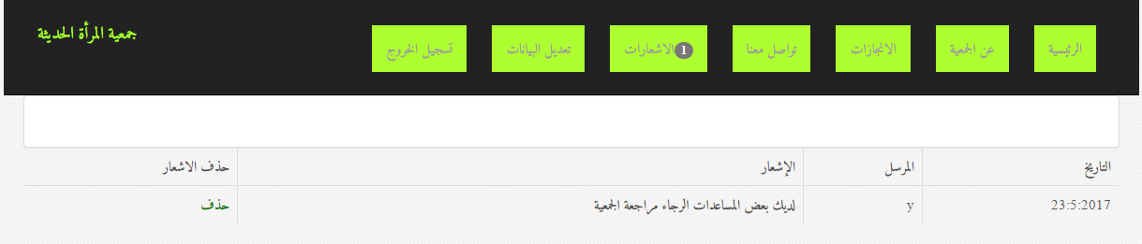
Show notifications

Slide 27
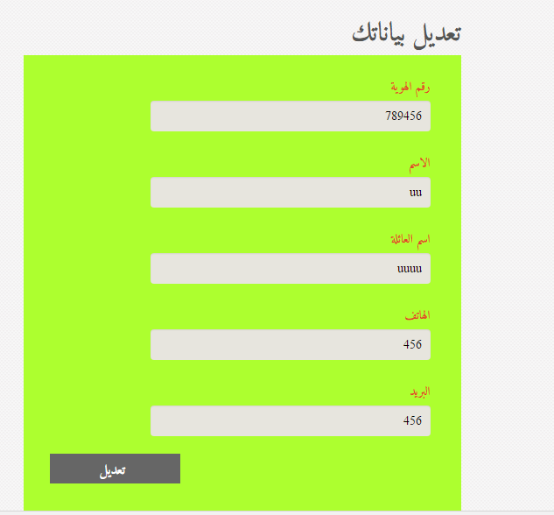
Update his information

Slide 28
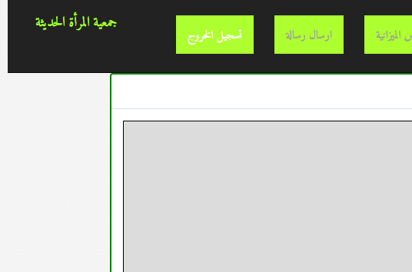
Finally log out for any user

Slide 29
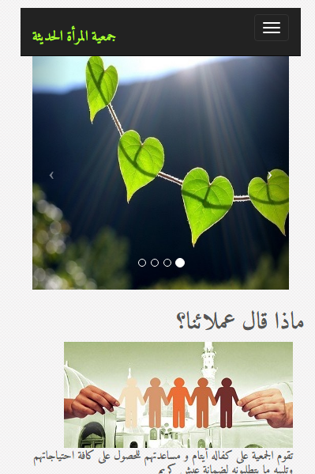
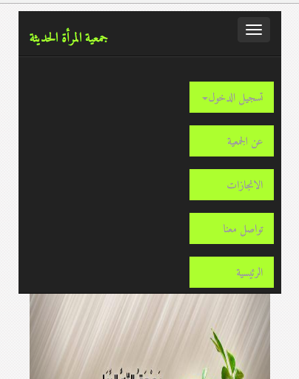
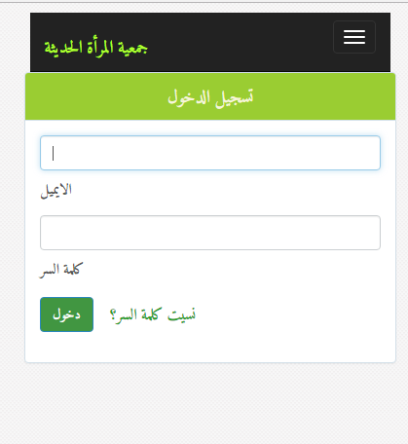
Responsive website for mobile views

Slide 30
Challenges:
First : choose the idea for graduation project.
Second: we don’t use any templet from internet.
Each detail done by our hand.
Third: Using Laravel with latest version and there was no enough tutorials.
Fourth : The Time .

Slide 31
Conclusion
Our project is an online website for Modern Women Association to facilities the communication between the association and beneficiaries and make the help become much easier for assistants and for anyone looking about place to proffer any service.
Admin can send notification for any beneficiaries if there was any new thing and get assistants in touch with the association and its employees.
This website was become the front door for the association. In addition, it will help the admin and employees to communicate with each other by using the real time chatting.

Slide 32
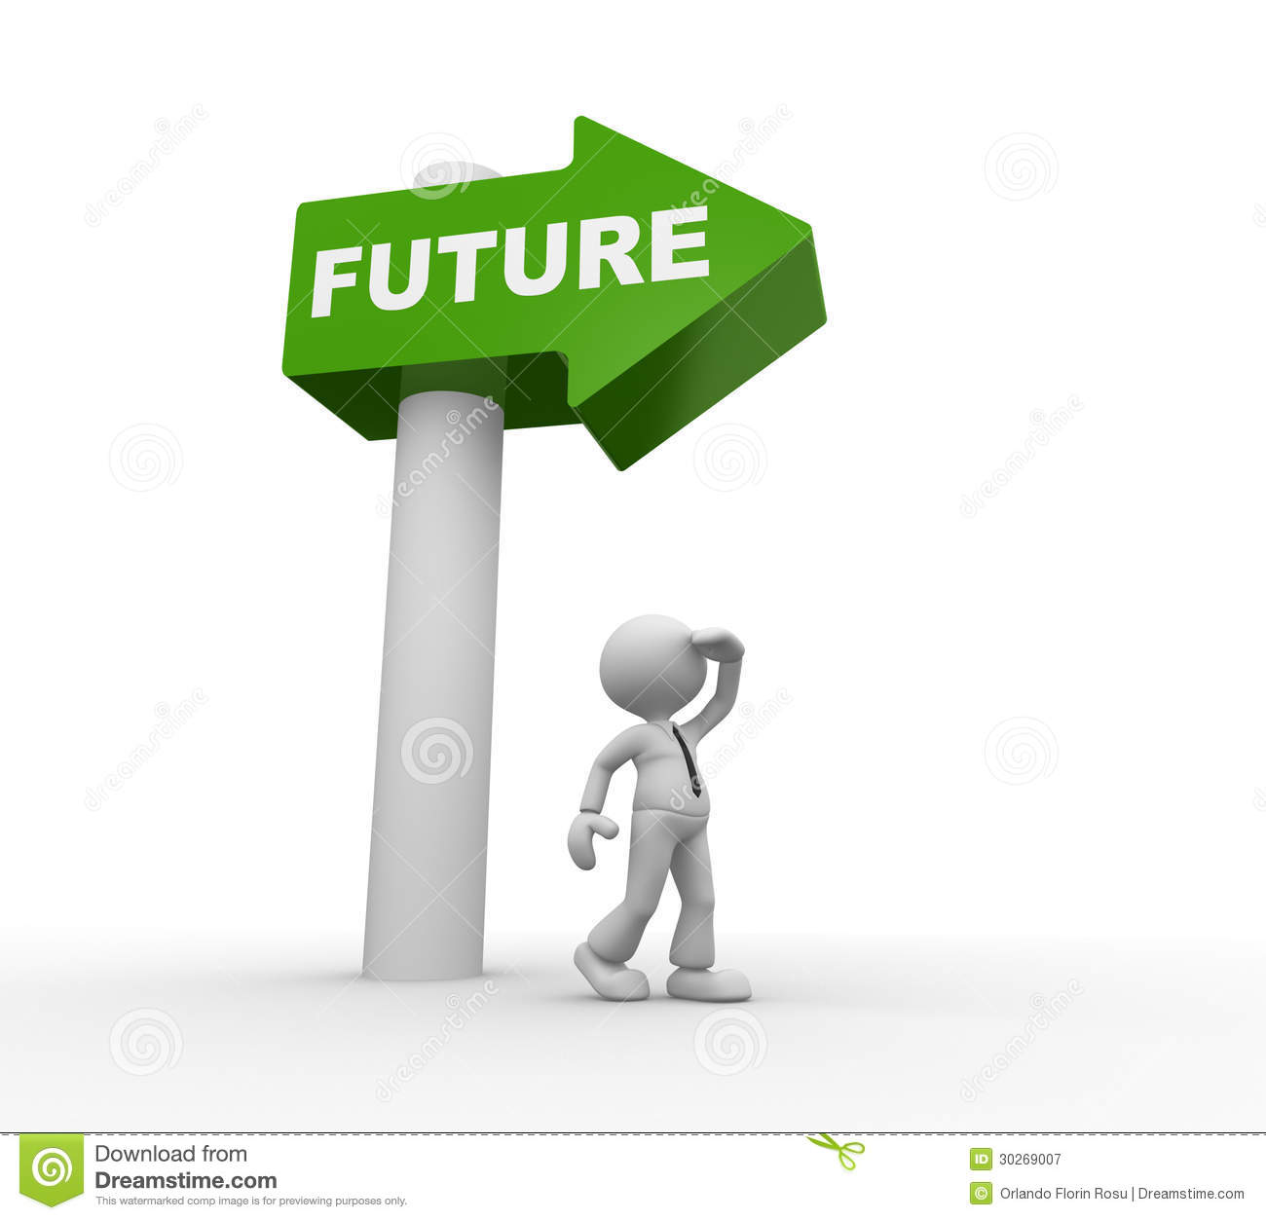
Future work:
Assistants can pay online by credited card or other way.
Making an Android application with more features like voice calls.

Slide 33


