Slide 1
Hey Taxi
Ethar Abu Sarah
Baidaa Al Bzoor
Dr. Luai Malhis

Slide 2
Outline:
What is “Hey Taxi”?
Objectives and main idea.
Programming used techniques.
application main activities and features.
Future work.

Slide 3
Objective:
The lack of transports , especially in universities , and other traffic places.
Assign the orders with the driver.

Slide 4
Programming techniques
Android Studio IDE
Google API
Microsoft Web Expression
Appserve web server

Slide 5
Main Activities:
Driver activity.
Customer activity.
Taxi Office.

Slide 6
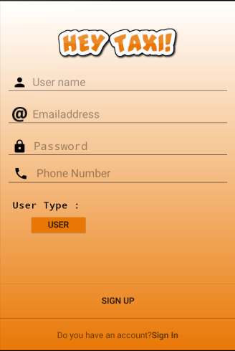
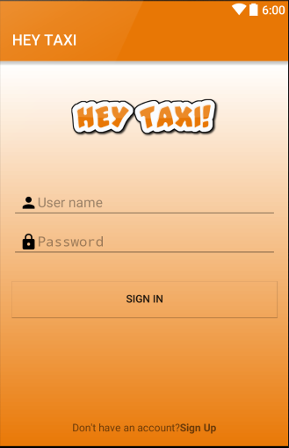
Client Side: Registration page
User Type
Registration
Login

Slide 7
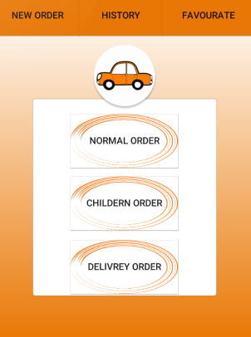
Main Page:
Normal Order (Shared/Not)
2. Delivery
3. Children

Slide 8
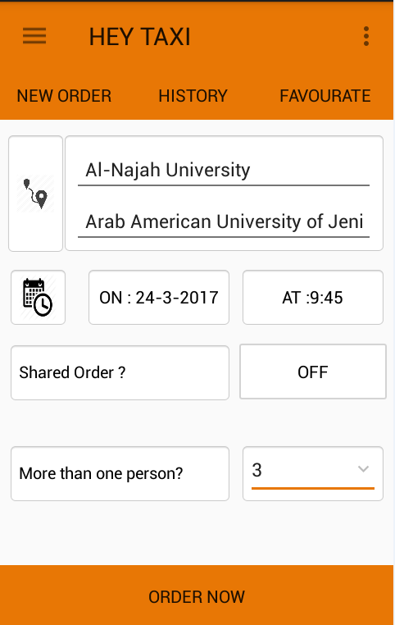
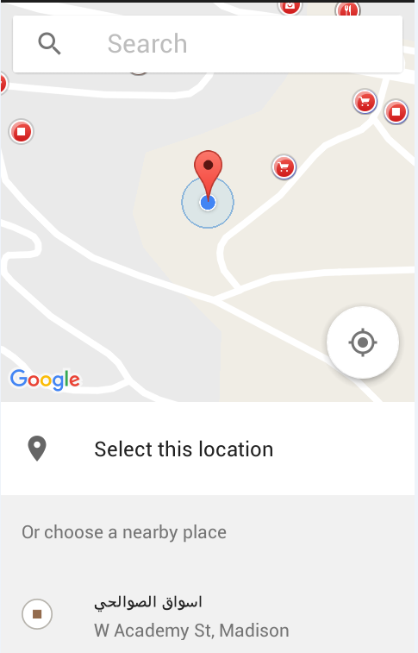
Normal Order:

Slide 9
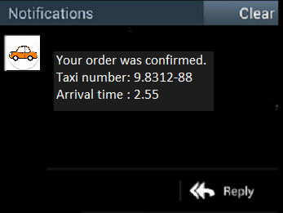
Notifications:
Customer

Slide 10
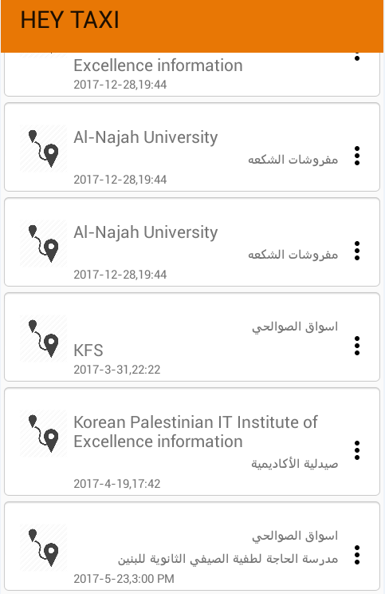
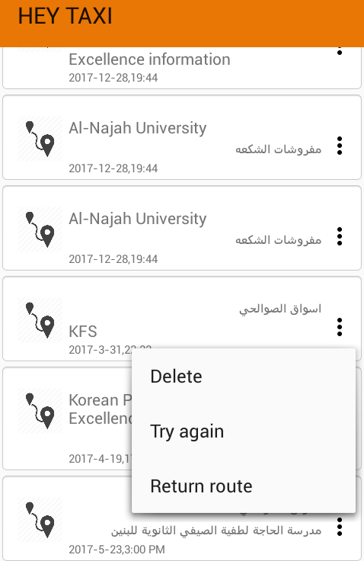
History:

Slide 11
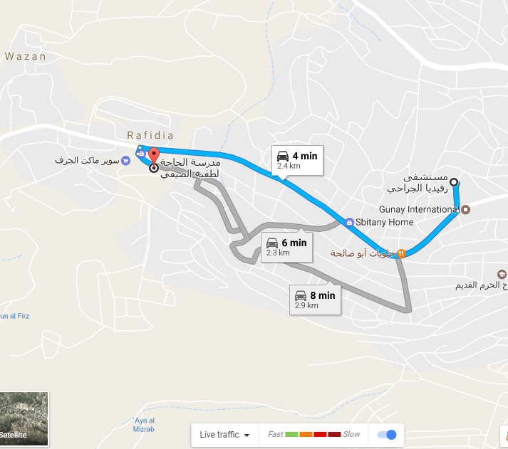
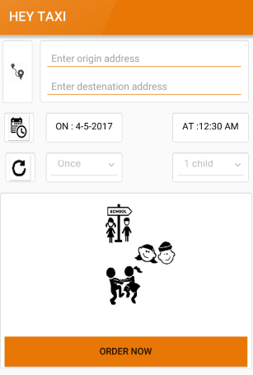
Children Order (Tracking)
Track the Order
Order

Slide 12
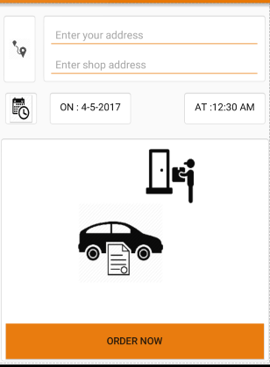
Delivery:

Slide 13
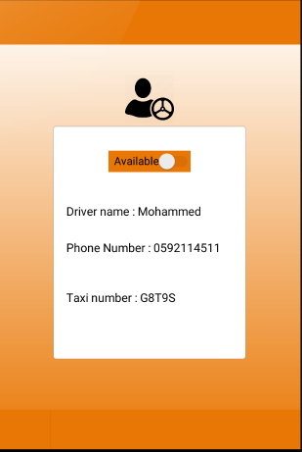
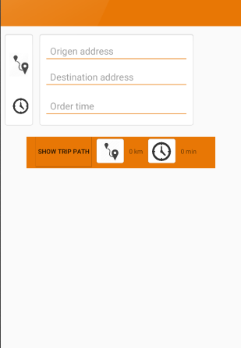
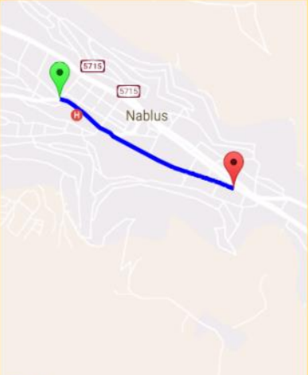
Driver Page:
(1) (2) (3)

Slide 14
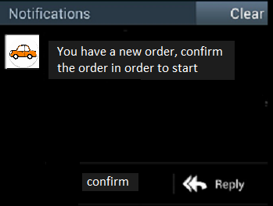
Notifications: Driver

Slide 15
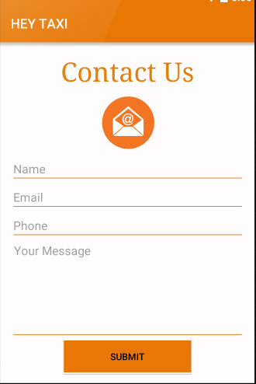
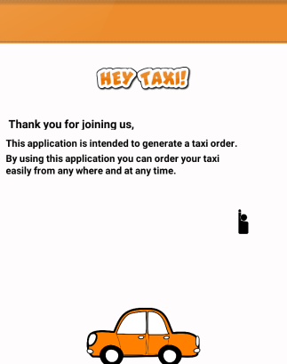
About /Contact (Us):
Contact Us
About Us

Slide 16
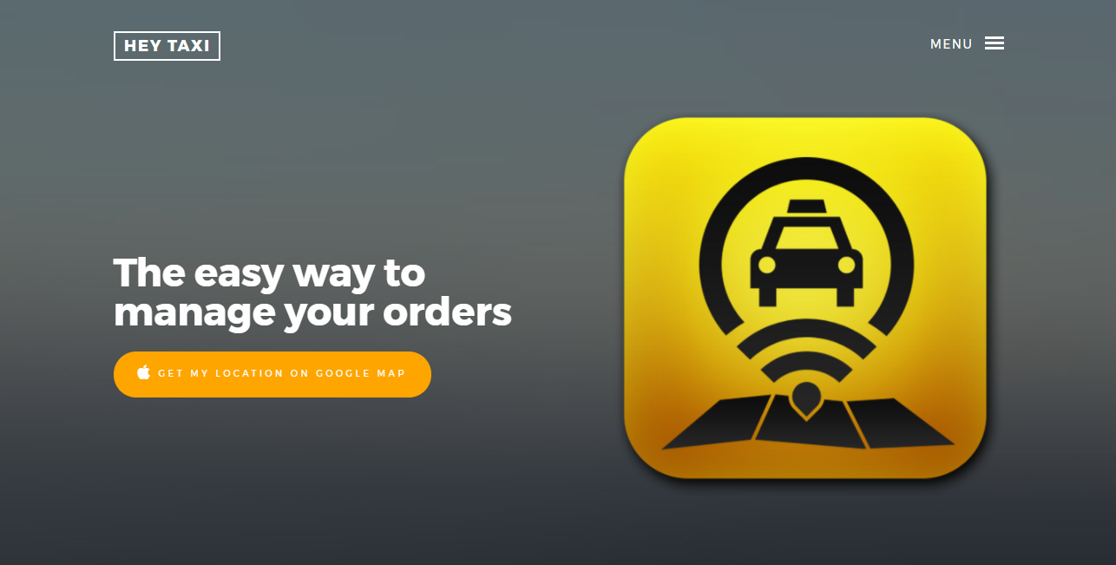
Web: (Taxi Office)

Slide 17
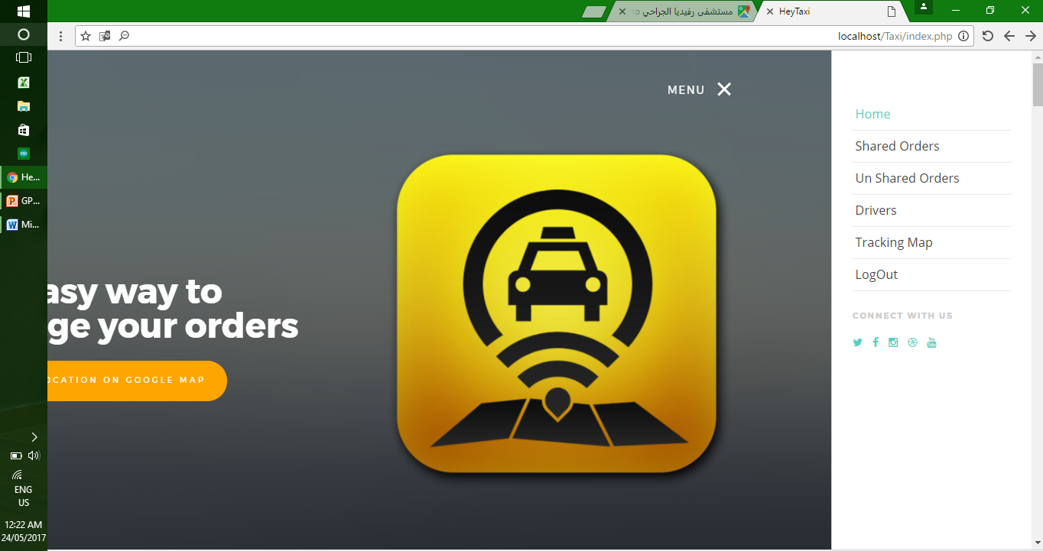
Web: Main Menu

Slide 18
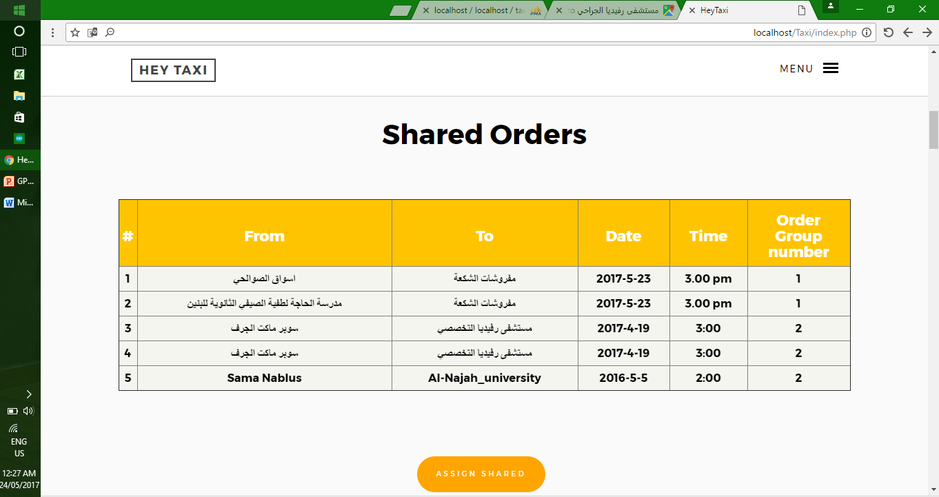
Shared Orders

Slide 19
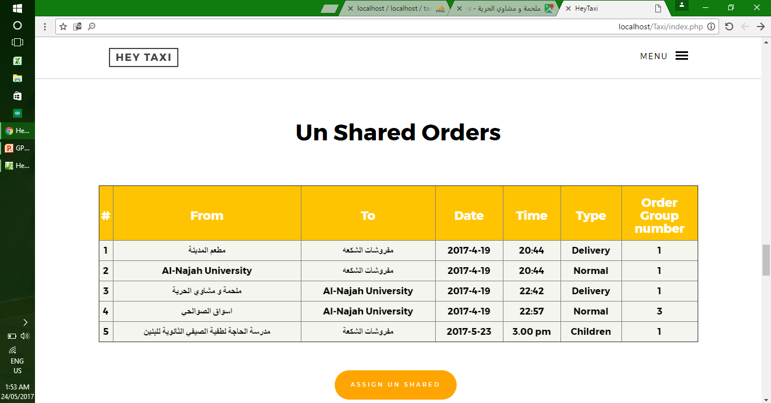
Un-Shared Orders:

Slide 20
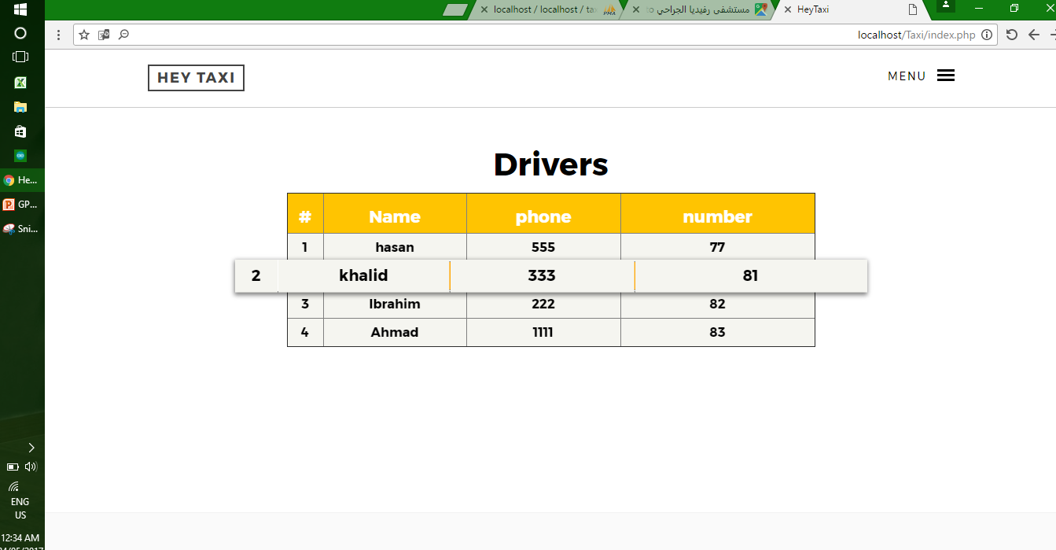
Drivers: (The available)

Slide 21
Demo ☺

