Slide 1

Medical Clinics Management System
Saeed Matar
&
Abdullah Lubbadeh
Supervised By
Dr. Sofian Samara
Medical Clinics Management System
Notes:
Perhaps we should begin.
Good afternoon, ladies and gentlemen. My name is Abdullah N L. On behalf of me and my friend Saeed O M, may I welcome you here this afternoon.
For those who don’t already know us. We are a 5th year computer engineering students.
Today we would like to present to you our work during the last four months working on Medical Clinic Management System.
Perhaps we can leave any questions you have until the end of the presentation.

Slide 2
What is a Clinics Management System?
Medical Clinics Management System
Notes:
In general , a Clinic Management System is computer software that coordinate and integrate all the inherent activities involved in the management and running of a healthcare facility. It must meet specified security, technology and functionality standards for managing electronic medical records and practice management information. Some systems maintain the complete Patient Information coupled with the Electronic Medical Records (EMR) and Medical billing.

Slide 3
Problems with conventional system
1. Lack of immediate retrievals
2. Lack of immediate information storage
3. Lack of prompt updating
4. Error prone manual calculation
5. Preparation of accurate and prompt reports
Medical Clinics Management System
Notes:
Problems with conventional system
Lack of immediate retrievals: -
The information is very difficult to retrieve
2. Lack of immediate information storage: -
The information generated by various transactions takes time and efforts to be stored at right place.
3. Lack of prompt updating: -
Various changes to information like patient details are difficult to make as paper work is involved.
4. Error prone manual calculation: -
Manual calculations are error prone and take a lot of time which may result in incorrect information.
5. Preparation of accurate and prompt reports: -
becomes a difficult task as information is difficult to collect from various registers

Slide 4
Alternative Solutions
Improved Manual System.
Batch System.
Online System.
Medical Clinics Management System
Notes:
1. Improved Manual System:-
One of the alternative solutions is the improvement of the manual system. Anything, which can be done by using automated methods, can be done manually. But the question arises how to perform things manually in a sound manner. Following are some suggestions, which can be useful in the manual system. o A more sophisticate register maintenance for various Patient Information, Doctor diary, Immunization Details and a good system for writing bill amount employees and stock availed for the customers can be maintained at central place. o Adequate staff may be maintained so that updates are made at the very moment at the same time. Proper person for proper work should be made responsible so that a better efficiency could be achieved. This needs a lot of work force.
2. Batch System:-
Another alternative solution can be used of computer based batch system for maintaining the information regarding purchase details, customers and employees. A batch system refers to a system in which data is processed in a periodical basis.
The batch system is able to achieve most of the goals and sub goals. But a batch system data is processed in sequential basis. Therefore batch system is not suggested.
3. Online System:-
This system (CMS) provides online storage/updates and retrieval facility. This system promises very less or no paper work and also provides help to Doctor and operational staff.
In this system everything is stored electronically so very less amount of paper work is required and information can be retrieved very easily without searching here and there into registers. This system is been discussed here.

Slide 5

Our System!
Medical Clinics Management System
Notes:
Our system,
MCMS [Medical Clinics Management System] is Web-Services based Clinics Information Management System. It’s an ERP [Enterprise Resource Planning] suite of software modules to computerize any large scale Clinic and its connected branches. It is fully online, it could be used as a web based software, mobile or even desktop application. The information is available anytime, anywhere. There are plenty of exhaustive modules, which make the software User friendly, highly versatile, Quick installable, Completely Database driven, and Centralized Database Clinic Information Management System.
It can be used in any Polyclinics, single Clinic or Dispensary for maintaining patient details and their test results.

Slide 6
Research
Information Gathering Perspective.
Technical Perspective.
Notes:
This stage was among the longest stage in our project, as all the system and Database design would be built upon it.
Research stage can be divided into 2 main perspectives.
As we won’t “reinvent the wheel”, researches for previous related system were done, meetings were held, and various information gathering techniques were used.
Al-Arabi Hospital
• Rafeedia
• Health Ministry
• Individual clinics like Dental Clinics
• Individual meetings with doctors and other staff in health care
• Accounting and billing systems Specialist, in order to build a complete ERP system that includes all the accounting and billing information needed.
We were looking for frameworks and tech. that would meet out requirements.

Slide 7
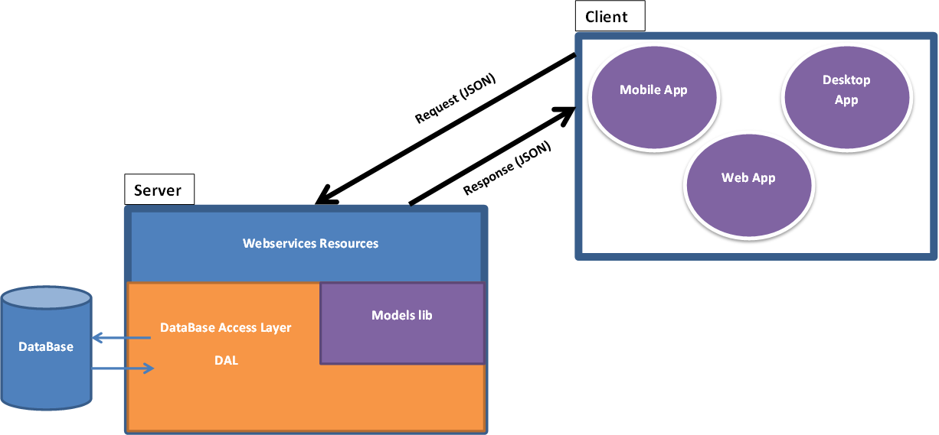
Project Architecture
Medical Clinics Management System
Notes:
Here we can see the three tire Architecture. CLIENT SERVER DATABASE.
WebServices Server listens for http requests and the message is a json format in the body of the request.
The message is JSON which means no matter from where the server got it. So we can see mobile , desktop , and web clients.
Restlet webservices resources gets the request. Handles the request and pass it to data access layer to get the requested functionality.
Data Access Layer makes queries to data base server and get the response and pass it to webservices to back the response to CLIENT.

Slide 8
How We Build the Project
Using Maven.
Maven is an Apache project.
Project management tool.
  Build tool.
  Project lifecycle.
  Set of standards.
  Dependency management system.
Maven has a repository system which makes dealing with frameworks and libraries much easier.
Medical Clinics Management System
Notes:
We build the project using maven.
What is maven??
Maven is an Apache project.
It is Project Management tool.
We build the project structure using maven.
And through maven Determined the project lifecycle and dependencies of Our Project modules.

Slide 9
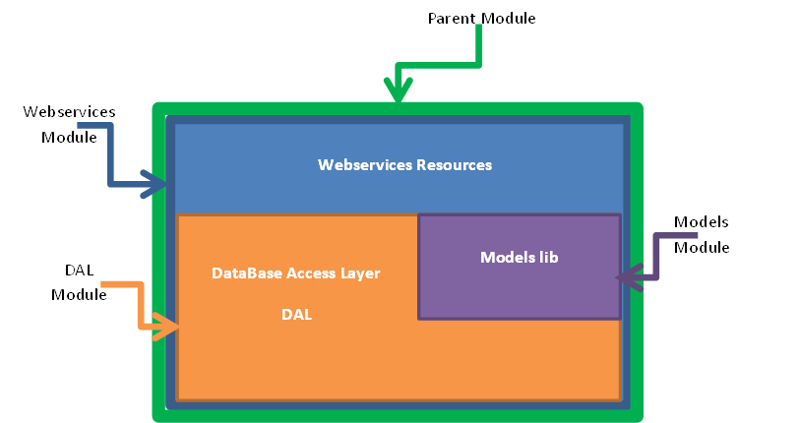
How We Build the Project
Multi-module Enterprise Project.
  Parent Project Module.
  Webservices Application Module.
  Model Module.
  Data Access Layer Module.
Medical Clinics Management System
Notes:
We build our Project to be Multi-module Enterprise Project.
First we build the Parent Project Module which represents the container of all modules.
Then we build the Webservices Application module inside the parent module.
Then we build the Models Modules which contains our Project Models inside the parent module.
Then Data Access Layer Module which is responsible for dealing with Database Server inside the parent module.

Slide 10
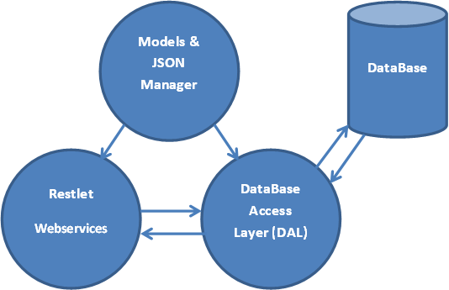
How We Build the Project
Project Modules Dependency and Interaction
Medical Clinics Management System
Notes:
Here is a graph shows our Project modules dependencies and interaction.
Here we can see webservices and data access layer both are have models lib.
And webservices and database interact with each other.
And Database server is accessed only from data base access layer.

Slide 11
Webservices
What is Webservices?
The W3C defines a "Web service" as:
  "a software system designed to support interoperable machine-to-machine interaction over a network".
We used open source project Restlet to build our Webservices server.
A restlet webservices implemented using HTTP and the principles of REST.
We used Restlet integrated with Spring to get benefits from the two frameworks.
Medical Clinics Management System

Slide 12
Webservices
Spring Framework
ContextLoaderListener
  Is a Listener Listens for Requests.
  Like http://clinics.com/login.
SpringBeanRouter.
  Routs the Requests to its proper resources.
The implementation of these functionality is Done by XML.
Medical Clinics Management System
Notes:
Spring Framework have two main parts:
First ContextLoaderListener
The second is SpringBeanRouter
And we know XML makes configuration and implementation much easier.

Slide 13
Webservices
Restlet Framework
Restlet ServerResources handles the requests for each HTTP methods(GET, POST, PUT, DELETE).
@Get
public String getMethodTest() {
//do some actions
return response;
}
@Post
public String postMethodTest(Representation representation) {
String postBody = representation.getText();
//do some actions
return response;
}
Medical Clinics Management System

Slide 14
Models and JSON
Models consist of application data and business rules.
JavaScript Object Notation (JSON).
Why JSON??
  Lightweight text-data interchange format.
  language independent.
  Message size is smaller than XML.
We used Jackson framework.
  For marshaling and unmarshaling Models.
Memory
JackSON
{
"employees": [
{ "firstName":"John"},
{ "firstName":"Anna"},
{ "firstName":"Peter"}
]
}
Object
Medical Clinics Management System
Notes:
marshaling is the process of transforming the memory representation of an object to a data format suitable for storage or transmission.
Unmarshaling is the reverse operation.
In our case the format is JSON and this is what Jackson Framework do.

Slide 15
Database
ER Model
Relational Model
Normalization of relations
Implementation in a DBMS
Programming of Web Services
Notes:
A big and an important part of this project is the process of designing and creating a relational database web services. This process includes development of an ER model, transfer to the relational model, normalization of relations, implementation in a DBMS, and programming of web services providing user interaction with the database. PostgreSQL used as the DBMS and Java as the programming language.

Slide 16
Postgres Database
PostgreSQL is a much more mature free product! They said it is Oracle free source.
Data Access Layer (DAL) access our Database.
We implement DAL module using Spring framework.
We used three main parts of Spring for database:
  JDBCTemplate handle queries on Database.
  Transaction Manager provide an “all-or-nothing” access specially in insert query.
  RowMapper mapping the response of queries to our models.
Medical Clinics Management System
Notes:
A good thing to mention here is that Our database is running on a Linux machine.
JDBCTemplate handle queries on DataBase.
Transaction Manager provide an “all-or-nothing”

Slide 17
Raw Mapper
Query
Result Set
Memory
Raw Mapper
DB
Object
Object

Slide 18
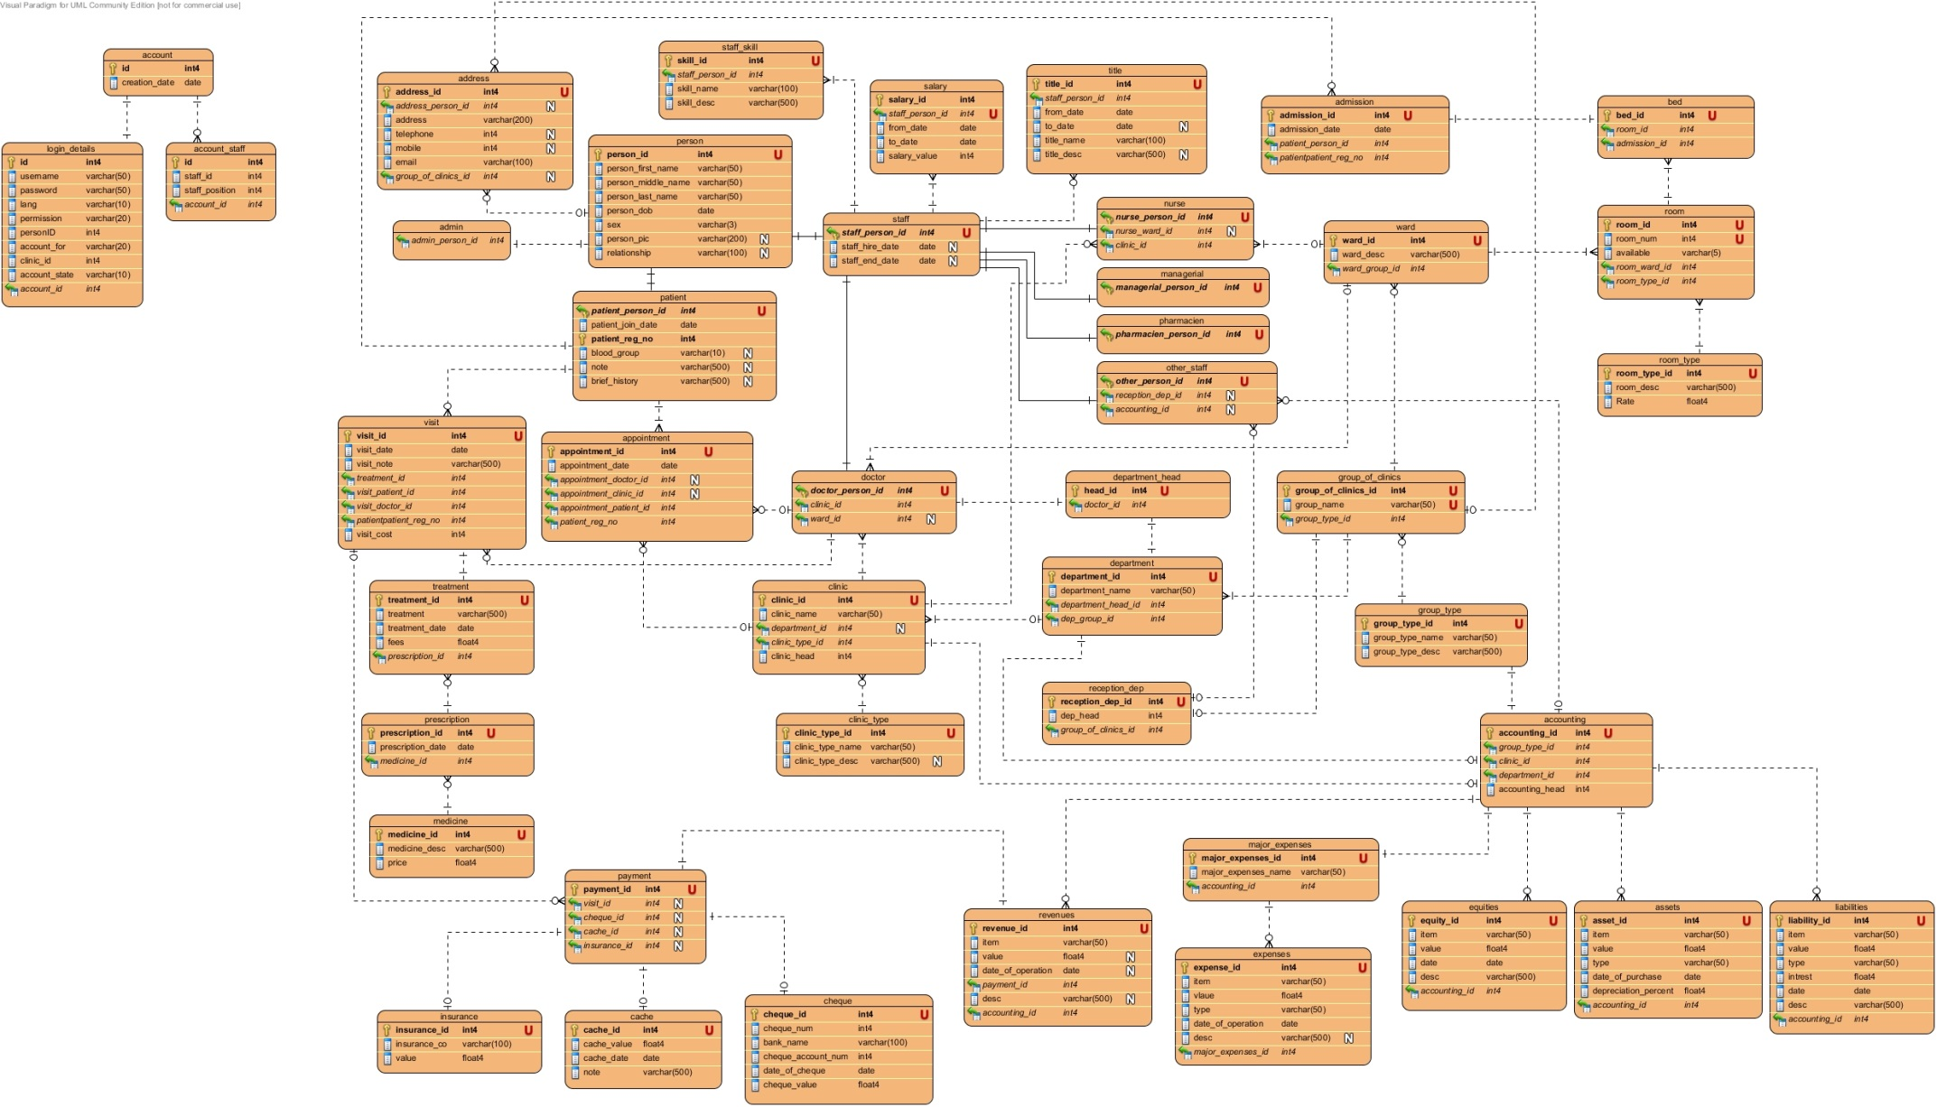
Schema
Medical Clinics Management System

Slide 19
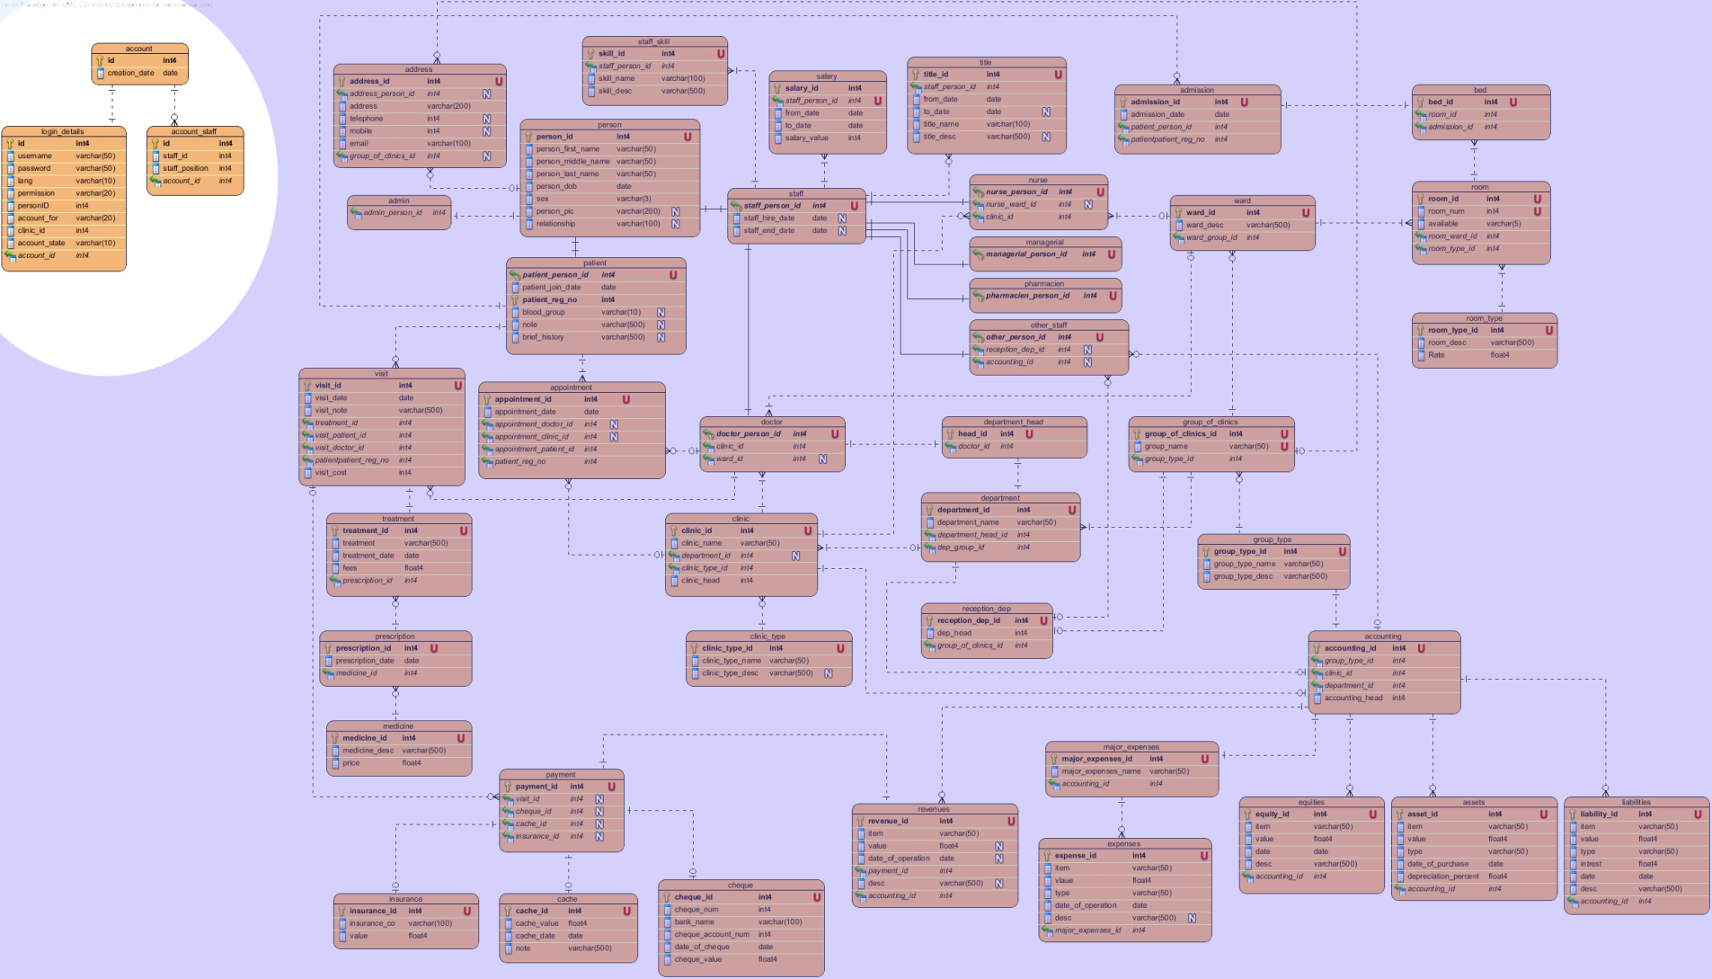
ACCOUNTS DETAILS
Medical Clinics Management System

Slide 20
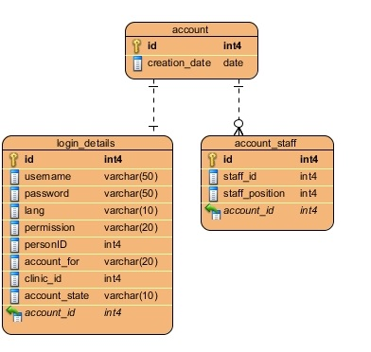
Account Details
Notes:
ACCOUNTS DETAILS
This part of scheme is specialized for user accounts and their login information. We construct this part to be separate from the rest of the database scheme, with no relations between its tables and the rest of the scheme table, in order to keep the login information secure, and make it easily customizable and easily change in case of changing the security policy or upgrading it.

Slide 21
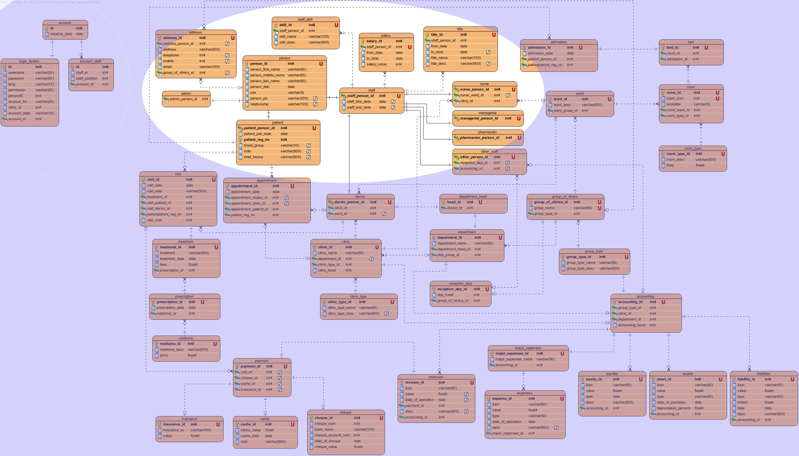
PERSONAL INFO AND USERS DETAILS
Medical Clinics Management System

Slide 22
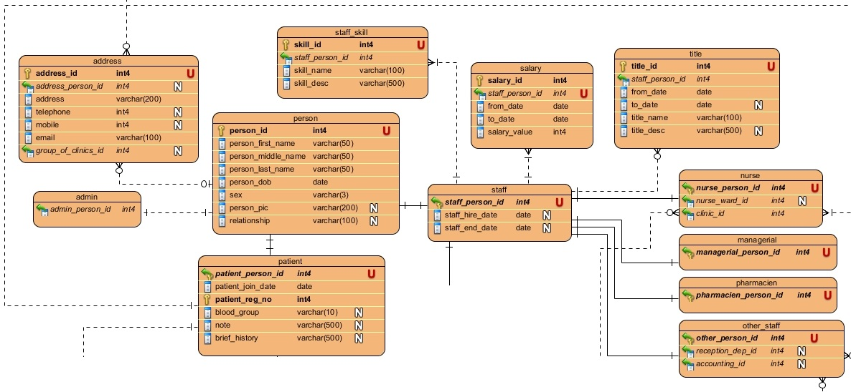
PERSONAL INFO AND USERS DETAILS
Notes:
This part contains the user characteristics and information [contacts, addresses, skills and others]. We use these tables mainly to collect information about system users, which would make search queries done easily. Moreover, these tables basically would be filled on the creation of the user, like on the signing up stage (e.g. Doctor) or by filling information (e.g. Patient).

Slide 23
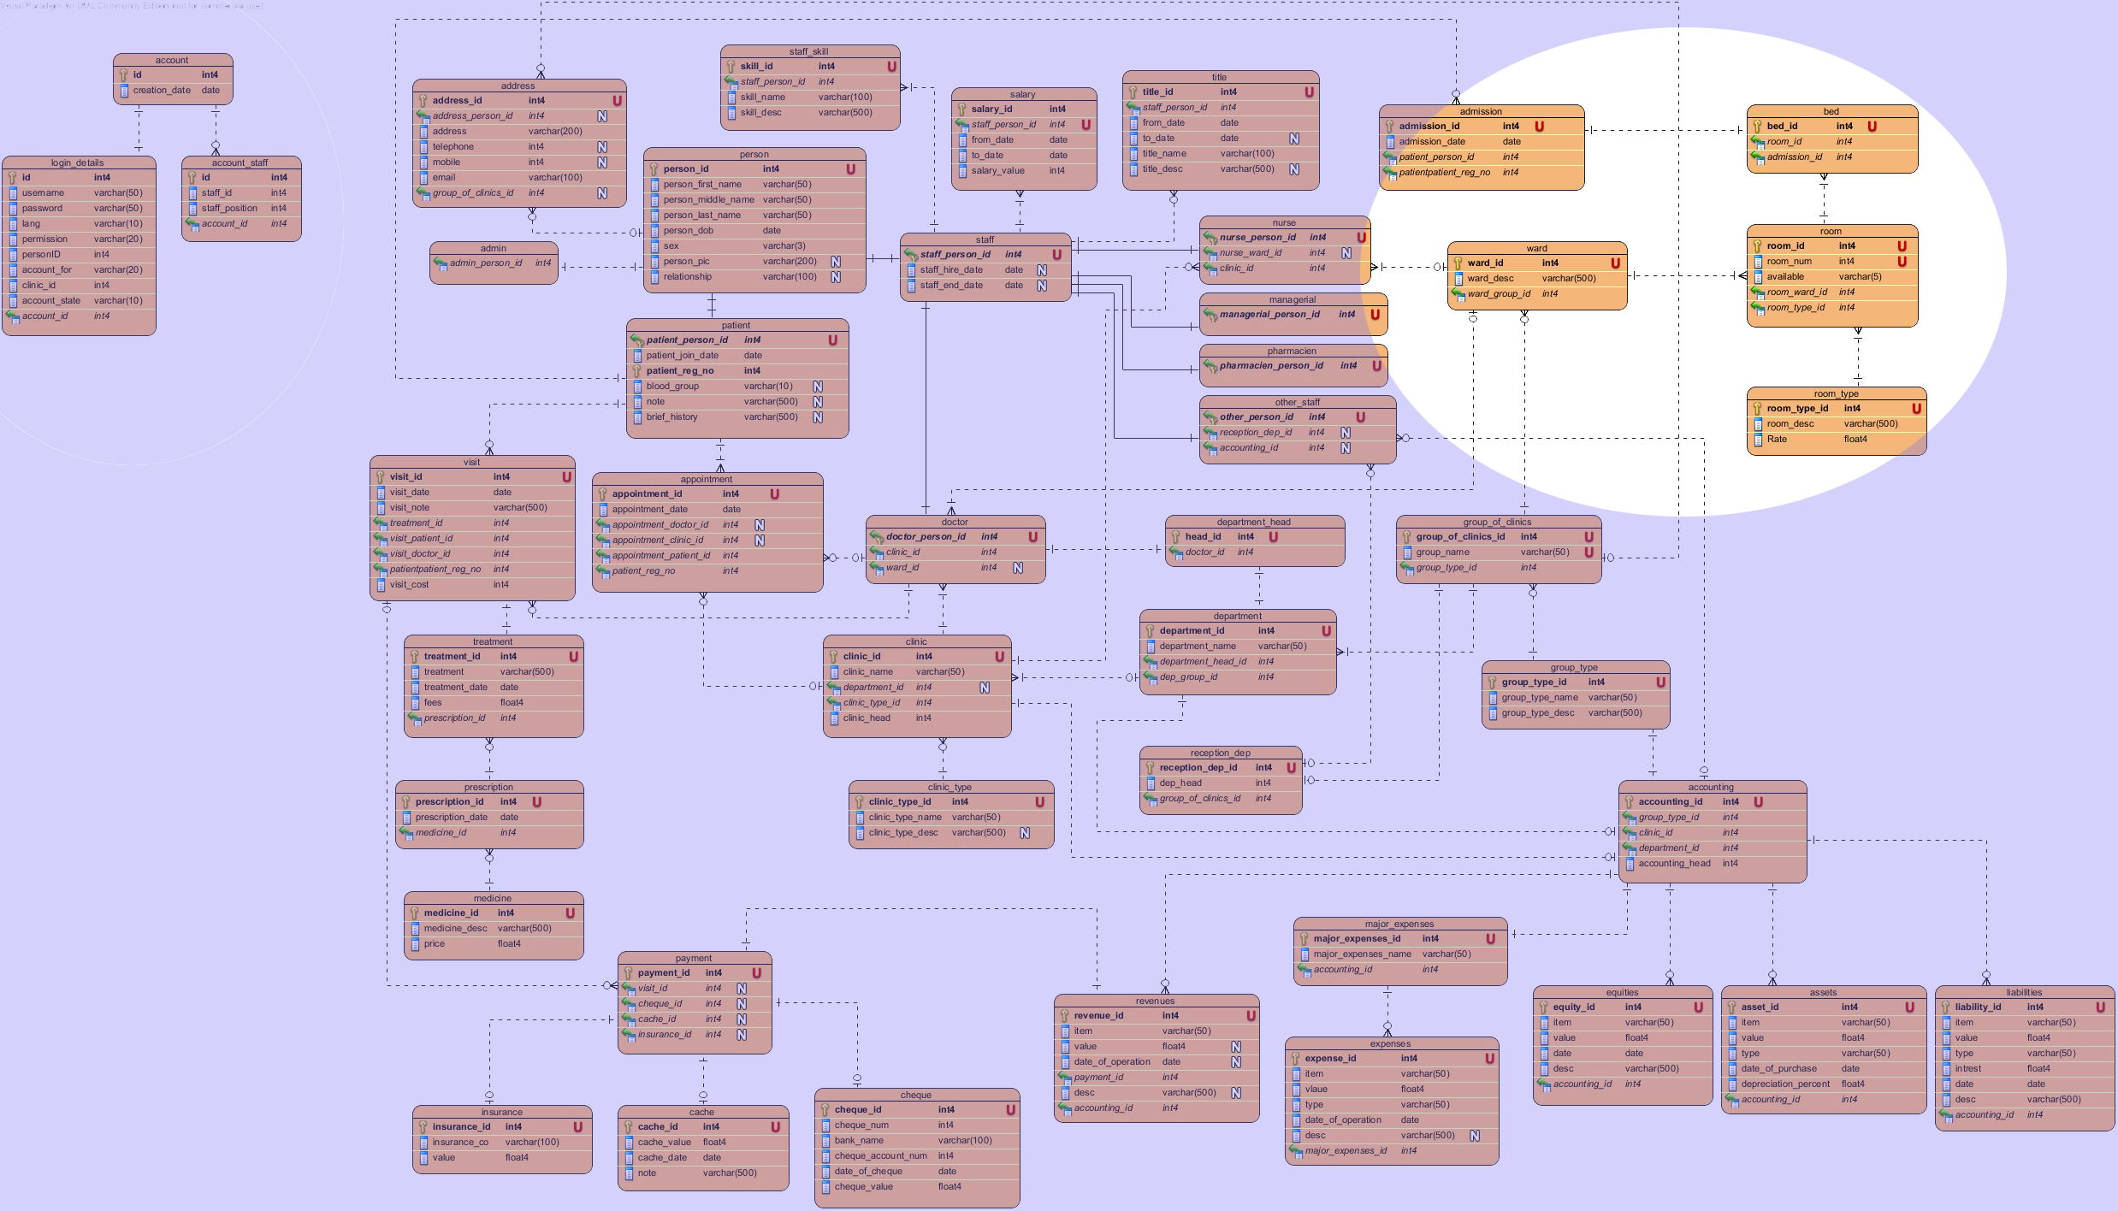
CLINIC ADMISSION AND ORGANIZATION
Medical Clinics Management System

Slide 24
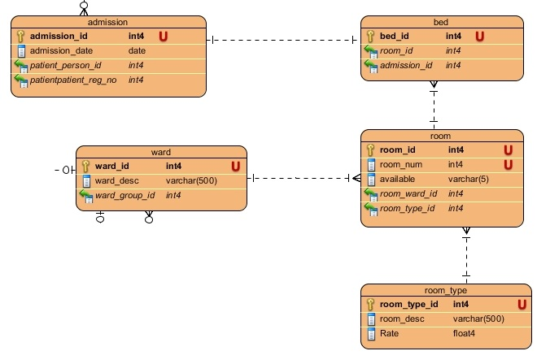
CLINIC ADMISSION
Notes:
This part of scheme would contain all the information that is needed to control the clinic/polyclinic and its facilities. All the wards, rooms, beds related issues are included. Furthermore, clinic information and head of that department are parts of this section.

Slide 25
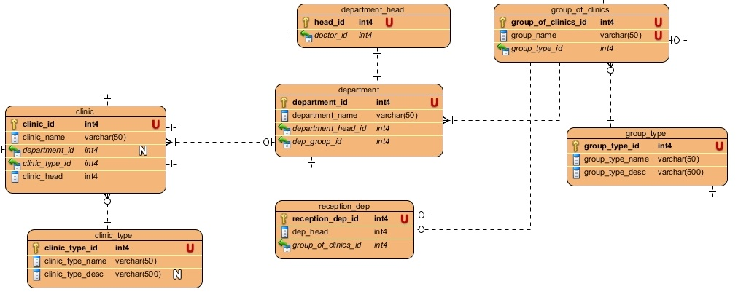
Clinic Organization

Slide 26
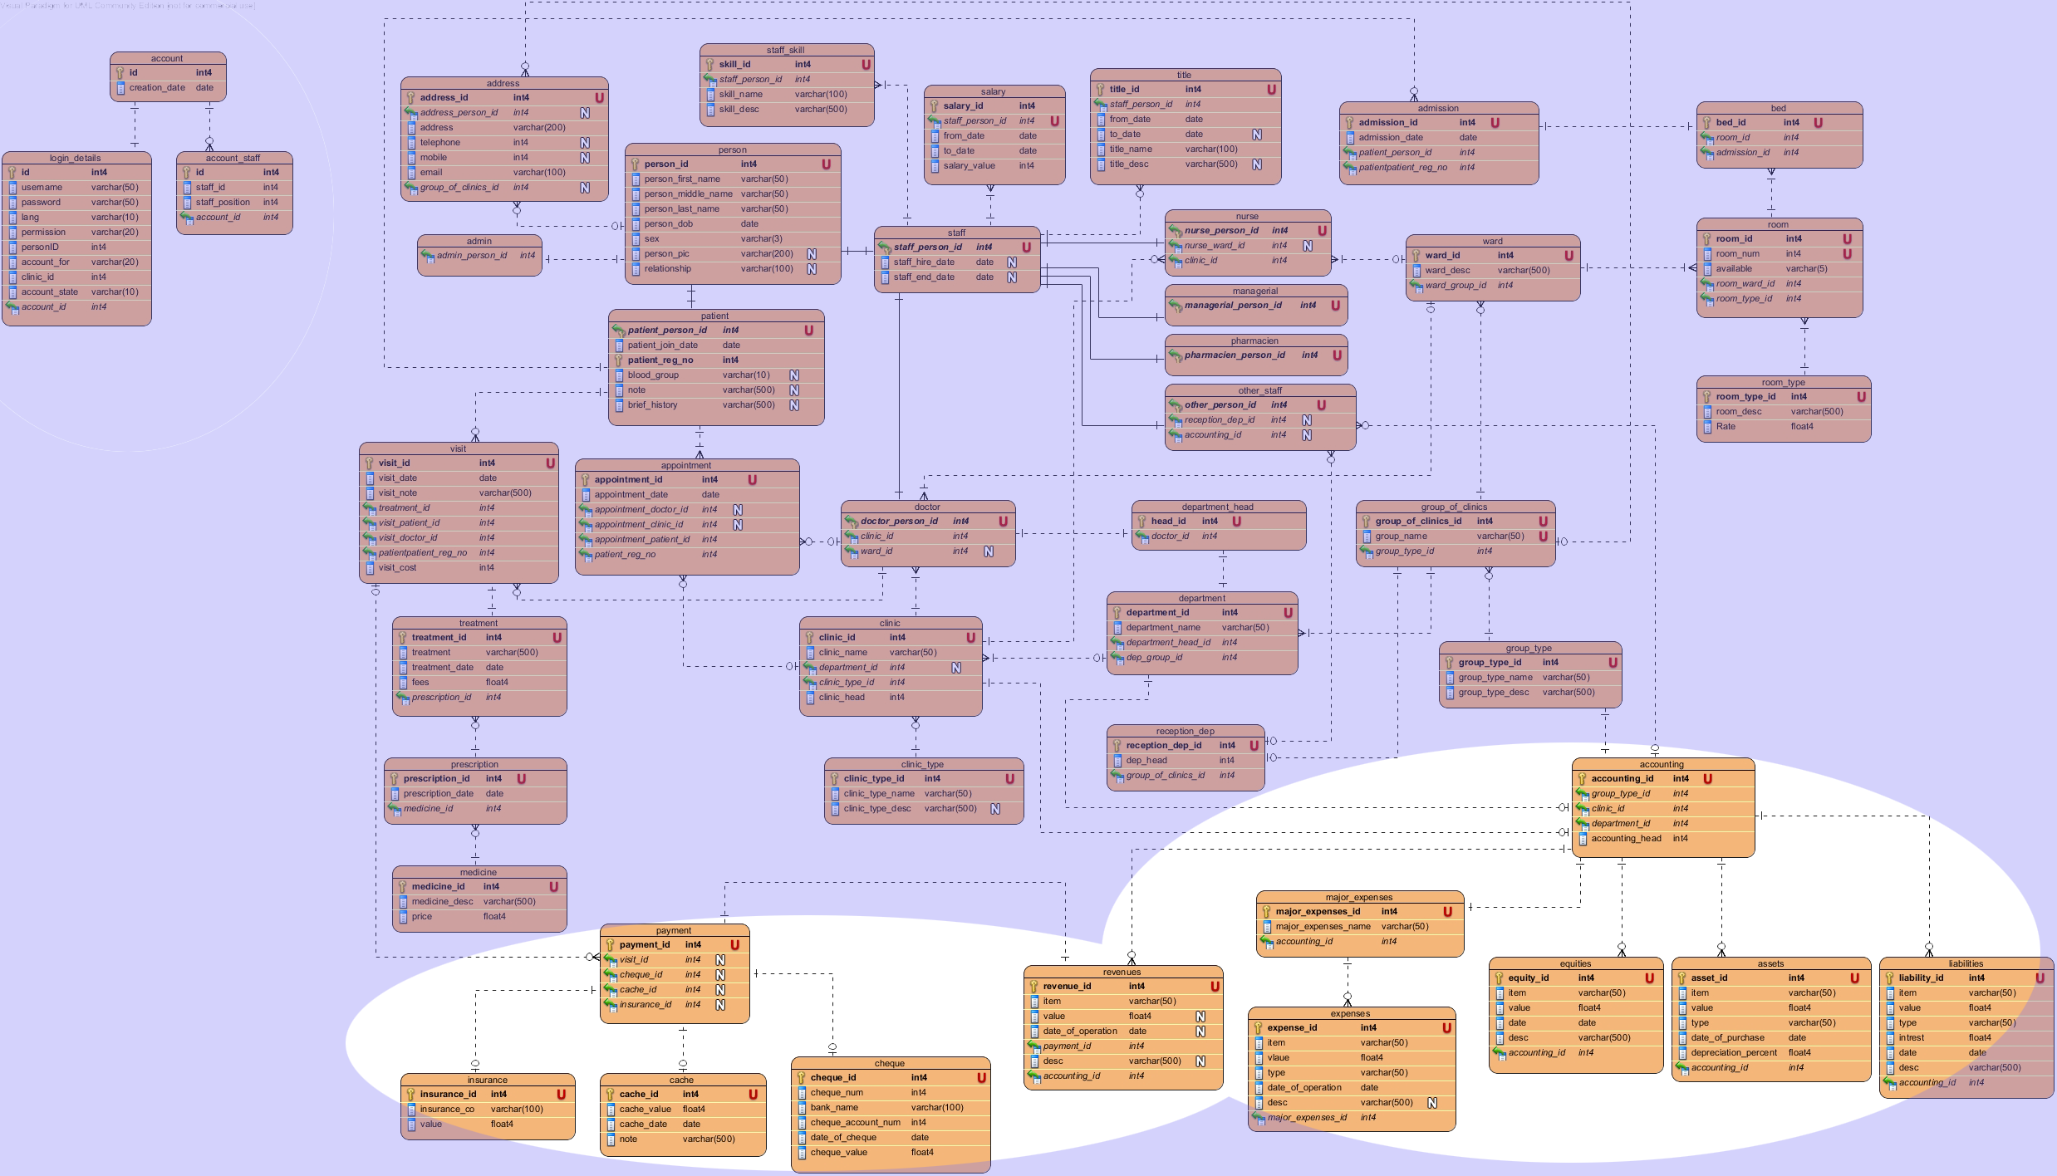
PATIENT BILLING and ACCOUNTING
Medical Clinics Management System

Slide 27
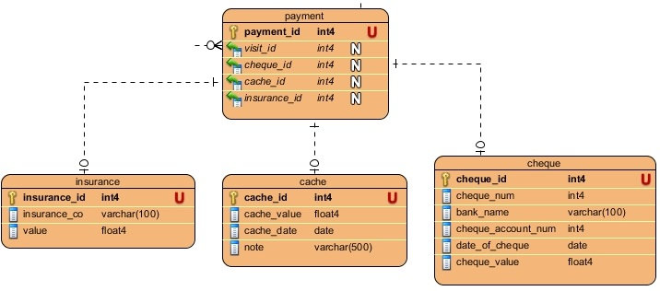
PATIENT BILLING
Notes:
This section contains the various payment methods that our system can accept.

Slide 28
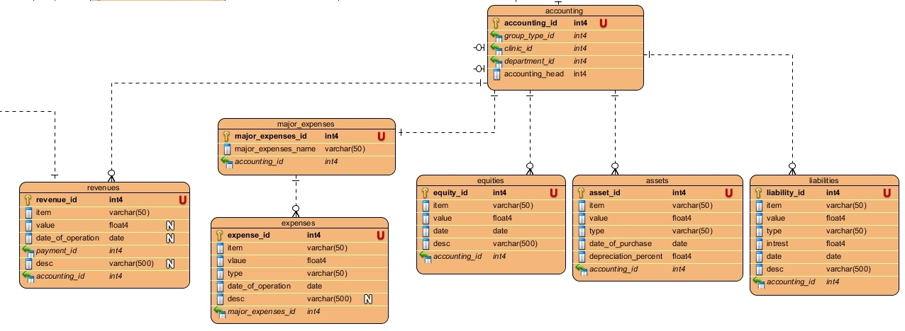
ACCOUNTING
Notes:
This section would maintain all the accounting information that is needed by any general company; all information needed for a complete accounting system is included.

Slide 29
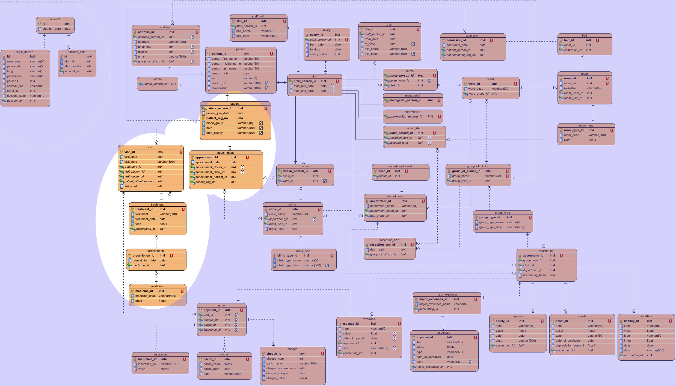
PATIENT HISTORY AND TREATMENT
Medical Clinics Management System

Slide 30
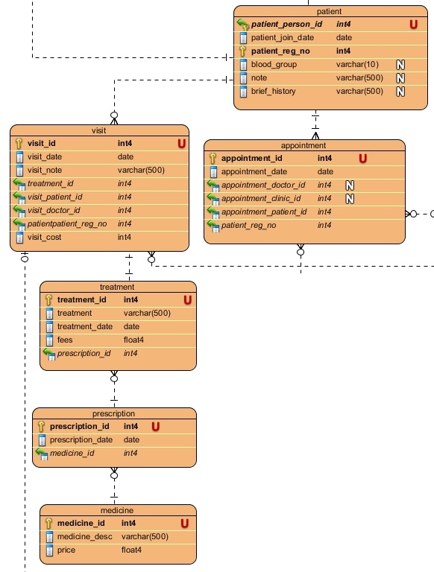
PATIENT HISTORY AND TREATMENT
Notes:
It contains the information needed for maintaining patient records and medical history. All treatment, visits and appointments details would be maintained within this section. This section is very useful in case of building the patient history and creating statistics.

Slide 31
Our System Modules
Create New Clinic.
Update Clinic info.
Add new Patient.
Add new Visit.
Add new Appointment.
Admission/Discharge.
Inventory.
And Accounting.

Slide 32
JSF
(Java Server Faces)
JSF is standard web user interface framework for Java.
JSF is a component oriented and event driven framework for web applications.
JSF eases the development of GUI for web applications.
No code of business rules inside webpages. This makes programming and design much easier.
It supports Localization and we built our web app supports Arabic and English.
Medical Clinics Management System
Notes:
For Client side we use JSF.

Slide 33
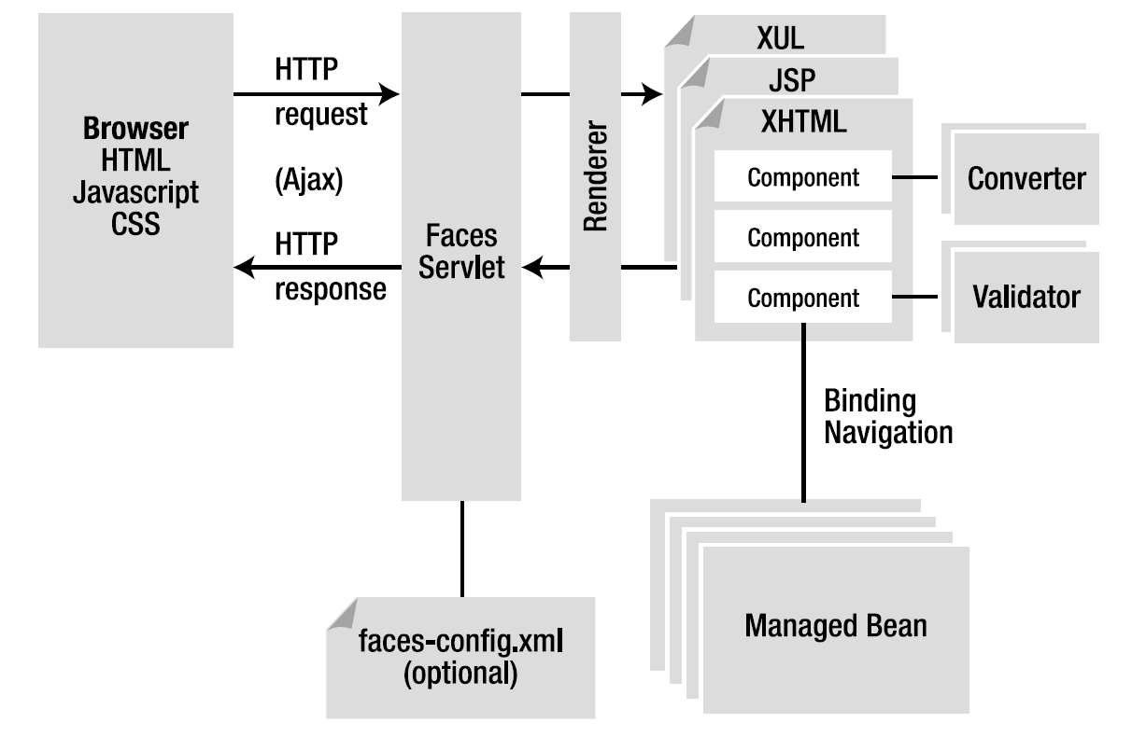
JSF
(Java Server Faces)
Medical Clinics Management System
Notes:
It is pure Java (OO). Built on top of Servlet API.
Managed beans have the logic and business rules.
JSF has its own tags and components.
Ajax in JSF is simpler than other frameworks or platforms.
It has Validator and Convertor.
We can stop any request in rendering stage and this is a good for security issues.

Slide 34
GlassFish
GlassFish is an open-source application server project.
GlassFish is now owned by Oracle and is maintained by both Oracle and its development community.
So it is the world's first implementation of the Java Platform, Enterprise Edition.
GlassFish has much better administration console.
Supports Hot deployment.
We used GlassFish for JSF and Restlet.
Medical Clinics Management System

Slide 35
https:// over Glassfish
HTTPS = HTTP + SSL encryption.
SSL encryption requires an SSL Certificate:
  Self Signed.
  Authorized third party.
Our Certificate:
  We get fixed IP and Domain Name.
  Using Java keytool we Generate an 2048 bit RSA private key.
  We Generate Certificate Request (.csr).
  We Request the Authorized Certificate for free from http://www.comodo.com/
  using the previously generated Certificate Request.
  Finally we Installed the certificate into Glassfish key store.

Slide 36
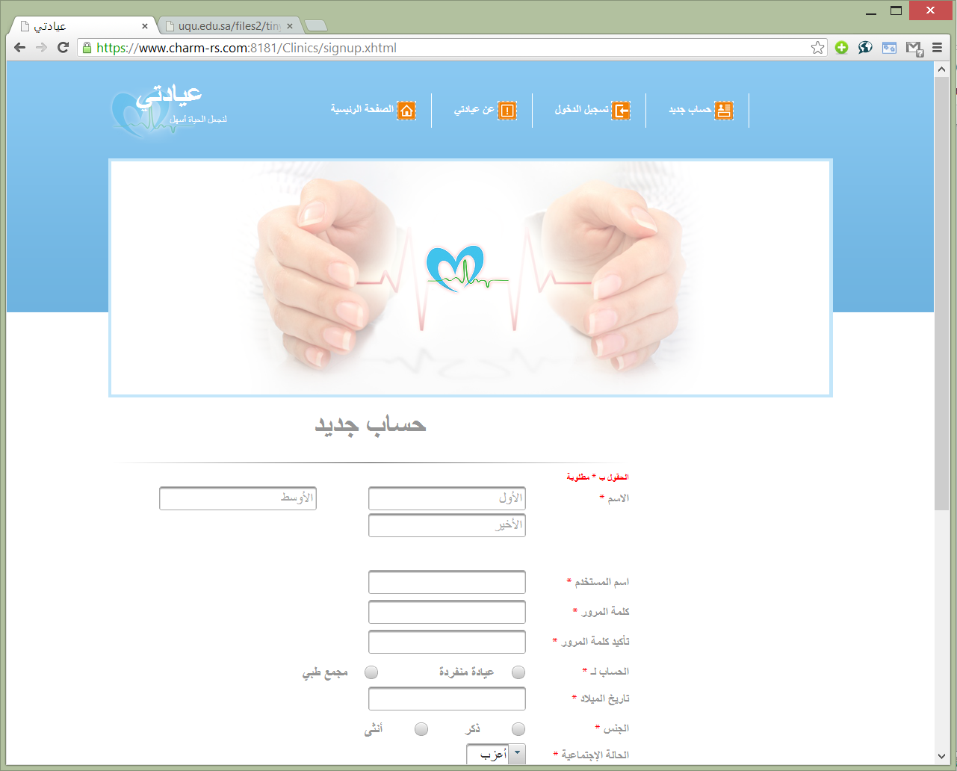

Slide 37
DEMO!
Medical Clinics Management System

