Slide 1
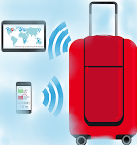
Smart Luggage Tracking System
Based on IoT
Prepared by: Thanaa Ahmed
Supervisor: Dr. Falah Hassan

Slide 2

Introduction
Internet of Things
Smart Luggage Tracking System is an application based on IoT
The idea is summarized in detection the coordinates of the lost or stolen luggage, then sending the information of its location to the user’s mobile.

Slide 3
Problem Statement
The searching process of lost luggage
The location detection inside the building is hard using the GPS module.

Slide 4

Objectives
1
2
Social Responsibility
Indoor Location Detection

Slide 5
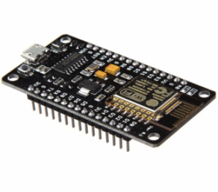


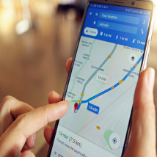
System Components
Node MCU ESP8266
Mail Application
Google Maps
Arduino IDE Simulator

Slide 6
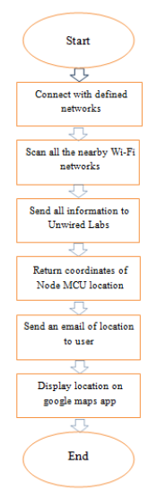
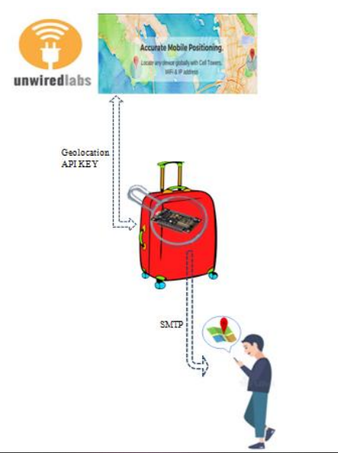
Procedure

Slide 7
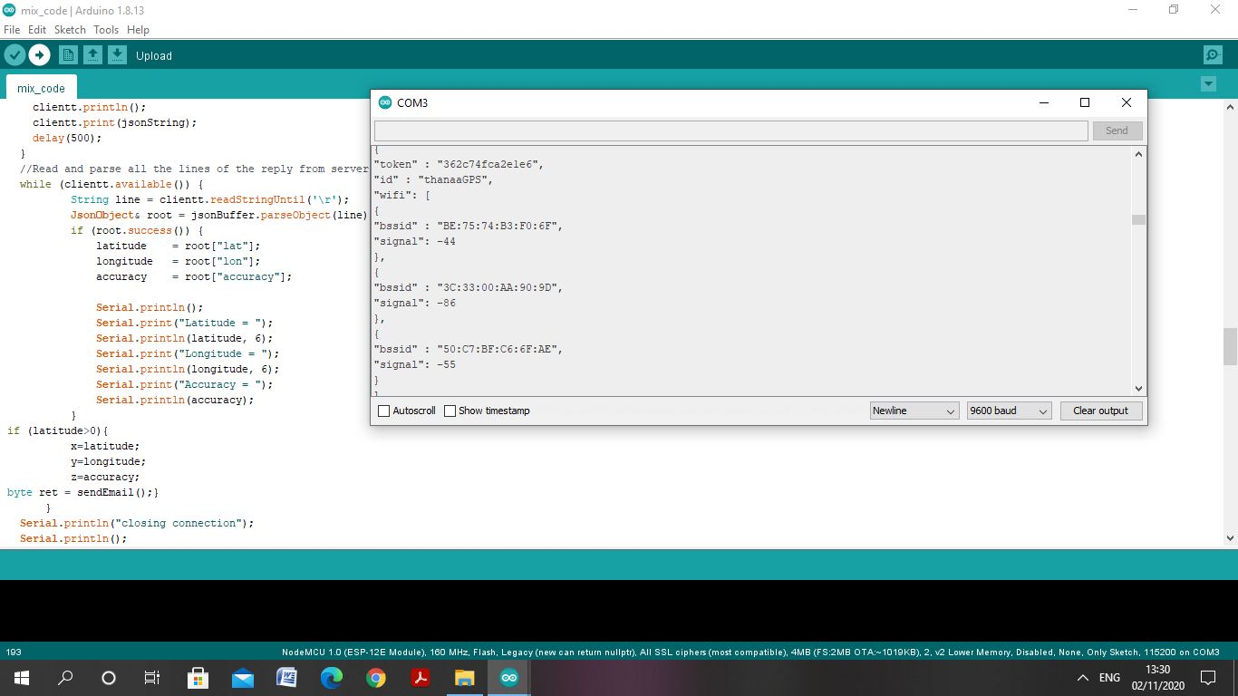
Results
First Attempt
Figure 1: Display the neighbor Wi-Fi networks

Slide 8
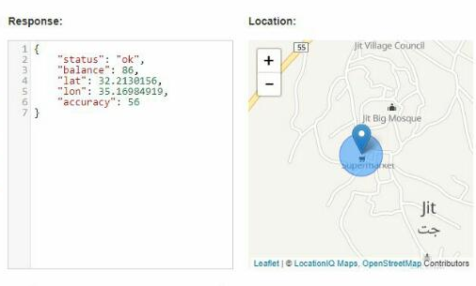
Figure 2: The coordinates for home using geolocation API

Slide 9
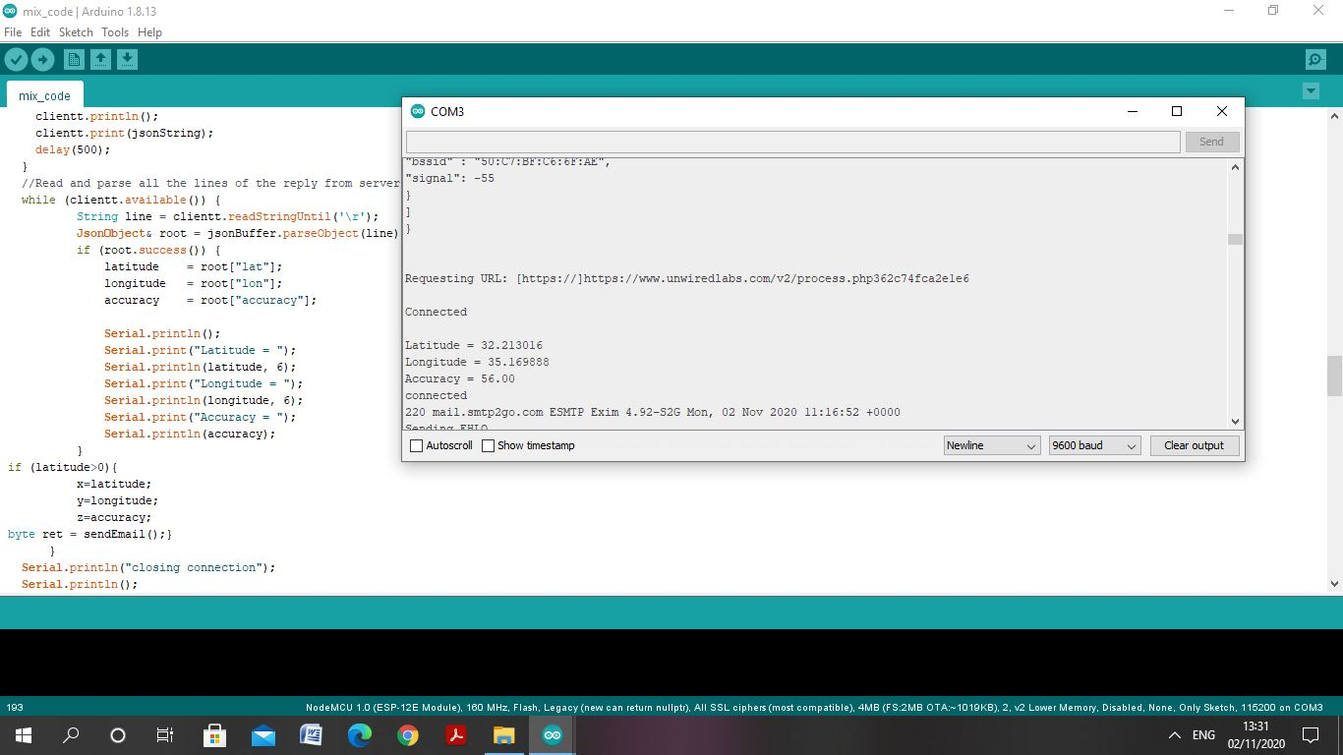
Figure 3: The coordinates for the first location at home on the serial monitor

Slide 10
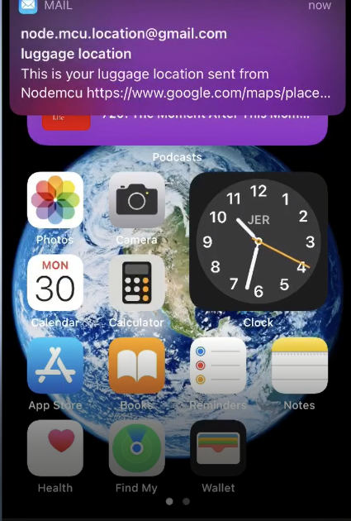
Figure 4: The notification of receiving email

Slide 11
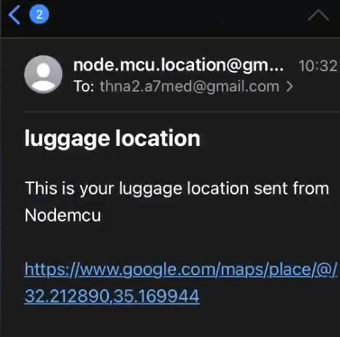
Figure 5: The incoming email for home coordinates

Slide 12
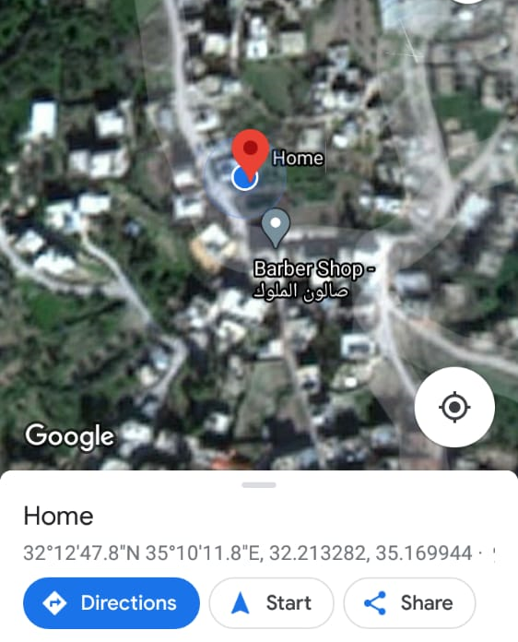
Figure 6: The location map for home

Slide 13
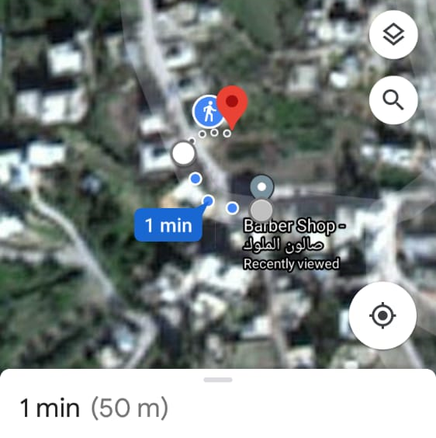
Figure 7: Example

Slide 14
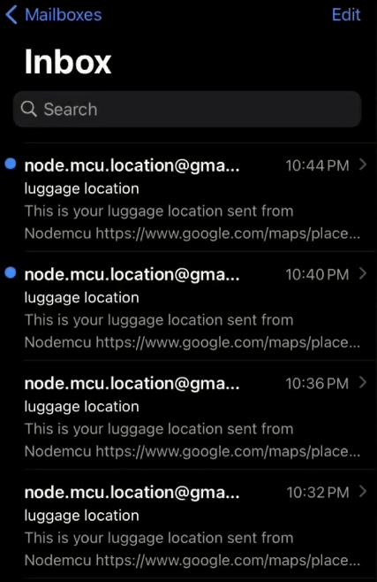
Figure 8: Incoming emails for updated locations

Slide 15
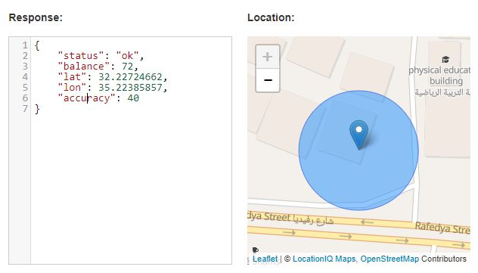
Second Attempt
Figure 9: The coordinates for collage(B1) using geolocation API

Slide 16
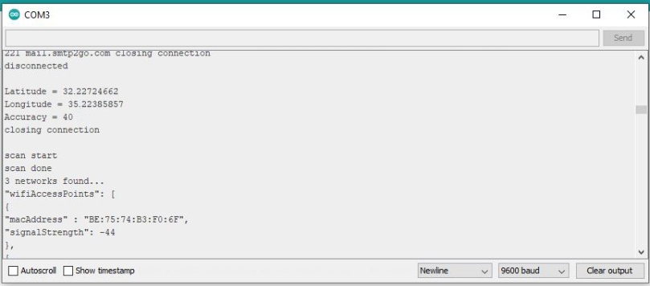
Figure 10: The coordinates for the second location at the collage(B1) on the serial monitor

Slide 17
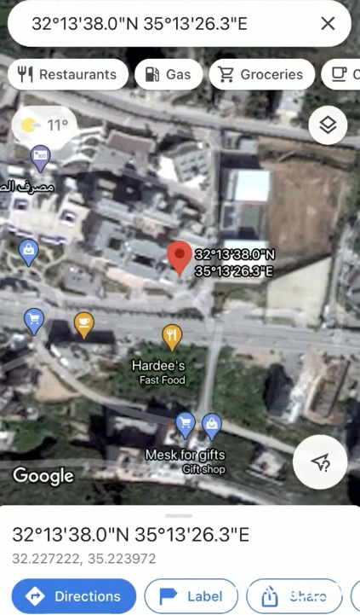
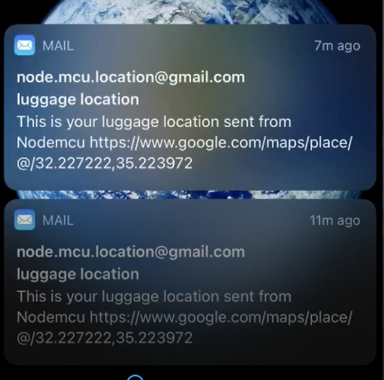
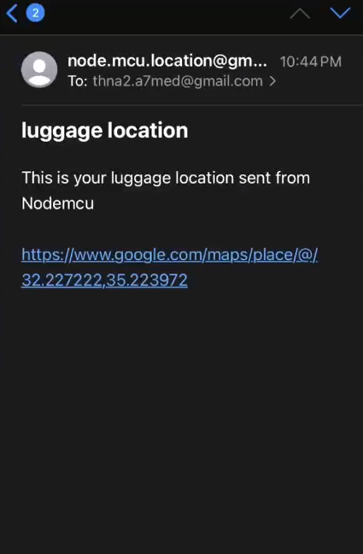
Figure 11: The results of the collage(B1)

Slide 18
Feasibility Study
Component | Cost
Node MCU ESP8266 | 12$
USB cable | 3$
Battery | 1$
Total Budget | = 16 $

Slide 19
Conclusion
We accomplished our objectives related to indoor location detection through the reliable, easy to use, smart, flexible, and acceptable cost system.
Recommendations
The potential future directions of our project based on the results which are presented in this study can be categorized into the following sections:
Improve the system capability to detect many bags in case someone have many bags.
Mobile application or web page.

Slide 20
Any question?
Thank You!

