Slide 1

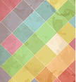
Characterization of Wood Ash and Potential Applications
Maram
Kilani
Naheel
Abed Rabbo
Munya
Mas’oud
Shurouq
Al-Wawi
Supervisor:
Dr. Hamdallah Bearat

Slide 2

Outlines:
Introduction.
pH and solubility characterization.
Experimental work of products.
Determination of elements concentration in ash.
Results.
Conclusions.

Slide 3

Wood Ash
Soap
Ceramic
Cement
Glass
Fertilizer

Slide 4
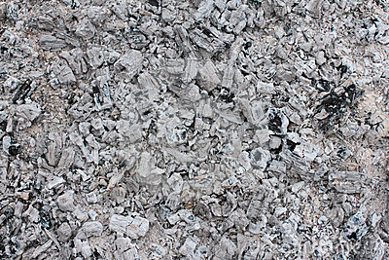
Wood Ash
Definition: residue from burning of wood or its products such as: chips, saw dust, bark, etc. It consists of organic and inorganic compounds.
Factors affecting ash properties:
Constituents of the wood.
The burning method (temperature, oven’s efficiency, fuels).
Soil and irrigation water chemistry.
Wood ash in this project is used as ingredient in industrial applications including: glass, ceramic, soap, cement and fertilizer.

Slide 5

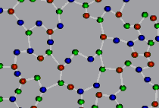
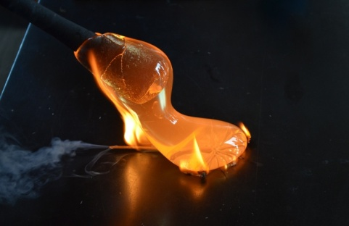
Glass
Definition: an amorphous substance, inorganic product which obtained either as a solid from the melt or by other methods in a compact form, or as a thin coherent films, wires, or fibers.
Glass in this project:
Soda-Lime-Silica Glass at °1000 C.
Quenching from the melt.

Slide 6
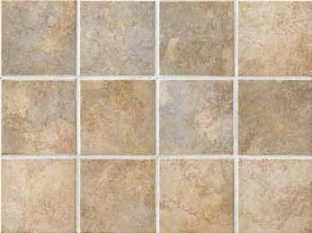
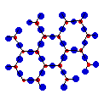
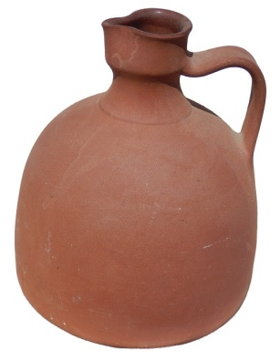
Ceramic
Definition: inorganic, non-metallic material of crystalline nature, insoluble in water and formed by heating to high temperatures.
Ceramic in this project:
- Traditional ceramic using clay and sand.
- Hand-forming method by adding ash to improve strength.

Slide 7
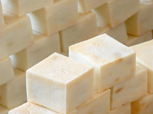
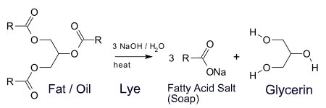
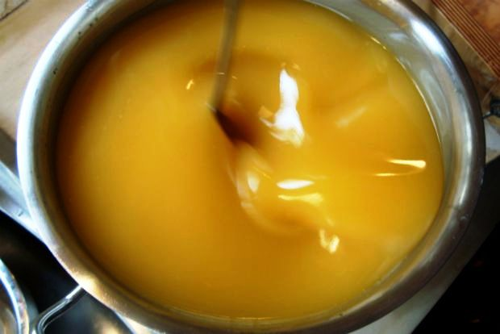
Soap
Definition: any salt of fatty acid and usually made by saponification of fatty oil with caustic soda.
Soap in this project:
Hard olive-oil soap using soluble part of ash.
Using hot method.

Slide 8
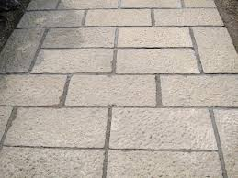
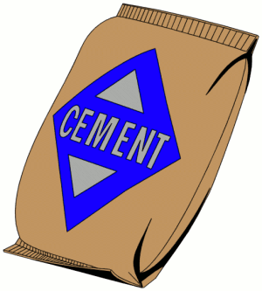
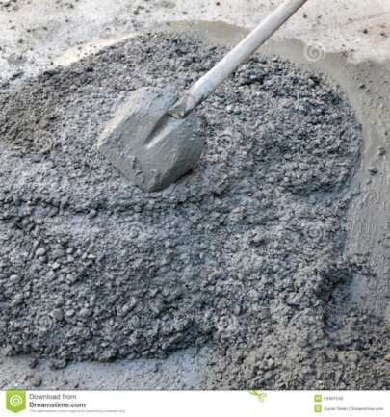
Cement
Definition: is a material which binds together solid bodies by hardening from a plastic state. It is a fine powder produced by grinding Portland cement clinker.
Cement in this project:
Portland cement using ash to improve strength.
Preparation from powder at 1000 °C.

Slide 9
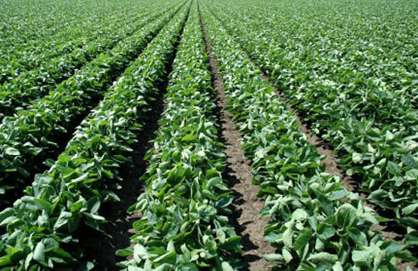


Fertilizer
Definition: is a material for plant growth and development by providing essential plant nutrient elements, such as: nitrogen, phosphorus, and potassium.
Fertilizer in this project:
Using the soluble part of ash.
Using total part of ash.

Slide 10
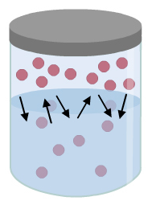
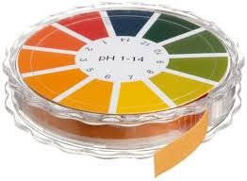
Solubility & pH Tests

Slide 11
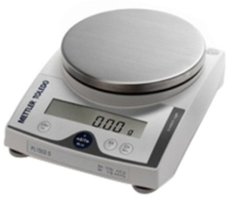
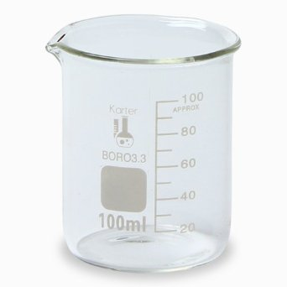
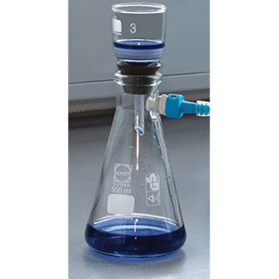
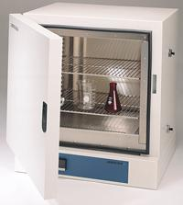

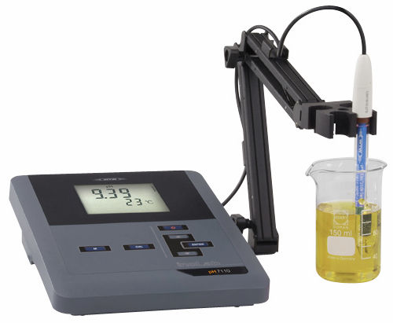
Solubility & pH Test in Cold Water
5 g of ash
100 mL water
Vacuum Filtration
Drying insoluble part
Insoluble part
pH Test
Soluble Part

Slide 12
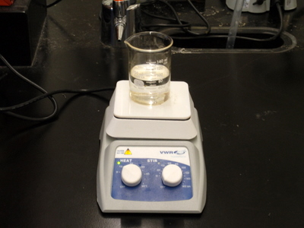
Solubility & pH Test in Hot Water
5 g of ash
100 mL water
Vacuum Filtration
Drying insoluble part
Insoluble part
pH Test
Soluble Part

Slide 13
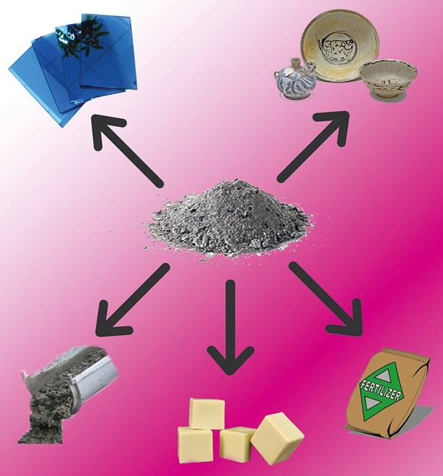
Experimental
Work of
products

Slide 14

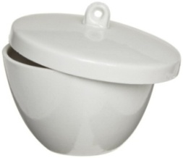
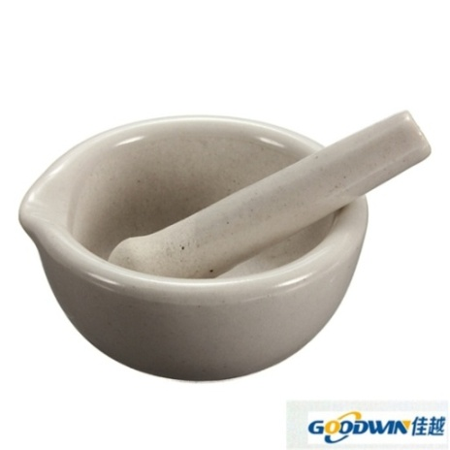
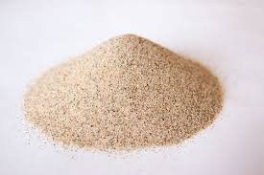
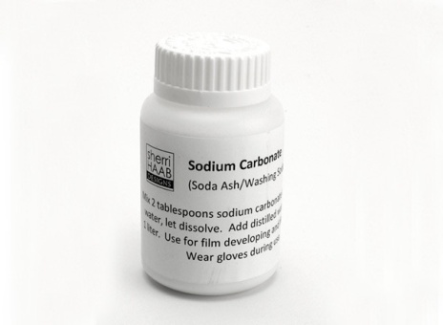
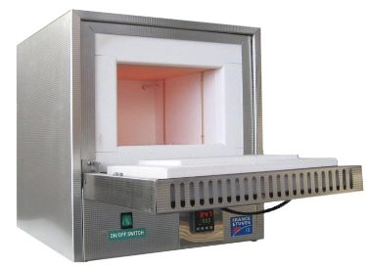
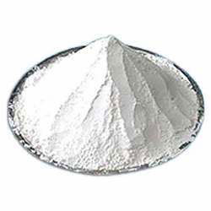
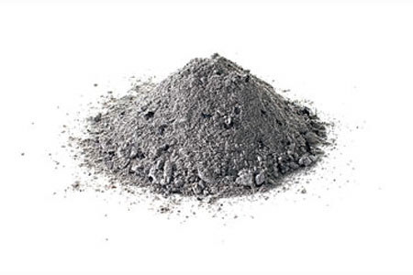
Glass Work
Silica Sand
Sodium Carbonate
Limestone
Almonds Ash

Slide 15
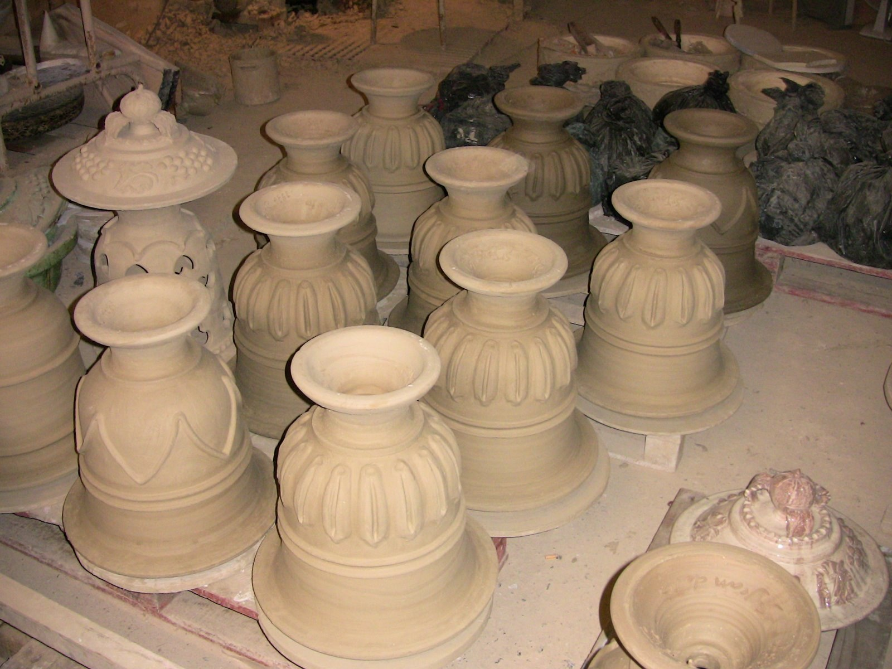
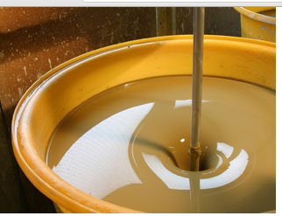

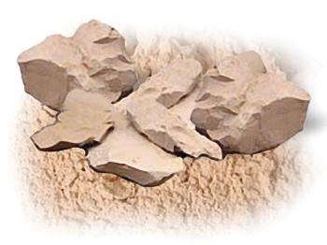
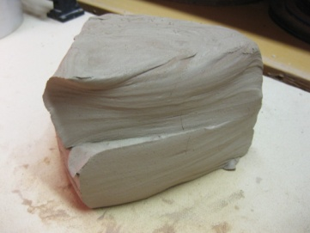
Ceramic Work
Almonds Ash
25 % water
Clay
Drying !
15 % water
2 Days
Oven (90 °C)
Silica Sand

Slide 16
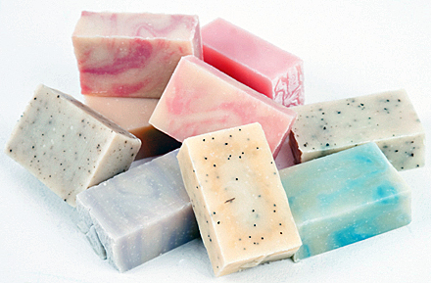
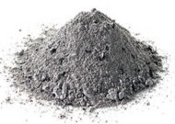
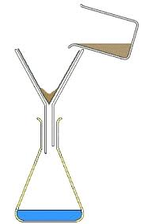
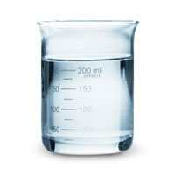
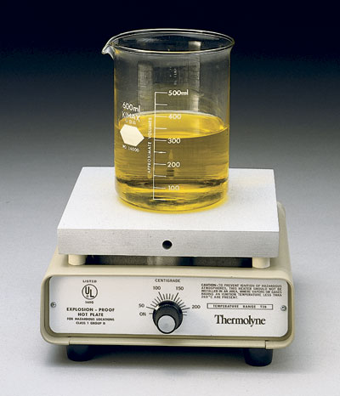
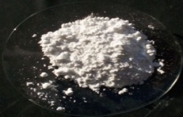
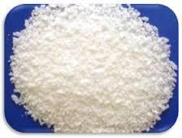
Soap Work
Olive Ash
CaCO3
NaOH
Olive Ash
NaOH
CaCO3

Slide 17
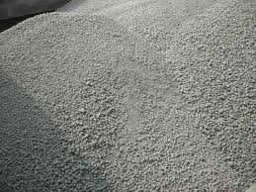
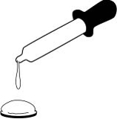

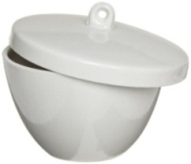
Cement Work
Citrus Ash
Clay
Limestone

Slide 18

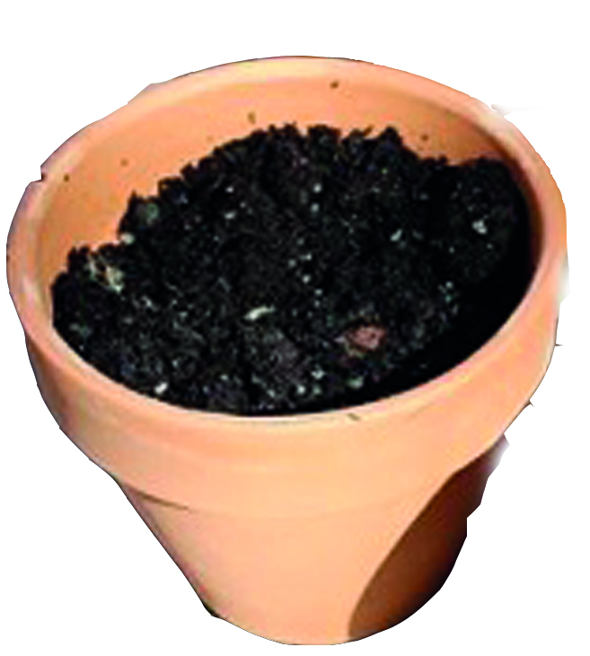
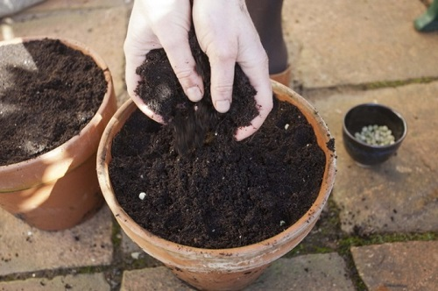
Fertilizer Work
100 g ash
5 mL
10 mL
5 mL
10 mL
Citrus Ash
1000 mL water
Citrus Ash
10 g
Olive-Olive cake Ash
10 g

Slide 19


Slide 20
Solubility Results
Hot Water Solubility (%) | Cold Water Solubility (%) | Ash Type
3.40 | 4.80 | Citrus Ash
9.60 | 8.80 | Almonds
17.60 | 19.20 | Olive

Slide 21
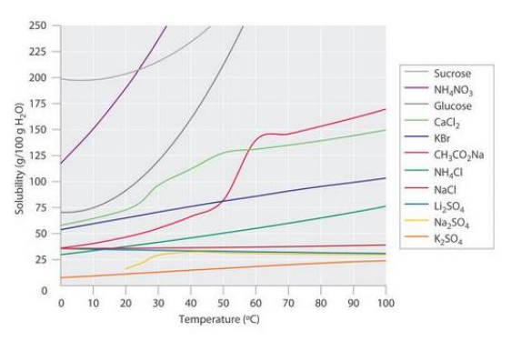
Solubilities of several inorganic and organic solids in water as a function of temperature

Slide 22
pH Results
pH | Ash Type
12.95 | Olive-Olive cake/Ramallah
12.90 | Olive
10.23 | Olive-Olive cake/Jenin
11.72 | Almonds

Slide 23
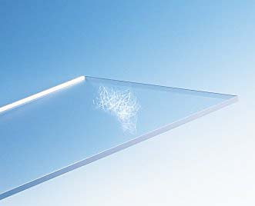

Glass Work Results
Kafr-Laqif silica sand
Ash
Limestone
Kafr-Laqif silica sand
Ash
Kafr-Laqif silica sand
Ash
Sodium Carbonate
40 %
30 %
30 %

Slide 24
Desert Silica Sand
Ash
Sodium Carbonate
50 %
20 %
30 %
Sea Silica Sand
Ash
Sodium Carbonate
Purified Sea Silica Sand
Ash
Sodium Carbonate
Purified Sea Silica Sand
1100 °C
Ash
Sodium Carbonate
40~45 %
27~30 %
27~30 %

Slide 25
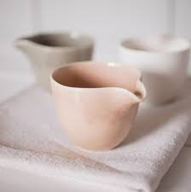
Ceramic Work Results
Slip Casted Ceramics
0 % Ash + 100 % (clay-sand)
10 % Ash + 90 % (clay-sand)
20 % Ash + 80 % (clay-sand)
30 % Ash + 70 % (clay-sand)
40 % Ash + 60 % (clay-sand)
50 % Ash + 50 % (clay-sand)
Plastic Paste Ceramics

Slide 26
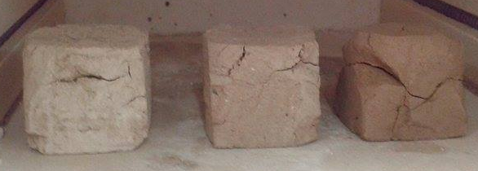
Comparison !
  Strength
Cracking
Color
Weight
20 % Ash
10 % Ash
0 % Ash

Slide 27


Soap Work Results
Ash
Calcium Hydroxide
Olive Oil
Caustic Soda + Water
Olive Oil
Ash
Calcium Hydroxide
NaOH + Water
Olive Oil
30 g
30 g
7 g
25 mL
60 g

Slide 28


Cement Work Results
5 g Ash
10 g Ash
15 g Ash
20 g Ash
25 g Ash

Slide 29
Fertilizer Work Results

Slide 30







Elements’ Concentration Results

Slide 31
Flame-photometry Analysis for Sodium
Sodium Concentration (ppm) | Ash Type
50 | Olive-cake
50 | Olive-Olive cake (Jenin)
300 | Almonds
550 | Olive
Effect on: Glass & Soap

Slide 32
Flame-photometry Analysis for Potassium
Potassium Concentration (ppm) | Ash Type
15 | Olive Cake
30 | Citrus
15000 | Almonds-Olive
15000 | Olive-Olive cake
Effect on: Soap & Fertilizer

Slide 33
Titration Results for Calcium
Calcium Concentration (ppm) | Ash Type
42,000 | Olive cake
28,800 | Almonds-Olive
15,600 | Olive
12,000 | Olive-Olive cake/Ramallah
Effect on: Glass

Slide 34
Titration Results for Magnesium
Magnesium Concentration (ppm) | Ash Type
72,900 | Olive Cake
32,076 | Citrus
4,374 | Olive
7,290 | Almonds-Olive
Effect on: Glass

Slide 35
Titration Results for Chlorine
Chlorine Concentration (ppm) | Ash Type
68,160 | Olive-Olive cake/Ramallah
58,575 | Olive-Olive cake/Jenin
20,235 | Citrus
36,210 | Almonds
Effect on: Soap & Ceramic

Slide 36
Spectro-photometry Analysis for Phosphorus
Phosphorus Concentration (ppm) | Ash Type
22.61 | Olive-Olive cake/Ramallah
39.56 | Olive-Olive cake/Jenin
1,283 | Olive
424 | Olive Cake
Effect on: Fertilizer

Slide 37
Conclusions
pH and solubility of ash ?
Using ash in glass preparation ?
Using ash in ceramic preparation ?
Using ash in soap making ?
Using ash in cement preparation ?
Using ash as fertilizer?
Chemical composition of ash and its effect ?

