Slide 1
Redesign the Faculty of Arts at Al-Najah National University
Prepared by :
Anas Hatoo
Isam Subhi
Mohannad B’ara
Under the supervision of : Dr.Sameh Mona

Slide 2
Contents:
Introduction
Site Analysis
Architectural Design
Structural Design
Passive Design
Mechanical Design
Electrical Design
Cost survey
Conclusion

Slide 3
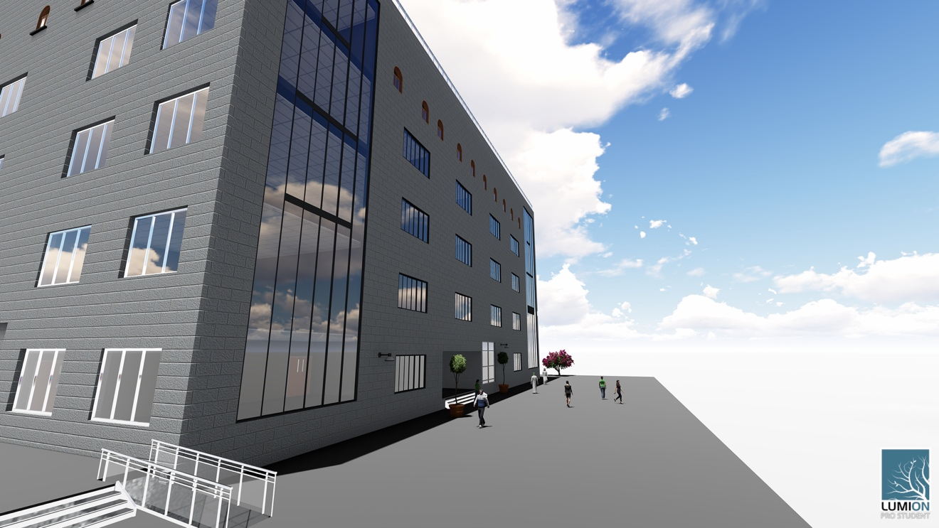
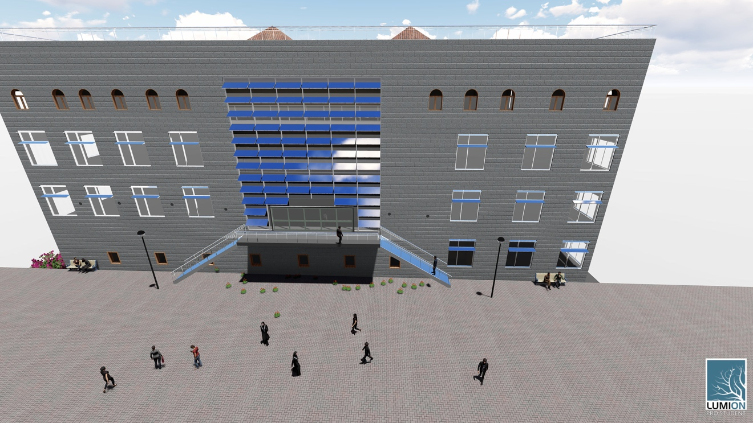
Introduction

Slide 4
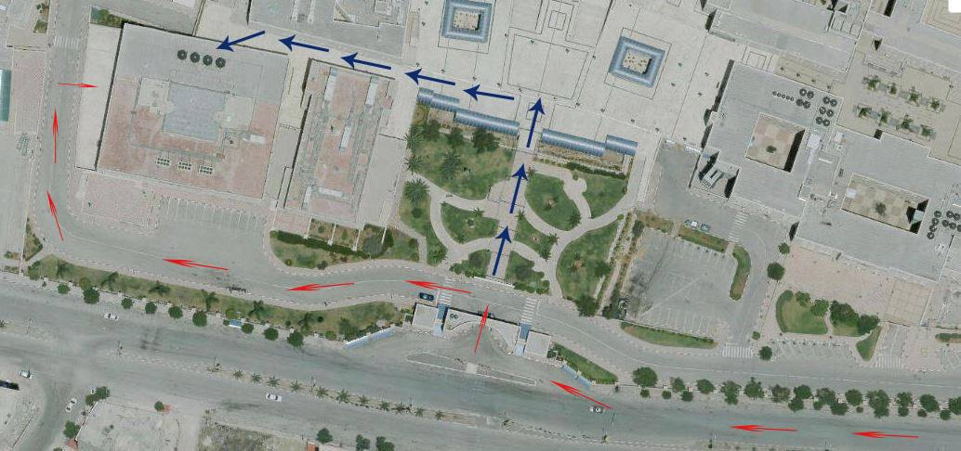
Site Analysis:
The site is located in Nablus city at Al- Junied region which is located 32°13'8.00" to the north and 35°14'24.05" to the east with an area around 2391.05m² and a periphery of 196.82m.

Slide 5
Site Plan and Parking

Slide 6
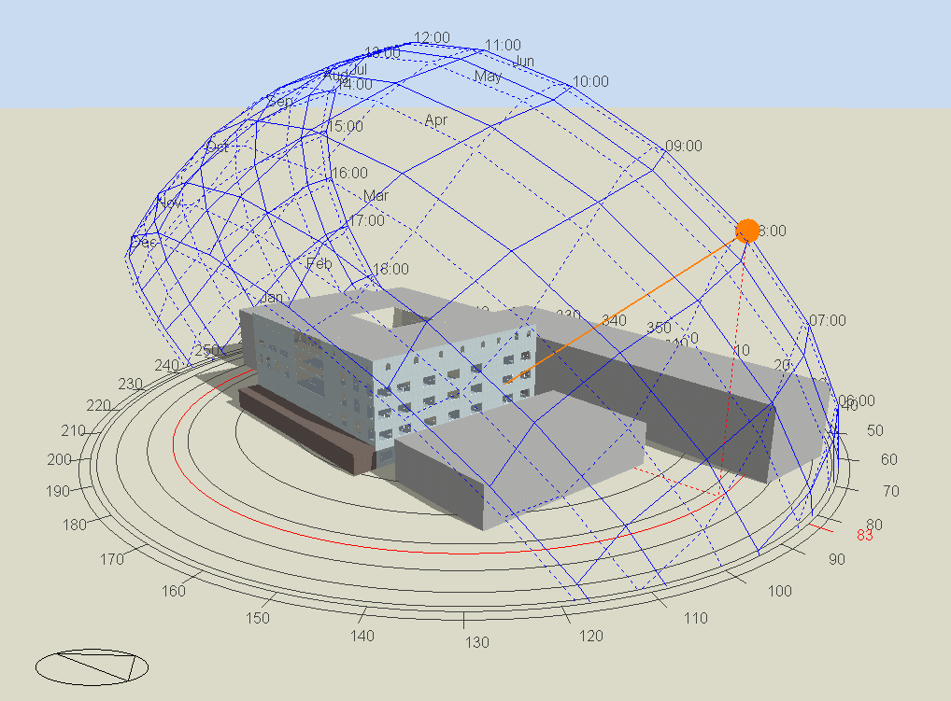
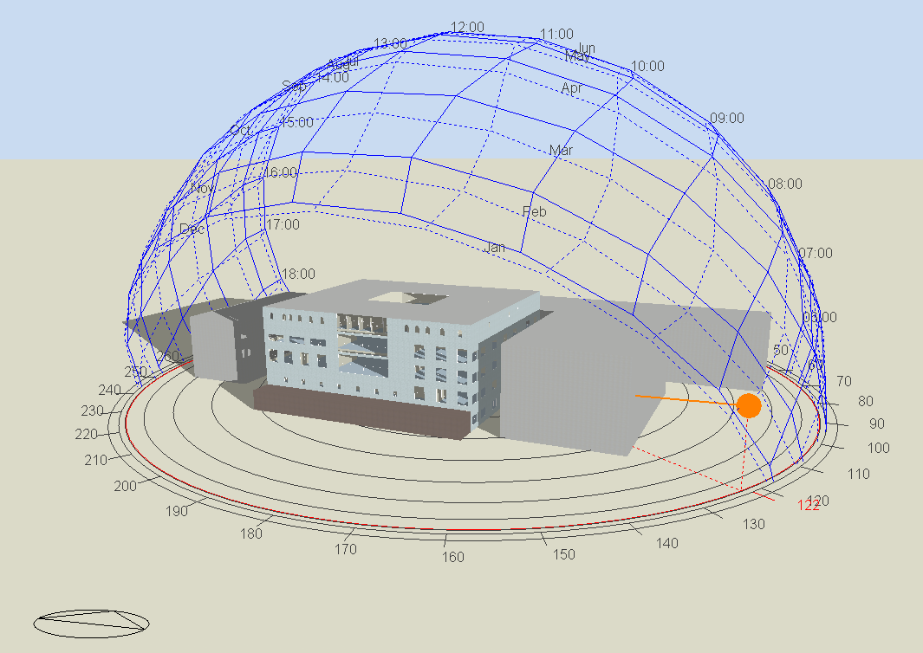
21/12 21/7

Slide 7
Architectural Design

Slide 8
The Architectural Plans

Slide 9
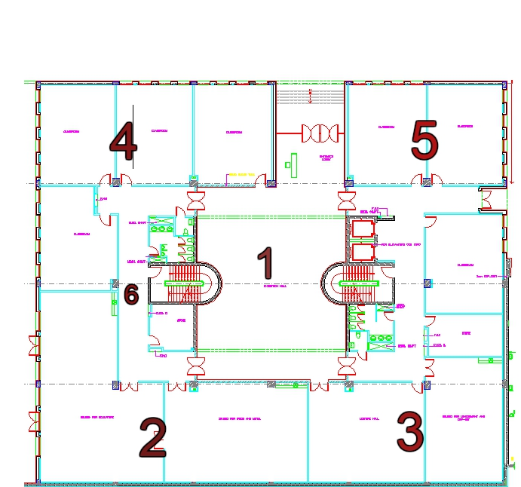
The existing Ground Floor plan

Slide 10
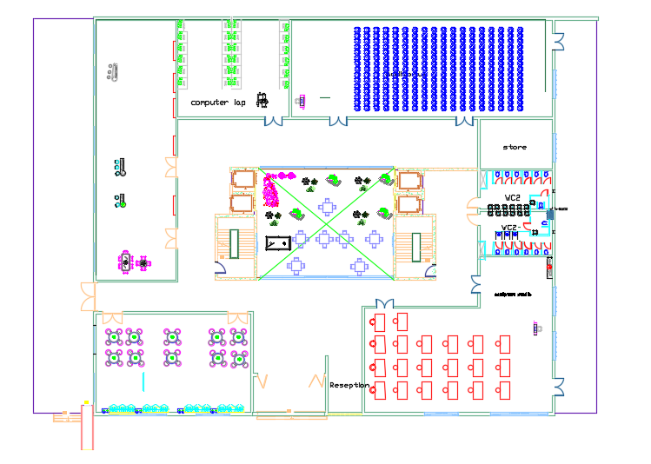
The new design of Ground floor

Slide 11
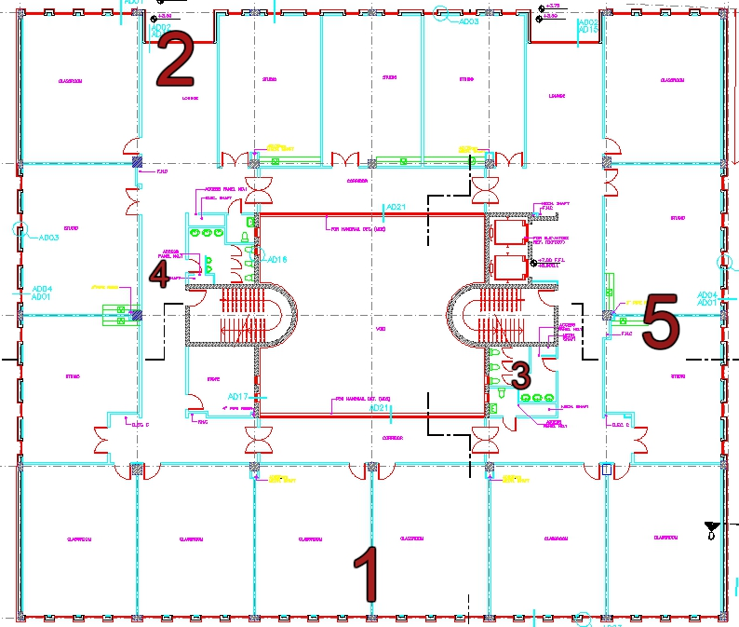
The existing First Floor Plan

Slide 12
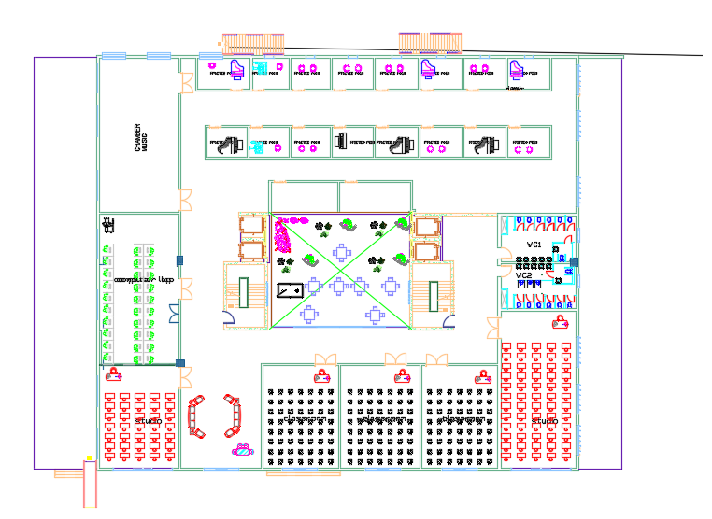
The new Design of the First Floor

Slide 13
The existing Second Floor Plan

Slide 14
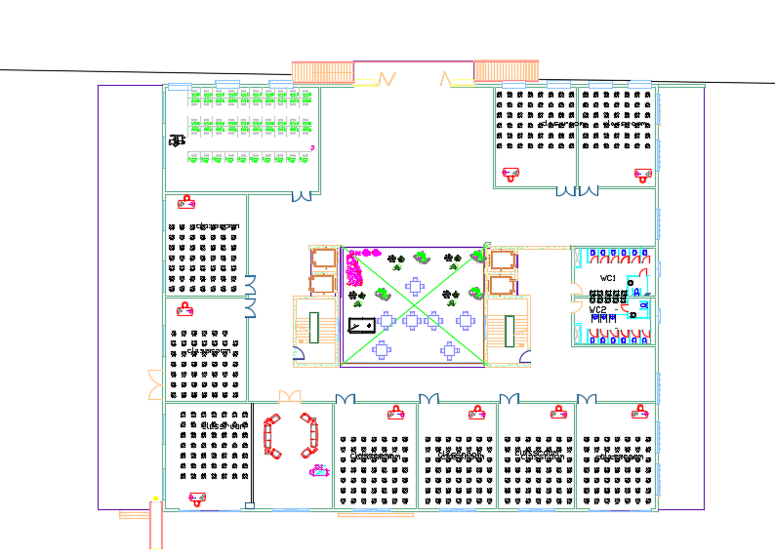
The New Design of Second Floor

Slide 15
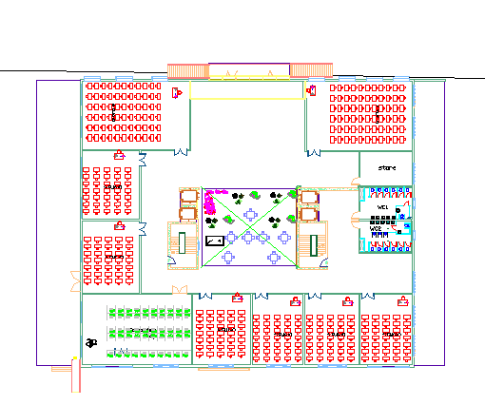
The New Third Floor Plan

Slide 16
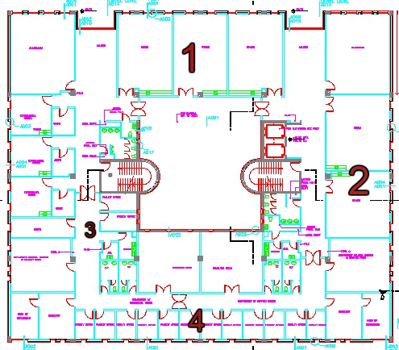
The Existing Fourth Floor :

Slide 17
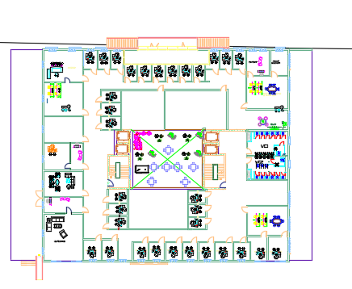
The new design of the fourth Floor

Slide 18
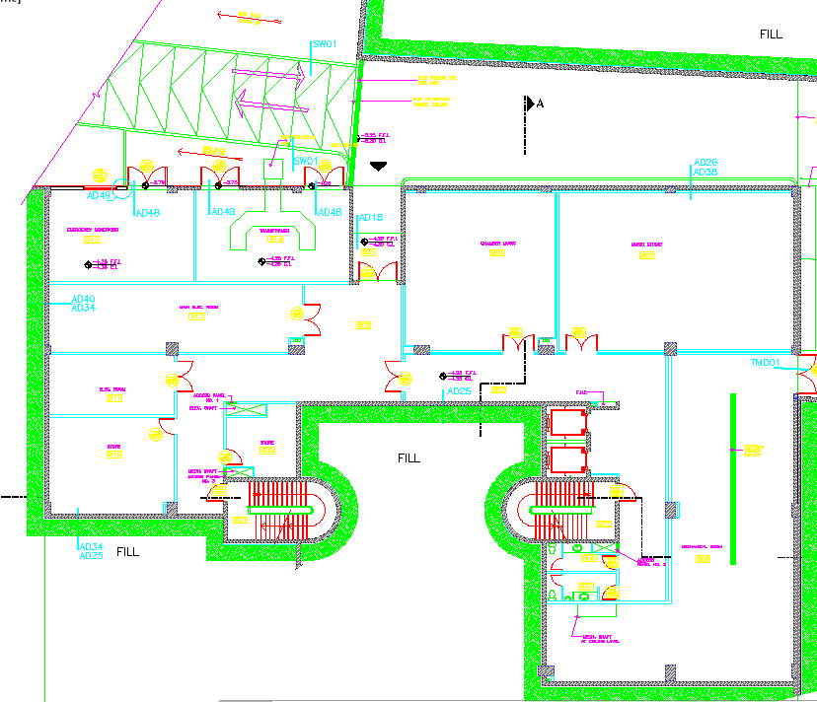
The existing Basement Floor

Slide 19
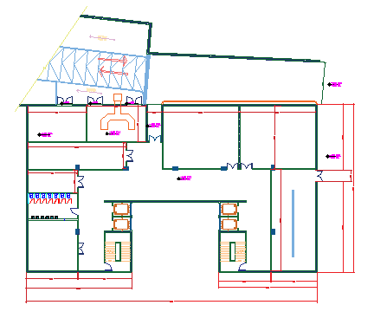
The new Design of Basement Floor

Slide 20
Elevations

Slide 21
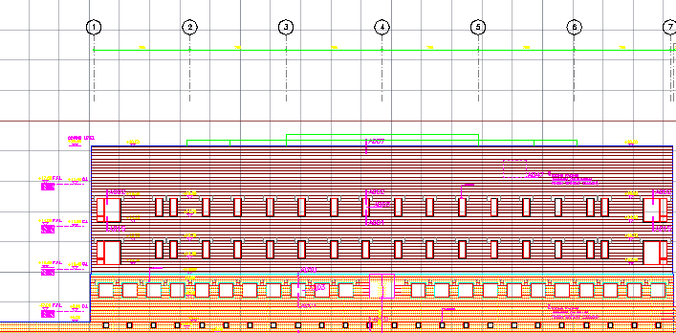
The Existing South Elevation

Slide 22
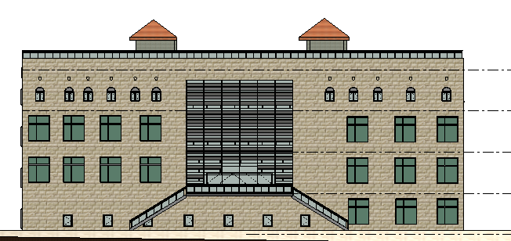
The new south Elevation

Slide 23
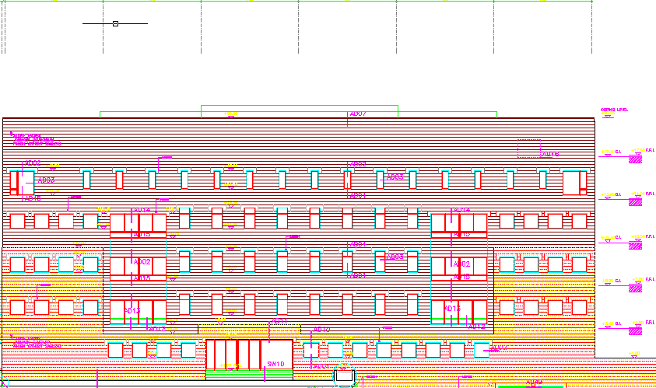
The existing North Elevation

Slide 24
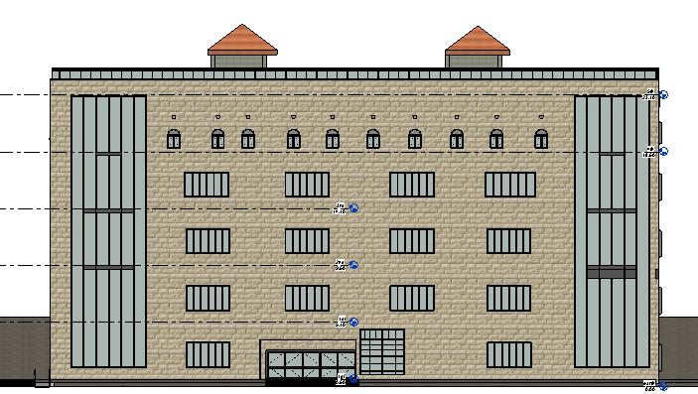
The New north Elevation

Slide 25
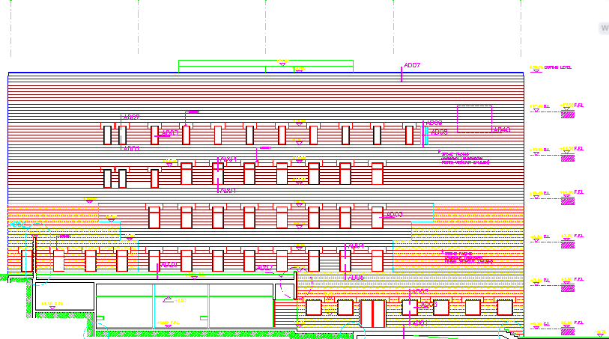
The existing East Elevation

Slide 26
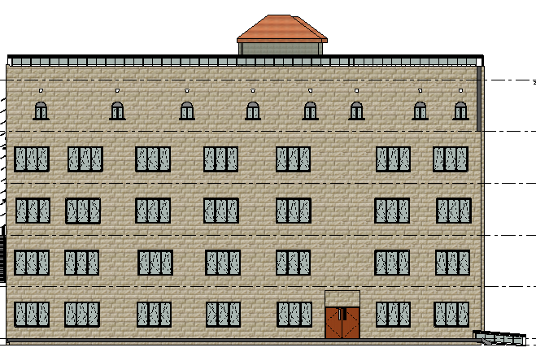
The new East Elevation

Slide 27
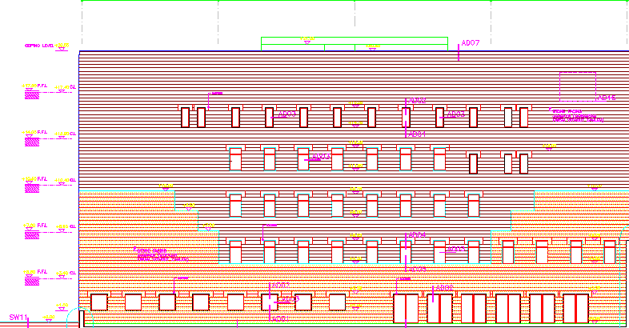
The existing West elevation

Slide 28
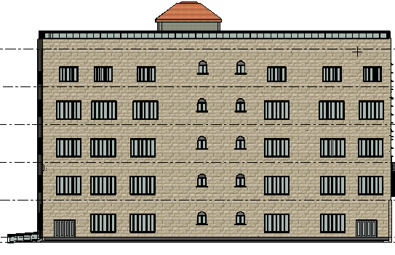
The new West Elevation

Slide 29
Sections

Slide 30
Section A-A

Slide 31
Section B-B

Slide 32
Structural Analysis

Slide 33
Codes used:
The

Slide 34
Concrete Materials:
Reinforced concrete :
Grade 25
Grade 30
Plain concrete
Grade 15
Grade 20

Slide 35
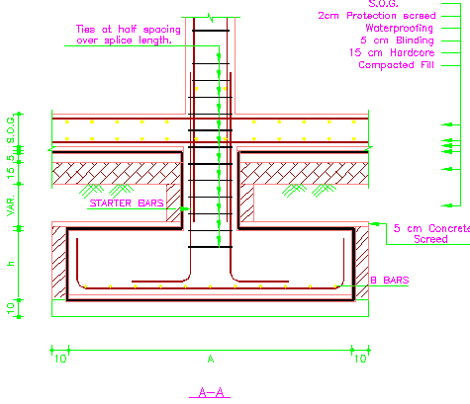
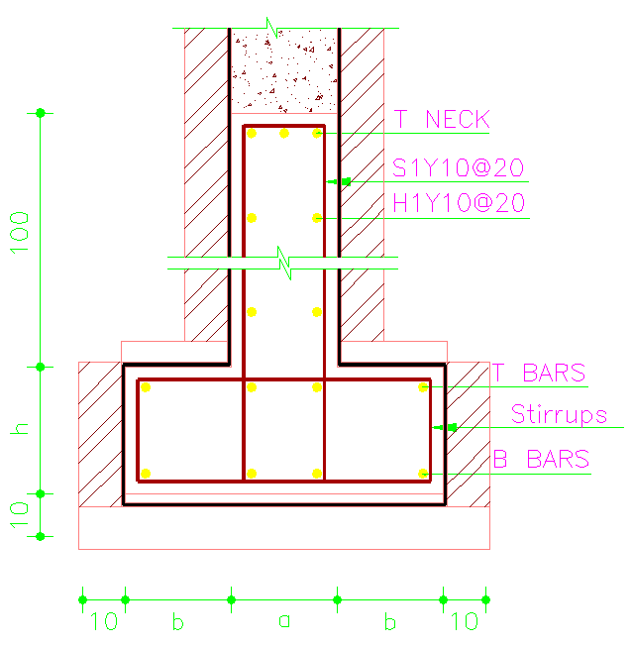
Foundations:
Isolated Footing
Strap Footing

Slide 36
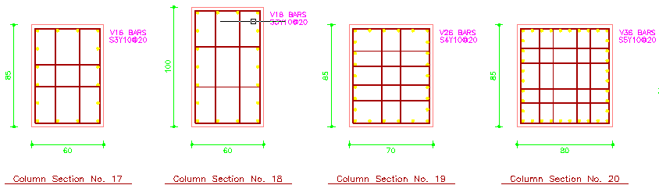
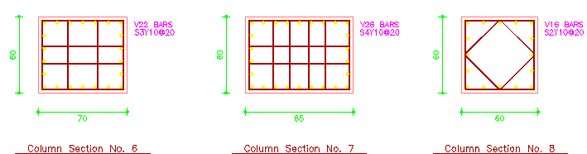
Columns

Slide 37
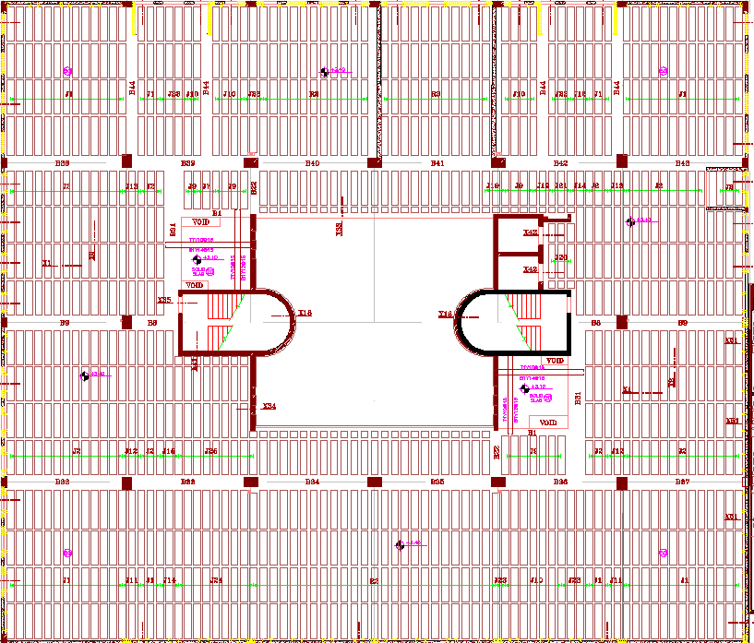
SLAB DESIGN

Slide 38
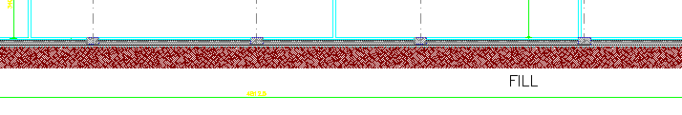
WALLS

Slide 39
BEAMS
Inverted Beams
Hidden Beams
Drop Beams
  Strap Beams

Slide 40
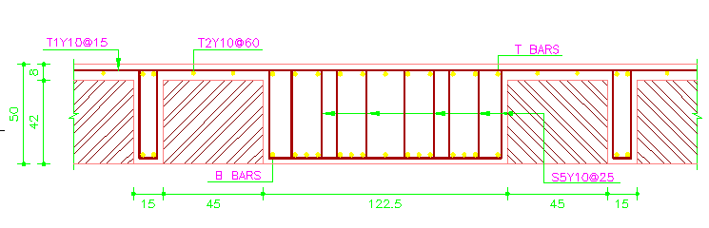
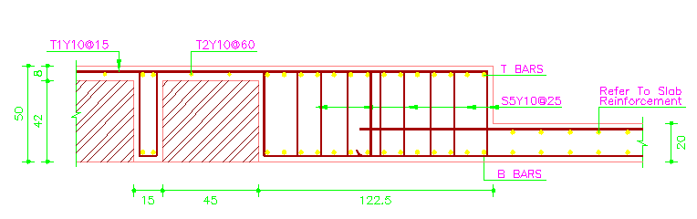
Detailing

Slide 41
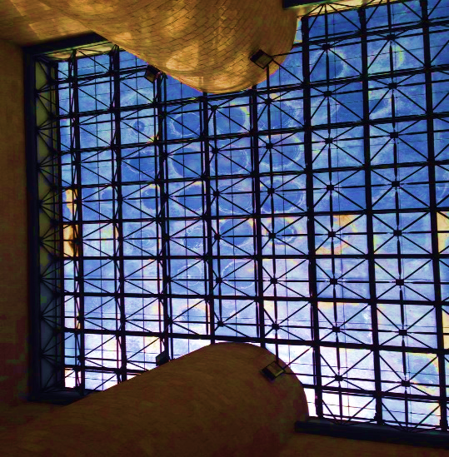
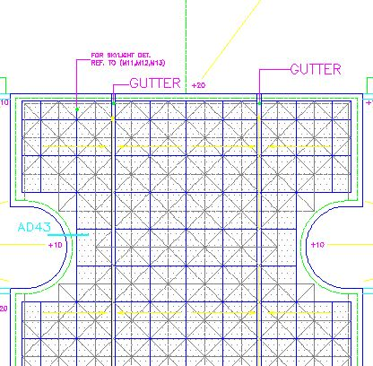
STEEL COVERING

Slide 42
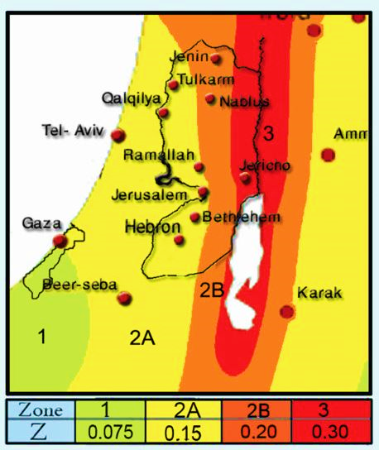
SEISMIC
Nablus city is located in zone 2B
and so the Z factor equals to 0.20

Slide 43
Environmental Analysis

Slide 44
Environmental Analysis:
Design Builder Software were used to calculate the U values for both walls and roof , calculate heating and cooling loads and the daylight factor.
Heating & Cooling Loads
Simulation
Comfort

Slide 45
Table1:U-Values Table2: Heating & Cooling Loads
Item | U-Value
External Walls | 2.9
Roof | 1.34
Heating Load | 245.5 KW
Cooling Load | 355.5 KW
Table3: Energy per Conditioned Building Area (KW/m2) Table4: Direct Heating & Direct Cooling (KWH)
Winter | 42.21
Summer | 188.56
Direct Heating | 42812.55
Direct Cooling | 48325.02

Slide 46
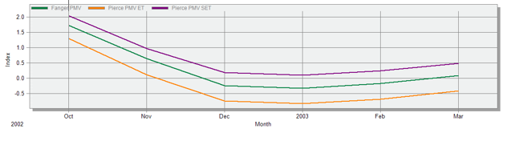
Comfort Analysis:
Table5: Hours of Heat Dissatisfaction
In Summer | 2820
In Winter | 2305

Slide 47
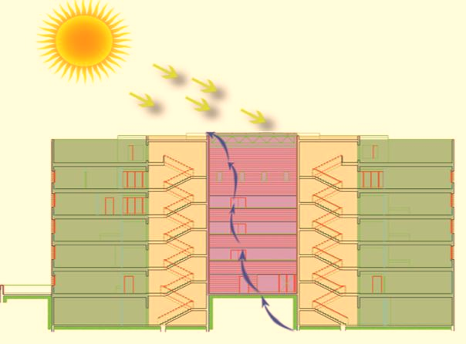
Ventilation:
1) Create openings in the drum of the courtyard and so circulation. 2) Enlarge Openings

Slide 48
Solar Photovoltaic Design :
The available area on the roof is about 1500 m2
And the building is widely open to the south
PV Syst software was used to reach best design for the system, solar cells was chosen

Slide 49
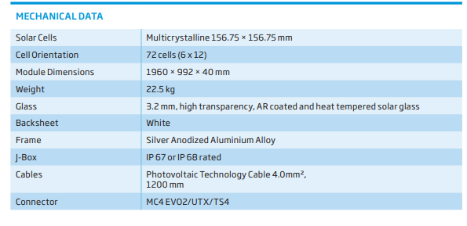
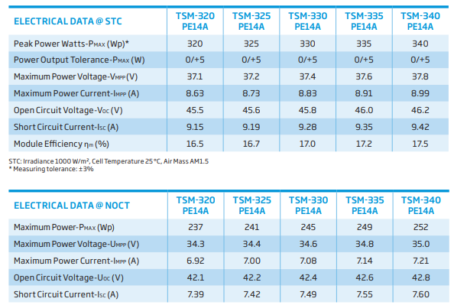
Specification of the Modules used :

Slide 50
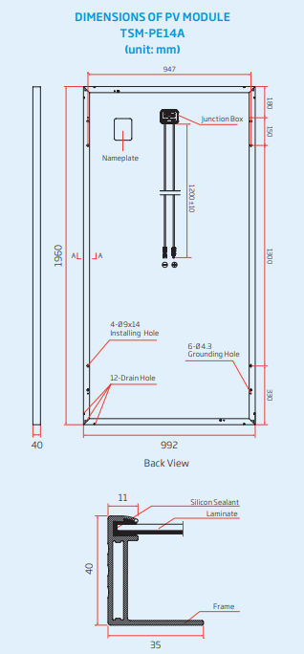
Detailing and Dimensions of the modules

Slide 51
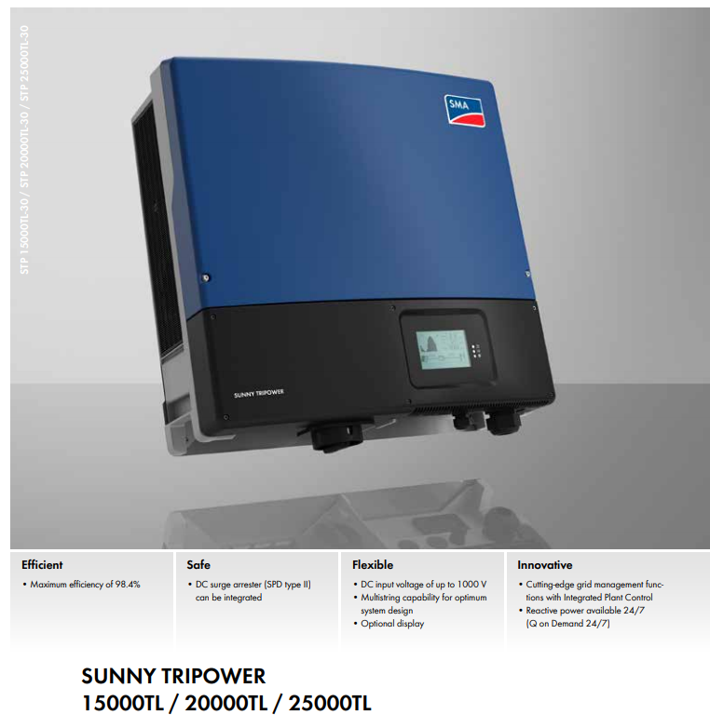
The inverter Used in the design

Slide 52
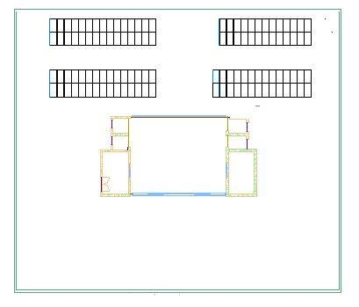
The distribution of the Modules on the Roof :
The capacity of the system = 117*350 = 40 KWp
Area of input module the system = 117*0.99*1.96 = 230 m2
The angle of the Modules “ tilt” = 22

Slide 53
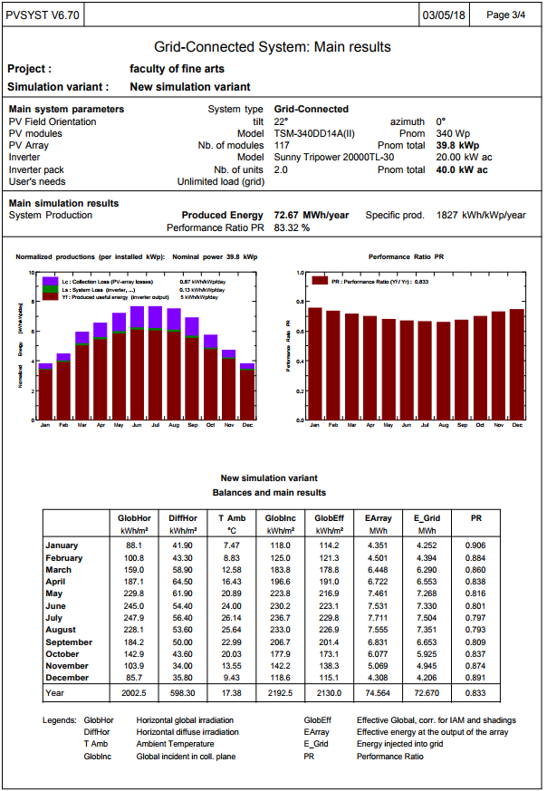
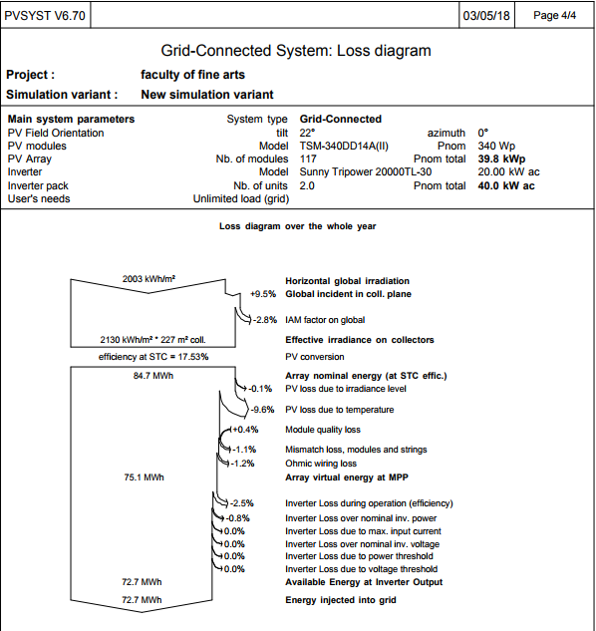
The main simulation results :
The possible loss diagram for the whole year

Slide 54
Cost of the PVs System
Cost of modules = 350*117 = 40950$
Cost of Inverters = 7475*2 = 14950$
Cost of Installation = 1200*2 $ = 2400 $
For 1500 m2 roofing area, 1200 meter length needed for the system,
assume 2$ each worker need for each meter length needed for the
system.
4. Operation Cost = 1400 $
Every 6 months maintenance done with 700 $, so it costs 1400 $ per
year.
Summary:
Initial cost of the PV system= 40950+ 14950+ 2400= 58300$
Operation costs= 1400 $/year.
Electricity production = 72700 KWh/yr.
Annual saving = 72700 * 0.17 = 12359 $/yr.
Payback Period = 59700/12359 = 4.83 years.

Slide 55
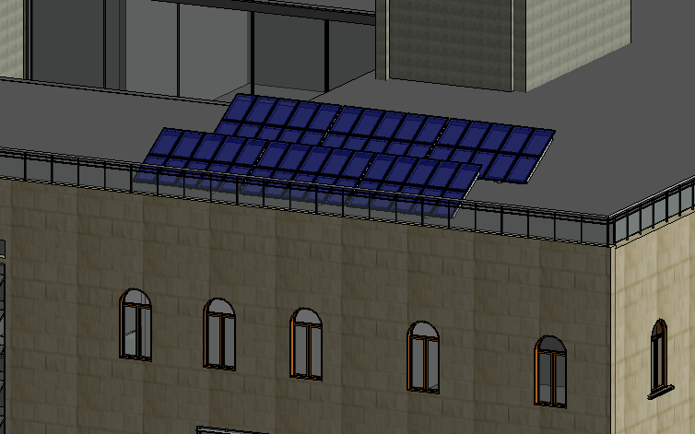
3D view of the Distribution

Slide 56
Acoustical Analysis

Slide 57
Acoustical Analysis:
RT60
STC & IIC
NC & Background Noise
Reverberation Time Values
Sound Transmission Class Values
Noise Criteria Values

Slide 58
Reverberation Time:
Three samples of rooms were taken to calculate the reverberation time at all frequencies these rooms are a class room in the ground floor, an office in third floor and a music class in the first floor.
The calculations are going to be performed in three cases:
a.When the space is zero occupied.
b.When the space is 50% occupied.
c.When the space is 100% occupied.

Slide 59
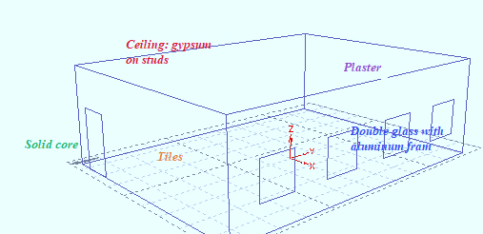
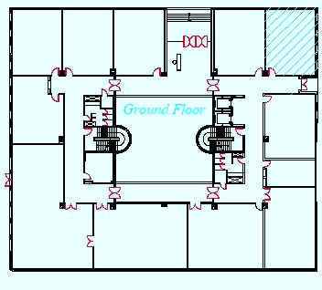
Class Room RT60 :

Slide 60
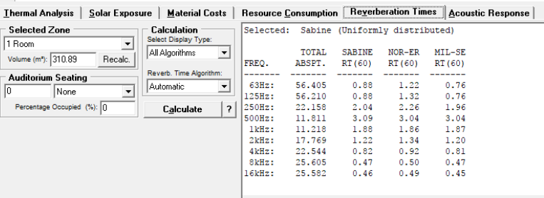
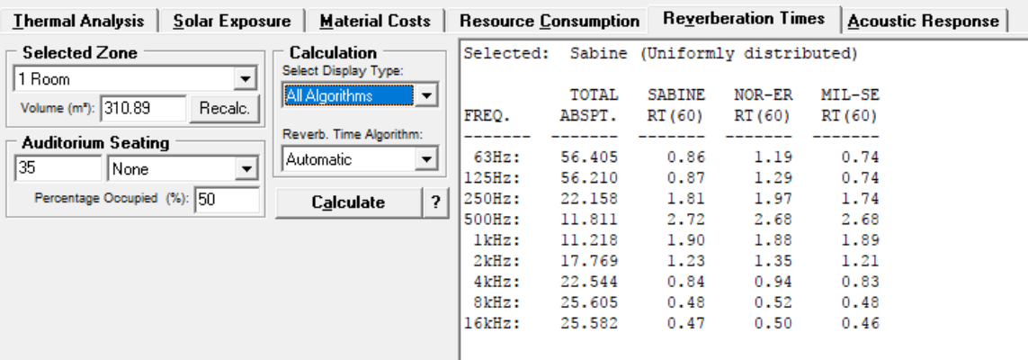
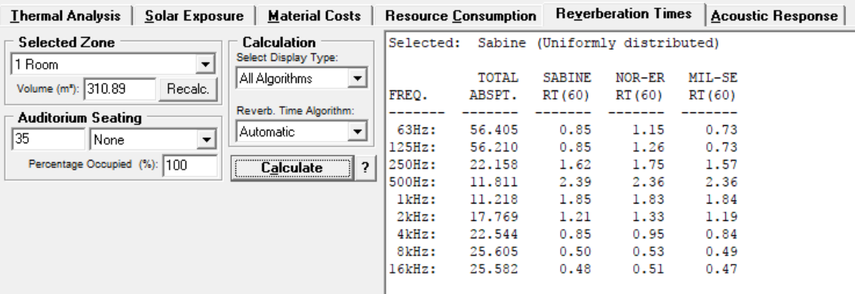
Using Autodesk Ecotect the RT₆₀ values at 500 Hz in the three cases are larger than the limit which is in the range of 0.4 and 0.6 sec.
So We Need Absorbers

Slide 61
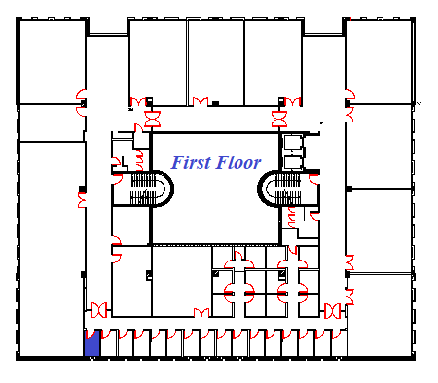

Music Room RT60

Slide 62



Using Autodesk Ecotect the RT₆₀ values at 500 Hz in the three cases are in the range of the standard which is 0.9 - 1.2 sec

Slide 63


Office RT60

Slide 64



Using Autodesk Ecotect the RT₆₀ values at 500 Hz in the three cases are in the range of 0.4 and 1.7 sec

Slide 65


Sound Transmission Class
STC for the external wall: The resulted STC = 40 db.
STC for the internal wall: The resulted STC = 51 db.

Slide 66

Impact Insulation Class:
IIC for the Ceiling: The resulted IIC = 46 db.

Slide 67

Background Noise:
Space | Back Ground Noise inside(db.) | Back Ground Noise Outside(db.)
Class Room | 50 | 80
Music Class | 42 | 62
Labor Office | 43 | 70

Slide 68
Mechanical Analysis

Slide 69


DRAINAGE SYSTEM

Slide 70

WATER SUPPLY SYSTEM

Slide 71

Roof Drainage Layout:

Slide 72


FIREFIGHTING SYSTEM

Slide 73

RAINWATER STOREGE

Slide 74
FUEL SUPPLY

Slide 75

ELEVATORS

Slide 76
HVAC SYSTEM

Slide 77


Slide 78



Roof plan HVAC ducting layout

Slide 79
ELECTRICAL SYSTEM ANALYSIS

Slide 80


Electrical System:

Slide 81
circuit breaker calculations and distribution
zone | Number of Z44 LED 61W 4000K DALI | Number of gbs 300 4*18W | Socket of (2 AMP)
A*3 | 24 | - | 72
B*5 | 60 | - | 15
C*5 | - | 60 | 3
D*21 | 42 | - | 19
WC *2 | - | 11 | 2
Tottal power (watt) | 7686 | 5112 | -
Tottal AMP | 34 | 23 | 222

Slide 82
Lighting Analysis

Slide 83
Main Lighting Characteristics
1.Intincity
2.Glare Index(UGR)
3.Uniformity
4.Color Irradiation

Slide 84


For Example : Classroom
The Unites :
3D view

Slide 85


Results:

Slide 86
CONSUMPTION

Slide 87
1.Water Consumption
2.Energy Consumption

Slide 88
Case Study

Slide 89

Site Analysis:

Slide 90

GALEF CENTER FOR FINE ARTS, OTIS COLLEGE

Slide 91


Architectural:

Slide 92

Otis Architectural:

Slide 93

Passive Design:

Slide 94

Structural:

Slide 95

Electromechanically:

Slide 96
CONCLUSION

Slide 97
1.Architectural aspects
2.Passive aspects
3.Structural aspects
4.Mechanical aspects
5.Electrical aspects
6.Lighting aspects
7.Consumption
Aspects:

