Slide 1
3D Printer Cake Decoration

Slide 2
3D Printer Cake Decoration
What is the project ?
Why we choose this project? What is the main purpose of the project?

Slide 3
3D Printer Cake Decoration
What is 3D printer?
Things limits the project work.

Slide 4
Fused Deposition Modeling
Fused deposition modeling (FDM) categories:
Cartesian 3D printer
Delta 3D printer
Polar 3D printer
Scara 3D printer
Why FDM?
What type of FDM should we use?

Slide 5
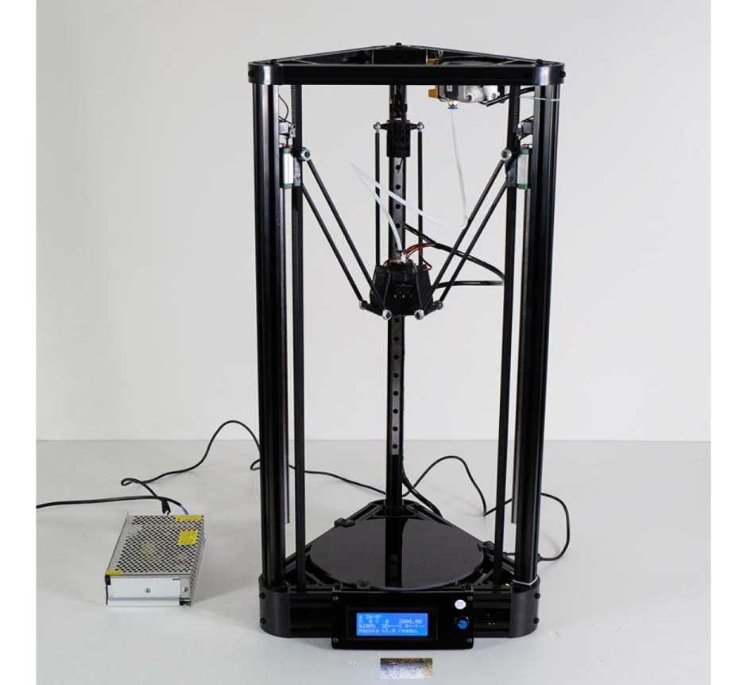
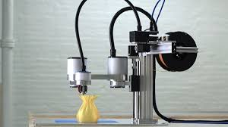
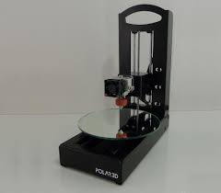
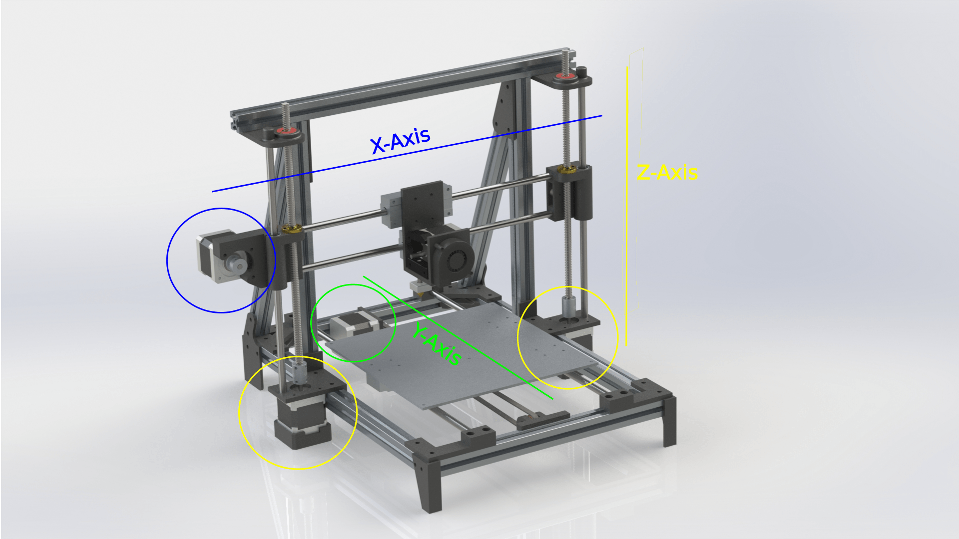

Slide 6
Extruder
Extruder we will use (special extruder) to convert the rotary motion to linear motion .

Slide 7
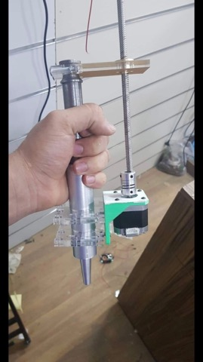

Slide 8
STL Files
What is STL Files?
Describes the Geometry
Generated by CAD program
Commonly used for 3D Printing

Slide 9
Firmware
What is Firmware?
Bridge between the hardware and software.
Translates the software commands.
most used firmware's :
Repetier
Marlin
Which Frimware should we use and why?

Slide 10
Software
3D Printing Design Software
SketchUp
Fusion 360
solidworks
3D Printer Slicer and Control Software
Cura
Repetier
Slic3r

Slide 11
Material
Sugar craft
Which is made of: butter, sugar powder, vanilla and corn powder.
Chocolate

Slide 12
Methodology
Electrical part
Mechanical part

Slide 13
Electrical components:
The controller
  Arduino
Ramps 1.4 Board
What is Ramps board?

Slide 14
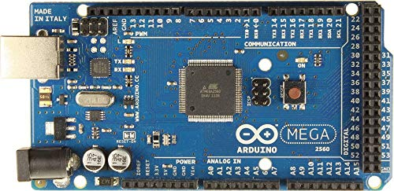
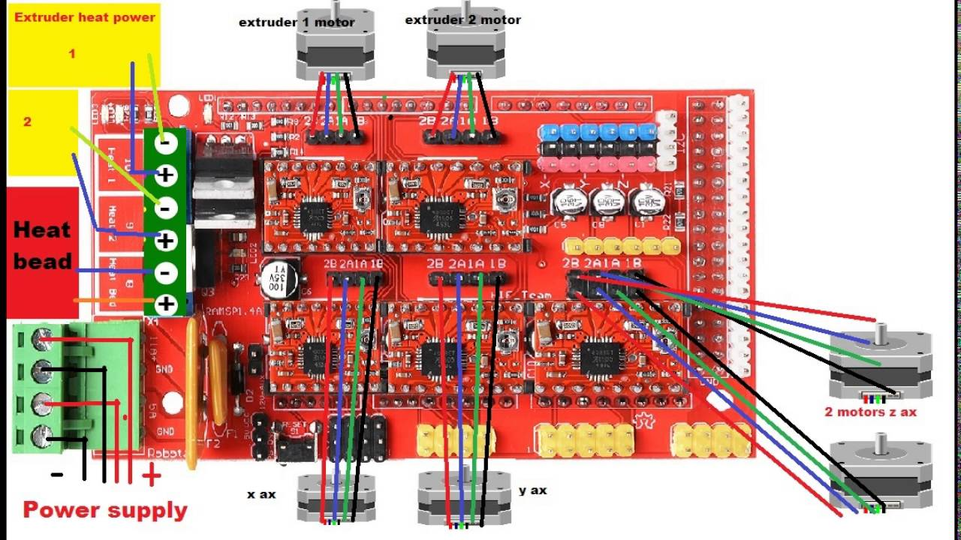

Slide 15
Stepper Motor
  NEMA 17 stepper motor
*Heated Bed

Slide 16
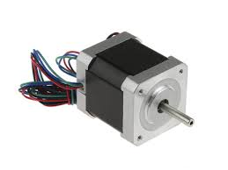

Slide 17
Mechanical part
Mechanical components
20mm*20mm aluminum profile.
3mm aluminum corner connectors.
12mm Hard chromium plated round steel.
LM12UU Linear Bearing.
3D Printed Bearing& shaft holders.
8mm lead power screw

Slide 18
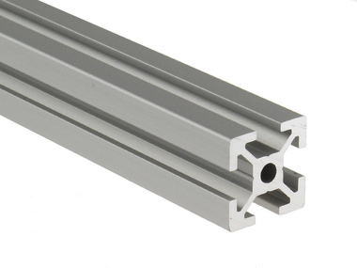
20mm*20mm aluminum profile

Slide 19
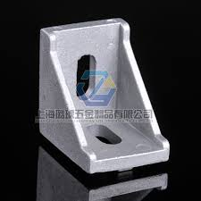
3mm aluminum corner connectors

Slide 20
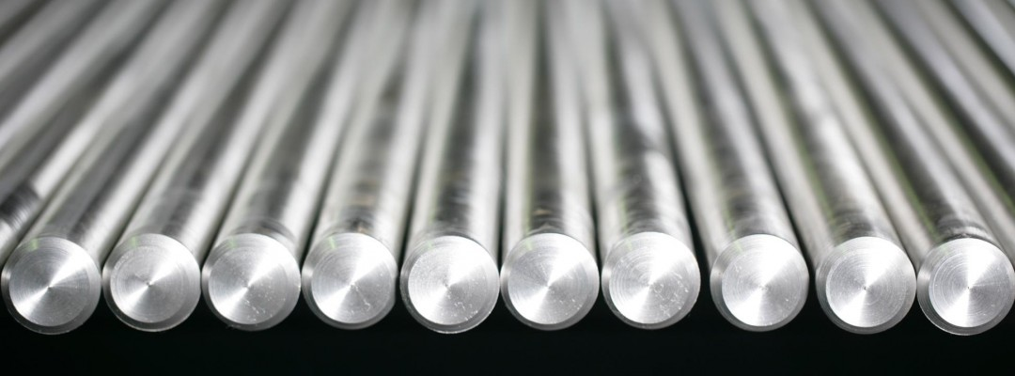
12mm Hard chromium plated round steel

Slide 21
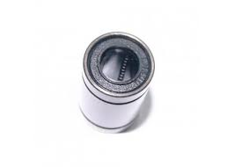
LM12UU Linear Bearing

Slide 22
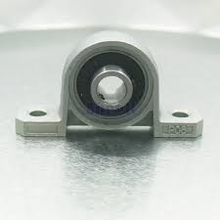
3D Printed Bearing& shaft holders

Slide 23
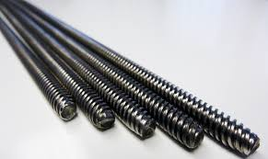
8mm lead power screw.

Slide 24
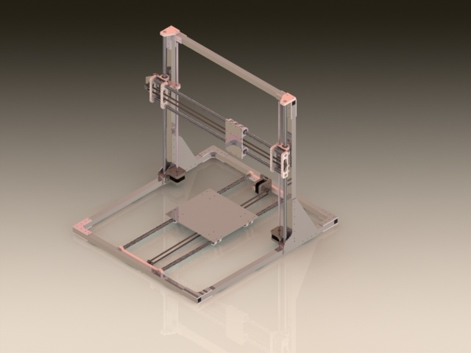
Mechanical Design(

