Slide 1
MazeMaster

Slide 2
Project Idea.
Origins of the idea.

Slide 3
Development Process:
Designing.
Programming.
Testing.

Slide 4
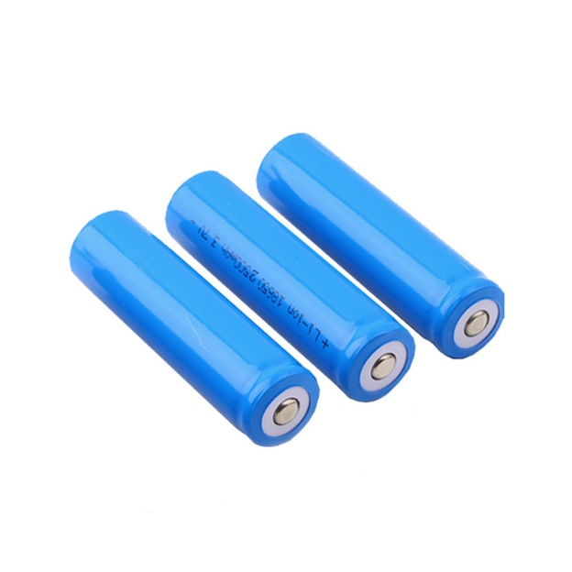
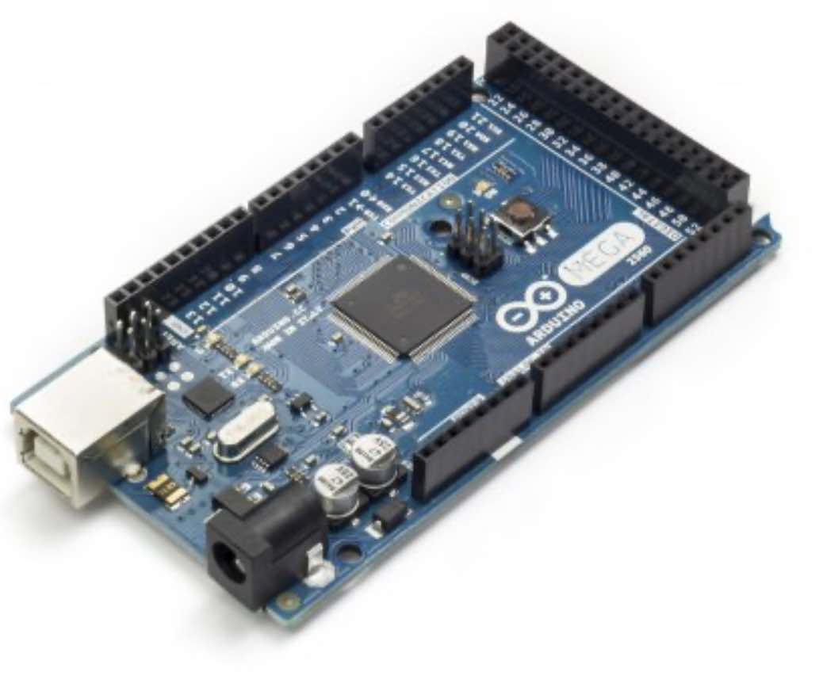
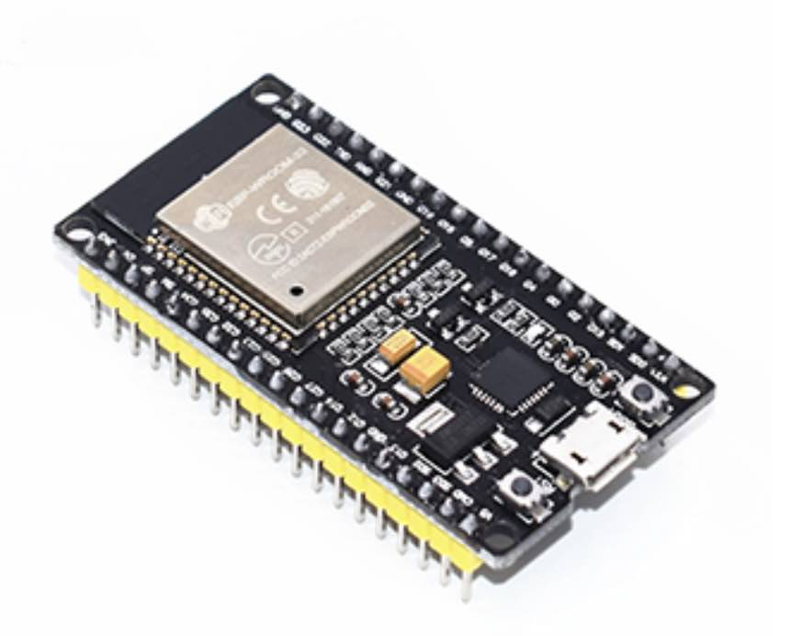
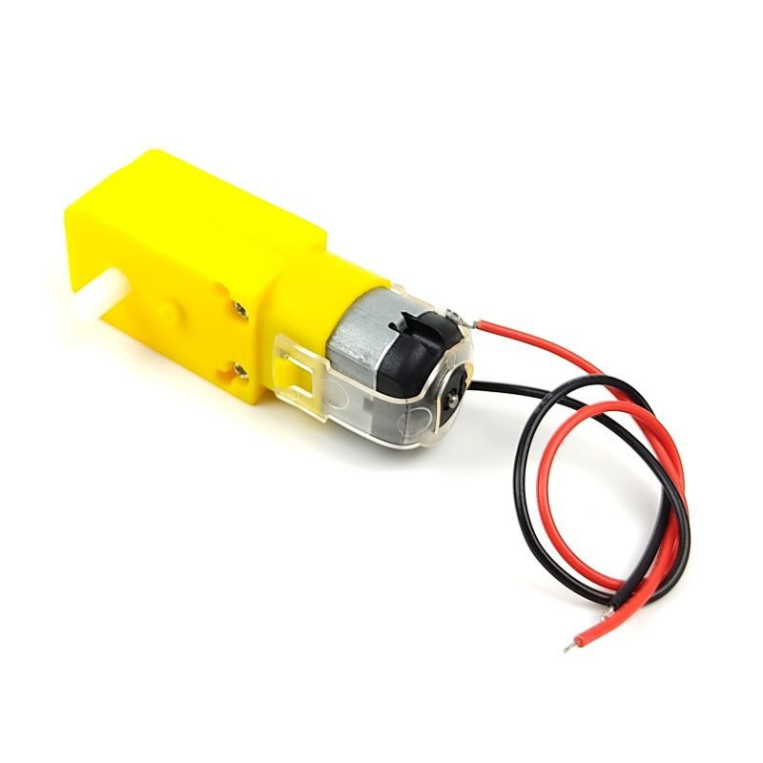
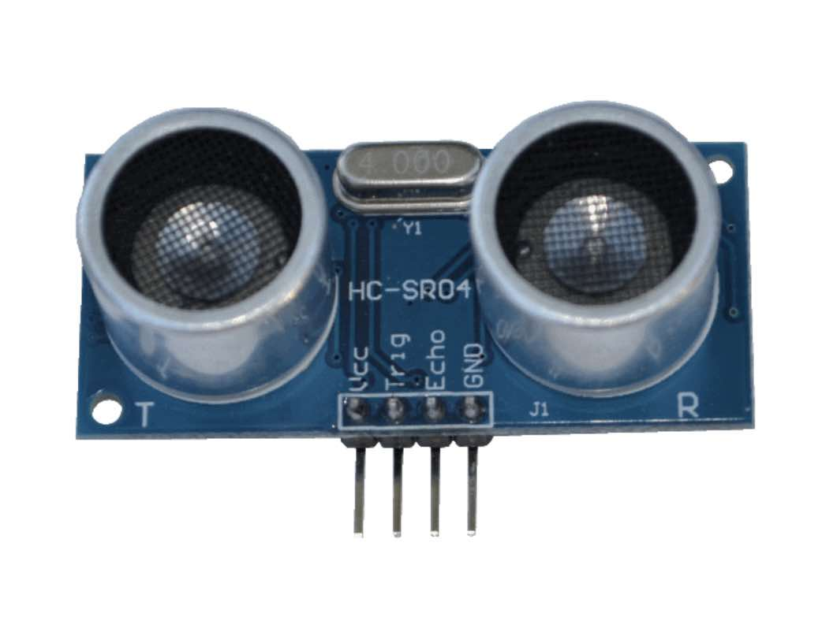
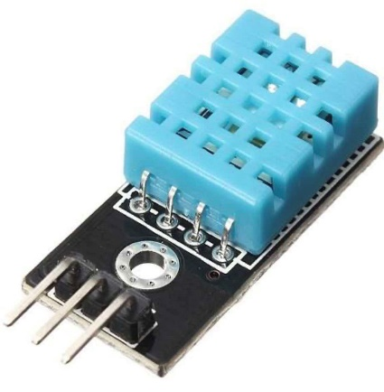
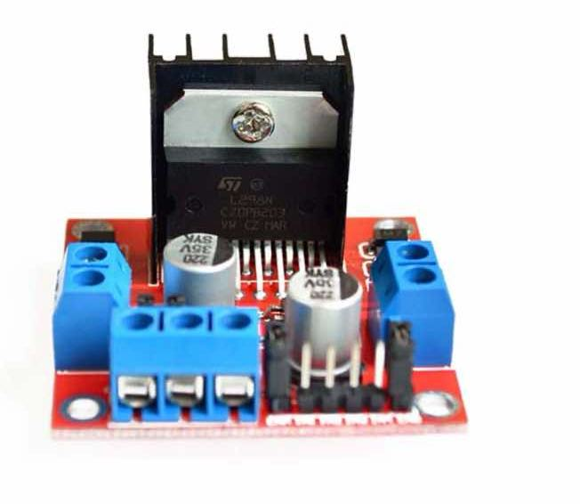
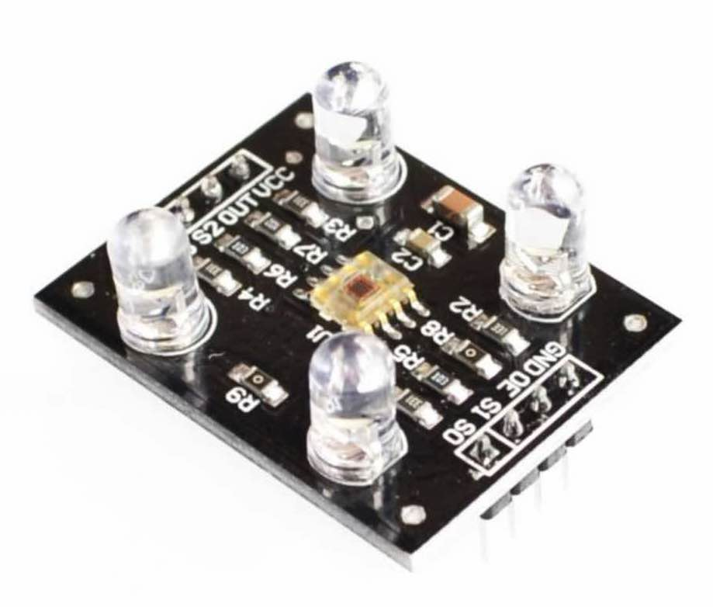
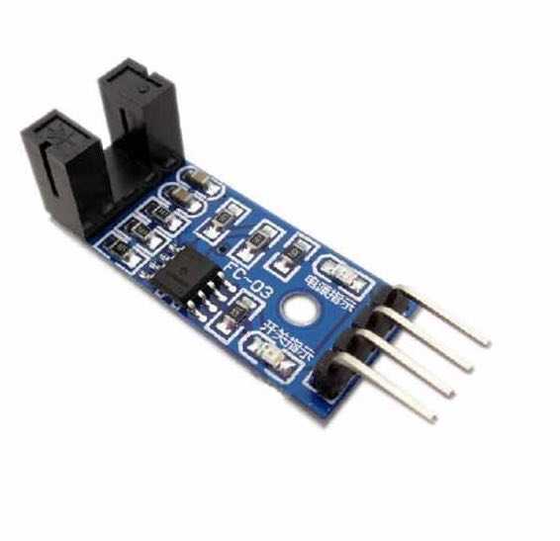
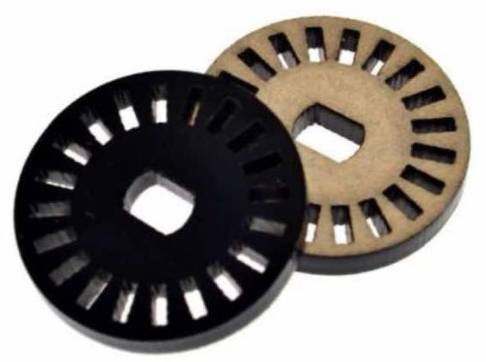
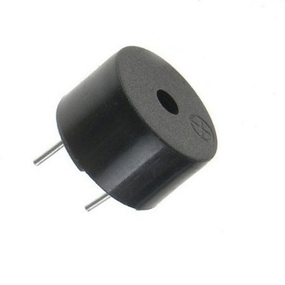
Tools and Components:

Slide 5

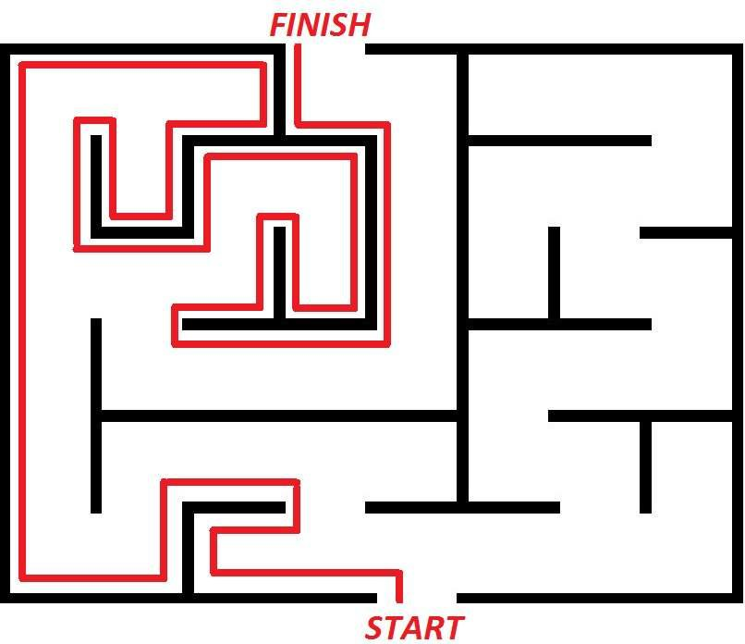





Algorithm Overview
Left-Wall Following

Slide 6
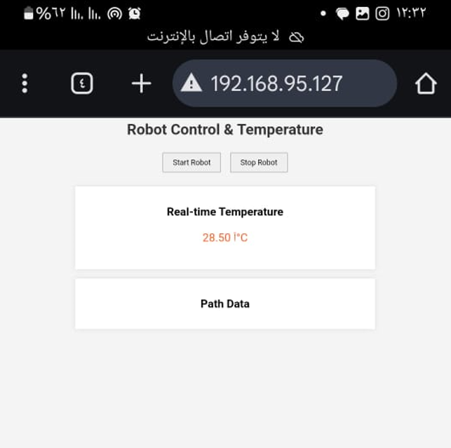

Control & Tempreture Interface:

Slide 7
Project constraints:

Slide 8

Project constraints:
Budget.
Movements and sensors accuracy.
Time and Place.

Slide 9
Future Work:
Upgrade motors and sensors.
Camera integration and manual control mode.

Slide 10
Thank you
Made by:
Mohammad Anwar Salman.
Mohammad Hamed Najjar.
Supervised by:
Sufyan Samara.
Muhannad Al-Jabi.

