Slide 1

An-Najah National University
Faculty of Engineering
Building Engineering Department
Graduation Project – 2
Integrated Design of Academic Library
Arab American University Library – Jenin
Prepared By:
Odai BaniOdeh
Ali Khuffash
Kassab Jaber
Bader Bozeyh
Project supervisor: Dr. Ahmad Saleh

Slide 2
CONTENTS
Introduction
Selected Site
Architectural Design
Structural Design
Environmental Design
Electrical Design
Mechanical Design
Safety Design
Estimated Cost

Slide 3
INTRODUCTION
The project is designing a library building in Arab American University – Jenin (AAUJ). This project is significant because the university campus lacks to an independent library.
The main concept of our project was to design an integrated Academic library(AAUJ), and our focus has been on Structure, Environmental, Electrical, Mechanical and Safety design to make a comfortable Library.

Slide 4
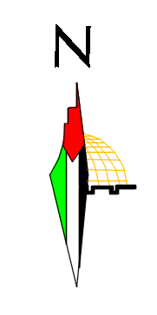
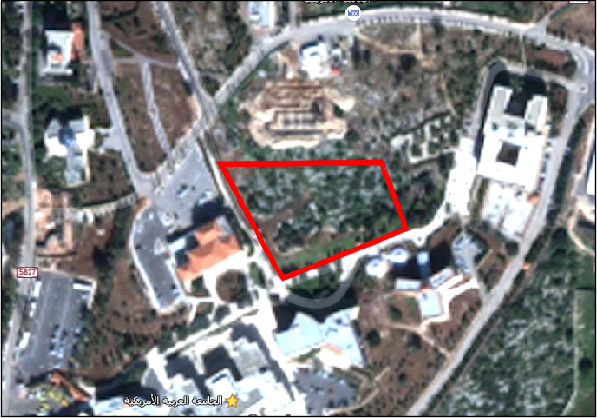
Selected Site
Site Area : 8443 m²
The suggested land locates at the middle of the university campus to insure that the students can easily arrive the library building from any faculty.

Slide 5
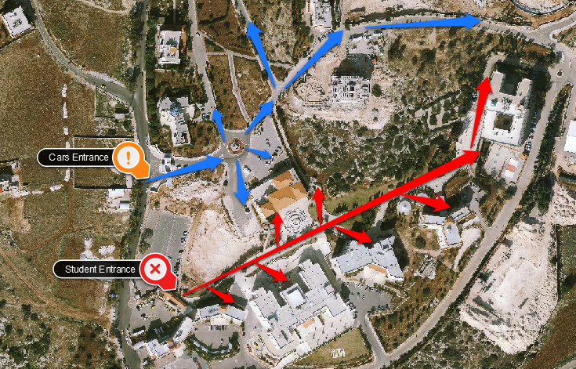
Selected Site

Slide 6
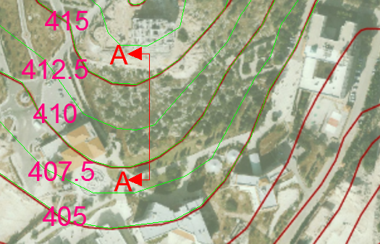
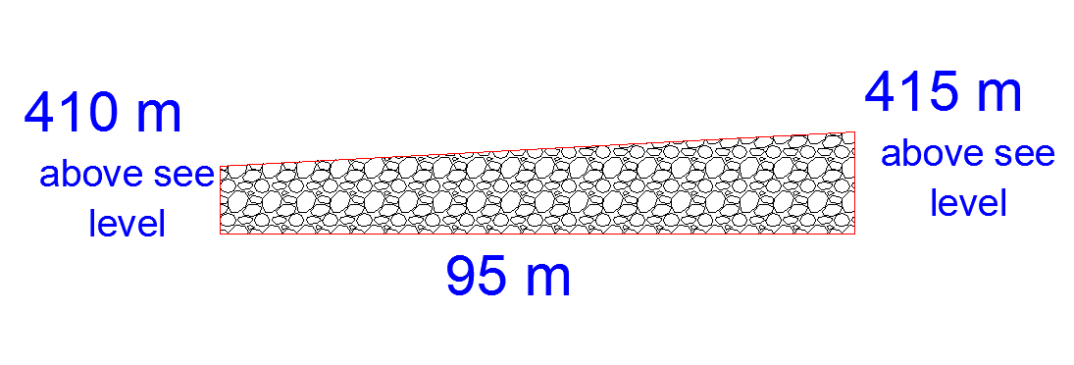
Section A-A
Selected Site
The slope of the site is about
5% as the contour lines and section A-A show below.

Slide 7
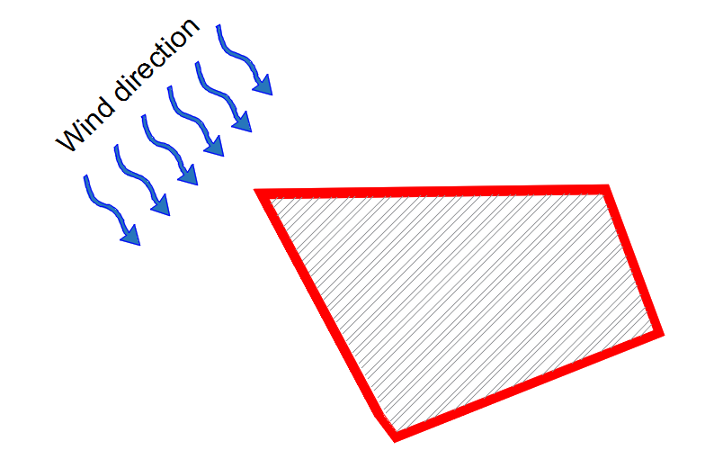
Selected Site

Slide 8
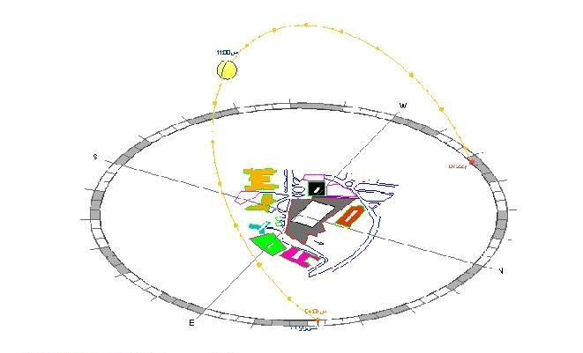
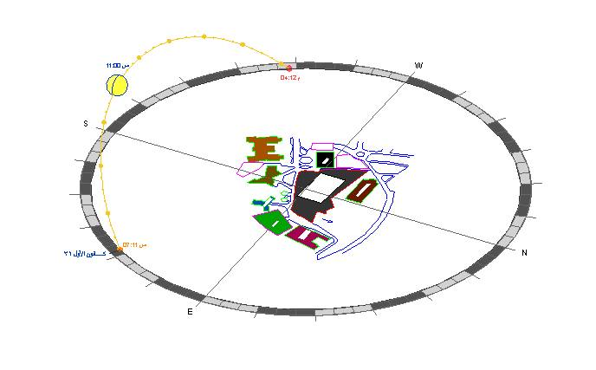
Selected Site
Sun path at winter and the location of the sun
at 11:00 am in 21/12
Sun path at summer and the location of
the sun
at 11:00 am in 21/6

Slide 9
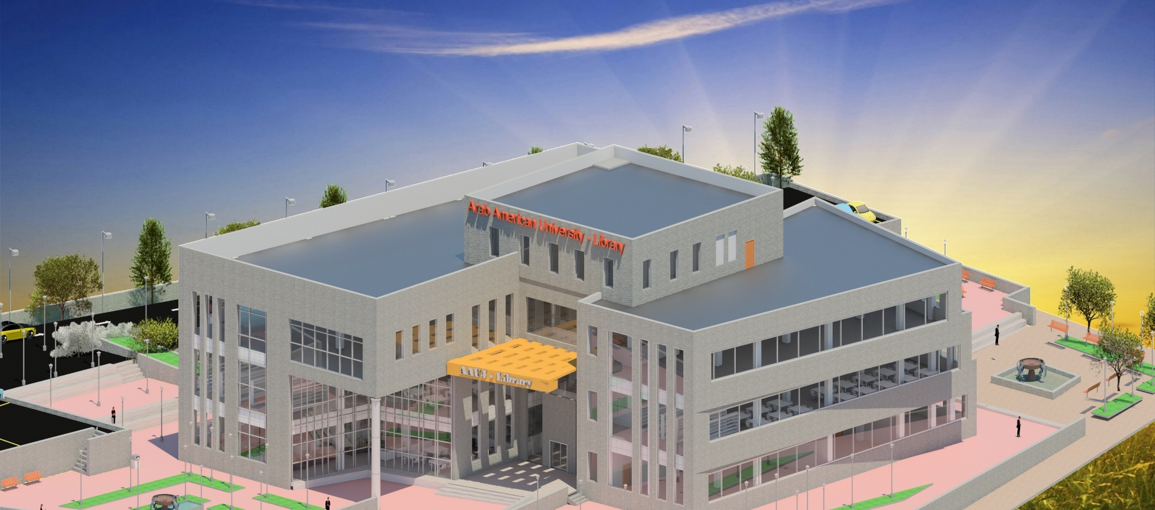
ARCHITECTURAL DESIGN

Slide 10
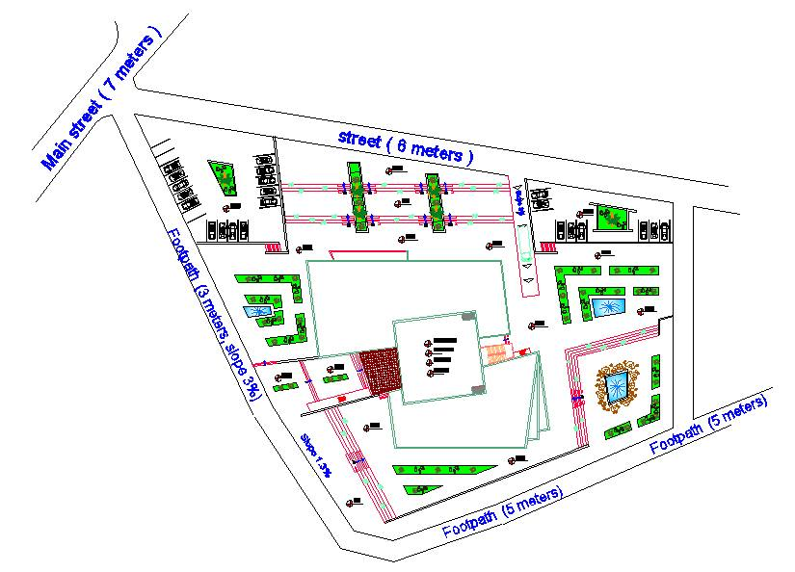
Site Plan

Slide 11
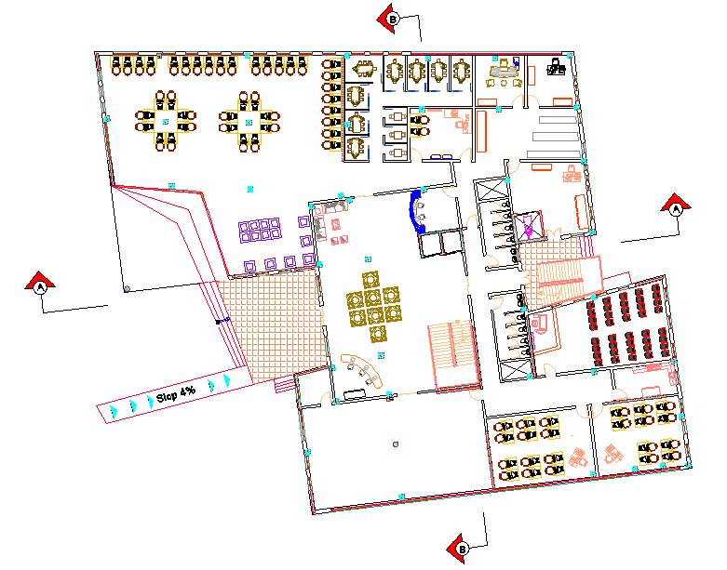
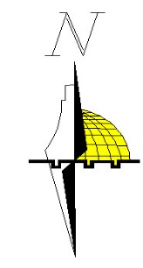
Ground Floor

Slide 12
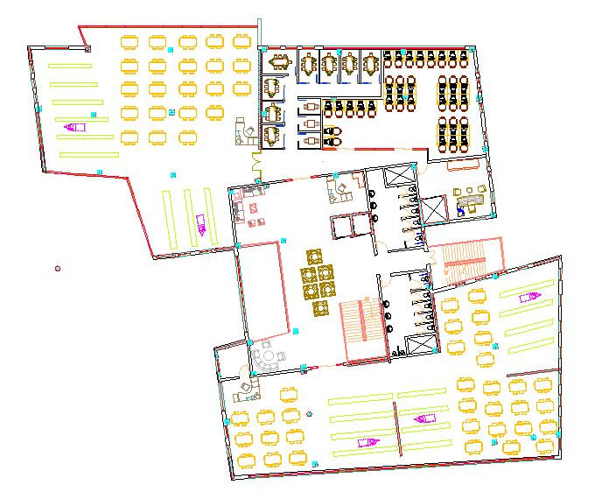

First Floor

Slide 13
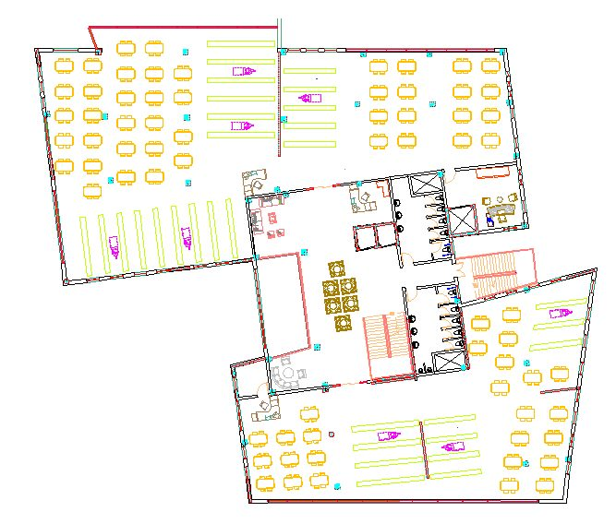
Second Floor

Slide 14
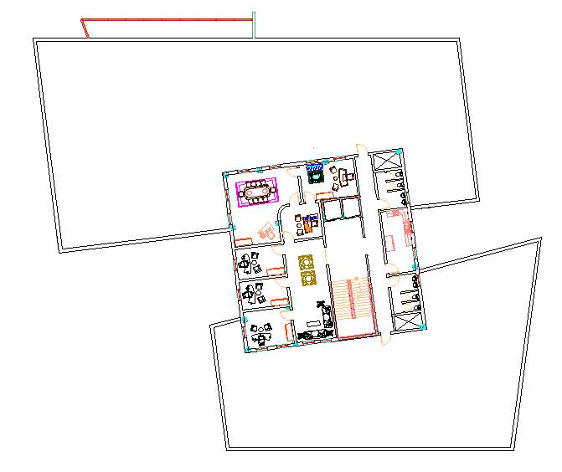
Third Floor

Slide 15
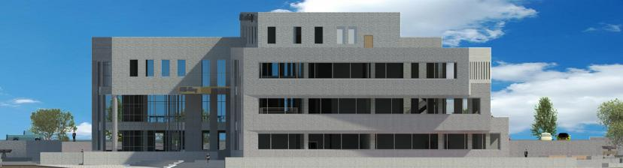
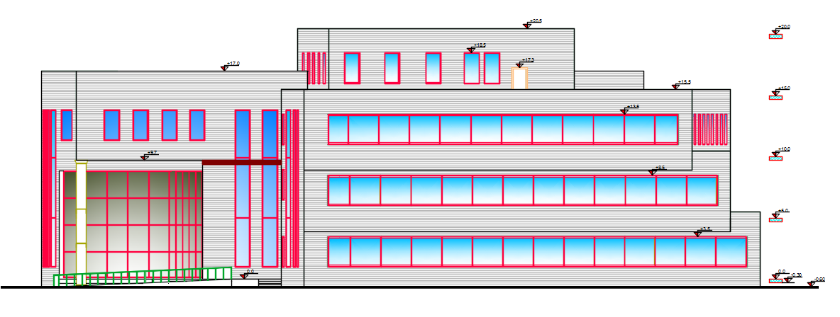
Elevations
South-Elevation

Slide 16
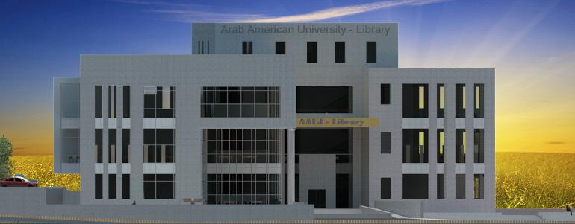
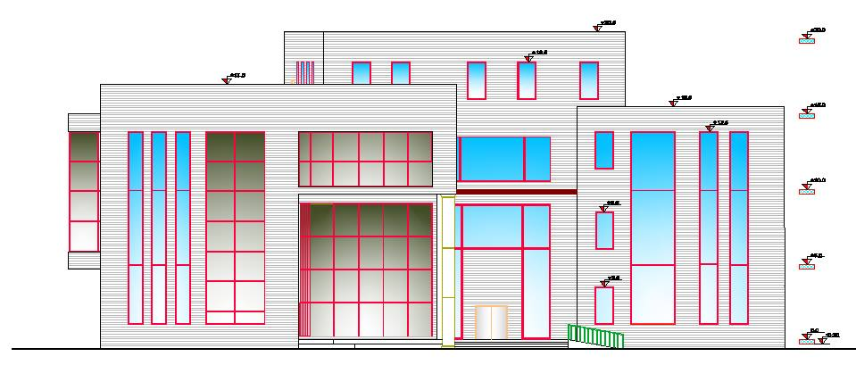
Elevations
West-Elevation

Slide 17
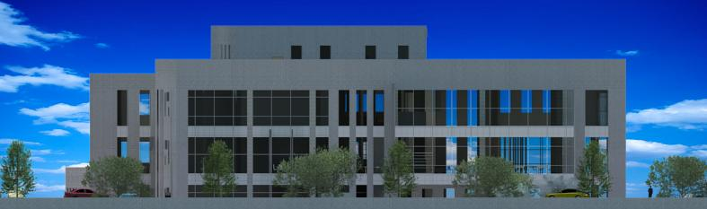
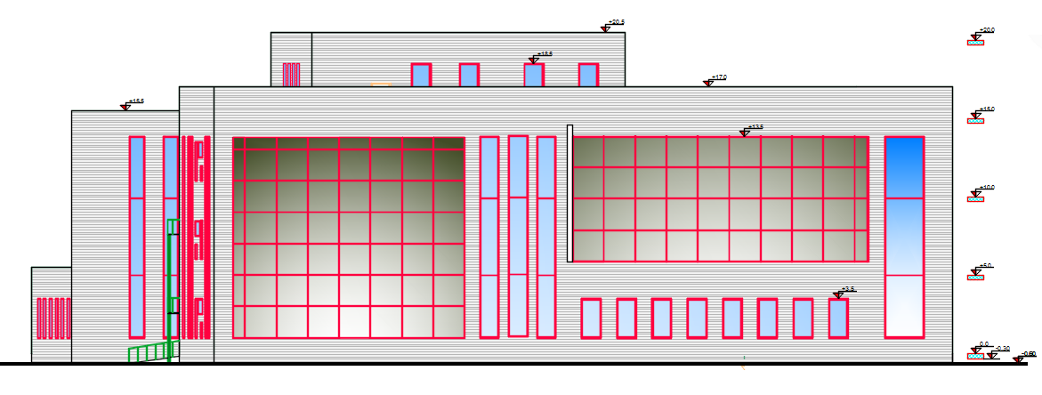
Elevations
North-Elevation

Slide 18
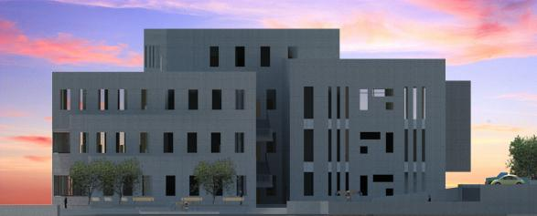
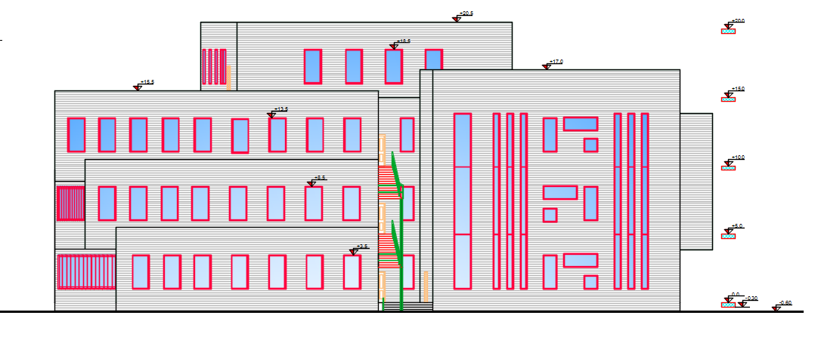
Elevations
East-Elevation

Slide 19
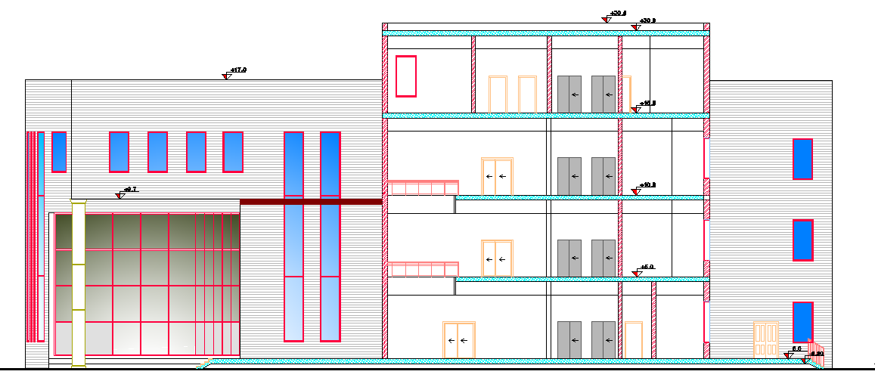
Sections
Section A-A

Slide 20
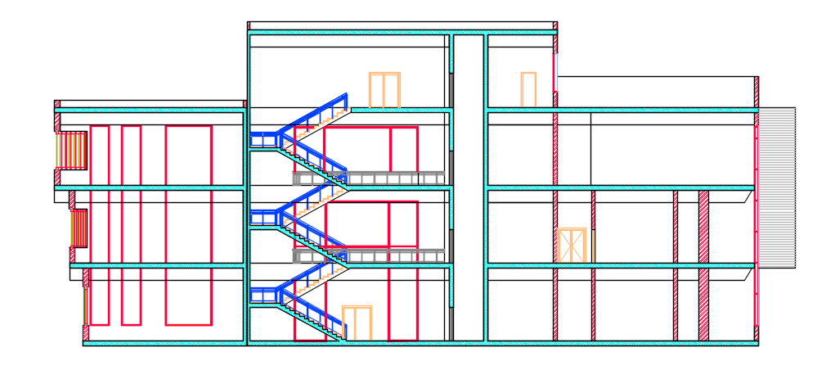
Sections
Section B-B

Slide 21
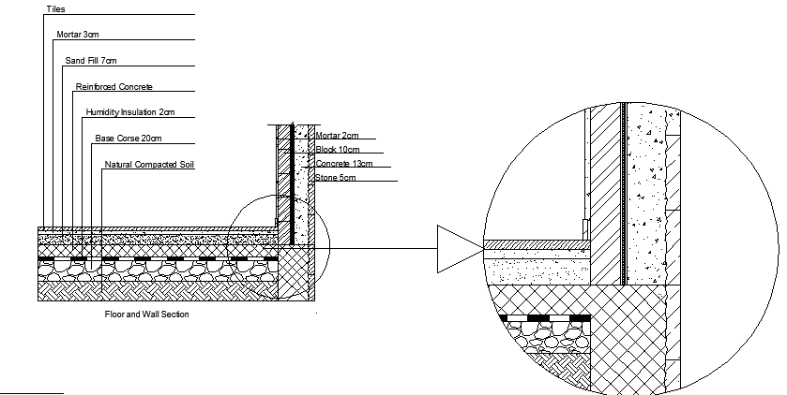
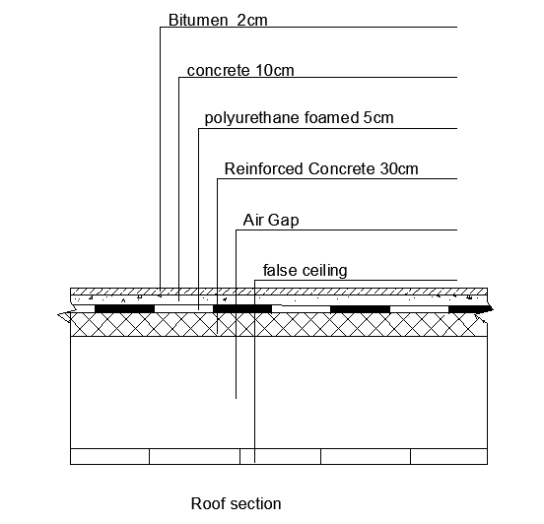
Sections
Floor and wall section
Roof section

Slide 22
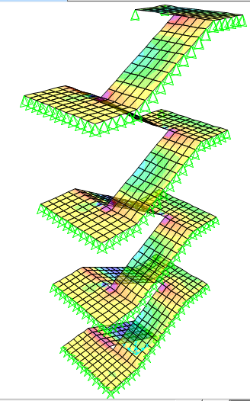
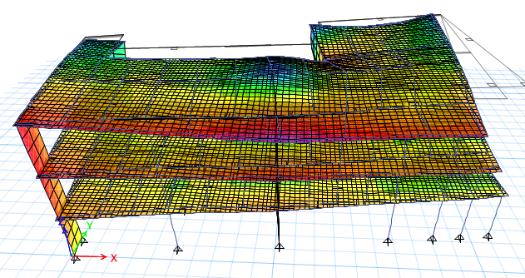
STRUCTURAL DESIGN

Slide 23
Design Codes
American Society of Civil Engineers (ASCE).
The American Concrete Institute code (ACI 318).
Uniform Building Code (UBC-97).

Slide 24
Material Property
Compressive strength of Concrete “f′c” :
    For columns and slabs f′c = 32 Mpa
    For all other elements in structure such as blinding and bracing f′c = 12 Mpa
Yielding strength of steel fy = 420 MPa.
Soil bearing capacity = 300 KN/m²

Slide 25
Seismic Design Data
Jenin Seismic Zone is 2B, Seismic Factor Z= 0.2
Importance Factor I = 1
Stiffness Factor R = 5.5
Seismic Coefficient (Cv) = 0.2
Seismic Coefficient (Ca) = 0.2
Soil profile = S_{B}

Slide 26
Loads
Super Imposed dead load (SI): 4 KN/m²
Live Load (L.L): 7 KN/m² (for reading area)
3 KN/m² (for other areas)
Lateral loads consider earthquake load.

Slide 27
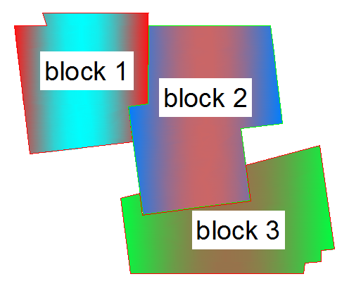
Design and Reinforcement of Structural Elements

Slide 28
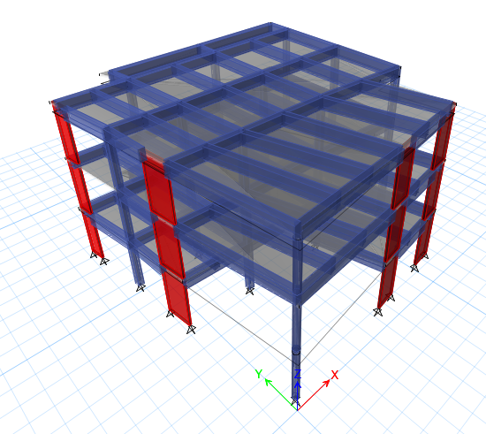
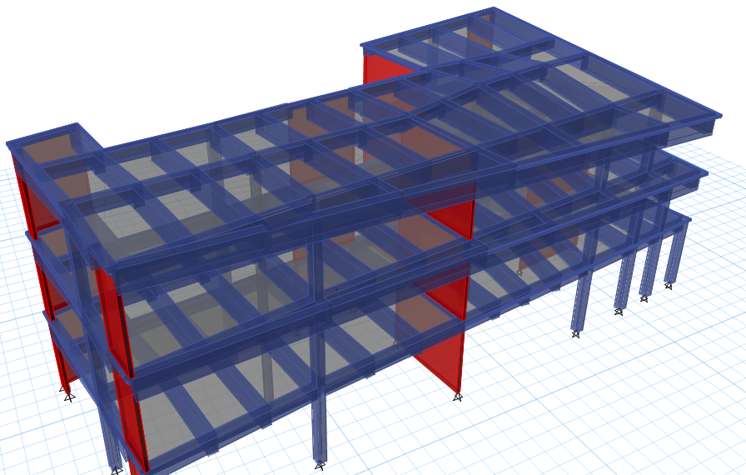
3D Models - Etabs

Slide 29
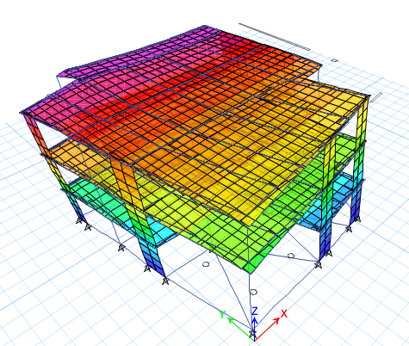
Model Checks
Compatibility

Slide 30
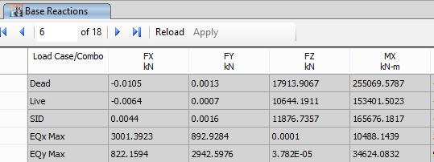
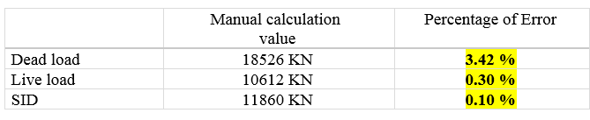
Model Checks
Equilibrium

Slide 31
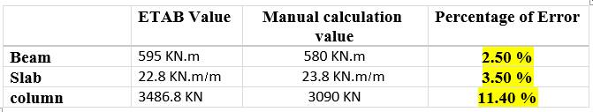
Model Checks
Internal Forces

Slide 32
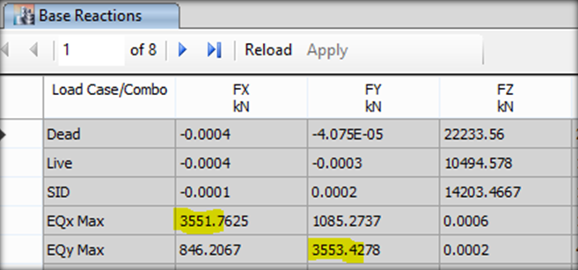
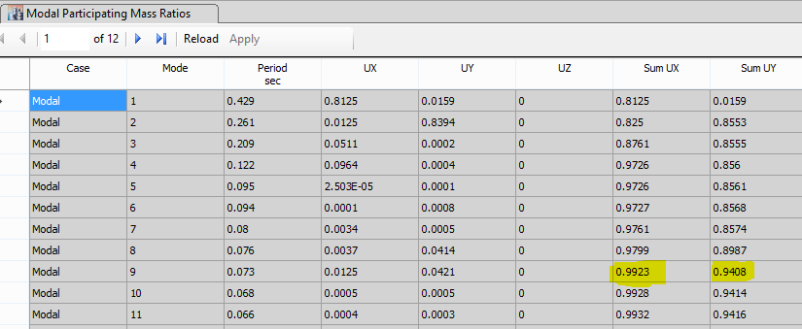
Seismic design
Cv = 0.2
Ca = 0.2
I = 1
R = 5.5
Soil profile S_{B}
Z =0.2
From Etabs
Base shear ( V ) = 3550 KN
Mass participation ratio is larger than 90% in X, Y .

Slide 33
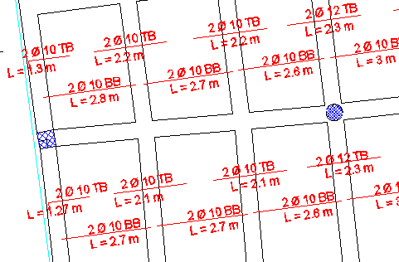
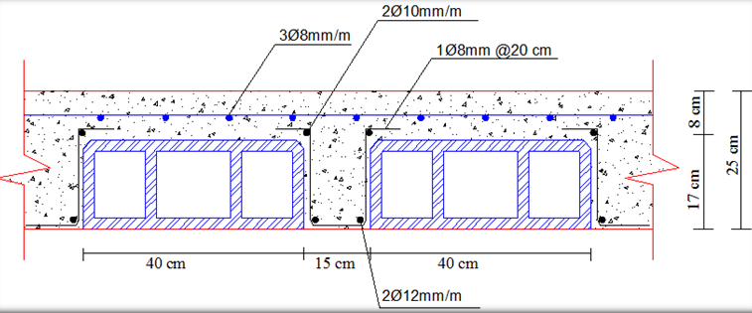
Slab Reinforcement Details

Slide 34
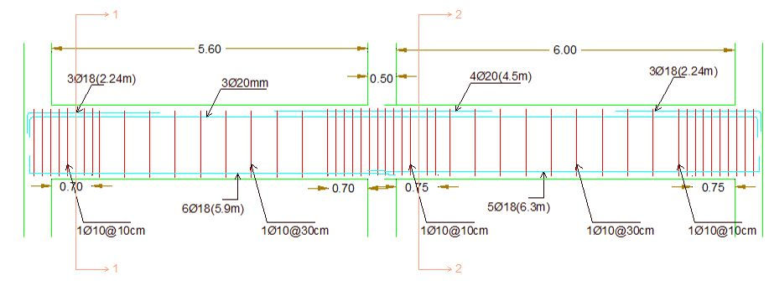
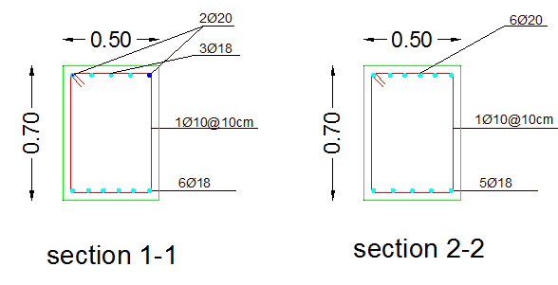
Beam Reinforcement Details

Slide 35
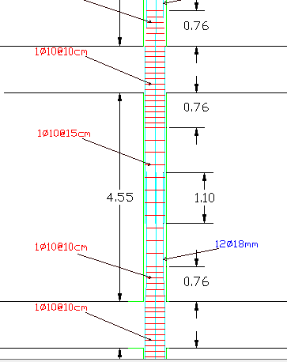
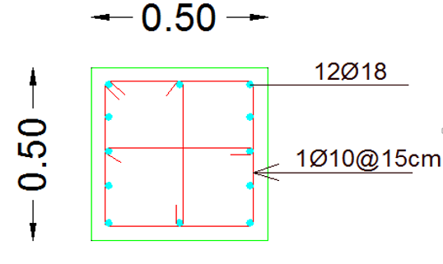
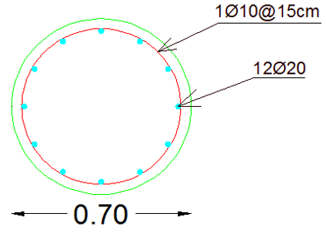
Column Reinforcement Details

Slide 36
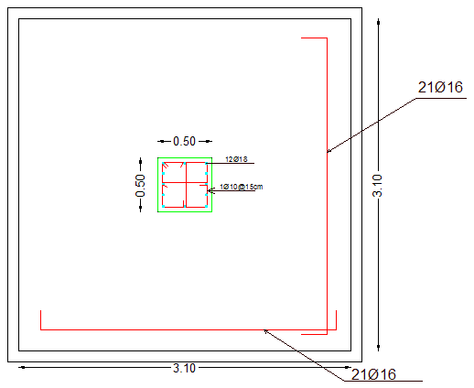
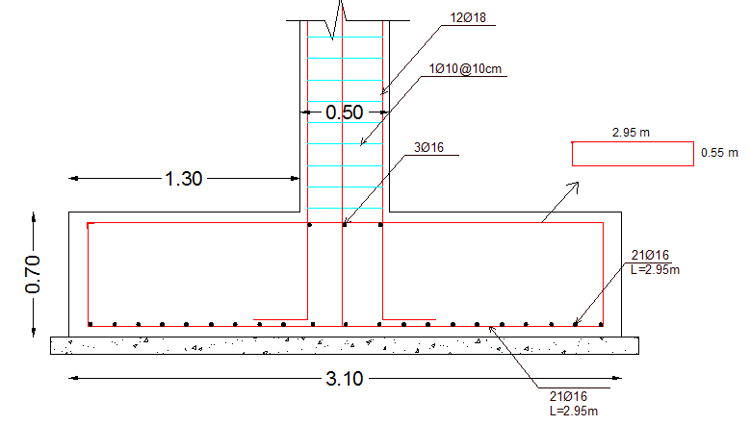
Footing Reinforcement Details
Single Footing

Slide 37
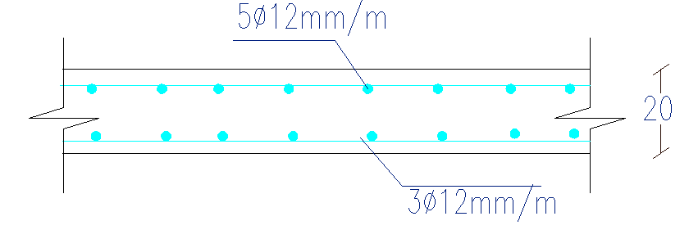
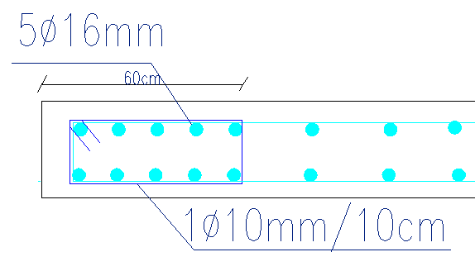
Shear Wall Details

Slide 38
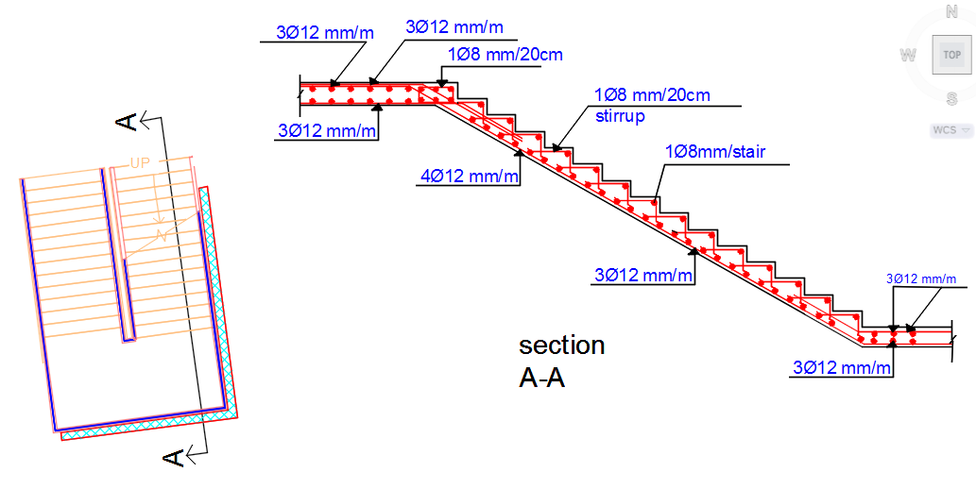
Stair Reinforcement Details

Slide 39

Environmental Design

Slide 40

Shading
Sun path and shadow on the building
shadow (8 am-18 pm) and annual sun path for the building using Ecotect

Slide 41


Shading Devices
shadow (11am) 21st June South and east elevation
shadow (2am) 21st June west elevation

Slide 42


Environmental Analysis
External wall layers and properties

Slide 43


Internal wall layers and properties

Slide 44


Floor layers and properties

Slide 45


Ceiling layers and properties

Slide 46


Roof layers and properties

Slide 47


Thermal Analysis
heating and cooling loads
Monthly heating and cooling load all visible thermal zones

Slide 48


Slide 49

Daylight Analysis (DF%)
Glass type used
BLUE (SGG COOL-LITE KS 746 II) with properties as follow

Slide 50


Electronic library (DF%)
Avg DF= 5.35%
Avg Level = 454.35 lux

Slide 51


Reading area 2nd floor (DF%)
Avg DF= 5.51%
Avg Level = 467.96 lux

Slide 52

Summary (DF%)

Slide 53



Acoustical Design
Sound Transmission Class (STC)
STC for external wall
STC for internal wall
Impact Insulation Class (IIC)

Slide 54


    Acoustical Design
    Reverberation Time (RT60)
    Range RT60 for Library 0.5-1.2sec
    RT60 values for Reading area before improving :

Slide 55


    Acoustical Design
    Improving RT60 by add Perforated metal panels

Slide 56


    Acoustical Design
    Reverberation Time (RT60)
    RT60 values for Reading area after improving (35% of ceiling area):

Slide 57

Electrical Design

Slide 58


Artificial Lighting
The simulation analysis and design by “DIALux Evo 5”

Slide 59


Entrance hall 3^{ed} floor

Slide 60



Reading area

Slide 61


Discussion room

Slide 62

Class room

Slide 63


Ground floor lamps distribution

Slide 64




Sound reinforcement System
Distribution of loudspeakers in multipurpose hall
Type of used loudspeaker- Control 322C

Slide 65

    Sockets Arrangement
Ground Floor

Slide 66

Mechanical DESIGN

Slide 67

    Water Supply Design

Slide 68

    Water Supply Design

Slide 69

    Water Supply Design

Slide 70

    Water Supply Design

Slide 71

    Drainage System

Slide 72

    Drainage System
    Ground Floor

Slide 73

    Drainage System
    First Floor

Slide 74

    Drainage System
    Second Floor

Slide 75

    Drainage System
    Third Floor

Slide 76

    Roof Drainage System

Slide 77

    Storm water Drainage System

Slide 78

    H-VAC System
    Max Cooling: 250 KW at 14:00 on 15th August
    The dimension from main duct = (1300*2400) mm

Slide 79


    H-VAC System
    Air to Air System
    Distribution of ducts in reading area

Slide 80


    H-VAC System
ceiling diffuser
    Distribution of ducts in entrance hall

Slide 81
    H-VAC System
Zone | Area (m²) | Number of diffuser
Reading area first floor | 433.13 | 20
Entrance hall ground floor: | 193 | 10

Slide 82

Safety
DESIGN

Slide 83

    Safety Design
    Ground floor movement escape

Slide 84

    Safety System

Slide 85

Estimated Cost

Slide 86
Estimated Cost
The total cost of the LIBRARY is about 13.5 million NIS.
The total cost per meter square for the Library is about 2400 NIS.

Slide 87


