Slide 1

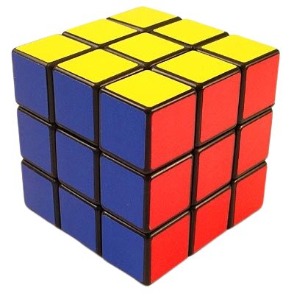


Rubik Cube Solver
Master Cube
Dr. Samer Arandi
Burhan & Bassam

Slide 2
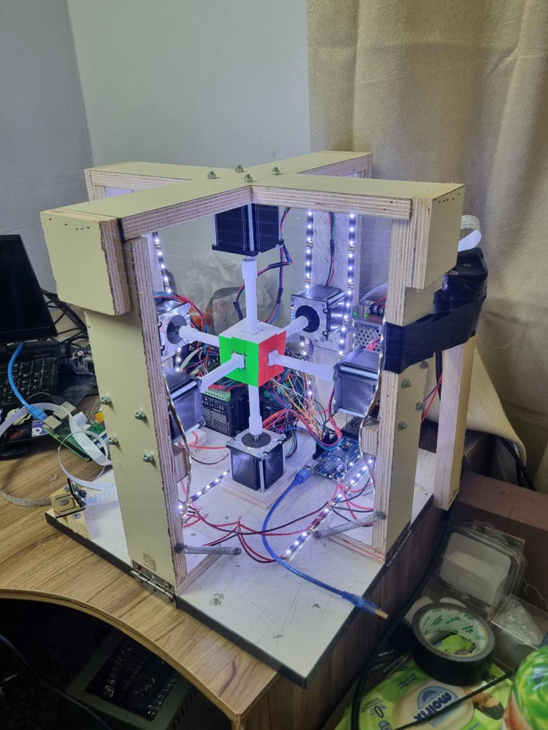
Rubik Cube Solver
Shaping the Future of Technology and Innovation
Buhan & Bassam

Slide 3




The Outline
  Introduction
  Tools
  Rubik Cube Solver Modes
  Image processing
  Communication
  Constraints
  Future work

Slide 4

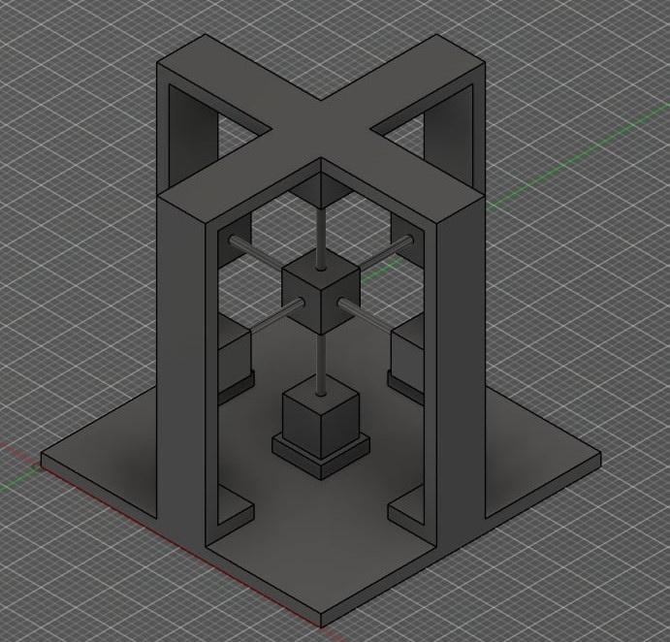
Introduction
  Our Rubik’s Cube Solver is used to solve 3*3 Rubik’s Cube.
  Its structure was designed using AutoDesk Fusion from wood & 3D-printed PCS.
  It uses CNN & OpenCV for detecting initial cube state .
  It uses three Algorithms for solving the cube
    Kociemba
    CFOP
    Begginers method .
  It has four different modes.

Slide 5
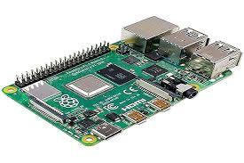

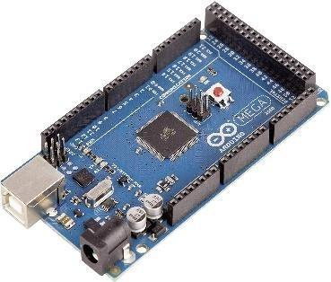
Tools
  Raspberry Pi 4 model b
  Arduino Mega 2560

Slide 6
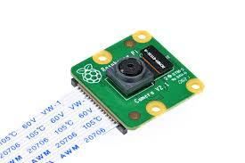
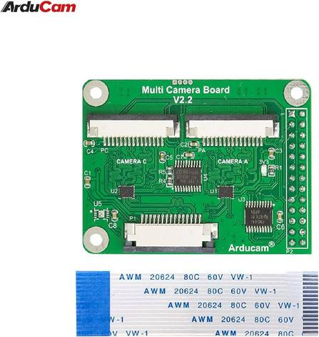
Tools
  Raspberry pi camera v2 × 2
  Arducam Multi Camera Adapter

Slide 7
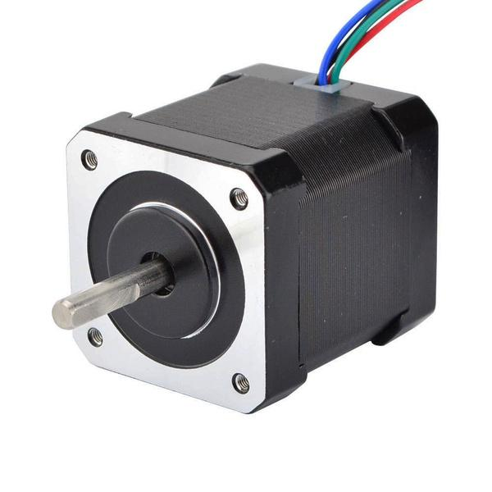
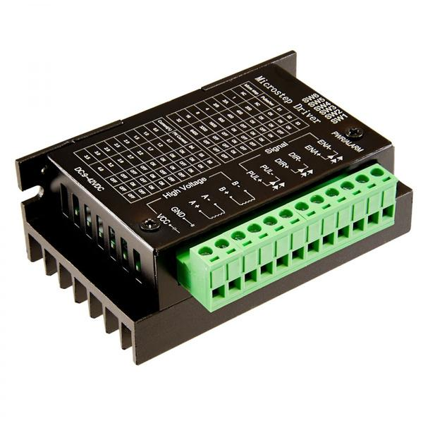
Tools
  Stepper Motor Nema 23
  Stepper moter driver TB6600

Slide 8
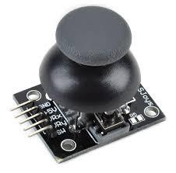
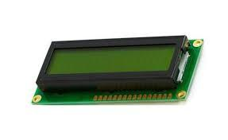
Tools
  Joystick
  LCD

Slide 9
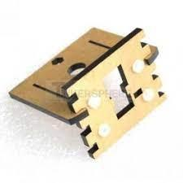
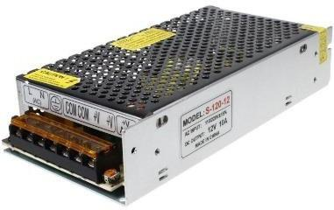
Tools
  Camera Module Mount Holder
  Power Supply 12.5A

Slide 10
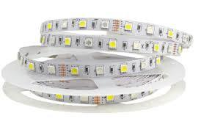
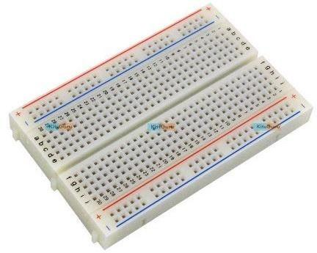
Tools
  LED Strip
  Bread board

Slide 11
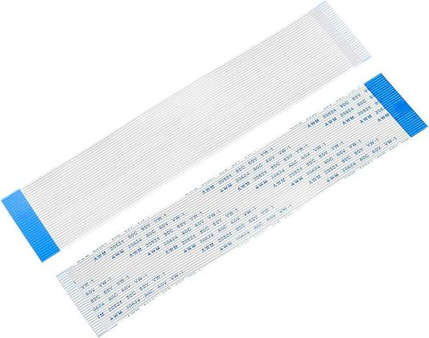

Tools
  Flexible Flat Cables (FFC)
  Rubik cube

Slide 12

Rubik Cube Solver Modes
  Fast Mode.
  Learning & Fun Mode.
  Teaching Mode.
  Free Mode

Slide 13
  Kociemba
  CFOP
  Begginers method
Flow Chart
Solve Cube
Fast Mode
Mode Selection
Start
Capture Initial State
Learning & Fun Mode
step-step by joystick
End
Select Algorithm
Select Algorithm
Solve Cube
Teaching Mode
Scramble
Free Mode

Slide 14
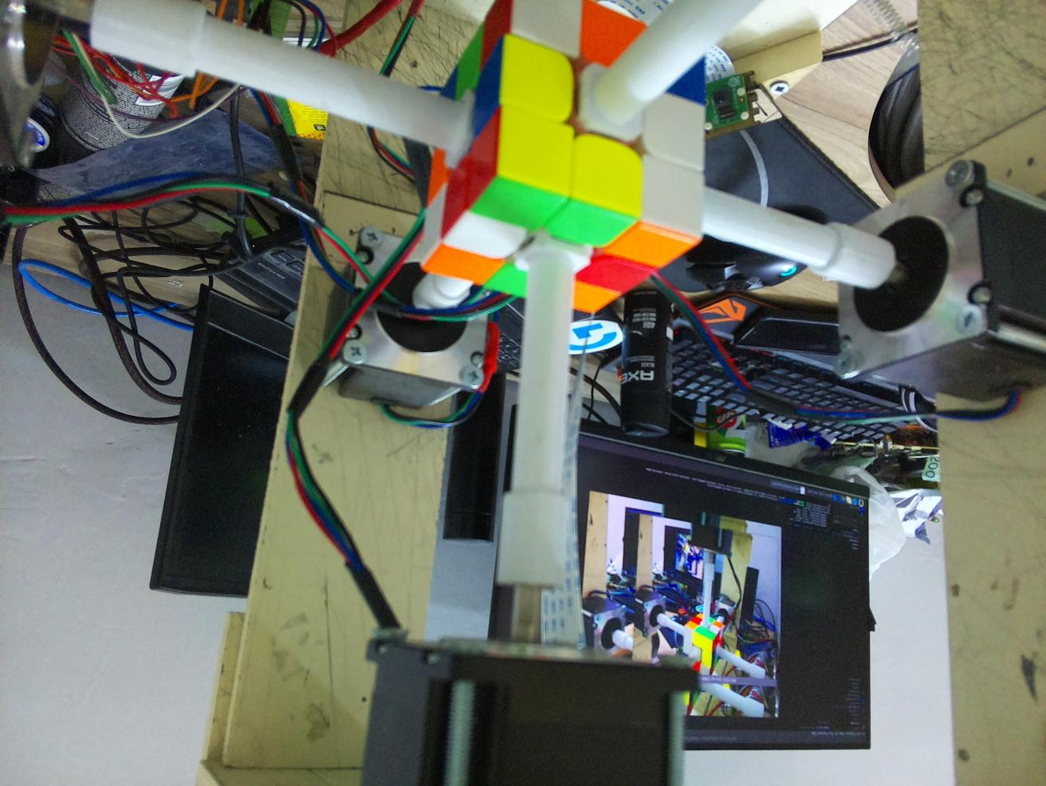
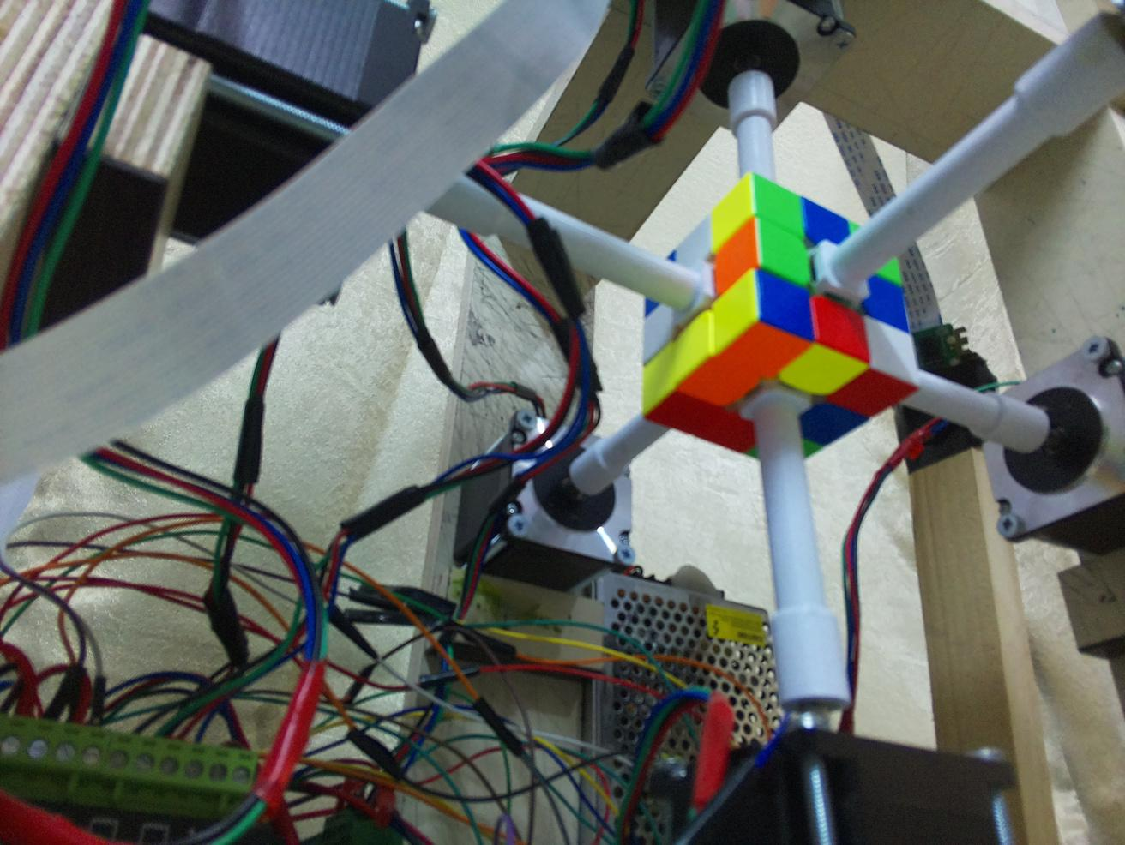
Image processing

Slide 15
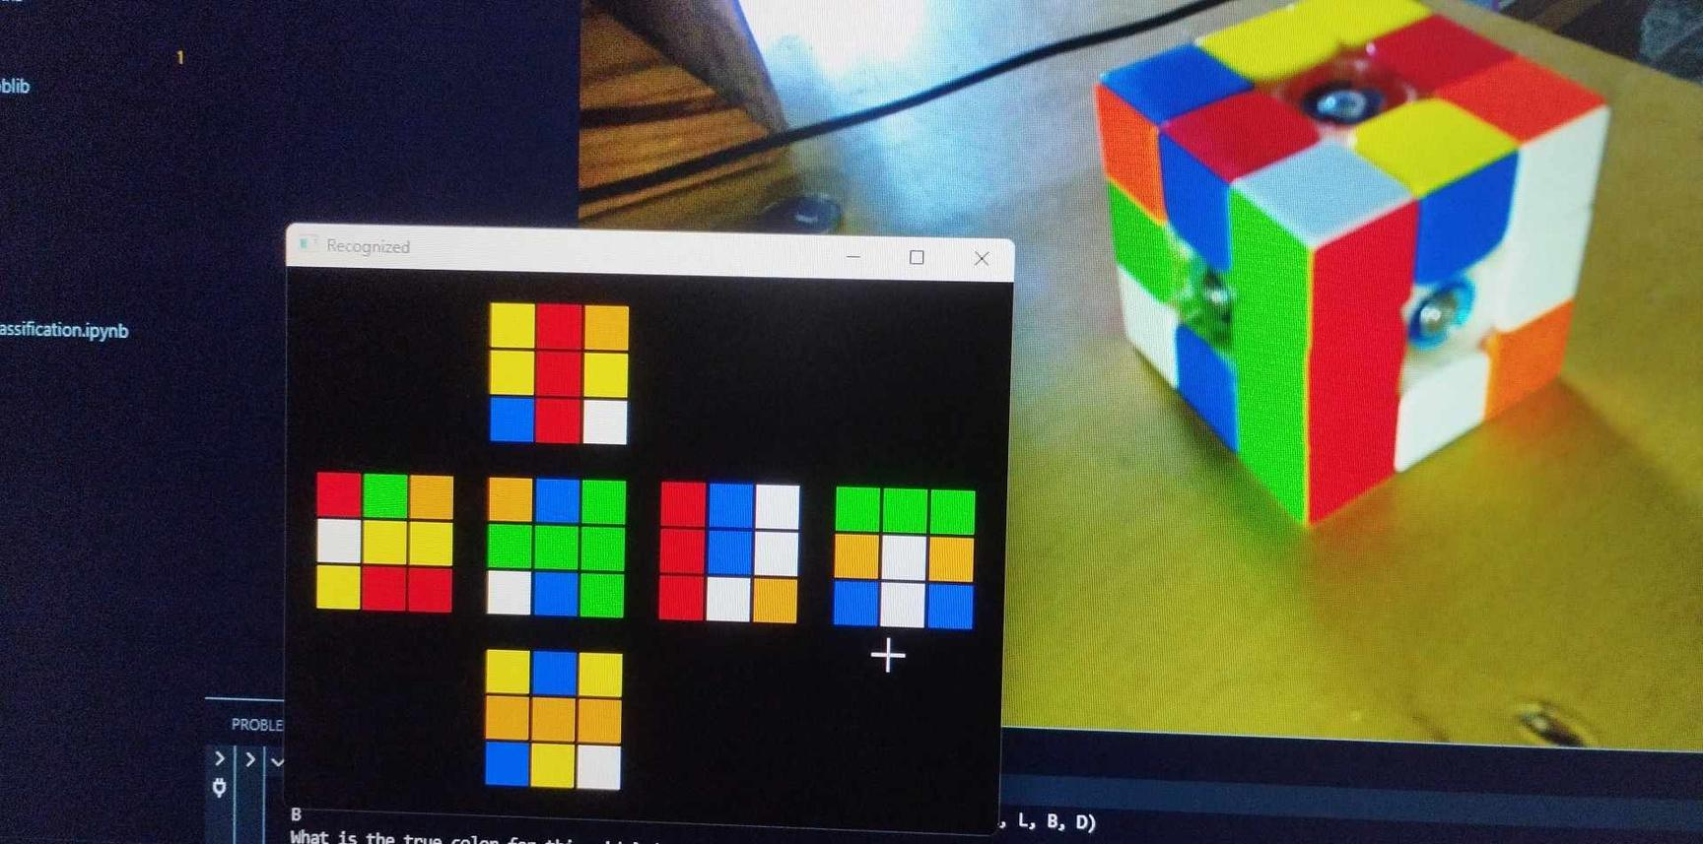
Image processing

Slide 16
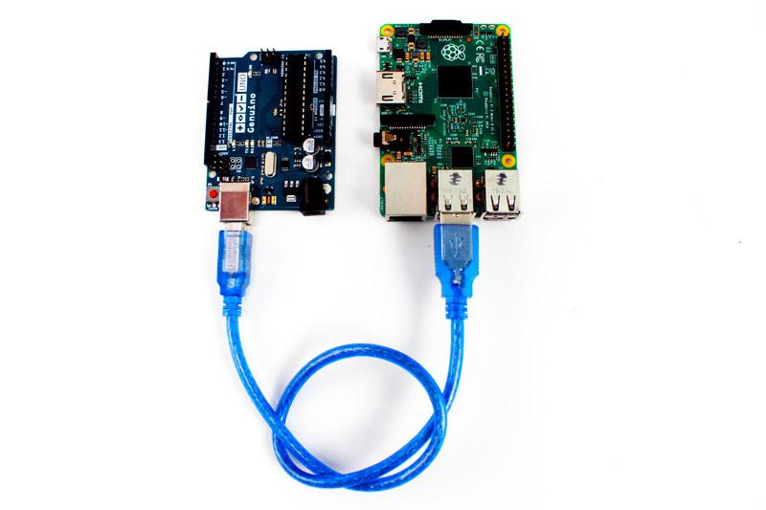
Communication
  We use serial communication between an Arduino and a Raspberry Pi.

Slide 17
Constraints
  High cost.
  Time constraint.
  Design constraints.

Slide 18
Future Work
  Make the Rubik cube solver compatible with all Rubik's cube sizes.
  Make better image processing experiments.
  Take care more about motors positions accuracy.
  Adding metal rotation axis (used to rotate the cube faces) instead of plastic.

Slide 19
Thank You
Burhan & Bassam

