Slide 1

An-Najah National University
Faculty of Engineering & Information Technology
Industrial Engineering Department
Graduation Project [IⅠ]
Comprehensive study for medical gauze factory in west bank

Slide 2




Authors:
Farah Najjar
Moath Abu Saleh
AbdulHadi Al- Berawi
Raghad Surakji
Abdullah Awad
Supervisor:
Dr. Muawia Ramadan

Slide 3
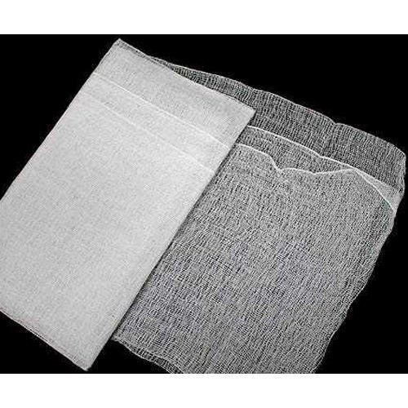
Outline
Introduction
Methodology
Production line
Layout
Feasibility study
Conclusion and Recommendation

Slide 4
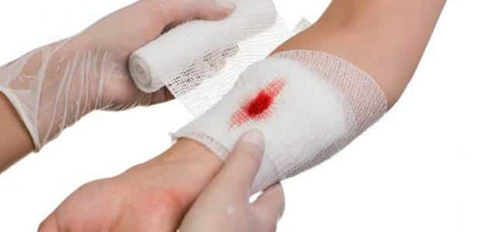
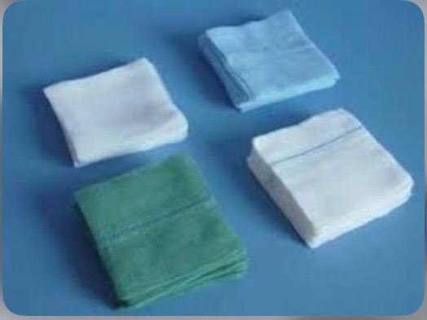
Introduction
Definition
Medical gauze is a thin, knit tissue that is applied over a wound to keep it clean while allowing air to pass in and aiding healing.

Slide 5
Methodology

Slide 6
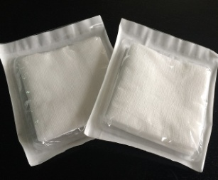
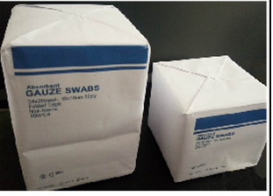
Types of selected medical gauze
1- Gauze Swab
No. | SIZES | Pictures | Price per unit (NIS) | PACKING
1 | 7.5x7.5cm, 17threads,8plys, without X-ray thread |  | 0.27 | 4PCS/pouch
 |  |  | 1.62 | 10PCS/pouch
2 | 10x10cm, 17threads,12plys, with X-ray thread
3 | 10x10cm, 17threads ,12plys, with X-ray thread |  | 8.5 | 100PCS/Pack

Slide 7
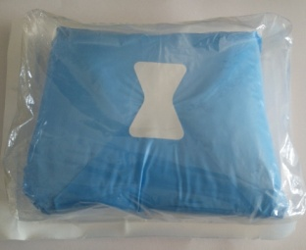
2- Laparotomy Sponge
No. | SIZES | Picture | Price per unit (NIS) | PACKING
1 | 30x30cm, ,4plys, withX-ray thread |  | 3.5 | 5PCS/sterile pack(double)
2 | 45x45cm, ,4plys, with X-ray thread |  | 4.5 | 5PCS/sterile pack(double)

Slide 8
Annual demand
Types | Dimension's | Annual Demand | 30% Annual Demand
Gauze swab | 7.5X 7.5 cm | 4,680,000 | 1,404,000
 | 10 X 10cm(10PCS/pack) | 260,000 | 78,000
 | 10 X 10cm (100PCS/Pack) | 845,000 | 253500
Laparotomy sponge | 30 X 30cm | 122,200 | 36,660
 | 45 X 45cm | 331,500 | 99,450

Slide 9
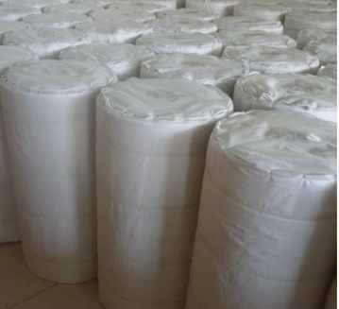
Raw materials
Types | Dimensions | Rolls | Number of products per one roll
Gauze swab | 7.5x7.5cm(4PCS/Pack) | 1 | 5000
 | 10x10cm(10PCS/pouch) | 1 | 750
 | 10x10cm (100PCS/Pack) | 1 | 75
LAPAROTOMY SPONGE | 30x30cm(4ply, 5pcs/pack) | 1 | 428
 | 45X45cm(4ply, 5pcs/pack) | 1 | 222
Jumbo Gauze Roll

Slide 10
Production Line
For first type : Gauze Swab
Process flow chart:

Slide 11
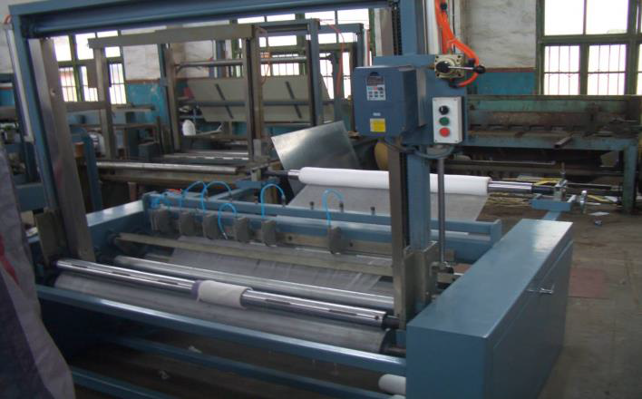
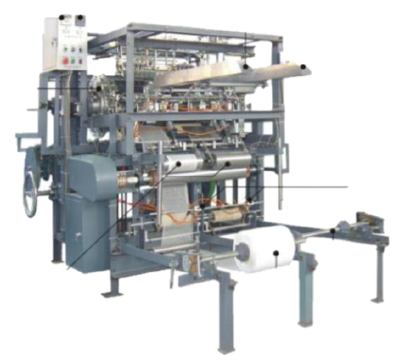
Gauze slitting and rolling machine
Gauze sponge folding machine

Slide 12
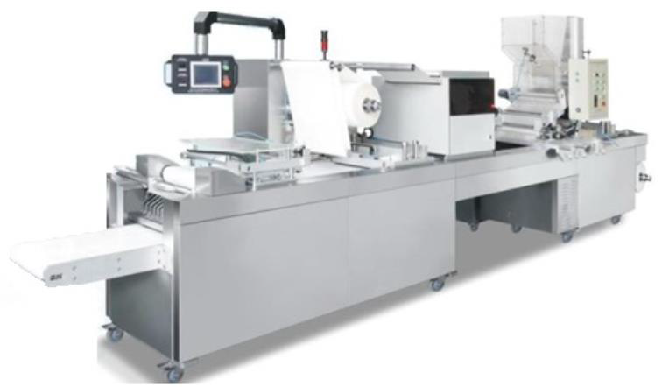
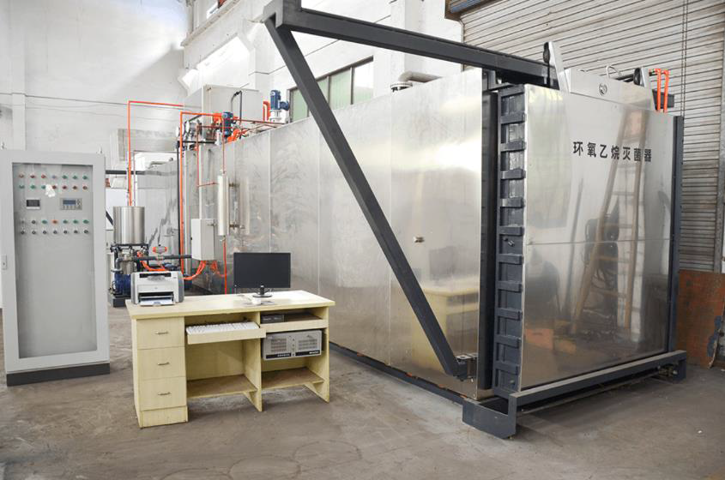
Sterilizing machine
Blister packaging machine

Slide 13
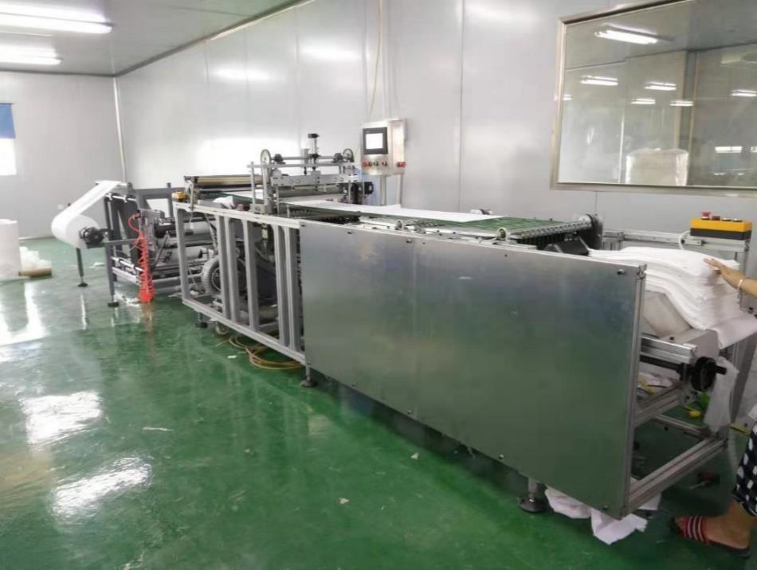
For second type:
Laparotomy Sponge
Lap sponge folding machine

Slide 14
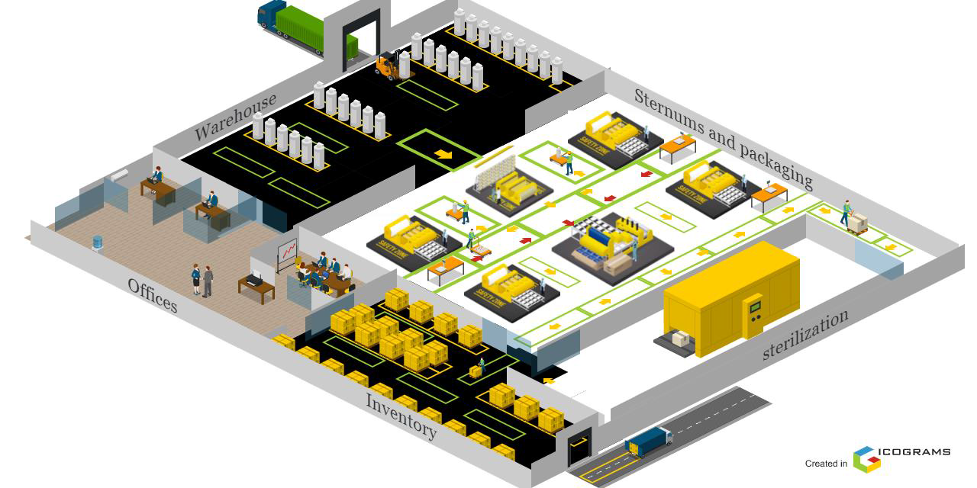
Layout

Slide 15
The area of the sternum = 172.66 m
So, the total area for factory = 606 m^2

Slide 16
Feasibility study
Initial setup costs
ID | Type | Cost (Nis)
1 | Land cost | 200,000
2 | factory infrastructure | 495,506
3 | Machine (production line) | 691,435
4 | Handling system and tools | 30,100
5 | Vehicles | 100,000
 | Total cost | 1,517,041

Slide 17
Running cost
ID | Cost type | Type | Annual cost (Nis)
1 | Fixed running cost | Salaries | 381,600
 |  | Electricity consumption | 71,376
2
 |  | Water consumption | 1,800
3
4 |  | Internet and phone | 6,000
5 |  | Fuel | 36,000
6 |  | Maintenance | 27,569
7 |  | Insurance | 5,613
8 |  | Depreciation | 30,320
9 |  | Waste (defect) | 79,993

Slide 18
Cont.
10 | Variable running cost | Raw materials (Jumbo roll) | 1,999,830.85
11 |  | Packaging | 106,026.76
Total running cot |  |  | 2,746,129

Slide 19
Production cost for each type
ID | Type | Cost of raw material (Unit) | Cost of packaging (Unit) | Fixed running cost (Unit) | Total cost (Unit)
1 | Gauze swab 10 *10 Cm (12ply, 100pcs/pack) | 6.203 | 0.200 | 1.986 | 8.390
2 | Gauze swab 7.5 * 7.5 Cm (8ply, 4pcs/pack) | 0.093 | 0.018 | 0.029 | 0.141
3 | Gauze swab 10 *10 Cm (12ply, 10pcs/pack) | 0.620 | 0.102 | 0.198 | 0.921
4 | LAPRATOMY SPONGE 30 X30Cm (4ply, 5pcs/pack) | 1.087 | 0.174 | 0.347 | 1.609
5 | Laparotomy sponge 45 *45 Cm (4ply, 5pcs/pack) | 2.095 | 0.152 | 0.670 | 2.918

Slide 20
Cost analysis
ID | Type | Demand | Cost per unit | Selling price | Cost(Nis) | Revenue(Nis) | Profit(Nis)
1 | Gauze swab 10 *10 Cm (12ply, 100pcs/pack) | 253,500 | 8.390 | 8.5 | 2,127,004 | 2,154,750 | 27,746
2 | Gauze swab 7.5 * 7.5 Cm (8ply, 4pcs/pack) | 1,404,000.00 | 0.141 | 0.27 | 198,013 | 379,080 | 181,067
3 | Gauze swab 10 *10 Cm (12ply, 10pcs/pack) | 78,000.00 | 0.921 | 1.62 | 71,908 | 126,360 | 54,452
4 | LAPRATOMY SPONGE 30 X30Cm (4ply, 5pcs/pack) | 36,660.00 | 1.609 | 3.5 | 59,004 | 128,310 | 69,306
5 | Laparatomy sponge 45 *45 Cm (4ply, 5pcs/pack) | 99,450.00 | 2.918 | 4.5 | 290,259 | 447,525 | 157,266
Total |  |  |  |  | 2,746,129 | 3,236,025 | 489,896

Slide 21
Break-even point for multiproduct
Type | Demand | Breakeven point (in Unit)
Gauze swab 10 *10 Cm (12ply, 100pcs/pack) | 253,500 | 125,679
Gauze swab 7.5 * 7.5 Cm (8ply, 4pcs/pack) | 1,404,000 | 696,068
Gauze swab 10 *10 Cm (12ply, 10pcs/pack) | 78,000 | 38,670
LAPRATOMY SPONGE 30 X30Cm (4ply, 5pcs/pack) | 36,660 | 18,175
Laparatomy sponge 45 *45 Cm (4ply, 5pcs/pack) | 99,450 | 49,305

Slide 22
Sensitivity analysis
ID | Type | Demand | Cost per unit | Selling price | Cost | Revenue | Profit
1 | Gauze swab 10 *10 Cm (12ply, 100pcs/pack) | 253,500 | 9.383 | 9 | 2,378,590.5 | 2,281,500 | -97,091
2 | Gauze swab 7.5 * 7.5 Cm (8ply, 4pcs/pack) | 1,404,000.00 | 0.155 | 0.27 | 218,807.7 | 379,080 | 160,272
3 | Gauze swab 10 *10 Cm (12ply, 10pcs/pack) | 78,000.00 | 1.021 | 1.62 | 79,649.7 | 126,360 | 46,710

Slide 23
Cont.
4 | LAPRATOMY SPONGE 30 X30Cm (4ply, 5pcs/pack) | 36,660.00 | 1.783 | 3.5 | 65,378.4 | 128,310 | 62,932
5 | Laparatomy sponge 45 *45 Cm (4ply, 5pcs/pack) | 99,450.00 | 3.253 | 4.89 | 323,600.3 | 486,310.5 | 162,710
 | Total |  |  |  | 3,066,026.8 | 3,401,560.5 | 335,534

Slide 24
Sensitivity analysis
Shipping | Cost for one container | Cost for one roll ($) | Net profit | Profit margin | Payback period (PBP)
Old shipping cost | 2,700$ | 145.4$ | 489,896 Nis | 15.1% | 3 years
New shipping cost | 15,000$ | 167.7$ | 335,534 Nis | 9.86% | 4.5 years

Slide 25
Conclusion and Recommendation
The most important information regarding medical gauze has been clarified in a detailed and comprehensive way.
This project is economically feasible

Slide 26


Slide 27


