Slide 1
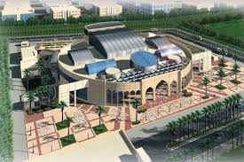
Analysis and design of the conference center of the Islamic university
Abd Alrahman Qadri Abu Eideh Izzideen Qaysar Yaish Manar Abd Alhameed Abu Zahra
Mohammed Zidan Masri Sabeeh Zidan Masri

Slide 2
Contents
Introduction
Preliminary Design
3D Static Analysis and Design
3D Dynamic Analysis and Design
Concrete design
Steel design

Slide 3
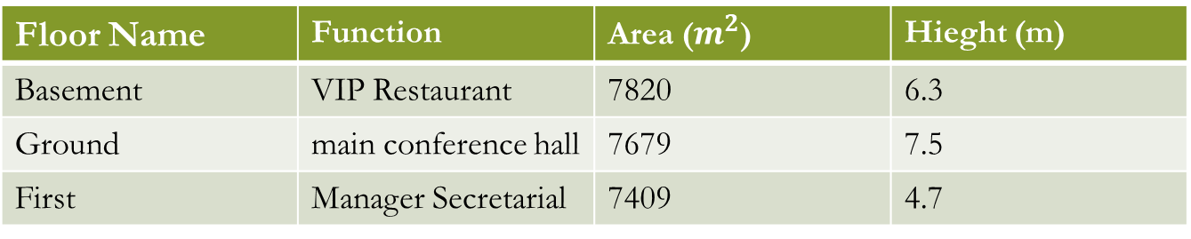
Project Description
Location
It is located at west of Nablus at 800 m elevation above mean sea level. It’s extended over an area 7800 m²
Stories and usage
Floor Name | Function | Area ($m^{2}$) | Hieght (m)
Basement | VIP Restaurant | 7820 | 6.3
Ground | main conference hall | 7679 | 7.5
First | Manager Secretarial | 7409 | 4.7

Slide 4

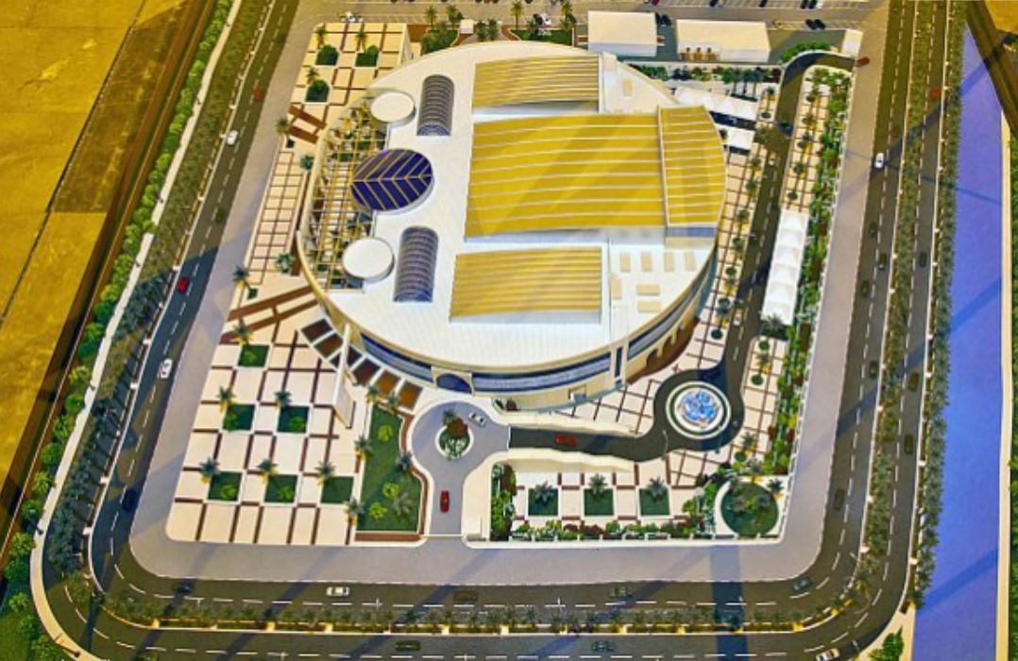

Slide 5
Codes and Standards
American Concrete Institute (ACI 318-14).
American Society of Civil Engineers (ASCE 7-10).
American Institute of Steel Construction (AISC 360-16).

Slide 6
Materials
Reinforcement Concrete
Rebar Steel
Structural Steel
Roof Sheeting
Glass
Bolts
Weld

Slide 7
Loads Types
Dead Load
Superimposed dead load
Live Load
Snow Load
Wind Load
Earthquake load

Slide 8
SD Load
In our structure, it is about these elements:
SD on concrete Slabs (tiles, partitions, false ceiling,…etc)
Steel Roof (solar panels, lighting and HVAC system)

Slide 9
Wind Load
Z (q_{z}) = 0.0613 * K_{z} * K_{zt} * K_{d} * V² *I
K_{d}: Directionality factor.
K_{zt}: Topographic factor.
K_{z}: Pressure-exposure coefficient depends on roughness, exposure and the height.
I: Importance factor depends on occupancy type.
v: basic wind speed (m/sec)

Slide 10
Wind Load
K_{d} = 0.85
K_{zt} = 1
v = 140 km/hr = 36.11 m/sec
I = 1.25
K_{z}= 1.25 (Roughness C and Exposure C)
P _{design} = P _{ext} - P _{int}
P_{int or ext} = q_{z}* G * C_{p}
G: Gust factor.
C_{p}: pressure coefficient.

Slide 11
Loads values
Superimposed dead load
4 kN/m2
Live load
Slabs = 4.8 kN/m²
Stadium = 5 kN/m²
Steel roof = 1 kN/m²
Snow load
Steel roof = 1 kN/m²
Wind X-direction
Walls = -0.95 kN/m²
Roof = -1.16 kN/m²
Wind Y-direction
Wind ward = 1.06 kN/m
Lee ward = -0.64 kN/m
Roof =-0.75 kN/m

Slide 12
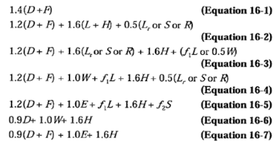
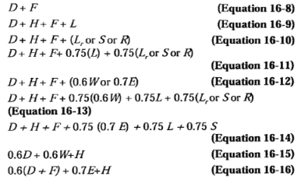
Combinations
Strength Combinations
Service Combinations

Slide 13
Preliminary Design
Slabs
Beams
Columns

Slide 14
Beams
Critical span is 9.6 m long.
h (beams) = 9.6/18.5 = 0.51 m.
but due to deflection requirements, the selected depth of the beam is 800 mm.

Slide 15
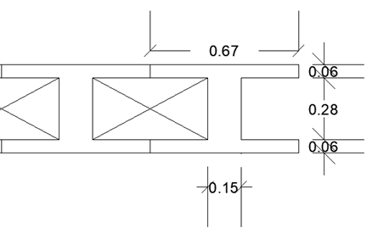
Slab
Starting by 25 cm thickness solid slab.
For deflection requirements, the depth of the slab is 36 cm.
For practical application, the slab is decided to be U-boot slab with total thickness of 40 cm

Slide 16
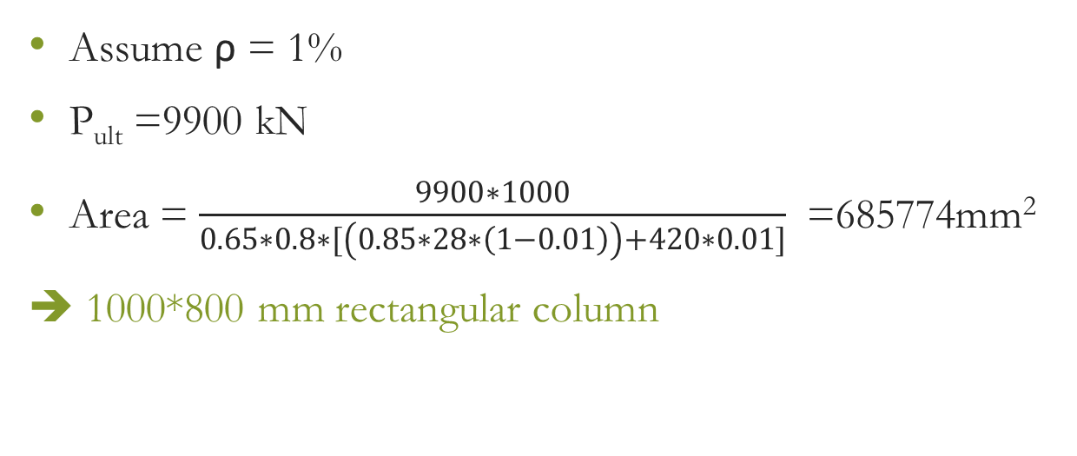
Columns
Assume ρ = 1%
P_{ult} =9900 kN
Area = $\frac{9900∗1000}{0.65∗0.8∗[\left(0.85∗28∗\left(1−0.01\right)\right)+420∗0.01]}$ =685774mm²
➔ 1000*800 mm rectangular column

Slide 17
3D Static Analysis and Design
Modeling in SAP2000 and Etabs
Analysis Verifications
Deflection
Results

Slide 18
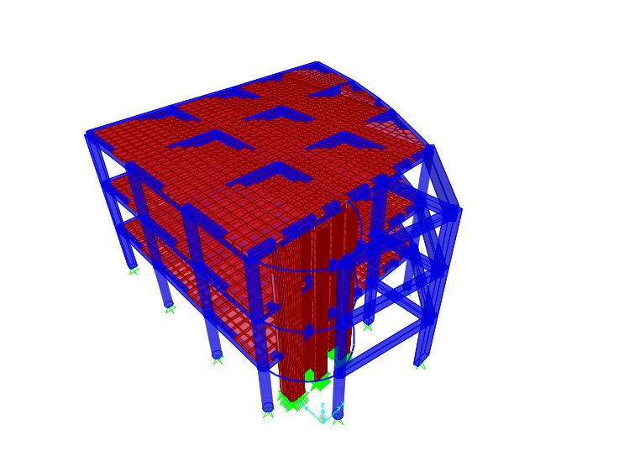
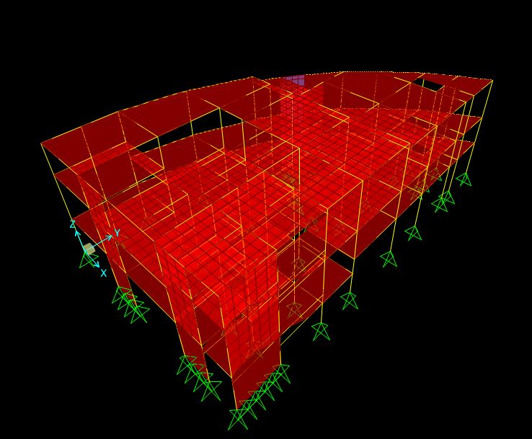
Modeling
blocks 1&3
block4

Slide 19
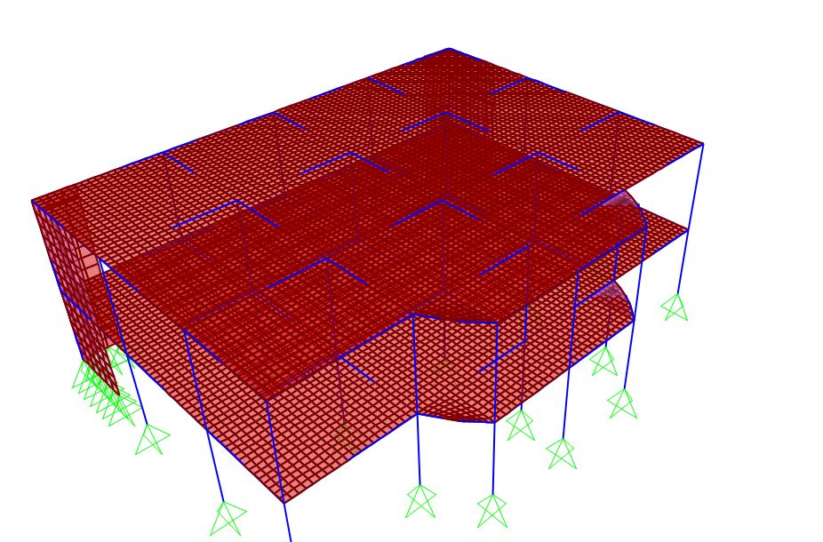
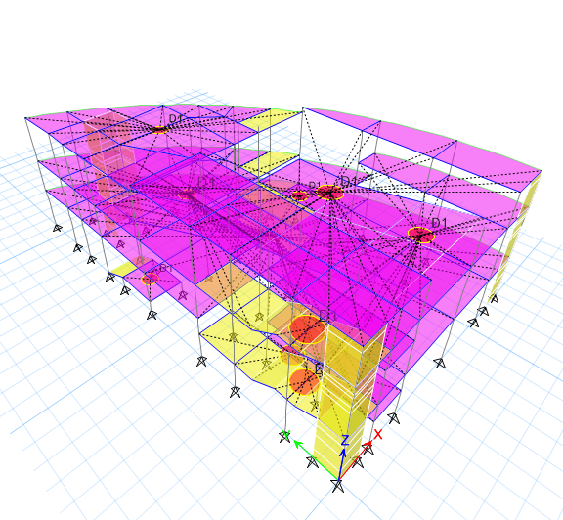
Block 2
block 6

Slide 20
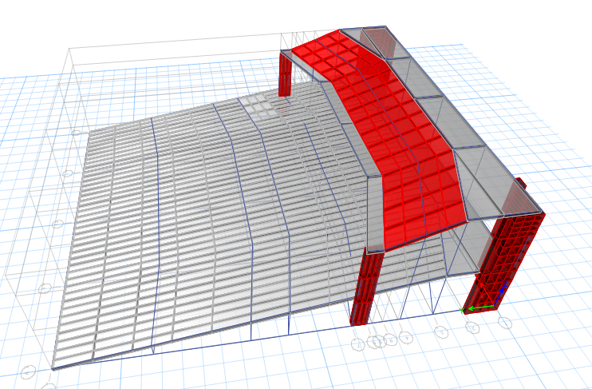
Block 5

Slide 21
Analysis Verifications
Compatibility check
Deflection
Equilibrium check
Internal Forces
Dead Load
Superimposed Dead Load
Live Load

Slide 22

Compatibility check
From the figure, it is clear that the component of the structure looks compatible with each other.
blocks 1&3
block4

Slide 23

Compatibility check
Block 2
block 6
block 5

Slide 24
Deflection Computations
Block 4
-Critical slab is 9.96 m long.
-Max Deflection = 35.9 mm
-Allowable deflection = L/240
=9960/240 = 41.5 mm
-Max < allowable (OK)

Slide 25

Deflection Computations
Steel deflection limit:
Live load deflection = $\frac{L}{180}$
Snow and wind load deflection = $\frac{L}{180}$
Dead +Live deflection = $\frac{L}{120}$

Slide 26
Deflection Computations for large truss
Live load deflection :
Δ_{allowable} = 319 mm.
From SAP ➔ Δ = 29 mm (OK)
Snow and wind load deflection :
Δ_{allowable} = 319 mm.
From SAP ➔ Δsnow = 30 mm (OK)
Δwind = 22.80 mm (OK)
(Dead + Live) deflection :
Δ_{allowable} = 479 mm.
From SAP ➔ Δ = 53 mm (OK)

Slide 27
Check For Equilibrium
All blocks satisfy the equilibrium check

Slide 28
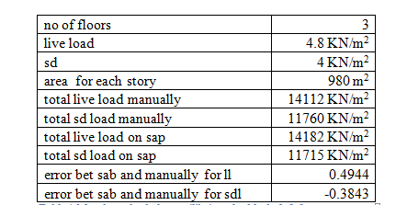
For block 1 & 3

Slide 29
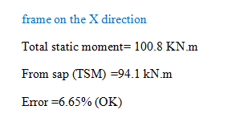
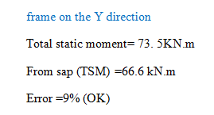
    Internal forces
    For block 5

Slide 30
3D Dynamic Analysis and Design
Mass source definition
Mass participation ratio
Period check
Seismic analysis
Seismic checks
Results

Slide 31
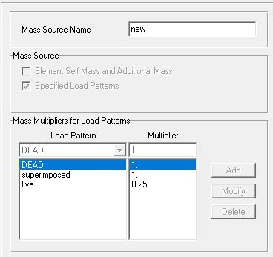
Mass source definition
All SD load and 25% of live load
considered as permanent mass.

Slide 32
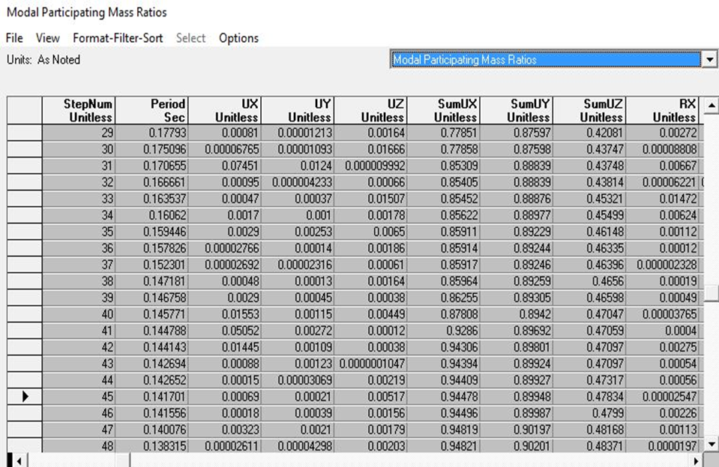
Mass participation ratio
the modal participation mass ratio in X and Y more than 90% after 46 Modes.

Slide 33
Period check
 | SAP | manual
Block 1 & 3 | 0.43 | 0.75
Block 2 | 0.64 | 0.75
Block 4 & 6 | 0.52 | 0.75
Block 5 | 0.54 | 0.75

Slide 34
Seismic analysis
Seismic parameters
Equivalent static definition
Response spectrum definition

Slide 35
Seismic parameters
Based on S_{s} = 0.375, S₁ = 0.1875
F_{a} = 1.2
F_{v} = 1.6125
S_{DS} = 0.25
S_{D1} = 0.05
Seismic design category “B”
Site classification “B”
Seismic importance factor I = 1.25
Response modification factor R = 5

Slide 36
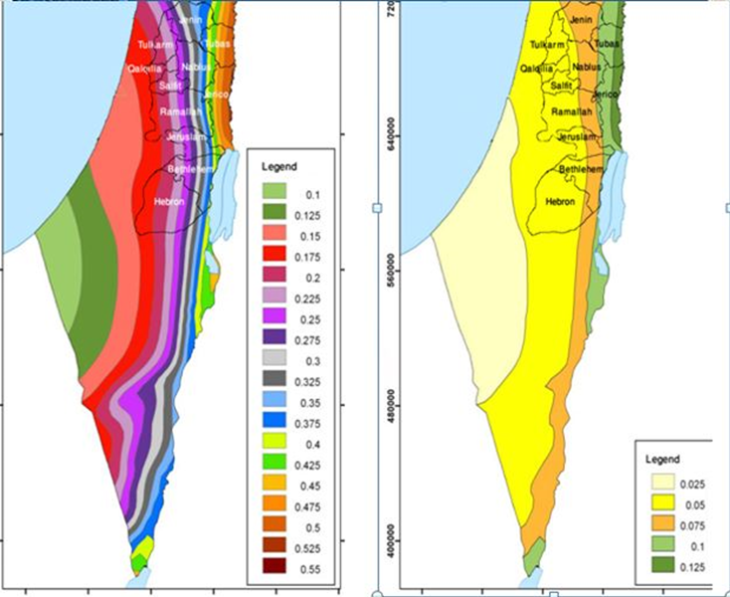

Slide 37
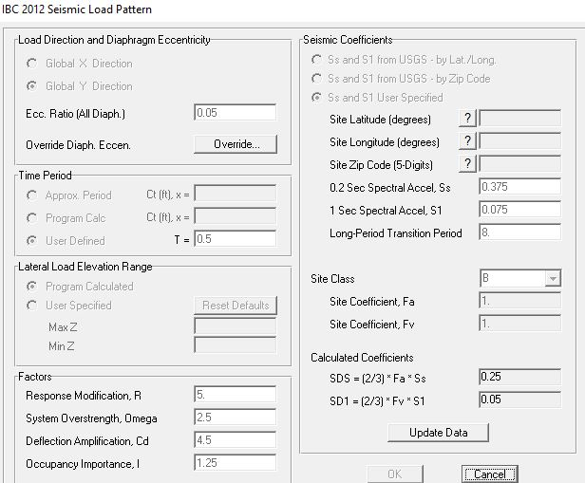
Equivalent static definition
According to IBC-2012

Slide 38
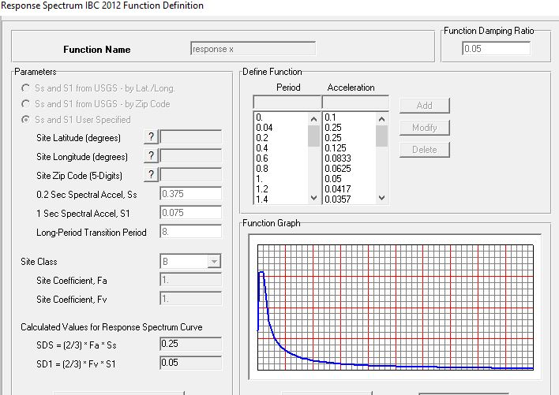
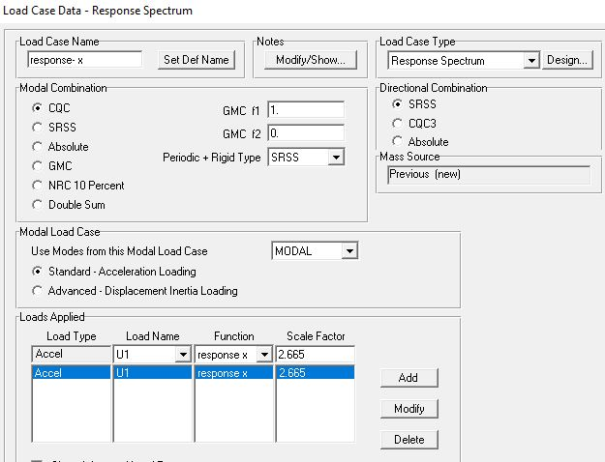
Response spectrum definition

Slide 39
Seismic checks
Base shear
 | V sap (kN) | V manual (kN) | Error %
Block 1 & 3 | 2000 | 2089 | 4.5
Block 2 | 1274 | 1320 | 3.4
Block 4 & 6 | 1452 | 1406 | 3.2
Block 5 | 1916 | 1957 | 2.1

Slide 40
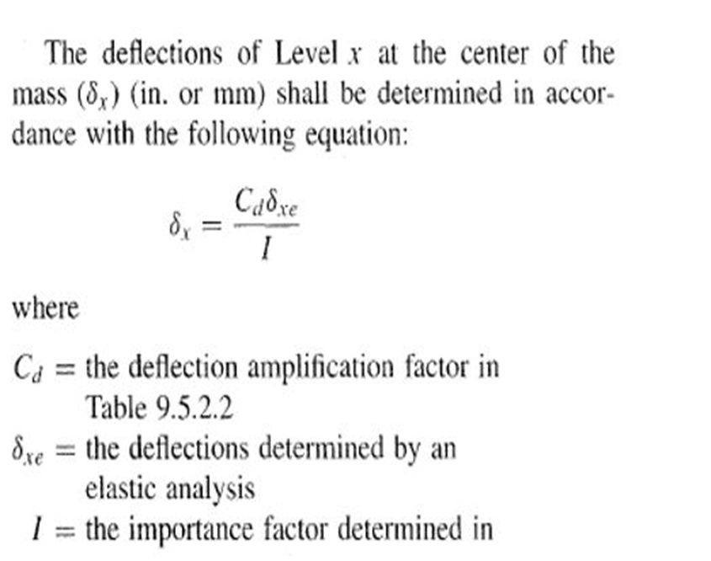
Siesmic checks-Drift check
Cd =5 , I = 1.25

Slide 41
Seismic checks
 | h story | max displacement | drift | cd | cd* drft | drft allow | check
basement | 6 | 0.0001 | -0.0009 | 5 | -0.0045 | 0.12 | ok
Ground floor | 6 | 0.001 | -0.001 | 5 | -0.005 | 0.12 | ok
story1 | 6 | 0.002 | 0.002 | 5 | 0.01 | 0.12 | ok
Block 1 & 3
Drift check
Allowable (m) | ᶋxe | height | cd | ᶋx(m)
0.227 | .063 | 6.31 | 4.5 | 5.3 *10-5 | Story1
0.27 | .075 | 7.5 | 4.5 | 0.000169 | Story2
0.178 | .05 | 4.95 | 4.5 | 0.000219 | Story3
Block 2

Slide 42
Seismic checks
Allowable(m) | ᶋx(m) | height | cd | ᶋxe
0.06316 | 0.0034 | 6.316 | 5 | 0.00086 | Story1
0.075 | 0.0052 | 7.5 | 5 | 0.0013 | Story2
0.047 | 0.0047 | 4.7 | 5 | 0.00119 | Story3
Block 4 & 6
(m) Allowable | ᶋx(m) | height | cd | ᶋxe
0.1262 | 4.24E-4 | 6.31 | 2.5 | 0.000212 | Story1
0.098 | 6.92E-4 | 4.9 | 2.5 | 0.000346 | Story2
0.052 | 5.18E-5 | 2.6 | 2.5 | 0.000259 | Story3
Block 5

Slide 43
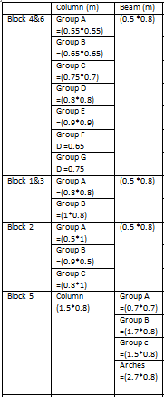

Results
Slabs (U-Boot)
All | 0.4
Shear Wall
All | 0.3
Steel sections resulting
For large truss
Top cord | HSS 3-1/2*1-1/2*1/8
Bottom cord | HSS 10*10*5/8
Inclined | HSS 7*5*3/16
columns | HSS 9*5*3/16
Purlins | W 8*40
Bracing | HSS 4*4*1/8
Steel sections resulting
For small truss
Top cord | HSS 2*1*1/8
Bottom cord | HSS 2*2*1/8
Inclined | HSS 2*2*1/8
columns | HSS 2-1/4*2-1/4*1/8
Purlins | W 6*15
Bracing | HSS 3*3*1/8

Slide 44
Stadium

Slide 45
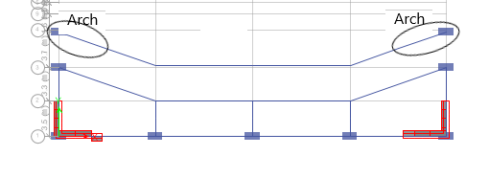
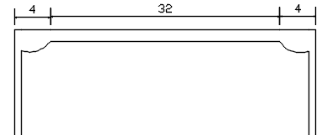
Stadium
Arches
Arches

Slide 46
Concrete design
Slabs
Beams
Columns
Shear walls
Footings

Slide 47
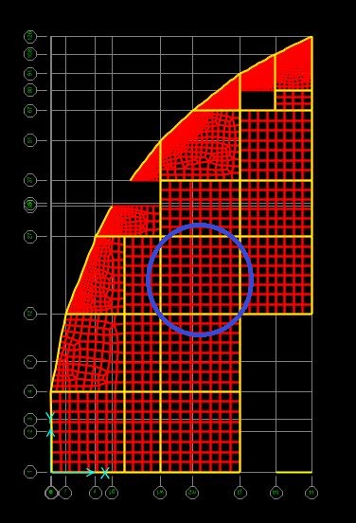
Slabs
We design 1st floor at level Z=6.316m (part 4+6)
Slab design on the X – direction :
Mu (bottom) Max on this panel = 57 KN.m
As = 758mm²/unit
design For tension , As top = As bottom = 86mm²
As=970 mm² /unit =4ø18/unit
Mu (top) Max on this rooms = 110KN.m
As=970 mm² /unit =4ø18/unit

Slide 48
Slab design on the Y – direction :
Mu (bottom) Max on this panel = 53 KN.m
So As =758mm²/unit
Design for tension , As top = As bottom = 125.6mm²
As =883mm²/unit=4ø18/unit
Mu (top) Max on this rooms = 105KN.m
As=1009mm²/unit =4ø18/unit

Slide 49

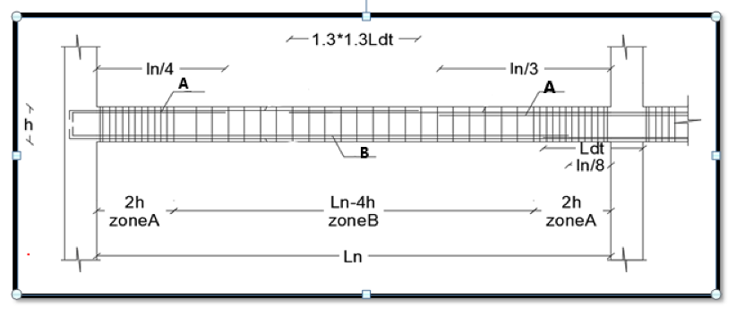
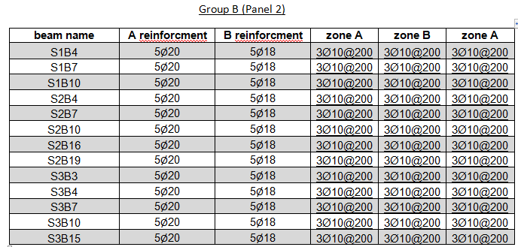
Beams
One-end continuous

Slide 50
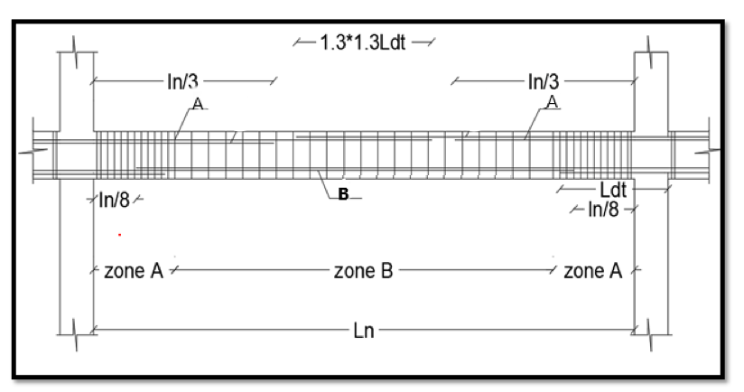
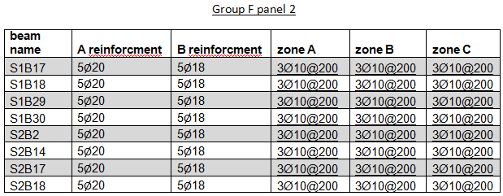
Beams
Two-end continuous

Slide 51
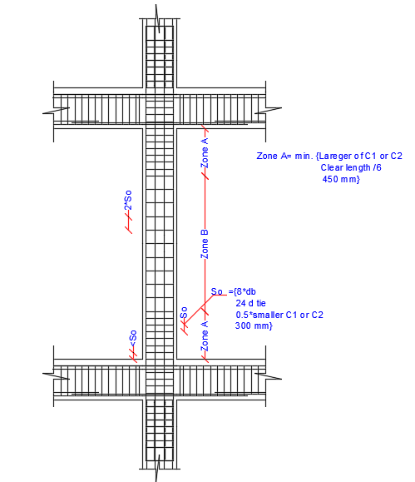
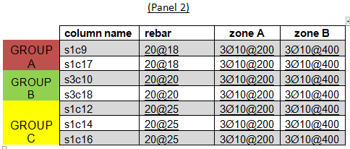
Columns

Slide 52
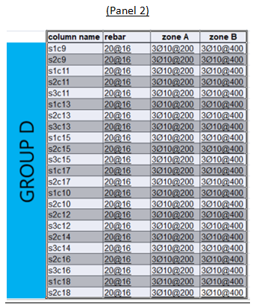

Slide 53
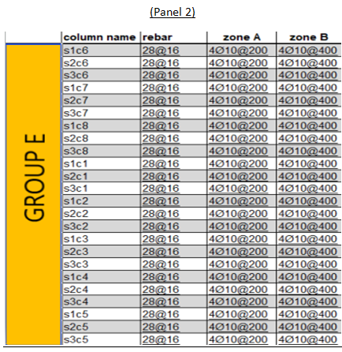

Slide 54
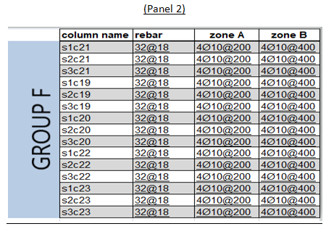

Slide 55
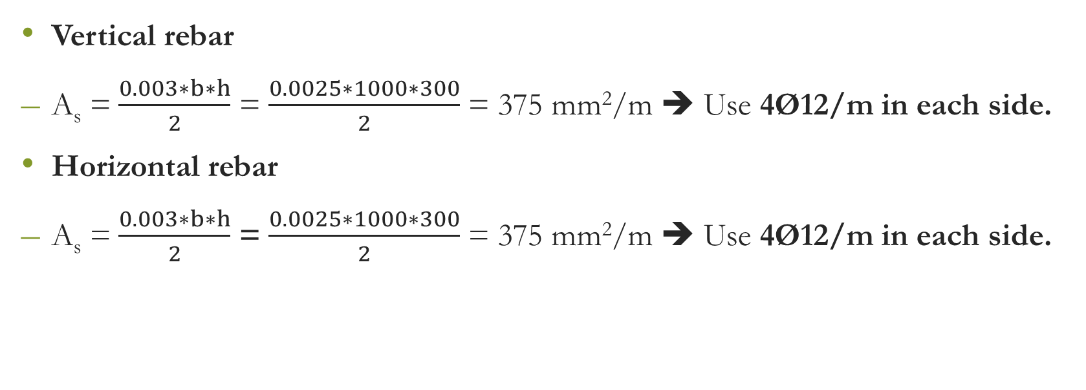
Shear walls
Vertical rebar
A_{s} = $\frac{0.003∗b∗h}{2}$ = $\frac{0.0025∗1000∗300}{2}$ = 375 mm²/m ➔ Use 4Ø12/m in each side.
Horizontal rebar
A_{s} = $\frac{0.003∗b∗h}{2}$ = $\frac{0.0025∗1000∗300}{2}$ = 375 mm²/m ➔ Use 4Ø12/m in each side.

Slide 56
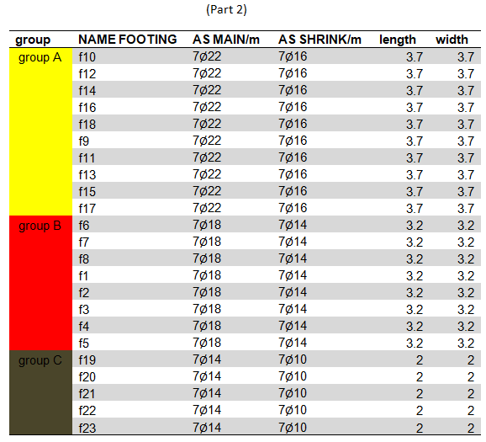
Footings

Slide 57
Steel Roofs
Large Roof Truss
53,7 * 37.5 m
Truss Depth 3m
Small Roof Truss
29.2 * 16.2 m
Truss Depth 2m

Slide 58
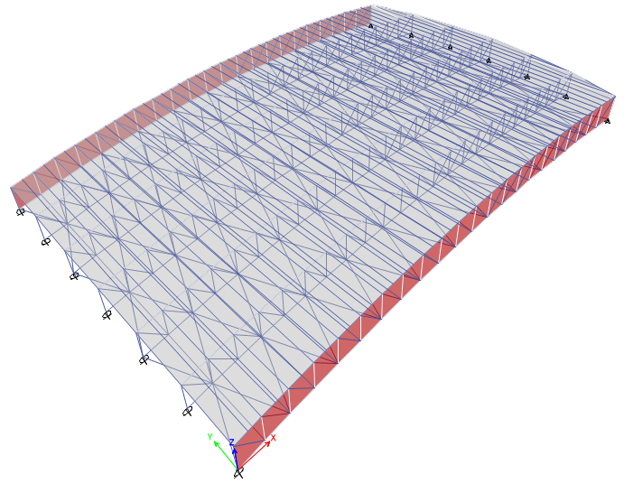
Large Truss

Slide 59
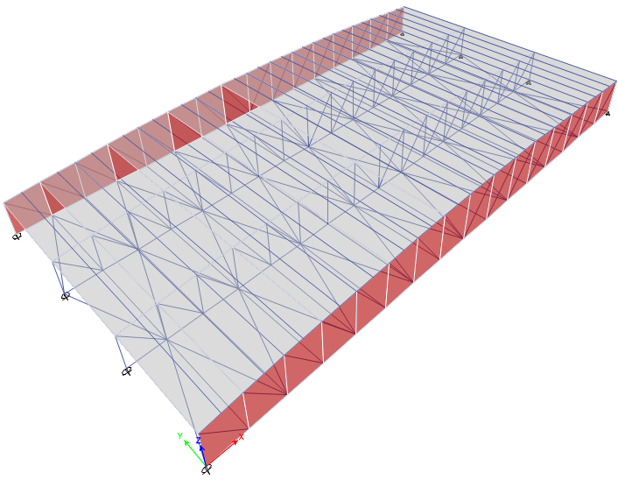
Small Truss

Slide 60
Steel member design
Tension Capacity
Compression Capacity
Moment Capacity
Lateral Torsional Buckling

Slide 61
Tension Capacity
Group | Sections Name | Etabs
 |  | ØTn(kN) | Tu(kN)
Top cord | HSS 3-1/2*1-1/2*1/8 | 154 | 16
Bottom cord | HSS 10*10*5/8 | 3026 | 0
inclined | HSS 7*5*3/16 | 574 | 349
column | HSS 9*5*3/16 | 674 | 380
purlins | W 8*40 | 1686 | 0
Bracing | HSS 4*4*1/8 | 255 | 30
ØT_{n} = Ø * F_{y} * A_{g}
ØT_{n}: Tension capacity for the member.
Ø: Reduction factor. In tension Ø = 0.9
F_{y}: Yielding stress of steel.
A_{g}: Gross sectional area of the member.

Slide 62
Compression Capacity
Group | Sections Name | Etabs
 |  | ØPn(kN) | Pu(kN)
Top cord | HSS 3-1/2*1-1/2*1/8 | 115 | 0
Bottom cord | HSS 10*10*5/8 | 2924 | 1656
inclined | HSS 7*5*3/16 | 458 | 423
column | HSS 9*5*3/16 | 542 | 33
purlins | W 8*40 | 813 | 0
Bracing | HSS 4*4*1/8 | 63 | 33

Slide 63
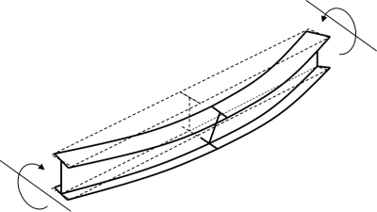
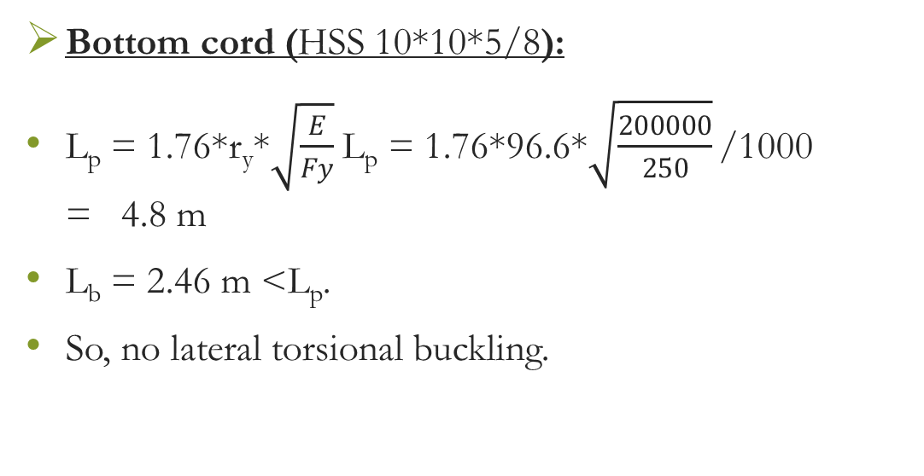
Lateral Torsional Buckling
Bottom cord (HSS 10*10*5/8):
L_{p} = 1.76*r_{y}*$\sqrt{\frac{E}{Fy}}$ L_{p} = 1.76*96.6*$\sqrt{\frac{200000}{250}}$ /1000 = 4.8 m
L_{b} = 2.46 m <L_{p}.
So, no lateral torsional buckling.

Slide 64
Moment capacity
Group | Sections Name | Etabs
 |  | ØMn(kN.m) | Mu(kN.m)
Top cord | HSS 3-1/2*1-1/2*1/8 | 5 | 0
Bottom cord | HSS 10*10*5/8 | 268 | 0
inclined | HSS 7*5*3/16 | 35 | 0
column | HSS 9*5*3/16 | 50 | 0
purlins | W 8*40 | 146 | 12
Bracing | HSS 4*4*1/8 | 9 | 0

Slide 65

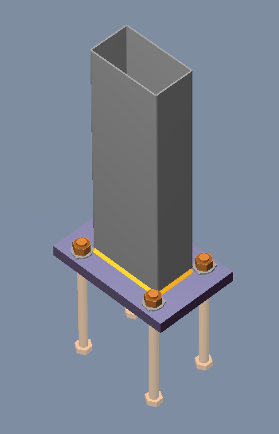


Steel Connections Design
Steel Connections Design

Slide 66
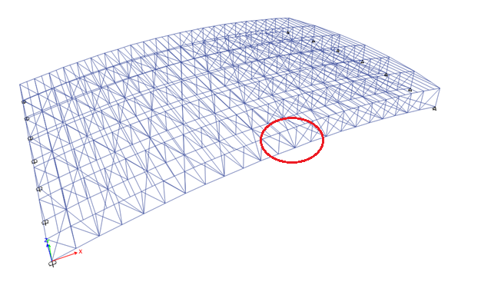

Slide 67
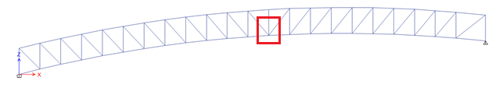

Slide 68
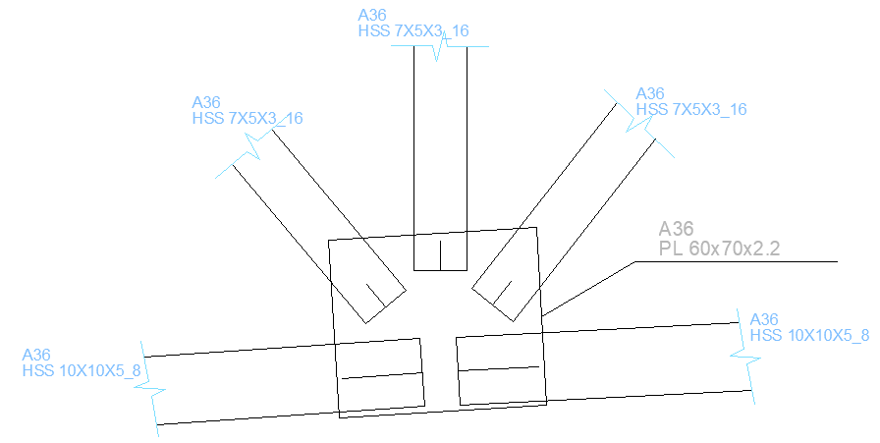

Slide 69
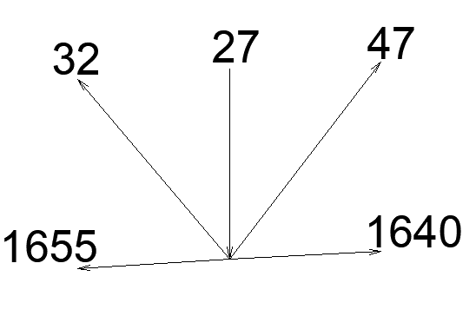

Slide 70
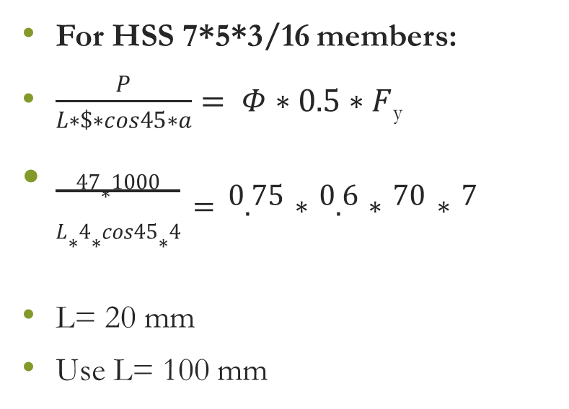
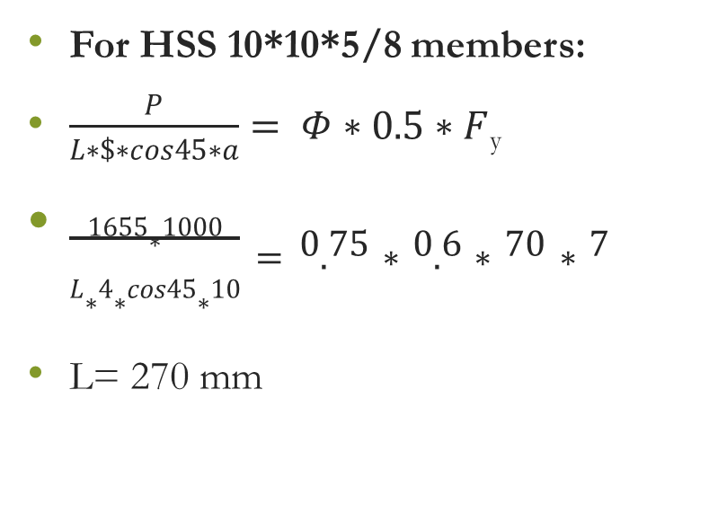
Weld Design
For HSS 10*10*5/8 members:
$\frac{P}{L∗\$∗cos45∗a}= Φ∗0.5∗F$_{y}
$\frac{1655∗1000}{L∗4∗cos45∗10}=0.75∗0.6∗70∗7$
L= 270 mm
For HSS 7*5*3/16 members:
$\frac{P}{L∗\$∗cos45∗a}= Φ∗0.5∗F$_{y}
$\frac{47∗1000}{L∗4∗cos45∗4}=0.75∗0.6∗70∗7$
L= 20 mm
Use L= 100 mm

Slide 71
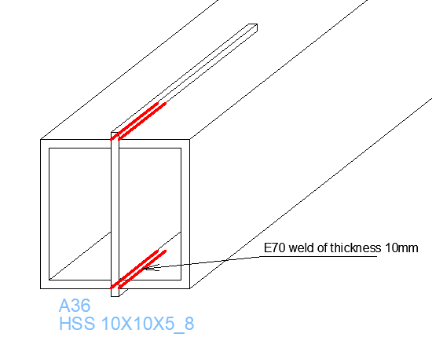


Slide 72


Slide 73


Slide 74

Base Plate Connection
Bolts material is
F1554 Gr36.

Slide 75
At the END ..

Slide 76
THANK YOU
THANK YOU

