Slide 1

Graduation Project Seminar
XboGame Spaco TV-Centric
Prepared By :
Abdallah Mustafa
Ali AbuSaleh
Supervisor :
Dr. Samer Arandi

Slide 2

Outline
Introduction
Motivation
system component
How system works
Game Mods
The Programming tools and Languages
constrains
Future work
Demo

Slide 3
Introduction
Free Educational video game .
An end-to-end tools to create educational game .
Run on android TV and any android device as a controller .

Slide 4
Motivation
The Video Educational Game has significant benefit in spelling and decoding area .
Significant time that kids spend it in front of the screen without interest .
The development of the player's capabilities in certain areas through educational video games.

Slide 5
System Component
Controller
  Android App
  Control the TV Game
TV
  Shows the second part of the Game
  Consist of five Pages :Login page, Main Page , Guess Page , Learn Page and Match Page
  Provide three type of challenge : Match , Guess , and learn

Slide 6
System Component
Communication App
NSD access to services that other devices provide on a local network
backbone of project to exchange data between TV & controller
Wizard

Slide 7
How the system Works
TV and Controller
controller send command to TV over TCP reliable connection
TV access the command and call the specific function in unity

Slide 8
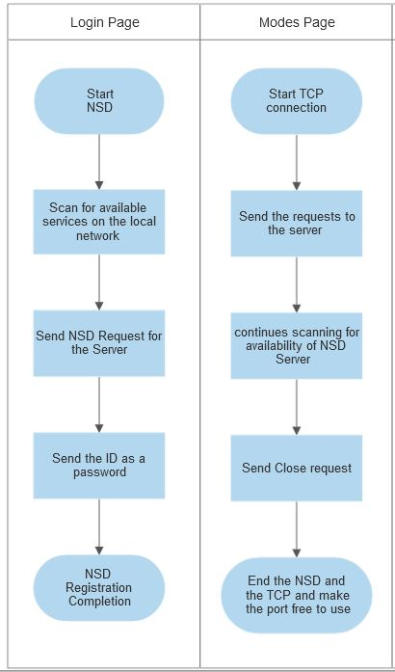
How the system Works
Communication

Slide 9
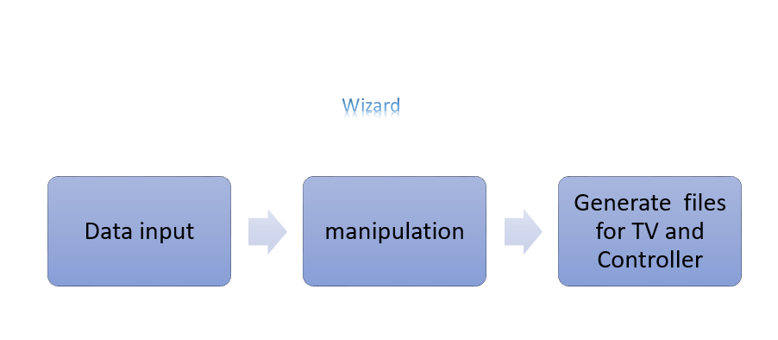
How system Works
Wizard :

Slide 10
How system Works
Loading for devices:
Controller:
  From SDCard .
  From the Internal storage.
TV :
  From the SDCard
  Re-Compile the application *
*in case the TV is not giving access to the storage

Slide 11
Game Mods
Learn Mode :
Recognize new object .
Learn the sound and the spell of object that shown in TV.
Read Extra information about the shown object in TV

Slide 12
Game Mods
Match Mode :
Match three object with correct names .
alert player when answer is wrong .
show the name of object in TV when answer is correct .
player can skip the current challenge .

Slide 13
Game Mods
Guess Mode
player should recognize this object by objects sound or objects figure .
player can skip the current challenge .
interactive with player when answer are true or wrong .

Slide 14
The Programming tools and Languages
Controller: Mobile App
Android Studio (Java )
TV: Android App for Android TV box
Unity IDE
Wizard: Desktop App
NetBeans IDE(Java)

Slide 15
Constrains
Many of essential Asset in unity Store are not free .
There is some of sound extension cannot be uploaded at run-time in Unity.
The documentation of NSD not clear .
Convert fixed layout to adapted layout in Controller by control number of rows in Learn Page .

Slide 16
Challenges
Documentation of NSD property not clear .
Communication between unity and TV .
Reliable communication between server and client .
Asses the Generated code from UNITY for android platform .

Slide 17
Future work
Support different platform for controller .
Support 3D object in TV .
Enhance the User Interface(UI) for TV and Controller .
Adding new sections for Stories and children movies .

Slide 18
Demo
The first video is explain how TV and Controller Work .
The second video shows the Wizard , which is responsible for adding new group of object

