Slide 1


Analysis and Development of an Improved Maintenance Management System for the Applied Engineering Laboratories at An-Najah National University.
Prepared by:
Deema Ismail
Mohammad Ameerah
Yousef Kawa
Jihad Imran
Ro’a Okal
Advisor:
Dr. Basheer Shaheen

Slide 2
Problem Statement
1
2
3
Operational Problems
Operational Consequences
Current System
  Reactive
  No CMMS
  Unplanned
breakdowns
  Poor scheduling
  High downtime
  Higher costs
  Lab inefficiency
1

Slide 3
Key Causes of the Problem
Process
Management
Absence of PM
No clear responsibility
ineffective
Maintenance System
Training
Absence of CMMS
Poor documentation
People
System
Documentation
Fishbone Diagram
2

Slide 4






Project Objectives
Establish a data-driven maintenance system
Integrate the system with digital platforms
Improve equipment performance and reliability
Evaluate current maintenance practices
Verify the system’s effectiveness
3

Slide 5
Methodology
START
END
Recommen
-dations
GP1
Initial Assessment of the Current State
CMMS Sample Implementation
Application of VR Technology for maintinance training
Data Collection Tools Selection
4

Slide 6



Current State Analysis – Faculty of Engineering Laboratories
This chapter presents a current state analysis of the maintenance environment in the Faculty of Engineering at An-Najah National University. The faculty includes a total of 32 practical laboratories and 7 computer laboratories, distributed across three academic departments:
INDUSTRIAL AND MECHANICAL ENGINEERING DEPARTMENT
ELECTRICAL AND COMPUTER ENGINEERING DEPARTMENT
ARCHITECTURAL AND CIVIL ENGINEERING DEPARTMENT
5

Slide 7
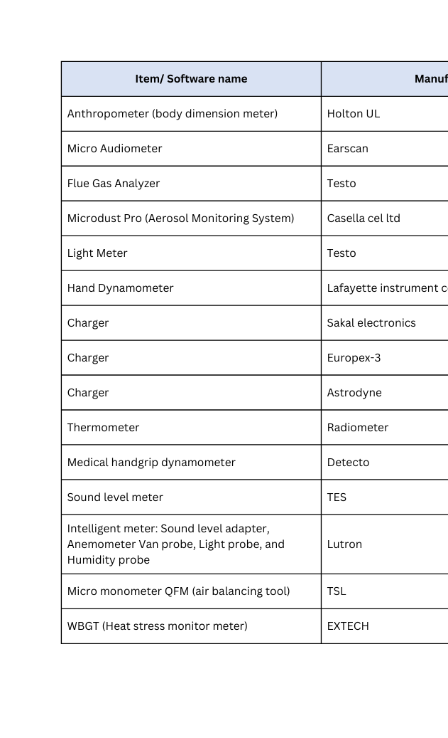
ASSETS ANALYSIS
Human Factors and Safety Engineering Lab apparatus
6

Slide 8
Reporting Process Stage Flowchart
FAILURE OCCURS
END
Person in charge of assets
Report
The direct supervisor
Procurment department
Maintinance request via zajel
Maintinance action stage
7

Slide 9
Maintenance Workflow- Covered Warranty
Failure received at procurement dep
END
WARRANTY COVERED
REPORT
SUBMIT WARRANTY REPAIR REQUEST
MAINTINANCE ACTION IS TAKEN
SEND TO WAREHOUSE
RECEIVING AT WAREHOUSE/
PLACE
8

Slide 10
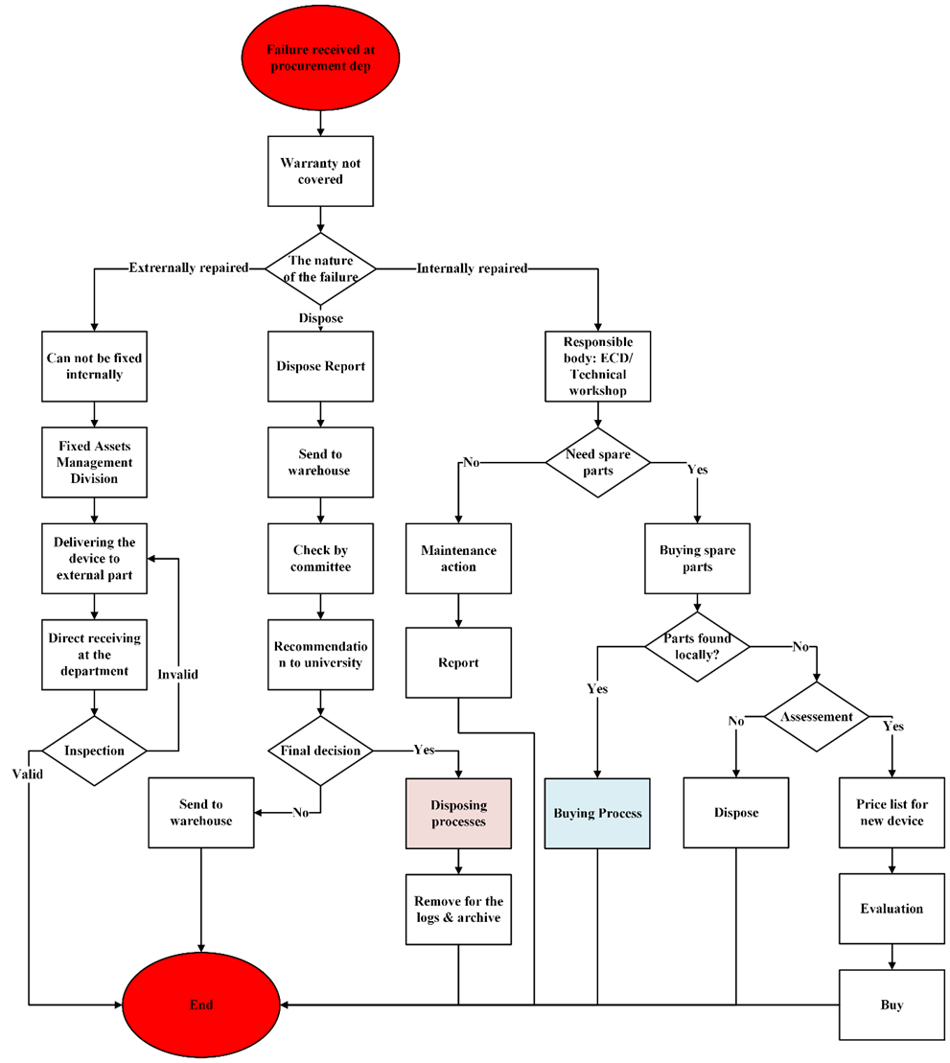
Reporting Process Stage Flowchart:
9

Slide 11
Machine
Man
No database
Inadequate number of lab technicians
Lack of PM
Deficiencies in the MMS
Absence of CMMS
Unclear workflow
Method
Fishbone Diagram
10

Slide 12
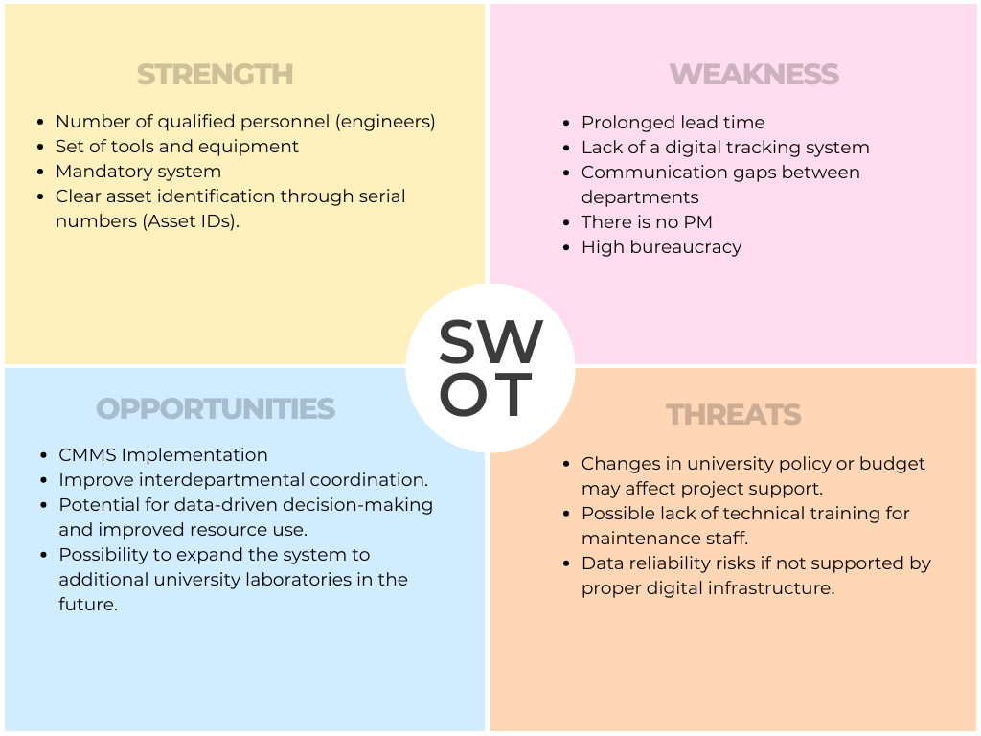
11

Slide 13
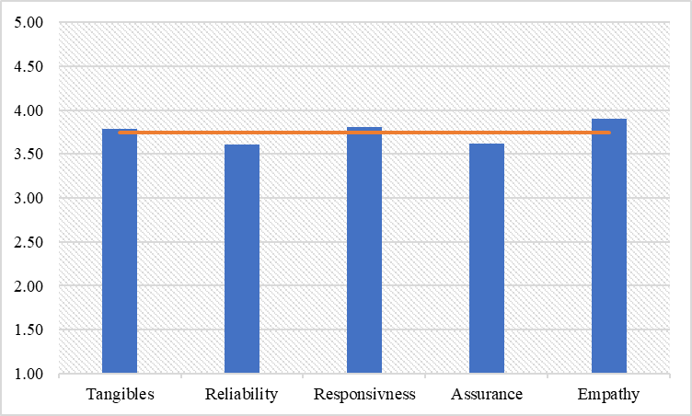
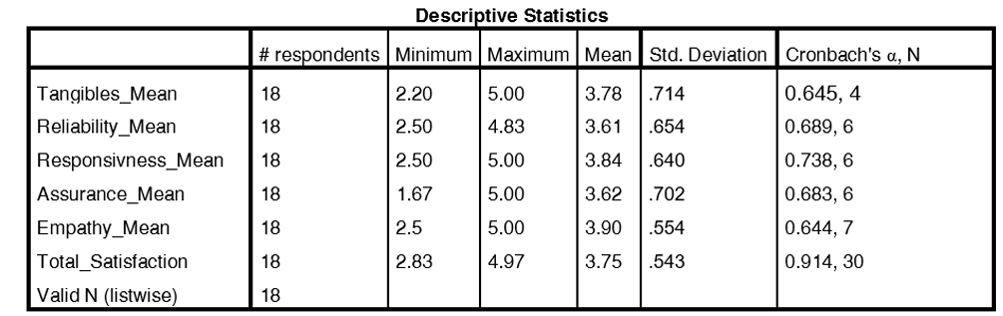
Questionnair Findings:
12

Slide 14
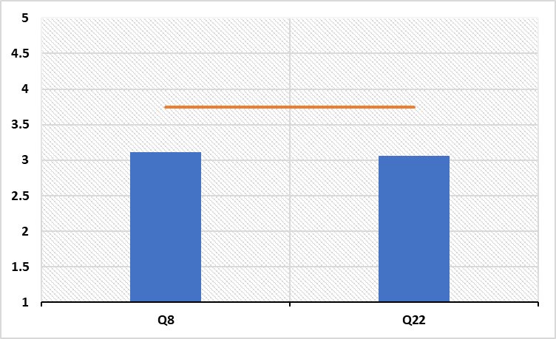
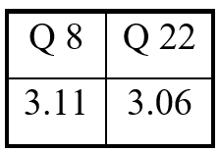
Questionnair Findings:
No PM
No Sufficient training
13

Slide 15





Improvements Roadmap
Technical Improvements (CMMS)
Training & Human Resources
Organizational & Administrative Improvements
Maintenance Strategy Improvements
Emerging Technologies (VR)
14

Slide 16
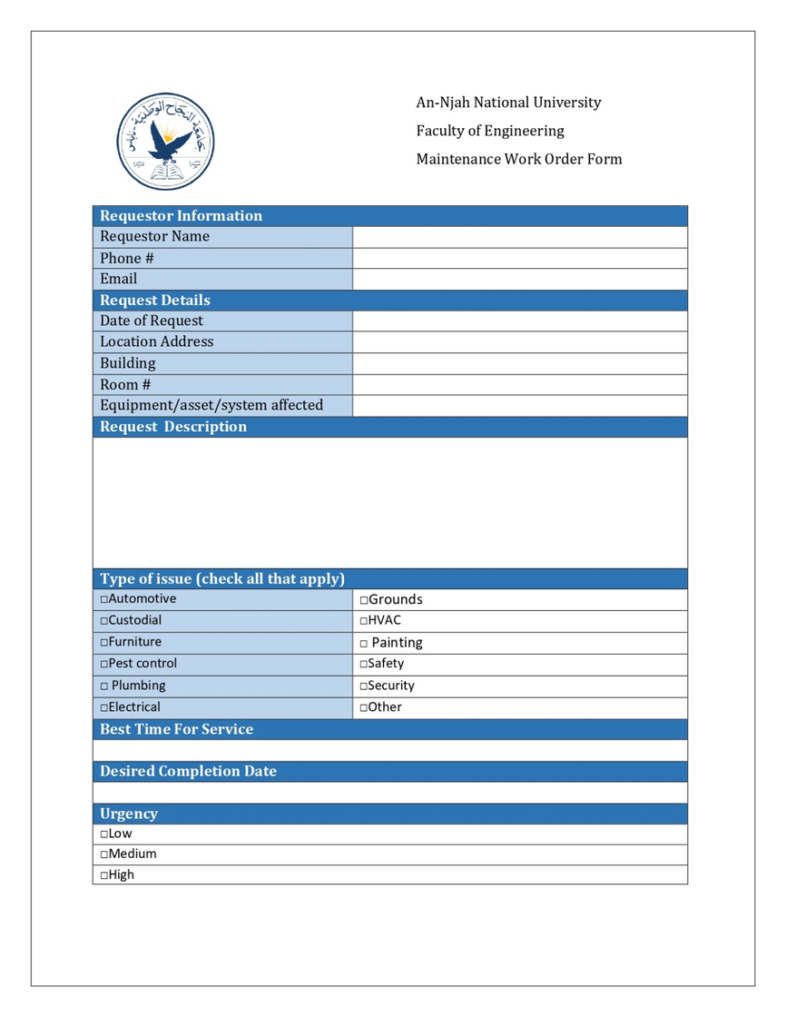
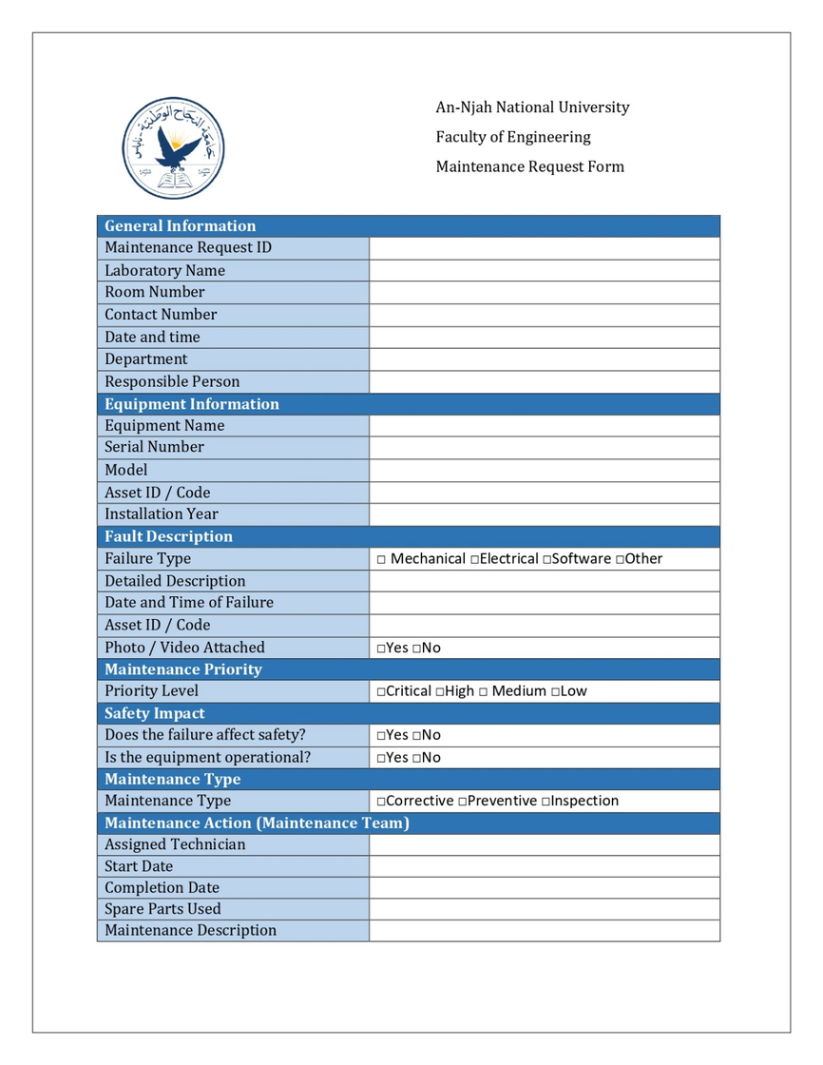
Organizational & Administrative Improvements
15
Standardized Maintenance Order Form
Standardized Maintenance Request Form

Slide 17

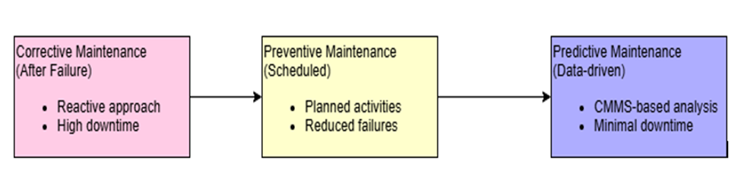
Technical (CMMS Improvement)
Full CMMS Implementation
Maintenance Strategy Improvements
16

Slide 18
Training & Human Resources
  Structured training programs on CMMS usage
  Improving maintenance documentation and reporting skills
Training Topic | Target Group | Frequency
CMMS usage | Technicians | Quarterly
PM | Lab technicians | Quarterly
Safety Procedures | All staff | Annual
17

Slide 19
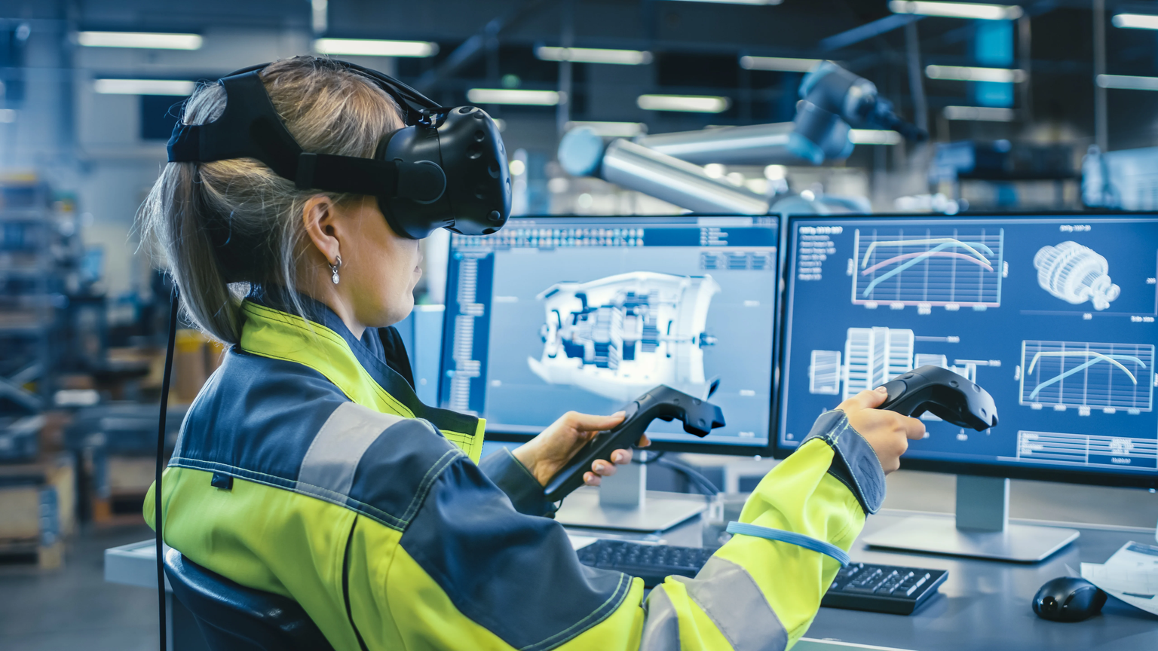
Emerging Technologies (VR) in Maintenance
Visual step-by-step maintenance guidance
  Error Reduction & Safety
  Guided Maintenance
18

Slide 20

Computerized Maintenance Management System
19

Slide 21
CMMS MAIN FUNCTIONS
Centralizes all maintenance activities in one digital platform
Helps with inventory management
Ensures compliance with safety standards
20

Slide 22
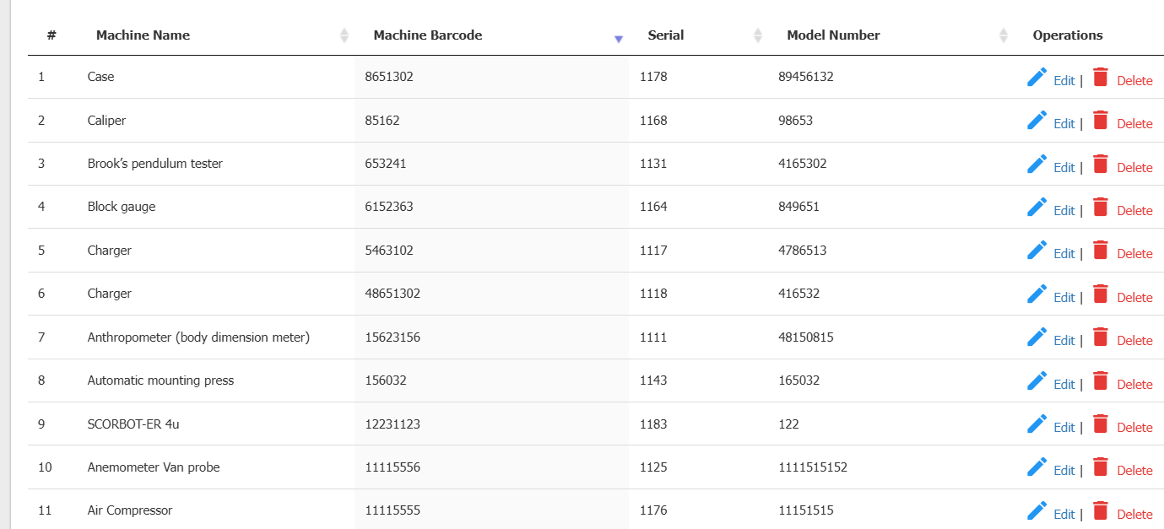
The CMMS was implemented in this pilot study within the Industrial Engineering laboratories.
21

Slide 23
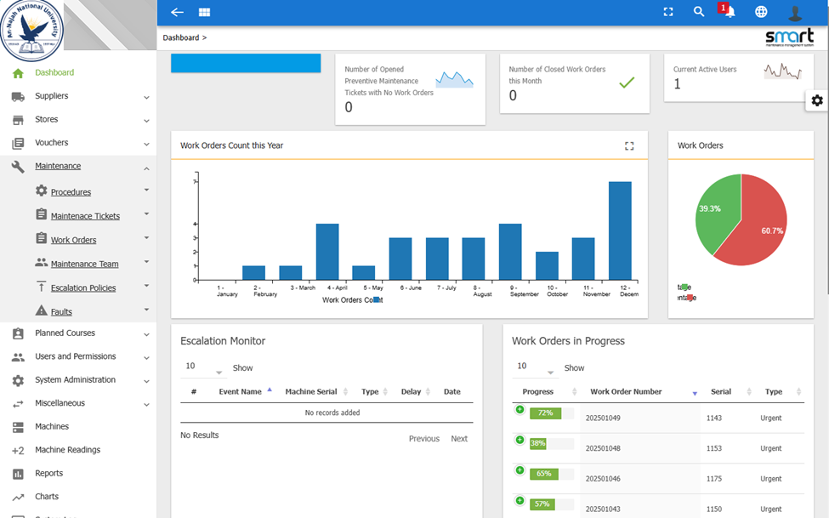
Mapping Smart CMMS Features to Laboratory Needs
22

Slide 24
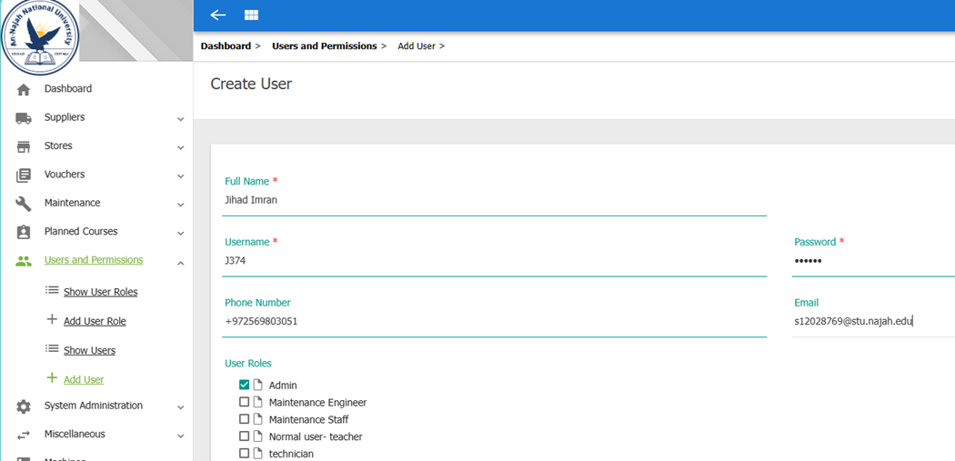
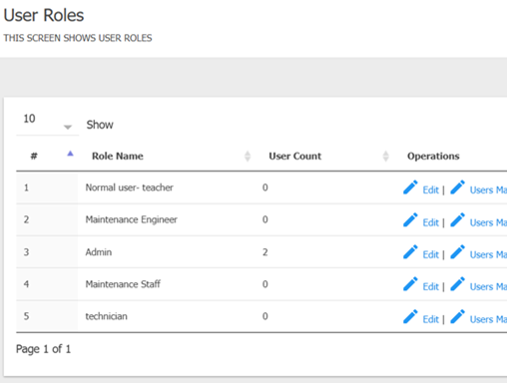
ADDING User
Users Roles & Permission
23

Slide 25
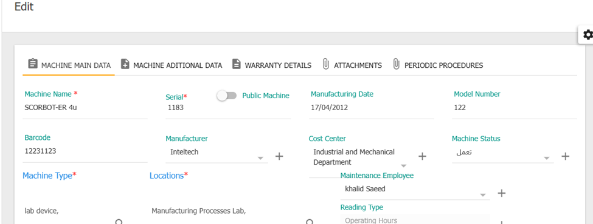
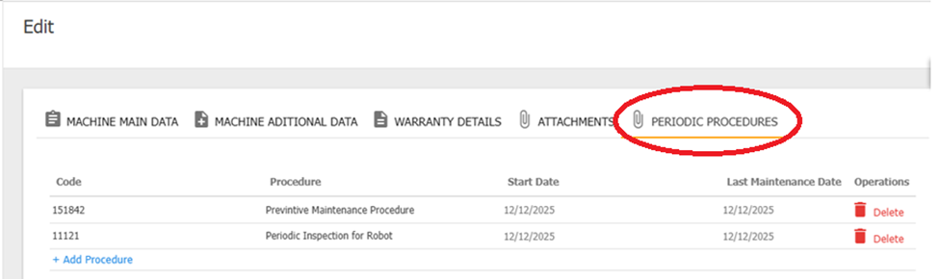
Manage Machines & Equipments
Preventive maintenance procedures for machine
Preventive Maintenance Procedures for Machine
24

Slide 26
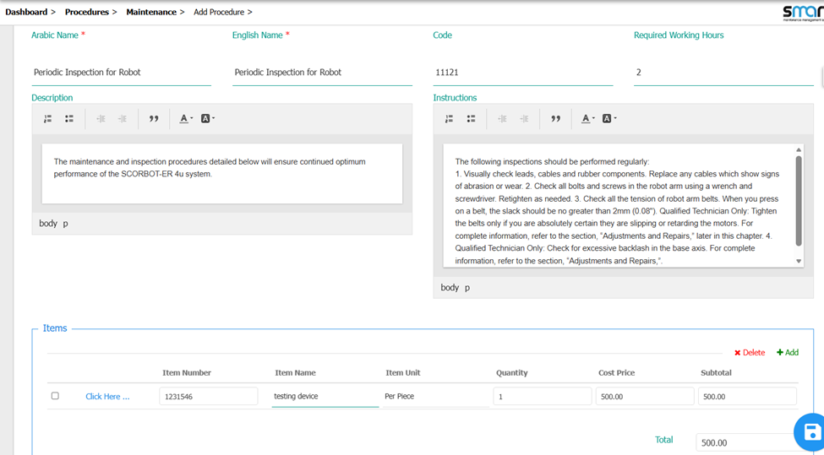
PM Plan for Periodic Inspection
25

Slide 27
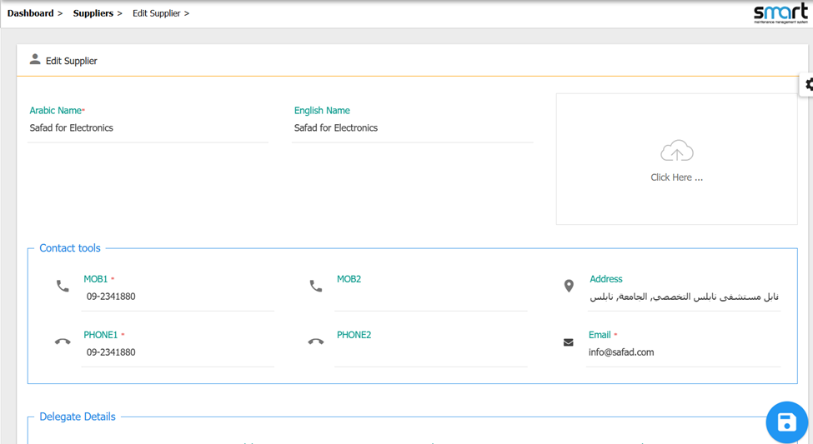
Supplier Management
26

Slide 28
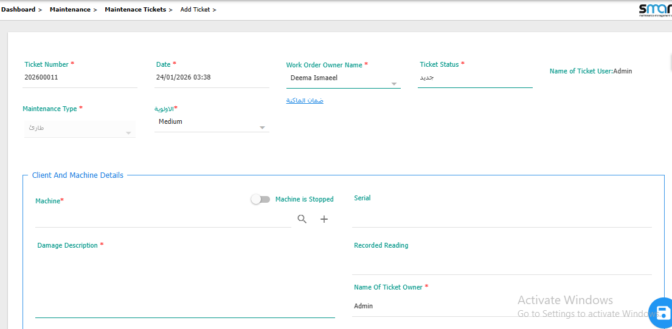
Maintenance Teckits
27

Slide 29
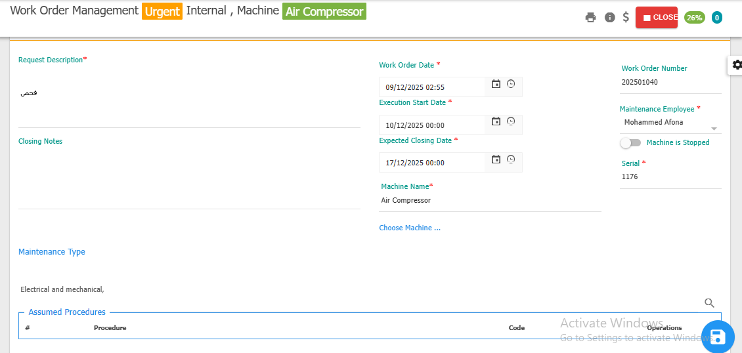
Create Work Order
28

Slide 30
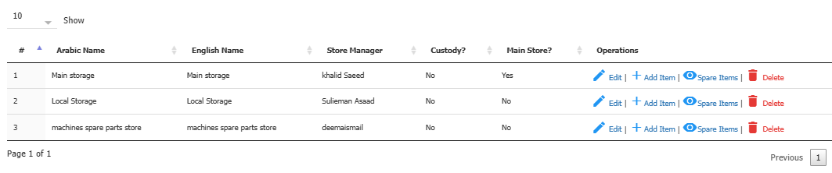
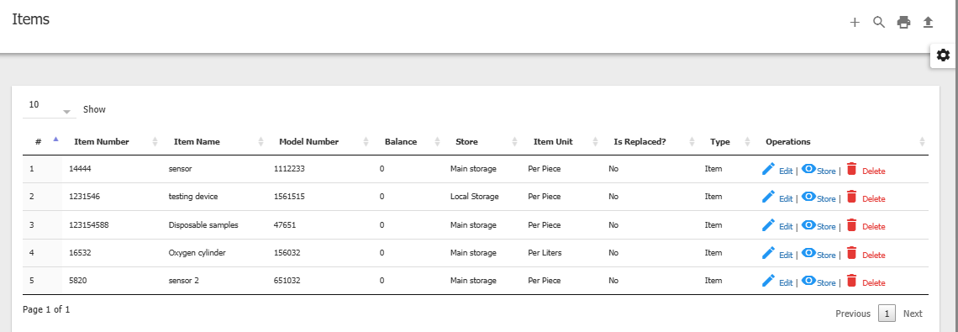
Spare Parts Management
29

Slide 31
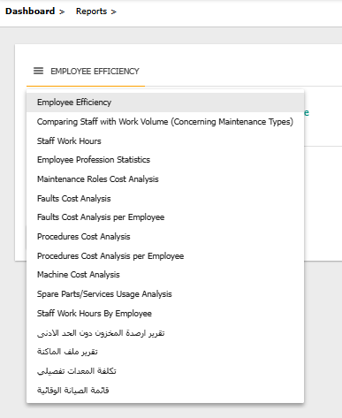
Types of reports
30

Slide 32
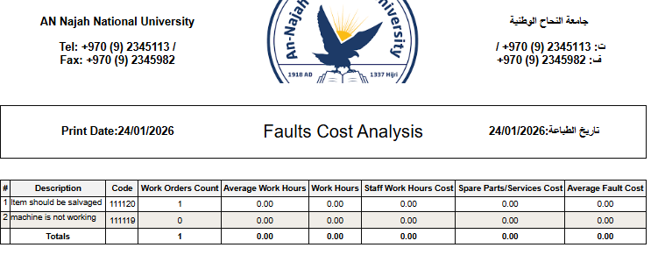
12
4:0
48
144
336
40
12
4:0
48
144
336
40
31

Slide 33
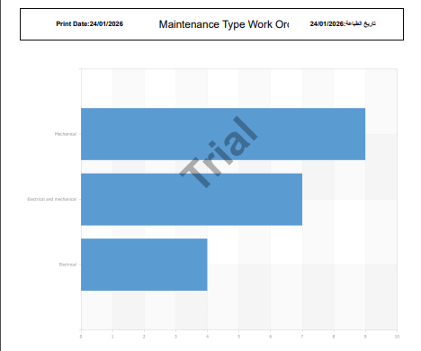
32

Slide 34
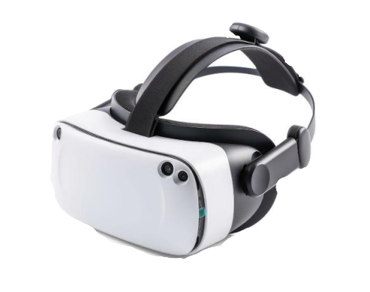
Application of Virtual Reality (VR) Technology
  Engineering laboratories face training limitations and equipment risks, increasing the need for VR integration.
  Integrating VR is a key step in improving training and supporting maintenance in engineering laboratories.
  VR enables safe, realistic training for understanding equipment ,practicing procedures efficiently and make Total Productive Maintenance.
33

Slide 35





Benefits of VR Training
Enhanced Skill Retention and Knowledge Transfer
Increased Confidence and Reduced Anxiety
Accessibility and Training Delivery
Safe Practice in High-Risk Environments
Consistency and Standardization
34

Slide 36

Why EON-XR Platform?
  Allows educators, trainers, and employers to create interactive lessons without coding or advanced technical skills.
  Lessons can be accessed on common devices
  Supports and enhances traditional training and teaching methods globally.
35

Slide 37
Strategic Recommendations for Future Development
RECOMMENDATIONS
Performance Monitoring & KPIs
Continuous Improvement
38

Slide 38

PERFORMANCE MONITORING & KPIS
CMMS-based KPI dashboard for maintenance performance tracking
Monitoring key maintenance indicators (downtime, work order completion)
Automated data collection using QR codes / RFID
39

Slide 39

CONTINUOUS IMPROVEMENT
Periodic maintenance audits
Data-driven decision-making for maintenance
Transition toward proactive maintenance culture
Application of the PDCA cycle
40

Slide 40

Conclusion
Improvement in
Integrated solution combining
Training effectiveness
Maintenance efficiency
Equipment reliability
VR-based training for skill development
Smart CMMS for maintenance management
40

Slide 41
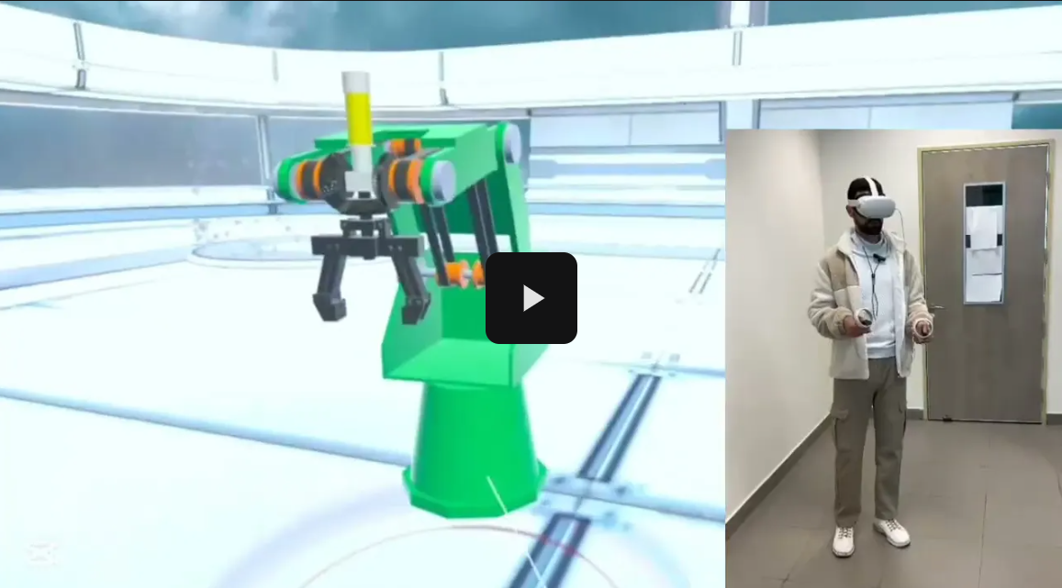
Proposed Implementation Plan for VR in the Engineering Laboratories
Sample Scenario: Scorbot
41

Slide 42
Thank you

