Slide 1

An-Najah National University
Chemical Engineering Department
Conversion of Used Engine Oil to
Lubricating Grease
Submitted by :
Atheer Shayeb
Isra’a Bani-Odeh
Merhan Tameem
Sahar Barahma
Supervisor:
Eng. Shadi Sawalha

Slide 2
List of Contents
Definition of the problem
Objectives of the project
Engine oil
Grease
Experimental work
Economic study
Layout of the plant
Results
Discussion of the results
Conclusion and recommendations

Slide 3

Problem Definition
Large quantities of used engine lubricating oil were
produced yearly in Palestine which was approximately
about (2,336,424) kg.
And all of these amounts were disposed in a wrong
ways.

Slide 4


Project Objectives
To keep environment from hazards that caused
by mismanagement of used engine oils.
Provide the local market with Palestinian made
grease with good quality and low price which
leads to economical growth.

Slide 5
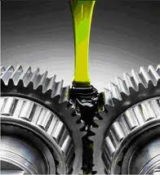
Lubrication definition
It is a substance that introduced between two moving surfaces to reduce the friction between them, improving efficiency and reducing wear.
It may also have the function of dissolving or transporting foreign particles and of distributing heat.

Slide 6
Types of Lubricants
Lubricants
Greases
Oils

Slide 7
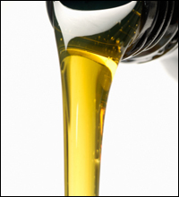

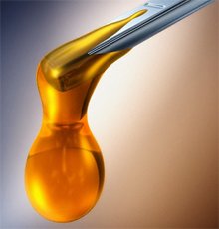
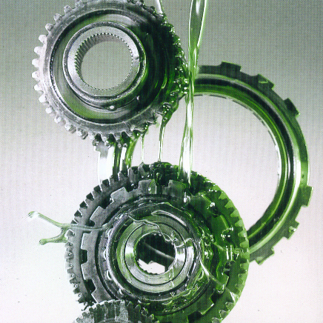
Lubricant Oil

Slide 8

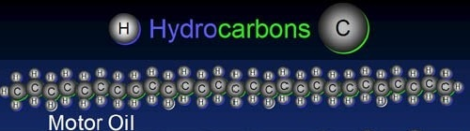
Definition
Viscous liquid Its color ranges from yellow-to-black.
Flammable.
Liquid mixture of thousands of hydrocarbons.

Slide 9

Used Lubricant Oil

Slide 10
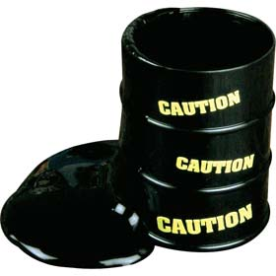
Definition
The automotive lubricating oil loses its
effectiveness during operation due to the
presence of certain types of contaminants.

Slide 11
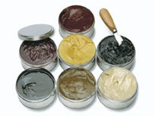
Lubricant Greases

Slide 12
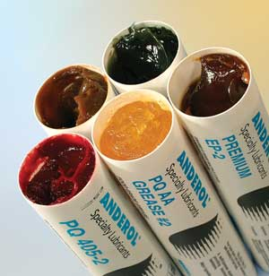
Definition
According to the Practical Handbook of Lubrication:
grease is a semisolid or solid lubricant
composed of a fluid lubricant thickened with a material that contributes a degree of plasticity.

Slide 13
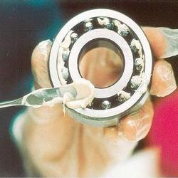
Applications
Greases are typically used in this situation:
Where sufficient lube oil cannot be effectively
maintained on machinery surfaces.

Slide 14
Grease Anatomy
Oil
70–95%
Thickener
5–25%
Additives
0-10%

Slide 15

Experimental Work

Slide 16
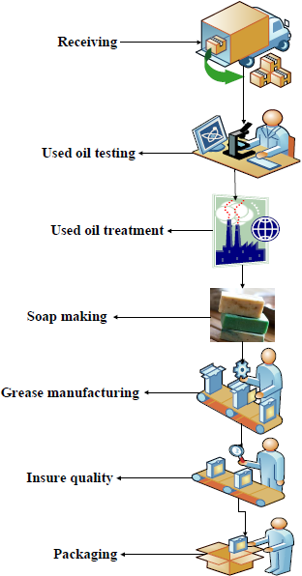

Slide 17
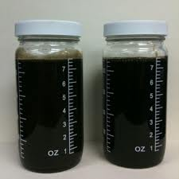
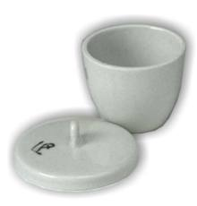
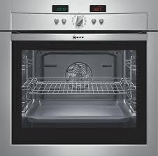
Used Oil Testing
Moisture content: this test is important in order to
determine the water percent in used oil which change
the properties of lubricating oil and adversely affect
on lubricity job.
Ash content: this test is important in order to determine
the amount of metals in the oil.

Slide 18
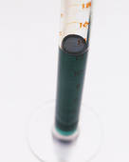
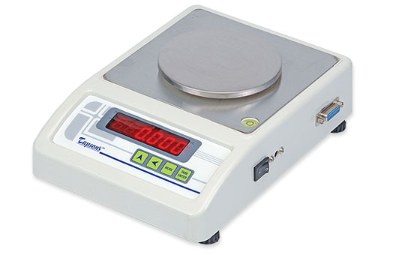
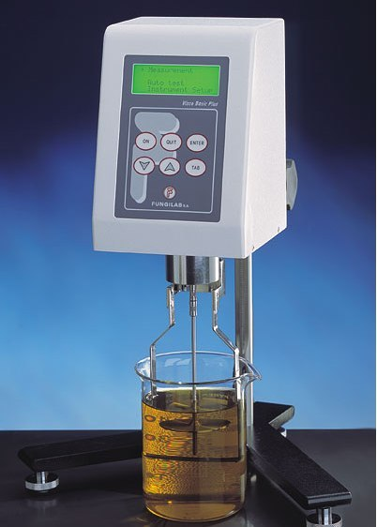
Density: This test was done by weighing a
predetermined volume sample and then the density was
calculated as (w/v).
Viscosity: This test was carried out using Viscometer
apparatus.

Slide 19
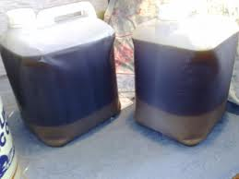
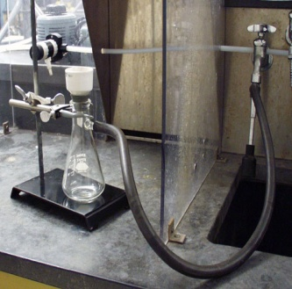
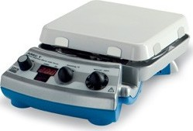
Used Oil Treatment
Settling
Vacuum
Filtration
Heating
Settling tanks used in order to separate water and sludge that found in a large quantities from oil to about one days.
The small strange contaminants would be removed.
used oil was heated to reach a 120 ⁰C, in order to evaporate the excess water from the oil and other low volatile compounds like gasoline.

Slide 20
Saponification Process
Calcium Soap
Olive Oil
Sodium Soap
Lye
Water
Water
Olive Oil
anhydrous lime

Slide 21
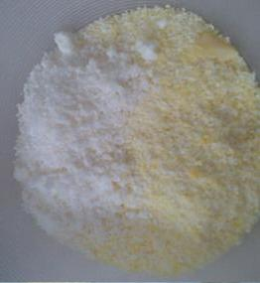
Grease Manufacturing
Soap is milled
Components of the grease were heated to reach 150 ⁰C
to get a homogenous mixture with continuous mixing of the components
Grease was left for one day to be cooled.
to provide a consistent dispersion

Slide 22
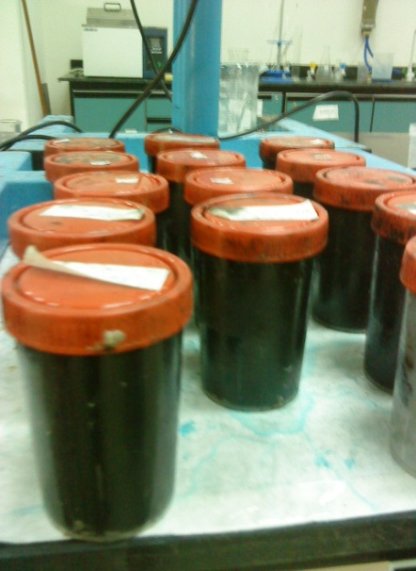
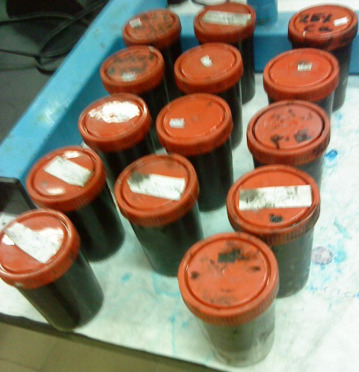
Greased samples prepared are shown in the table below:
sodium soap grease Soap wt% | Complex-soap grease (Na-Ca) soap grease wt% | Sodium-soap grease with ( P.E) filler wt%
5 | 5% Na+ 20% Ca | 10% Na+ 2% P.E
10 | 10% Na+ 15% Ca | 10% Na+ 3% P.E
15 | 15% Na+ 10% Ca | 10% Na+ 4% P.E
20 | 20% Na+ 5% Ca
25 | 10% Na+ 10% Ca

Slide 23
Grease Tests
Viscosity: the samples viscosities were measured
using Viscometer model VISCO BASIC Plus.
Dropping Point: For sodium soap dropping point is
in the range of (149-177 ºC) and for calcium is
(79.5-93.5 ºC).

Slide 24
Lubricity: means the ability of an oil or grease
to lubricate.
This test was performed by naked eye according to
grease viscosity and based oil percent in the grease.

Slide 25
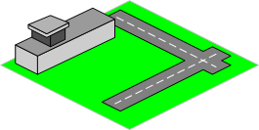
Grease Plant
Main equipment that used for grease production:
Receiving tank for used oil
Storage tank of raw material
Mixing tank of sodium soap
Reactor with a scraper-and-paddle stirrer

Slide 26
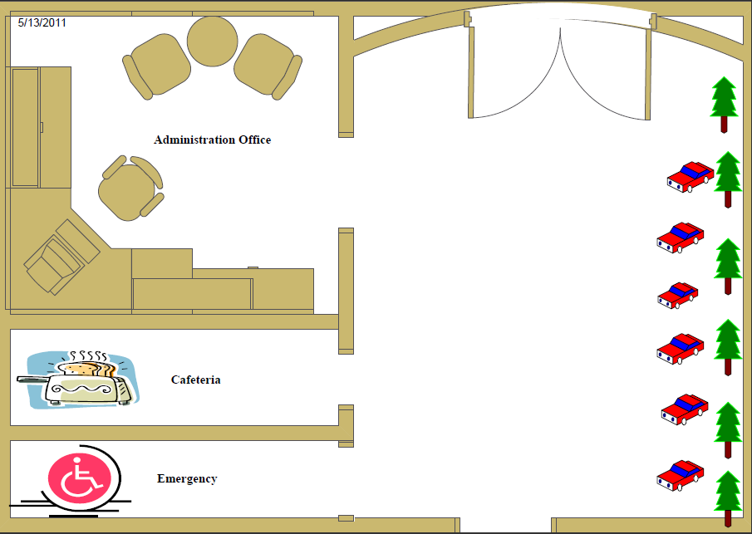
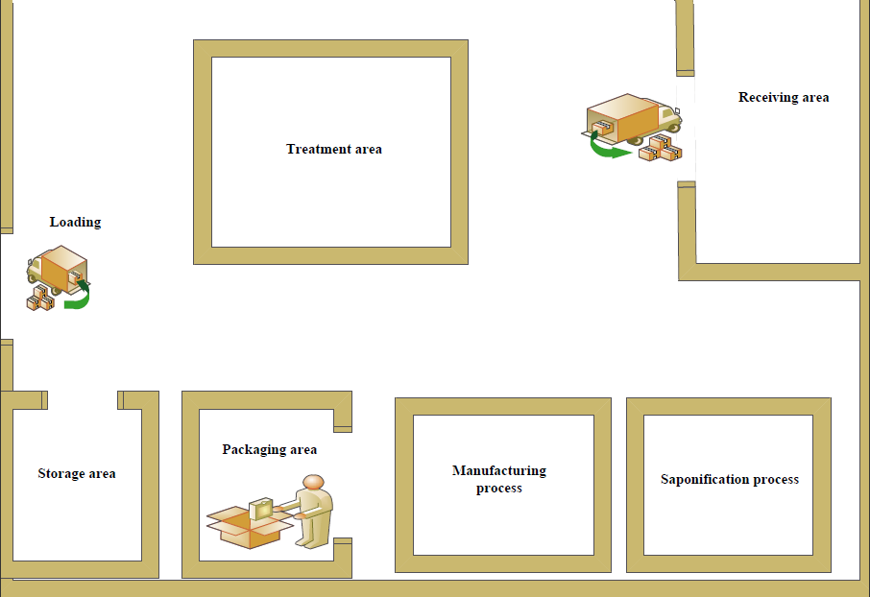

Slide 27
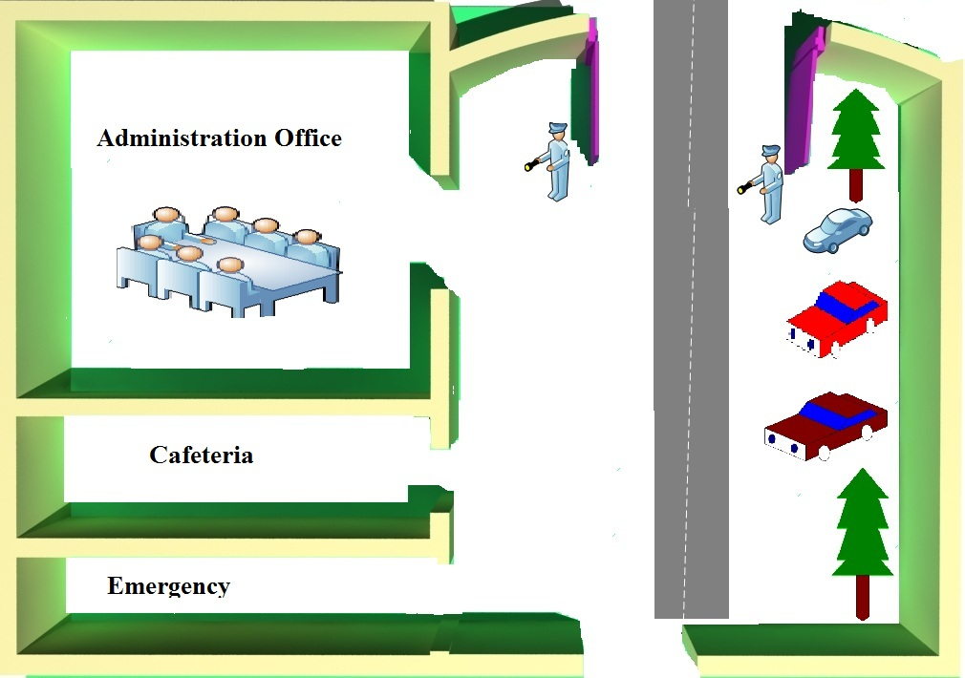

Slide 28
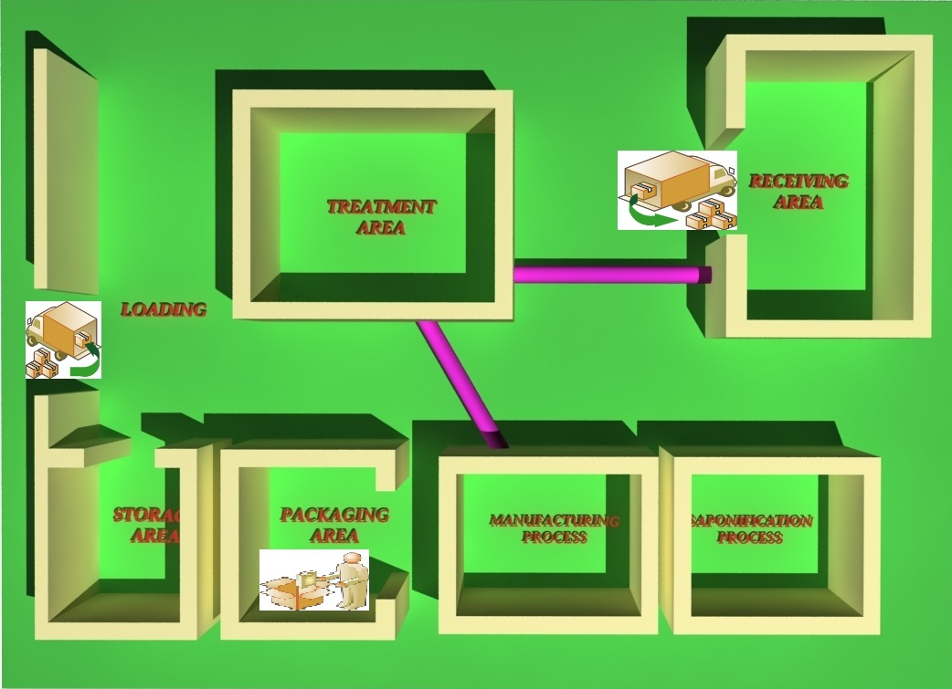

Slide 29


Slide 30
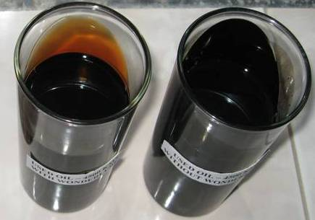
The Results of Used oil Tests
The average results after treatment | The average results before treatment | Test
0.84 | 0.828 | Density (g/ml)
557.9 | 318.3 | Viscosity (mPa.s)
7.1 | 5.03 | pH
0.0002 | 0.055 | Moisture content %
1.4 | 2.7 | Ash content %

Slide 31
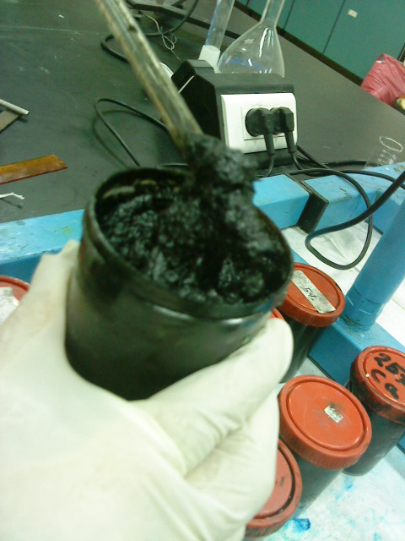
Sodium-soap Grease Properties
Lubricity of grease | Dropping point (ºC) | Viscosity (mPa.s) | Amount of Na- soap in grease %
Weak | 50 | 1732 | 5
Moderate | 70 | 1770 | 10
Excellent | 150 | 3888 | 15
Weak | 160 | 4431 | 20
bad | 190 | 5071 | 25

Slide 32
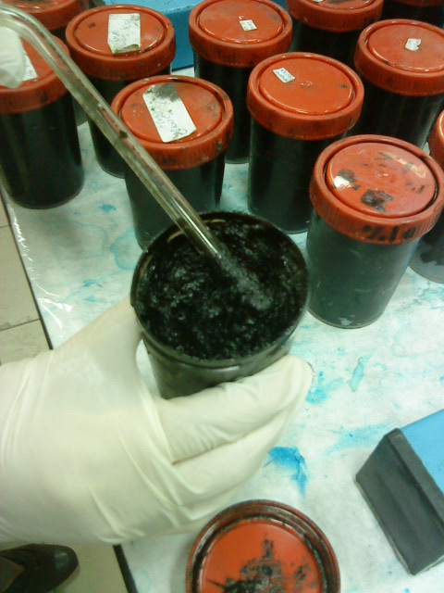
Complex-soap Grease Properties
Lubricity of grease | Dropping point (ºC) | Viscosity (mPa.s) | Amount of complex- soap in grease %
bad | 45 | 2130 | 5% Na+ 20% Ca
weak | 78 | 4000 | 10% Na+15% Ca
excellent | 170 | 4525 | 15% Na+10% Ca
good | 200 | 4750 | 20% Na+5% Ca

Slide 33
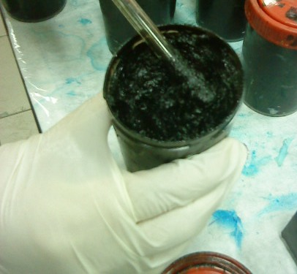
Sodium-Soap Grease with Poly ethylene (P.E) filler Properties
Lubricity of grease | Dropping point (ºC) | Viscosity (mPa.s) | Amount of sodium soap- P.E in grease %
good | 165 | 3322 | 10% Na+ 2% P.E
weak | 181 | 4298 | 10% Na+ 3% P.E
bad | 220 | 5876 | 10% Na+ 4% P.E

Slide 34
Tank Design
Thickness (m) | Diameter (m) | Height (m) | Tank type
0.0024 | 2.6 | 7.05 | Receiving tank of used oil
0.0024 | 2.4 | 6.5 | Storage tank of used oil
0.0021 | 1.4 | 3.7 | Sodium soap mixing tank

Slide 35
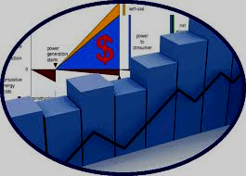
Economical Study

Slide 36
Cost of Production for Sodium Soap Grease
Cost (NIS/year) | Amount of Na- soap in grease %
1,231,490 | 5
1,645,231 | 10
2,058,973 | 15
2,472,715 | 20
2,886,457 | 25

Slide 37
Cost of Production for Complex Soap Grease
Cost (NIS/year) | Amount of complex- soap in grease %
2,703,437 | 5% Na+ 20% Ca
2,749,192 | 10% Na+15% Ca
2,402,427 | 15% Na+10% Ca
2,840,702 | 20% Na+5% Ca
2,381,205 | 10% Na+10% Ca

Slide 38
Cost of Production for Sodium Soap - P.E Grease
Cost (NIS/year) | Amount of sodium soap- P.E in grease %
1,839,155 | 10% Na+ 2% P.E
1,936,116 | 10% Na+ 3% P.E
2,033,078 | 10% Na+ 4% P.E

Slide 39
Equipment Purchase Cost
Cost of (NIS) | Tank type
20,220 | Receiving tank of used oil
17,154 | Storage tank of used oil
5,621 | Sodium soap mixing tank

Slide 40
Economical Study Results
The project was profitable were the results for 15% Na soap based grease :
Total investment cost = 349,303,3 NIS
Total fixed cost of production = 481,830 NIS
Total variable cost of production = 657,380,1 NIS
Net profit = 143,879 NIS
Payback period = 3.6 Year

Slide 41

Discussion of the Results

Slide 42
Discussion
Viscosity of used oil was somehow low, after treatment it was increased because of removing water and some fuels like gasoline by dehydration method.
pH in used oil was an acidic media but after treatment it was increased to be basic one.

Slide 43
Cont….
Ash content was somehow high it was lowered by settling method and vacuum filtration.
Finally the moisture content was found to be (0.055%) but after dehydration it was reduced to be low value.

Slide 44
Effect of Na soap on grease viscosity
Fig (1):Variation of Grease viscosity (mPa.s) with sodium soap percentage in grease.

Slide 45
Effect of complex soap thickener percentage on grease viscosity
Fig (2): The variation of Grease viscosity (mPa.s) with sodium- calcium soap percentage in grease.

Slide 46
Effect of Filler on Grease
viscosity
Fig (3): Variation of Grease viscosity (mPa.s) with sodium- P.E soap percentage in grease.

Slide 47


Slide 48
Conclusion
  (2,336,424 kg) of used lubricant oil was produced in
  west bank yearly.
  Used lubricating oil can be used in economical
  friendly manner as lubricating grease.
  Disposal of the used lubricating oil in landfills or
  incineration causes environmental and health problems.

Slide 49
  Used oil treatment used was settling, dehydration,
  and vacuum filtration to improve used oil properties;
  and this method was effective to remove contaminants
  from used lubricating base oil and return the oil to
  a quality suitable for grease manufacturing.
  Since there is no grease plants in Palestine this
  project was useful for local economy.

Slide 50
  Different thickeners were used for producing
  different types of greases which were sodium,
  calcium and complex soaps, polyethylene was used
  as filler.
The presence of filler such as the P.E in grease, cause a higher viscosity of the base oil.

Slide 51
The optimum grease compositions were:
15% Na soap based grease .
(15% Na+10% Ca ) complex soap based grease.
10% Na+ 2% P.E grease.
Titanium dioxide was used to improve grease color.
An increase on the percentage of soap concentration enhances the viscosity and lubricity of the grease and

Slide 52
Recommendation:
 | Trying different methods of used oil treatment and refining then comparison between them could be done to find the optimum way of treatment. Search for thickeners and additives which are good for grease manufacturing and protect environment from pollution.

Slide 53



Any Question

