Slide 1

An-Najah National University
Faculty of Engineering
Electrical Engineering Department
Graduation Project 2
Home medication dispensing system
Prepared By:
Ahmad Barahmah
Muhammad Odeh
Khaled Al-Taweel
Supervisor :
Dr.Samer Mayaleh

Slide 2
ABSTRACT
This project presents a Smart Medicine Reminder (SMR) prototype. The main purpose of this system is to help the patients, primarily seniors, take their medications on time in an easy way without the possibility of missing pills, also reduce the risk of over or under dosing accidentally. Not taking medications correctly can have serious consequences such as delayed recovery, illness and even death. The Smart Medicine Reminder (SMR) could solve such problems by informing and alerting the patients to take the appropriate dose at the right time. Also, it provides direct communication between the patients and the caregivers as it will immediately notify the caregiver in case the patient missed his/her pill. In addition, SMR provides the user with a touch interface available as an application on their smartphone which will allow them to remotely manage and control pill schedules and usage data.

Slide 3
I. INTRODUCTION
Medication adherence is a growing concern throughout the healthcare industry with doctors, healthcare systems, and other stakeholders (insurance companies) since the elderly or senior patients’ medication has a big issue of drugs misuse. It is very likely for them to forget to take their pills on time. Especially, those who take multiple medications at the same time. Also, they might take wrong dosage accidentally which may lead to unfortunate consequences such as death. This is a clear proof that it is a widespread problem and clearly related to adverse patient outcomes and higher healthcare costs.
Many medical errors are due to the fact that people in charge of patient or elder’s medication have to deal with sorting huge amounts of pills each day. This paper consists on the conception, design and creation of a pillbox prototype intended to solve this deficiency in the medical area as it has the ability of sorting out the pills by itself as well as many other advanced features, with this device being intended to be used by hospitals or retirement homes. This medication pill box is focused on patients who frequently take medications or vitamin supplements, or attendants who deal with the more seasoned or patients. Our Medicine box is programmable that enables medical caretakers or clients to remind to take pills, and the service times for every day. Our shrewd pills box contains eight separate sub-boxes. In this manner, medical caretakers or clients can set data for eight distinct pills. At the point when the pill time has been set, the pillbox will remind clients or patients to take pills utilizing sound, light and vibration. The warning of pills should be taken will be shown by an android application which is held by the patient. Contrasted and the conventional pill box that requires clients or attendants to stack the crate each day or consistently. Our shrewd pill box would essentially discharge medical attendants or clients’ weight on much of the time preloading pills for patients or clients and overlook the measurements which must be taken.

Slide 4
II. PROPOSED SYSTEM

Slide 5
III. MOTIVATION
There can be a lot of individuals out there who need constant help may it be our elderly people, family members, the ones who have special needs. Elders are more affected by the timing of taking a certain drug than others, in order to prevent any dysfunction or illness timing is a must. But as with aging comes poor eye sight and poor memory, what if the patient has a dementia like Alzheimer. Some people may forget to take the medicines at the correct time and can forget the medicines which they have to take. In order to eliminate the factors of always needed observation like nurses or taking a risk of a missed dose, we had to find an easy, portable and efficient solution. Pill boxes already exist but most of them are either has limited use, doesn’t fit for elder ages or even has a big size that makes it not suitable to take it with you anywhere. In order to make a really useful smart pillbox it had to be easily integrated with the recent sweeping smart technologies. While at the same time it had be fit for the elders and their limited knowledge and experience to implement the ease of use. Size and portability were also an important fact that we had to keep in mind.
• To come up with an Innovative idea that can be helpful for society.
• Medicines help us to cure the diseases.
• Main Reason for not taking medicine is that they forget.

Slide 6
IV. PROBLEM STATEMENT
There can be a lot of individuals who need constant help such as elderly people, family members are affected by the timing of talking a certain drug, in order to prevent any dysfunction or illness timing is must. As pills have taken such an important role in everyday life there has been the past years an increase in the number of medical neglect cases related to incorrect medication given to patients, such as the case of the nurse who gave a patient a paralytic instead of an antacid that was prescribed by the doctor, causing the patient’s death . After seeing so many of these cases it is evidently crucial that the correct pill is taken by the correct person at the correct time, otherwise taking an incorrect one or not taking one at all may expose the patient to several dangerous situations, ranging from mild health issues up to death.

Slide 7
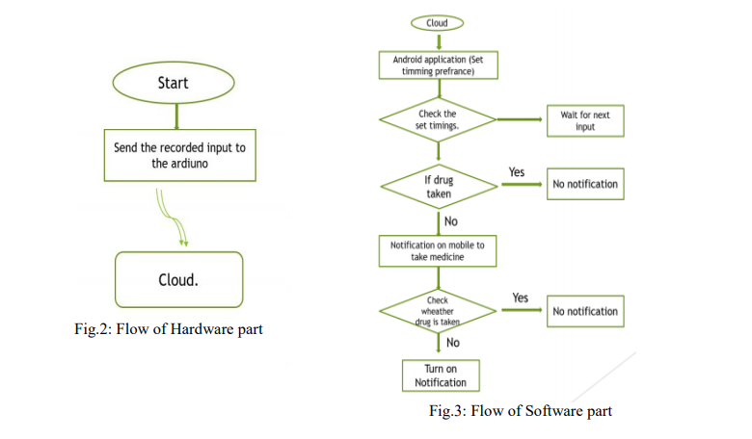
V. FLOWCHART

Slide 8
VI. PROJECT REQUIREMENTS & SPECIFICATIONS

Slide 16
2. SOFTWARE REQUIREMENT:
2.1. Android studio:
• Android Studio is the official integrated development environment for Google’s Android operating system, built on JetBrains’ IntelliJ IDEA software and designed specifically for Android development. It is available for download on Windows, mac OS and Linux based operating systems
• License: Freeware +Source code Operating system: Windows, mac OS, Linux, Chrome OS Developed by: Google, JetBrains Written in: Java, Kotlin , C++.
• Android Studio is the official Integrated Development Environment (IDE) for Android app development, based on IntelliJ IDEA. On top of IntelliJ’s powerful code editor and developer tools, Android Studio offers even more features that enhance your productivity when building Android apps.
• In our project we have built the android application with the help of Android studio. This android application fetches data from the cloud and checks whether the notification show be given or not

Slide 17
2.2. Firebase
Firebase is a platform developed by Google for creating mobile and web applications. It was originally an independent company founded in 2011. In 2014, Google acquired the plat form and it is now their flagship offering for app development.
2.3. Arduino IDE
The Arduino Integrated Development Environment (IDE) is a cross-platform application (for Windows, mac OS, Linux) that is written in functions from C and C++. It is used to write and upload programs to Arduino compatible boards, but also, with the help of third-party cores, other vendor development boards.
The source code for the IDE is released under the GNU General Public License, version 2. The Arduino IDE supports the languages C and C++ using special rules of code structuring. The Arduino IDE supplies a software library from the Wiring project, which provides many common input and output procedures. User-written code only requires two basic functions, for starting the sketch and the main program loop, that are compiled and linked with a program stub main() into an executable cyclic executive program with the GNU toolchain, also included with the IDE distribution. The Arduino IDE employs the program avrdude to convert the executable code into a text file in hexadecimal encoding that is loaded into the Arduino board by a loader program in the board's firmware. By default, avrdude is used as the uploading tool to flash the user code onto official Arduino boards.

Slide 18
VII. WORKING PROCESS

Slide 19
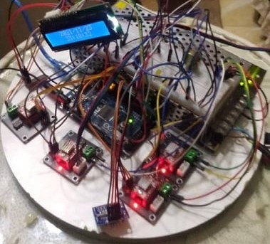
In the previous picture, we notice the internal parts of the machine and the way to connect them to each other.

Slide 22
VIII. APPLICATIONS AND ADVANTAGES
• Time to time Reminder to take Medicine.
• Easy Android User Interface to Monitor.
• Easily accessible to family members.
• Avoiding taking of wrong medicine.
• Avoiding wastage of Medicine.
• Compactible
• Flexible
• Easy to detect the errors if any.
• No complex connection
• User friendly
• Low cost
• Zero maintenance.
• Especially very useful for aged people.

Slide 23
IX. CONCLUSION
The proposed SMR system takes the idea of automated dispenser to the next level as it has some functionalities that are not included in any other automated dispensers. Also, some statistics are provided about the pills taken with their alarms and the already existing ones. Online database of the users, pills and their alarms are also a great feature that helped in the design of the project. The pills can be edited and created using an android application remotely through smartphones.

Slide 24
X.REFERENCE
https://store-usa.arduino.cc/products/arduino-mega-2560-rev3
https://firebase.google.com/docs/database/android/start?authuser=0
https://developer.android.com/studio?gclid=CjwKCAiA78aNBhAlEiwA7B76p--Xu1IQ7R5ADXjtOGjFuUbi-AQ8eUvHEFHW_f53yJmmP0P59BKpAxoCP8AQAvD_BwE&gclsrc=aw.ds
https://www.youtube.com/watch?v=nFin_KqJ98M&list=PLMYF6NkLrdN8giOLjGRx81fjEIaE5ef-8
https://datasheetspdf.com/pdf/1260602/Schneider/NEMA17/1
https://datasheetspdf.com/pdf/853652/EspressifSystems/ESP8266/1
https://cdn-learn.adafruit.com/downloads/pdf/adafruit-optical-fingerprint-sensor.pdf

