Slide 1
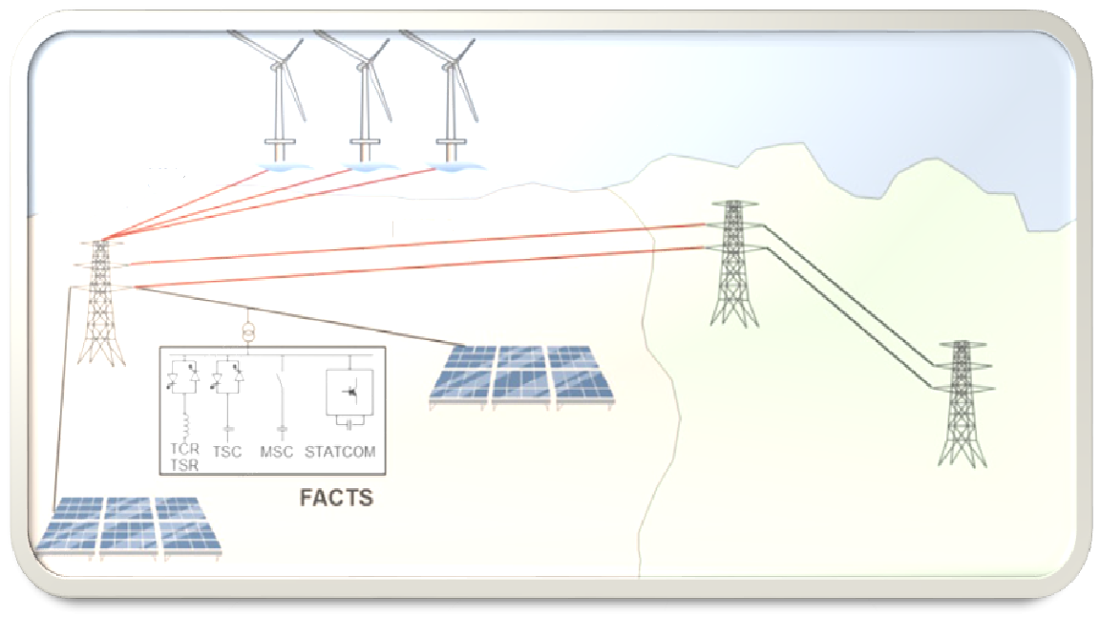
Single Phase PV-STATCOM Using Multilevel Inverter

Slide 2
Outline
Overview.
Power factor.
photovoltaic system.
Static synchronous compensator.
Control techniques.
Methodology and results.
-P.V system design .
-Design and simulation of DSTATCOM.
-H-bridge with PI PWM.
-H-bridge with hysteresis.
-H-5 with PI PWM.
-Cascaded H-bridge with PI Level shifted PWM.
Recommendation and future work.

Slide 3
Overview.
power systems are facing a number of power quality problems that classified as voltage and current quality problems. There are a number of current power quality problems such as :-
  Poor power factor .
  Poor voltage regulation.
  Harmonics .

Slide 4
Power Factor.
P.F is the ratio of the real power absorbed by the load to the apparent power.
Problem of poor power factor:
    High current for suppling the load.
    high cost of equipment's .
    High losses .
    Drop voltage.

Slide 5
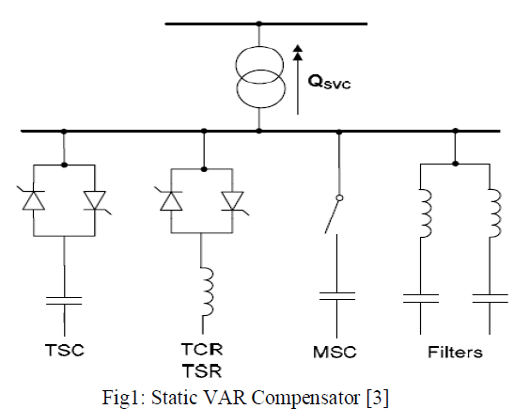
Power factor improvement.
1)Static VAR compensator.
is a set of electrical devices for providing fast-acting reactive power using capacitors and controller .
Disadvantage:
-Slow response time.
-High power loss.
-Low elimination for harmonics
-Reactive power decreases when grid voltage . decreases.
-Switching transient
-Harmonics causing capacitor overheating.

Slide 6
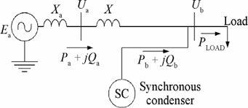
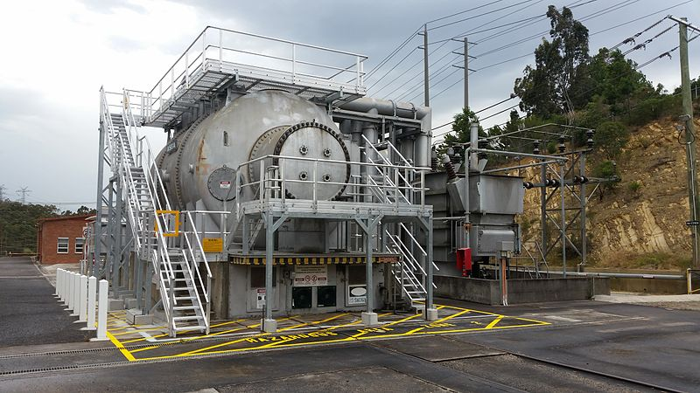
SYNCHRONOUS CONDENSERS.
A synchronous condenser is a synchronous device that produces reactive power which leads real power by 90.
Disadvantage .
- Higher energy losses.
-Limited voltage support.
-Produces noise.
- Maintenance cost is high.
-Except in sizes above 500 kVA.
-No self-starting torque.
- Losses in the motor.

Slide 7
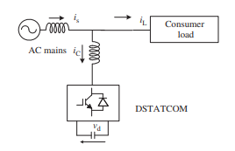
STATCOM.
A regulating device used on alternating current electricity transmission networks.
Advantage:
-Fast response time .
-Lower power losses
-Can filter the harmonics.
-Not effected with drop voltage.
-Can interfaced with real power sources.

Slide 8
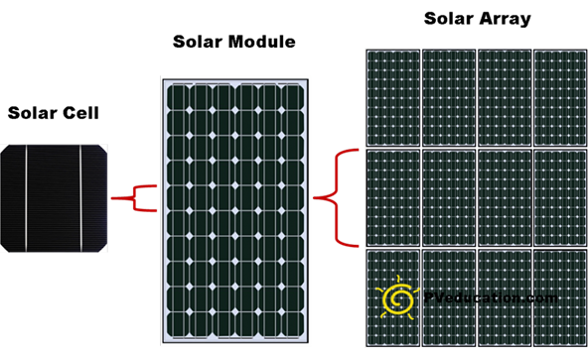
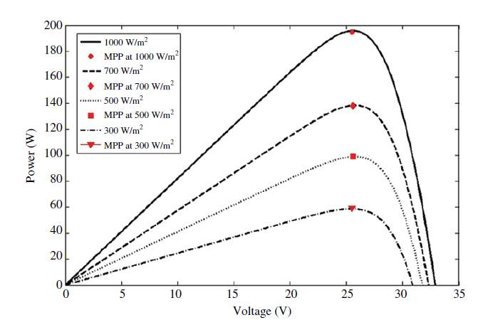
Photovoltaic System.
- is an energy system that is designed to transform the energy from the sun into electricity by means of photovoltaics.
-Solar PV has specific advantages as an energy source: once installed, its operation generates no pollution and no greenhouse gas emissions.

Slide 9
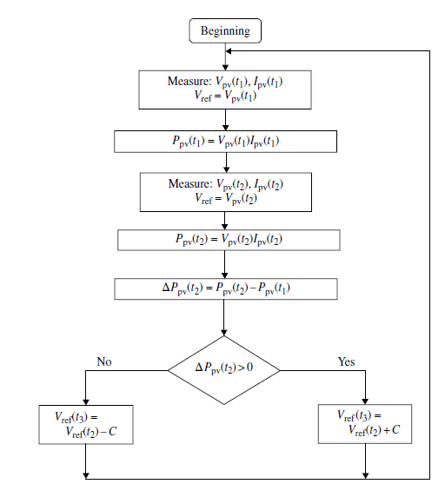
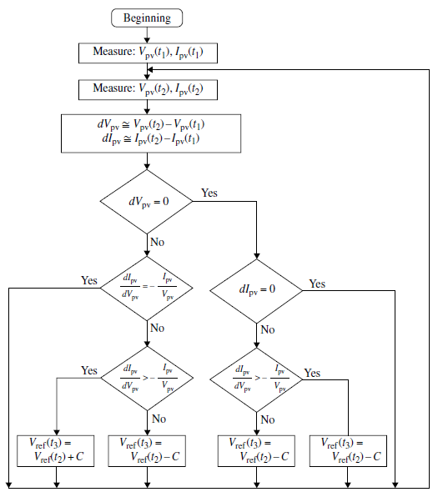
MPPT
Perturbation and Observation
2. IC Method

Slide 10
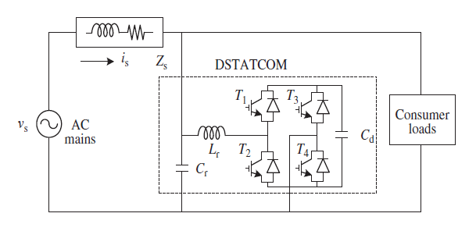
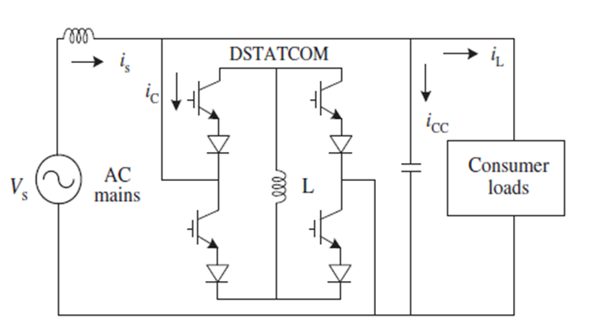
STATCOM.
Static Synchronous Compensator (STATCOM) is a reactive power compensation device that is shunt connected to the AC transmission and distribution systems.

Slide 11
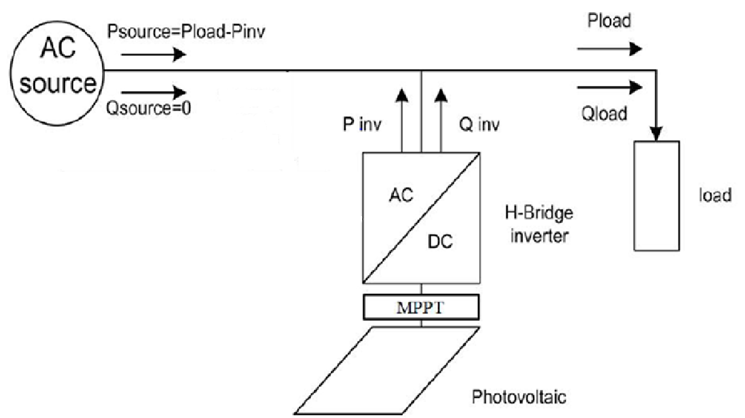
Layout system.

Slide 12
Control techniques.
The main objective of a control algorithm of DSTATCOMs is to estimate the reference currents
using feedback signals.
There are many control algorithms of DSTATCOMs such as:
    -SRF(d-q)
    -IRPT(α-β)

Slide 13
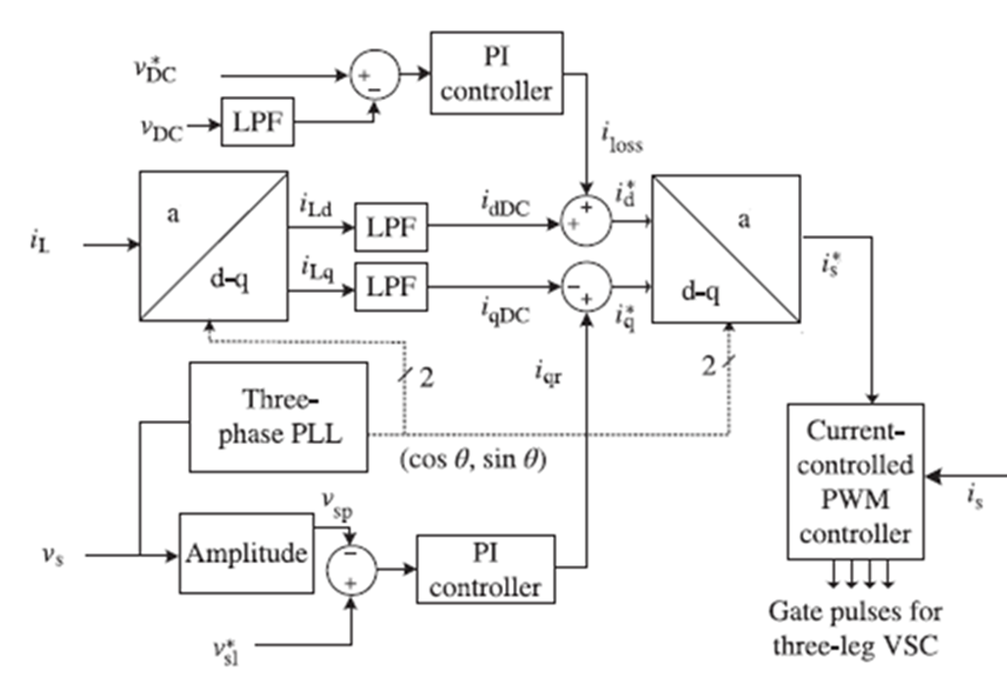
SRF(d-q).

Slide 14
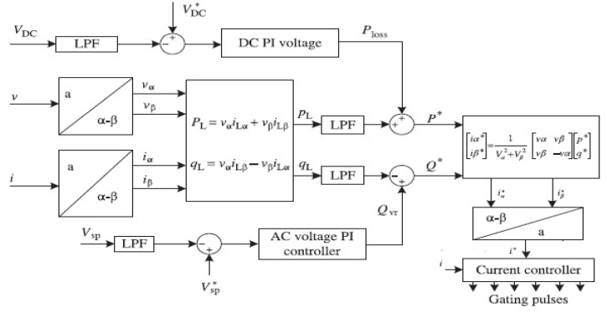
IRPT(α-β).

Slide 15
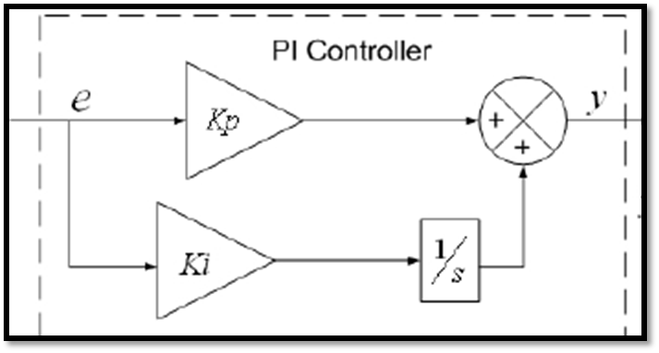
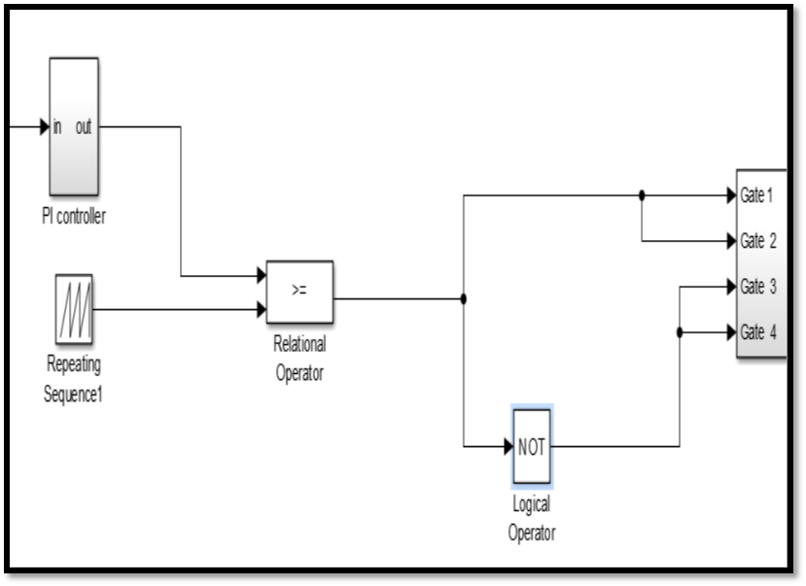
Gating controlling
PI controller with PWM

Slide 16
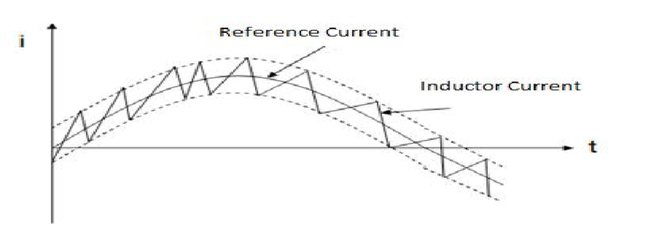
Gating controlling
Hysteresis controller

Slide 17
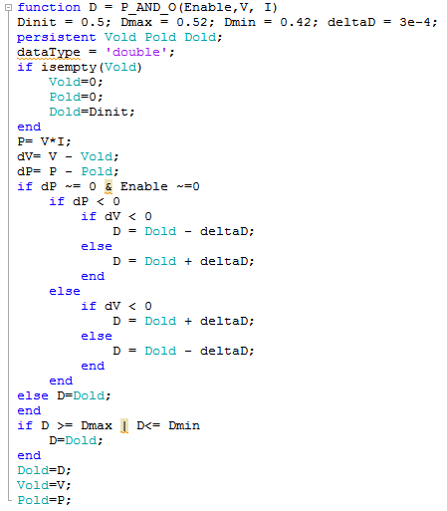
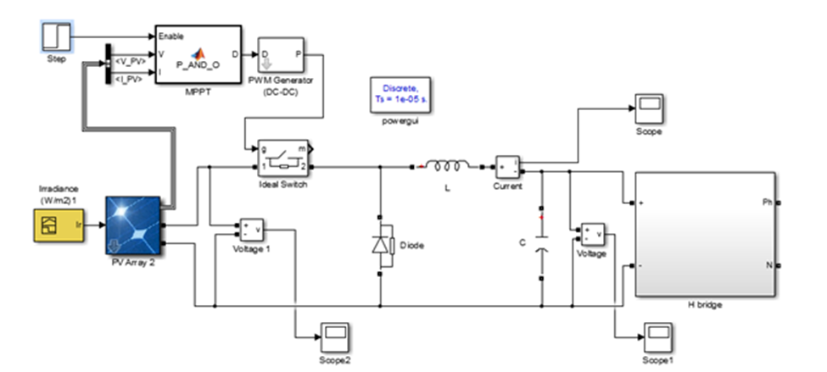
Methodology and results.
P.V system design.

Slide 18
D-Statcom
H bridge PI PWM
Night Mode Linear
Night Mode Nonlinear
H bridge Hysteresis
Cascaded H bridge
H5
Nonlinear Load
Linear Load
Nonlinear Load
Linear Load
Night Mode Linear
Night Mode Nonlinear
Nonlinear Load
Linear Load
Night Mode Nonlinear
Linear Load
Nonlinear Load
Night Mode Linear
Design of DSTATCOM.

Slide 19
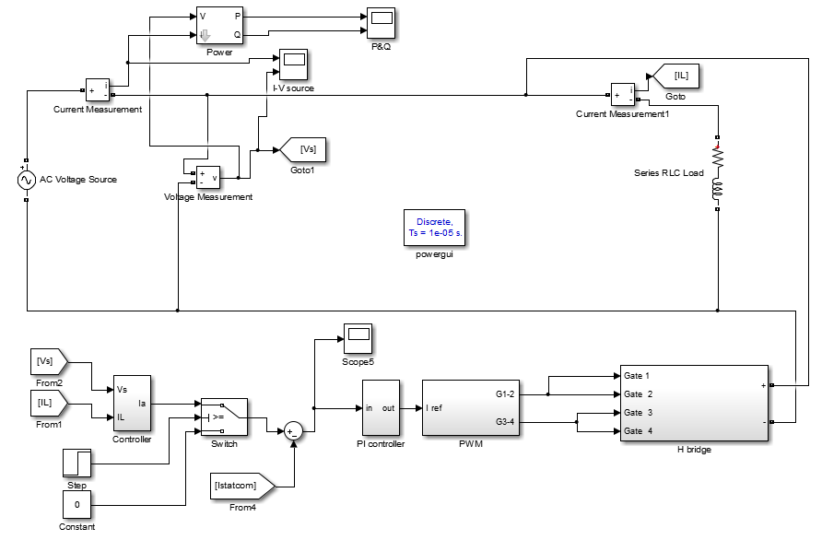
H-bridge PI PWM with Linear Load
Methodology and results.

Slide 20
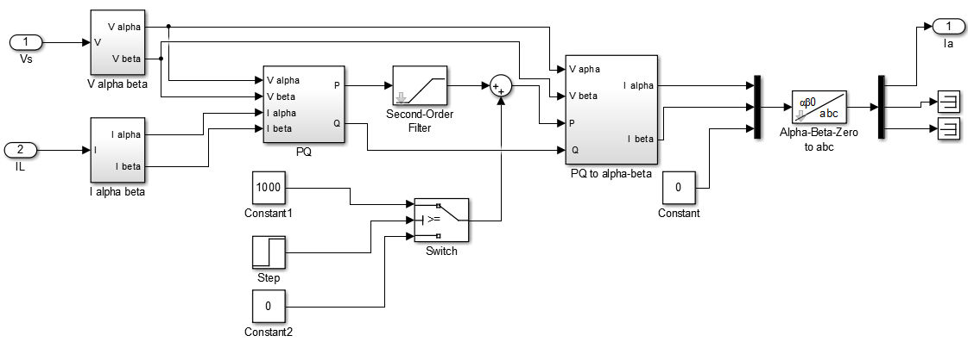
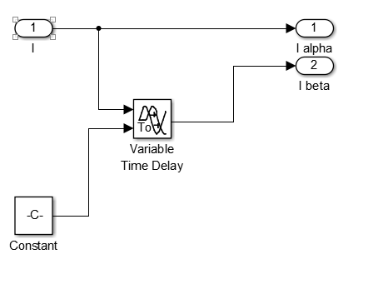

Slide 21
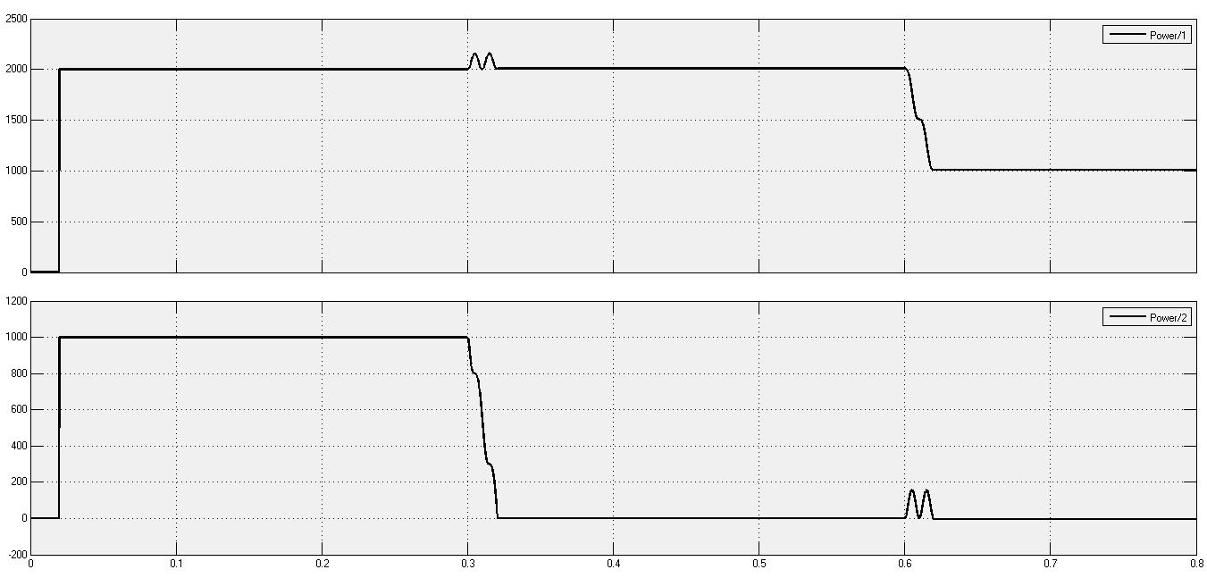
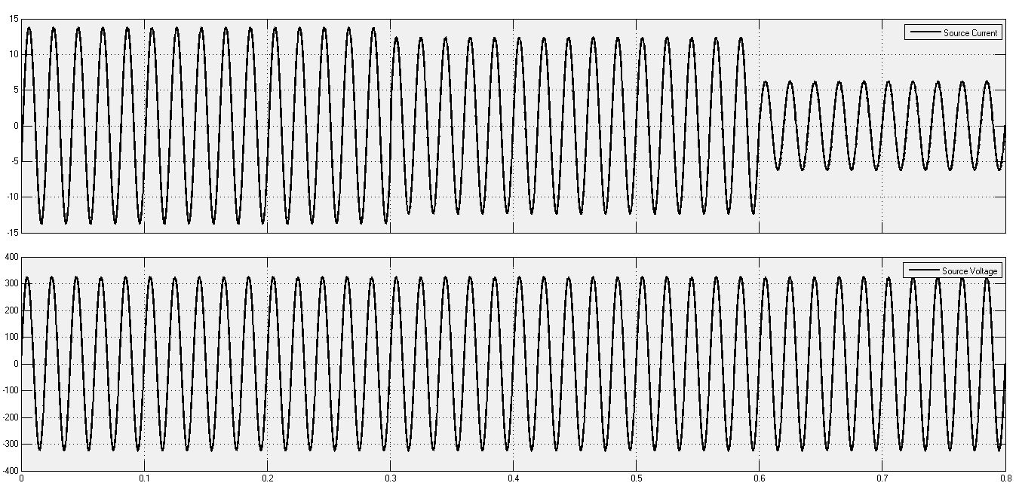
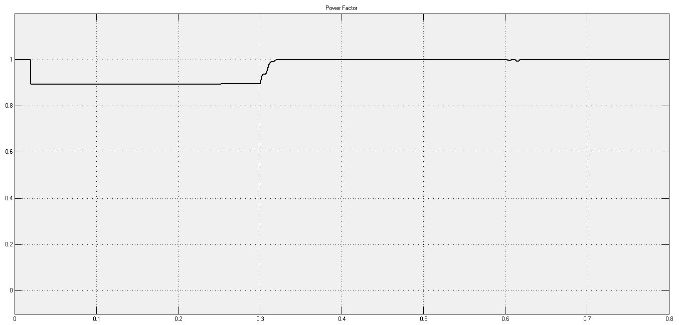
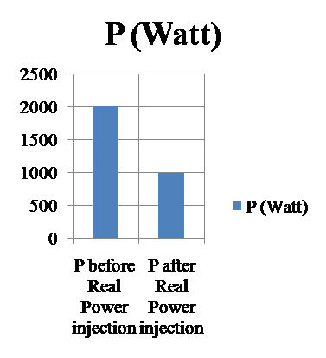
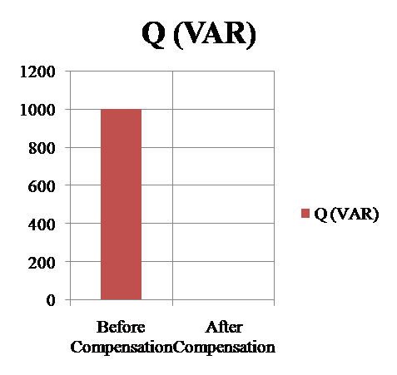

Slide 22
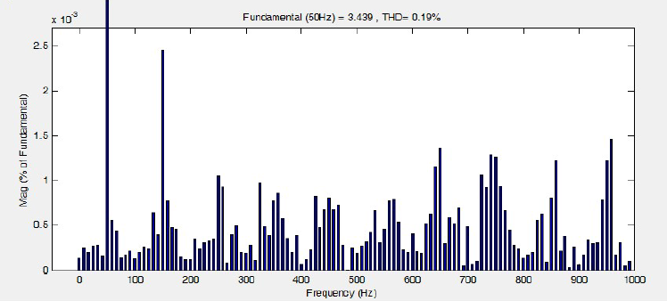
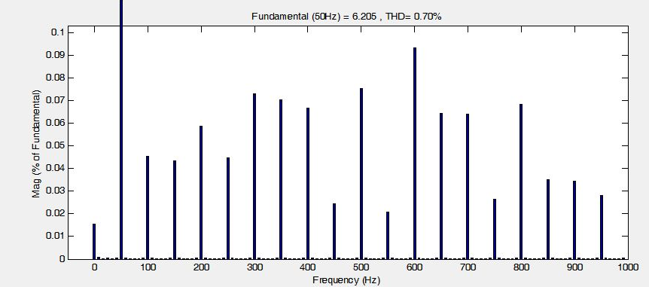
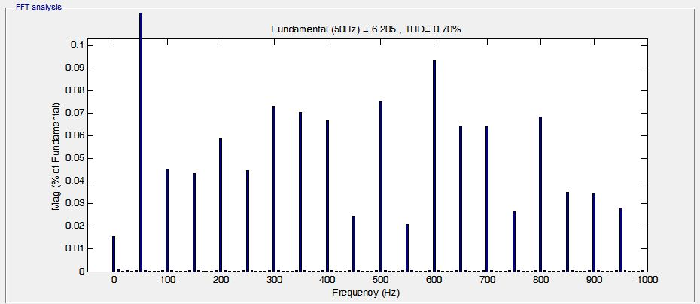
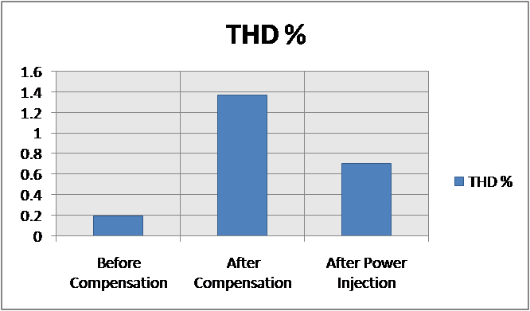

Slide 23
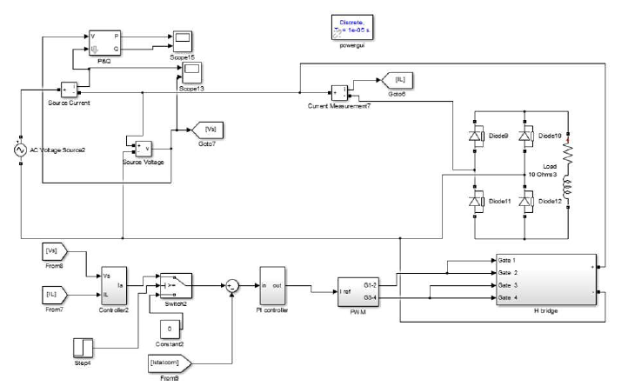
H-bridge With PI PWM Non Linear Load

Slide 24
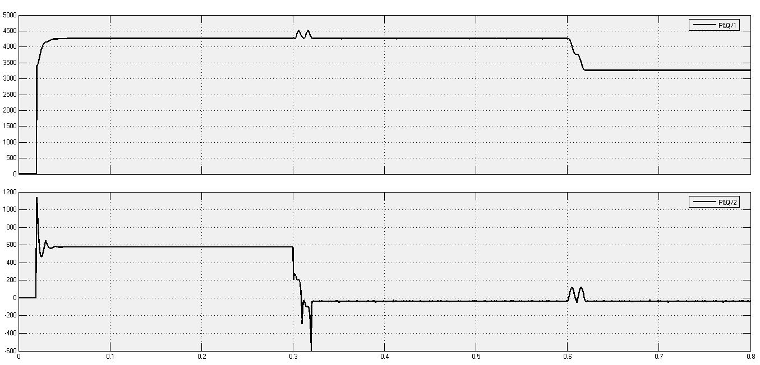
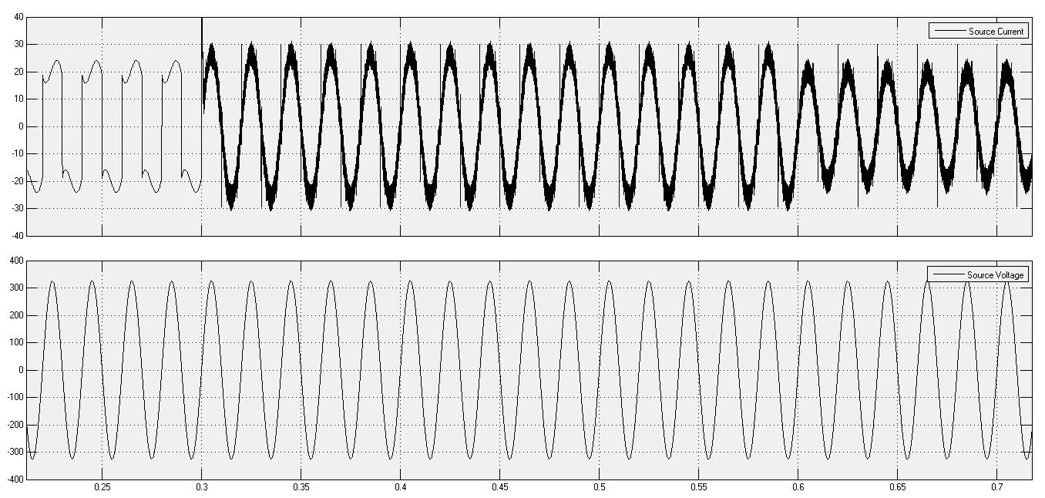
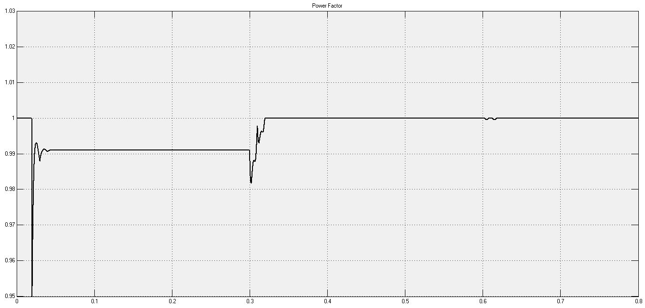
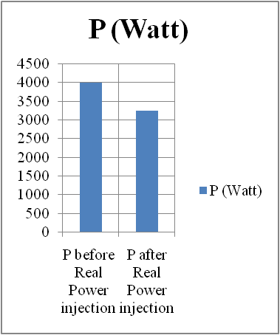
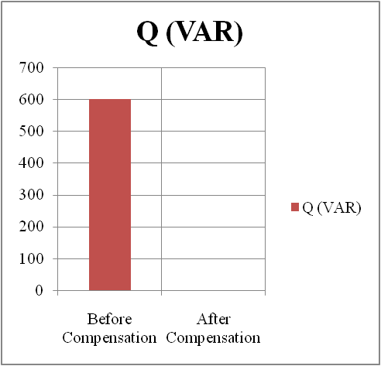

Slide 25
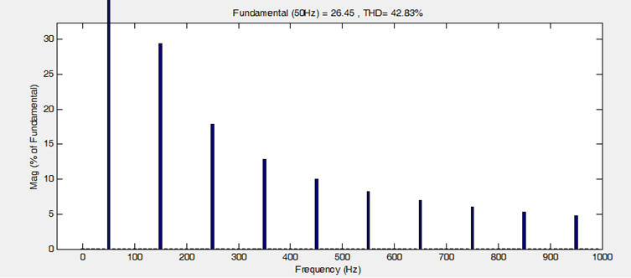
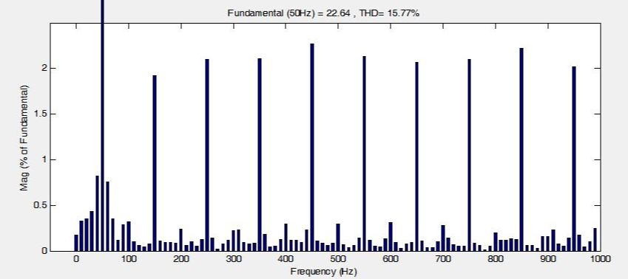
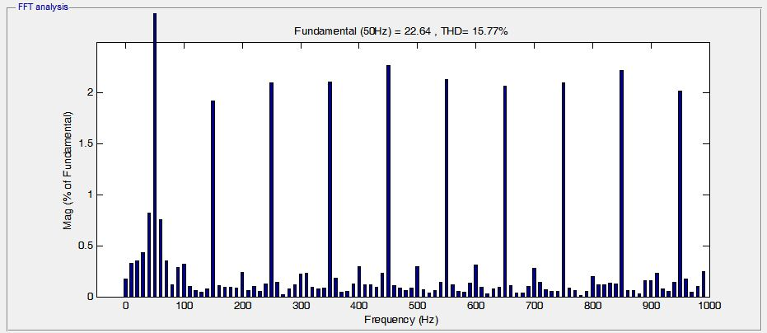
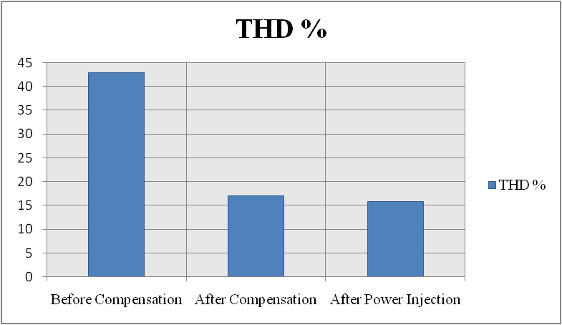

Slide 26
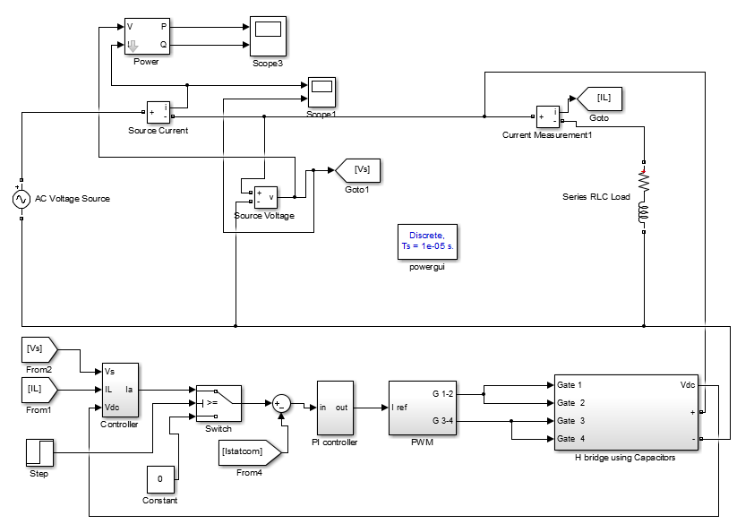
Night mode PWM with Linear load

Slide 27
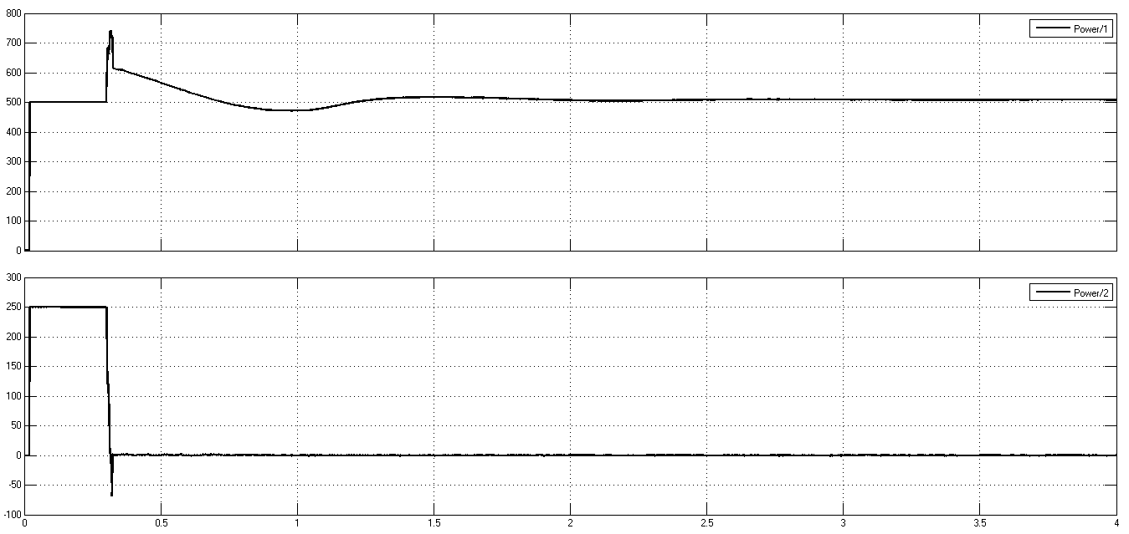
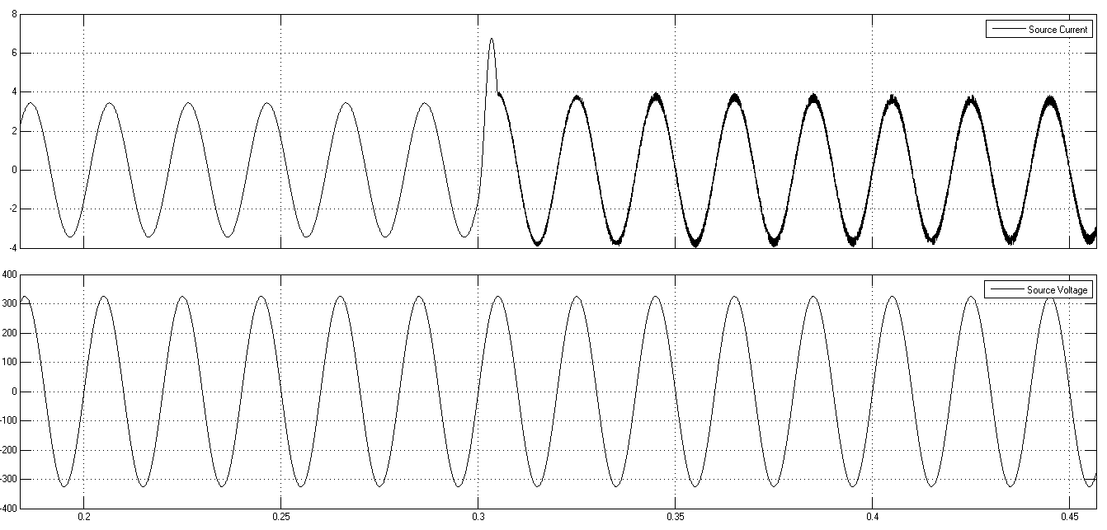
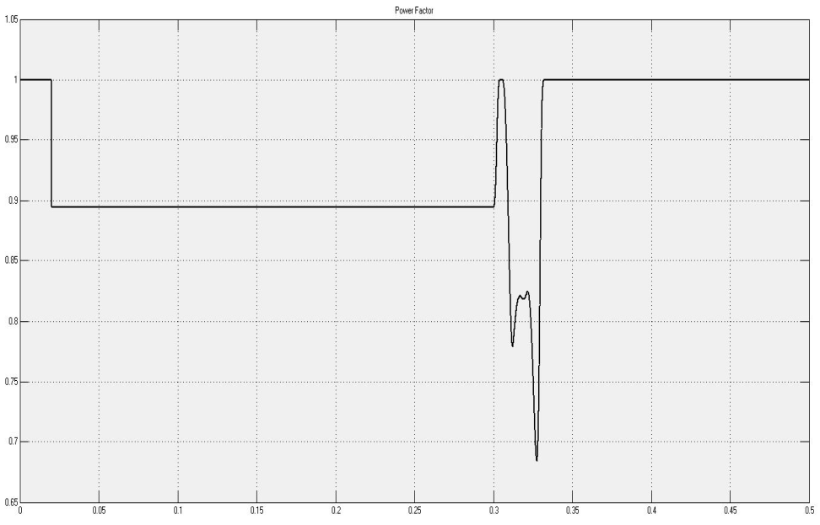
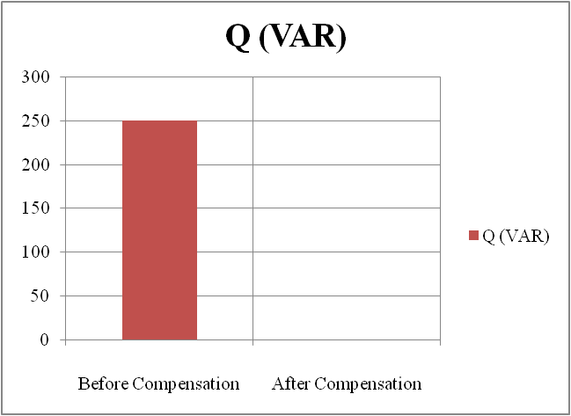

Slide 28
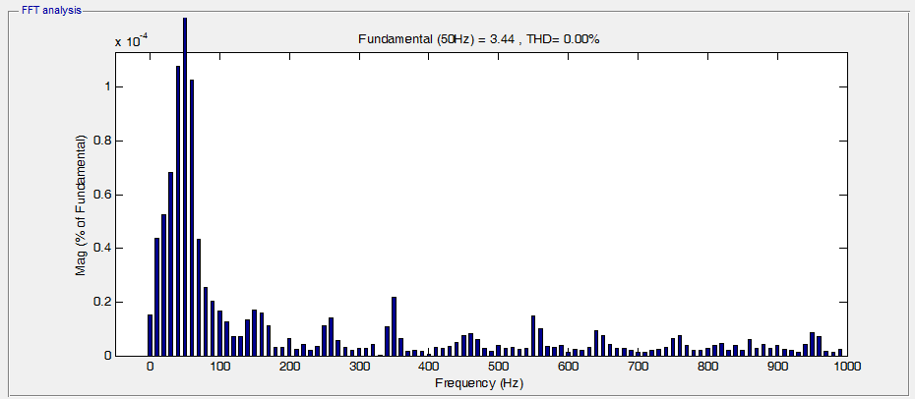
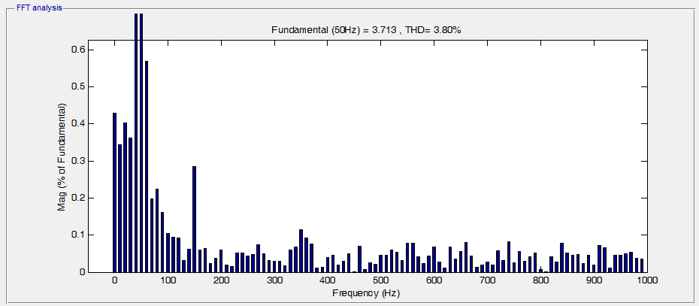
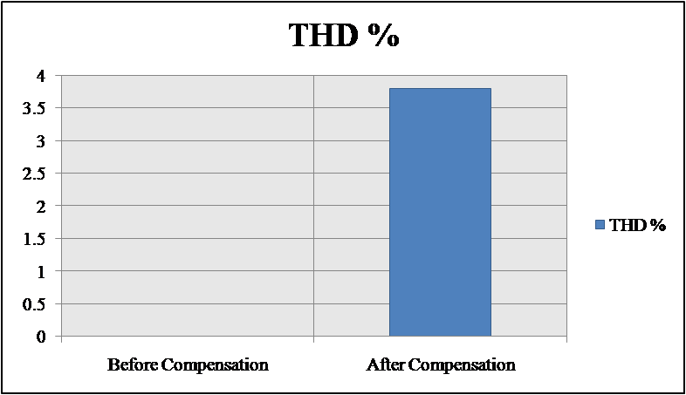

Slide 29
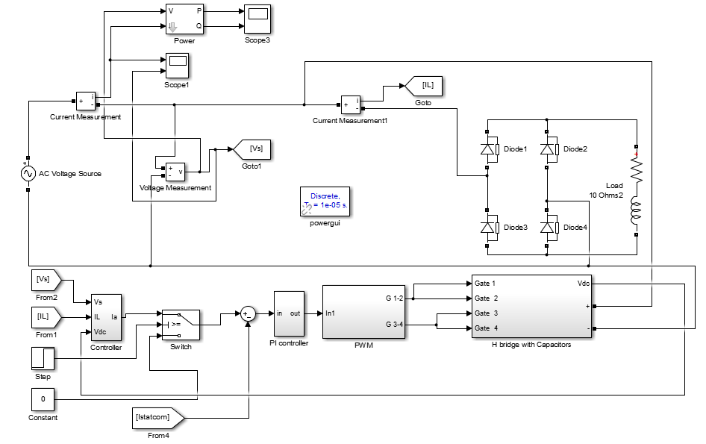
Night mode PWM with non linear load

Slide 30





Slide 31




Slide 32

      H-bridge hysteresis With Linear Load

Slide 33




Slide 34





Slide 35

H-bridge hysteresis with non linear load

Slide 36






Slide 37





Slide 38

Night Mode hysteresis With linear load

Slide 39





Slide 40




Slide 41

Night mode hysteresis with nonlinear load

Slide 42





Slide 43




Slide 44

H-5 bridge.

Slide 45

      H5 PI PWM With Linear Load

Slide 46




Slide 47





Slide 48

H5 PI PWM with nonlinear load

Slide 49






Slide 50





Slide 51


Cascaded H-bridge.

Slide 52

Cascaded H-bridge Multilevel inverter Level Shifted PWM with linear load

Slide 53




Slide 54





Slide 55

Cascaded H-bridge Multilevel inverter Level Shifted PWM with non linear load

Slide 56






Slide 57





Slide 58

Night Mode Cascaded H-bridge Multilevel inverter with linear load

Slide 59





Slide 60




Slide 61

Night Mode Cascaded H-bridge Multilevel inverter with nonlinear load

Slide 62





Slide 63




Slide 64

Recommendations & future work.
Building the H-Bridge with PI PWM and its gate drives and control this H-Bridge using MATLAB Simulink and Arduino controller.

