Slide 1
CLAW MACHINE
Students:
Nira Khateeb
Noor Suliman
Supervised by :
Dr.Samer Arandi

Slide 2
About Our Project
A claw machine is a vending machine and it’s a type of enjoyable game for children . The goal of this machine is to entertain children, helps them to focus, and encourage them to challenge and try. A person who wants to get something from a claw machine must move the gripper to pick up a toy. If he or she succeeds, the toy will be fallen, otherwise, nothing will be earned.
The gripper is controlled by gloves which have a flex sensor and a gyroscope sensor connected to NodeMCU(ESP8266 WeMos D1 Mini), the NodeMCU sends data to other NodeMCU(connected to Arduino Mega) using WiFi, the NodeMCU sends data to Arduino Mega using serial, and the Arduino Mega control gripper movements , gyroscope sensor moves in two directions (x, y) and this leads to move the gripper in two directions (right and left , Front and back ) depending on gyroscope movements, flex sensor movements leads to open and close the gripper, and to move the gripper up and down .

Slide 3
This machine is not the first machine to do the same thing, there are similar machines, but the way of playing in this machine is different, players can use gloves to play, and depending on the movement of the glove, the gripper will move, this way of playing is easier.

Slide 4
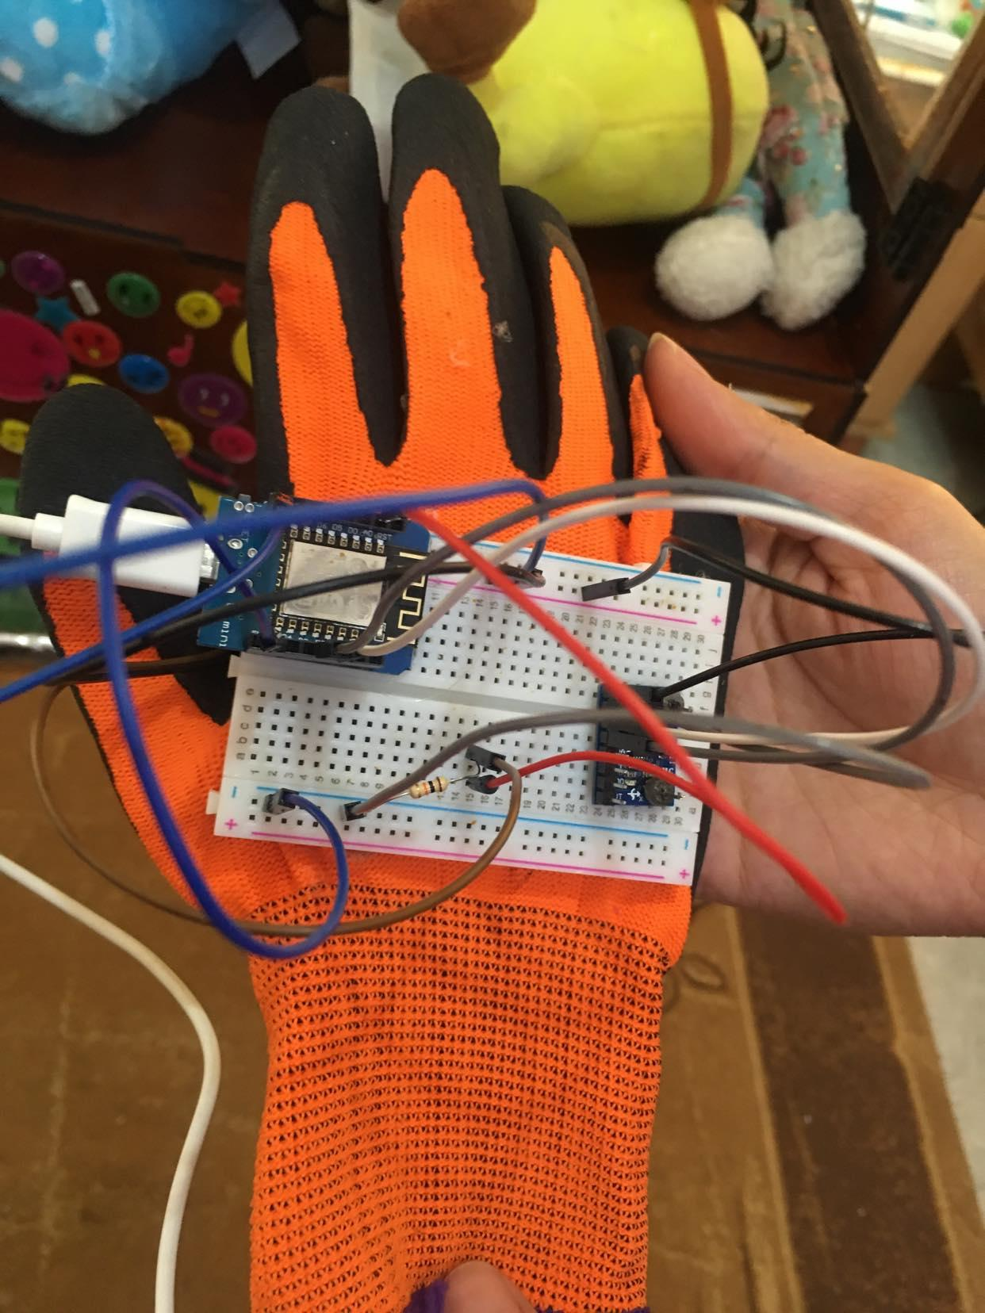

Slide 5
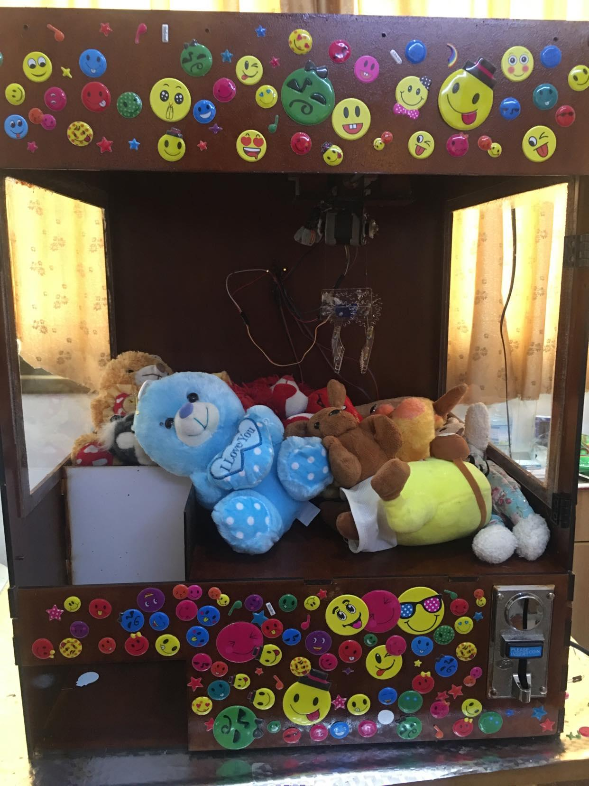

Slide 6
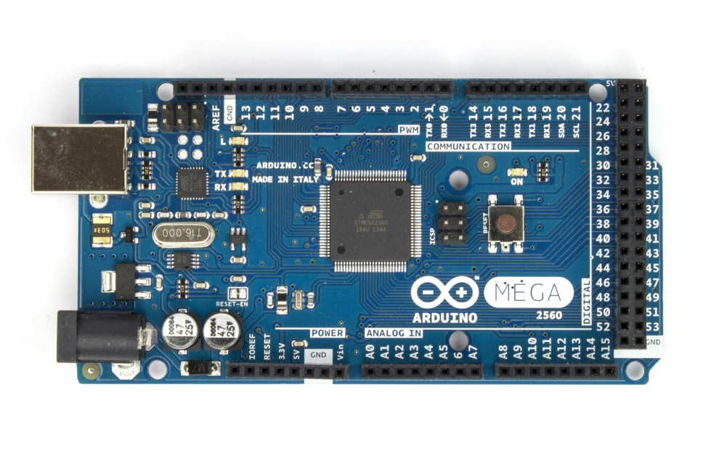
Hardware Components
Arduino Mega 2560 :
it controls the motors (Stepper motors, servo motor) in our project.

Slide 7
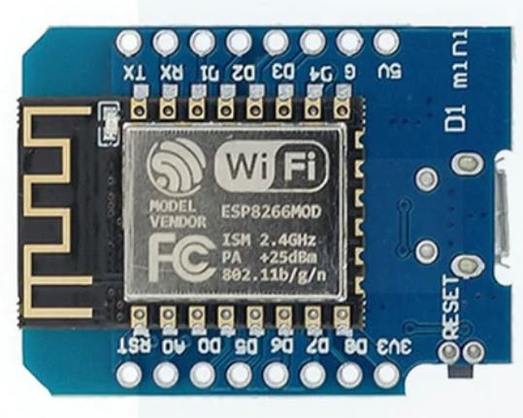
NodeMCU ESP8266 (WeMos D1
Mini) :
Two ESP8266 NodeMcu were used in this project, the first NodeMcu on the glove which acts as a server, this server send data (data for gyroscope and flex sensors) to the other NodeMCU by Wifi, the second NodeMCU acts as a client that receives data from the NodeMCU server and then sends this data to the Arduino Mega by serial to control the stepper motor and move the gripper.

Slide 8
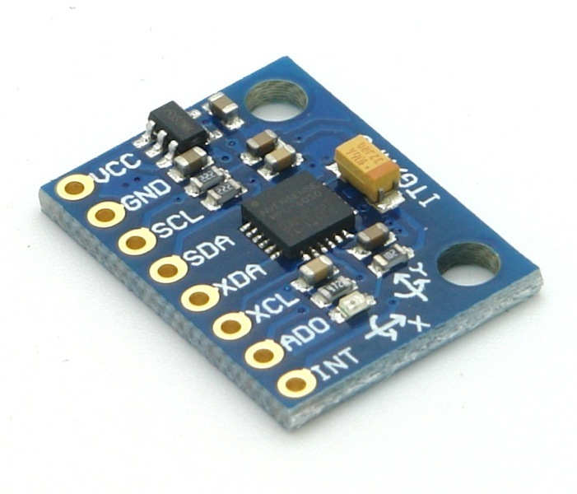
MPU6050 :
when MPU6050 moves on the X-axis this will lead to moving X stepper motor so the gripper will move in the right and left directions, and when it moves on the Y-axis this will lead to moving Y stepper motor so the gripper will move to the front and back.

Slide 9
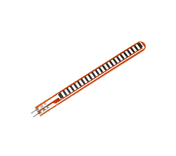
Flex Sensor :
When the sensor is straightened, the resistance is at its original value, so this leads to making the gripper close, and when the sensor is bent, the resistance will change and this leads to moving the gripper down, opening the gripper, then closing the gripper, after that moving the gripper up.

Slide 10
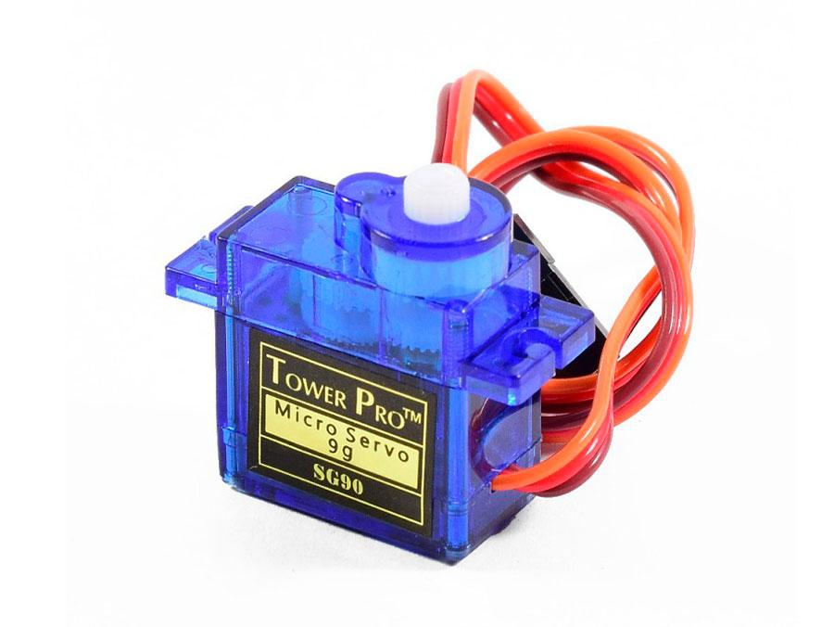
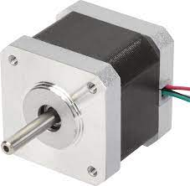
Servo Motor SG90 :
Gripper opening and closing are controlled by a servo motor.
Stepper Motor :
The gripper can move in 3 directions (x dimension, y dimension, z dimension) so 3 stepper motors were used in this project, each one used to control one direction.

Slide 11
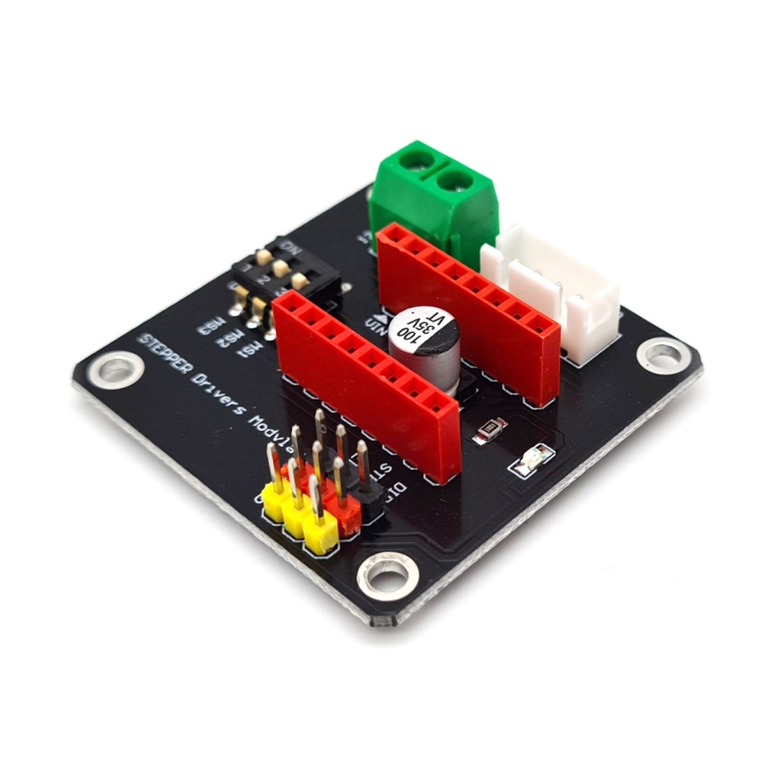
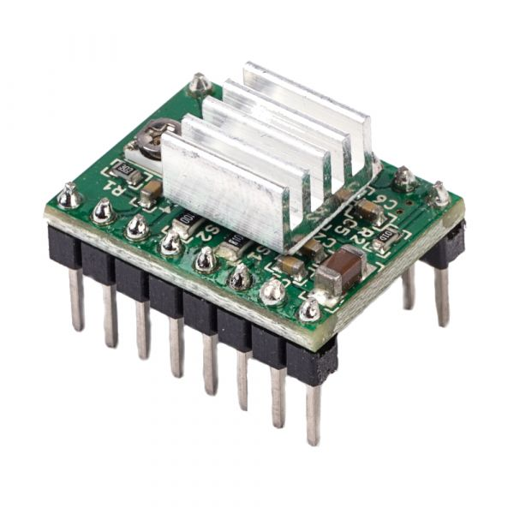
A4988 Stepper Motor Driver :
The A4988 is a micro-stepping driver for controlling stepper motors. The Stepper motor can be controlled with just 2 pins from A4988 one for controlling the rotation direction and the other for controlling the steps.

Slide 12
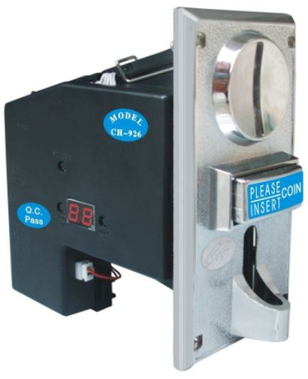
Coin Acceptor CH926 :
Types of coins that are accepted in this project are 1 Shekel, 2 Shekel, 5 Shekel, and 10 Shekel, when entering 1 Shekel the time that allowed to play is 1 minute, when entering 2 Shekel the time that allowed to play is 2 minute, when entering 5 Shekel the time that allowed to play is 5 minute, and when entering 10 Shekel the time that allowed to play is 10 minute.

Slide 13
Challenges
• The serial is slow when transmitting on it, so when sending data from the NodeMcu to the Arduino Mega to power the stepper, the movement of the stepper motor is slow.
• Moving the Z stepper motor, at first, we considered that the movement of the gyroscope in the direction of Z causes the Z stepper motor to move, but this method causes a problem that the stepper motor will always move up while the glove is up.
• Time-Limited was the main challenge so many features didn’t be completed.

Slide 14
Future Work
• LCD screen to show the time while playing .
• Add a keypad as another way of playing.
• Led that lights up in a different color depending on the
remaining time .

Slide 15
Thank you

