Slide 1
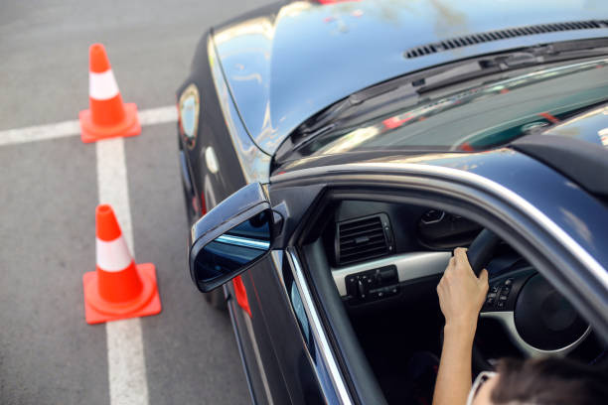


DRIVE SMART

Slide 2

OUR
TEAM
Ahmad Dweikat
Ibraheem Qadi
SUPERVISOR
DR. Sufyan Samara

Slide 3
CONTENT
01
INTRODUCTION
04
TYPES OF USERS
02
MOTIVATION
05
FUTURE WORK
03
TECHNOLOGIES
06
CONCLUSION

Slide 4
INTRODUCTION
The "Drive Smart" project introduces a cutting-edge platform designed to revolutionize driving school management. By streamlining processes for students, trainers, and school managers, it fosters a connected and efficient ecosystem. This project emphasizes user-centric features and innovative technology to create a seamless and intuitive experience, ensuring effective coordination and skill development within the driving school community.

Slide 5

MOTIVATION
The motivation behind Drive Smart is to develop a comprehensive platform that bridges the gap between driving schools and their students, trainers, and administrators. Unlike traditional management systems, which often lack integration and user-centric features, this application aims to provide an organized, efficient, and seamless experience for managing driving lessons, scheduling, and communication within the driving education ecosystem.

Slide 6




TECHNOLOGIES
  Frontend:
    React for the web.
    React Native with Expo for mobile.
  Backend:
    Node.js.
    MySQL database.
    JWT and role-based authentication and authorization.
    Data Validation in both backend and frontend
    Client-side caching for performance optimization.

Slide 7
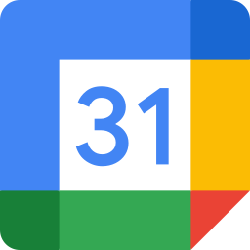


TECHNOLOGIES
  API Integrations:
    Google API for calendar integration
    OpenAI API for chatbot functionality
  Cloud Services (AWS):
    Simple Email Service (SES) for sending emails
    S3 bucket for storing files and profile pictures
    RDS for hosting the MySQL database
  Firebase:
    Real-time chat using Firestore database
    Real-time notifications using Firebase Cloud Messaging

Slide 8
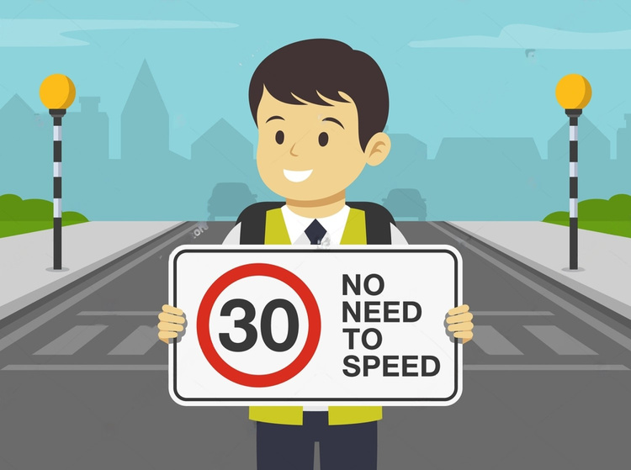
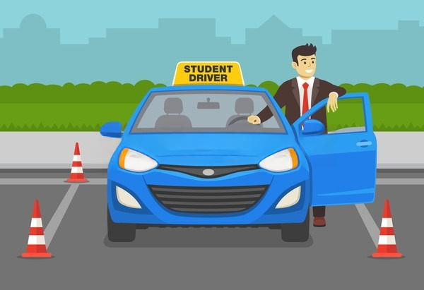

TYPE OF USERS
STUDENT
TRAINER
MANAGER

Slide 9
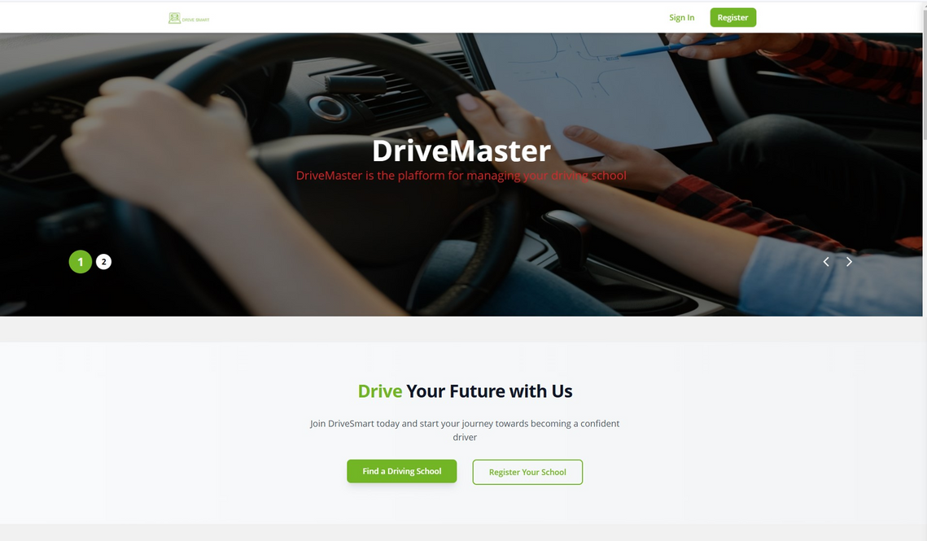
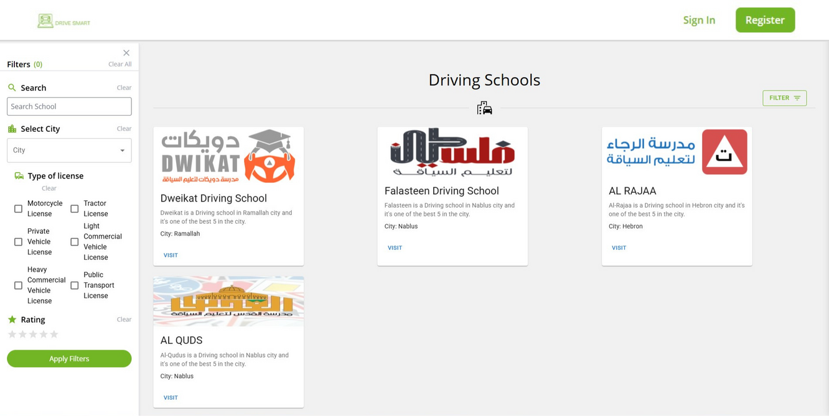
HOME
  Students can easily find and register at a suitable school.
  School managers can expand their reach by joining and investing in our platform.
Home page
Schools

Slide 10
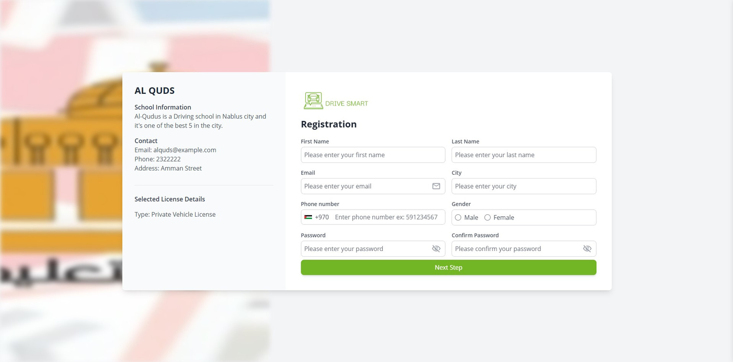
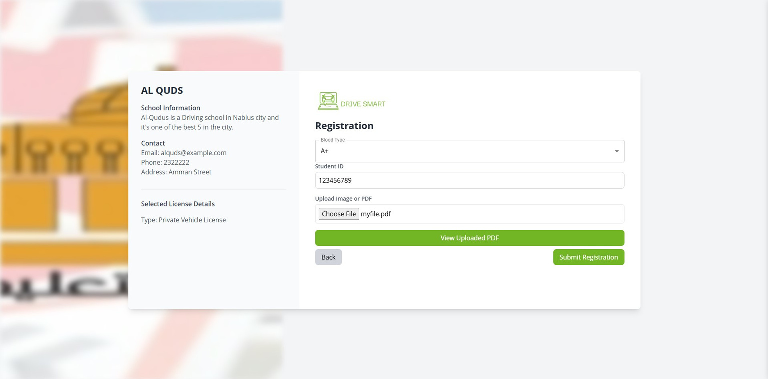
REGISTER
Student Register
Second Register page

Slide 11
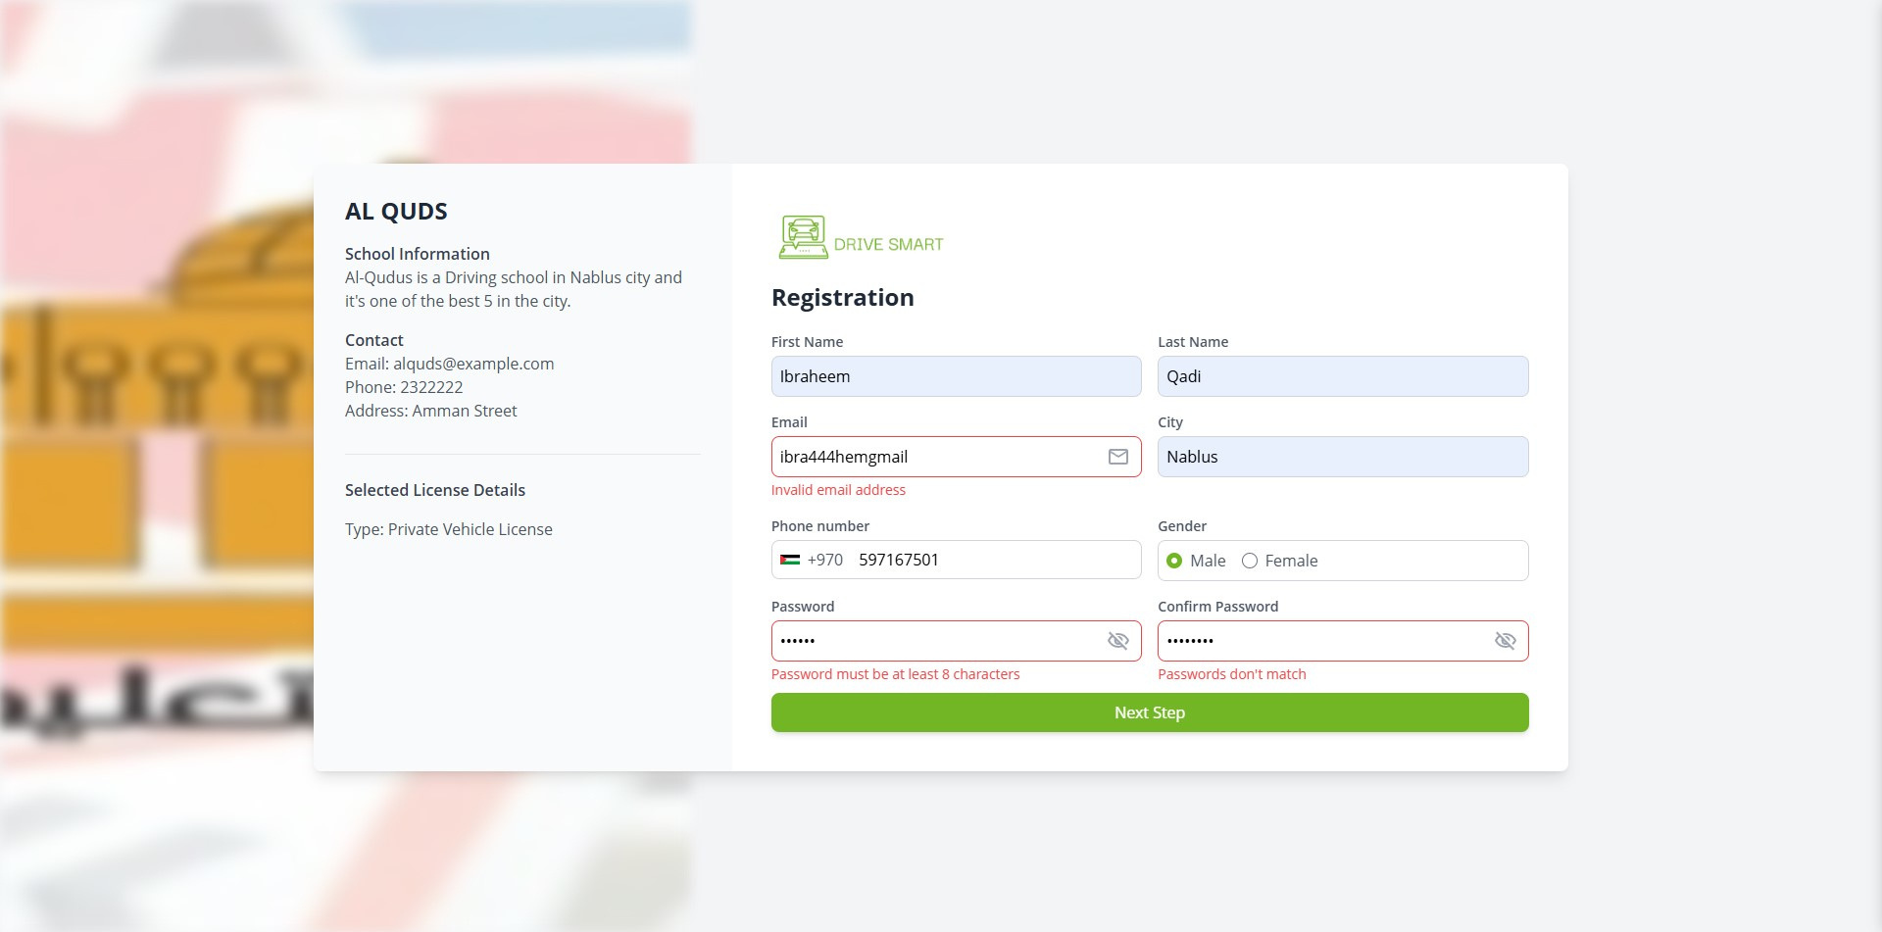
REGISTER
VALIDATION
Student Register Validation

Slide 12

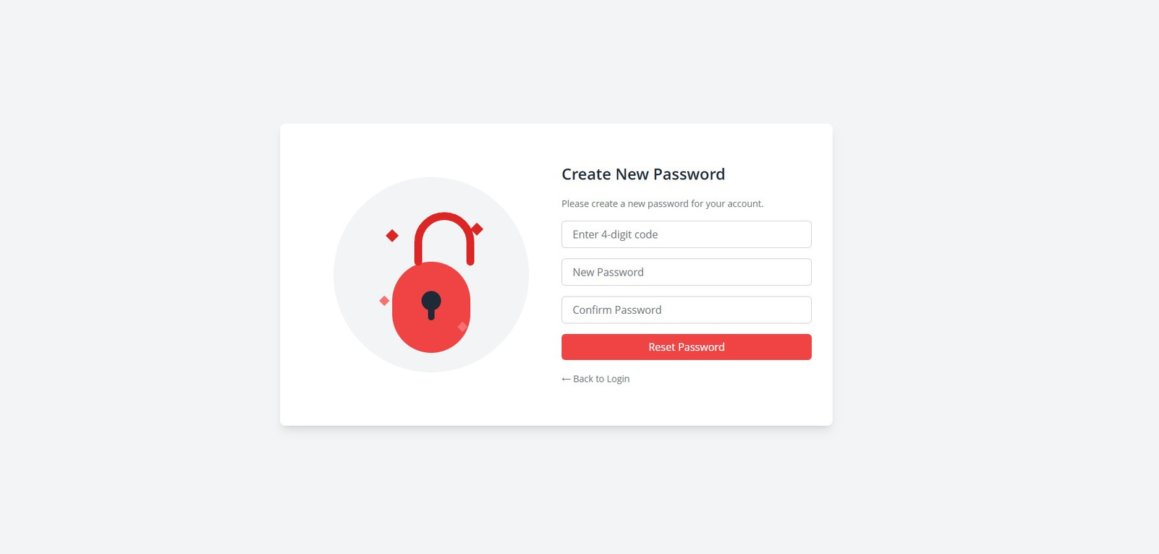
PASSWORD
RECOVERY
Email Field
Create New Password

Slide 13
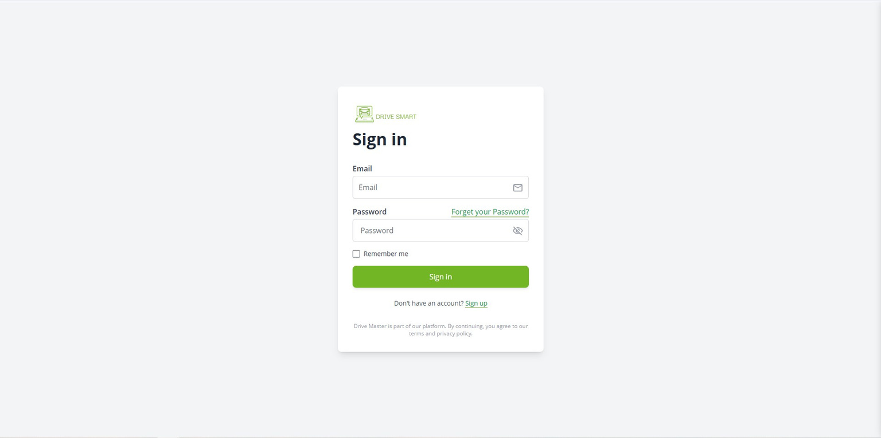
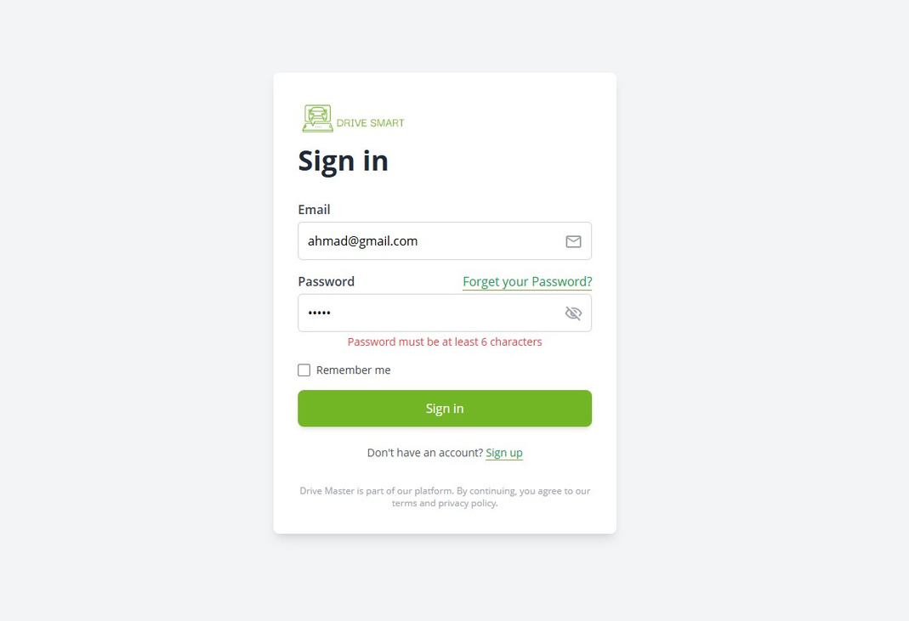
LOGIN
Login page
Login Validation

Slide 14
STUDENT
SUMMARY
  Student Dashboard & Profile Management
  Theoretical Exam Preparation
    Study using platform-provided materials.
    Practice with simulated exams on the website.
    Get assistance through the integrated chatbot.
    Request an exam and check results on the Ministry's website.
  Practical Exam Preparation
    Book a trainer based on their availability.
    Track progress and review feedback on the lessons page (we’ll explore this from the trainer’s perspective).
    Request an exam and check results on the Ministry's website.

Slide 15
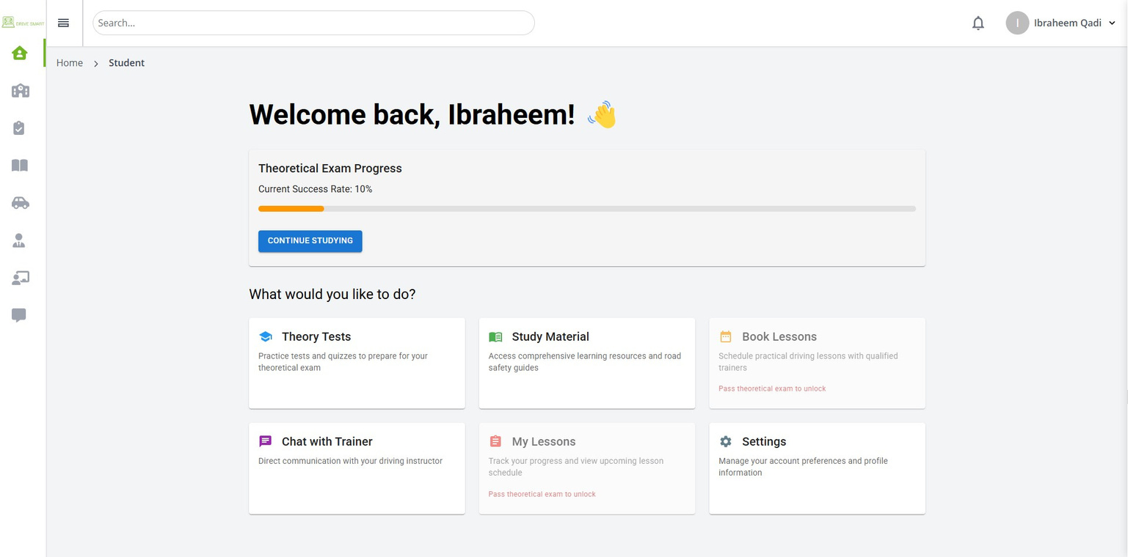
1- STUDENT
DASHBOARD
Student Home Page

Slide 16
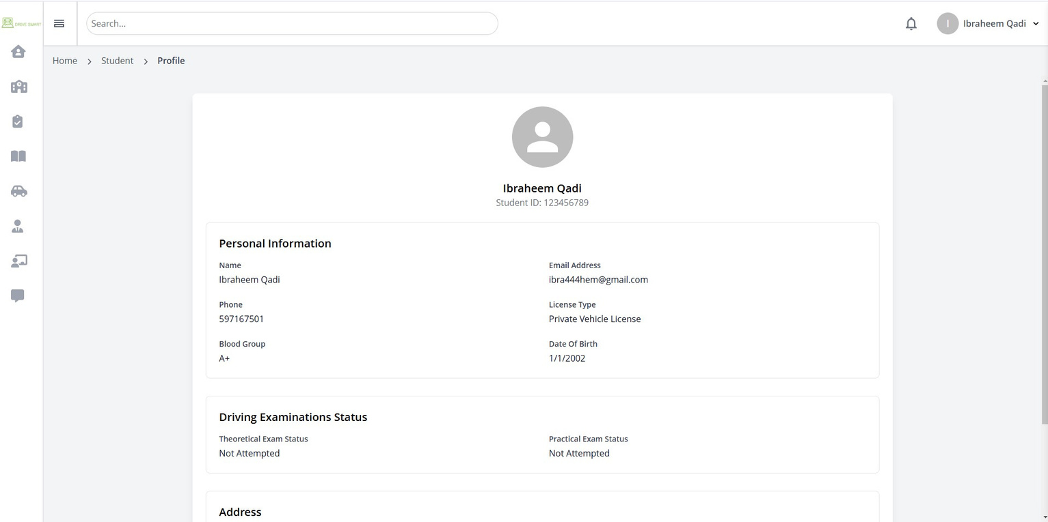
1- STUDENT
DASHBOARD
Profile Page

Slide 17
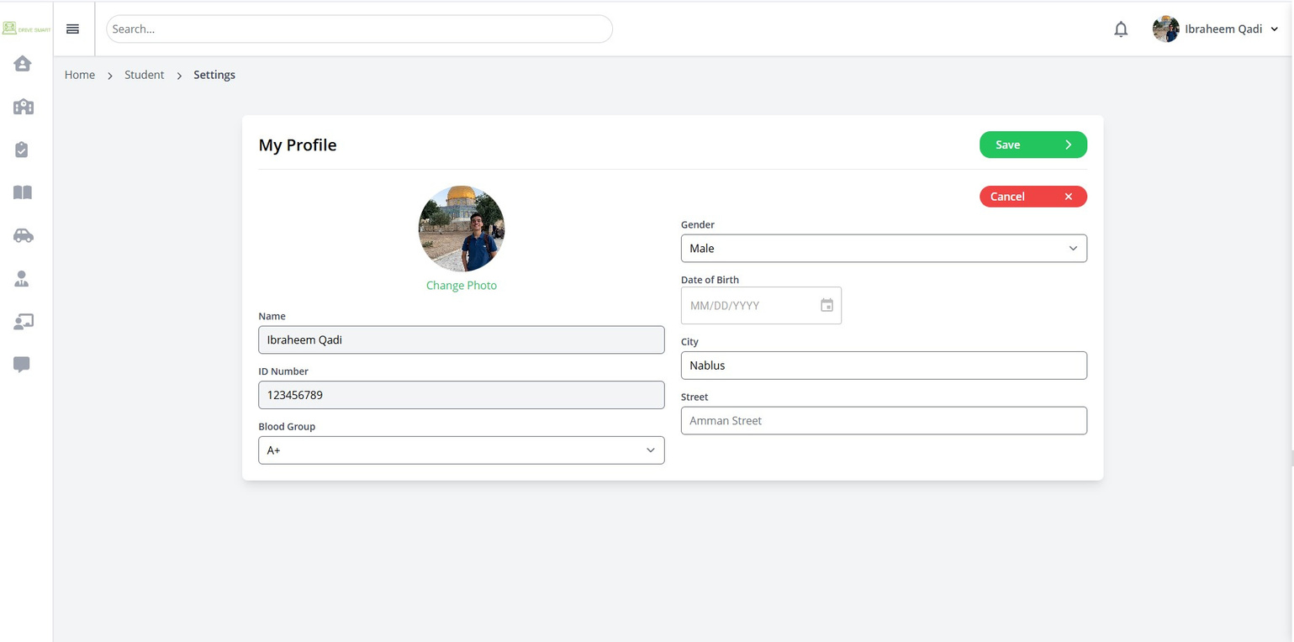
1- STUDENT
DASHBOARD
Settings Page

Slide 18
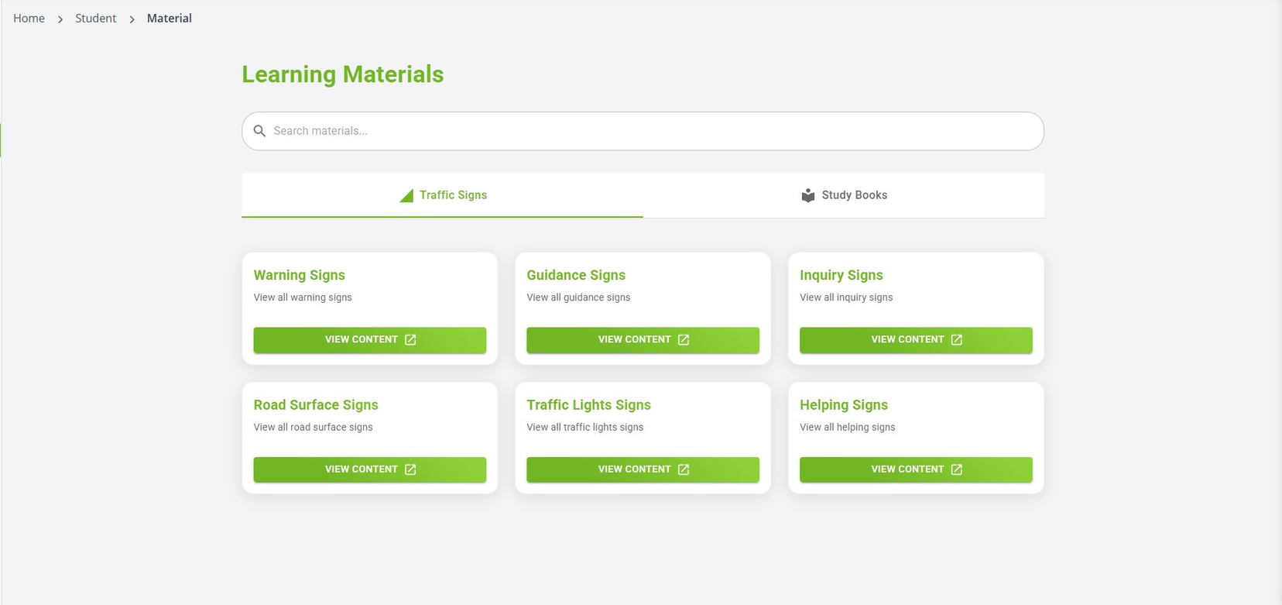
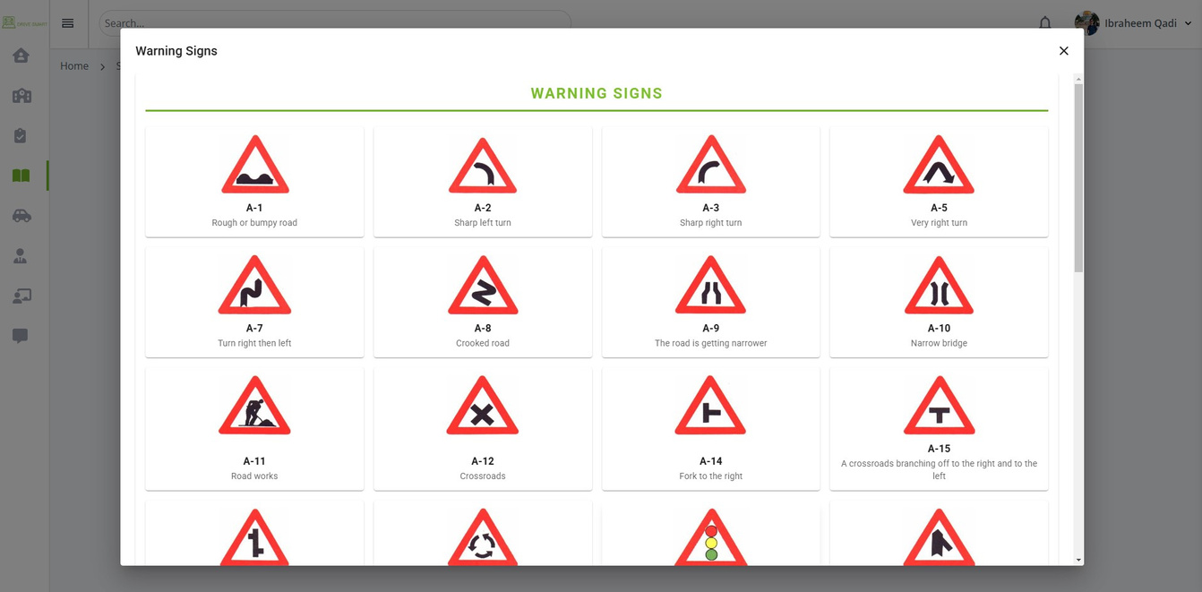
2- Theoretical Exam Preparation
MATERIAL
Signs Tab
Warning Signs

Slide 19
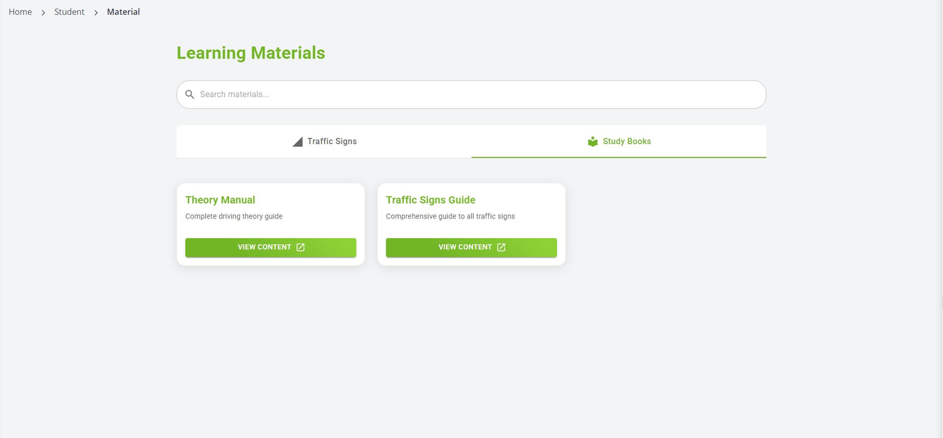
2- Theoretical Exam Preparation
MATERIAL
Study Books Tab

Slide 20
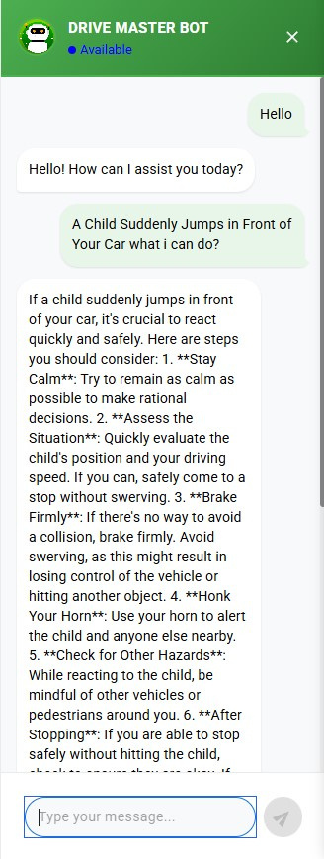
2- Theoretical Exam Preparation
CHATBOT
ChatBot

Slide 21
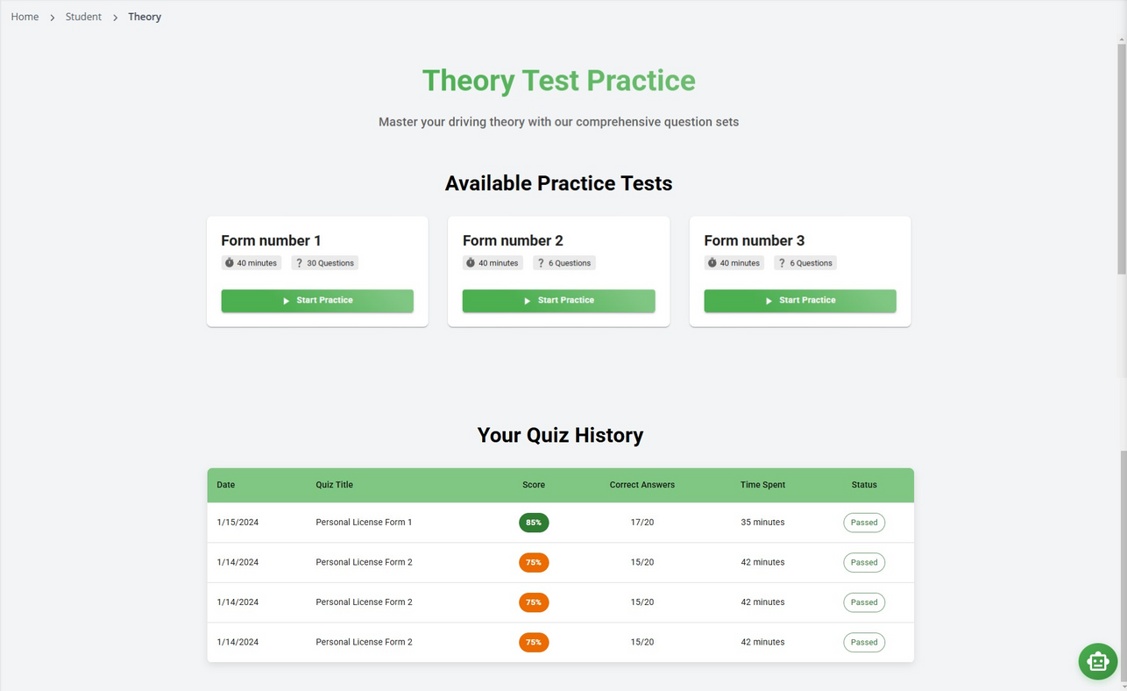
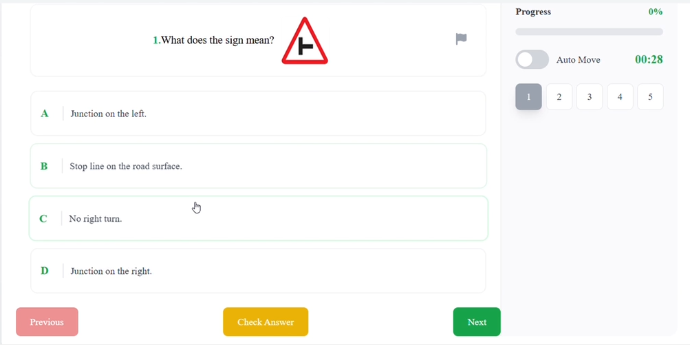
2- Theoretical Exam Preparation
PRACTICE
Theory Page
Quiz Starting

Slide 22
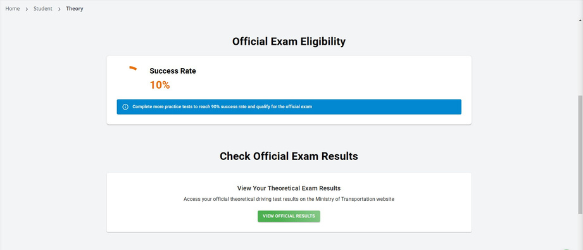
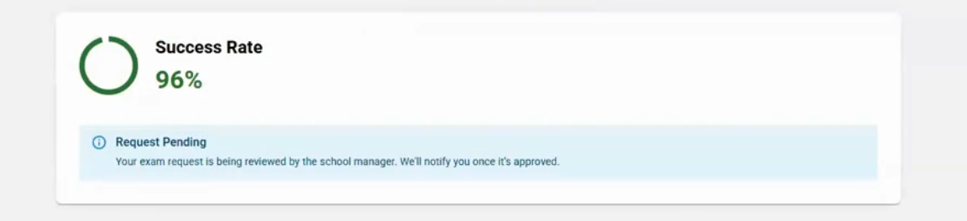
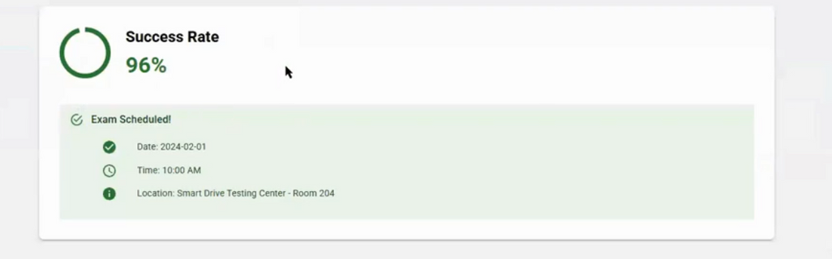
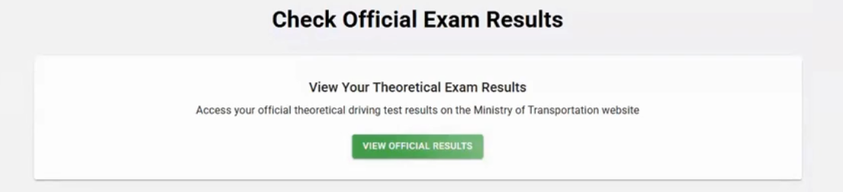
2- Theoretical Exam Preparation
ELIGIBLITY
1- Study more on the website.
2- Request for an theoretical exam
3- Wait for the response.
4- Check your result on Ministry website

Slide 23
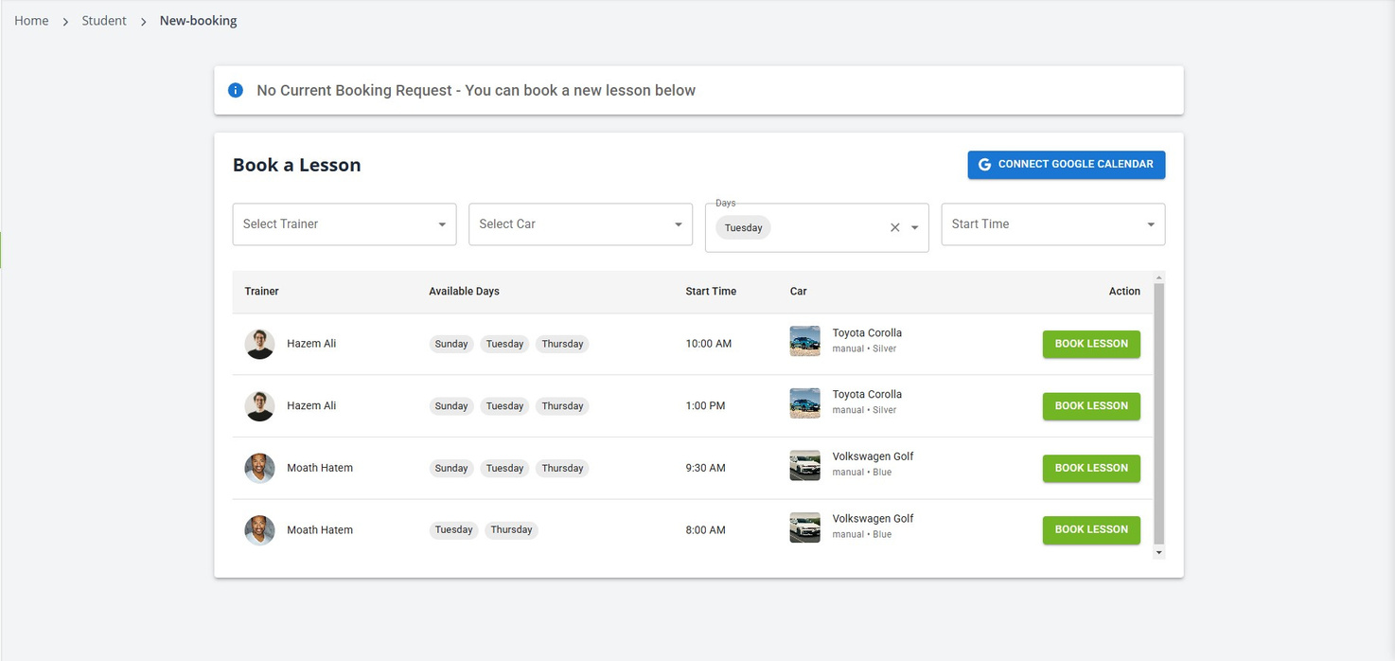
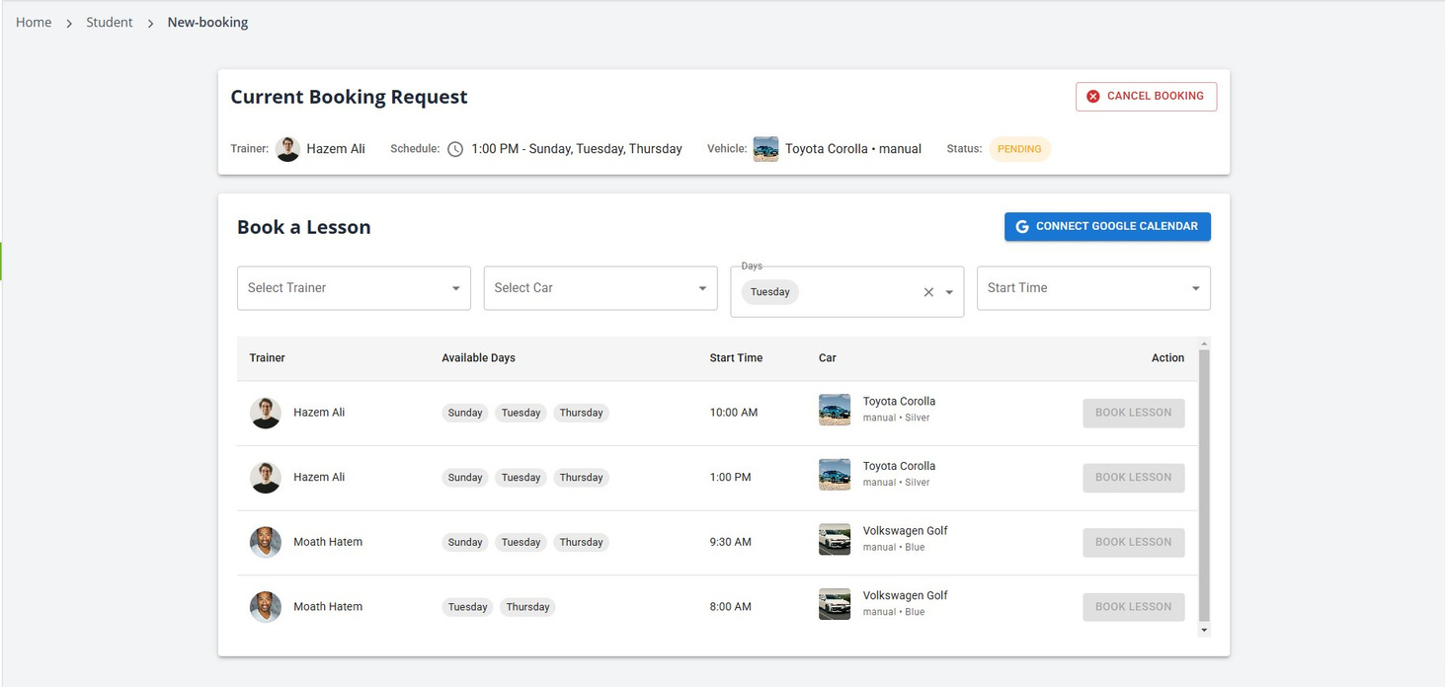
3- Practical Exam Preparation
BOOKING
Booking a Lesson
Booking status

Slide 24
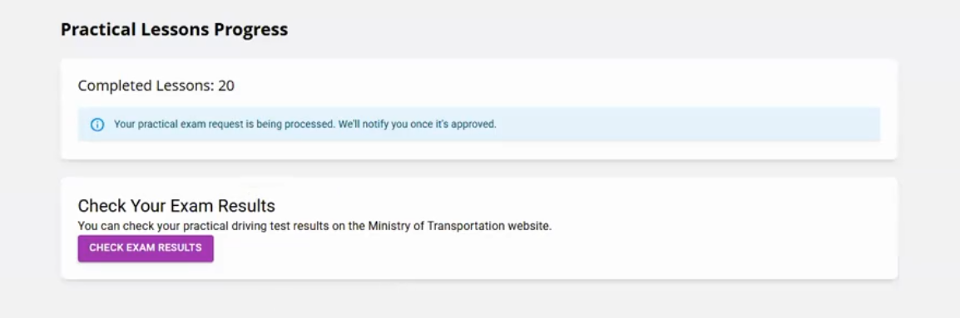
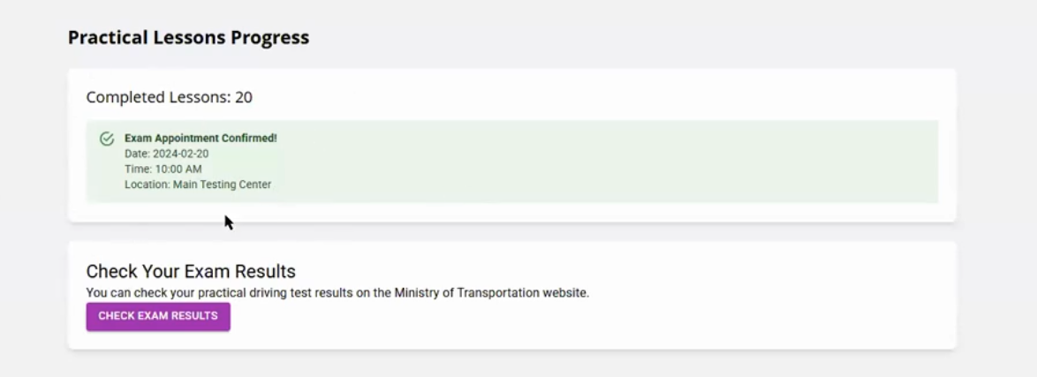
3- Practical Exam Preparation
BOOKING
  Complete at least 15 lessons to become to request a Practical driving test."

Slide 25
TRAINER
SUMMARY
  Trainer Dashboard
  Student Management (view and track student progress)
  Availability Management (set and update availability)
  Booking Management (manage student lesson bookings)
  Exam Requests Management (handle student exam requests)
  Quizzes Management (create and review quizzes)
  Lesson Management (cancel lessons, provide ratings, and give feedback)

Slide 26
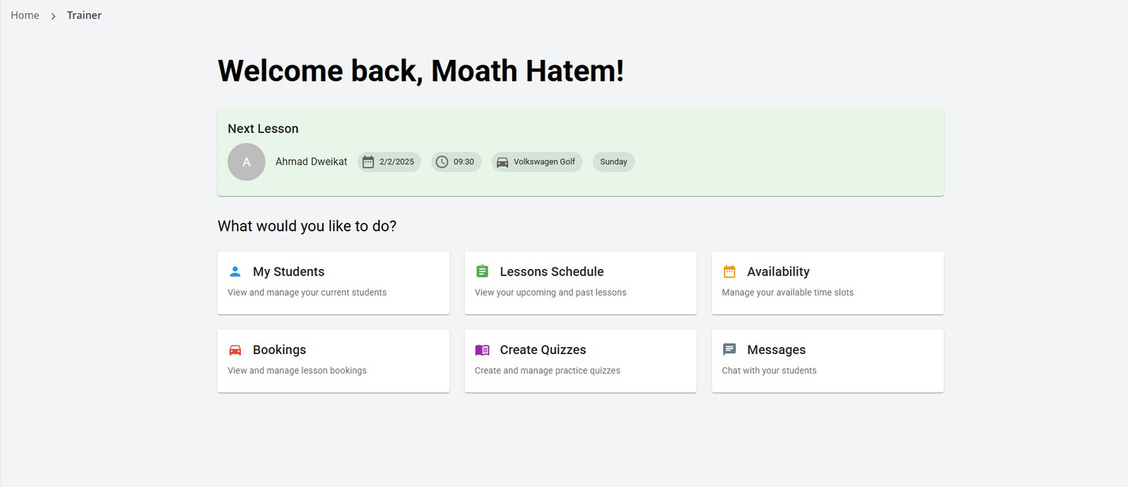
1- Trainer Dashboard
Trainer Home Page

Slide 27
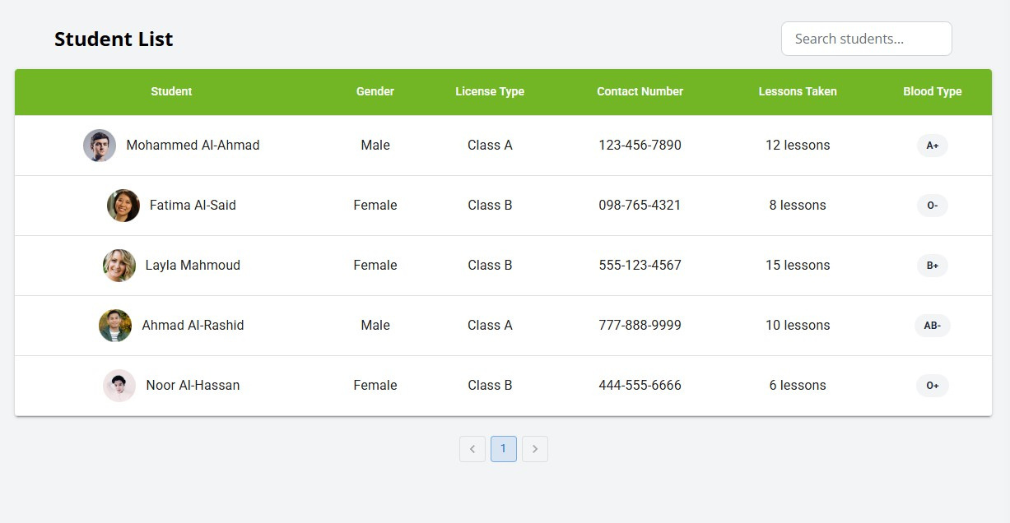
2- Trainer Students
Students page

Slide 28
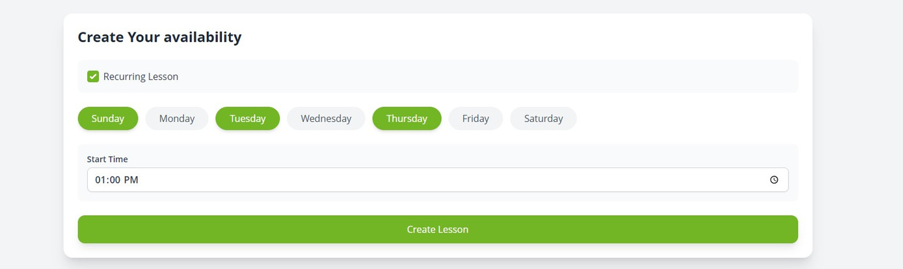
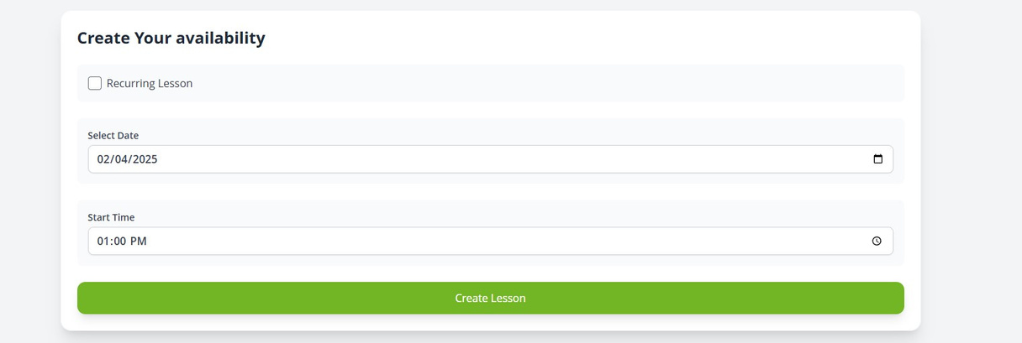
3- Availability Management
Recurring Lesson
non-Recurring Lesson

Slide 29
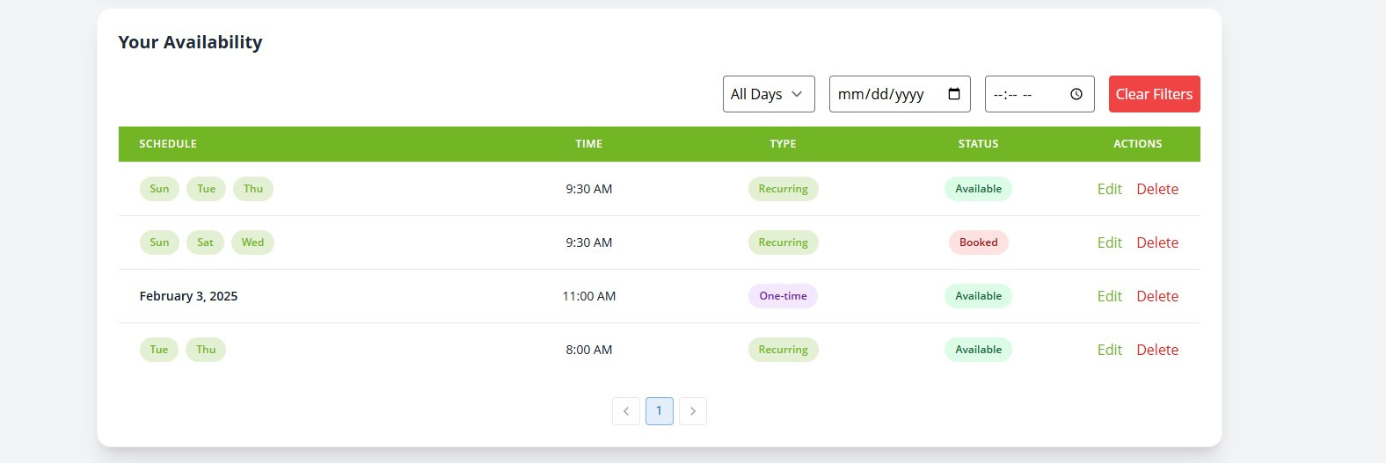
3- Availability Management
Table of Availability

Slide 30
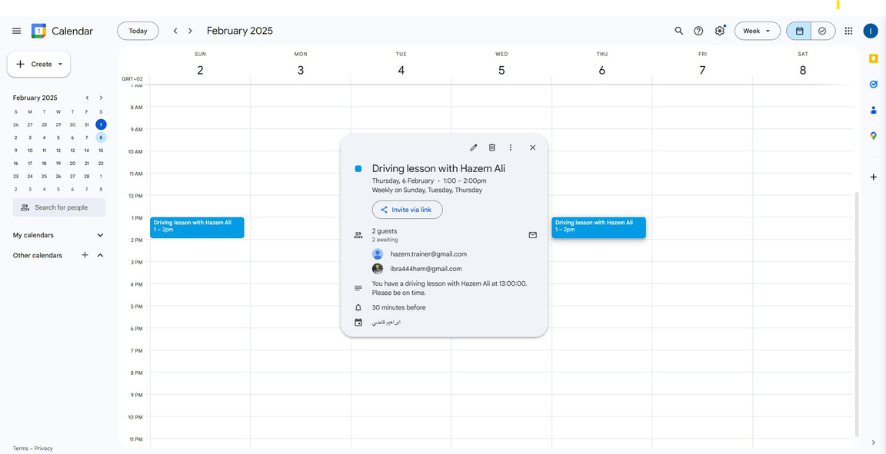
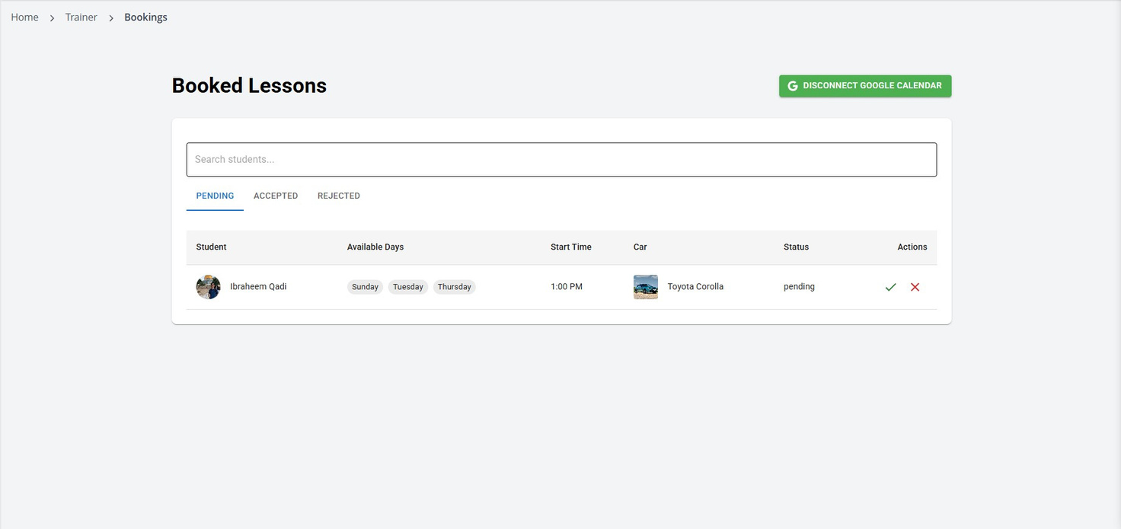
4- Booking Management
Pending Lessons
Google Calendar

Slide 31
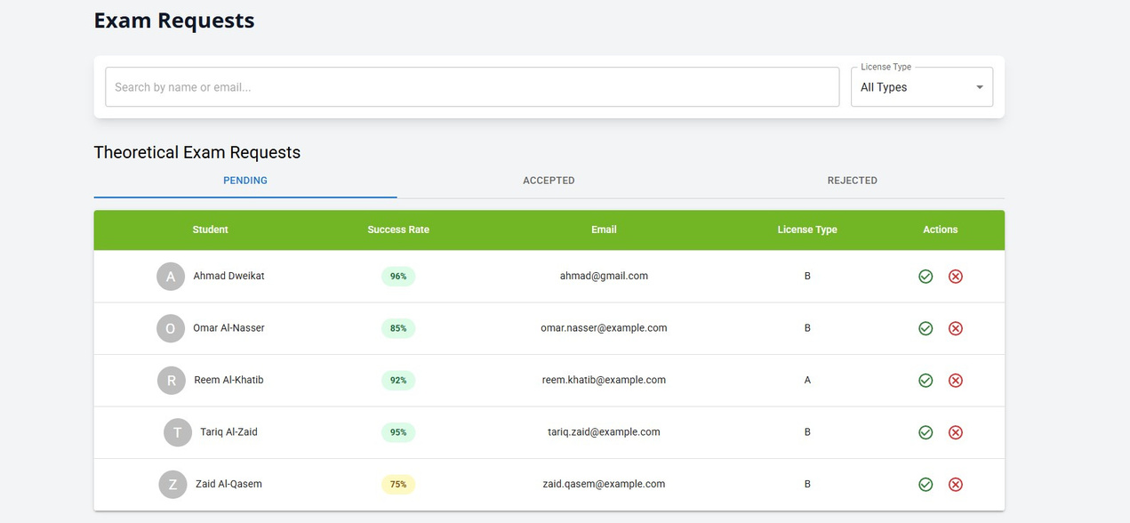
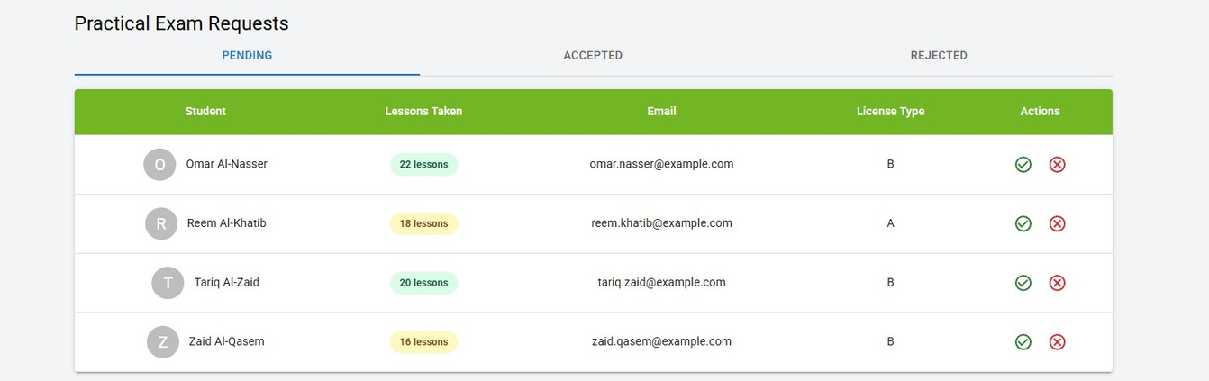
5- Exam Requests Management
Theoretical Exams Requests
Practical Exams Requests

Slide 32
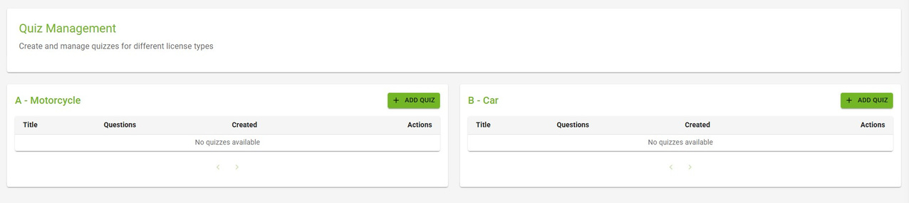
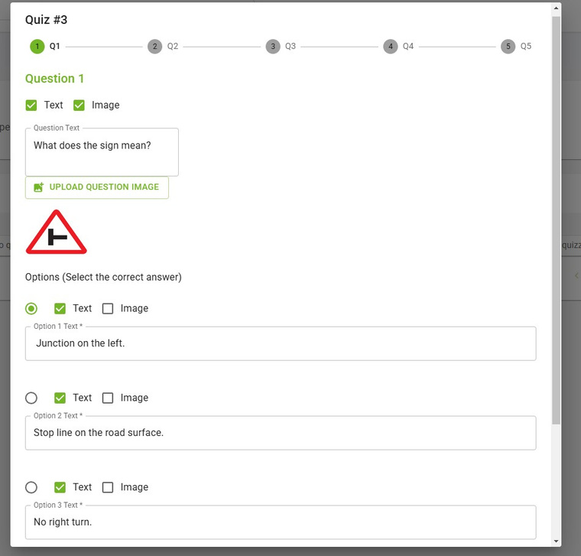
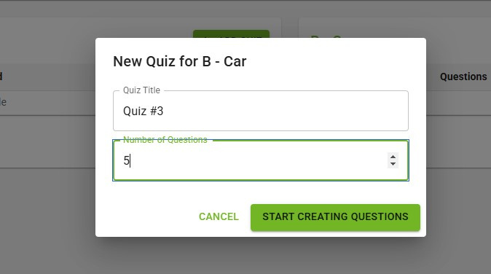
6- Quizzes Management
Quizzes Categories
Quizzes Categories
Quiz form

Slide 33
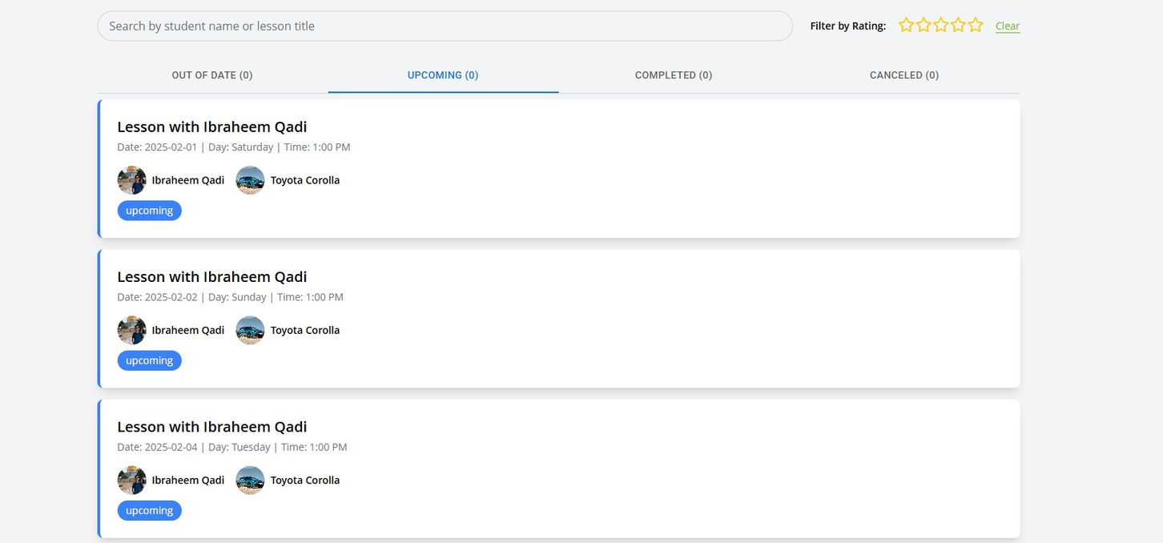
7- Lesson Management
LESSONS
Lessons Page

Slide 34
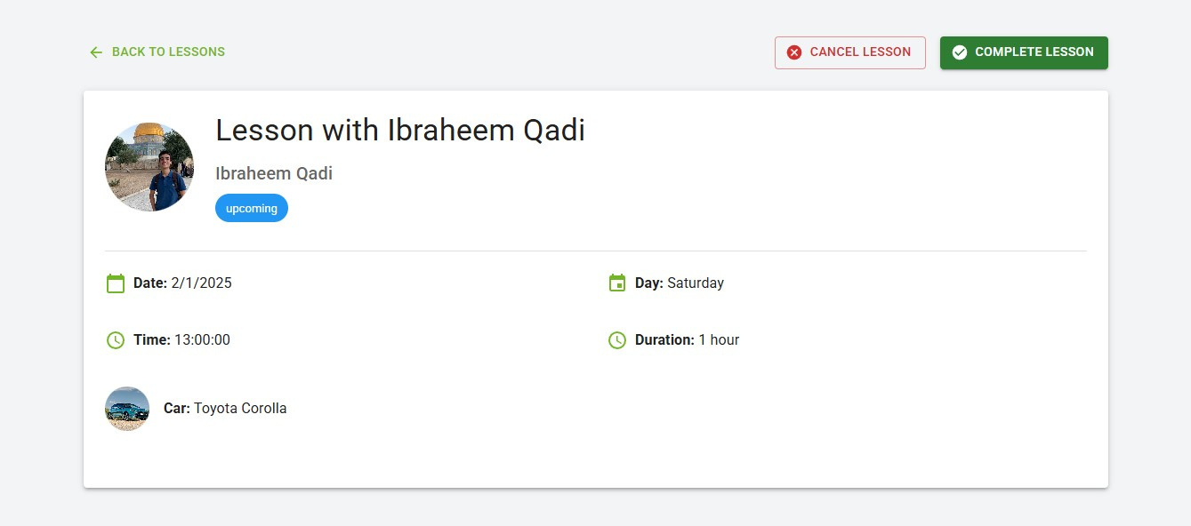
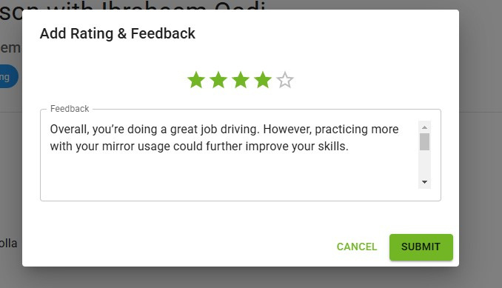
7- Lesson Management
LESSONS
Lesson Details
Lesson Feedback

Slide 35
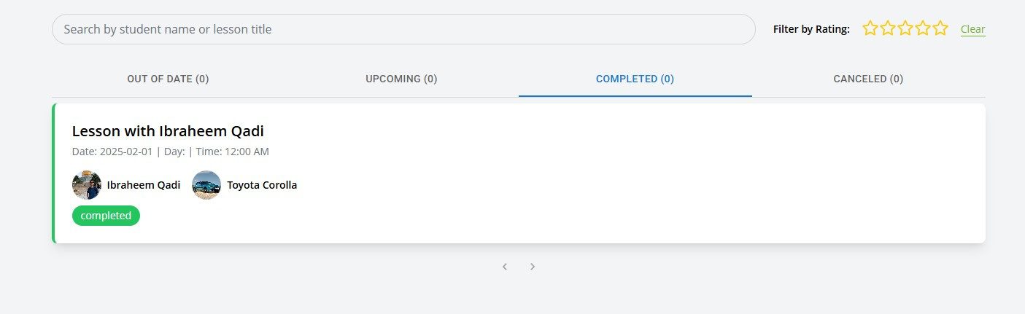
7- Lesson Management
LESSONS
Completed Lessons

Slide 36
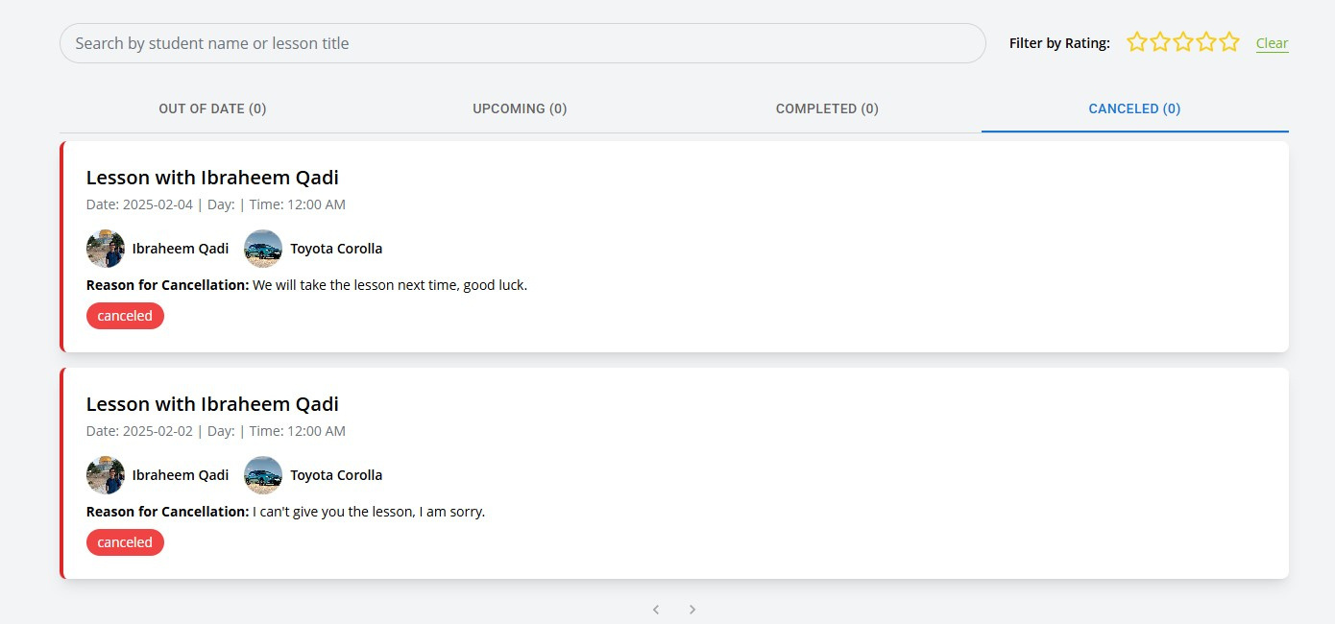
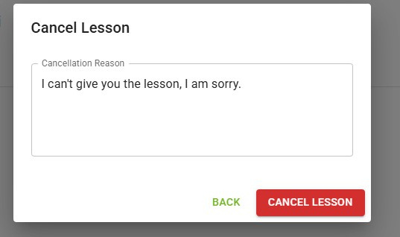
7- Lesson Management
LESSONS
Cancellation Reason
Canceled Lessons

Slide 37
MANAGER
SUMMARY
  Manager Dashboard (overview of all activities and performance)
  Student Registration Requests (review and approve student sign-ups)
  Trainer Invitations (instead of adding them manually)
  School Trainers (manage and oversee all trainers)
  School Vehicle Management (track and manage school cars)
  School Students (monitor and manage enrolled students)

Slide 38
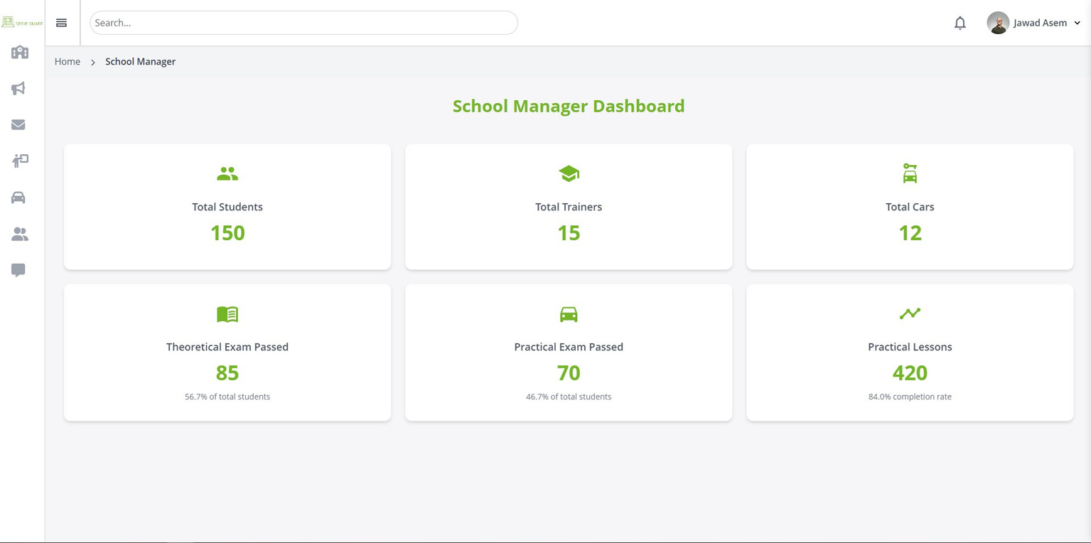
1- Manager Dashboard
Manager Home Page

Slide 39
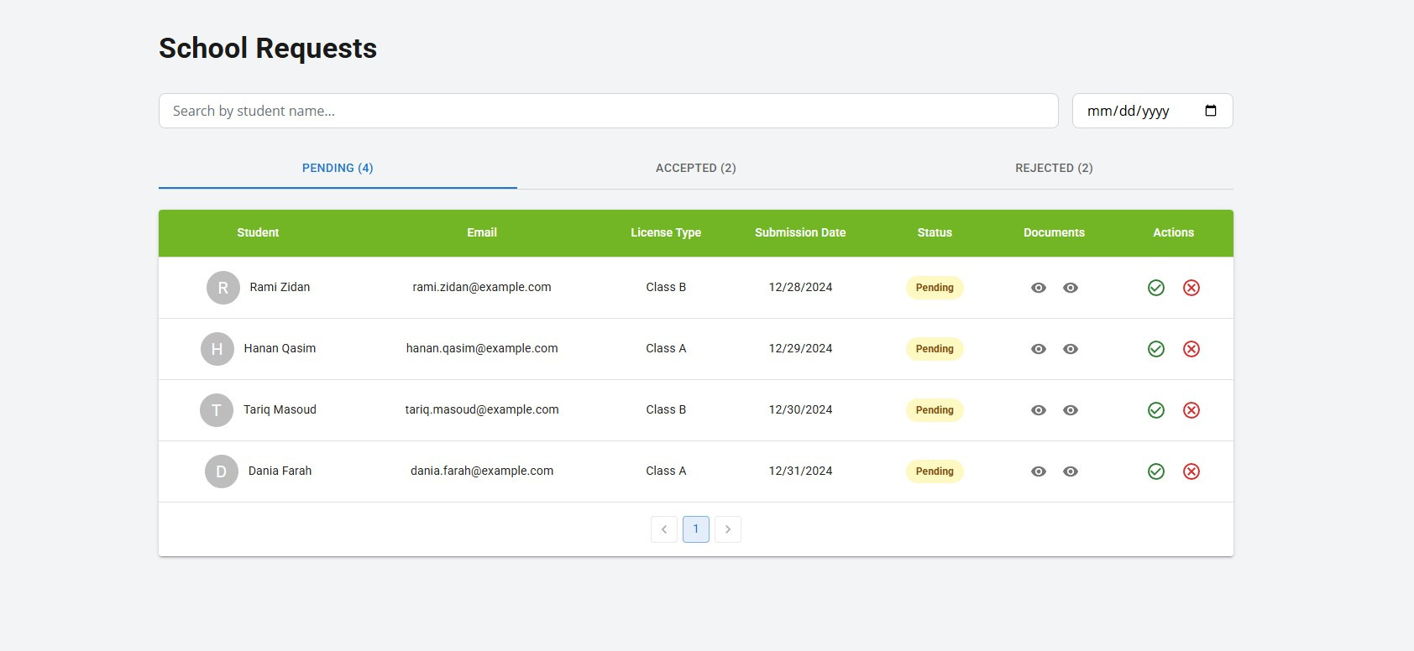
2- Student Registration Requests
REQUESTS
Students Register Requests

Slide 40
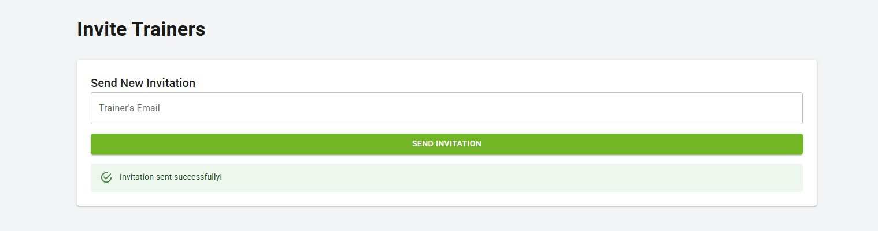
3- Invite Trainer
INVITATION
Trainer Invite Box

Slide 41


4- School Trainers
TRAINERS
School Trainers
Trainers Details

Slide 42


5- School Vehicle Management
CARS
School Cars
Add New Car

Slide 43

6- School Students
STUDENTS
School Students

Slide 44
ADMIN
SUMMARY
  Admin Dashboard Overview (centralized view of all platform activities)
  School Registration Requests (review and approve new school registrations)
  School Management (manage and oversee all registered schools)

Slide 45

1- Admin Dashboard
Admin Home Page

Slide 46

2- School Registration Requests
REQUESTS
School Requests

Slide 47

3- Platform schools
SCHOOLS
Schools

Slide 48

REAL TIME CHAT
  All roles can access the chat and find anyone within their school.

Slide 49

NOTIFICATIONS
  Real-time notifications are available to all roles.

Slide 50

MOBILE LOGIN
Login page

Slide 51

STUDENT
DASHBOARD
MOBILE
home page

Slide 52




MOBILE STUDENT
DASHBOARD
Upcoming Lessons
Completed Lessons
Canceled Lessons
Out Of Date Lessons

Slide 53


MOBILE STUDENT
DASHBOARD
BOOKING
Booking page
Current Bookin Request

Slide 54

MOBILE TRAINER
DASHBOARD
HOME
Trainer Home Page

Slide 55

MOBILE TRAINER
DASHBOARD
STUDENTS
Student list

Slide 56




MOBILE TRAINER
DASHBOARD
Upcoming Lessons
Completed Lessons
Canceled Lessons
Out Of Date Lessons

Slide 57



MOBILE TRAINER
DASHBOARD
Pending Booking Lessons
Accepted Booking Lessons
Declined Booking Lessons

Slide 58


MOBILE PROFILES
Student Profile
Trainer Profile

Slide 59


MOBILE CHAT
Student Chat
Trainer Chat

Slide 60


MOBILE NOTIFICATIONS
Student Notifications
Trainer Notifications

Slide 61
FUTURE WORK
Add the Drive Smart Calendar alongside Google Calendar.
Add Payment methods.
Multi Language

Slide 62
CONCLUSION
In conclusion, Drive Master serves as a comprehensive and efficient platform designed to streamline driving school management by connecting students, trainers, and school managers in a structured and organized manner. The system enhances the learning experience by providing essential tools such as scheduling, messaging, notifications, and progress tracking, ensuring that students receive quality training while trainers and managers can efficiently oversee operations.

Slide 63
THANK
FOR
LISTENING

