Slide 1
COVID-19 diagnosis from chest X-ray images using transfer learning: Enhanced performance by debiasing dataloader
Supervisor by: Dr. Allam Mousa
Prepared by : Abeer Sawalha

Slide 2
Contents
Objectives
Introduction
Methods
Methodology
Procedure
Results
The Prototype Tool
Conclusion

Slide 3
Objectives
Knowledge about traditional and enhancement methods for COVID-19 detection includes, the way that how both methods are done, advantages, challenges and limitations.
Knowledge of AI importance in detecting especially for x-ray chest scanning.
To know the way that AI methods and algorithms improve medical detection for COVID-19 in roughly perfectly and low-cost detection for that life - threaten disease.

Slide 4
Introduction
The COVID-19 outbreak has risen to the status of one of the most severe public health issues of the last several years. Some affected people may not notice any symptoms in the early stages, while fever and cough were the most common core symptoms for the majority of patients. However, Though RT-PCR diagnosis techniques might not be able to give a precise diagnosing for COVID-19 since they have only 60% - 70% for accuracy.
Moreover, the false-negative cases of RT-PCR show positive results on chest X-ray imaging. So, other modernized and more accurate technique should be implemented by tending to use Ai algorithms with its techniques for diagnosis.AI is a combination of Machine Learning techniques and Deep Learning. It plays an important role for detecting diseases such as COVID 19.Convolutional Neural Networks (CNNs) and Recurrent Neural Networks (RNNs) are two prominent deep-learning-based networks that have been extensively utilized in medical research and have often produced commendable results.

Slide 5
Introduction (Cont.)
The project proposed three models of an intelligent deep learning architecture such as a DenseNet, ResNet, and Inception with RMSprop optimizer to detect COVID-19 disease. For this project, 12192 X-ray image data were collected from the dataset. Then, 30069 X-ray image data were collected from the dataset. Image processing methods such as enhancement, normalization, and data augmentation were used to help the proposed model not only to avoid over fitting but also to demonstrate an accuracyof 97.1 %. The Activation Mapping method was used to create activation maps that highlights the crucial areas of the radiograph to improve causality and intelligibility. Therefore, there was an ability to diagnose COVID-19 disease using efficient artificial intelligence specially CNNs methods Image processing methods such as enhancement, normalization, and data augmentation were used to help the proposed model not only to avoid over fitting but also to demonstrate the highest accuracy.

Slide 6
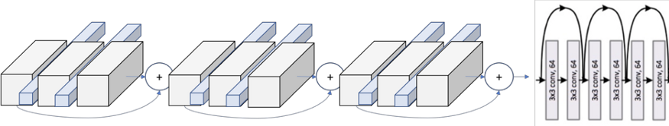
Methods
ResNet50
ResNet, short for Residual Networks is a classic neural network used as a backbone for many computer vision tasks. This model was the winner of ImageNet challenge in 2015. The fundamental breakthrough with ResNet is to make it possible to train extremely deep neural networks with 150+ layers successfully.

Slide 7
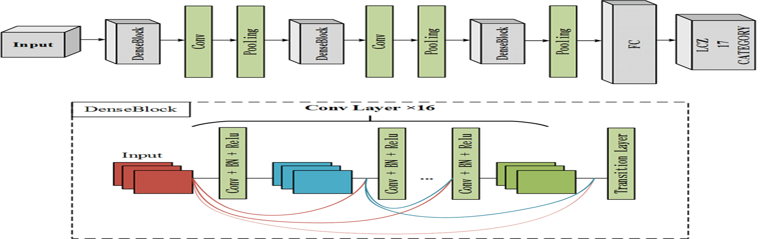
Methods (Cont.)
DenseNet121
Dense Convolutional Network (DenseNet). A possibly counter-intuitive effect of this dense connectivity pattern is that it requires fewer parameters than traditional convolutional networks, as there is no need to relearn redundant feature-maps. Traditional feed-forward architectures can be viewed as algorithms with a state, which is passed on from layer to layer. Each layer reads the state from its preceding layer and writes to the subsequent layer.

Slide 8
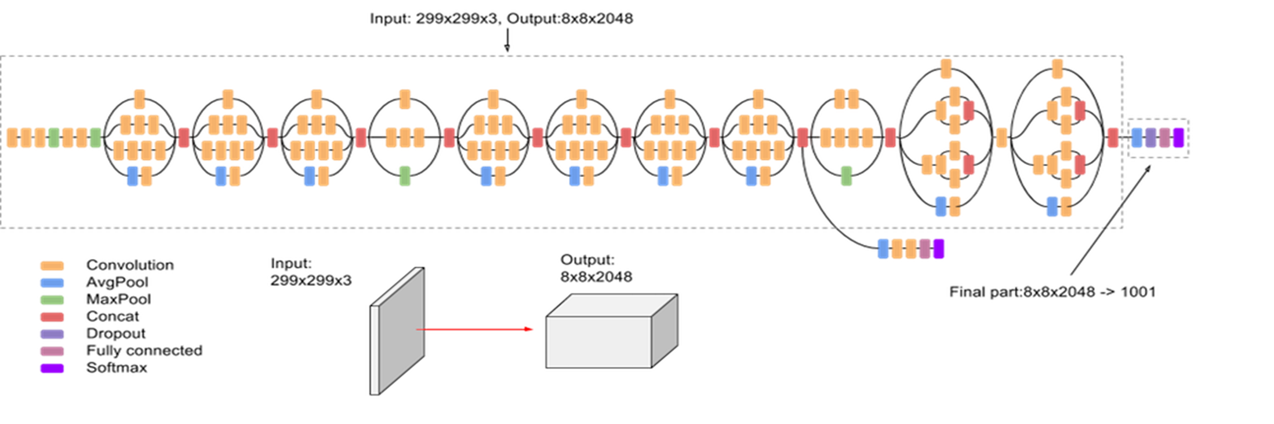
Methods (Cont.)
InceptionV3
InceptionV3,a convolutional neural network used for assisting in image analysis and object detection, and got its start as a module for Googlenet.
It is the third edition of Google's Inception Convolutional Neural Network (CNN), originally introduced during the ImageNet Recognition Challenge. The design of Inceptionv3 was intended to allow deeper networks while also keeping the number of parameters from growing too large: it has "under 25 million parameters", compared against 60 million for AlexNet.

Slide 9
Methodology
In this project a design for COVID -19 detection was implemented , at first it is crucial to have an initial detection for patients which would be essential for the primary idea of the patient’s health condition weather he/she was affected by COVID 19 pandemic (Positive case) or not (Negative case) . To do so, a newly developed algorithm was considered, labeled by Symptom Net. Simply based on patients data samples 12 symptoms have been found that are mainly responsible for COVID-19 identification. Fever, cough, fatigue, shortness of breath, and muscle pain are the top five symptoms of COVID-19. Chill, dizziness, headache, sore throat, nausea or vomiting, diarrhea, and nasal congestion can also play a vital role for detection and diagnosing when a person is infected by COVID-19. To validate the results from primary detection, it was necessary to use AI algorithms and models specially deep learning models i.e.CNN ones for effective and accurate results .Although, that would be considered later on .

Slide 10
Methodology (Cont.)
As previous illustration the clinical original symptoms (12 symptom) were considered to build symptom Net algorithm. However, this symptom weight table can be modified. If someone wants to impose a new symptom weight table instead of the default table, the SymptomNet algorithm can accommodate it . Considering the weights of symptoms, the prediction and threshold equations have been derived as follows
Here, ω is denoted as the weight of the symptom, x is denoted as the symptom.
T_{r} is denoted as the threshold.
The latter could be programed by using Python programming language , since it much easier and time saver ,beside it is possible to have an accurate results for the initiated purpose.

Slide 11
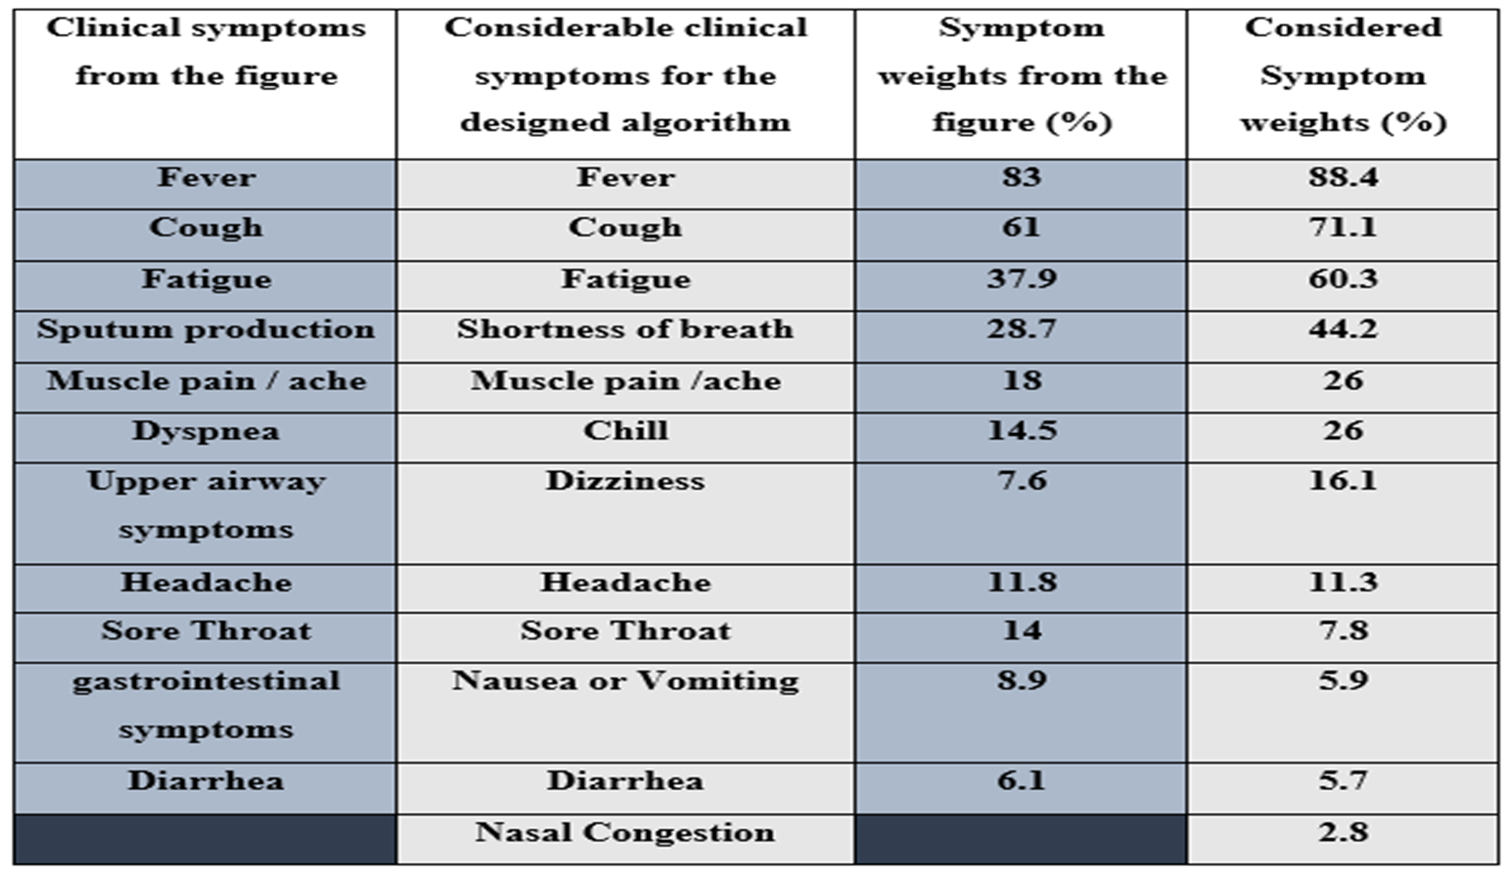
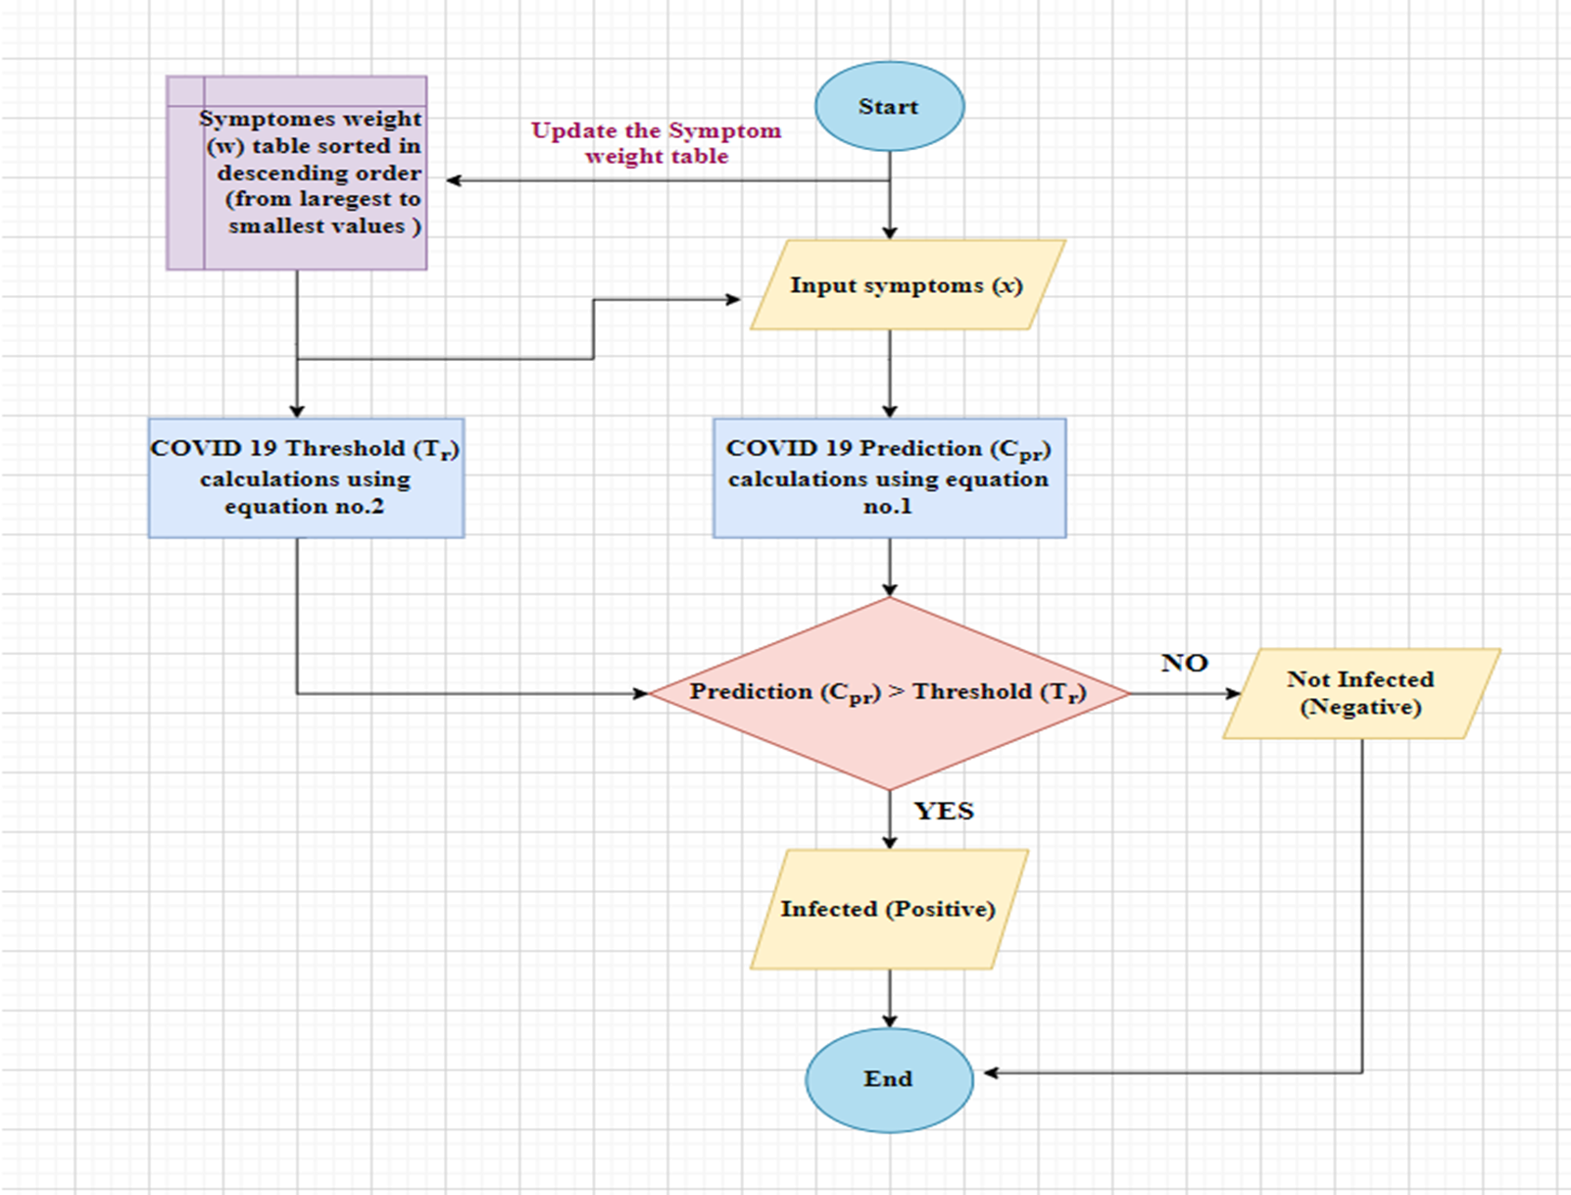
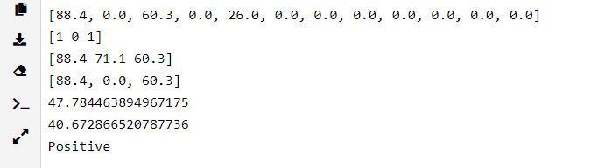
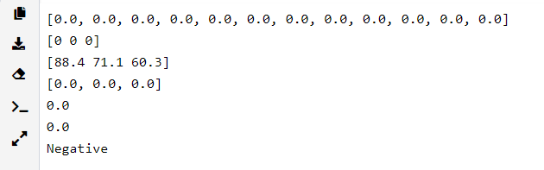
Python code simulation - COVID -19 positive detection
Python code simulation - non COVID -19 negative detection

Slide 12
Procedure
Previously, in the first project I have trained 3 CNN models, which are Inceptionv3, Resnet50, and Densenet121 for a COVID-19 dataset that classified to 2 classes, which are COVID -19, and non-COVID -19 cases. The dataset contains 12194 AP x-ray images. However, AP is an X-ray picture in which the beams pass from front-to-back (anteroposterior). As opposed to a PA (posteroanterior) film in which the rays pass through the body from back-to-front.The contents of that latter dataset have been classified into 3 classifications (i.e., training, testing , and validation), each one has categorized to both COVID -ve (class1) and COVID +ve (class0).
First, the consolidated images normalized and resized from their original shape 1048 × 1488 into 256 × 256, note that, the shaped images for normalization 255 × 255 image’s size could use. Then the images are shuffled and split into training, test and validation data. The training data have 8588 .Thus, images where 5124 images are for class 1 (Negative) and 3456 images are for class 0 (Positive). The test data have 1803 images where 1170 images are for class 1 (Negative) and 663 images for class 0 (Positive). Similarly, the validation data have 1803 images where 1170 images are for class 1 and 663 images for class 0.The accuracy of the previously mentioned pre-trained models considered the latter dataset was roughly 90%.

Slide 13
Procedure (Cont.)
To ensure higher accuracy, I have modified the dataset that has been used, to be collected from different sources, Kaggle considered as the most important one of them. The accuracy of these labels is reported to be over 90% .The bit-depth of the radiographs in 16-bit Digital Imaging and Communications in Medicine (DICOM) format was reduced to 8-bit Portable Network Graphics (PNG) format without compression (without Joint Photographic Experts Group (JPEG) artifacts).
At this stage, 256 times data loss was experienced. Furthermore, that dataset there were 10625 radiographs for COVID-19 case and 10192 radiographs for non-COVID-19 However, for testing and validating the models there were 2313 radiographs for COVID-19 case and 2313 radiographs for non-COVID-19 and 2313 for viral pneumonia or Pneumonia as short for training the models with Posteroanterior (PA) and Anteroposterior (AP) views.
However, this database, which also includes contralateral and lateral view chest radiographs, is created to transform the data obtained from the articles and resources into a database for access to COVID-19 radiological data. Hence, it contains lossy-images taken from articles beside resources. In addition, it has been noticed that some of the properties such as brightness, contrast, sharpness are modified by the authors in most of the images. It can be said that the database may be biased due to such effects.

Slide 14
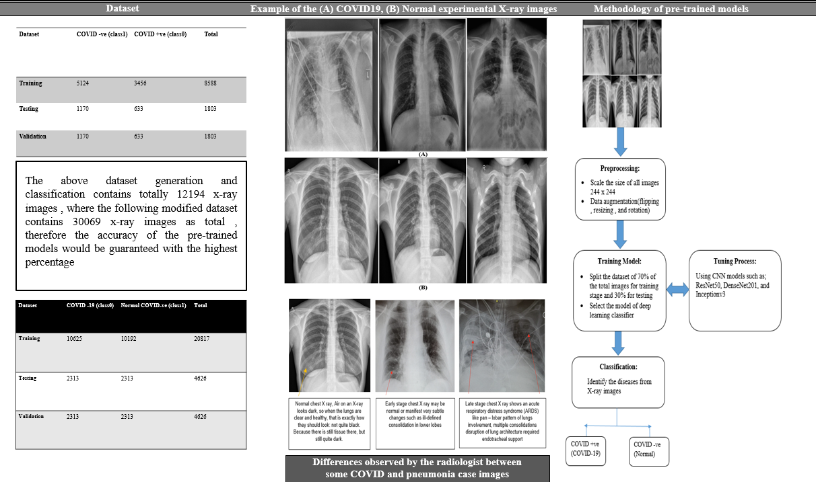

Slide 15
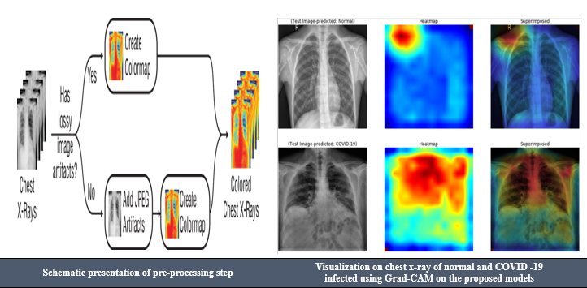
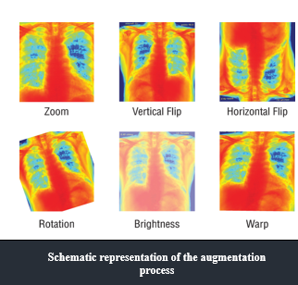


Slide 16
Results
Recently, Deep learning technique in the field of machine learning has been fascinating researchers significantly. The improvement of its utilization presents an opportunity to analyze medical images and solve critical tasks. Identification and classification of COVID-19 cases from Normal and Pneumonia cases using CXR images can help to isolate the infectious subjects, which is a significant step to fight against the virus. In this project, I have trained and tested 3 different deep CNN models with different versions in a transfer learning process and their comparative evaluation is presented. There are some essential factors for an individual model that influence their performance, such as imaging modality, image content, image quantity, distribution of the dataset, the structure of the model, model complexity, loss function, optimizer, number of epochs and so on. Therefore, it is evident that a shallow network performs well than very deep networks in this type of image dataset.

Slide 17
Results (Cont.)
If it was analyzed the architecture of Densenet, it is observed that the network architecture is very simple and straightforward. As known, with the progress of network depth, the vanishing gradients and degradation problem become prominent. So it is remarked that network depth can improve the performance but at a certain label.
The improved version of ResNet implies Batch normalization and ReLU activation before the convolution operation, which can be the reason behind its improved performance. However, the DensNet series provide good performance with the increase of the network layer. It can be because DenseNet concatenates the output from the previous layers, whereas ResNet does the additive operation among the previous layer with the future layer.
It is also recognized that the lower version of the Inception network (InceptionV3) performs better on the dataset, compared to ResNet50. ResNet and InceptionNet demonstrate that extremely deep networks are not suitable for the dataset. Moreover , DesneNets are computationally 75 less expensive than other types of networks, with its less time consuming Therefore it is easier to train.

Slide 18
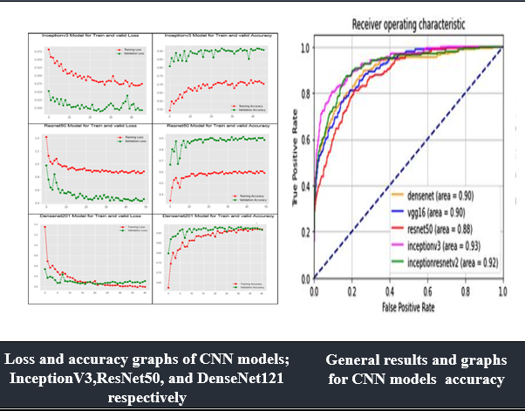

Slide 19
The Prototype Tool
In the COVID-19 epidemic, radiological imaging plays an important role in addition to the diagnostic tests performed for the early diagnosis, treatment, and isolation stages of the disease. Chest radiography can detect a few characteristic findings in the lung associated with COVID19. Deep learning models are sensitive in detecting COVID-19 lung involvement and hence the diagnostic accuracy rate is high. During the evaluation of the model, X-ray radiographs of COVID-19 patients confirmed positive by the PCR Test are used. The model can easily detect Ground-glass opacity (GGO), consolidation areas, and nodular opacities, which are the pathognomic findings of patients for COVID-19 on X-ray radiography. In COVID-19, bilateral, lower lobe, and peripheral involvement observed, and the proposed model can detect localization of the lesion. These models are particularly important in identifying early stages of COVID-19 patients. Early diagnosis of the disease is important to provide immediate treatment and to prevent disease transmission.

Slide 20
The Prototype Tool (Cont.)
There is a margin of error in patients with diffuse late lung parenchyma and in patients with significantly reduced lung ventilation due to poor quality X-ray images. X-rays that are not of optimal quality are difficult to evaluate by radiologists.
The clinical and radiological images of later-stage patients are well established and it is easier to detect the findings by experts. The role of deep learning models is more prominent in screening and diagnosis when the infection is at its early stages. Based on the proposed solution, a simple desktop tool for the detection of COVID-19 positive and negative cases has been developed. This allows any medical personnel to browse a chest X-ray image and feeding it to the application.
The application, in turn, will execute the model proposed in this work and provide the label for the given Chest X-Ray image. As a result, this will detect the COVID +ve and COVID –ve cases along with their probabilities

Slide 21
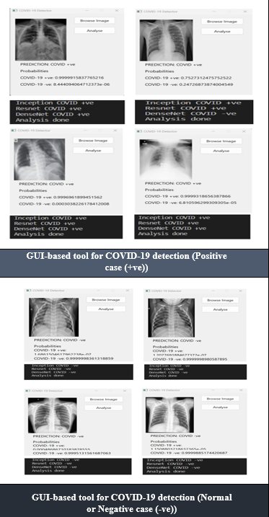
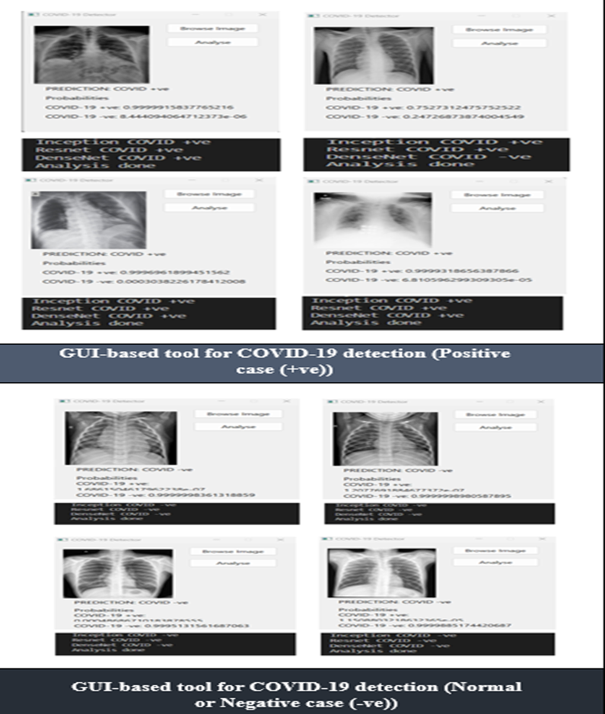

Slide 22
Conclusion
The chest X-ray images (COVID-19, healthy) were mostly applied to analyze lung problems. The primary diagnosing for COVID -19 depending on symptoms with different mathematical weights is vital but insufficient, because of that, the project attempts to understand the specific strengths and weaknesses of common deep learning models in order to identify COVID-19 with acceptable accuracy. This is critical for a doctor’s decision-making, since each has benefits and drawbacks.

